Slide 1
RF Technology for fundamental physics Lecture slides Part 1 : RF in free space
Akira Miyazaki

Slide 2
Part 1: outline
Maxwell equations and Helmholtz equation (30mins)
Plane wave solution
Gaussian beam
Higher-order Gaussian beam
Gaussian beam optics (30 mins)
Gaussian lens formula
Lens and mirrors
Integral form: diffraction of waves (30 mins)
Airy disk diffraction
Fourier transform
Excises (60 mins)
Gaussian optics with two lenses

Slide 3
Part 1: outline
Maxwell equations and Helmholtz equation (30mins)
Plane wave solution
Gaussian beam
Higher-order Gaussian beam
Gaussian beam optics (30 mins)
Gaussian lens formula
Lens and mirrors
Integral form: diffraction of waves (30 mins)
Airy disk diffraction
Fourier transform
Excises (60 mins)
Gaussian optics with two lenses

Slide 4
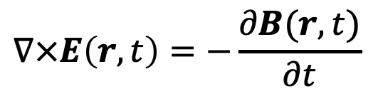


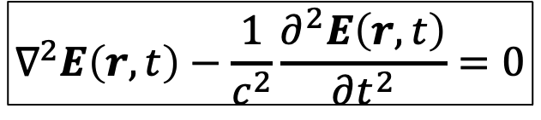



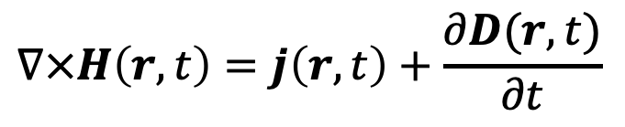
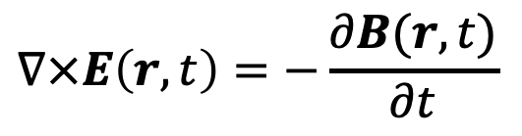
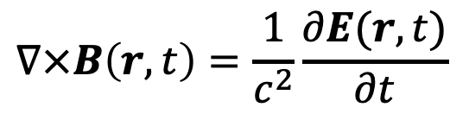
Maxwell equations
In material
In vacuum
$$∇⋅D\left(r,t\right)=ρ(r,t)$$
$$∇⋅E\left(r,t\right)=0$$
In Part 2
$$∇⋅B\left(r,t\right)=0$$
$$∇⋅B\left(r,t\right)=0$$
$$∇×E\left(r,t\right)=−\frac{∂B(r,t)}{∂t}$$
$$∇×E\left(r,t\right)=−\frac{∂B(r,t)}{∂t}$$
$$∇×H\left(r,t\right)=j\left(r,t\right)+\frac{∂D(r,t)}{∂t}$$
$$∇×B\left(r,t\right)=\frac{1}{c^{2}}\frac{∂E(r,t)}{∂t}$$
$$∇×\left(∇×E\left(r,t\right)\right)=−∇×\frac{∂B\left(r,t\right)}{∂t}=−\frac{∂\left(∇×B\left(r,t\right)\right)}{∂t}=−\frac{1}{c^{2}}\frac{∂^{2}E(r,t)}{∂t^{2}}$$
$$=∇\left(∇⋅E\left(r,t\right)\right)−∇^{2}E\left(r,t\right)$$
$$∇^{2}E\left(r,t\right)−\frac{1}{c^{2}}\frac{∂^{2}E\left(r,t\right)}{∂t^{2}}=0$$

Slide 5
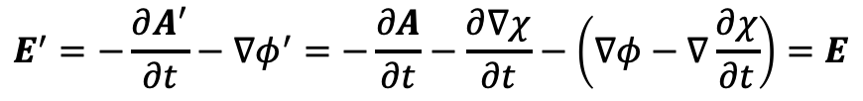
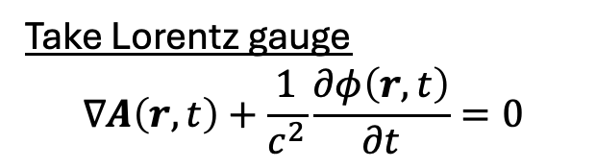
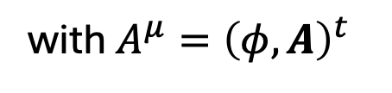

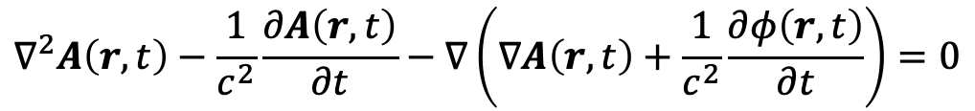
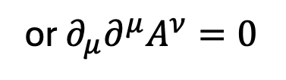
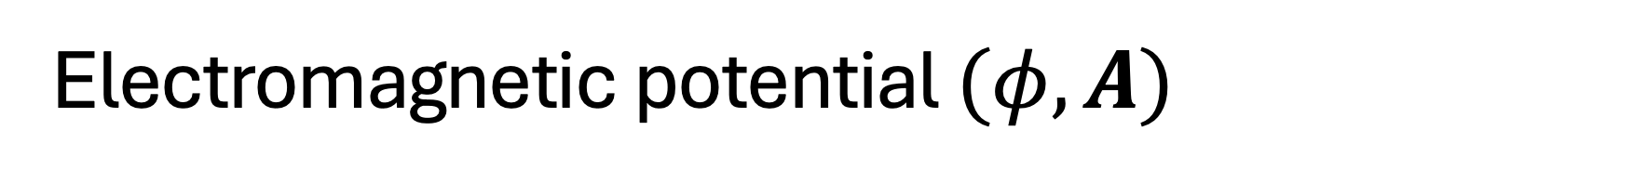
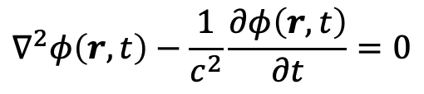
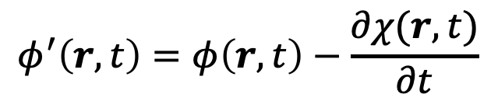



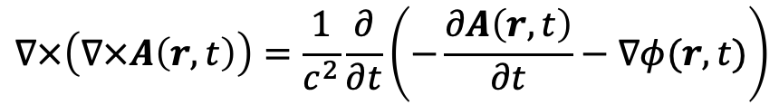

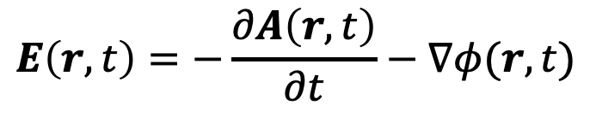
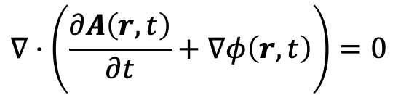
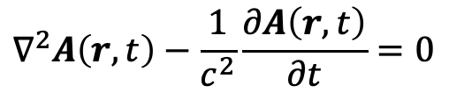
Electromagnetic potential $(φ,A)$
$$∀χ:ℝ^{4}→ℂ$$
$$B(r,t)=∇×A\left(r,t\right)$$
$$φ^{′}\left(r,t\right)=φ\left(r,t\right)−\frac{∂χ(r,t)}{∂t}$$
do not change under Gauge transformation
$$E\left(r,t\right)=−\frac{∂A\left(r,t\right)}{∂t}−∇φ(r,t)$$
$$A^{′}\left(r,t\right)=A\left(r,t\right)+∇χ(r,t)$$
$$∵B^{′}=∇×A^{′}=∇×A+∇×∇χ=B$$
Substitute them into the Maxwel equations
$$E^{′}=−\frac{∂A^{′}}{∂t}−∇φ^{′}=−\frac{∂A}{∂t}−\frac{∂∇χ}{∂t}−\left(∇φ−∇\frac{∂χ}{∂t}\right)=E$$
$$∇⋅\left(\frac{∂A\left(r,t\right)}{∂t}+∇φ\left(r,t\right)\right)=0$$
$$∇\left(∇⋅A\left(r,t\right)\right)−∇^{2}A\left(r,t\right)$$
$$∇×\left(∇×A\left(r,t\right)\right)=\frac{1}{c^{2}}\frac{∂}{∂t}\left(−\frac{∂A\left(r,t\right)}{∂t}−∇φ(r,t)\right)$$
$$∇^{2}A\left(r,t\right)−\frac{1}{c^{2}}\frac{∂A\left(r,t\right)}{∂t}−∇\left(∇A\left(r,t\right)+\frac{1}{c^{2}}\frac{∂φ\left(r,t\right)}{∂t}\right)=0$$
Take Lorentz gauge
$$∇A\left(r,t\right)+\frac{1}{c^{2}}\frac{∂φ\left(r,t\right)}{∂t}=0$$
$$∇^{2}φ\left(r,t\right)−\frac{1}{c^{2}}\frac{∂φ\left(r,t\right)}{∂t}=0$$
or $∂_{μ}∂^{μ}A^{ν}=0$
$$∀χ_{0}, ∇^{2}χ_{0}\left(r,t\right)−\frac{1}{c^{2}}\frac{∂χ_{0}\left(r,t\right)}{∂t}=0$$
$$∇^{2}A\left(r,t\right)−\frac{1}{c^{2}}\frac{∂A\left(r,t\right)}{∂t}=0$$
with $A^{μ}={\left(φ,A\right)}^{t}$

Slide 6
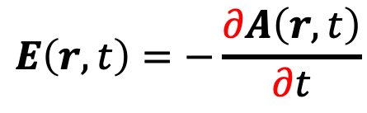
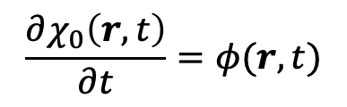

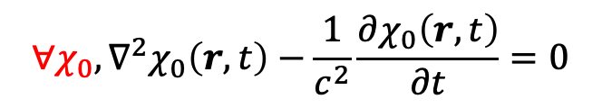
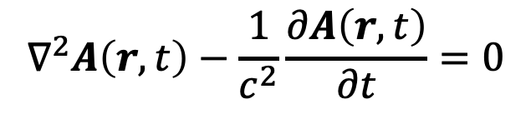

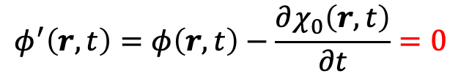
Lorentz + Coulomb gauge in vacuum
Lorentz gauge
Coulomb gauge in vacuum
$$∀χ_{0}, ∇^{2}χ_{0}\left(r,t\right)−\frac{1}{c^{2}}\frac{∂χ_{0}\left(r,t\right)}{∂t}=0$$
→ We can choose
$$\frac{∂χ_{0}\left(r,t\right)}{∂t}=φ(r,t)$$
Such an additional gauge fixing allows
$$φ^{′}\left(r,t\right)=φ\left(r,t\right)−\frac{∂χ_{0}\left(r,t\right)}{∂t}=0$$
(→ We remove ‘ from this new fields)
Then, the remaining set of equations is
$$∇A\left(r,t\right)=0$$
$$B(r,t)=∇×A\left(r,t\right)$$
with
$$∇^{2}A\left(r,t\right)−\frac{1}{c^{2}}\frac{∂A\left(r,t\right)}{∂t}=0$$
$$E\left(r,t\right)=−\frac{∂A\left(r,t\right)}{∂t}$$
In this Lorentz + Coulomb gauge, working on $A, E, B$ is in principle the same (in vacuum)

Slide 7

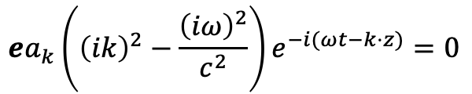
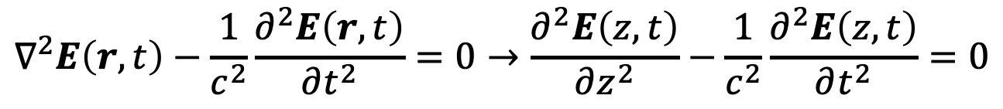
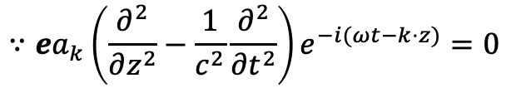
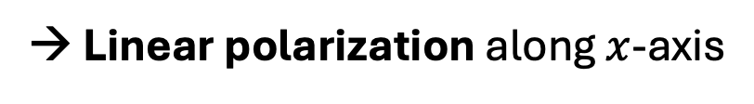

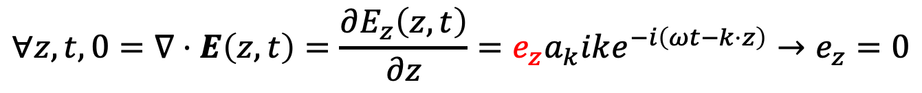
Plane wave solution
Perfect plane wave going to $z$-direction = uniform over $(x, y)$plane: $E\left(r,t\right)=E\left(z,t\right)$
$$∇^{2}E\left(r,t\right)−\frac{1}{c^{2}}\frac{∂^{2}E\left(r,t\right)}{∂t^{2}}=0→\frac{∂^{2}E\left(z,t\right)}{∂z^{2}}−\frac{1}{c^{2}}\frac{∂^{2}E\left(z,t\right)}{∂t^{2}}=0$$
has a solution
$$E\left(z,t\right)=ea_{k}e^{−i(ωt−k⋅z)}$$
$$∵ea_{k}\left(\frac{∂^{2}}{∂z^{2}}−\frac{1}{c^{2}}\frac{∂^{2}}{∂t^{2}}\right)e^{−i(ωt−k⋅z)}=0$$
with a dispersion relation
$$ea_{k}\left({\left(ik\right)}^{2}−\frac{{\left(iω\right)}^{2}}{c^{2}}\right)e^{−i(ωt−k⋅z)}=0$$
$$ω=ck$$
and a polarization vector $e$ and amplitude $a_{k}$, which has another constraint by
$$∀z, t, 0=∇⋅E\left(z,t\right)=\frac{∂E_{z}\left(z,t\right)}{∂z}=e_{z}a_{k}ike^{−i\left(ωt−k⋅z\right)}→e_{z}=0$$
The polarization is transverse to the propagation direction $z$, such as $e={\left(1,0,0\right)}^{t}$
→ Linear polarization along $x$-axis

Slide 8

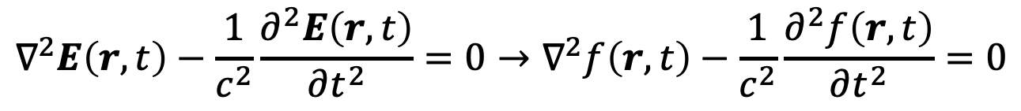

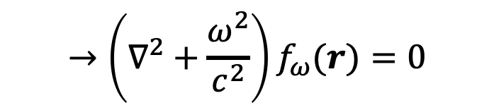
Helmholtz equation (not uniform in x and y)
Assuming linear polarization in $x$ direction $E=e_{x}f\left(r,t\right)$
$$∇^{2}E\left(r,t\right)−\frac{1}{c^{2}}\frac{∂^{2}E\left(r,t\right)}{∂t^{2}}=0→∇^{2}f\left(r,t\right)−\frac{1}{c^{2}}\frac{∂^{2}f\left(r,t\right)}{∂t^{2}}=0$$
Scalar equation
We consider a wave propagating with a single frequency
$$f\left(r,t\right)=e^{iωt}f_{ω}(r)$$
(← Implicitly thinking of Fourier transform)
$$→\left(∇^{2}+\frac{ω^{2}}{c^{2}}\right)f_{ω}(r)=0$$
$$≡k^{2}$$
Helmholtz equation:
$$\left(∇^{2}+k^{2}\right)f_{ω}(r)=0$$

Slide 9

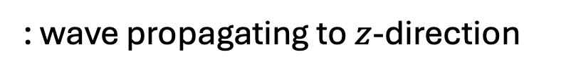
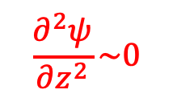

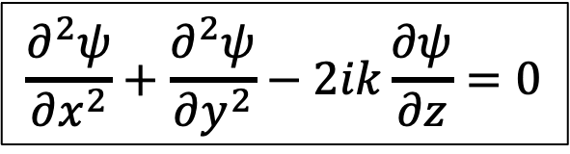
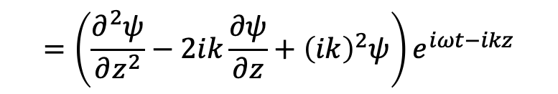
Gaussian beam solution 1/3
Gaussian beam is a spatially confined solution introduced in the following way
$$f_{ω}\left(r\right)=ψ\left(x,y,z\right)e^{−ikz}$$
: wave propagating to $z$-direction
Substitute it into Helmholtz equation
$$\left(∇^{2}+k^{2}\right)ψ\left(x,y,z\right)e^{−ikz}=0$$
$$\left(\frac{∂^{2}ψ}{∂x^{2}}+\frac{∂^{2}ψ}{∂y^{2}}\right)e^{−ikz}+\frac{∂^{2}}{∂z^{2}}\left(ψ\left(x,y,z\right)e^{−ikz}\right) +k^{2}ψ\left(x,y,z\right)e^{−ikz}=0$$
Paraxial approximation
$$\frac{∂^{2}ψ}{∂z^{2}}\sim 0$$
$$=\left(\frac{∂^{2}ψ}{∂z^{2}}−2ik\frac{∂ψ}{∂z}+{\left(ik\right)}^{2}ψ\right)e^{iωt−ikz}$$
Cancel out
$$\frac{∂^{2}ψ}{∂x^{2}}+\frac{∂^{2}ψ}{∂y^{2}}−2ik\frac{∂ψ}{∂z}=0$$
Helmholtz equation in paraxial approximation

Slide 10
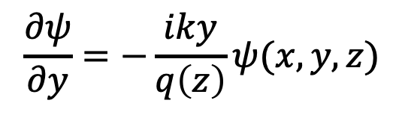
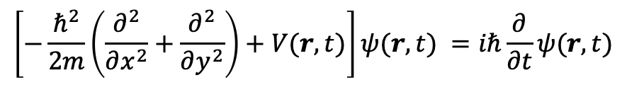
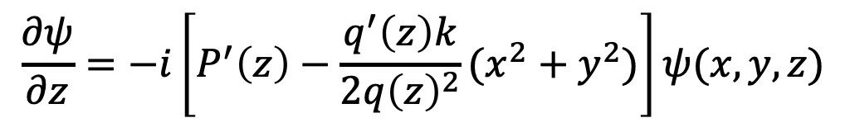
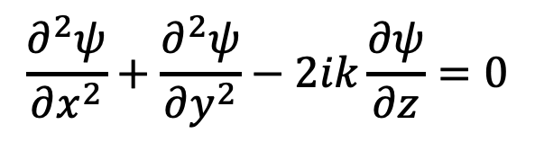
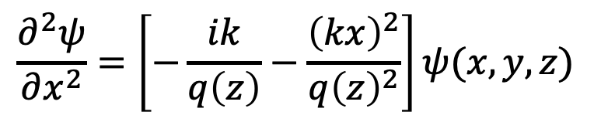
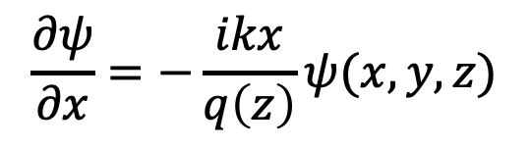
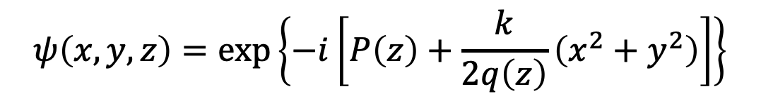
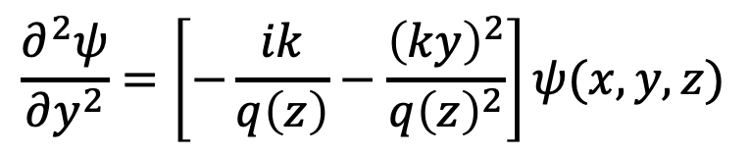
Gaussian beam solution 2/3
$$\frac{∂^{2}ψ}{∂x^{2}}+\frac{∂^{2}ψ}{∂y^{2}}−2ik\frac{∂ψ}{∂z}=0$$
$$\left[−\frac{ℏ^{2}}{2m}\left(\frac{∂^{2}}{∂x^{2}}+\frac{∂^{2}}{∂y^{2}}\right)+V(r,t)\right]ψ(r,t) =iℏ\frac{∂}{∂t}ψ(r,t)$$
Time dependent 2D Schrödinger equation
This equation has a solution of this shape:
$$ψ\left(x,y,z\right)=\exp\left\{−i\left[P\left(z\right)+\frac{k}{2q\left(z\right)}\left(x^{2}+y^{2}\right)\right]\right\}$$
Proof
$$\frac{∂ψ}{∂x}=−\frac{ikx}{q\left(z\right)}ψ(x,y,z)$$
$$\frac{∂^{2}ψ}{∂x^{2}}=\left[−\frac{ik}{q\left(z\right)}−\frac{{\left(kx\right)}^{2}}{q{\left(z\right)}^{2}}\right]ψ(x,y,z)$$
$$\frac{∂ψ}{∂y}=−\frac{iky}{q\left(z\right)}ψ(x,y,z)$$
$$\frac{∂^{2}ψ}{∂y^{2}}=\left[−\frac{ik}{q\left(z\right)}−\frac{{\left(ky\right)}^{2}}{q{\left(z\right)}^{2}}\right]ψ(x,y,z)$$
$$\frac{∂ψ}{∂z}=−i\left[P^{′}\left(z\right)−\frac{q^{′}\left(z\right)k}{2q{\left(z\right)}^{2}}(x^{2}+y^{2})\right]ψ(x,y,z)$$

Slide 11
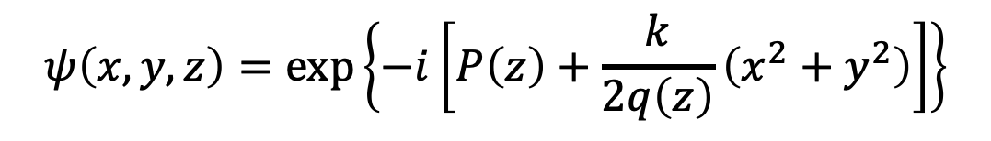
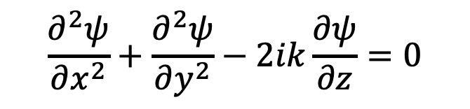

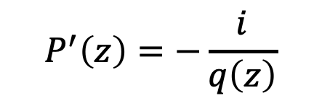
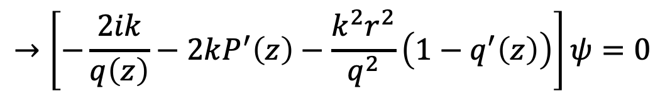
Gaussian beam solution 3/3
$$\frac{∂^{2}ψ}{∂x^{2}}+\frac{∂^{2}ψ}{∂y^{2}}−2ik\frac{∂ψ}{∂z}=0$$
$$→\left[−\frac{ik}{q\left(z\right)}−\frac{{\left(kx\right)}^{2}}{q{\left(z\right)}^{2}}\right]ψ+\left[−\frac{ik}{q\left(z\right)}−\frac{{\left(ky\right)}^{2}}{q{\left(z\right)}^{2}}\right]ψ−2k\left[P^{′}\left(z\right)−\frac{q^{′}\left(z\right)k}{2q{\left(z\right)}^{2}}\left(x^{2}+y^{2}\right)\right]ψ=0$$
$$→\left[−\frac{2ik}{q\left(z\right)}−2kP^{′}\left(z\right)−\frac{k^{2}r^{2}}{q^{2}}\left(1−q^{′}\left(z\right)\right)\right]ψ=0$$
$$q^{′}\left(z\right)=1$$
The condition
$$P^{′}\left(z\right)=−\frac{i}{q\left(z\right)}$$
$$ψ\left(x,y,z\right)=\exp\left\{−i\left[P\left(z\right)+\frac{k}{2q\left(z\right)}\left(x^{2}+y^{2}\right)\right]\right\}$$
makes
a solution

Slide 12
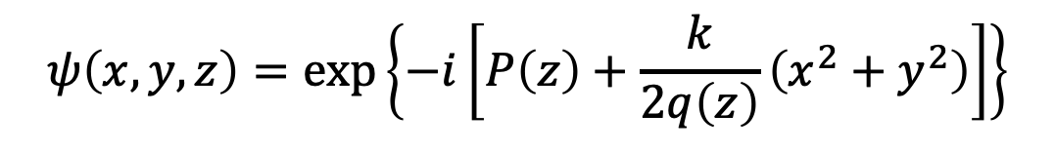

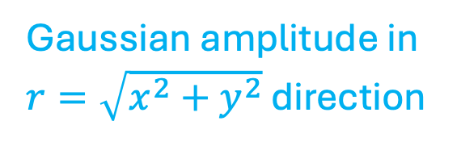

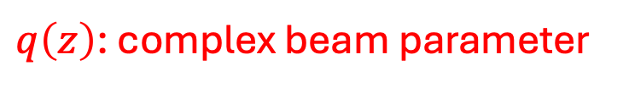
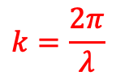
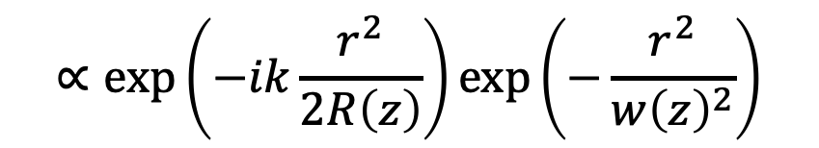


Parametrization of Gaussian beam
$$q^{′}\left(z\right)=1$$
$$→q\left(z\right)=z+q_{0}∈ℂ$$
$q\left(z\right)$: complex beam parameter
Real beam parameters $(R(z),w(z))$ are introduced
$$\frac{1}{q(z)}=\frac{1}{R\left(z\right)}−\frac{iλ}{πw{\left(z\right)}^{2}}$$
$$k=\frac{2π}{λ}$$
These parameters make
$$ψ\left(x,y,z\right)=\exp\left\{−i\left[P\left(z\right)+\frac{k}{2q\left(z\right)}\left(x^{2}+y^{2}\right)\right]\right\}$$
$$=\exp\left\{−i\left[P\left(z\right)+\frac{kr^{2}}{2}\left(\frac{1}{R\left(z\right)}−\frac{iλ}{πw{\left(z\right)}^{2}}\right)\right]\right\}$$
$$∝\exp\left(−ik\frac{r^{2}}{2R\left(z\right)}\right)\exp\left(−\frac{r^{2}}{w{\left(z\right)}^{2}}\right)$$
Gaussian amplitude in $r=\sqrt{x^{2}+y^{2}}$ direction
Wavefront of isophase surface

Slide 13








Spherical wavefront
Spherical wave from a point source at $z=0$
$$E∝\frac{1}{R}\exp\left(−ikR\right)=\frac{1}{R}\exp{(−ik\sqrt{x^{2}+y^{2}+z^{2}})}$$
$$z$$
Near the axis $z^{2}≫x^{2}+y^{2}$
$$=\frac{1}{R}\exp\left(−ikz{\left(1+\frac{x^{2}+y^{2}}{z}\right)}^{1/2}\right)$$
$$\sim \frac{1}{R}\exp\left(−ikz\left(1−\frac{x^{2}+y^{2}}{{2z}^{2}}\right)\right)$$
Cf) Gaussian beam
$$\sim \frac{1}{R}\exp\left(−ikz−ik\frac{r^{2}}{2R}\right)$$
$$ψe^{−ikz}∝\exp\left(−ikz−ik\frac{r^{2}}{2R}\right)$$
Gaussian beam is a combination of plane and spherical waves in paraxial approximation

Slide 14






Gaussian beam propagation with $w(z)$ and $R(z)$
$$\frac{1}{q(z)}=\frac{1}{z+q_{0}}≡\frac{1}{R\left(z\right)}−\frac{iλ}{πw{\left(z\right)}^{2}}$$
Consider a purely imaginary $q_{0}≡iz_{R}$ with a position $z_{R}∈ℝ$
$$\frac{1}{z+iz_{R}}=\frac{z−iz_{R}}{z^{2}+z_{R}^{2}}$$
Comparing real and imaginary parts
$$\frac{λ}{πw{\left(z\right)}^{2}}=\frac{z_{R}}{z^{2}+z_{R}^{2}}→w^{2}\left(z\right)=\frac{λz_{R}}{π}\left(1+\frac{z^{2}}{z_{R}^{2}}\right)=w_{0}^{2}\left[1+{\left(\frac{λz}{πw_{0}^{2}}\right)}^{2}\right]$$
$$≡w_{0}^{2}$$
$$\frac{λ}{R(z)}=\frac{z}{z^{2}+z_{R}^{2}}→R\left(z\right)=z\left[1+{\left(\frac{πw_{0}^{2}}{λz}\right)}^{2}\right]$$

Slide 15







Property of $w(z)$ and $R(z)$
$$w\left(z\right)=w_{0}\sqrt{1+{\left(\frac{λz}{πw_{0}^{2}}\right)}^{2}}$$
“Beam spot size”
is a hyperbolic function with a minimum $w_{0}$ at $z=0$ called beam waist
An asymptotic behavior $z→∞$ gives
$$w\left(z\right)\sim \frac{λ}{πw_{0}}z$$
Far field diffraction angle $Θ$
The phase curvature function
$$R\left(z\right)=z\left[1+{\left(\frac{πw_{0}^{2}}{λz}\right)}^{2}\right]≥\frac{2πw_{0}^{2}}{λ}$$
$$A+B≥2\sqrt{AB}$$
gives minimum $z=z_{R}≡{πw_{0}^{2}}/λ$ called Rayleigh range (or length) $z_{R}$
$R\left(z\right)→∞$ (plane wave) for $z→0$ and $R\left(z\right)→z$ (point-source like spherical) for $z→∞$

Slide 16






Rewrite the Gaussian beam function with $P(z)$
$$ψ\left(x,y,z\right)=\exp\left\{−i\left[P\left(z\right)+\frac{k}{2q\left(z\right)}\left(x^{2}+y^{2}\right)\right]\right\}$$
$$P^{′}\left(z\right)=−\frac{i}{q\left(z\right)}=−\frac{i}{z+iz_{R}}→iP^{′}\left(z\right)=\frac{{−i}/{z_{R}}}{1{−iz}/{z_{R}}}→iP\left(z\right)=\log\left(1−\frac{iz}{z_{R}}\right)$$
$$re^{−iθ}=1−\frac{iz}{z_{R}}→r=\sqrt{1+{\left(z/{z_{R}}\right)}^{2}}, θ(z)=\tan^{−1}{(z/{z_{R}})}$$
Guoy phase
$$∴P\left(z\right)=\frac{1}{i}\log{\sqrt{1+{\left(z/{z_{R}}\right)}^{2}}}−\tan^{−1}{(z/{z_{R}})}$$
Principal value in complex analysis
$$={w(z)}/{w_{0}}$$
$$f_{ω}(x,y,z)=ψe^{−ikz}=\frac{w_{0}}{w\left(z\right)}\exp\left\{−i\left(kz−θ(z)\right)−r^{2}\left(\frac{1}{w{\left(z\right)}^{2}}+\frac{ik}{2R\left(z\right)}\right)\right\}$$

Slide 17





Visualization of Gaussian beam from wiki
$z_{R}≡{πw_{0}^{2}}/λ=167 nm$
z
Beam waist’s size and position with wavelength unique determines the Gaussian beam!
$w(z)$ is 2$σ$ in power not amplitude
A Gaussian beam is just a solution
→ infinite other solutions exist!

Slide 18








Higher order modes in Cartesian coordinates
$$\frac{∂^{2}ψ}{∂x^{2}}+\frac{∂^{2}ψ}{∂y^{2}}−2ik\frac{∂ψ}{∂z}=0$$
Hermite-Gauss mode
has a general solution
$$ψ\left(x,y,z\right)=X\left(\frac{x}{w\left(z\right)}\right)Y\left(\frac{y}{w\left(z\right)}\right)\exp\left\{−i\left[P\left(z\right)+\frac{k}{2q\left(z\right)}\left(x^{2}+y^{2}\right)\right]\right\}$$
Where $X$ or $Y$ satisfies
Hermite differential equation
$$\frac{d^{2}X}{dx^{2}}−2x\frac{dX}{dx}+2mX=0$$
Then
$$X=H_{m}\left(\sqrt{2}\frac{x}{w\left(z\right)}\right)$$
$$Y=H_{n}\left(\sqrt{2}\frac{x}{w\left(z\right)}\right)$$
$H_{m}$: Hermite polynomials

Slide 19





Direct measurement of transverse modes
Hermite Gauss beam inside 200 GHz a ring cavity
TEM₀₀ measurement
TEM₀₁ measurement
IR camera
View port
TEM₀₀ theory
TEM₀₁ theory
(45 degree tilt)
The modes were observable through heat dissipation via IR (1 kW system)

Slide 20







Higher order modes in Cylindrical coordinates
$$\frac{∂^{2}ψ}{∂x^{2}}+\frac{∂^{2}ψ}{∂y^{2}}−2ik\frac{∂ψ}{∂z}=\frac{1}{r}\frac{∂}{∂r}\left(r\frac{∂}{∂r}ψ\left(r,φ,z\right)\right)+\frac{1}{r^{2}}\frac{∂ψ}{∂φ}−2ik\frac{∂ψ}{∂z}=0$$
Laguerre-Gauss mode
has a general solution
$$ψ\left(x,y,z\right)=G\left(\frac{r}{w\left(z\right)}\right)\exp\left\{−i\left[P\left(z\right)+\frac{k}{2q\left(z\right)}r^{2}+lφ\right]\right\}$$
Here $G$ satisfies
$$G={\left(\frac{\sqrt{2}r}{w\left(z\right)}\right)}^{l}L_{p}^{l}\left(2\frac{r^{2}}{w{\left(z\right)}^{2}}\right)$$
Where $L_{p}^{l}$ is a Laguerre polynomial obeying
$$x\frac{d^{2}L_{p}^{l}}{dx^{2}}+\left(l+1−x\right)\frac{dL_{p}^{l}}{dx}+pL_{p}^{l}=0$$
Laguerre differential equation

Slide 21




Higher order modes: key point is the phase
Mathematics is complex ☹ but one thing is important to note
The Guoy phase factor in the fundamental mode
$$θ(z)=\tan^{−1}{(z/{z_{R}})}$$
$$E∝\exp\left\{−i\left(kz−θ(z)\right)\right\}$$
Is further delayed for higher moder modes
Hermite Gaus mode:
$$θ(z)=(m+n+1)\tan^{−1}{(z/{z_{R}})}$$
Laguerre Gaus mode:
$$θ(z)=(2p+l+1)\tan^{−1}{(z/{z_{R}})}$$
They are (annoying but useful) measurement observables in a resonator → Part 2

Slide 22








Remark: Gaussian beam is not linearly polarized!
The starting point $E=e_{x}f\left(r,t\right)$ in fact self-contradicts!
→ Finite size solution of the Maxwell equation must have a longitudinal component!
$$E_{x}\left(r,t\right)=ψ\left(x,y,z\right)e^{iωt−ikz}$$
← We have considered this component only
$$E_{y}\left(r,t\right)=0$$
$$E_{z}\left(r,t\right)=φ\left(x,y,z\right)e^{iωt−ikz}$$
← We have ignored this component
$$∇^{2}E_{x}\left(r,t\right)−\frac{1}{c^{2}}\frac{∂^{2}E_{x}\left(r,t\right)}{∂t^{2}}=0$$
$$\frac{∂^{2}ψ}{∂x^{2}}+\frac{∂^{2}ψ}{∂y^{2}}−2ik\frac{∂ψ}{∂z}=0$$
$$\frac{∂ψ}{∂x}+\frac{∂φ}{∂z}−ikφ=0$$
$$∇⋅E=0$$
$$∴φ\left(x,y,z\right)=−e^{ikz}\int{\frac{∂ψ(x,y,z′)}{∂x}e^{−ikz′}dz′}≠0$$
Linearly polarized Gaussian beam is just an approximation near the beam axis

Slide 23
Part 1: outline
Maxwell equations and Helmholtz equation (30mins)
Plane wave solution
Gaussian beam
Higher-order Gaussian beam
Gaussian beam optics (30 mins)
Gaussian lens formula
Lens and mirrors
Integral form: diffraction of waves (30 mins)
Airy disk diffraction
Fourier transform
Excises (60 mins)
Gaussian optics with two lenses

Slide 24













Propagation of a Gaussian beam
The complex beam parameter
$$\frac{1}{q(z)}≡\frac{1}{R\left(z\right)}−\frac{iλ}{πw{\left(z\right)}^{2}}$$
determines everything
The beam propagates freely like $z→z+d$
$$\frac{1}{q_{2}}=\frac{1}{q_{1}+d}$$
$$\left[∵q^{′}\left(z\right)=1\right]$$
$$f$$
The beam is converted by mirror or lens at $z$
$$R_{1}$$
$$R_{2}$$
$$z$$
$$w_{2}\left(z\right)=w_{1}(z)$$
$$→\frac{1}{q_{2}\left(z\right)}=\frac{1}{q_{1}\left(z\right)}−\frac{1}{f}$$
$$\frac{1}{R_{2}\left(z\right)}=\frac{1}{R_{1}\left(z\right)}−\frac{1}{f}$$
$$w_{2}\left(z\right)=w_{1}(z)$$
Lens / mirrors are phase-front converter while conserving the beam size

Slide 25









ABCD law: Helmholtz equation through lens 1/2
$$∇^{2}=∇_{t}^{2}+\frac{∂^{2}}{∂z}=\frac{∂^{2}}{∂r^{2}}+\frac{1}{r}\frac{∂}{∂r}+\frac{∂^{2}}{∂z^{2}}$$
$$\left(∇^{2}+k^{2}\right)f_{ω}(r)=0$$
$$k^{2}=\frac{ω^{2}}{c^{2}}n^{2}≡\frac{ω^{2}}{2}\left[1−g^{2}r^{2}\right]$$
With refractive material (lens) or focusing mirror
$$g^{2}r^{2}≪1$$
In cylindrical symmetry
$$f_{ω}(r)=ψ\left(r,z\right)e^{−ikz}$$
with paraxial approximation
$$∇_{t}^{2}ψ−2ikψ^{′}−k^{2}g^{2}r^{2}ψ=0$$
The Gaussian beam
New term
$$ψ\left(x,y,z\right)=\exp\left\{−i\left[P\left(z\right)+\frac{kr^{2}}{2q\left(z\right)}\right]\right\}$$
Is still valid but with another differential equation on the parameter
$${\left(\frac{1}{q(z)}\right)}^{2}+{\left(\frac{1}{q(z)}\right)}^{′}+g^{2}=0$$
$$P^{′}\left(z\right)=−\frac{i}{q\left(z\right)}$$
and

Slide 26












ABCD law: Helmholtz equation through lens 2/2
$${\left(\frac{1}{q(z)}\right)}^{2}+{\left(\frac{1}{q(z)}\right)}^{′}+g^{2}=0$$
$$→\frac{1}{q^{2}}−\frac{q^{′}}{q^{2}}+g^{2}=0$$
can be simplified by
$$\frac{1}{q}≡\frac{u′}{u}$$
$$→u^{′′}+g^{2}u=0$$
$$∵u^{′′}=\frac{u^{′}q−uq′}{q^{2}}=\frac{u−uq^{′}}{q^{2}}→\frac{u^{′′}}{u}=\frac{1}{q^{2}}−\frac{q^{′}}{q^{2}}$$
A general solution is with arbitrary constants $(a,b)$
$$u\left(z\right)=a\sin{gz}+b\cos{gz}$$
$$→u^{′}(z)=ag\cos{gz}−bg\sin{gz}$$
The beam parameter is
$$q(z)=\frac{q_{0}\cos{gz}+(1/g)\sin{gz}}{−q_{0}g\sin{gz}+\cos{gz}}$$
$$≡ \frac{Aq_{0}+B}{Cq_{0}+D}$$
$$q=\frac{a\sin{gz}+b\cos{gz}}{ag\cos{gz}−bg\sin{gz}}$$
With Initial condition
$$q\left(0\right)=\frac{b}{ag}≡q_{0}$$
$$AD−BC=\cos^{2}{gz}+\sin^{2}{gz}=1$$

Slide 27















ABCD matrix for optics design
$$AD−BC=1$$
$$q_{2}≡\frac{Aq_{1}+B}{Cq_{1}+D}$$
$$q_{3}≡\frac{A′q_{2}+B′}{C′q_{2}+D′}=\frac{A′′q_{1}+B′′}{C′′q_{1}+D′′}$$
$$\left[\begin{matrix}A′′ & B′′ \\ C′′ & D′′\end{matrix}\right]=\left[\begin{matrix}A′ & B′ \\ C′ & D′\end{matrix}\right]\left[\begin{matrix}A & B \\ C & D\end{matrix}\right]$$
$$\left[\begin{matrix}A & B \\ C & D\end{matrix}\right]=\left[\begin{matrix}1 & d \\ 0 & 1\end{matrix}\right]$$
$$\left[\begin{matrix}A & B \\ C & D\end{matrix}\right]=\left[\begin{matrix}1 & 0 \\ {−1}/f & 1\end{matrix}\right]$$
$$\left[\begin{matrix}A & B \\ C & D\end{matrix}\right]=\left[\begin{matrix}1 & d/n \\ 0 & 1\end{matrix}\right]$$
$$f$$
$$R_{1}$$
$$R_{2}$$
$$z$$
$$z$$
$$z$$
$$d$$
$$n$$
$$d$$
$$w_{2}\left(z\right)=w_{1}(z)$$
The same matrices for geometrical optics and Gaussian beam optics

Slide 28













Beam waist conversion
$$f$$
$$d_{1}$$
$$d_{2}$$
$$q_{2}≡\frac{Aq_{1}+B}{Cq_{1}+D}$$
$$w_{1}$$
$$w_{2}$$
$$\left[\begin{matrix}A & B \\ C & D\end{matrix}\right]=\left[\begin{matrix}1 & d_{2} \\ 0 & 1\end{matrix}\right]\left[\begin{matrix}1 & 0 \\ {−1}/f & 1\end{matrix}\right]\left[\begin{matrix}1 & d_{1} \\ 0 & 1\end{matrix}\right]$$
$$z$$
$$=\left[\begin{matrix}1 & d_{2} \\ 0 & 1\end{matrix}\right]\left[\begin{matrix}1 & d_{1} \\ {−1}/f & {−d_{1}}/f+1\end{matrix}\right]$$
$$q_{1}$$
$$q_{2}$$
$$=\left[\begin{matrix}1{−d_{2}}/f & d_{1}{−d_{1}d_{2}}/f+d_{2} \\ {−1}/f & {−d_{1}}/f+1\end{matrix}\right]$$
$$→q_{2}≡\frac{\left(1{−d_{2}}/f\right)q_{1}+(d_{1}+d_{2}{−d_{1}d_{2}}/f)}{({−1}/f)q_{1}+\left(1{−d_{1}}/f\right)}$$
$$1=AD−BC=\left(1−\frac{d_{2}}{f}\right)\left(1−\frac{d_{1}}{f}\right)−\left(d_{1}+d_{2}−\frac{d_{1}d_{2}}{f}\right)\left(−\frac{1}{f}\right)$$
One constraint:

Slide 29
















Gaussian Lens formula 1/3
$$f$$
$$d_{1}$$
$$d_{2}$$
$$q_{2}≡\frac{\left(1{−d_{2}}/f\right)q_{1}+(d_{1}+d_{2}{−d_{1}d_{2}}/f)}{({−1}/f)q_{1}+\left(1{−d_{1}}/f\right)}$$
$$w_{1}$$
$$w_{2}$$
$$\frac{1}{q(z)}=\frac{1}{R\left(z\right)}−\frac{iλ}{πw{\left(z\right)}^{2}}$$
$$z$$
$$w^{2}\left(z\right)=w_{0}^{2}\left[1+{\left(\frac{z}{z_{R}}\right)}^{2}\right]$$
are measured from beam waist position
$$q_{1}$$
$$q_{2}$$
$$R\left(z\right)=z\left[1+{\left(\frac{z_{R}}{z}\right)}^{2}\right]$$
$(q_{1},q_{2})$ are both defined at the beam waist of each Gaussian beam left and right of the lens
$$\frac{1}{q_{2}}=−\frac{iλ}{πw_{2}^{2}}=\frac{1}{{iz}_{R2}}$$
$$iz_{R2}=\frac{\left(1{−d_{2}}/f\right)\left(iz_{R1}\right)+(d_{1}+d_{2}{−d_{1}d_{2}}/f)}{({−1}/f)\left(iz_{R1}\right)+\left(1{−d_{1}}/f\right)}$$
$$\frac{1}{q_{1}}=−\frac{iλ}{πw_{1}^{2}}=\frac{1}{{iz}_{R1}}$$
$$=\frac{A\left(iz_{R1}\right)+B}{C\left(iz_{R1}\right)+D}$$

Slide 30









Gaussian Lens formula 2/3
$$f$$
$$d_{1}$$
$$d_{2}$$
$$iz_{R2}=\frac{A\left(iz_{R1}\right)+B}{C\left(iz_{R1}\right)+D}=\frac{(Aiz_{R1}+B)(−Ciz_{R1}+D)}{C^{2}z_{R1}^{2}+D^{2}}$$
$$w_{1}$$
$$w_{2}$$
$$=1$$
$$z$$
$$=\frac{ACz_{R1}^{2}+\left(AD−BC\right){iz}_{R1}+BD}{C^{2}z_{R1}^{2}+D^{2}}$$
$$=\frac{ACz_{R1}^{2}+BD+{iz}_{R1}}{C^{2}z_{R1}^{2}+D^{2}}$$
$$q_{1}$$
$$q_{2}$$
Comparing real and imaginary parts
$$z_{R2}=\frac{z_{R1}}{−C^{2}\frac{BD}{AC}+D^{2}}=\frac{1}{D}\frac{z_{R1}}{−\frac{BC}{A}+D}$$
$$ACz_{R1}^{2}+BD=0$$
Eliminate $z_{R1}^{2}$
$$z_{R2}=\frac{z_{R1}}{C^{2}z_{R1}^{2}+D^{2}}$$
$$=\frac{1}{D}\frac{z_{R1}}{\frac{−BC+AD}{A}}=\frac{A}{D}z_{R1}=\frac{1{−d_{2}}/f}{1{−d_{1}}/f}z_{R1}$$

Slide 31









Gaussian Lens formula 3/3
$$f$$
$$d_{1}$$
$$d_{2}$$
$$z_{R1}^{2}=−\frac{BD}{AC}=\frac{(d_{1}+d_{2}{−d_{1}d_{2}}/f)\left(1{−d_{1}}/f\right)}{\left(1{−d_{2}}/f\right)({−1}/f)}$$
$$w_{1}$$
$$w_{2}$$
$$=\frac{(d_{1}f+d_{2}f−d_{1}d_{2})\left(f−d_{1}\right)}{−\left(f−d_{2}\right)}$$
$$z$$
$$→\frac{z_{R1}^{2}}{f−d_{1}}=\frac{\left(f−d_{2}\right)d_{1}+d_{2}f}{−\left(f−d_{2}\right)}=−d_{1}−\frac{d_{2}f}{f−d_{2}}$$
$$q_{1}$$
$$q_{2}$$
$$→d_{1}+\frac{z_{R1}^{2}}{f−d_{1}}={\left(\frac{1}{f}−\frac{1}{d_{2}}\right)}^{−1}$$
Cf) geometrical optics
$$\frac{1}{d_{1}+{z_{R1}^{2}}/{(f−d_{1})}}=\frac{1}{f}−\frac{1}{d_{2}}$$
$$\frac{1}{d_{1}}=\frac{1}{f}−\frac{1}{d_{2}}$$
$$∴$$
$$z_{R2}=\frac{1{−d_{2}}/f}{1{−d_{1}}/f}z_{R1}$$
$$\frac{z_{R1}^{2}}{f−d_{1}}$$
Is the diffraction effect of Gaussian beam
with
Self, Sidney A. “Focusing of Spherical Gaussian Beams.” Applied Optics, vol. 22, no. 5, Jan. 1983

Slide 32








Focus length of a lens: Teflon as an example
Aperture $a$
https://www.teflon.com/en/products/resins/amorphous-fluoropolymer
Curvature radius $R$
thickness $t$
AM PhD work
Focus length of semi-spherical lens
$$n\sim \sqrt{ε^{∗}}$$
$$\frac{1}{f}=\frac{n−1}{R}\sim \frac{0.38}{R}$$
$$n\sim \sqrt{1.9}\sim 1.38$$

Slide 33








Reflection by a spherical mirror (circle in 2D)
$$R_{M}$$
In case of heads-on reflection
The curvature of the mirror $R_{M}$ matches the phase-front curvature of the Gaussian beam
$$w_{0}$$
$$z=d$$
$$z$$
$$R\left(d\right)=d\left[1+{\left(\frac{z_{R}}{d}\right)}^{2}\right]=R_{M}$$
The reflected beam flips the sign
$$\frac{1}{R_{2}\left(z\right)}=−\frac{1}{R_{M}}=\frac{1}{R_{M}}−\frac{1}{f}$$
This is the basis of confocal Fabry-Pérot resonator → (Part 2)
$$\frac{1}{f}=\frac{2}{R_{M}}→f=\frac{R_{M}}{2}$$

Slide 34









Tilted spherical mirror = off-axis reflection
The reflected beam axis
$$y=\frac{\sin{2θ}}{\cos{2θ}}\left(x−R\cos{θ}\right)+R\sin{θ}$$
Implicit representation $f\left(x,y,θ\right)=0$ with
$$f\left(x,y,θ\right)=x\sin{2θ}−y\cos{2θ}−R\sin{θ}$$
Set of points in the envelope
$$∵\sin{2θ=2\sin{θ}\cos{θ}}$$
$$\cos{2θ=2\cos^{2}{θ}−1}$$
$$\left\{\left(x,y\right)| ∃θ∈\left[0,2π\right) f\left(x,y,θ\right)=0 ∧\frac{∂f}{∂θ}=0\right\}$$
Explicit representation of the envelope by solving the conditions for $(x,y)$
$$\sin{2θ=2\sin{θ}\cos{θ}}$$
$$\cos{2θ=\cos^{2}{θ}−\sin^{2}{θ}}$$
$$\left(\begin{matrix}x\left(θ\right) \\ y\left(θ\right)\end{matrix}\right)=R\left(\begin{matrix}\sin{θ}\sin{2θ}+\frac{1}{2}\cos{θ}\cos{2θ} \\ −\sin{θ}\cos{2θ}+\frac{1}{2}\cos{2θ}\sin{2θ}\end{matrix}\right)=R\left(\begin{matrix}\cos{θ} \\ \sin{θ}\end{matrix}\right)−\frac{R}{2}\cos{θ}\left(\begin{matrix}\cos{2θ} \\ sin2{θ}\end{matrix}\right)$$
Focusing length $f_{1}$
Focus point

Slide 35





Toroidal mirror to convert bi-Gaussian
The other direction (y-direction in the pictures) is a just $\cos{θ}$ projection
$$f_{2}=\frac{R}{2\cos{θ}}$$
R /2
θ
θ
R /(2cosθ)
Toroidal mirror with two curvature in two directions is useful to convert bi-Gaussian
$$f_{1}=\frac{R_{1}}{2}\cos{θ}$$
$$f_{2}=\frac{R_{2}}{2\cos{θ}}$$
AM PhD thesis’s focusing mirror design: two toroidal mirrors

Slide 36


Spherical or toroidal mirror has spherical aberration
$$\left(\begin{matrix}x\left(θ\right) \\ y\left(θ\right)\end{matrix}\right)=R\left(\begin{matrix}\cos{θ} \\ \sin{θ}\end{matrix}\right)−\frac{R}{2}\cos{θ}\left(\begin{matrix}\cos{2θ} \\ sin2{θ}\end{matrix}\right)$$
The design is simple (easier for machining), but the beam does not focus perfectly
→ Parabolic mirror for plan wave or ellipsoidal mirror for Gaussian beam

Slide 37







Focal length of an ellipsoidal mirror (ellipse in 2D)
$$w_{z1}\left(d_{1},w_{01}\right)=w_{z2}(d_{2}, w_{02})$$
Beam 2
$$R_{1}\left(d_{1} \right)=r_{1}$$
$$R_{2}\left(d_{2} \right)=r_{2}$$
$$a=\frac{r_{1}+r_{2}}{2}$$
Jacob Egge MADMAX
Beam 1
$$b=\sqrt{r_{1}r_{2}}\cos\left(\frac{θ}{2}\right)$$
$${\left(\frac{x}{a}\right)}^{2}+{\left(\frac{y}{b}\right)}^{2}=1$$
Free of spherical aberration but mechanically more tricky

Slide 38




MADMAX Gaussian beam design along beam axis
$z>0$ between FM and antenna
$z=0$ at FM
$z<0$ between FM and antenna

Slide 39









Dimensions and Gaussian beam from Bonn antenna
$$E(x,y,z)=E_{0}\frac{w_{0}}{w\left(z\right)}\exp\left\{−i\left(kz−θ(z)\right)−r^{2}\left(\frac{1}{w{\left(z\right)}^{2}}+\frac{ik}{2R\left(z\right)}\right)\right\}$$
phase
phase
$$w\left(z\right)=w_{0}\sqrt{1+{\left(\frac{λz}{πw_{0}^{2}n}\right)}^{2}}$$
is $2σ$ in a power distribution ${\left|E\right|}^{2}$
$d_{2}=2300$ mm
f [GHz] | PC [mm] | ET [-8.68 dB] | $w_{01}$ [mm]
18 | -129 | -10.5 | 28.624
19 | -136 | -10.3 | 27.656
20 | -143 | -10.1 | 26.804
21 | -151 | -9.9 | 26.055
22 | -159 | -9.7 | 25.393
23 | -165 | -9.5 | 24.810
24 | -171 | -9.3 | 24.298
25 | -177 | -9.1 | 23.847
26 | -183 | -8.9 | 23.454
$w_{02}=85$ mm
$d_{1}=835.069$ mm
$w_{01}=25.393$ mm
(Phase Center is inside the horn antenna)
$(w_{01},d_{1},w_{02},d_{2})$ depends on frequency

Slide 40



Mechanical distance between FM and antenna
Cf. from wiki
Quasi-2D simulation
Phase Center = beam waist
f [GHz] | PC [mm]
18 | -129
19 | -136
20 | -143
21 | -151
22 | -159
23 | -165
24 | -171
25 | -177
26 | -183
Flat wavefront of isophase surface
?
–PC
PC
The optical distance between the beam waist in horn antenna and the center of the FM ($d_{1}$) is NOT the same as the mechanical distance to the horn antenna’s opening ($d_{mech}$)
The distance between the beam waist position at each frequency is corrected to the distance relative to the horn antenna’s opening

Slide 41





Frequency dependence: three scenarios from Jacob
$w_{01}$ is fixed at a given frequency, $d_{mech}$ is tunable, $(d_{1},w_{02},d_{2})$ are the control target
→ Solution is not unique → multiple optimization strategies
Antenna-FM side
Booster-FM side
Strategy 1: no control in $d_{mech}$ for different frequency
Strategy 2: Control in $d_{mech}$ to keep $d_{2}$ (beam waist in booster) constant
Strategy 3: Control in $d_{mesh}$ to keep $w_{02}$ (waist size in booster) constant
→ Each scenario gives Gaussian beam of different beam size everywhere

Slide 42







$2σ$ power envelope of the MADMAX Gaussian beam
FM
Flat mirror
$d_{mech}=−688$ fixed
18 GHz
26 GHz
$d_{1}$ moves
$d_{2}=2300$ fixed
$d_{1}$ slightly moves
$w_{02}=85$ fixed
$d_{1}$ moves

Slide 43




2D simulation in COMSOL
→ hands-on 1
Courtesy: Justine Gebrael (Bachelor report in Université Paris Saclay)

Slide 44
Part 1: outline
Maxwell equations and Helmholtz equation (30mins)
Plane wave solution
Gaussian beam
Higher-order Gaussian beam
Gaussian beam optics (30 mins)
Gaussian lens formula
Lens and mirrors
Integral form: diffraction of waves (30 mins)
Airy disk diffraction
Fourier transform
Excises (60 mins)
Gaussian optics with two lenses

Slide 45











Superposition of plane waves = Fourier transform
Fourier transform of $E(x,y)$
$$E\left(x,y,0\right)=\iint{A\left(k_{x},k_{y}\right)\exp\left(−ik_{x}x−ik_{y}y\right)dk_{x}dk_{y}}$$
$$z=0$$
$$z$$
$$A\left(k_{x},k_{y}\right)=\frac{1}{{\left(2π\right)}^{2}}\iint{E(x,y)\exp\left(+ik_{x}x+ik_{y}y\right)dxdy}$$
Inverse FT
Propagation along $z$ axis
$$E\left(x,y,z\right)=\iint{A\left(k_{x},k_{y}\right)\exp\left(−ik_{x}x−ik_{y}y\right)\exp\left(−ik_{z}z′\right)dk_{x}dk_{y}}$$
$$k_{z}={\left(k^{2}−k_{x}^{2}−k_{y}^{2}\right)}^{1/2}\underset{→}{k_{x},k_{y}≪k}k−\frac{k_{x}^{2}+k_{y}^{2}}{2k}$$
$$→E\left(x,y,z\right)=\iint{A\left(k_{x},k_{y}\right)\exp\left(−ik_{x}x−ik_{y}y\right)\exp\left[−ikz+{ik(k_{x}^{2}+k_{y}^{2})}/{2k}\right]dk_{x}dk_{y}}$$
Fourier transform of $E(x,y,z)$
$$E\left(x,y,z\right)=\frac{1}{{\left(2π\right)}^{2}}\iint{dx′}dy′\iint{dk_{x}dk_{y}E\left(x^{′},y^{′}\right)e^{−ik_{x}\left(x−x^{′}\right)−ik_{y}(y−y^{′})}e^{−ikz+{iz(k_{x}^{2}+k_{y}^{2})}/{2k}}}$$

Slide 46








Fresnel Kirchhoff diffraction integral
$$E\left(x,y,z\right)=\frac{1}{{\left(2π\right)}^{2}}\iint{dx′}dy′\iint{dk_{x}dk_{y}E\left(x^{′},y^{′}\right)e^{−ik_{x}\left(x−x^{′}\right)−ik_{y}(y−y^{′})}e^{−ikz+{iz(k_{x}^{2}+k_{y}^{2})}/{2k}}}$$
$$→E\left(x,y,z\right)=\frac{ie^{−ikz}}{λz}\iint{E\left(x^{′},y^{′}\right)\exp\left[\frac{−ik\left\{{\left(x−x^{′}\right)}^{2}+{\left(y−y^{′}\right)}^{2}\right\}}{2z}\right]dx′}dy′$$
$$∵\int_{−∞}^{∞}{e^{−αx^{2}−βx}dx}=\sqrt{\frac{π}{α}}\exp\left(\frac{β^{2}}{4α}\right)$$
$$E\left(x,y \right)$$
$$E\left(x,y,z \right)$$
2D field distribution is propagating to z direction with a superposition of a lot of spherical waves from $(x,y,0)$
$$\sim \frac{1}{R}\exp\left(−ikR\right)$$
→ Huygens principle
$$z=0$$
$$z$$

Slide 47








Airy disk diffraction: far field of a circle aperture
From wikipedia
Constant field inside the circle
$$L$$
$$a$$
$$E\left(x,y,z\right)=\frac{ie^{−ikz}}{λz}\iint{E\left(x^{′},y^{′}\right)\exp\left[\frac{−ik\left\{{\left(x−x^{′}\right)}^{2}+{\left(y−y^{′}\right)}^{2}\right\}}{2z}\right]dx′}dy′$$
Fraunhofer approximation $k\left(x^{′2}+{y^{′}}^{2}\right)≪2L$
$$E\left(x,y\right)=\frac{ik}{2πL}\exp\left(−ikL−\frac{ikr^{2}}{2L}\right)\iint{E\left(x^{′},y^{′}\right)\exp\left[\frac{ik}{L}(xx^{′}+yy′)\right]dx′}dy′$$
$$E(r,θ)\sim \frac{E_{0}J_{1}\left(ka\sin{θ}\right)}{ka\sin{θ}}$$
$J_{1}$: the Bessel function of the first kind of order one
Aperture makes Gaussian-like beam with side robes

Slide 48









Diffraction conserves Gaussian beam
$$E\left(x,y,z\right)=\frac{ie^{−ikz}}{λz}\iint_{−∞}^{∞}{E\left(x^{′},y^{′},0\right)\exp\left[\frac{−ik\left\{{\left(x−x^{′}\right)}^{2}+{\left(y−y^{′}\right)}^{2}\right\}}{2z}\right]dx′}dy′$$
$$z=0$$
$$z$$
At $z=0$
$$E\left(x,y,0\right)=E_{0}\exp{({−(x^{2}+y^{2})}/{w_{0}^{2}})}$$
$$→E\left(x,y,z\right)=\frac{E_{0}e^{−ikz}}{1−\frac{iλz}{πw_{0}^{2}}}\exp\left(−\frac{ik}{2R(z)}r^{2}−\frac{r^{2}}{{w(z)}^{2}}\right)$$
$$R\left(z\right)=z+\frac{1}{z}{\left(\frac{πw_{0}^{2}}{λ} \right)}^{2}$$
$$w{\left(z\right)}^{2}=w_{0}^{2}\left(1+{\left(\frac{zλ}{πw_{0}^{2}}\right)}^{2}\right)$$
$$\int_{−∞}^{∞}{e^{−αx^{2}−βx}dx}=\sqrt{\frac{π}{α}}\exp\left(\frac{β^{2}}{4α}\right)$$
Diffraction = Fourier transform → Fourier transform of Gaussian is Gaussian
The distribution stays as Gaussian for any $z$
→ Gaussian beam propagation is an eigenmode of free space Maxwell equation

Slide 49








Vector diffraction: complete Kirchhoff integral
It has been scalar diffraction approximation
$$E\left(x\right)=\iint_{S}{\left[iω\left(n^{′}×B\right)G+\left(n^{′}×E\right)×∇^{′}G+\left(n^{′}⋅E\right)∇^{′}G\right]ds}$$
$$S$$
$$n′$$
$$G\left(x,x^{′}\right)=\frac{e^{ikR}}{4πR}$$
$$x$$
$$x′$$
$$R=x−x′$$
This is the theory to predict cross-polarization due to curved mirrors
Scalar theory and/or Fraunhofer approximation is often sufficient in high frequency applications like optical laser with large structure >> $λ$
$lense, mirror, etc\sim 1 cm> w_{0}\sim 1 mm≫1 μm\sim λ$
Even geometrical optics is very nice 1st order approximation
20 GHz quasi-optical system is on the border:
$lense, mirror, etc\sim 30 cm> w_{0}\sim 85 mm>3 mm\sim λ$

Slide 50










Cf) dark photon emission from Gaussian beam
Dark photons
$$m_{γ′}=0.2ω$$
$$B$$
photons
$$A$$
Proca equation (Vector Klein Gordon eq.)
$$\left(\frac{∂^{2}}{∂t^{2}}−∇^{2}+m_{γ^{′}}^{2}\right)B=χm_{γ^{′}}^{2}A$$
Dark photons
$$m_{γ′}=0.5ω$$
The vector potential of dark photon $B$
$$B\sim \iiint{\frac{\exp{(ik^{′}\left|r^{′}−r\right|)}}{4π\left|r^{′}−r\right|}A\left(x^{′},y^{′},z^{′} \right)dx′dy′}dz′$$
with $k′=\sqrt{ω^{2}−m_{γ^{′}}^{2}}<ω/c$
Dark photons
$$m_{γ′}=0.8ω$$
Similar to Kirchhoff integral (S→V integral)
Finite mass → shorter wavelength
A. Miyazaki, 2021 46th International Conference on Infrared, Millimeter and Terahertz Waves (IRMMW-THz), Chengdu, China, 2021, pp. 1-2, doi: 10.1109/IRMMW-THz50926.2021.9567608.

Slide 51








Cf) microwave emission from axions
MADMAX
$$a$$
$$γ$$
$$\vec{B}$$
JCAP08(2019)026
Basic theory of Julia package BoostFractor.jl

Slide 52




Historical remark
First proof of Gaussian beam being the solution of Helmholtz equation (Scalar theory)
Firstly introduced Gaussian beam as an approximate formula based on Kirchhoff integral
Gaussian beam as a solution of Maxwell equation cannot be truly linearly polarized
Vector theory
Higher order modes contain an additional free parameter

Slide 53
Remark: simulation or not?
Monte Carlo simulation (Geant4, fluka, EGS, PYTHIA, …)
Some experimental particle physicists a priori think simulation = Monte Carlo
Not solving fundamental differential equations
Incoherent elementary processes
Stochastically model (=simulate) the physics
Finite Element Method / Finite Difference Time Domain simulation (CST, ANSYS, COMSOL, …)
Numerically model Maxwell partial differential equations
Simulation of Maxwell equations under (complicated) boundary condition
Coherent process
Kirchhoff integral simulation?
Exact formal solution of Maxwell equation under a simple boundary condition
Numerical integral to exactly evaluate such a formal solution
Mathematically equivalent to Maxwell equation itself
Miscommunication was observed between particle physicists and engineers
→ MW engineers may not call Kirchhoff integral simulation
(unless we claim Maxwell equation is a simulation of reality → too philosophical…)

Slide 54
Part 1: outline
Maxwell equations and Helmholtz equation (30mins)
Plane wave solution
Gaussian beam
Higher-order Gaussian beam
Gaussian beam optics (30 mins)
Gaussian lens formula
Lens and mirrors
Integral form: diffraction of waves (30 mins)
Airy disk diffraction
Fourier transform
Excises (60 mins)
Gaussian optics with two lenses

Slide 55













Gaussian beam conversion via two lenses
L
$$f_{12}$$
$$w_{1}$$
$$w_{2}$$
$$s_{1}$$
$s_{2}>$0
$${L−s}_{2}>0$$
$$s_{3}$$
$$w_{3}$$
$$f_{23}$$
$$c_{1}=\frac{πw_{1}^{2}}{λ}$$
$$c_{2}=\frac{πw_{2}^{2}}{λ}$$
$$\left\{\begin{aligned}\frac{1}{s_{2}}=\frac{1}{−s_{1}+\frac{c_{1}^{2}}{−s_{1}+f_{1,2}}}+\frac{1}{f_{1, 2}} \\ w_{2}^{2}=\frac{w_{1}^{2}}{\sqrt{{\left(1+\frac{−s_{1}}{f_{1,2}}\right)}^{2}+\left(\frac{c_{1}}{f_{1,2}}\right)}}\end{aligned}\right.$$
$$\left\{\begin{aligned}\frac{1}{s_{3}}=\frac{1}{−(L−s_{2})+\frac{c_{2}^{2}}{−(L−s_{2})+f_{2,3}}}+\frac{1}{f_{2, 3}} \\ w_{3}^{2}=\frac{w_{2}^{2}}{\sqrt{{\left(1+\frac{−(L−s_{2})}{f_{2,3}}\right)}^{2}+\left(\frac{c_{2}}{f_{2,3}}\right)}}\end{aligned}\right.$$

Slide 56




Example
Bi-Gaussian beam
$$θ={45}^{∘}$$
$$θ={45}^{∘}$$
Gaussian beam

Slide 57



























Calculate the final beam waist and position $f=200 GHz$
Horizontal
$$L=600 mm$$
$$f_{12}?$$
$$w_{1}=15.1 mm$$
$$w_{2}?$$
$$s_{1}=652.7 mm$$
$s_{2}>$0
$${L−s}_{2}>0$$
$$s_{3}?$$
$$w_{3}?$$
$$f_{23}?$$
$$R_{h}=1776 mm$$
$$R_{h}=1482 mm$$
Vertical
$$θ={45}^{∘}$$
$$θ={45}^{∘}$$
$$L=600 mm$$
$$f_{12}?$$
$$w_{1}=8.4 mm$$
$$w_{2}?$$
$$s_{1}=606.8 mm$$
$s_{2}>$0
$${L−s}_{2}>0$$
$$s_{3}?$$
$$w_{3}?$$
$$f_{23}?$$
$$R_{v}=2902 mm$$
$$R_{v}=679 mm$$
$$θ={45}^{∘}$$
$$θ={45}^{∘}$$

Slide 58
Practical use of conversion formulae
The forward problem to follow Gaussian beam conversion through given lens parameters is straightforward
The real case is inverse problem
How to design lens parameters and position in order to achieve the desirable Gaussian beam conversion?
How many geometrical constraints?
This type of problem is non-solvable (maybe?) by human beings
Some nonlinear equation solvers (mathematica, python, Julia, etc)
Multiple solutions are to be found
Different set of lens configurations which end up with the same Gaussian beam conversion
Some of them are non-physical / non-practical
Image solution

