Slide 1
RF Technology for fundamental physics Hands-on instructions 3: Cavity field measurement with beads-pulling method and VNA
Akira Miyazaki

Slide 2
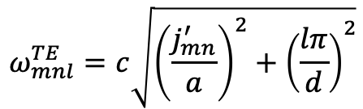
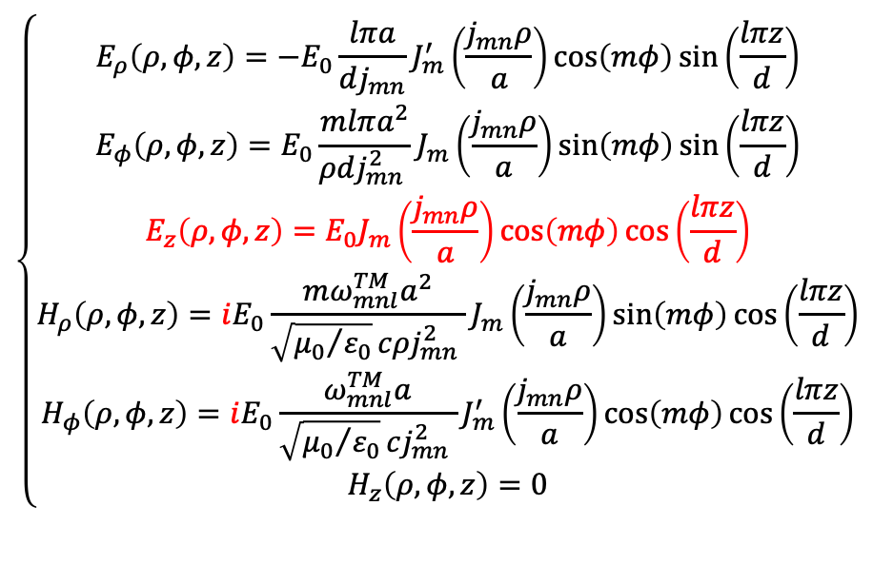
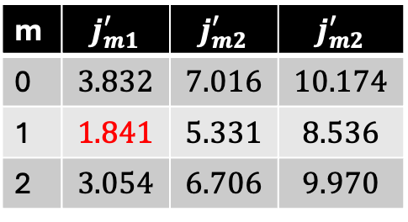
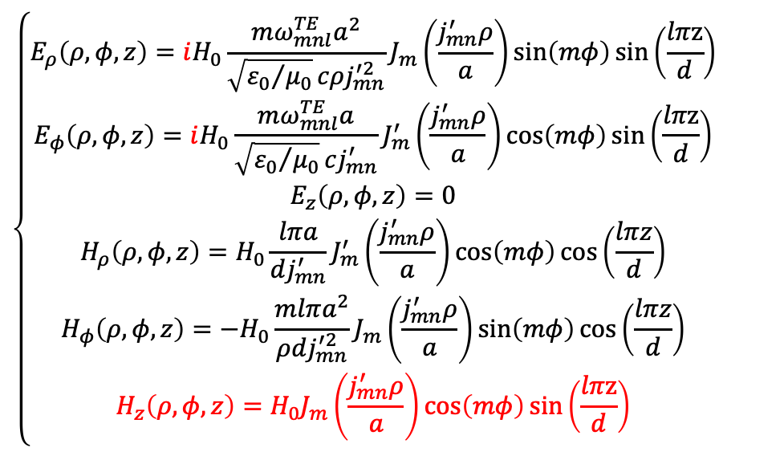
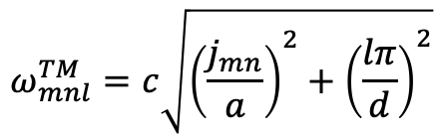
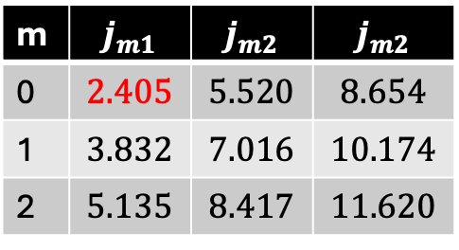
Pill-box cavity modes
TM_{mnl}
TE_{mnl}
$$\left\{\begin{aligned}E_{ρ}\left(ρ,φ,z\right)=−E_{0}\frac{lπa}{dj_{mn}}J_{m}^{′}\left(\frac{j_{mn}ρ}{a}\right)\cos\left(mφ\right)\sin\left(\frac{lπz}{d}\right) \\ E_{φ}\left(ρ,φ,z\right)=E_{0}\frac{mlπa^{2}}{ρdj_{mn}^{2} }J_{m}\left(\frac{j_{mn}ρ}{a}\right)\sin\left(mφ\right)\sin\left(\frac{lπz}{d}\right) \\ E_{z}\left(ρ,φ,z\right)=E_{0}J_{m}\left(\frac{j_{mn}ρ}{a}\right)\cos\left(mφ\right)\cos\left(\frac{lπz}{d}\right) \\ H_{ρ}\left(ρ,φ,z\right)=iE_{0}\frac{mω_{mnl}^{TM}a^{2}}{\sqrt{{μ_{0}}/{ε_{0}}}cρj_{mn}^{2} }J_{m}\left(\frac{j_{mn}ρ}{a}\right)\sin\left(mφ\right)\cos\left(\frac{lπz}{d}\right) \\ H_{φ}\left(ρ,φ,z\right)=iE_{0}\frac{ω_{mnl}^{TM}a}{\sqrt{{μ_{0}}/{ε_{0}}}cj_{mn}^{2} }J_{m}^{′}\left(\frac{j_{mn}ρ}{a}\right)\cos\left(mφ\right)\cos\left(\frac{lπz}{d}\right) \\ H_{z}\left(ρ,φ,z\right)=0\end{aligned}\right.$$
$$\left\{\begin{aligned}E_{ρ}\left(ρ,φ,z\right)=iH_{0}\frac{mω_{mnl}^{TE}a^{2}}{\sqrt{{ε_{0}}/{μ_{0}}}cρj_{mn}^{′2}}J_{m}\left(\frac{j_{mn}^{′}ρ}{a}\right)\sin\left(mφ\right)\sin\left(\frac{lπz}{d}\right) \\ E_{φ}\left(ρ,φ,z\right)=iH_{0}\frac{mω_{mnl}^{TE}a}{\sqrt{{ε_{0}}/{μ_{0}}}cj_{mn}^{′}}J_{m}^{′}\left(\frac{j_{mn}^{′}ρ}{a}\right)\cos\left(mφ\right)\sin\left(\frac{lπz}{d}\right) \\ E_{z}\left(ρ,φ,z\right)=0 \\ H_{ρ}\left(ρ,φ,z\right)=H_{0}\frac{lπa}{dj_{mn}^{′}}J_{m}^{′}\left(\frac{j_{mn}^{′}ρ}{a}\right)\cos\left(mφ\right)\cos\left(\frac{lπz}{d}\right) \\ H_{φ}\left(ρ,φ,z\right)=−H_{0}\frac{mlπa^{2}}{ρdj_{mn}^{′2}}J_{m}\left(\frac{j_{mn}^{′}ρ}{a}\right)\sin\left(mφ\right)\cos\left(\frac{lπz}{d}\right) \\ H_{z}\left(ρ,φ,z\right)=H_{0}J_{m}\left(\frac{j_{mn}^{′}ρ}{a}\right)\cos\left(mφ\right)\sin\left(\frac{lπz}{d}\right)\end{aligned}\right.$$
m | $$j_{m1}$$ | $$j_{m2}$$ | $$j_{m2}$$
0 | $$2.405$$ | $$5.520$$ | $$8.654$$
1 | $$3.832$$ | $$7.016$$ | $$10.174$$
2 | $$5.135$$ | $$8.417$$ | $$11.620$$
m | $$j_{m1}^{′}$$ | $$j_{m2}^{′}$$ | $$j_{m2}^{′}$$
0 | $$3.832$$ | $$7.016$$ | $$10.174$$
1 | $$1.841$$ | $$5.331$$ | $$8.536$$
2 | $$3.054$$ | $$6.706$$ | $$9.970$$
$$ω_{mnl}^{TM}=c\sqrt{{\left(\frac{j_{mn}}{a}\right)}^{2}+{\left(\frac{lπ}{d}\right)}^{2}}$$
$$ω_{mnl}^{TE}=c\sqrt{{\left(\frac{j_{mn}^{′}}{a}\right)}^{2}+{\left(\frac{lπ}{d}\right)}^{2}}$$

Slide 3
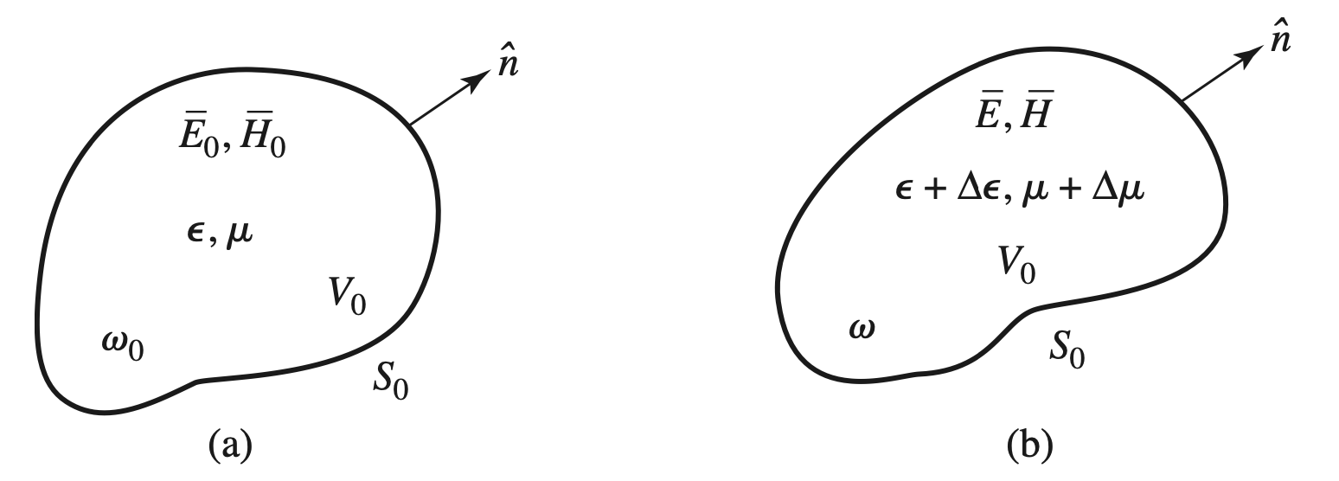
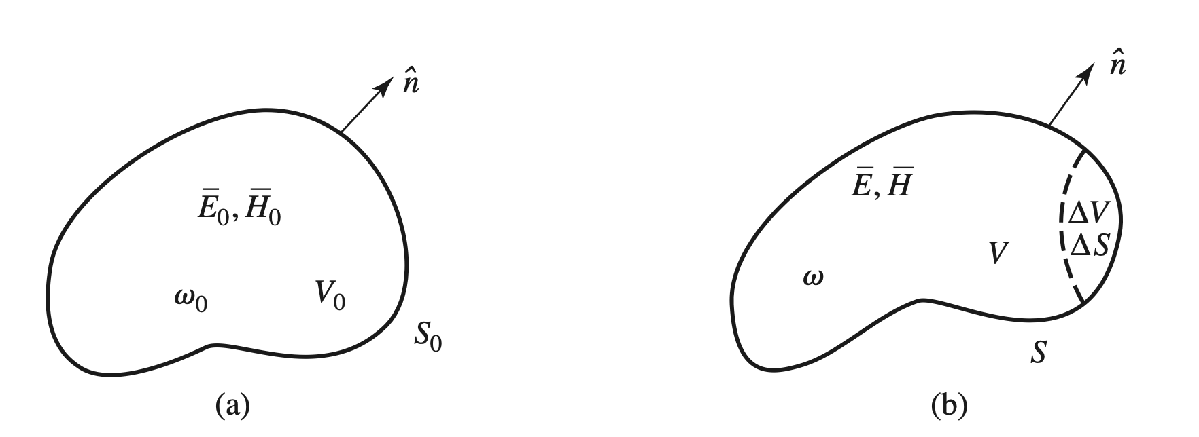
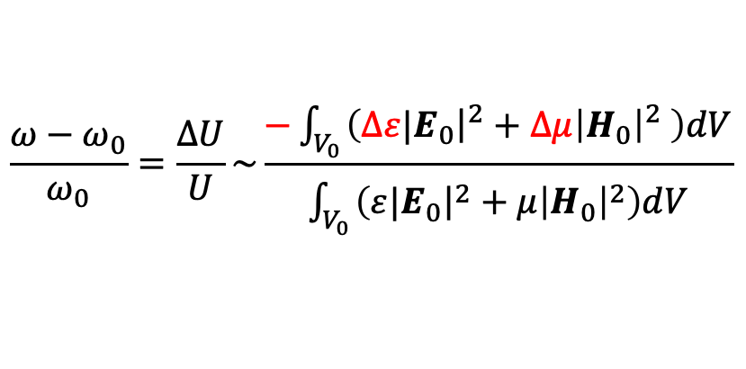
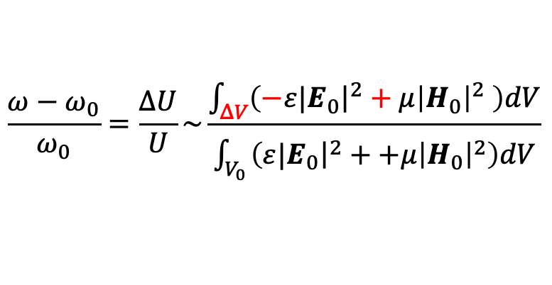








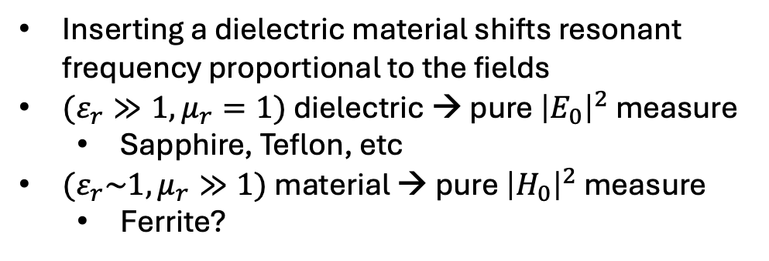
Resonant cavity perturbation: Slater’s theorem
Material perturbation
Shape perturbation
$$∇×E_{0}=−iω_{0}μH_{0}$$
$$∇×E=−iω\left(μ+Δμ\right)H$$
$$∇×E_{0}=−iω_{0}μH_{0}$$
$$∇×E=−iωμH$$
$∇×H_{0}=$ $iω_{0}εE_{0}$
$∇×H=$ $iω\left(ε+Δε\right)E$
$∇×H_{0}=$ $iω_{0}εE_{0}$
$∇×H=$ $iωεE$
$$\frac{ω−ω_{0}}{ω_{0}}=\frac{ΔU}{U}\sim \frac{−\int_{V_{0}}{\left(Δε{\left.​|E_{0}\right|}^{2}+Δμ{\left|H_{0}\right|}^{2} \right)dV}}{\int_{V_{0}}{\left(ε{\left.​|E_{0}\right|}^{2}+μ{\left|H_{0}\right|}^{2}\right)dV}}$$
$$\frac{ω−ω_{0}}{ω_{0}}=\frac{ΔU}{U}\sim \frac{\int_{ΔV}{\left(−ε{\left.​|E_{0}\right|}^{2}+μ{\left|H_{0}\right|}^{2} \right)dV}}{\int_{V_{0}}{\left(ε{\left.​|E_{0}\right|}^{2}++μ{\left|H_{0}\right|}^{2}\right)dV}}$$
Inserting a dielectric material shifts resonant frequency proportional to the fields
$(ε_{r}≫1, μ_{r}=1)$ dielectric → pure ${\left|E_{0}\right|}^{2}$ measure
Sapphire, Teflon, etc
$(ε_{r}\sim 1, μ_{r}≫1)$ material → pure ${\left|H_{0}\right|}^{2}$ measure
Ferrite?
Deform the cavity wall at
E-field region: push in → lower frequency
H-field region: push in→ higher frequency
(energy conservation of work against Lorentz force)
Inserting a metal = decreasing the volume

Slide 4

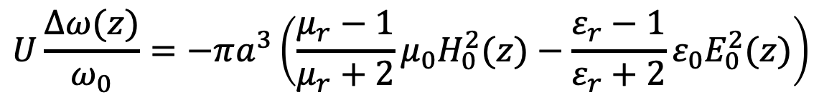


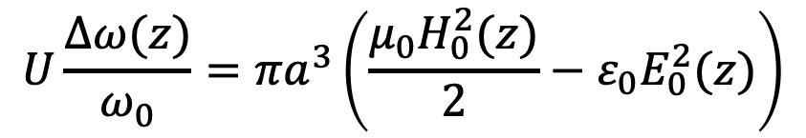
Frequency Perturbation → field measurement
VNA
Metal sphere with a radius $a$
$$U\frac{Δω(z)}{ω_{0}}=πa^{3}\left(\frac{μ_{0}H_{0}^{2}(z)}{2}−ε_{0}E_{0}^{2}(z)\right)$$
$$z$$
Metal sphere with a radius $a$
$$U\frac{Δω(z)}{ω_{0}}=−πa^{3}\left(\frac{μ_{r}−1}{μ_{r}+2}μ_{0}H_{0}^{2}(z)−\frac{ε_{r}−1}{ε_{r}+2}ε_{0}E_{0}^{2}(z)\right)$$
Ellipsoidal bead could resolve field components
This is possible if we measure a resonator with a well-defined resonant frequency $ω_{0}$

Slide 5
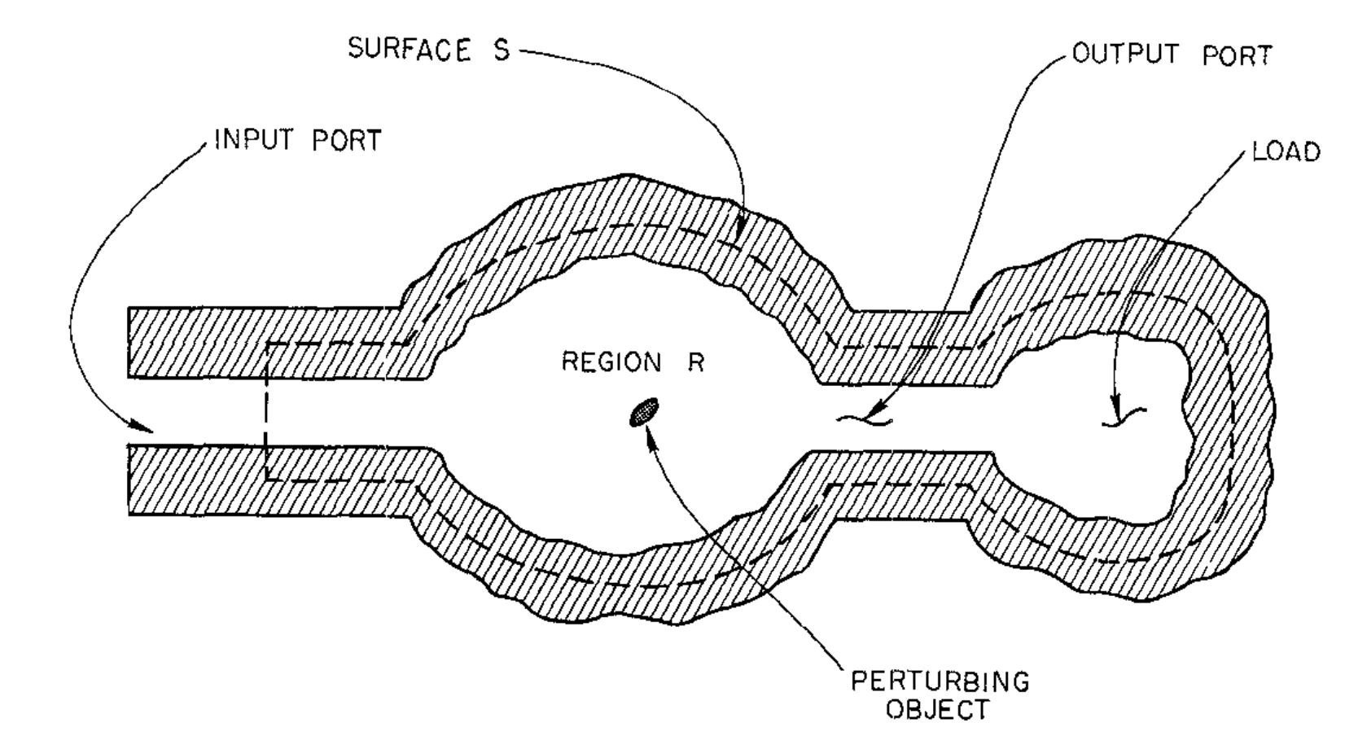

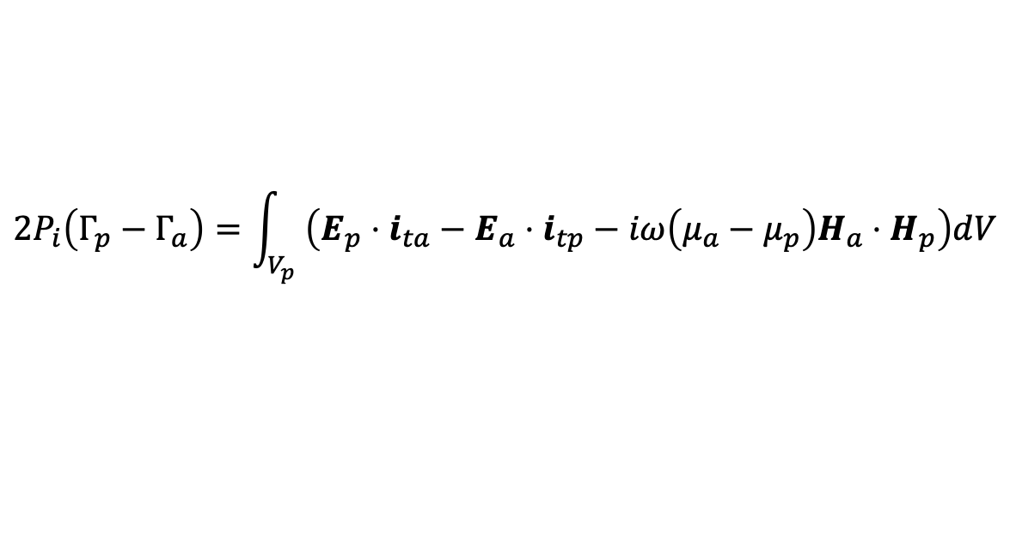

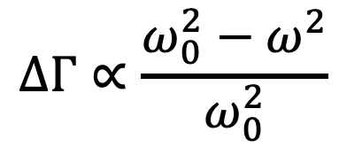
Non-resonant perturbation: Lorentz reciprocity
$$p≡E_{a}×H_{p}−E_{p}×H_{a}$$
Original field
perturbed field
$$2P_{i}\left(Γ_{p}−Γ_{a}\right)=\int_{V_{p}}{\left(E_{p}⋅i_{ta}−E_{a}⋅i_{tp}−iω\left(μ_{a}−μ_{p}\right)H_{a}⋅H_{p}\right)dV}$$
$$i_{t}≡i_{c}+i_{d}≡ i_{c}+iωεE=∇×H$$
C.W. Steele. “A Nonresonant Perturbation Theory”. In: IEEE Transactions on Microwave Theory and Techniques 14.2 (1966), pp. 70–74
Change in reflection coefficient is given by field and current integrated over the volume of the perturbing object
If the resonance is unclear and resonant frequency $ω_{0}$ cannot be identified, change in reflection coefficient is
$$ΔΓ∝\frac{ω_{0}^{2}−ω^{2}}{ω_{0}^{2}}$$
This $ΔΓ$ w/ and w/o perturbation is useful even for non-resonators

Slide 6
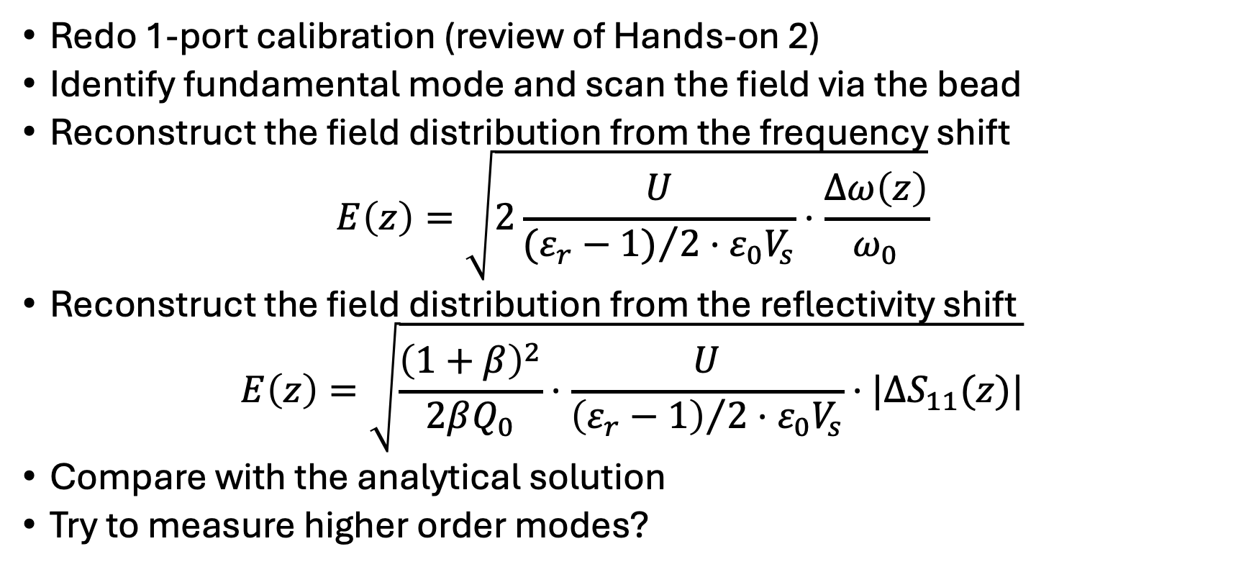
List of interesting experiments
Redo 1-port calibration (review of Hands-on 2)
Identify fundamental mode and scan the field via the bead
Reconstruct the field distribution from the frequency shift
$$E\left(z\right)=\sqrt{2\frac{U}{{(ε_{r}−1)}/2⋅ε_{0}V_{s}}⋅\frac{Δω\left(z\right)}{ω_{0}}}$$
Reconstruct the field distribution from the reflectivity shift
$$E\left(z\right)=\sqrt{\frac{{\left(1+β\right)}^{2}}{2βQ_{0}}⋅\frac{U}{{\left(ε_{r}−1\right)}/2⋅ε_{0}V_{s}}⋅|ΔS_{11}(z)|}$$
Compare with the analytical solution
Try to measure higher order modes?

