Slide 1
Noise power increase by noise diode +15 dB
Alan Aliyali, Juan Maldonado. Akira Miyazaki

Slide 2
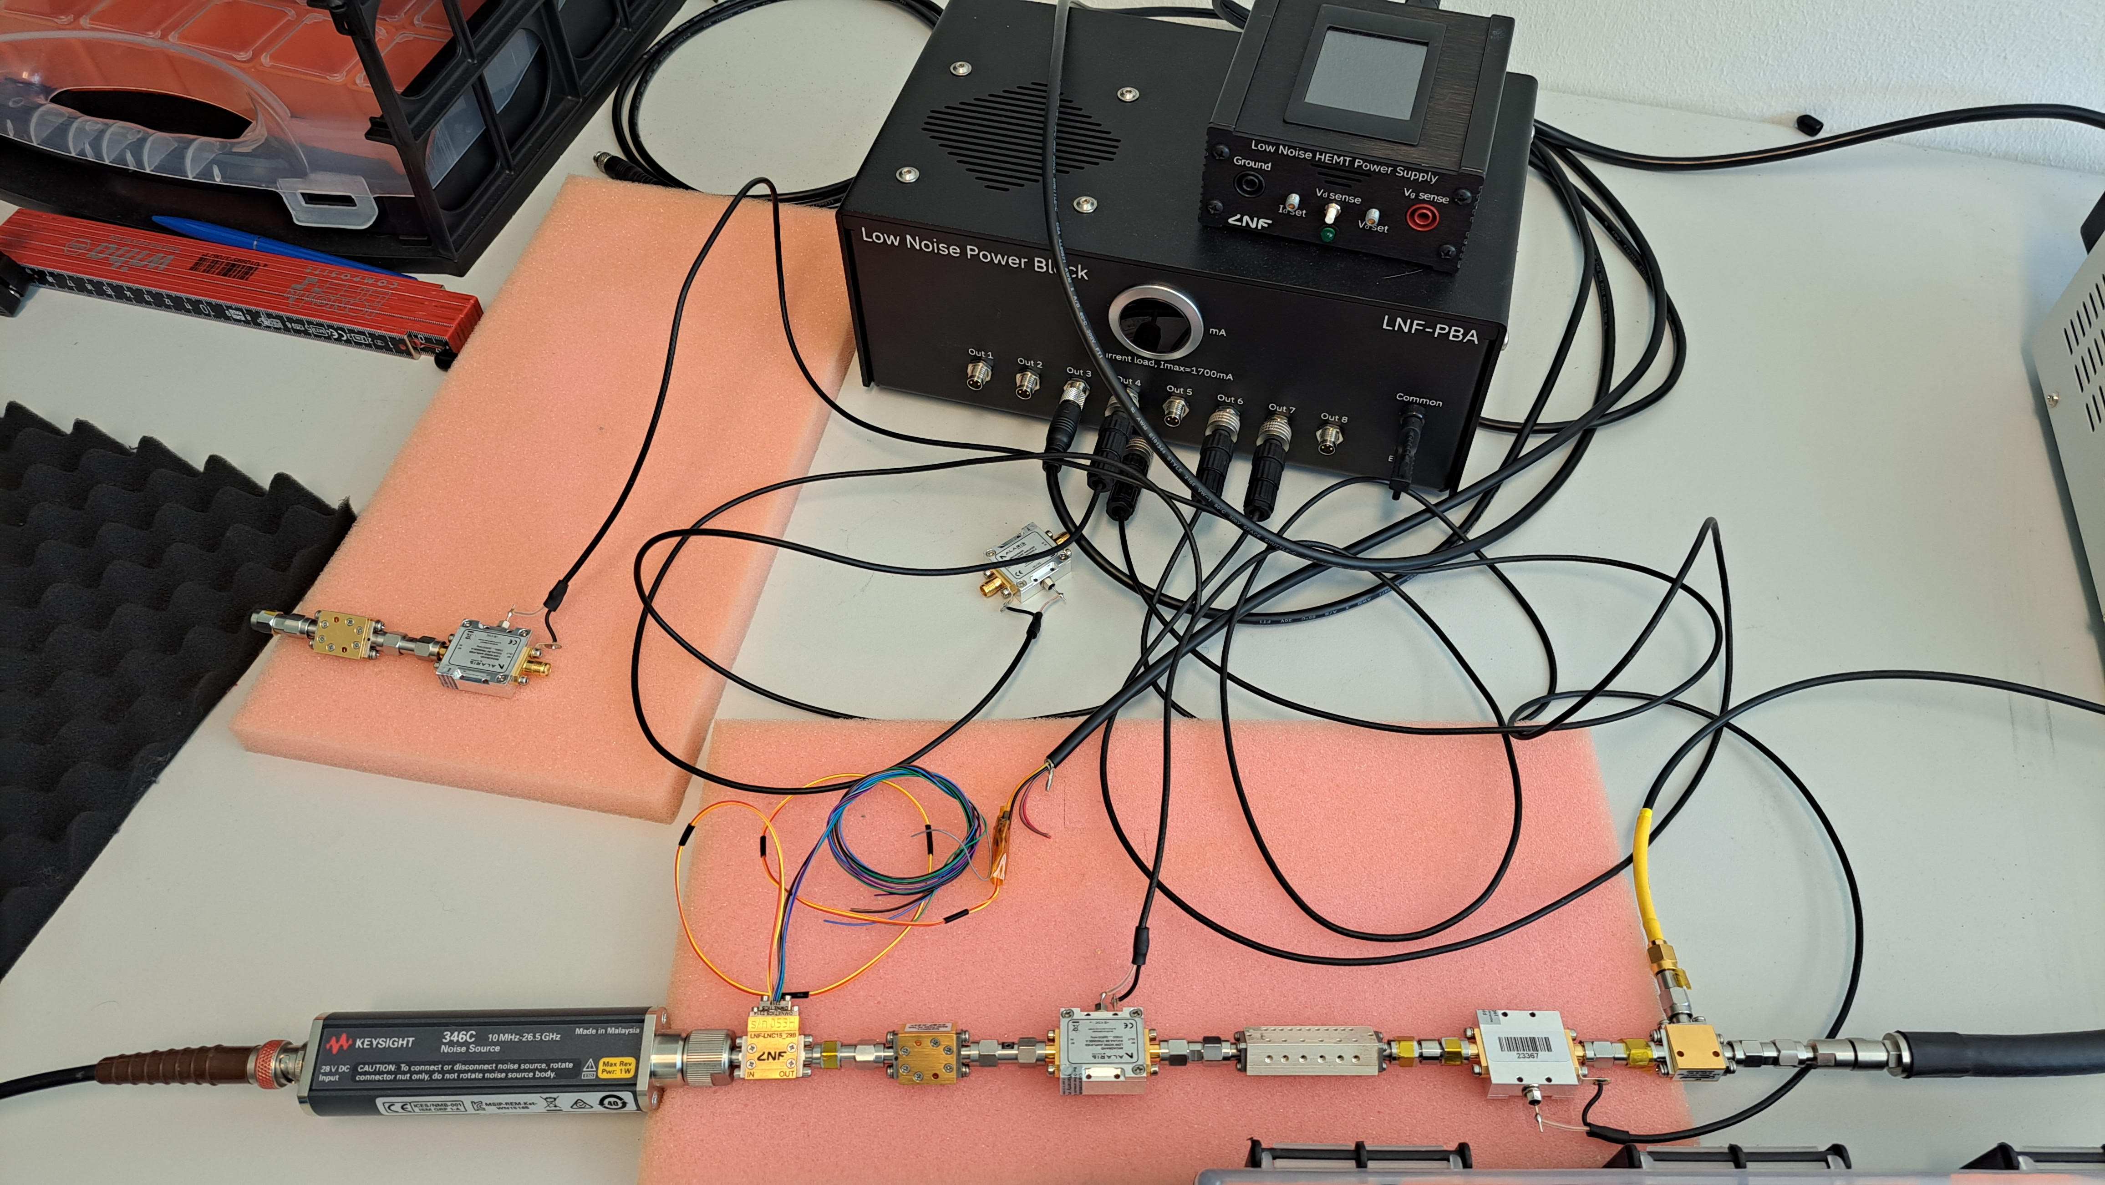
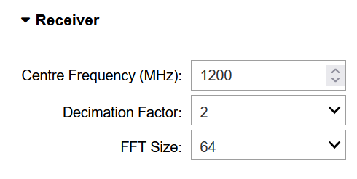

Slide 3
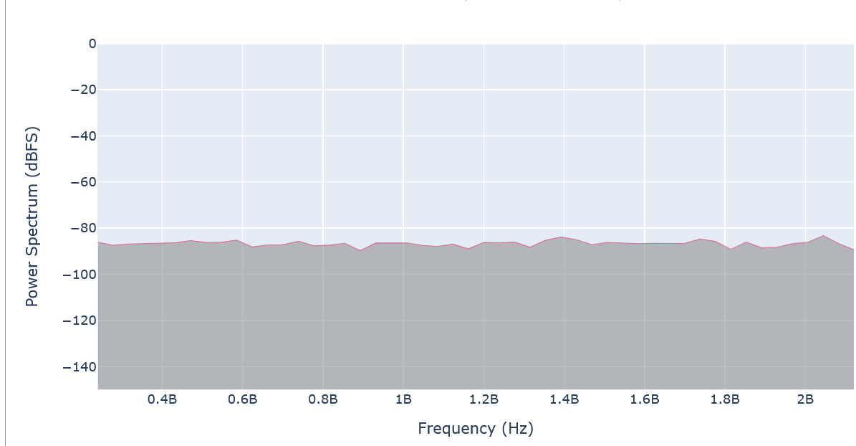
All off

Slide 4
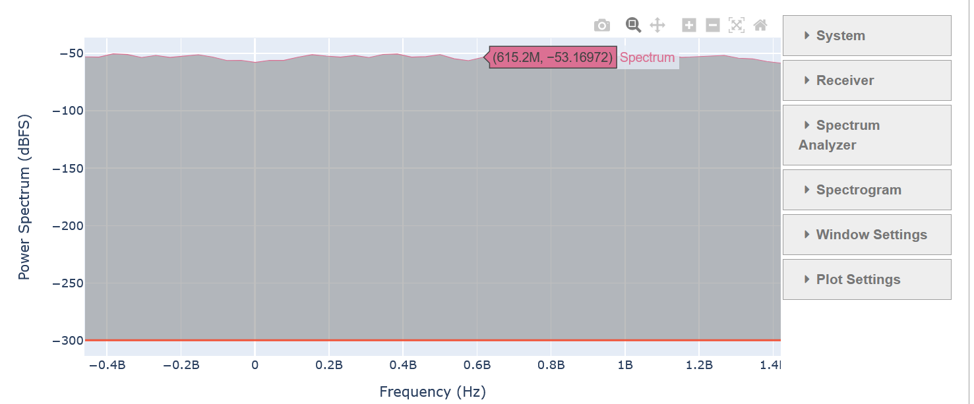
Chain on, noise diode off

Slide 5
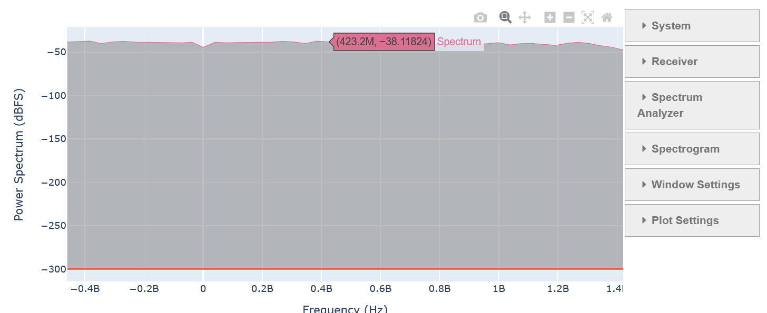
Chain on, noise diode ON

