Slide 1
R&S calibration kit with Keysight VNA
Akira Miyazaki

Slide 2
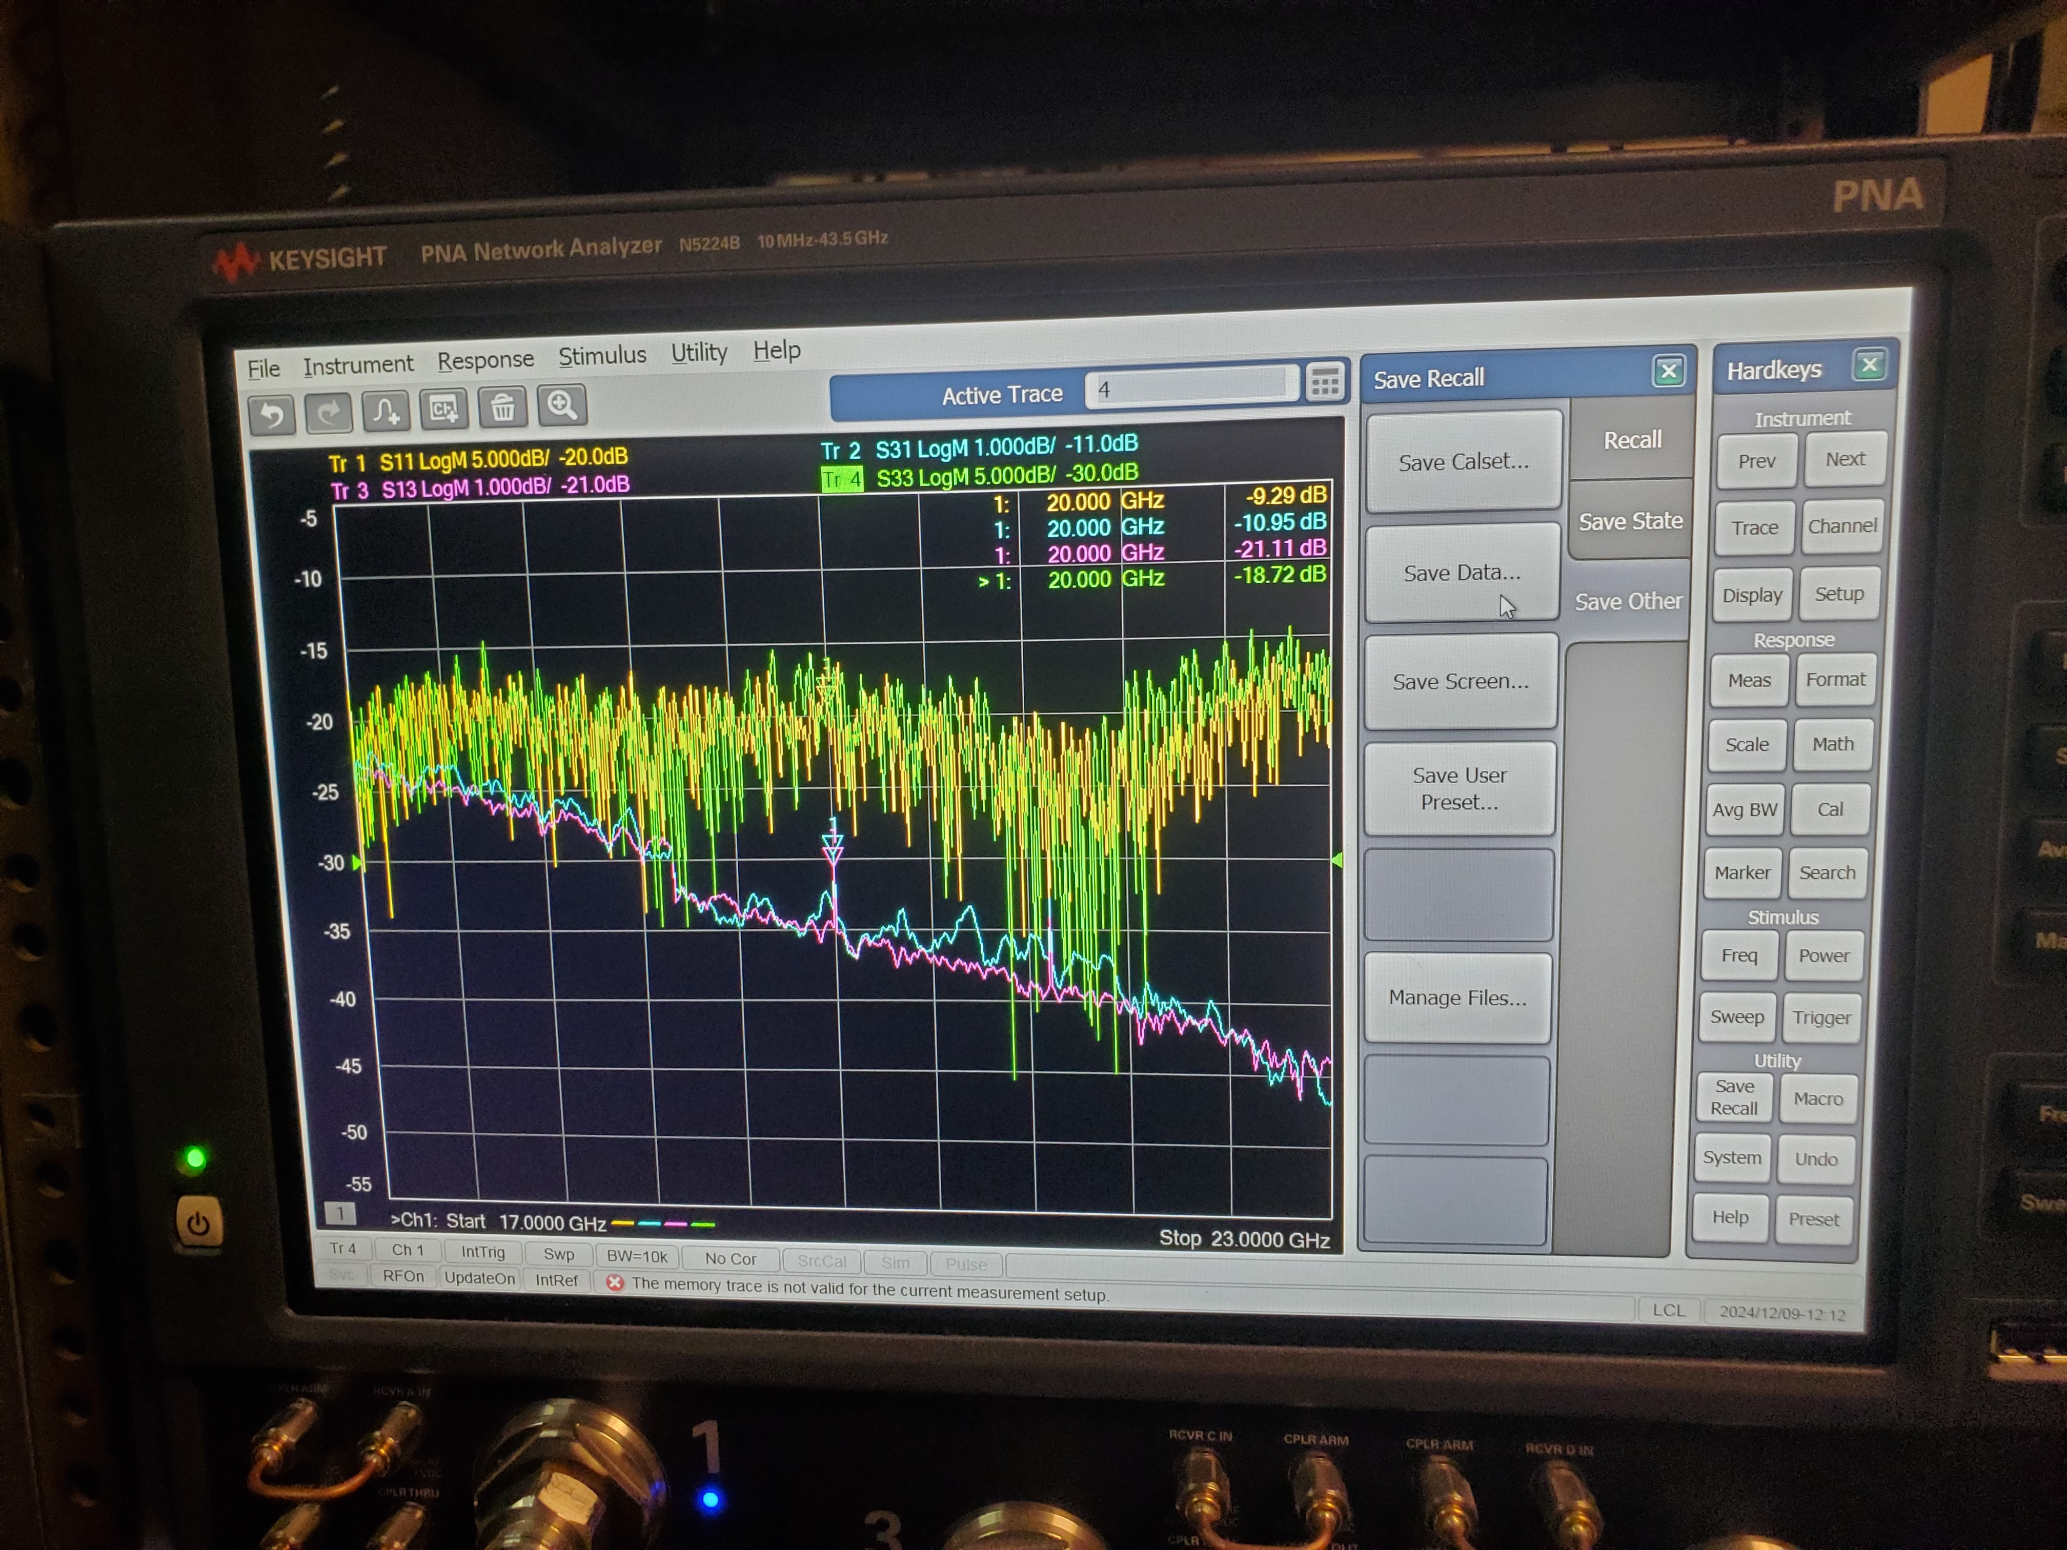
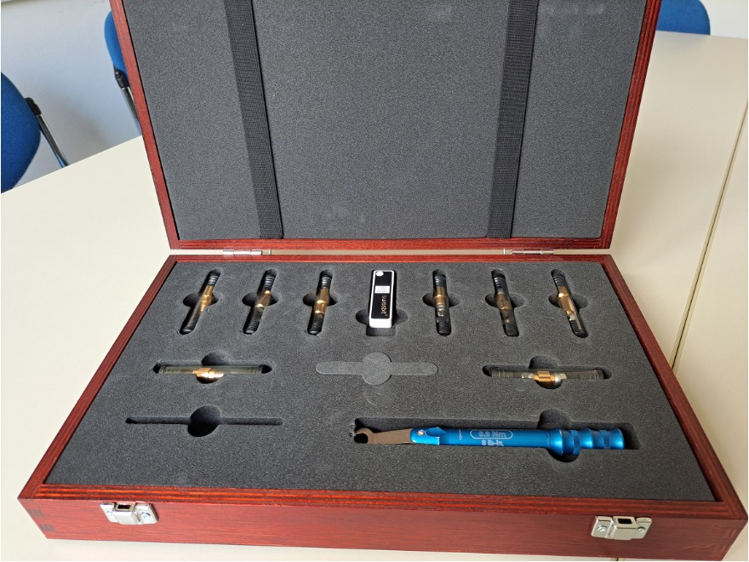
What we (IAS) have in Orsay
KEYSIGHT N5224B
R&S ZV-Z229
IAS professor Bruno had R&S VNA and two calkits in his former laboratory and brought only one calkit to IJCLab

Slide 3
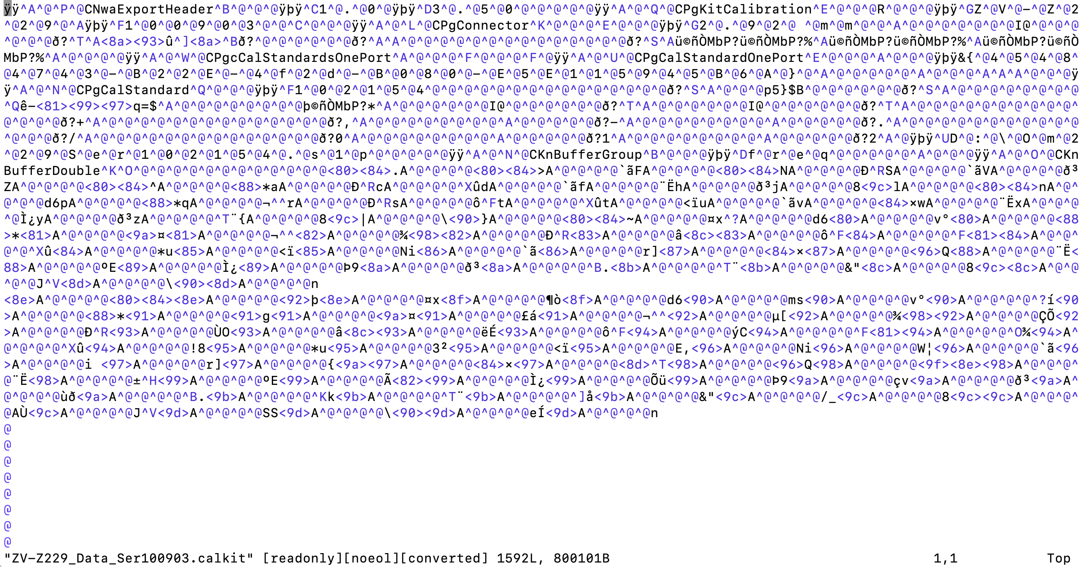
Incompatible “calkit” data binary files
KEYSIGHT binary
R&S binary
.xkt file
.calkit file
→ R&S calibration kit + “file.calkit” is not useful for KEYSIGHT VNA

Slide 4
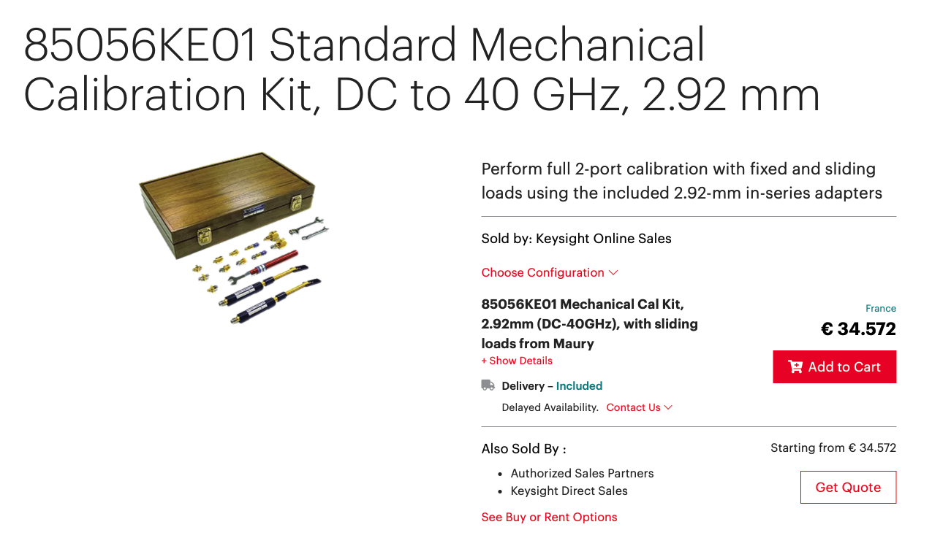
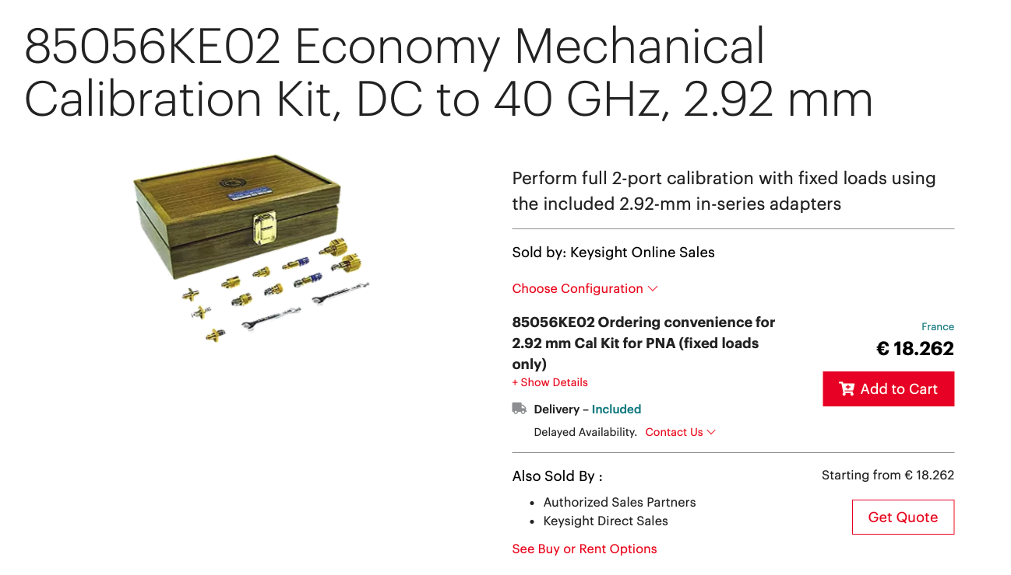
Let’s buy KEYSIGHT calkit ☺

Slide 5

Let’s buy KEYSIGHT calkit ☺

Slide 6

Motivation pour leberité
The authentic calkits exceed our budget
We have less expensive options
KEYSIGHT firefox calkit: ~ 5 kEUR
Rosenberger (MPP & UHamburg): ~5 kEUR
RF Lamda (Aachen): ~5.4 kEUR
ERAVAN: ~ 7 kEUR
The 3rd party / less expensive option costs anyway a lot
We could buy receiver chain + RFSoC DAQ board with 6 kEUR!
We already have 3rd party calkit by R&S anyway
→ no fundamental change!
We need to reverse engineer the R&S calkit data format
What is “VNA calibration” in the end ????????

Slide 7
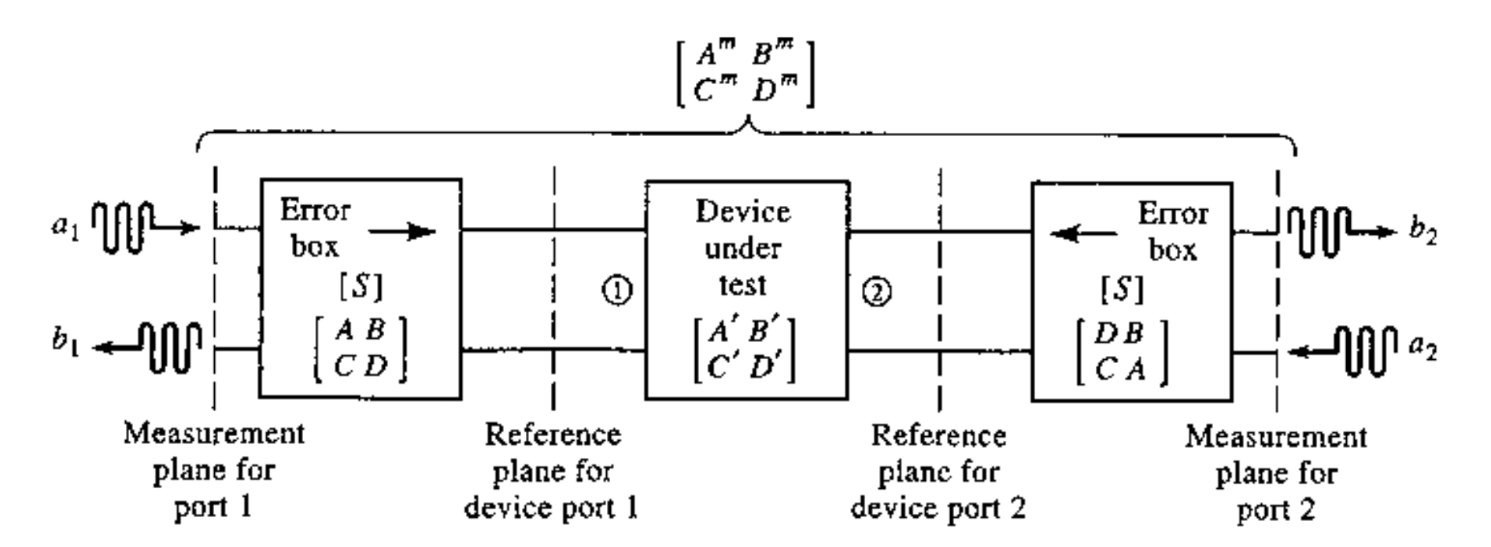
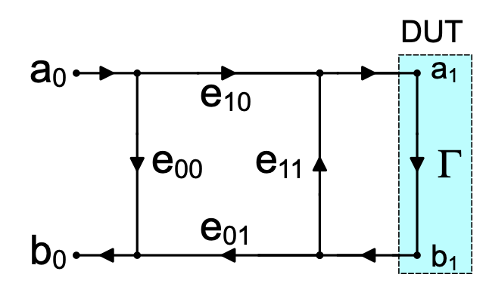
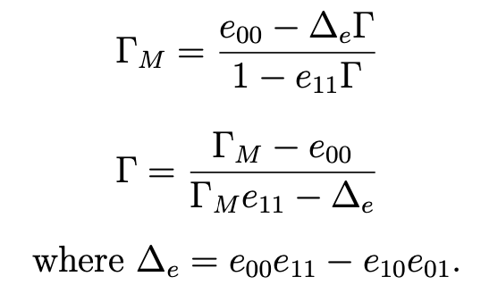
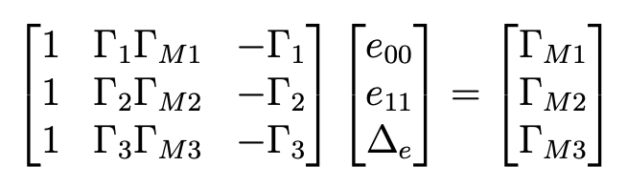
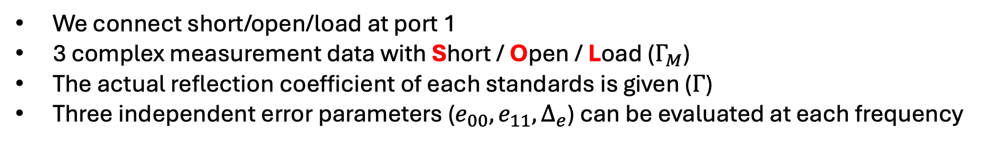
VNA calibration 1 port
To define the reference planes to evaluate S-parameters of DUT not the transmission line around
https://www.minicircuits.com/app/AN49-016.pdf?srsltid=AfmBOooqx7NqwhZanfjyLFoyBampczlLDHa6g43AwZ7PvChcFP1TlwUJ
We connect short/open/load at port 1
3 complex measurement data with Short / Open / Load ($Γ_{M}$)
The actual reflection coefficient of each standards is given ($Γ$)
Three independent error parameters ($e_{00}, e_{11}, Δ_{e}$) can be evaluated at each frequency

Slide 8
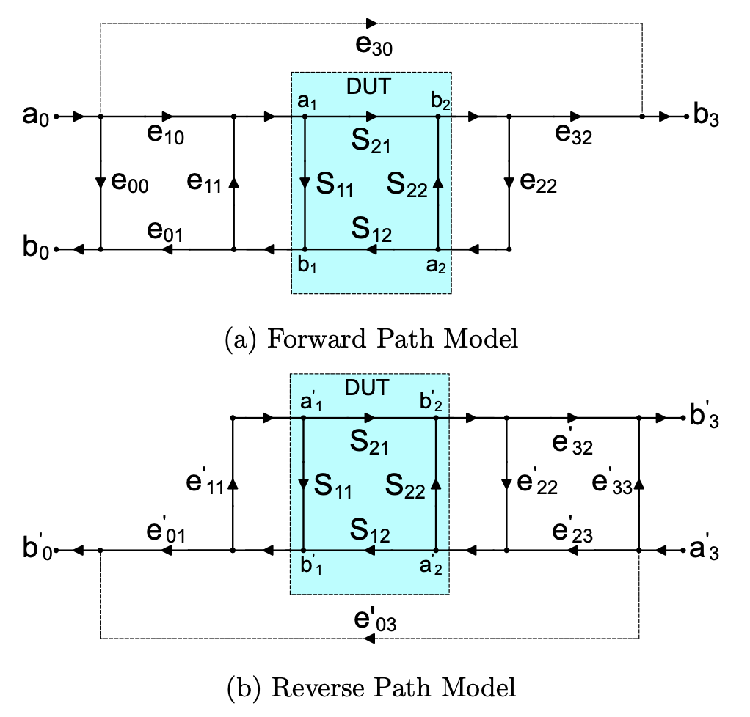
VNA calibration 2 ports
To define the reference planes to evaluate S-parameters of DUT not the transmission line around
https://www.minicircuits.com/app/AN49-016.pdf?srsltid=AfmBOooqx7NqwhZanfjyLFoyBampczlLDHa6g43AwZ7PvChcFP1TlwUJ
We connect Short/Open/Load at port 1 and 2 and then connect Through between 1 & 2
7 complex measurement data for one gender
Critical process before measuring resonant cavities, antennas, with S21 parameter

Slide 9

Who specifies actual $Γ$ (calibration target)?
→ Usually the calkit company!
Two ways
Model based specification
Circuit model with some parameters over frequency
Real-data based specification
Factory-calibrated VNA to “calibrate” the individual calibration standards for the customers

