Slide 1
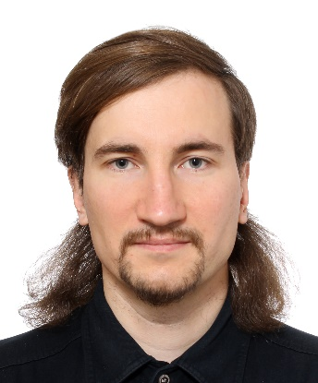
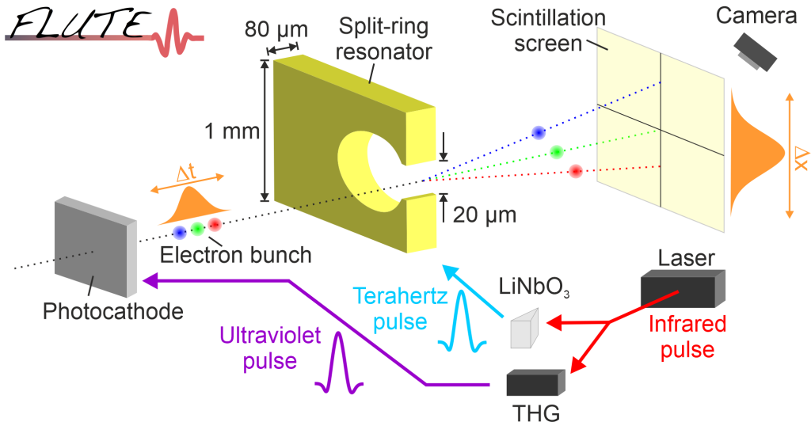
Sergei Glukhov, Karlsruhe Institute of Technology (KIT)
2005 — 2019: Budker Institute of Nuclear Physics (BINP), Novosibirsk, Russia
Beam dynamics studies, particle tracking software development
2015 — 2019: BINP and FAIR/GSI, Darmstadt, Germany
Magnet design and production for FAIR
2019 — 2022: TU Darmstadt (PhD term)
Instability studies in energy recovery linacs
sergei.glukhov@kit.edu
2022 — 2025: TU Darmstadt and KIT
2025 — present: KIT
Compact transverse deflecting system simulations and development at FLUTE

