Slide 1
Bunch Compression at the SwissFEL Injector Test Facility
Bolko Beutner
13.3.2014
SwissFEL Meeting

Slide 2
Contents
Introduction
Bunch Compression Theory
Measurements at the SwissFEL Injector Test Facility
Conclusions

Slide 3
Introduction

Slide 4
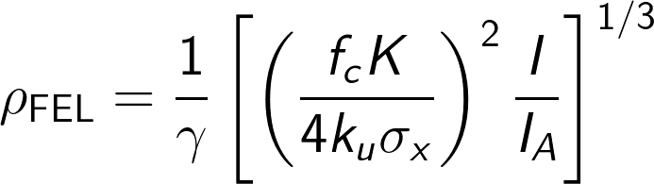
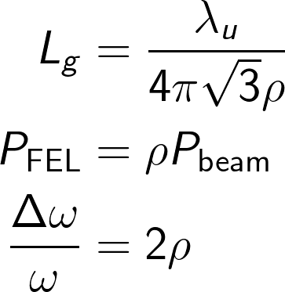
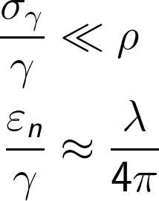
FEL Performance
FEL performance is determined by the peak current and the emittance – the charge density in 6D.
Low emittance and high peak current beams are required in the undulators, but not available at feasible electron sources.
Typically long beams are produced with low emittance and the compressed later.
Therefore compression should not dilute emittance to much (i.e. Space Charge Forces).
SASE Performance:
Beam Requirements for SASE:

Slide 5
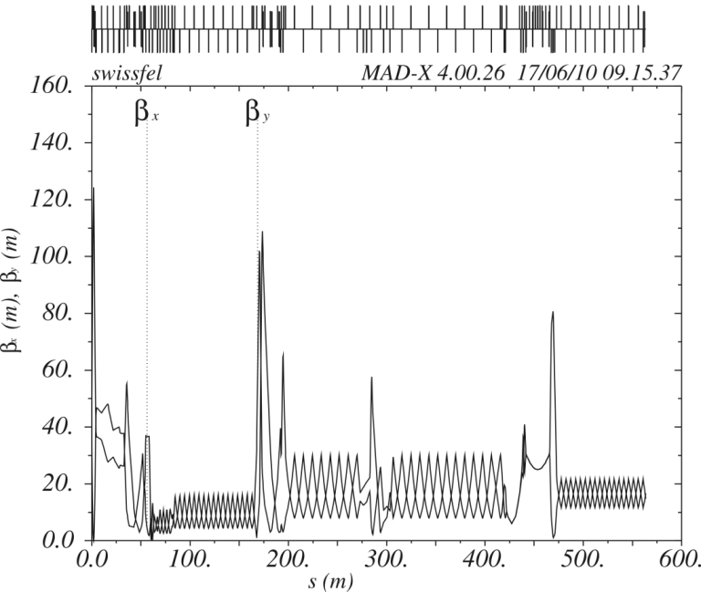
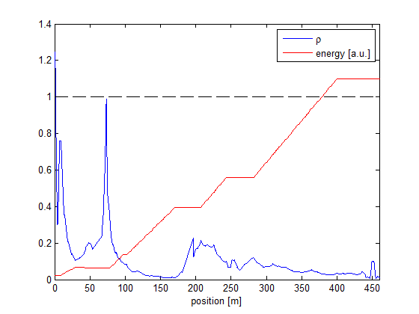
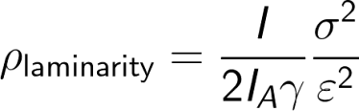
Were to compress the beam?
Early compression would lead to high charge density beams at low energies which would increase the emittance.
Late compression would require the transport of long bunches trough the linac without emitance dilution, which is difficult (RF-curvature, wake fields, …)
Multi-stage-compression
2 stages in case of LCLS, FLASH, and SwissFEL
3 stages in case of xfel.eu
BC1
BC2

Slide 6
Bunch Compression Theory

Slide 7
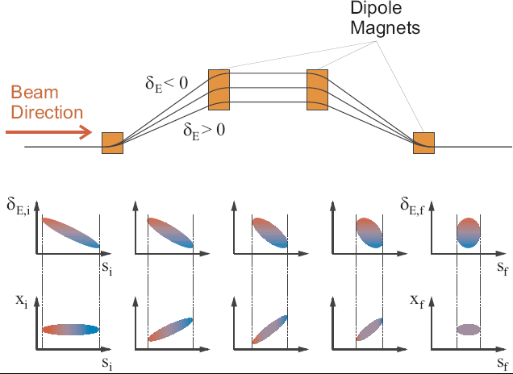
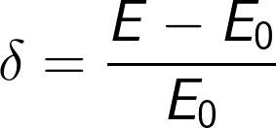
Basic Principle
with

Slide 8
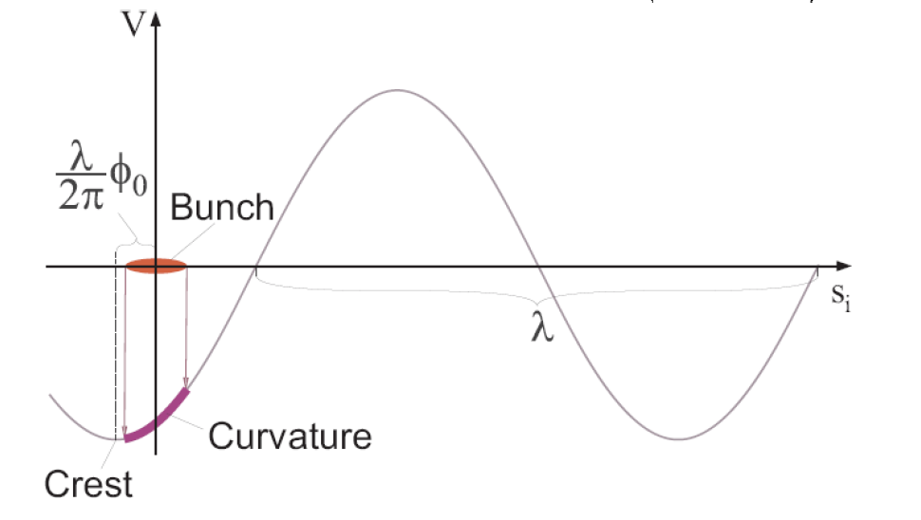
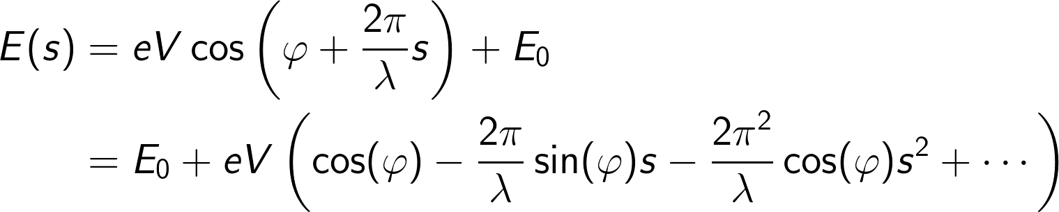
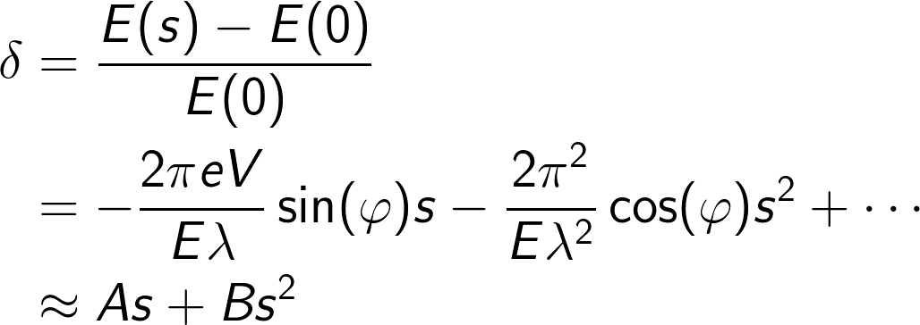
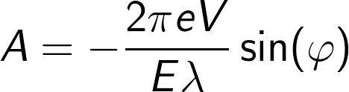
Energy Chirp Generation

Slide 9

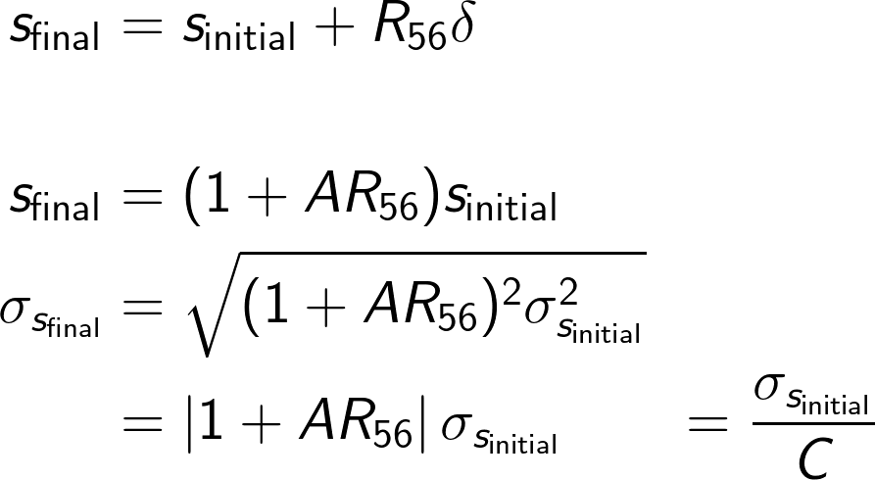
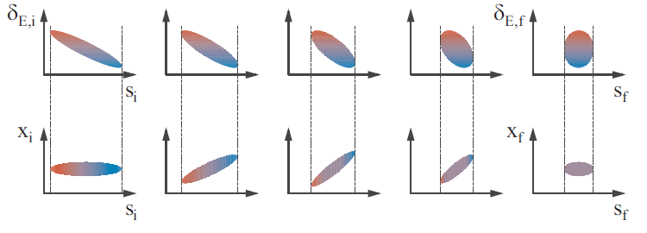
Linear Compression

Slide 10

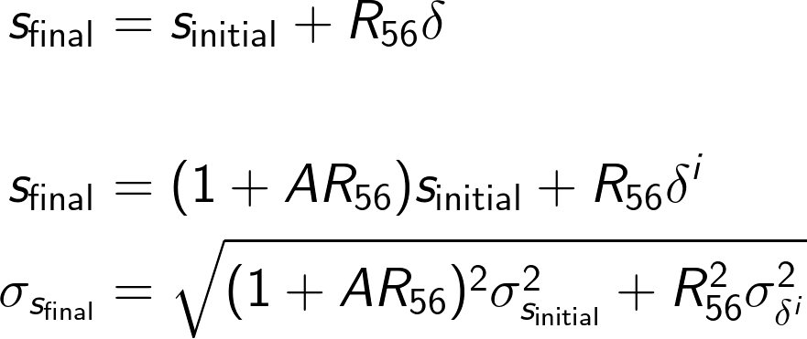


Linear Compression with Uncorrelated Energy Spread
each particle i has an individual “random” energy offset
Typically the “full” compression is avoided…

Slide 11
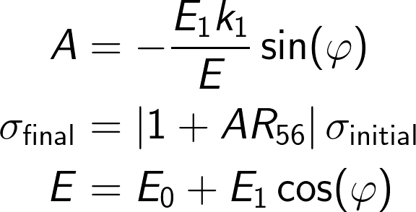
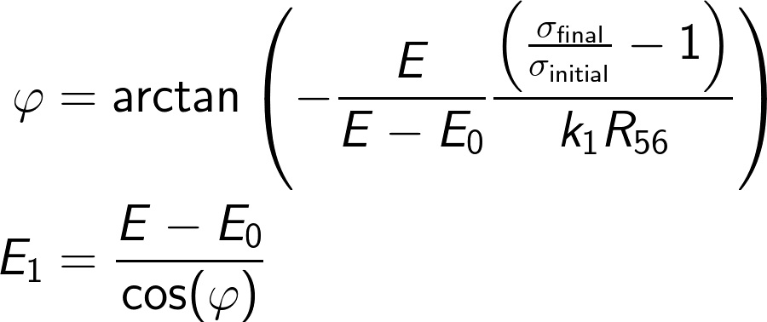

Simple Compression Setup
E₀,k₁,0 deg
E₁,k₁,phi
total energy E
Is this Ok?

Slide 12
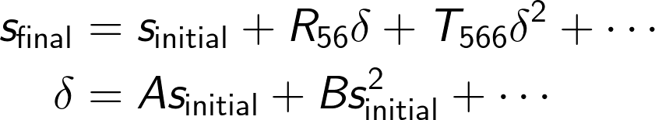
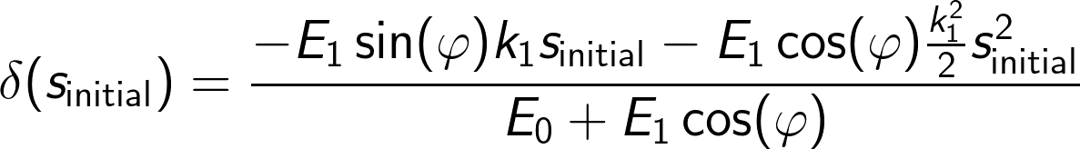
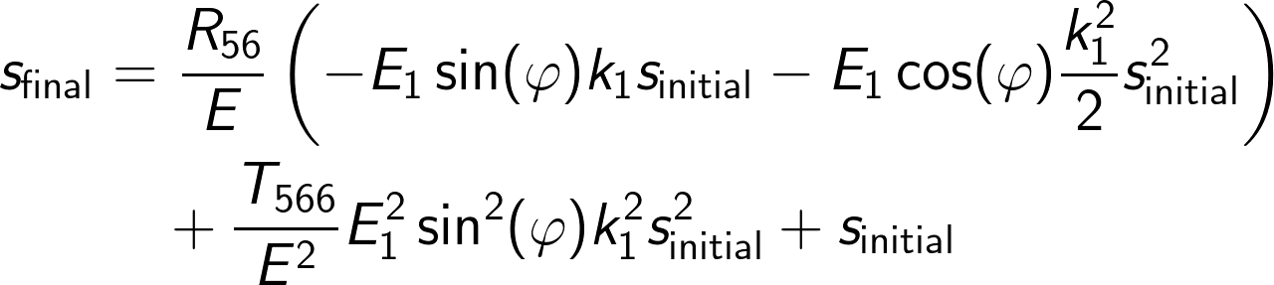
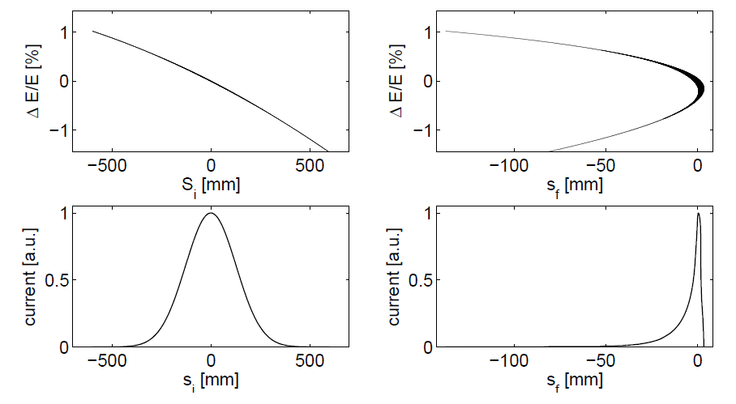
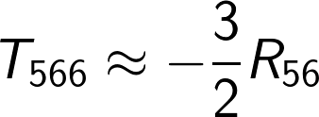
Nonlinear compression
E₀,k₁,0 deg
E₁,k₁,phi
total energy E
Can we tune the T₅₆₆-term to compensate the E₁ quadratic-term?
This is NOT Ok!
No since

Slide 13
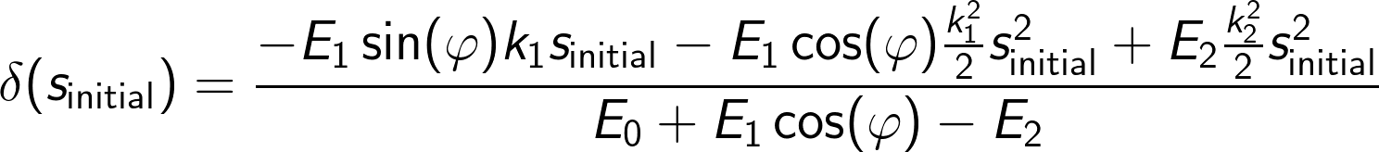
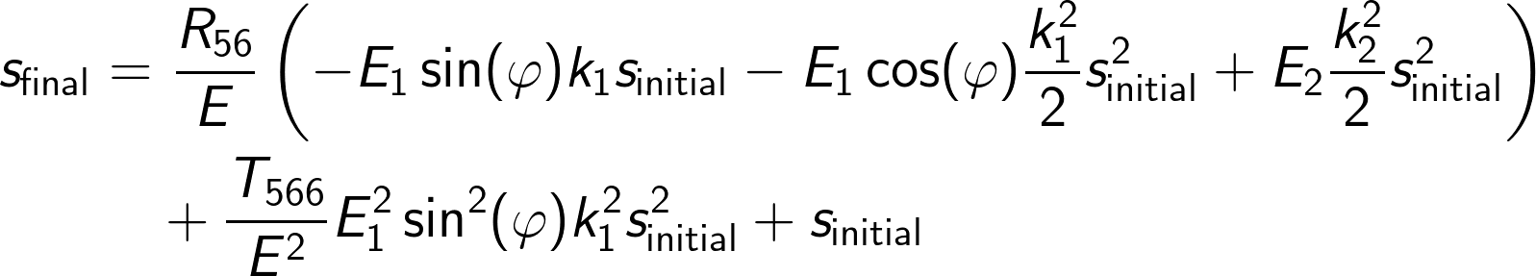
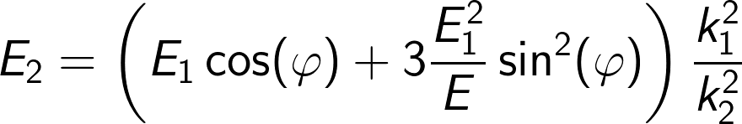
Linarised Compression
E₀,k₁,0 deg
E₁,k₁,phi
E₂,k₂,180deg
total energy E

Slide 14
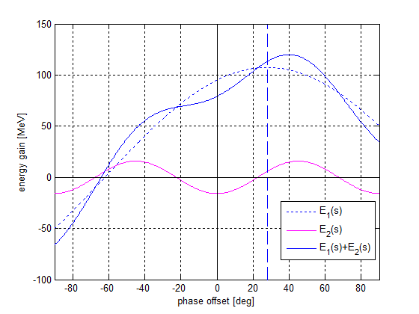
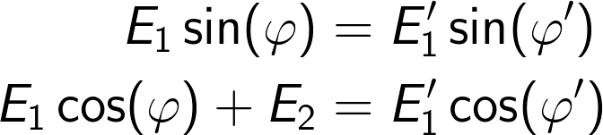
Energy Compensation
E₀,k₁,0 deg
E₁,k₁,phi
E₂,k₂,180deg
total energy E
Compensation of energy loss is required while the slope must be maintained.

Slide 15
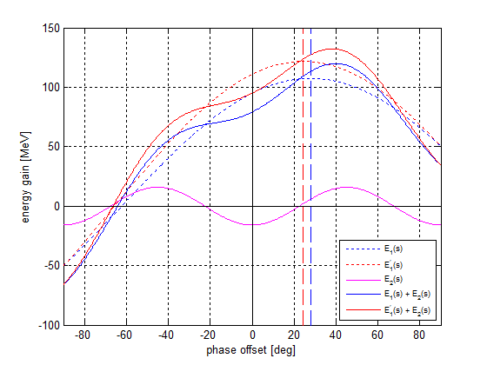
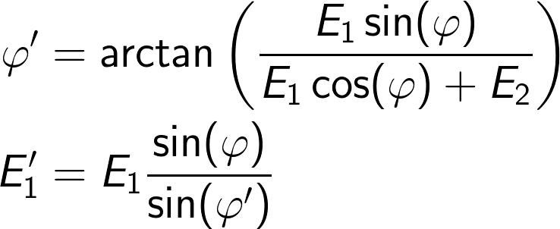
Energy Compensation
E₀,k₁,0 deg
E₁,k₁,phi
E₂,k₂,180deg
total energy E
Compensation of energy loss is required while the slope must be maintained.

Slide 16
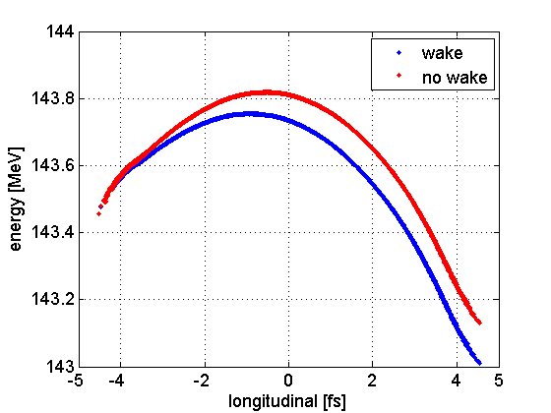

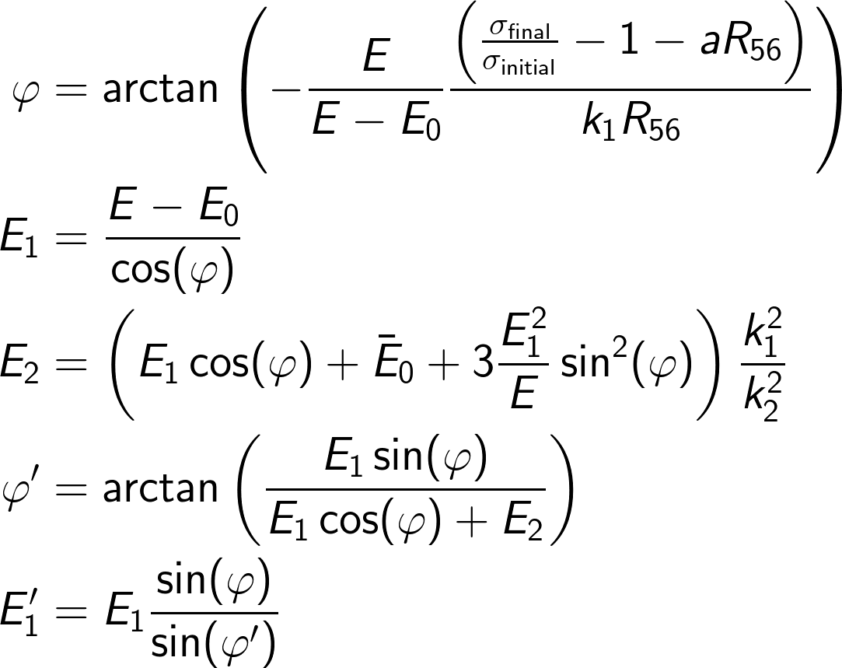
(Almost) General Solution for Single Stage BC
head
E₀,k₁,0 deg
E₁,k₁,phi
E₂,k₂,180deg
total energy E
If x-band is not operated “anti-on-crest” an additional linear compression term plays a role.

Slide 17
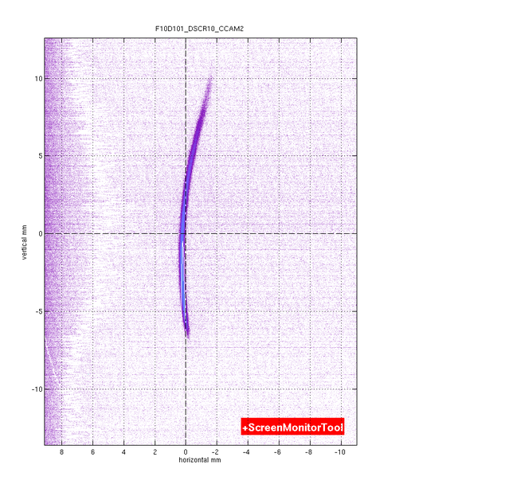
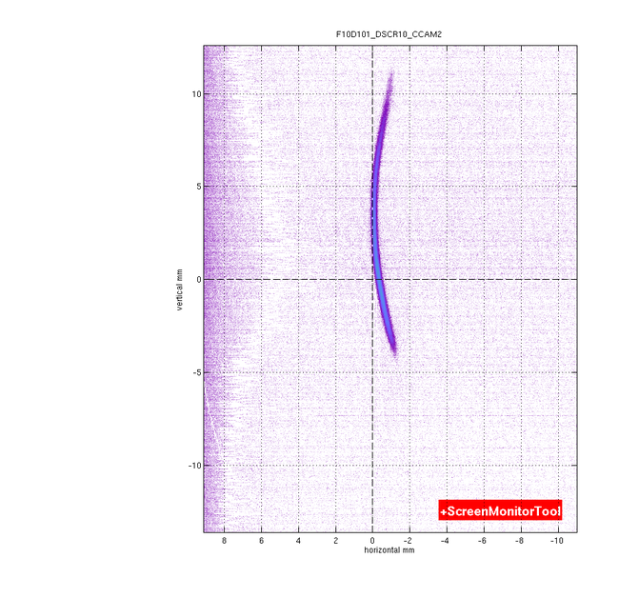
Adjust phase to remove incoming chirp
Initial chirp from the gun affects the compression (“aR₅₆”-term). An adjustment of FINSB02 phase proved useful to correct for it.
tail
longitudinal axis
longitudinal axis
head
energy axis
energy axis

Slide 18
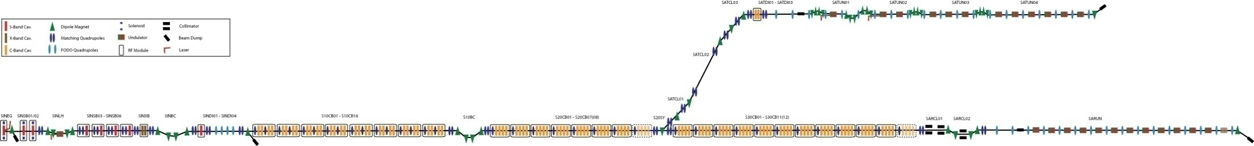
Multi-Stage Compression
E₀,k₁,0 deg
E₁,k₁,phi
E₂,k₂,180deg
total energy E
X-band is compensating the quadratic terms from:
initial curvature
Second order contributions in S-band RF (E₀ and E₁)
T₅₆₆-components in BC1
T₅₆₆-components in BC2 and Energy Collimator
RF curvature from the C-band RF
Quadratic chirp generated by self field interactions
BC 1
BC 2
Energy Collimator

Slide 19
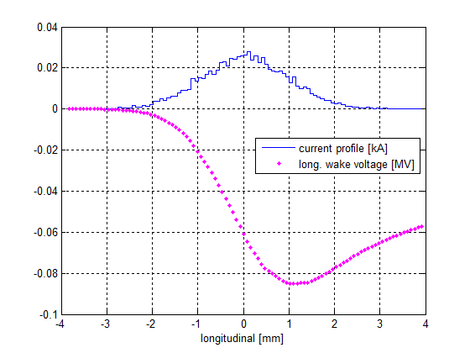
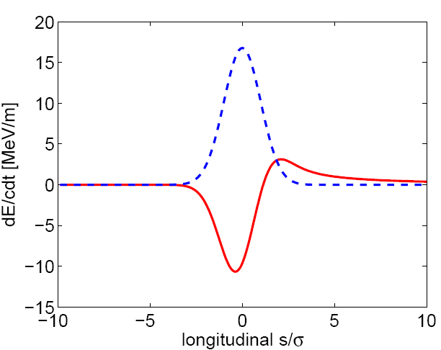
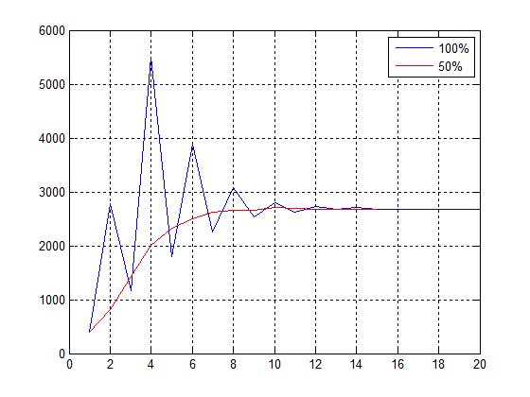
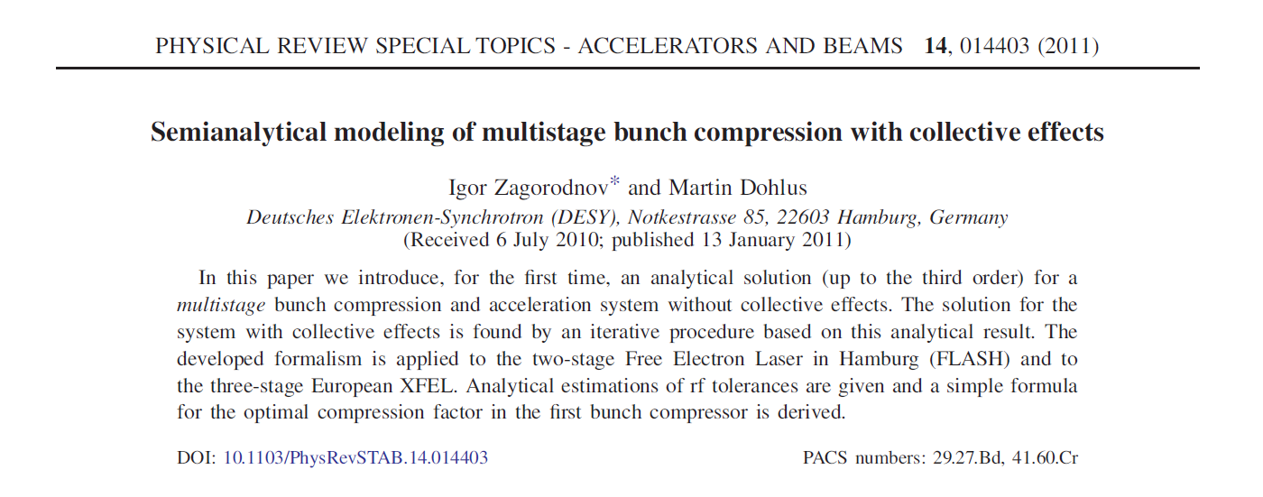
Multi-Stage Compression
Coherent Synchrotron Radiation
Longitudinal Space Charge
Longitudinal Wake Fields
tail
tail
head
head
tail
head
Forces generated by self field interactions have an effect on the compression but is affected by compression as well. Analytic calculations are very difficult.
=> Self-Consistent Tracking
Iterative semi-analytic procedure to setup compression:
Peak current [A]
Iteration step
Previous talks:
Operation Modes and Longitudinal Layout for the SwissFEL Hard X-Ray Facility
http://indico.psi.ch/conferenceDisplay.py?confId=308
Bunch Compression Optimization for SwissFEL
http://indico.psi.ch/conferenceDisplay.py?confId=1248

Slide 20
Measurements at the SwissFEL Injector Test Facility*
*with contributions from the SwissFEL Injector Commissioning Team

Slide 21
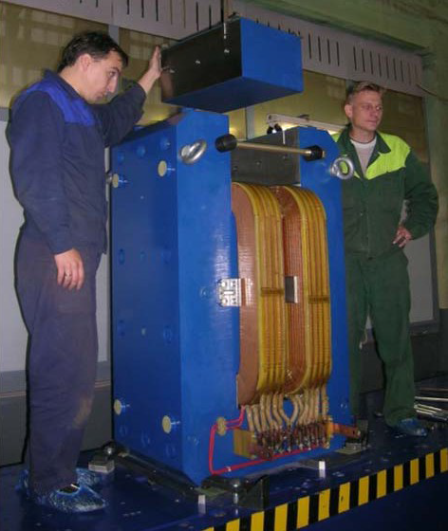
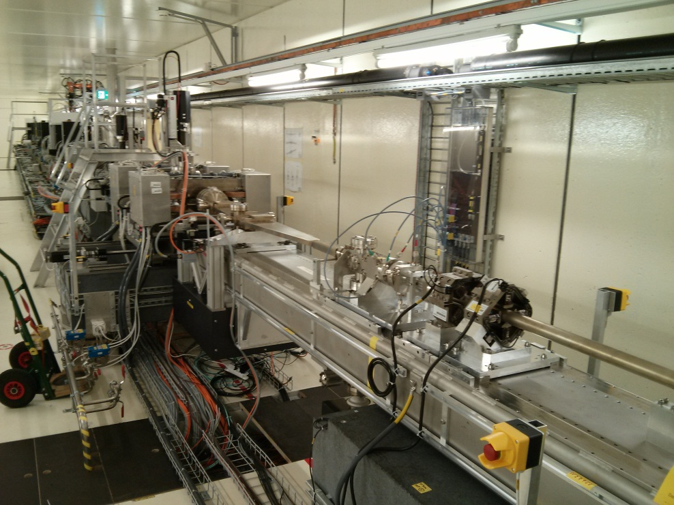
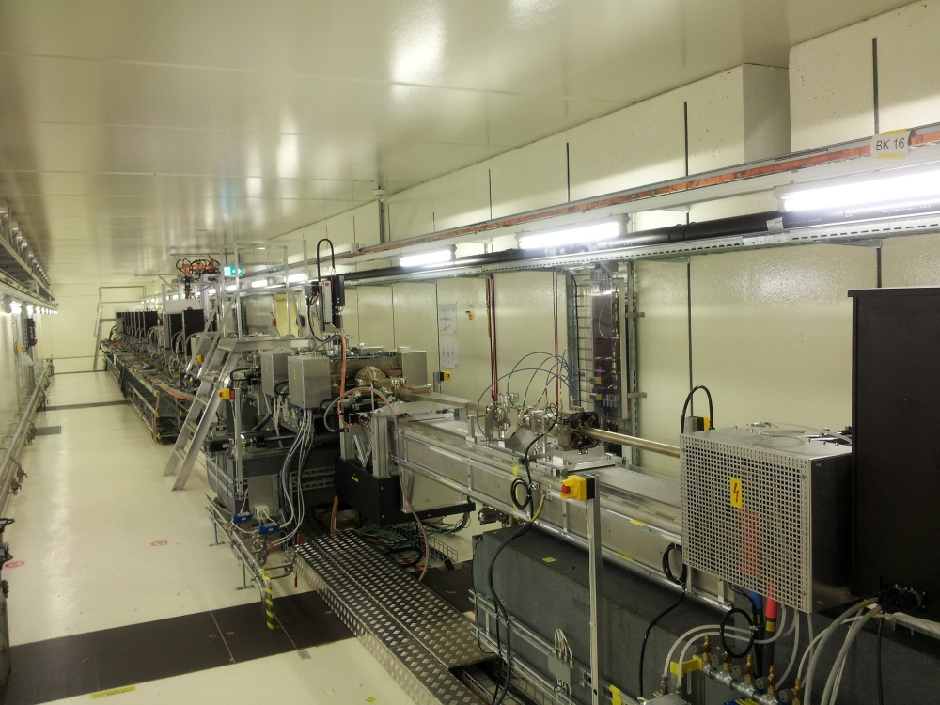
BC Movable Girder
alpha [deg] | B[T] at 200MeV | R₅₆[mm]
0 | 0 | 0
1 | 0.0466 | -2.767
2 | 0.0931 | -11.07
3 | 0.1397 | -24.90
4 | 0.1861 | -44.27
5 | 0.2326 | -69.17
xfel.eu

Slide 22

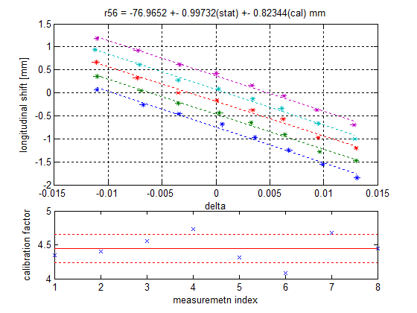
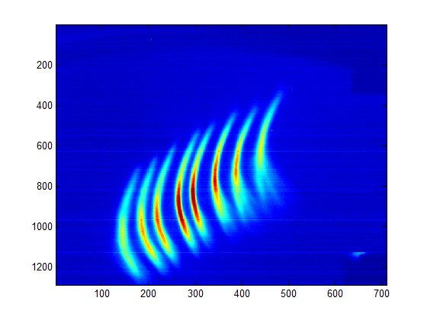
BC Angle Setup
Bending angle needs to be set up to achieve a certain R₅₆.
Analytic formula results can be checked with measurements.
tail
longitudinal position
R₅₆
head

Slide 23
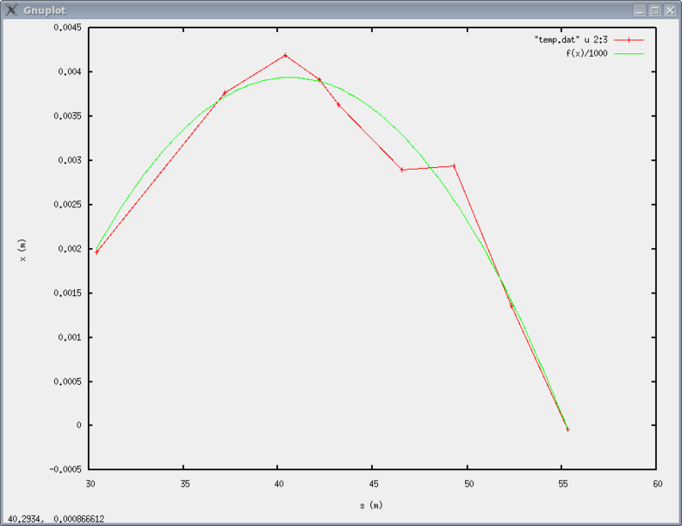
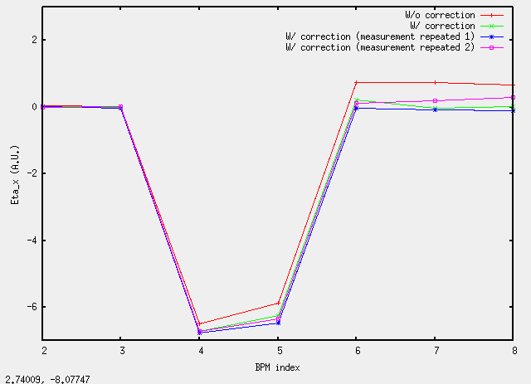
BC Field Correction
Compensation of magnetic fields with trim coils
Dispersion correction using orbit correctors either manually or with an SVD based method
f(x)=-26.6110258+1.50357605*x-0.018499*x**2 => Average geomagnetism of 28.4 uT
F10BC-MCRX10: = 0.20 A F10BC-MCRX20: = 0.24 A F10BC-MCRX30: = 0.24 A F10BC-MCRX40: = 0.23 A
Correction of position in dipole 4
Correction of angle at dipole 4

Slide 24
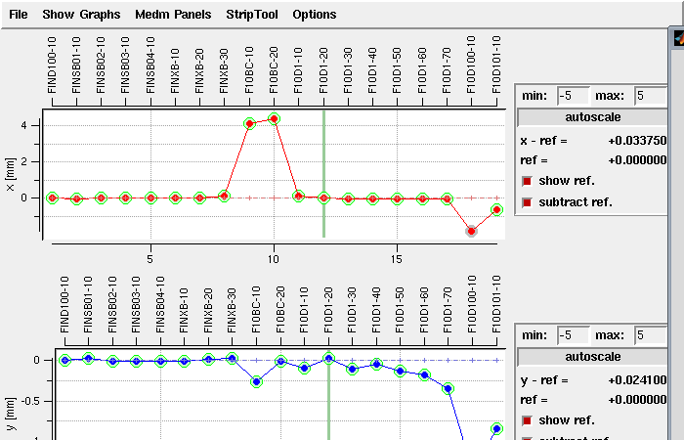
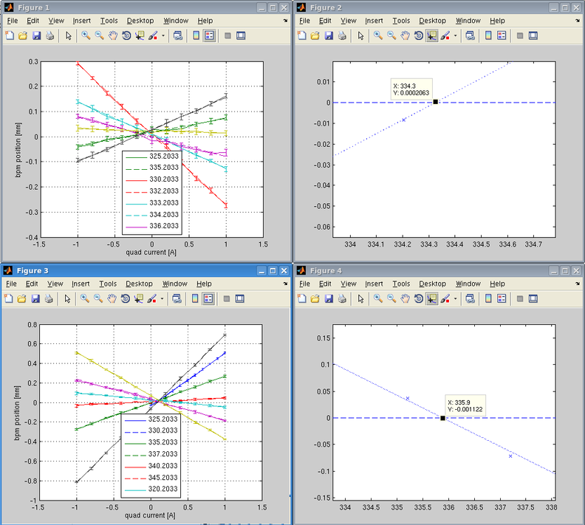
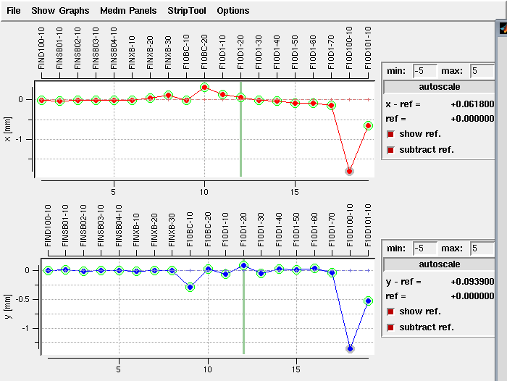
BC Beam-Based-Alignment
Scan of downstream BPM position vs. quad current – position with “zero” slope is the optimum position.
After the BC girder is aligned the orbit offsets in the BC BPMs are removed.

Slide 25
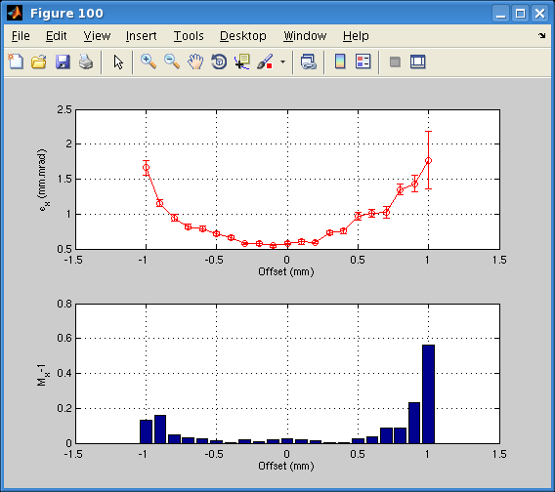
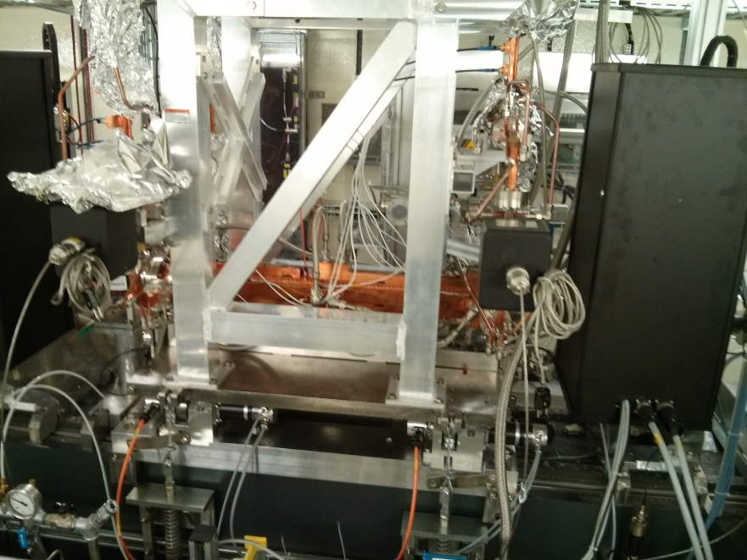



X-band Setup
Alignment of X-band cavity to minimise emittance growth and wake fields.
Projected Emittance vs. beam offset in X-band
Wake field monitor
X-band position/orbit setup:
Voltage [V]
horizontal [micron]
vertical [micron]

Slide 26



RF Power Calibration
Calibration of energy gain of each structure against the RF input power using the spectrometer.

Slide 27


Setup Procedure
Set RF phases of all stations with scan tool to nominal. This is low energy spread for FINSS, on-crest for the FINSB01-04 and 180deg in FINXB.
Measure beam energy after FINSB02 (FINSB034 and FINXB off)
Set on-crest beam energy with FINXB off to nominal
Match Optics
FINXB
FINSB03

Slide 28


Calculate RF Parameters
All calculations are done in a small GUI
Required energy gains (losses) in the RF structures are calculated
A calibrated RF power setup of the voltages is used for setup
As a backup an procedure using the spectrometer dipole can be used to set the RF without precise calibration of the voltage vs. power

Slide 29






Phase Space Linearisation in WLHA
on-crest
xband off
xband on
head
head
head
Spike is resolution limited

Slide 30



Longitudinal Measurements with TDC
Longitudinal bunch profiles are measured using the TDC.

Slide 31

Compression Measurements
After carefully machine set-up bunch compression factors can just be “dialled” in.
“Blind”-setup is in principle possible but a TDC is still increasing the reliability (i.e. initial chirp removal or measurement)

Slide 32


First Observations
Slice emittance increases for compression factors higher than about 5-6.
Uncorrelated (slice) energy spread increases for compressed beams.
Examples:

Slide 33
Energy Spread and Compression
Due to the conservation of longitudinal emittance the energy spread scales with the compression factor.
Off-axis longitudinal fields in the transverse deflector increase the uncorrelated energy spread. This effect is not dominant in WLHA
energy
longitudinal position

Slide 34


Energy Spread and Compression
For chirped electron beams the vertical spot size (the longitudinal resolution) generates artificial energy spread contributions.
vertical resolution/ spot size
vertical axis (longitudinal)
slope S
horizontal axis (energy)
The measurement is dominated by the
.

Slide 35

Emittance vs. Compression Factor
Slice and projected emittance increases about linear (?) with the compression factor .
Slightly stronger increase in the horizontal plane.
=> CSR?

Slide 36

Emittance vs. Energy
While the projected emittance, in both planes, depend on the energy
the slice emittance is conserved.

Slide 37

Emittance vs. BC Angle
The compression factor was kept constant while the bending angles, and thus the R₅₆, were varied. => varying energy chirp
Emittance is clearly diluted at higher angles. => CSR interactions (?)

Slide 38




Dispersion?
To identify contributions from dispersion the beam is accelerated on both flanks of the RF wave.
Energy spread is the same but the sign of the chirp is reversed.
Emittance is only diluted in case of compression.
compressed beam
voltage
de-compressed beam
phase

Slide 39


Optics
The emittance growth can be mitigated by adapting the optics along the chicane.
Emittance growth due to CSR is affected by the optics in the chicane.
More studies are required...

Slide 40
Conclusions

Slide 41
Summary and Outlook
Procedures for the operation and setup of the Compression were developed and tested.
Bunch Compression at the SwissFEL Injector Test Facility is successfully used and in agreement with the theory.
Confirmation of the basis for the SwissFEL compression design.
Effects from compression on energy spread can not be determined due to chirp
Beam emittance, or their measurement, is growing stronger then expected.
CSR is a likely candidate, but the effect is too strong
Initial correlations in the beam
….
Emittance growth studies require more studies.
Laser studies
Comparison horizontal vs. vertical plane
…

Slide 42
Thank You for Your Attention!
Special Thanks to:
Masamitsu Aiba, Simona Bettoni, Gian Luca Orlandi , Eduard Prat, Thomas Schietinger
and to the
WLHA Team

