Slide 1








CALO5D
Calorimetry in five dimensions
2nd Face-to-Face Project Meeting October 2025
BCTP Bonn

Slide 2
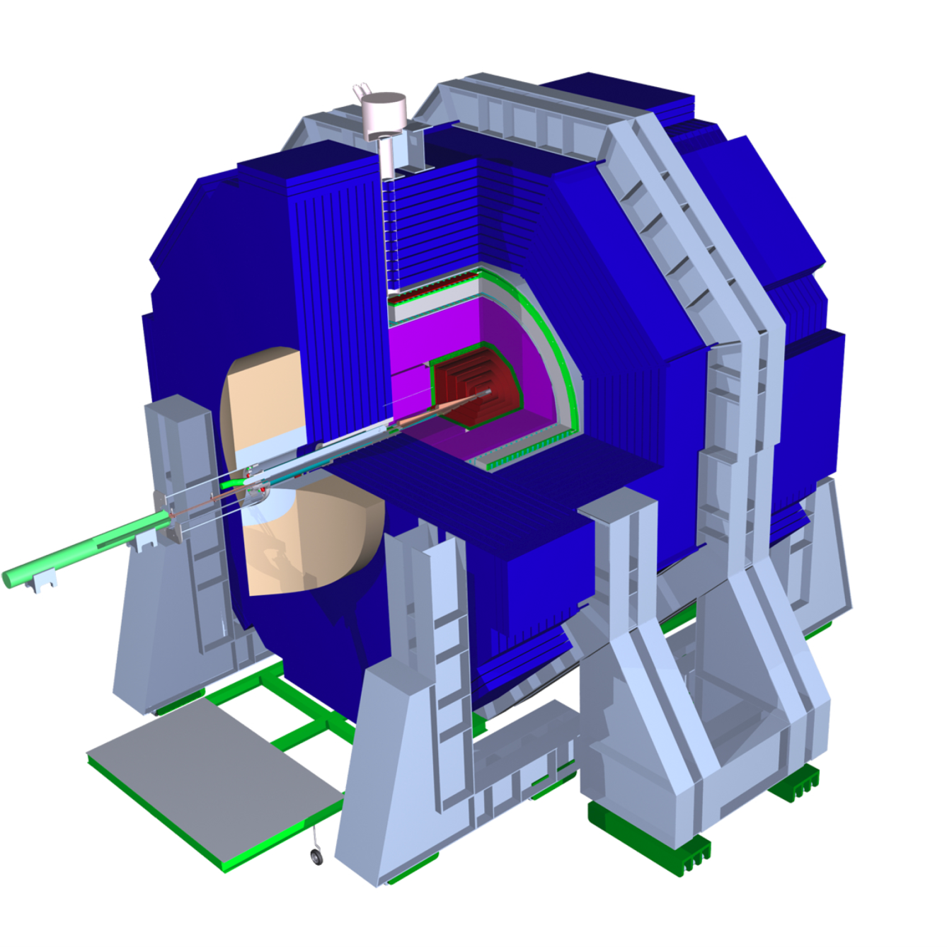
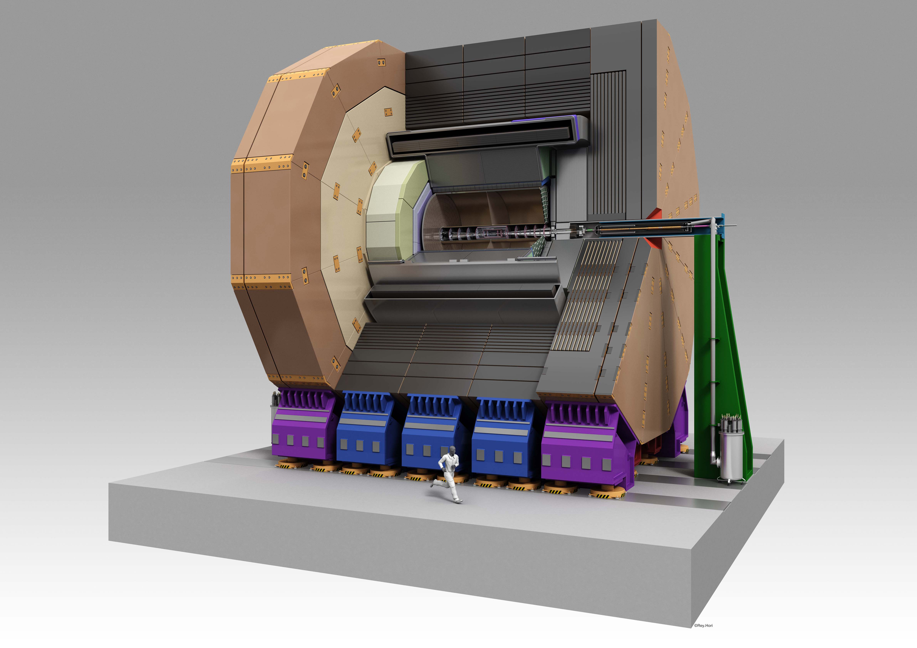
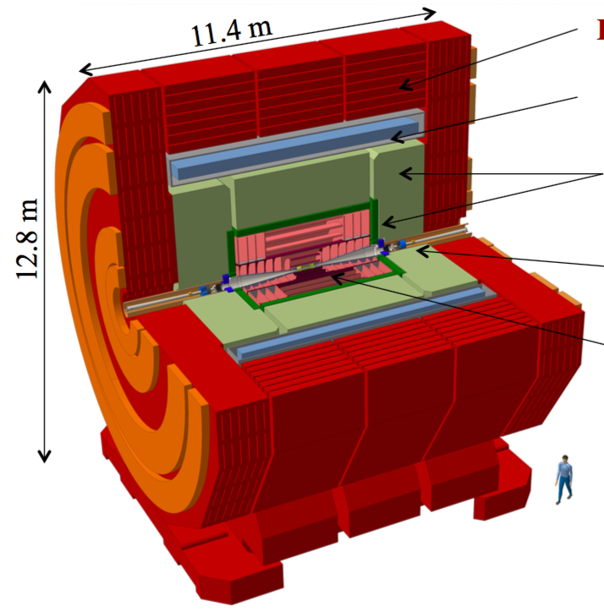
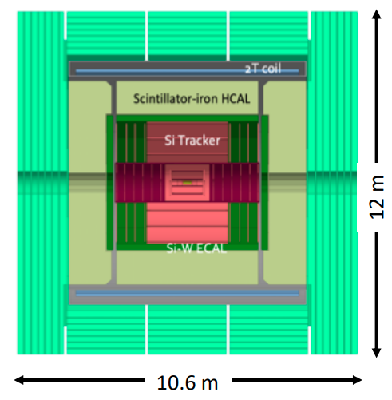
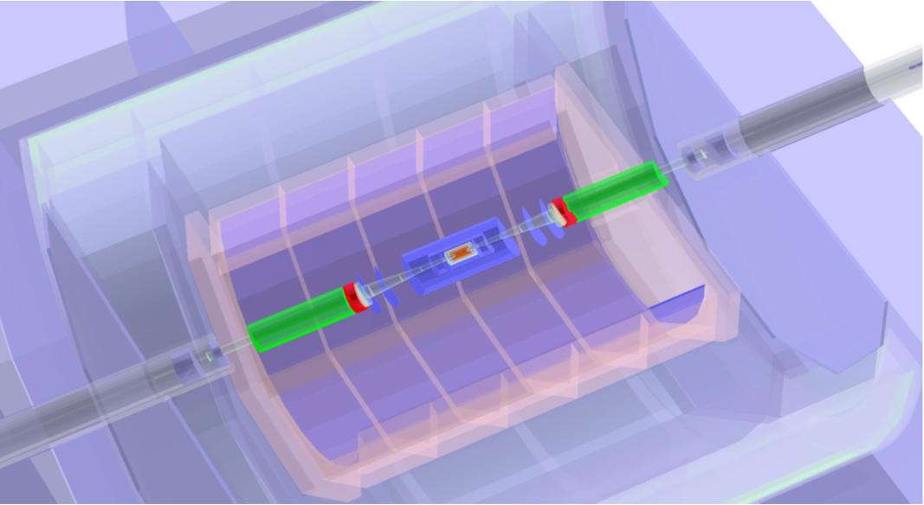
Detector systems – Target projects
Detectors for Higgs Factories
<number>
Notes:
<number>

Slide 3
Acknowledgements
Thanks to the Bethe-Center of Theoretical Physics for hosting us
  Local team: Herbert Dreiner, Patricia Zündorf, Lora Schindler, Nadine Hassani and Florian Löbbert for
  setting up the logistics
Thanks to the Management (Dirk and Thomas) of German-French laboratory DMLAB for helping
us to organise our meeting as satellite meeting to annual DMLAB Meeting
  … and once more thanks to Herbert Dreiner for reacting so promptly on the request
3
Notes:
3

Slide 4
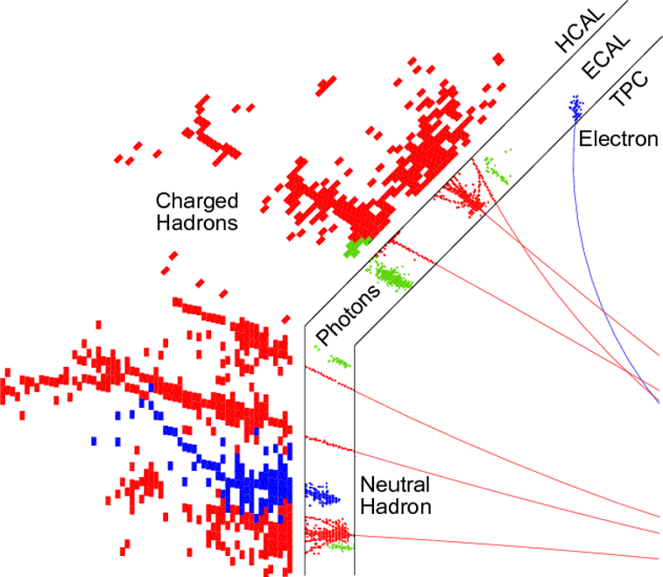
Particle Flow Detector
Base measurement as much as possible on measurement of charged particles in tracking devices
Separate of signals by charged and neutral particles in highly granular calorimeters
Typical cell size ~1cm³
Available information: Position and amplitude of energy deposit -> 4D
Complicated topology
by (hadronic) showers
Overlap between showers
compromises correct
assignment of calo hits
⇒ Confusion Term
Need to minimize the confusion
term as much as possible !!!
ECAL =
Electromagnetic
Calorimeter
Expertise by French Groups
HCAL =
Hadronic
Calorimeter
Expertise by German Groups
L
Notes:
<number>

Slide 5
Time as 5th information ?
A look to 2030 make resolutions between 20ps and 100ps at system level realistic assumptions
  -> Time resolution at the level of cell size (1cm = 30ps x c)
At which level: 1 MIP or Multi-MIP?
For which purpose ?
  Mitigation of pile-up (basically all high rate experiments)
  Support of PFA – unchartered territory
    Overall excellent time resolution
    A few layers with excellent time resolution
A topic on which calorimetry has to make up it's mind
  Remember also that time resolution comes at a price -> High(er) power consumption and (maybe)
higher noise levels
CALO5D will address these questions in a consistent way
?
?
<number>
Notes:
<number>

Slide 6
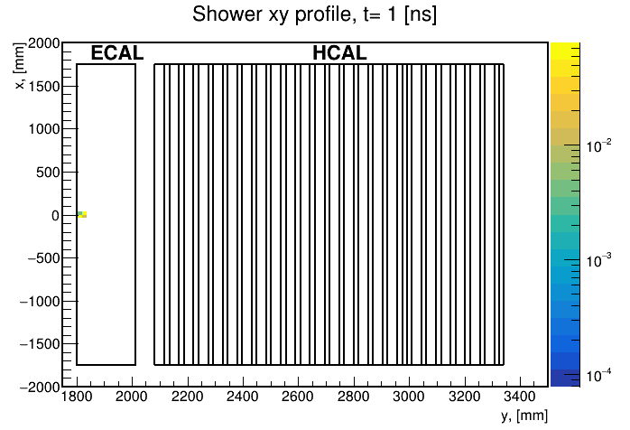
Turning films of interactions with matter
Timing allows for disentangling different stages
of a particle shower
In case of multiparticle event one may be able to
follow particles until they overlap
CALO5D will exploit information provided by
highly granular calorimeters with modern
machine learning tools
Combining the expertise of French and German
groups is instrumental for success
Y. Padniuk, Master student
Technical University of Kiyv
<number>
Notes:
<number>

Slide 7
CALO5D – Workpackages and Delivrables
Work Package 1: Management
  Deliverable (Month 3): Project Webpage (M3)
Work Package 2 : Implementation of Timing in Calorimeter Simulation (Lead LLR)
  Deliverable (Month 12): Documented algorithms that implement timing in the simulation of granular
calorimeters.
Work Package 3: Particle Flow with Timing (Lead DESY)
  Classical cut based PFA and application of Machine Learning
  Deliverable (Month 30): Improved particle flow algorithms using space-time and energy information.
Work Package 4: Impact on Key Physics Processes (Lead IJClab)
  Higgs Boson prodiuction and weak boson production
  Deliverable (Month 36): Demonstrate the benefit for the physics analyses from improved PFA and
hence from timing. The results will be presented in the form of scientific documents such as pre-prints
or conference proceedings.
Work Package 5: Implications for Detector Design (Lead KIT)
  Deliverable (Month 36): The deliverable of this task is a scientific document in the form of an arXiv pre-
print that summarises hardware requirements for the realisation of a detector that meets the timing
requirements formulated in Work Packages 3 and 4.
<number>
Notes:
<number>

Slide 8
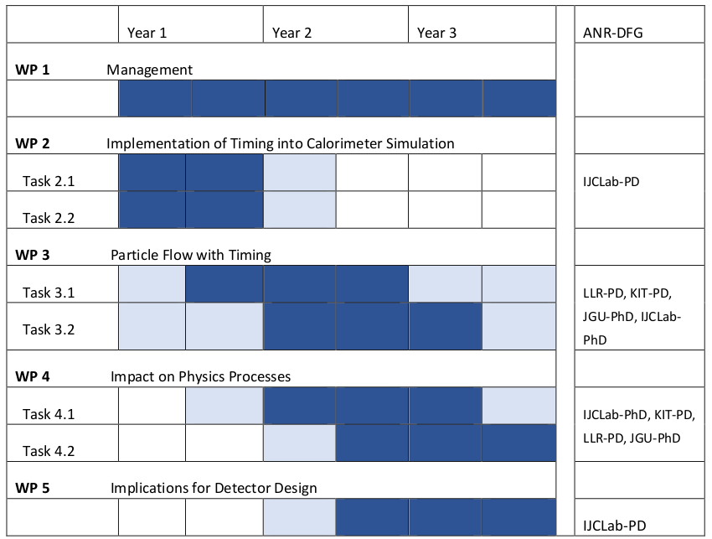
CALO5D – Timeplan
Three years project
Official Start March 1st 2024
  Real start rather 1st of September
Since last F2F Meeting
  Completion of recruitment
  Jesus, Yukun and Hao joined
There might be good reasons to extend
the project by at least half a year
  w/o further funding though
  Have to signal (soon) to French ANR
  DFG seems to be more relaxed on actual
  project duration
<number>
Notes:
<number>

Slide 9
2nd CALO5D F2F Meeting
Take stock of first results and vet against original project plan
  Understand difficulties and search for remedies
  It is important that we have a clear(er) view on which results we can expect
    On short notice
    In around six months
    In around one year from now
Reminder on relevant physics processes
Have to put more focus on the benefit (or not) of timing
Calo5D is part of a large “ecosystem”, all seeking to improve event reconstruction with granular calorimeters using Machine Learning (and timing)
  Partners in Japan and China
  Experts working in ATLAS and CMS on machine learning in HEP
  Deepening contacts with experts in Computer Science
    Important to get input and to avoid “rookie mistakes”
  Have to understand how to best integrate CALO5D into this ecosystem
    e.g. best balance between project meetings, local meetings and larger scale meetings
Application of Machine Learning - Many approaches, many ideas
  Need clear view on projects goals
  How to follow up one idea to the end while still keeping an eye on alternatives?
Explore applications in fields other than collider physics
  SHiP talk at this meeting
<number>
Notes:
<number>

Slide 10
Backup

