Slide 1



Analysis of Strong-Field QED Data from FACET-II for the LUXE Experiment
Status Report – FTX Group, DESY
Karim Mahmoud
Supervised by Antonios Athanassiadis, Luke Hendriks and Jenny List

Slide 2
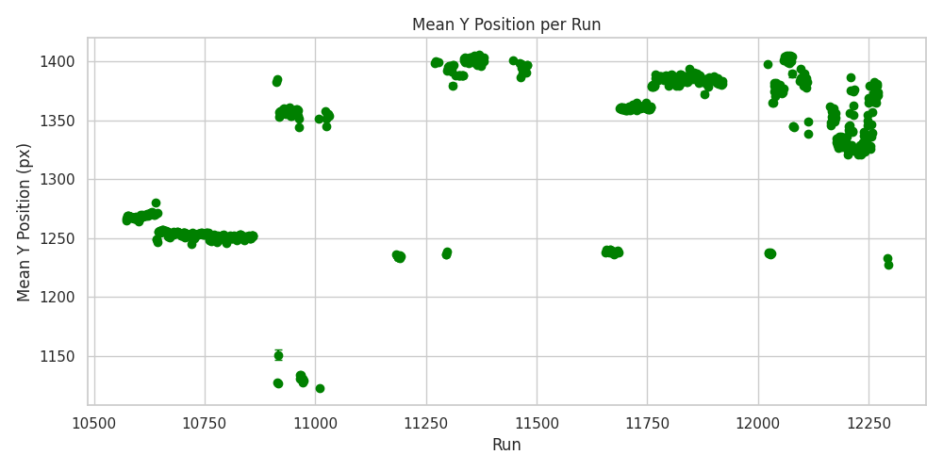
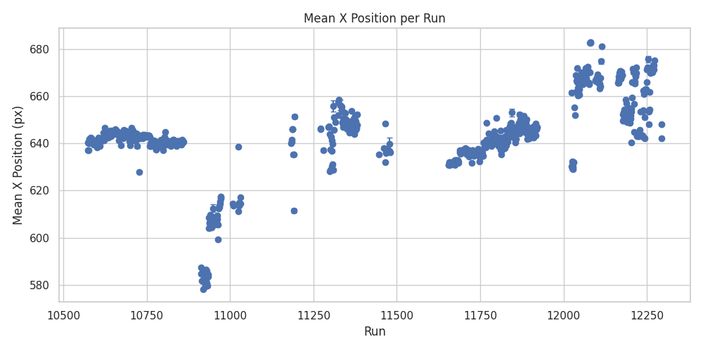

Beam spot position analysis
Applied spatial cuts to define an effective area of interest on the screen for consistent event selection.
Calculated average beam spot positions (x and y) after cuts.

Slide 3
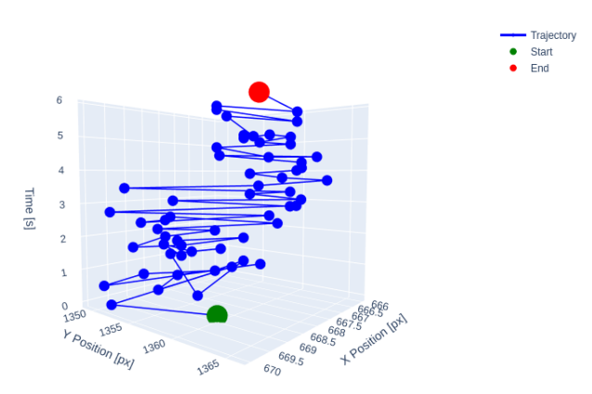
Beam spot position analysis
Examined time evolution using known event time interval (Δt = 0.1 s).
Constructed 3D trajectory:

Slide 4

Beam Position Correlations – Setup & Data Cuts
Goal:
Evaluate consistency and behavior of beam position measurements.
Approach:
Compare differences in average positions (∆Y) between BPM 3265 & BPM 3315, and Each BPM & the screen.
Simulated Data Cuts:
Scatter plots generated for ∆Y correlations.
Linear fits applied for BPM-to-screen correlations.

Slide 5
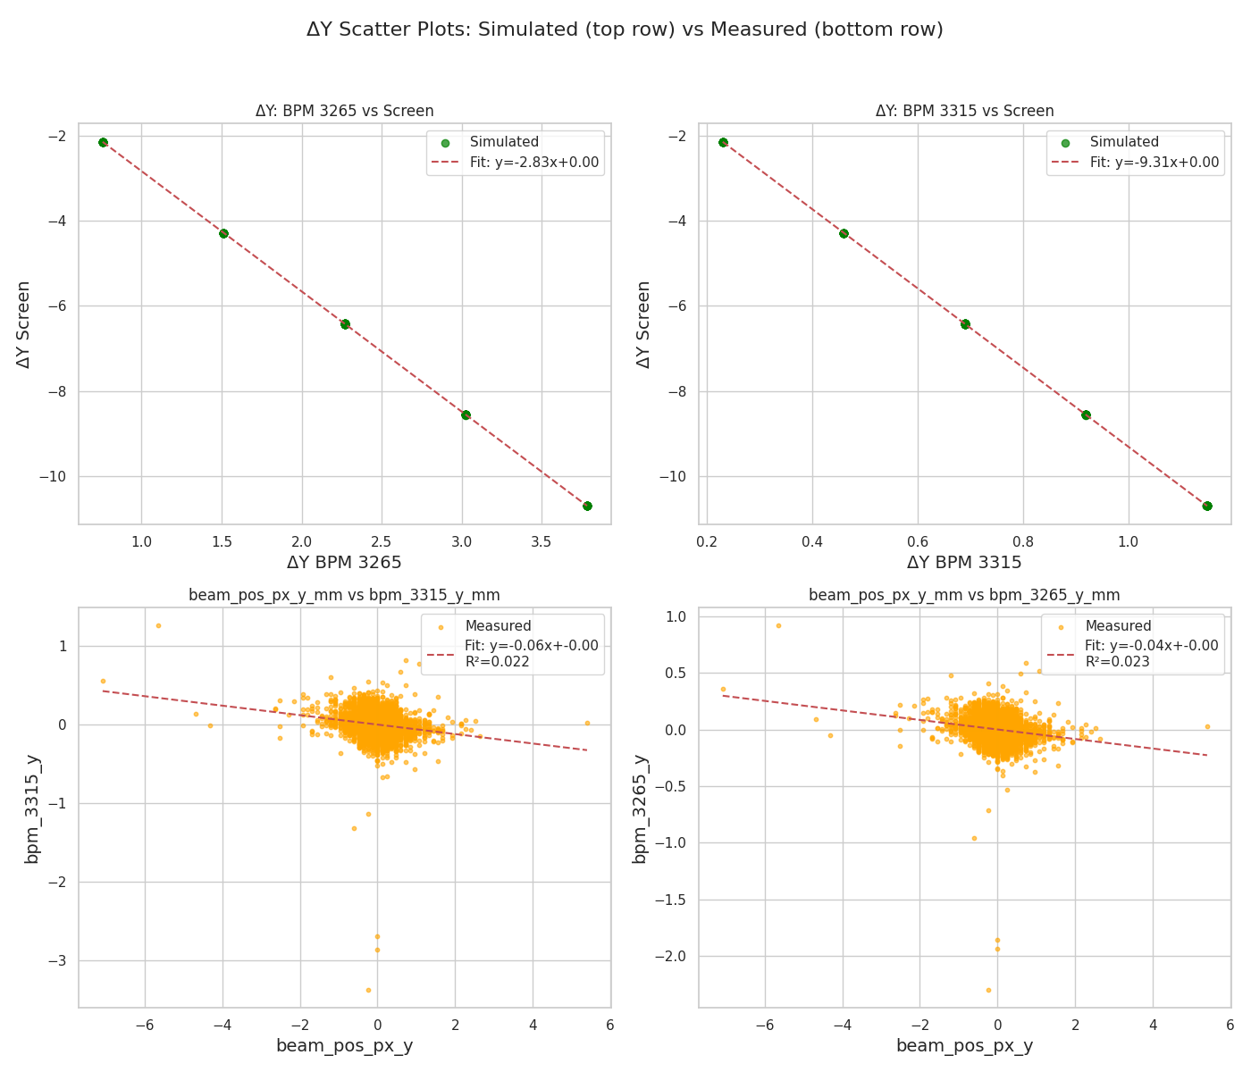
Beam Position Correlations – Results
BPM-to-BPM Correlation:
Linear correlation observed in both simulated and measured data.
Y Coordinate:
Simulated runs: strong linear correlation with screen.
Measured data: weak or inconsistent correlation.

Slide 6
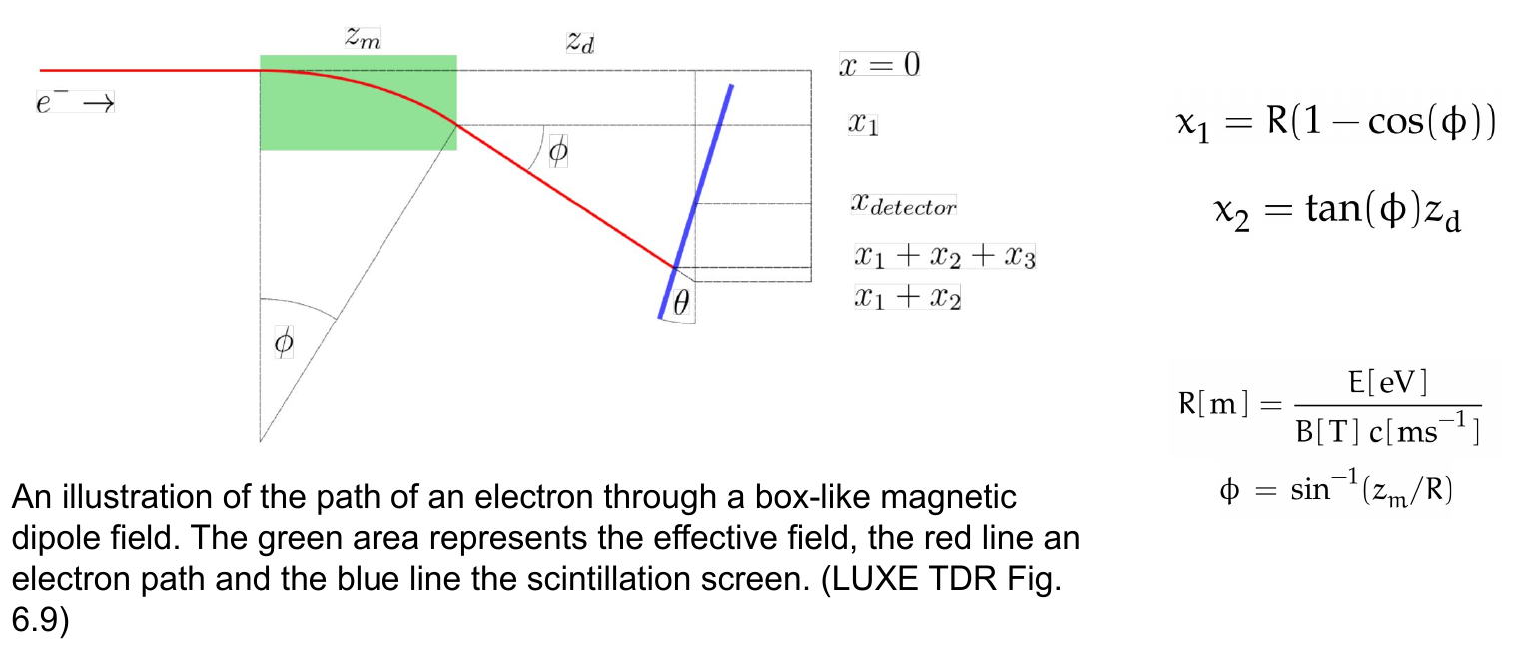
Analytical Deflection Dependence on Dipole Strength
Slide courtesy of Luke Hendriks, EDS team update 12.02.2025

Slide 7
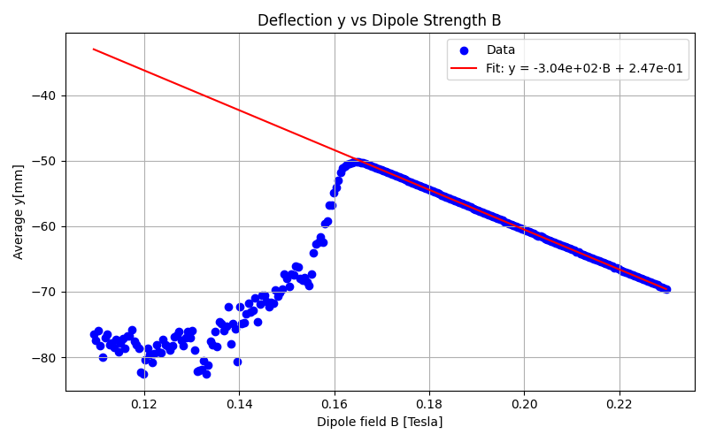

Analytical Deflection Dependence on Dipole Strength
Analytical approximation for vertical deflection:
Tested with Geant4 runs:
Varied dipole strength with B
Fixed beam energy E=10 GeV
Only used points with B>0.17 T to avoid low-field noise
Result: C = -3.0389e+12 ± 1.0825e+09 mm.eV/T
Expected: C = -3.0571e+12 mm.eV/T
C_experimental = (-3.11 ± 0.08)e+12.

Slide 8
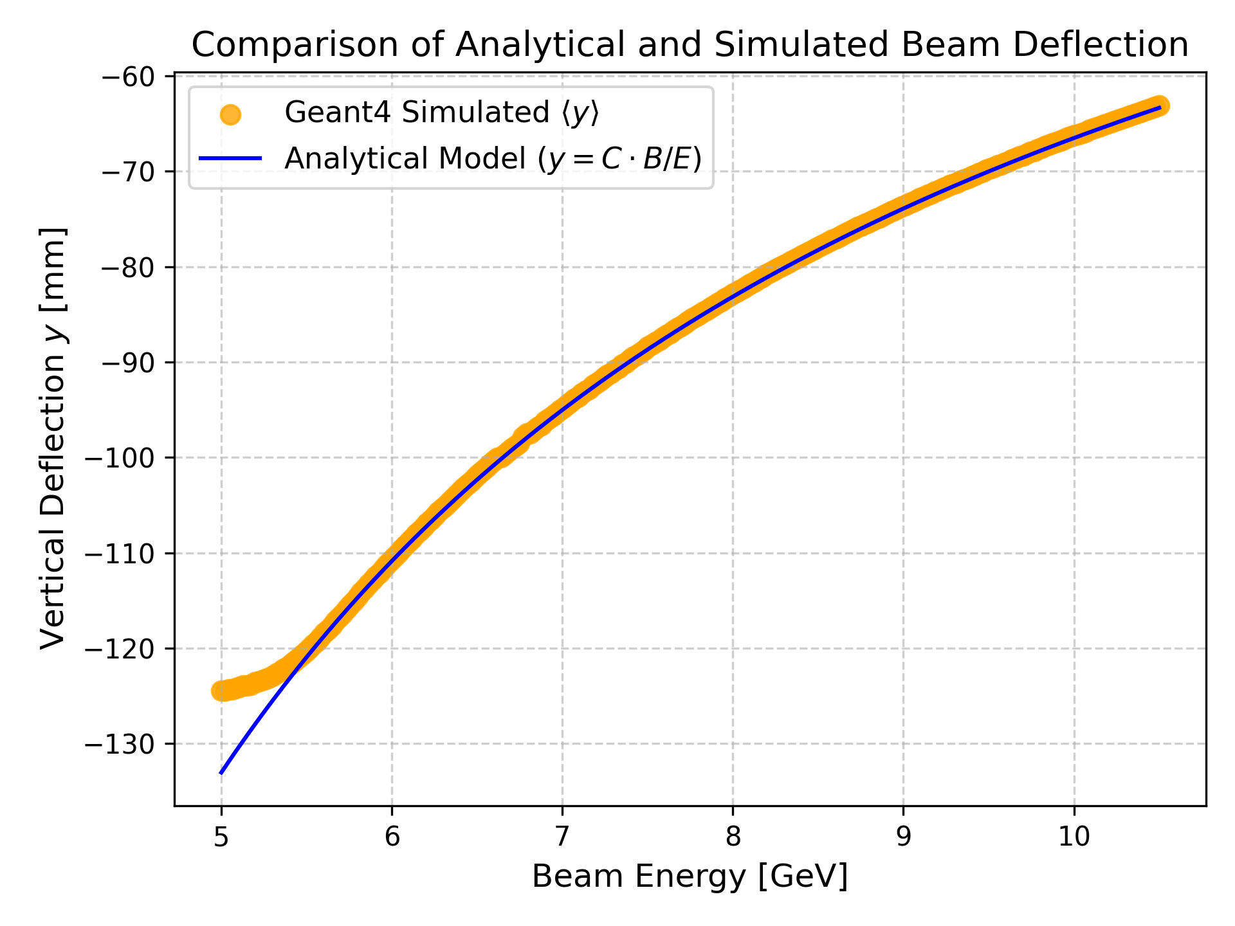
Analytical Deflection Dependence on Dipole Strength
Used obtained C to compute expected deflection y for varying beam energies at fixed B.
Compared analytical formula with Geant4 simulation results.
Excellent agreement across most of the energy range.
Slight deviation at low energies, possibly due to beam divergence, scattering, or detailed field effects not in the simple model.

Slide 9
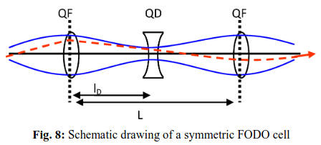
Effect of Quadrupole Strength on Beam Focusing
Three quadrupoles positioned in a FODO like lattice, with the middle having a positive value of quadrupole gradient (defocusing), and the other two having a negative value of quadrupole gradient (focusing).
Simulated different values of initial beam energies, at different values of quadrupole strengths to study the relationship between the two.

Slide 10
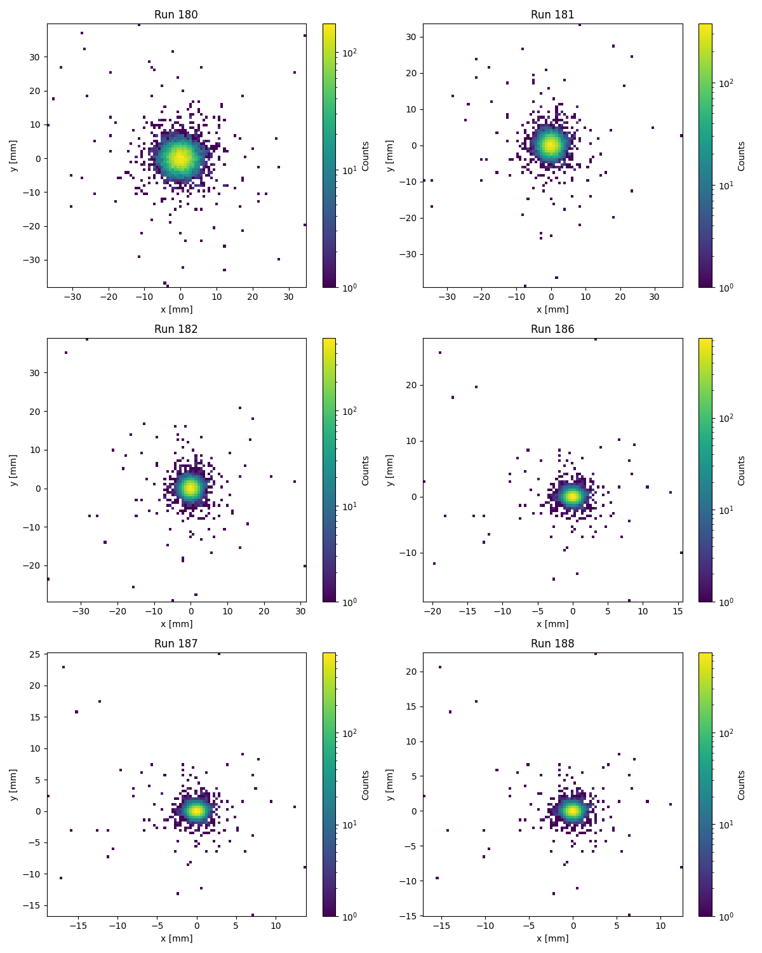
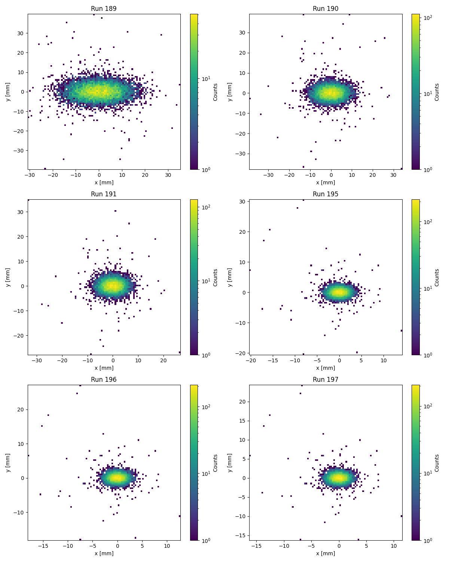
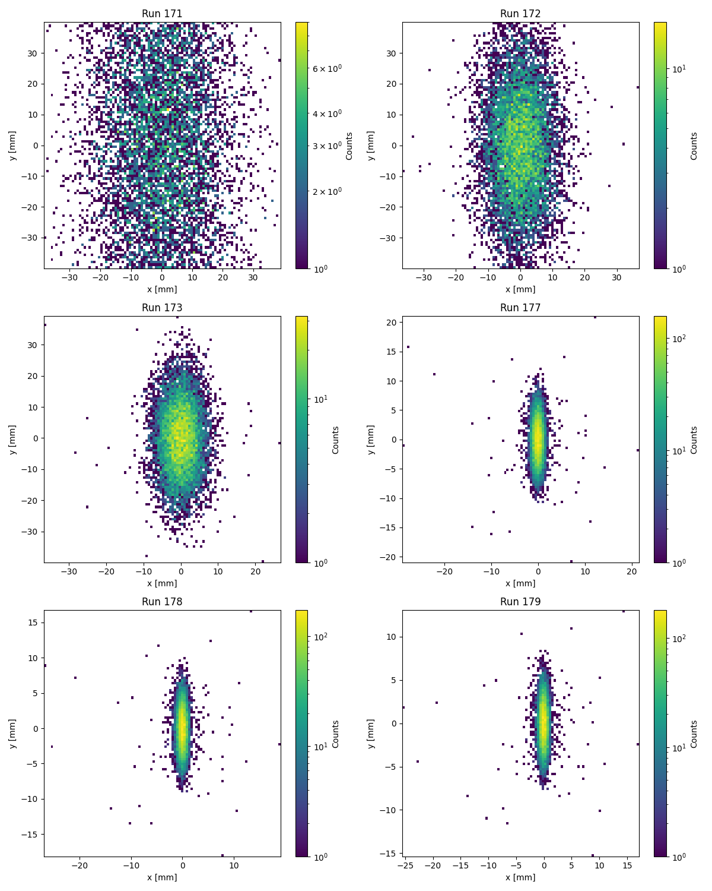
Effect of Quadrupole Strength on Beam Focusing
Low -ve Q high +ve Q high -ve Q

Slide 11
Discussion & Conclusion
Beam Study:
Calculated average x and y positions along the beam; studied deflection patterns.
Analytical formula successfully predicts beam deviation trends with energy and quadrupole settings.
Analyzed beam correlations between the different BPMs and the screen.
Quadrupole Effects:
Observed on-screen impact of quadrupoles on beams of different energies:
+ve quadrupole gradient → defocusing in horizontal (x) direction
-ve quadrupole gradient → defocusing in vertical (y) direction
Data Observations & Issues:
Some projected energies are identical for different quadrupole values → needs clarification.
The 10 GeV beam appears most focused in simulations → unexpected; requires expert insight.
Next Steps / Discussion Points:
Seek guidance on why certain quadrupole values yield identical projected energies.
Understand why the 10 GeV beam is unusually focused compared to higher energies.

