Slide 1

Calibration of APTS Prototypes Developed in 65 nm CMOS Imaging Technology
Summer Student:
Diego Alexander Watko Zerecero
Supervisors:
Finn King - ATLAS Group
Gianpiero Vignola - ATLAS Group

Slide 2
Overview of the project
Laboratory Characterization of Monolithic Active Pixel Sensors (MAPS)
Summary of main steps:
Waveform Analysis
Gain Characterization
Charge Calibration Using Fe-55 Source
Getting the Calibration Curve

Slide 3
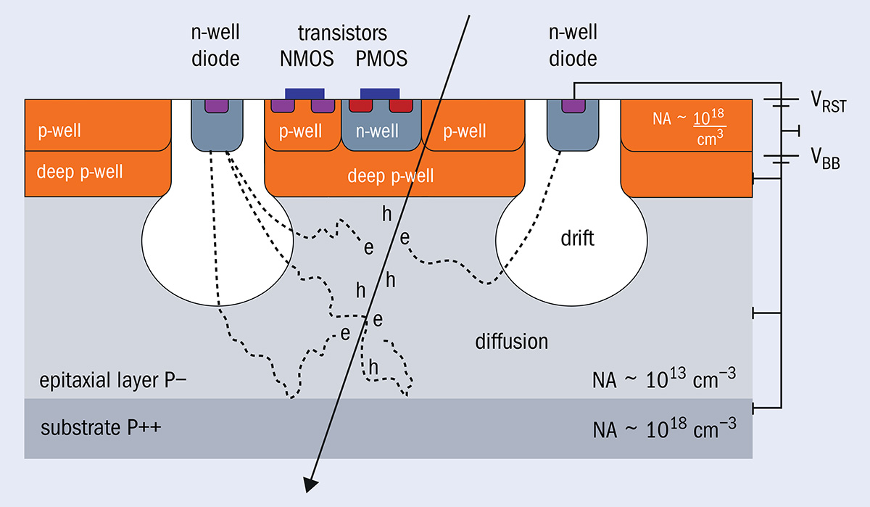
MAPS Detectors
CMOS: Complementary Metal-Oxide Semiconductor
A charged particle or X-ray in Si creates e⁻/h⁺ pairs.
Depleted region steers e⁻ to the n-well diode (fast drift); the rest comes by diffusion.
In-pixel CMOS electronics turn the collected charge into a signal level.
We need a calibration to express signals in meaningful physical units and map per-pixel gain/charge differences, to have a clearer picture of the detector’s behavior.

Slide 4
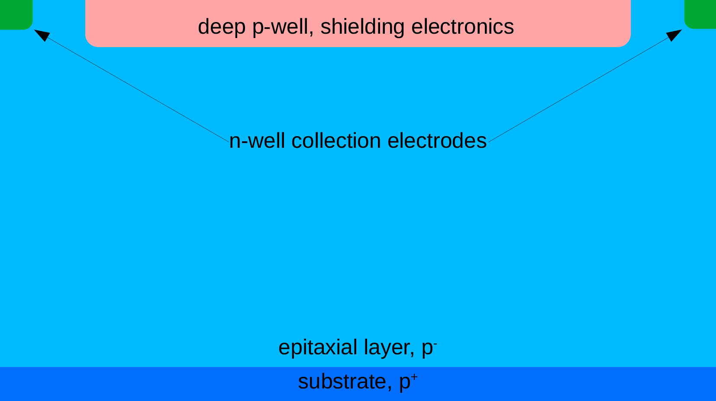
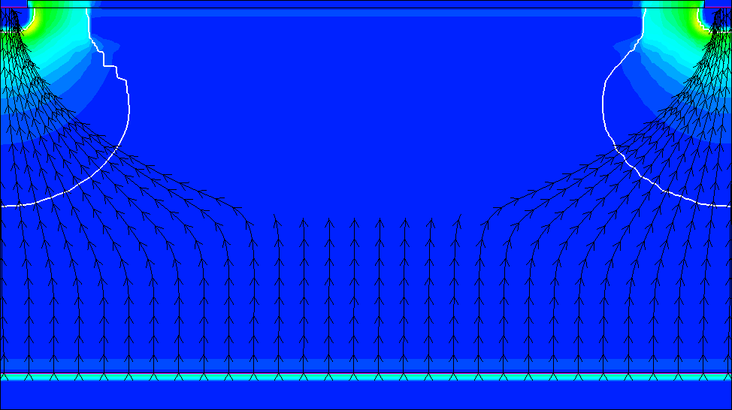
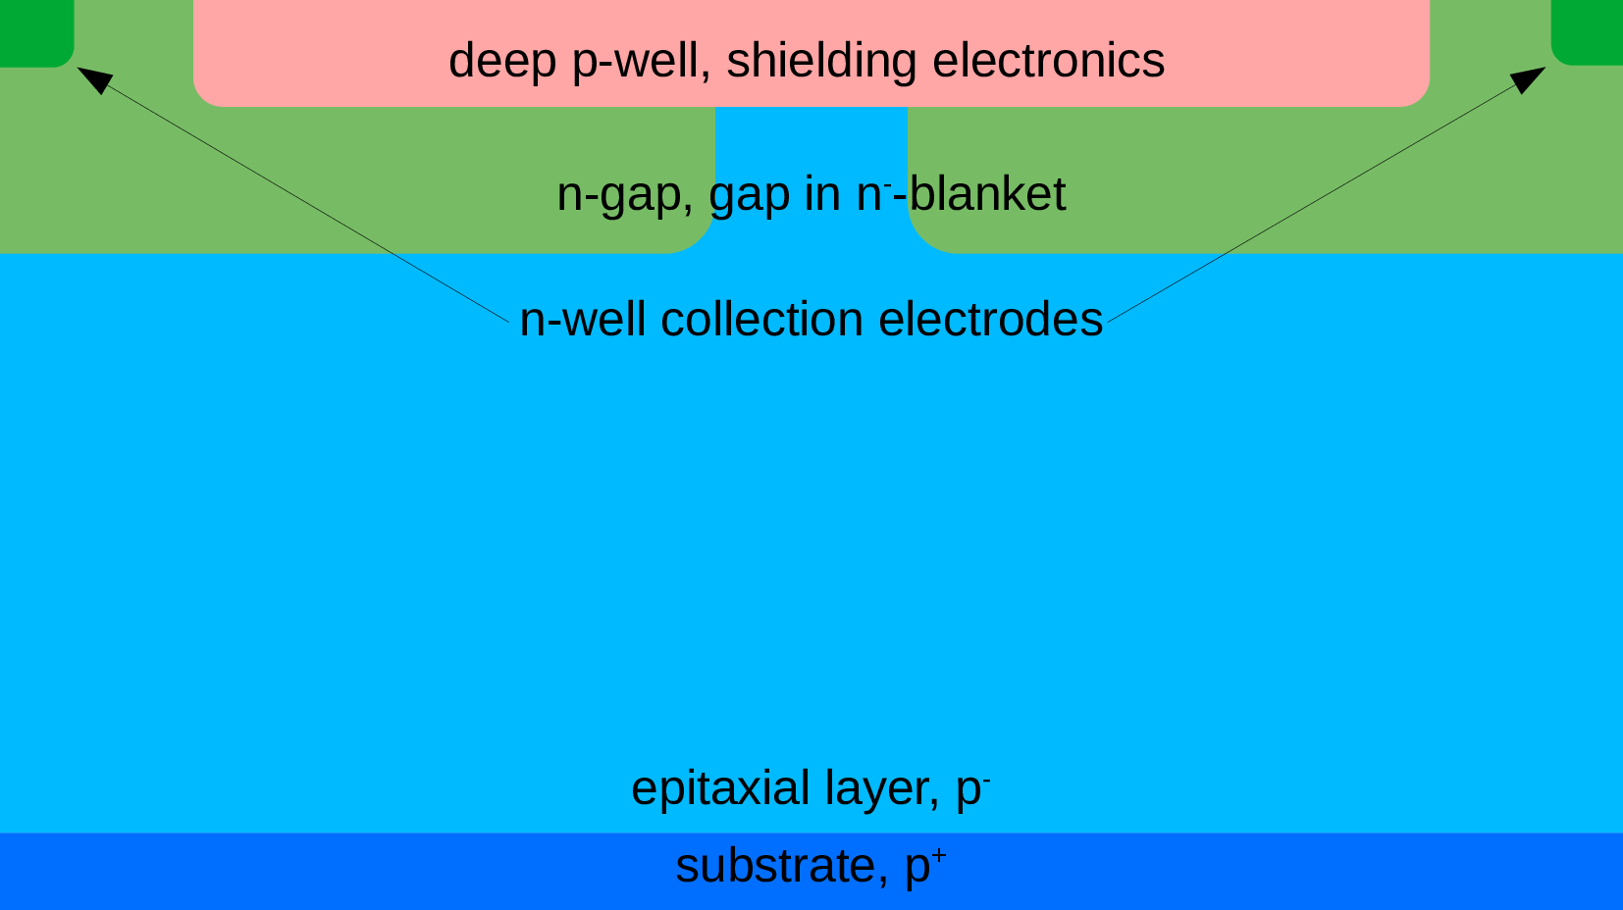
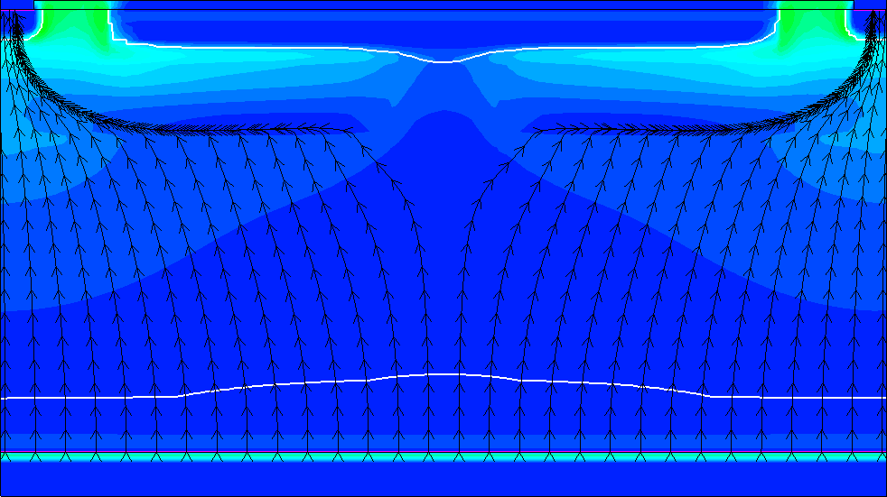
MAPS Layouts
Standard
N-Gap
Slow Charge Collection
More shared charge (Higher Spatial Resolution)
Low efficiency at High Thresholds
Fast Charge Collection
Less shared charge (Lower Spatial Resolution)
High efficiency at High Thresholds
Depleted
Region

Slide 5
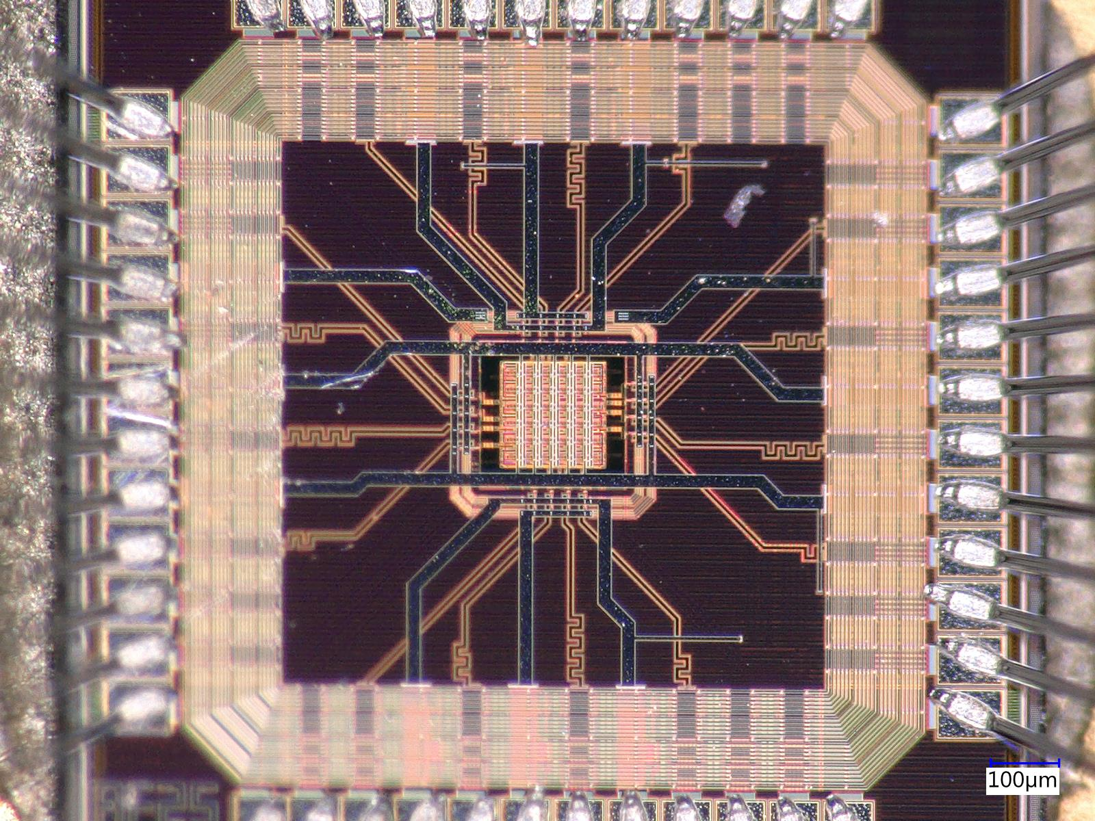
Details of APTS Chip ID 27
From diode to analog voltage
The diode collects electrons and makes a small voltage step on the pixel node.
A tiny amplifier copies/boosts that voltage to the analog output.
A gentle reset current brings the node back to baseline after the pulse.
For tests, a small injection capacitor (C_inj) can fake a hit with a voltage step
Layout: N-Gap
Gap Size: 2.5 µm
Die size: 1.5 mm × 1.5 mm
Matrix: 6 × 6 pixels
Readout: Direct analogue of central 4 × 4 pixels
Pixel Pitch 15 µm × 15 µm
p-sub
Amp
Read out
Sensor Diode
Cinj
Simplified structure
of the electronics

Slide 6
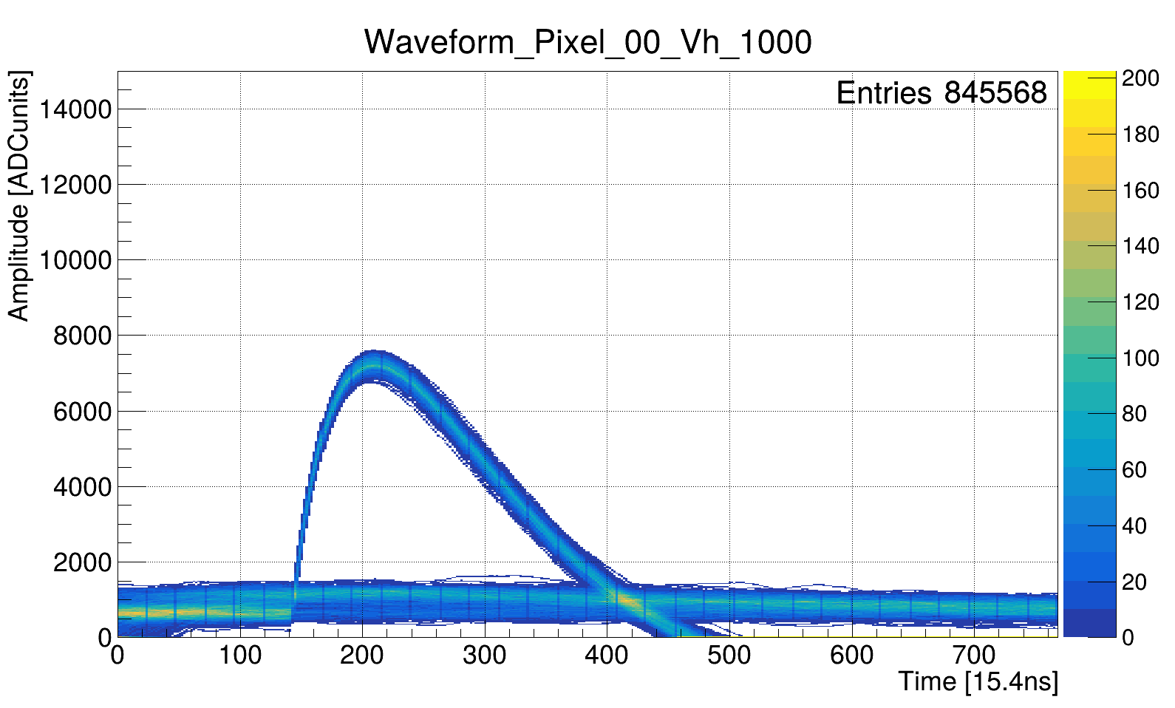
Waveform Analysis
Amplitude
Noise
Baseline
Baseline (BL): Mean of pre-signal samples; used to remove DC offsets per waveform.
Noise (σ): RMS fluctuation around BL; higher σ means harder hit discrimination.
Amplitude (A): Peak height above BL (Max − BL) in ADC counts.
S/N: Ratio of signal strength to noise (𝐴/𝜎); higher is better.
ADC: Analog-to-Digital Converter; digitizes the analog voltage into discrete counts.
Voltage test-pulse scan: 0 → 1200 mV in 10 mV steps.

Slide 7
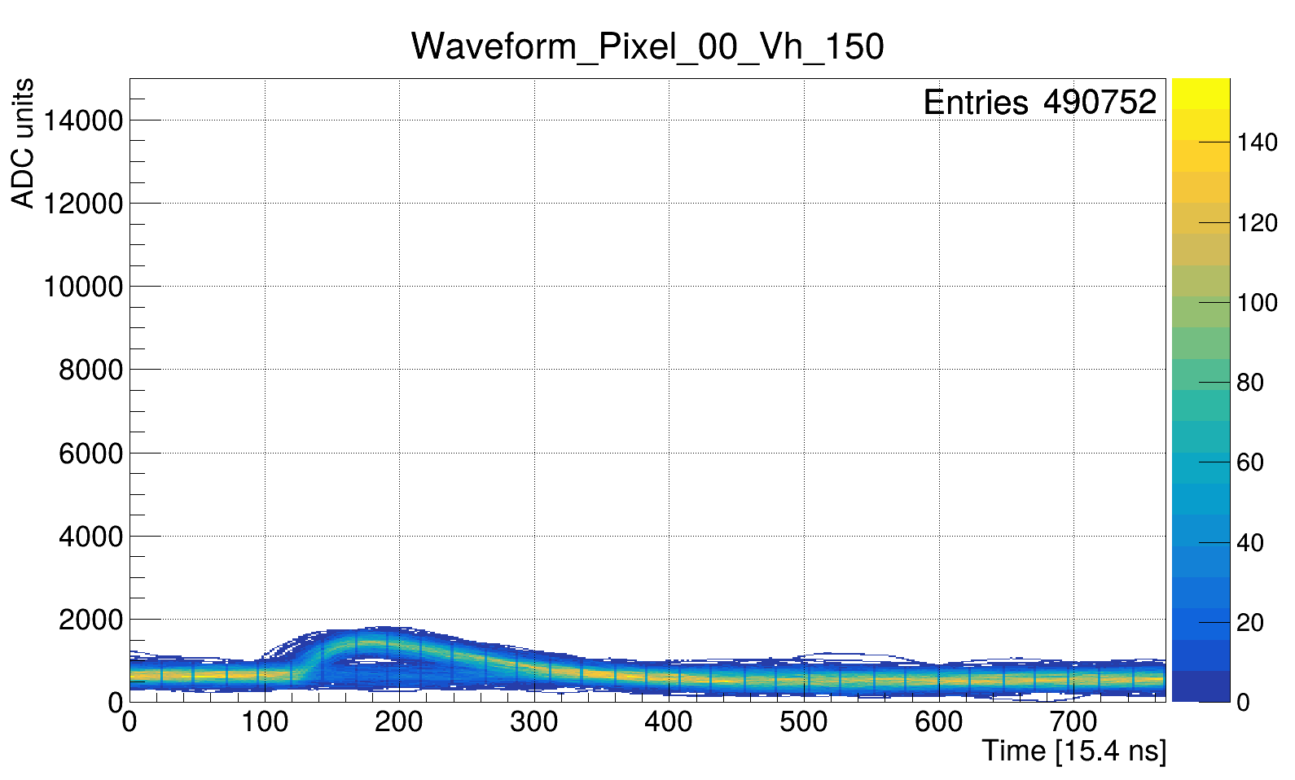
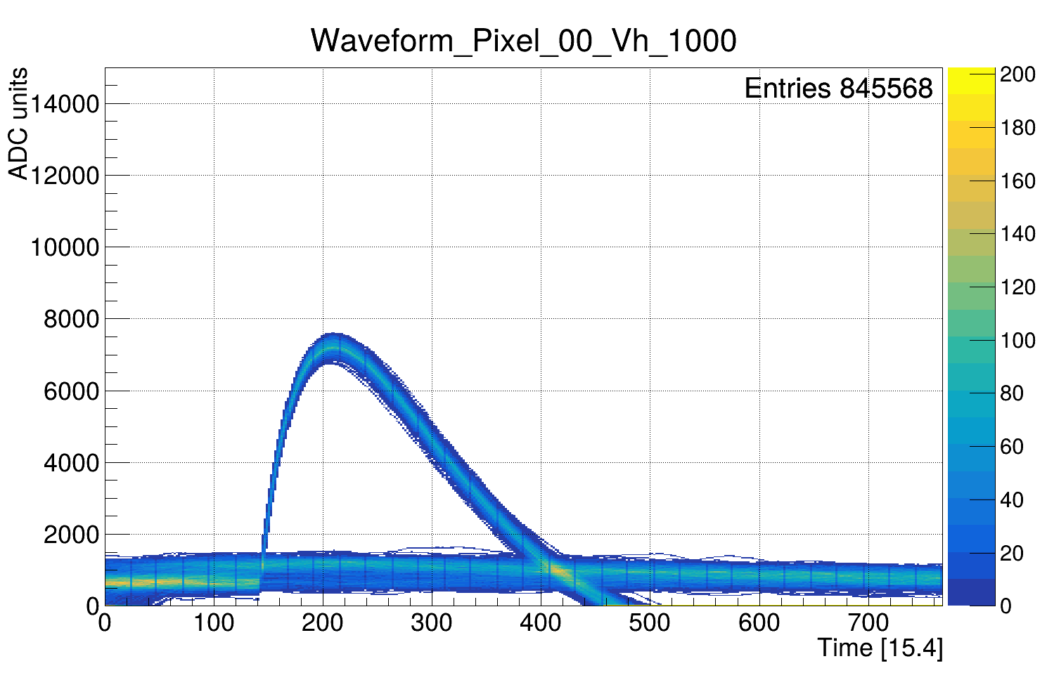
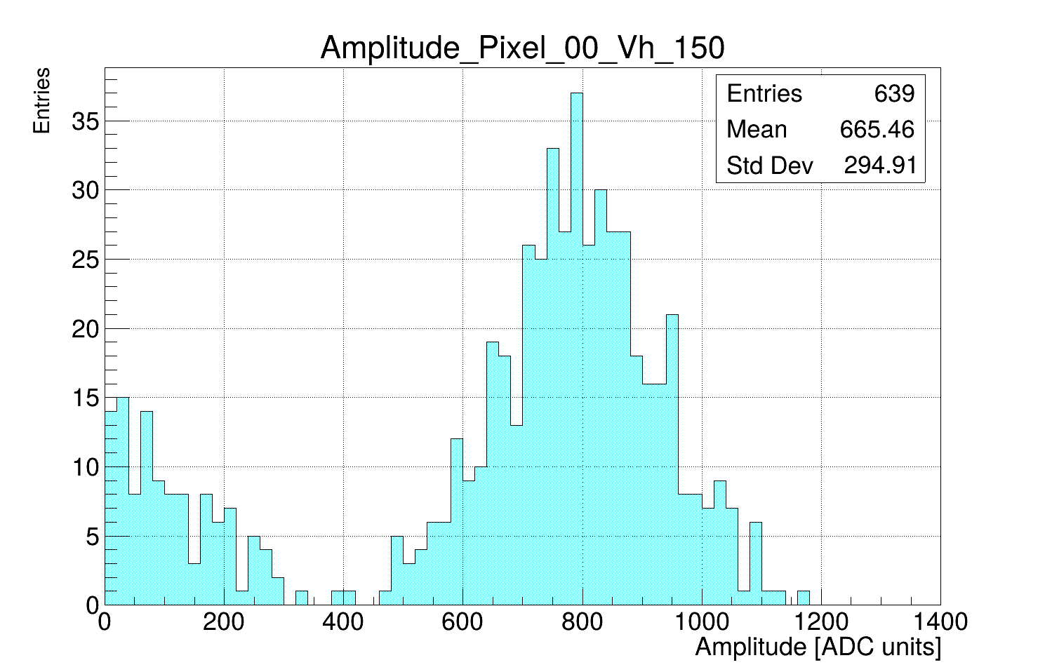
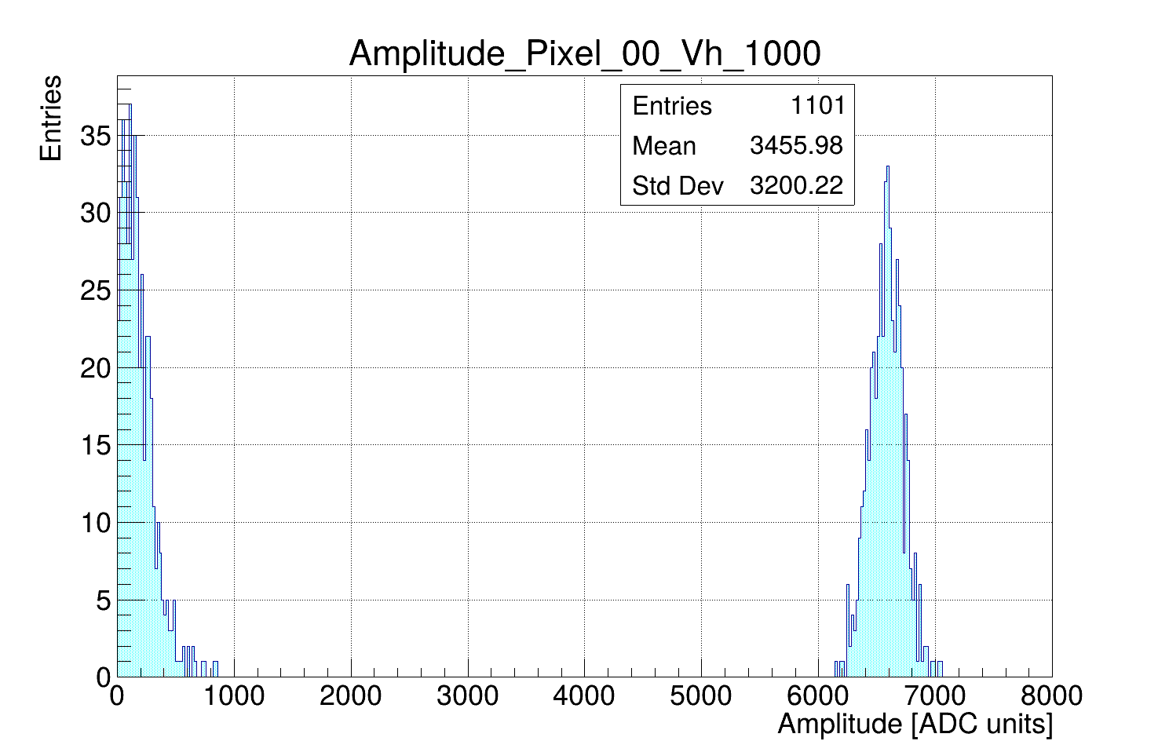
Behavior of Waveforms at High and Low Amplitude Test Pulse

Slide 8
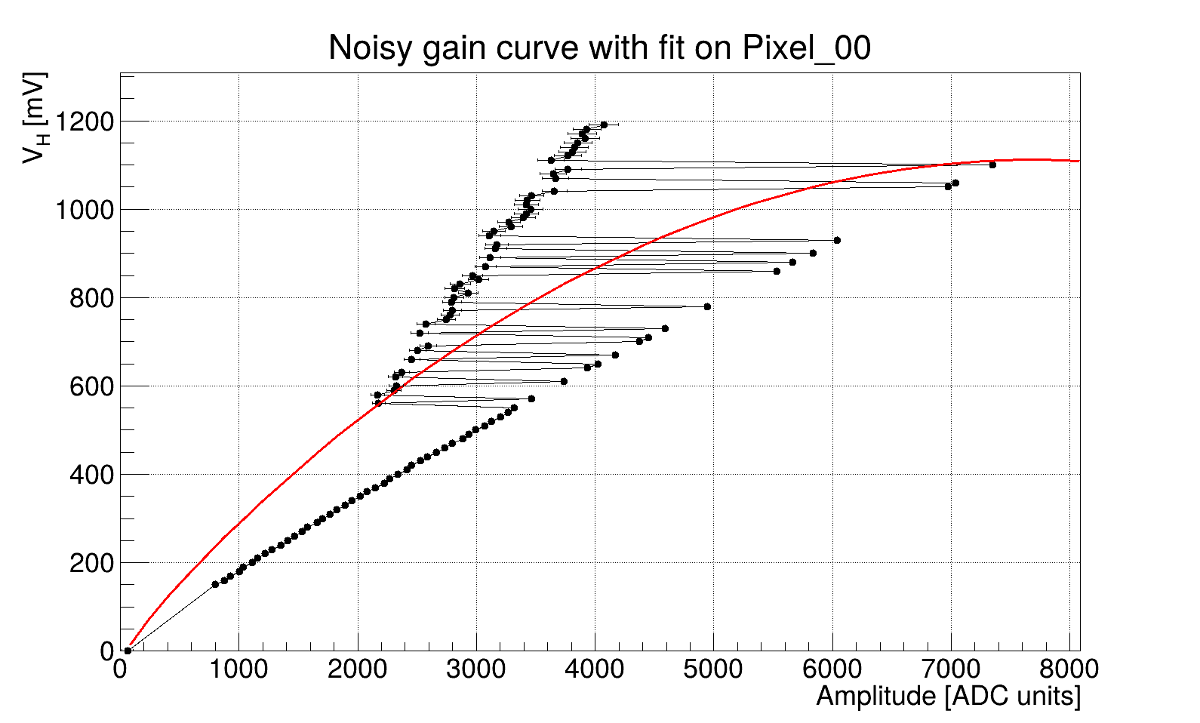
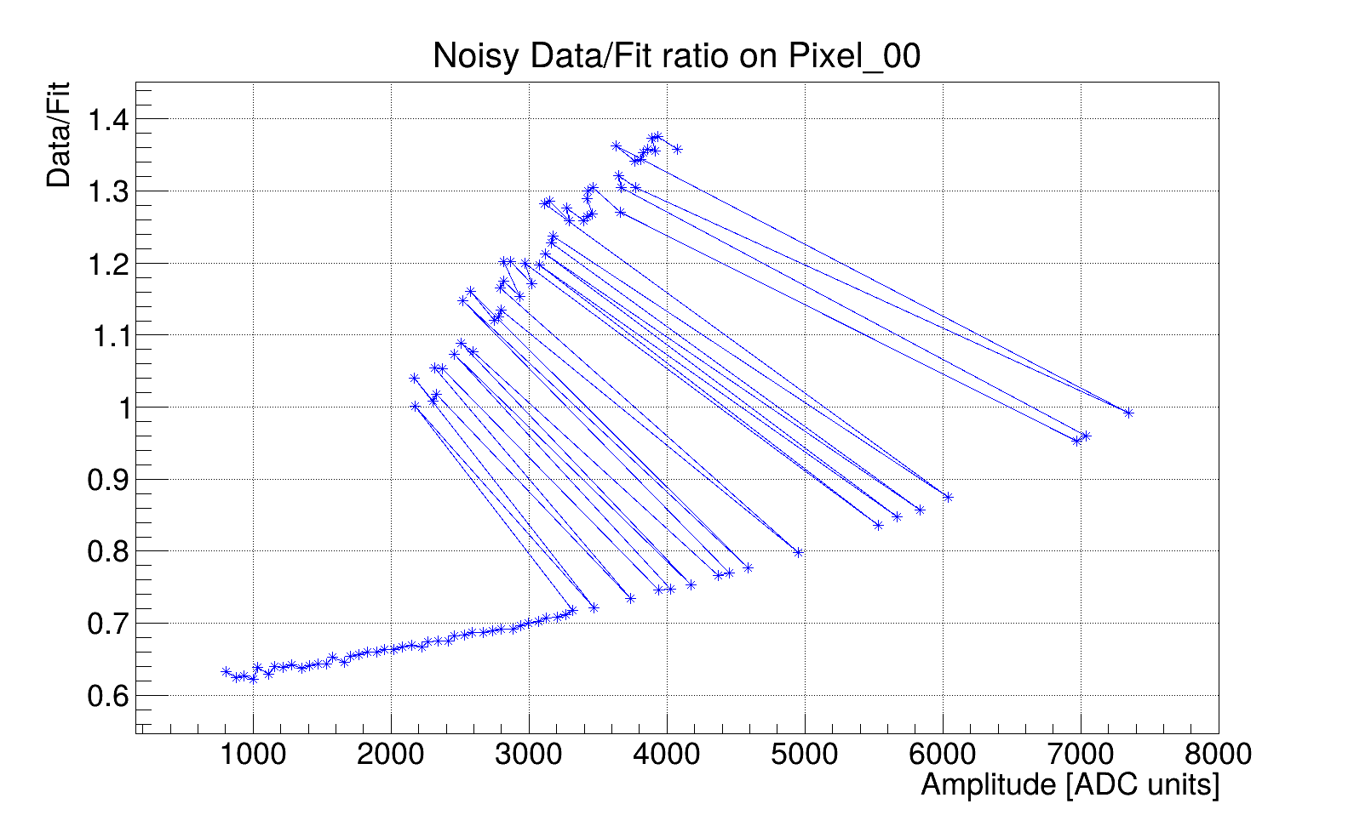
Gain Curve Problem Code
Old method: center Gaussian fit on the max bin of the amplitude histogram (per Vh).
At high Vh: noise population can become the largest bin → fit locks on noise, not the signal peak.

Slide 9
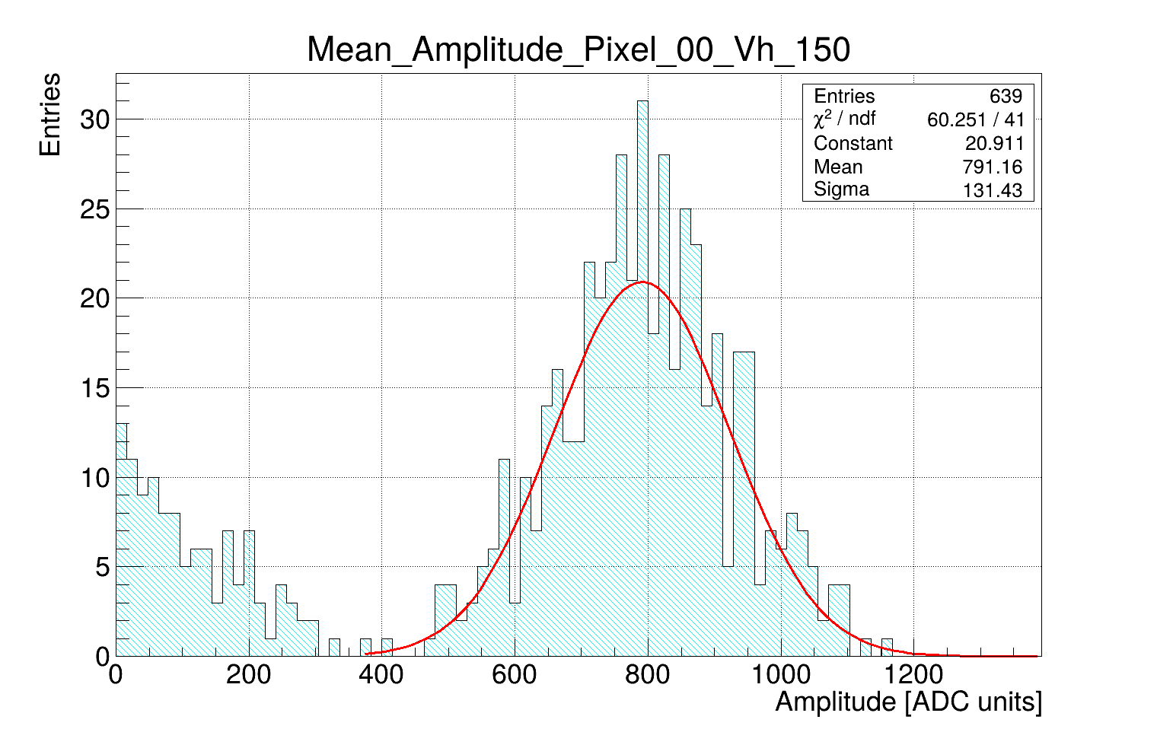
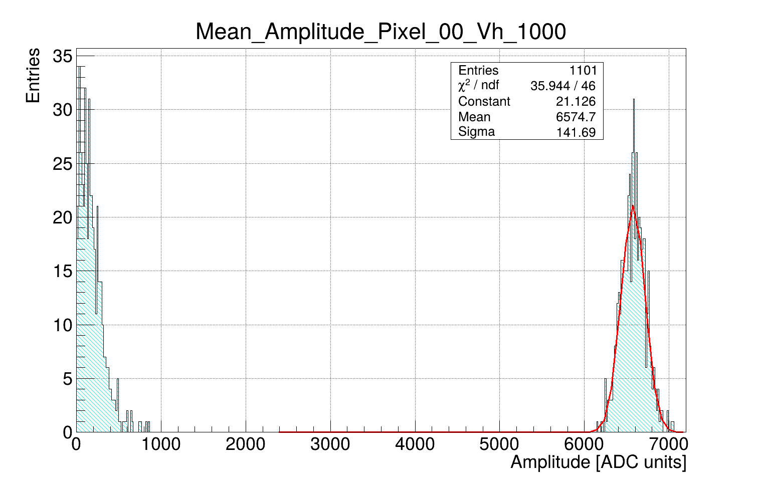
How did we solve the Gain curve Problem Code?
Robust mean extraction: quantile-centered Gaussian fit
Fix: Use a quantile (e.g., q = 0.8) as the initial fit center instead of the max bin.
Window: Fit a Gaussian in a ±2σ window around that center.

Slide 10
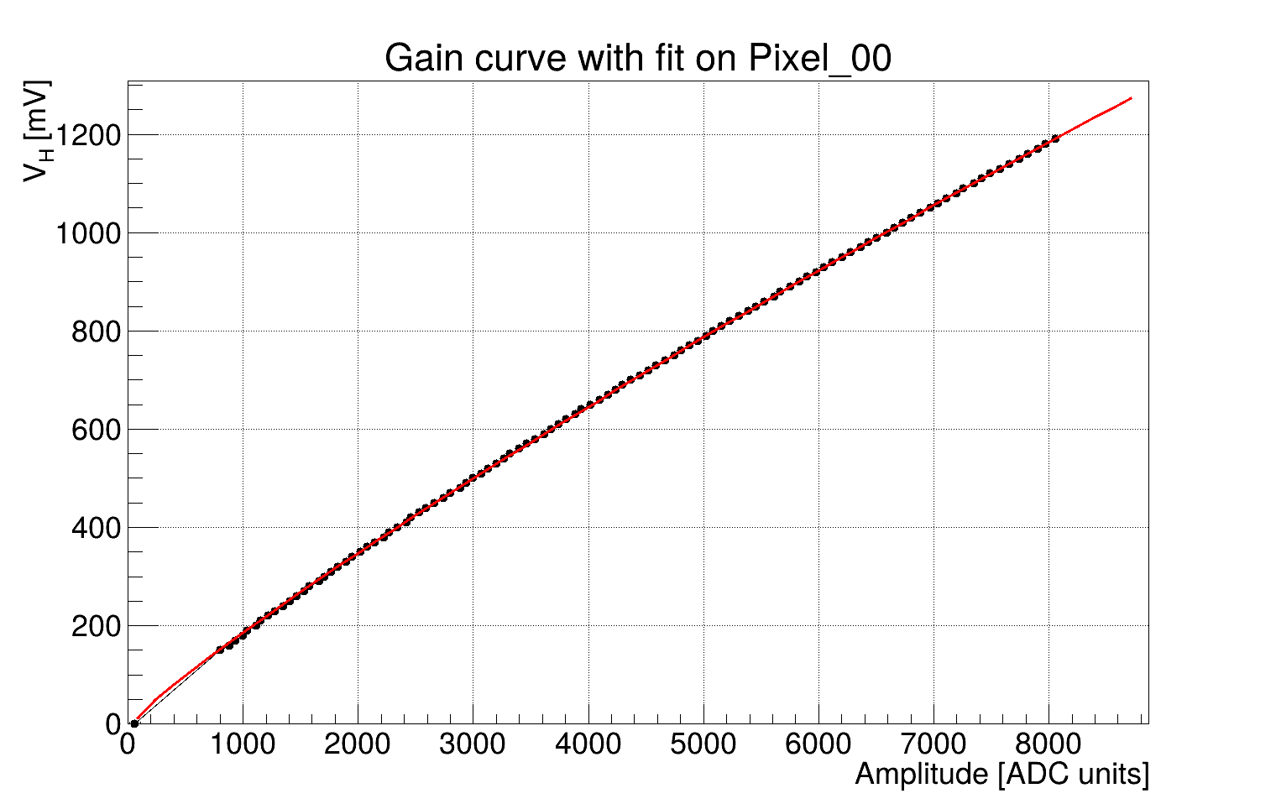
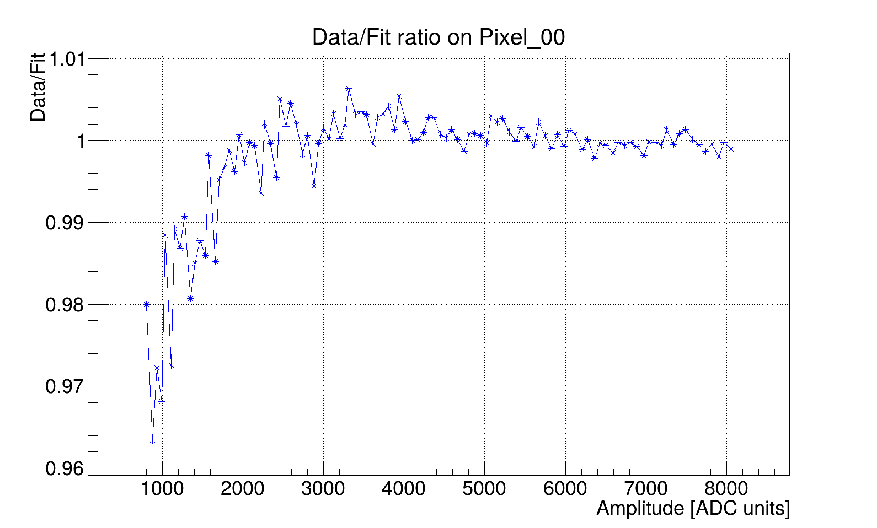
Gain curve Problem Code Solved
We obtained a per-pixel mapping of how amplitude grows with test pulses: V_{H} = g(x), where x = average waveform amplitude (ADC counts).
The fit is anchored at the noise point: g(x₀) = 0, with x₀​ the mean baseline amplitude.
We use a stable empirical function where the gain curve in VH units is ready for charge calibration.
$$V_{H}=\left(p_{0}\left(x−x_{0}\right)+p_{1}{\left|x−x_{0}\right|}^{0.5}\right)×\left(p_{2}x+p_{3}\right),$$

Slide 11
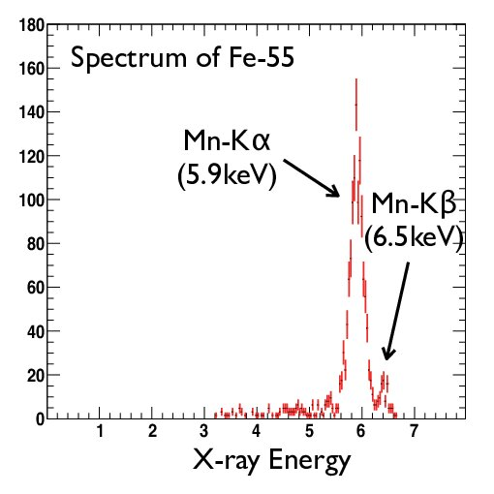
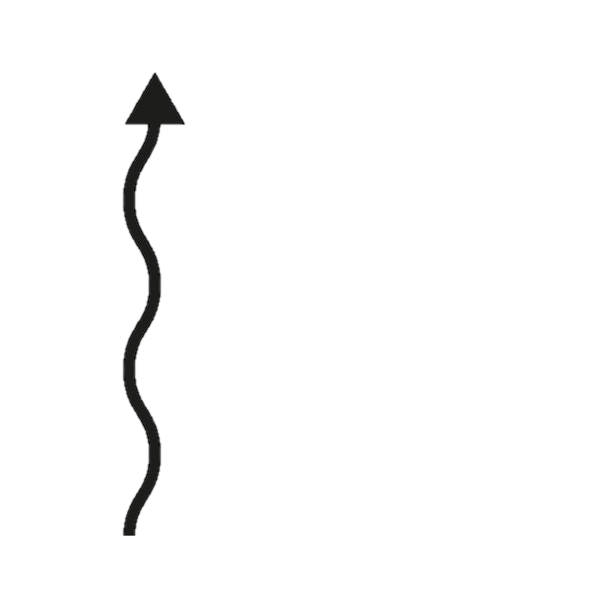
Charge Calibration Using Fe-55 Source
Why use Fe-55?
Fe-55 is a stable, low-rate X-ray source that decays by electron capture to Mn-55.
The Mn emits characteristic X-rays, mainly K-α (~5.9 keV) and a smaller K-β (~6.49 keV) line.
These X-ray energies are narrow and repeatable, giving a known deposited energy—perfect to define an absolute charge scale.
K-alpha
What happens in silicon?
A 5.9 keV (K-α) X-ray is absorbed creating a localized cloud of electron–hole pairs.
In silicon, it takes about 3.6 eV to make one e–h pair; in our calibration we use K-α ≈ 1609 electrons as the reference charge.
e⁻

Slide 12
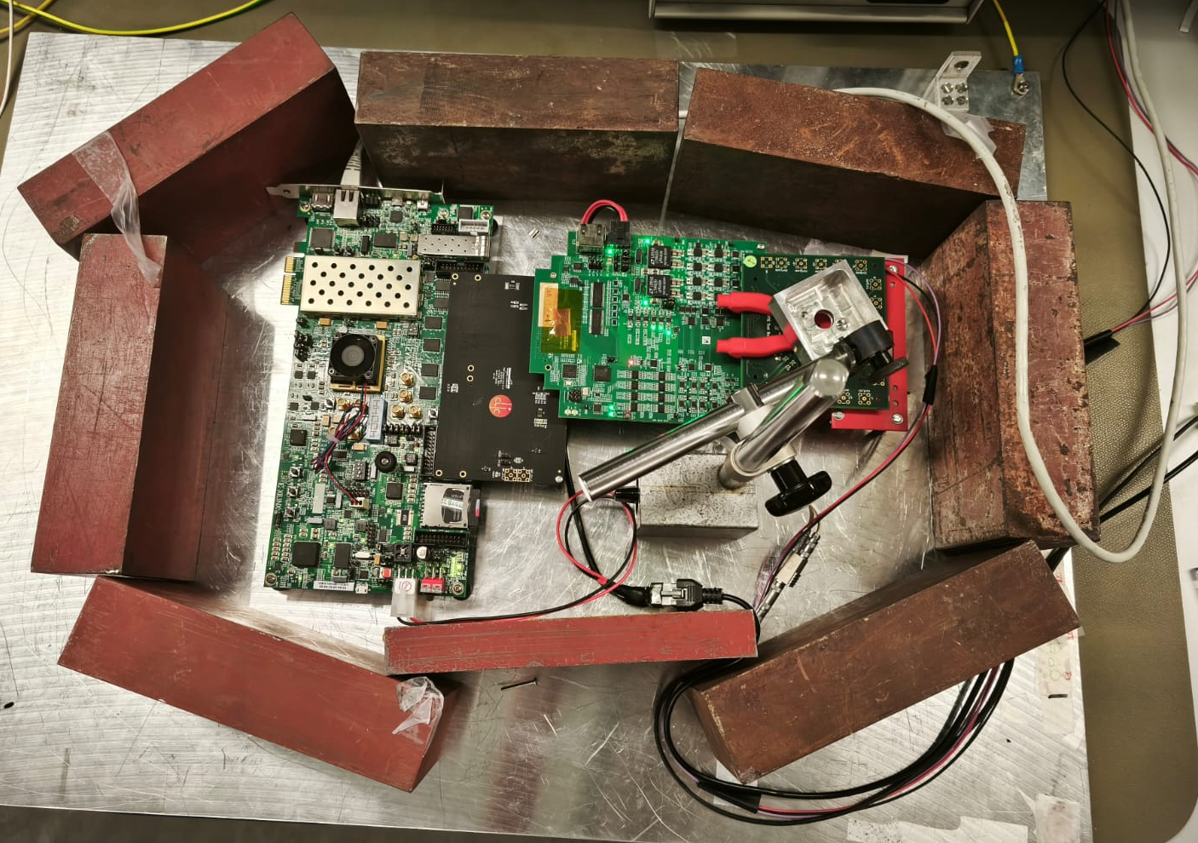
Fe-55 Source Data-Acquisition Setup
Setup: Place the Fe-55 source in front of the sensor.
Data: ~124k events acquired; raw files processed with corryvreckan.
Config: analysis.conf loads the fit parameters per pixel, performs the ADC→Vh units transform.

Slide 13
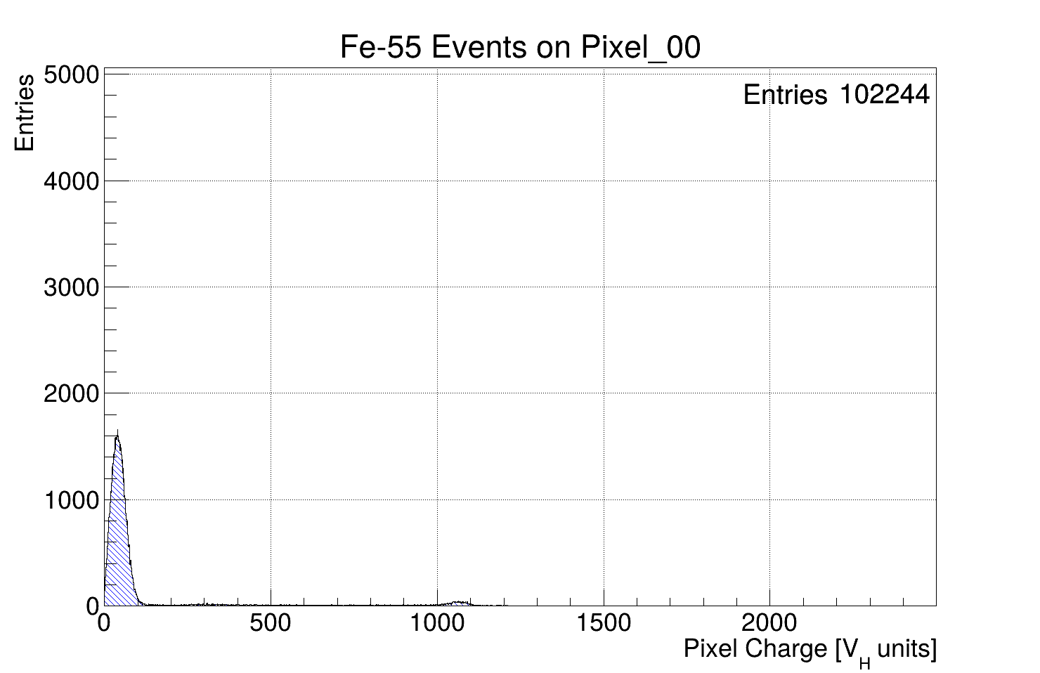
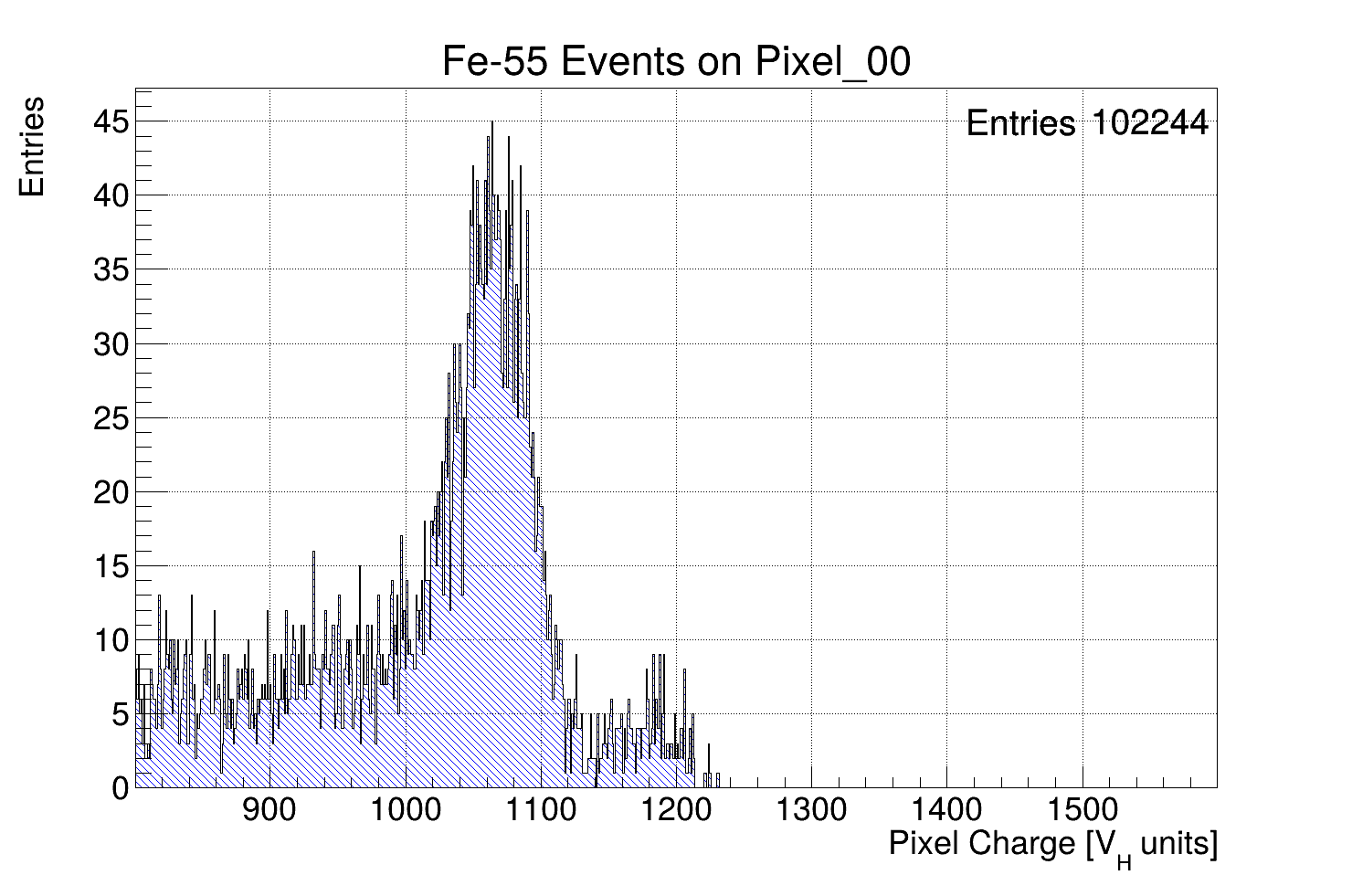
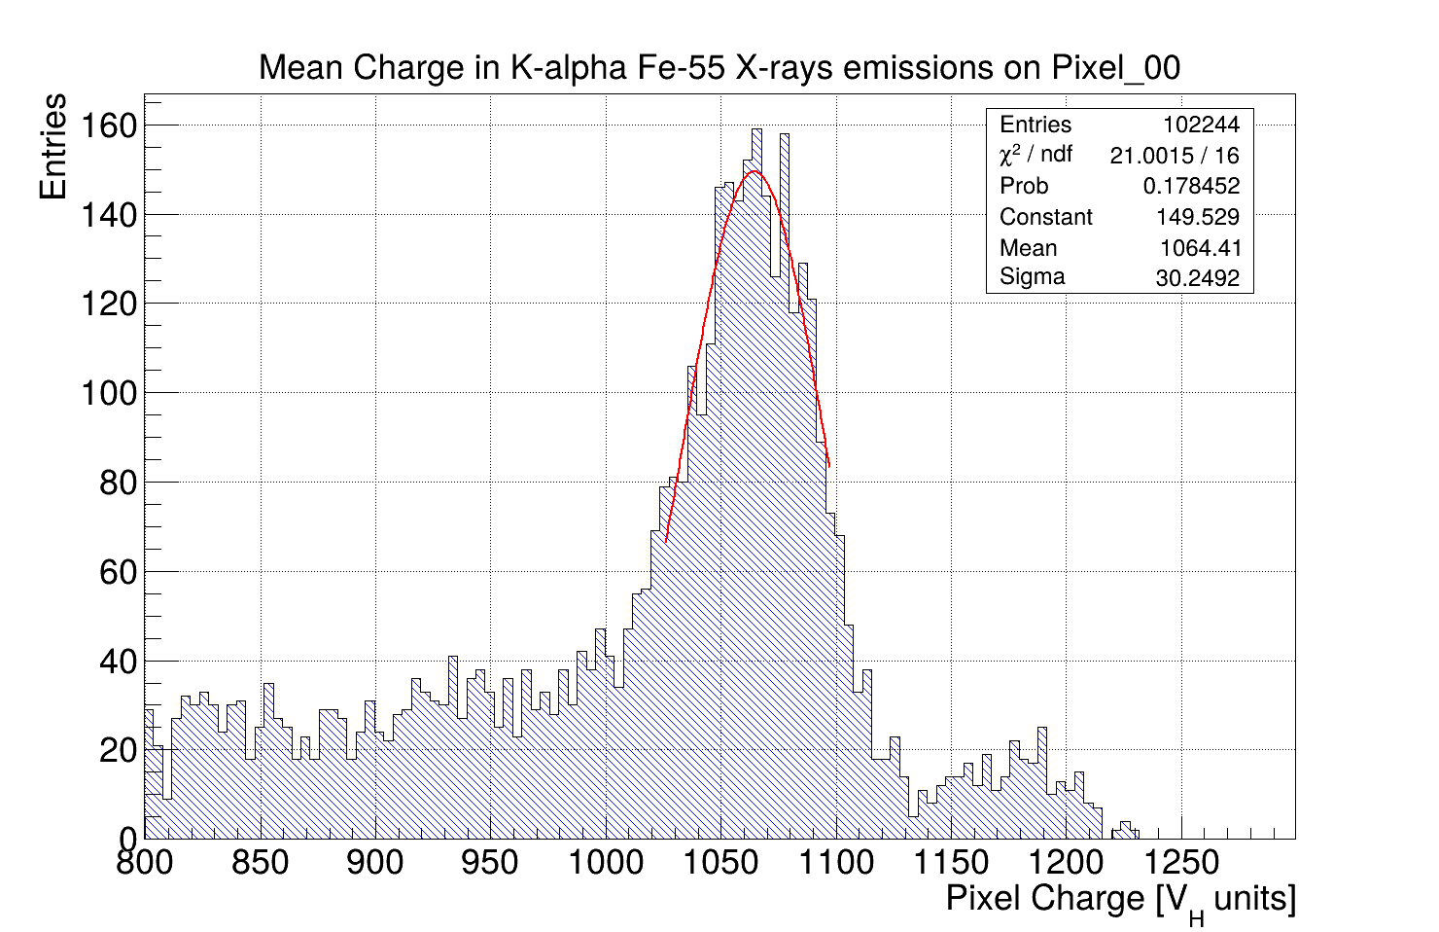
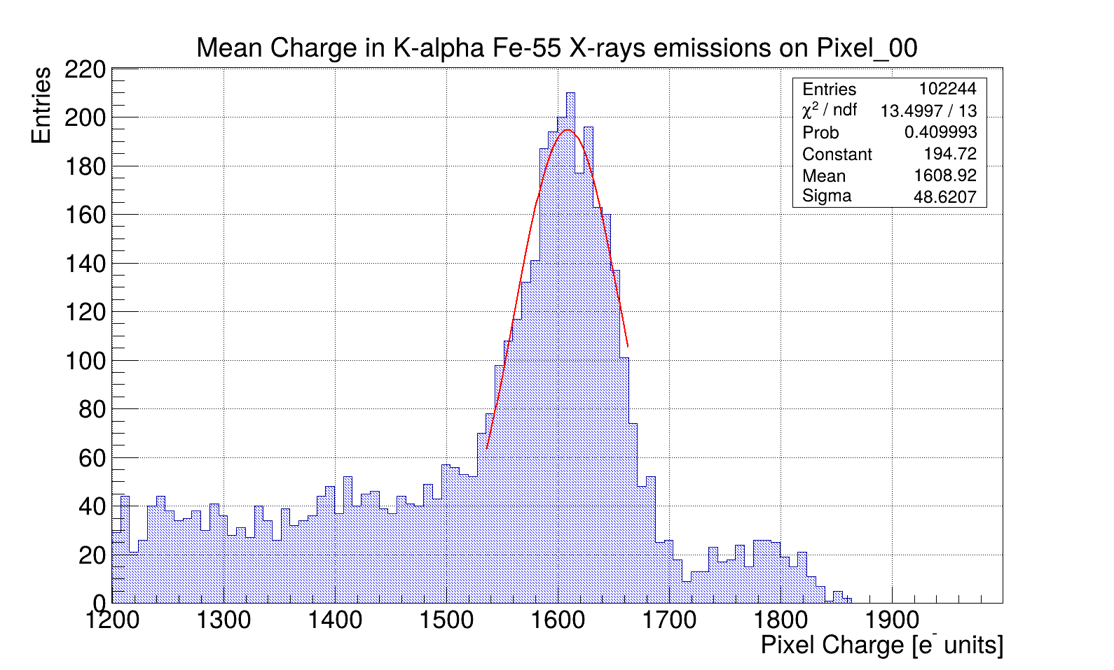
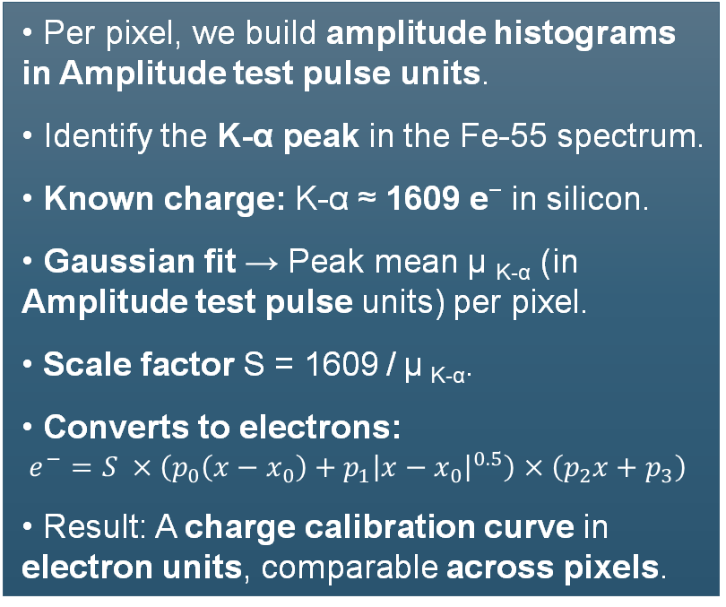
Charge Calibration Using Fe-55 Source
Per pixel, we build amplitude histograms in Amplitude test pulse units.
Identify the K-α peak in the Fe-55 spectrum.
Known charge: K-α ≈ 1609 e⁻ in silicon.
Gaussian fit → Peak mean μ _{K-α} (in Amplitude test pulse units) per pixel.
Scale factor S = 1609 / μ _{K-α}.
Converts to electrons: $e^{−}=S ×\left(p_{0}\left(x−x_{0}\right)+p_{1}{\left|x−x_{0}\right|}^{0.5}\right)×\left(p_{2}x+p_{3}\right)$
Result: A charge calibration curve in electron units, comparable across pixels.
?
?

Slide 14
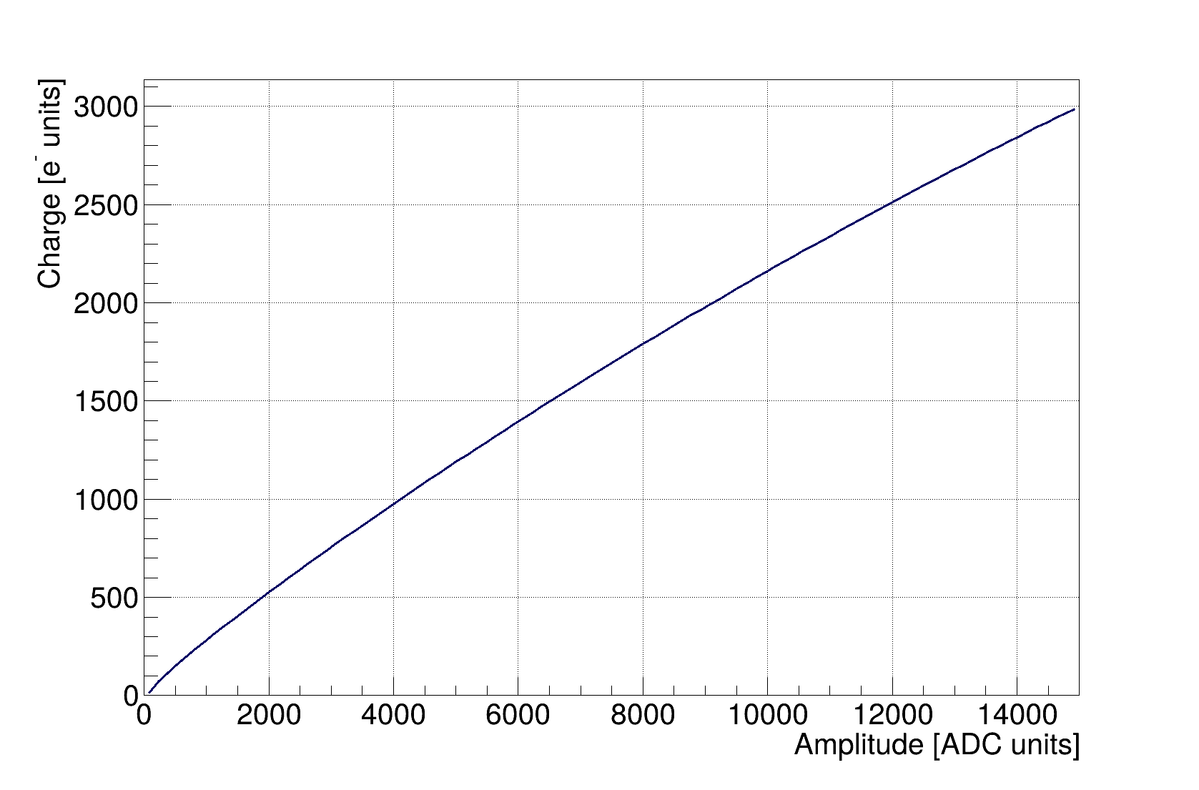
Example of calibration curves
Calibration curve Pixel_00
$$e^{−}=S×\left(p_{0}\left(x−x_{0}\right)+p_{1}{\left|x−x_{0}\right|}^{0.5}\right)×\left(p_{2}x+p_{3}\right),$$

Slide 15
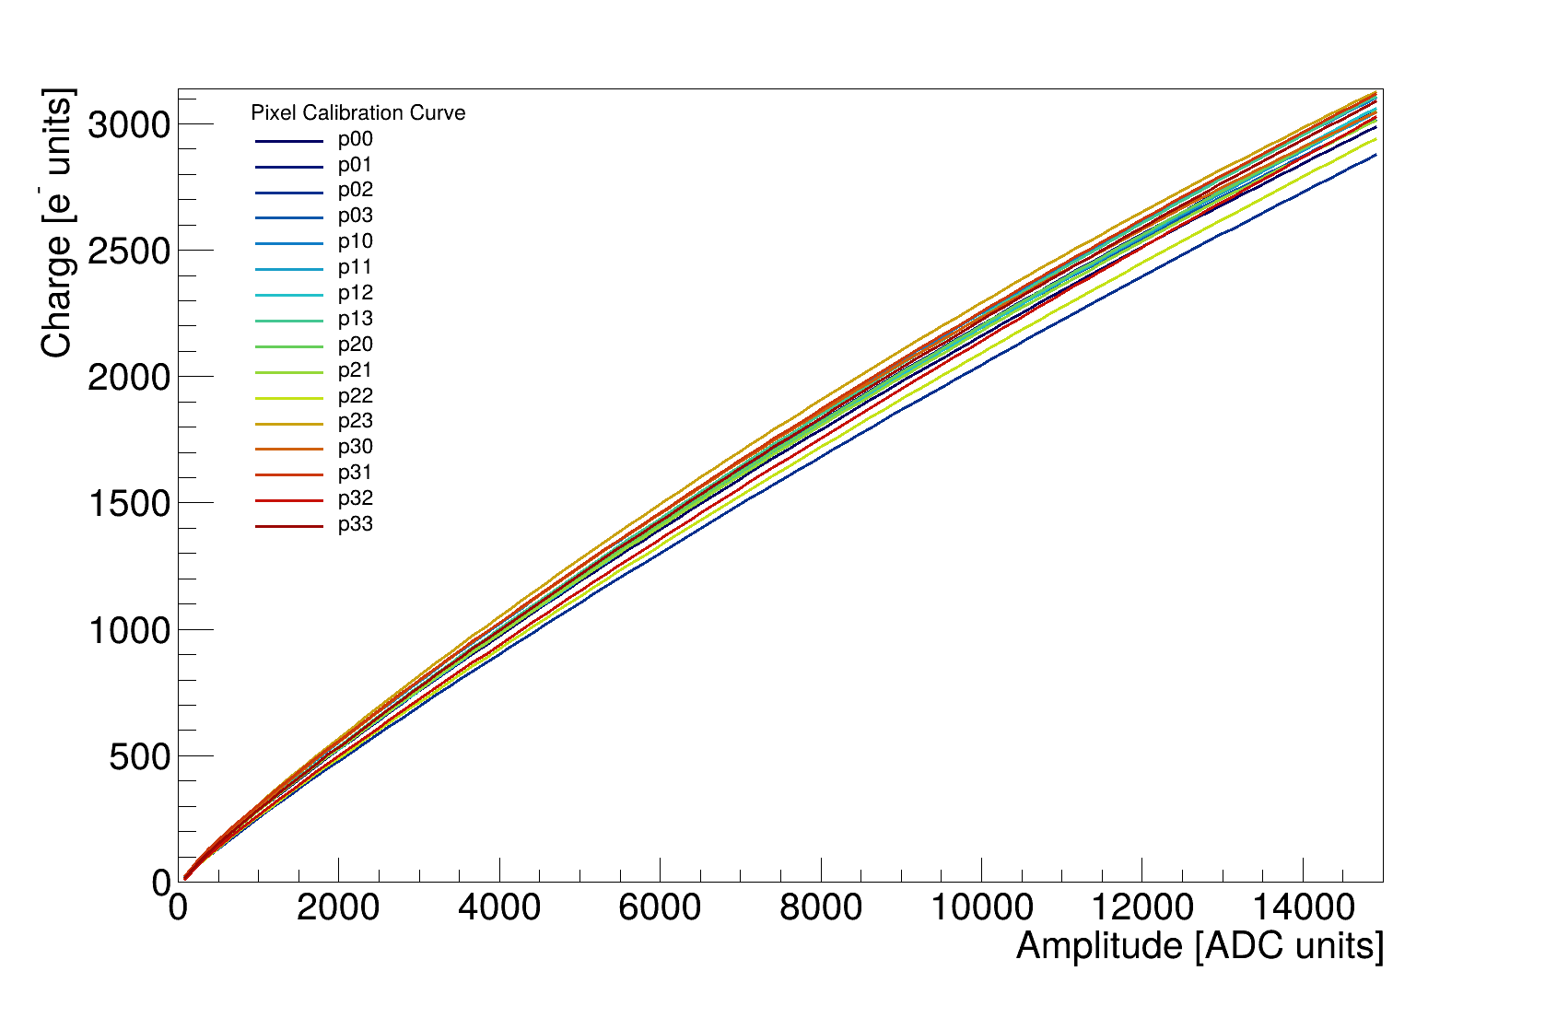
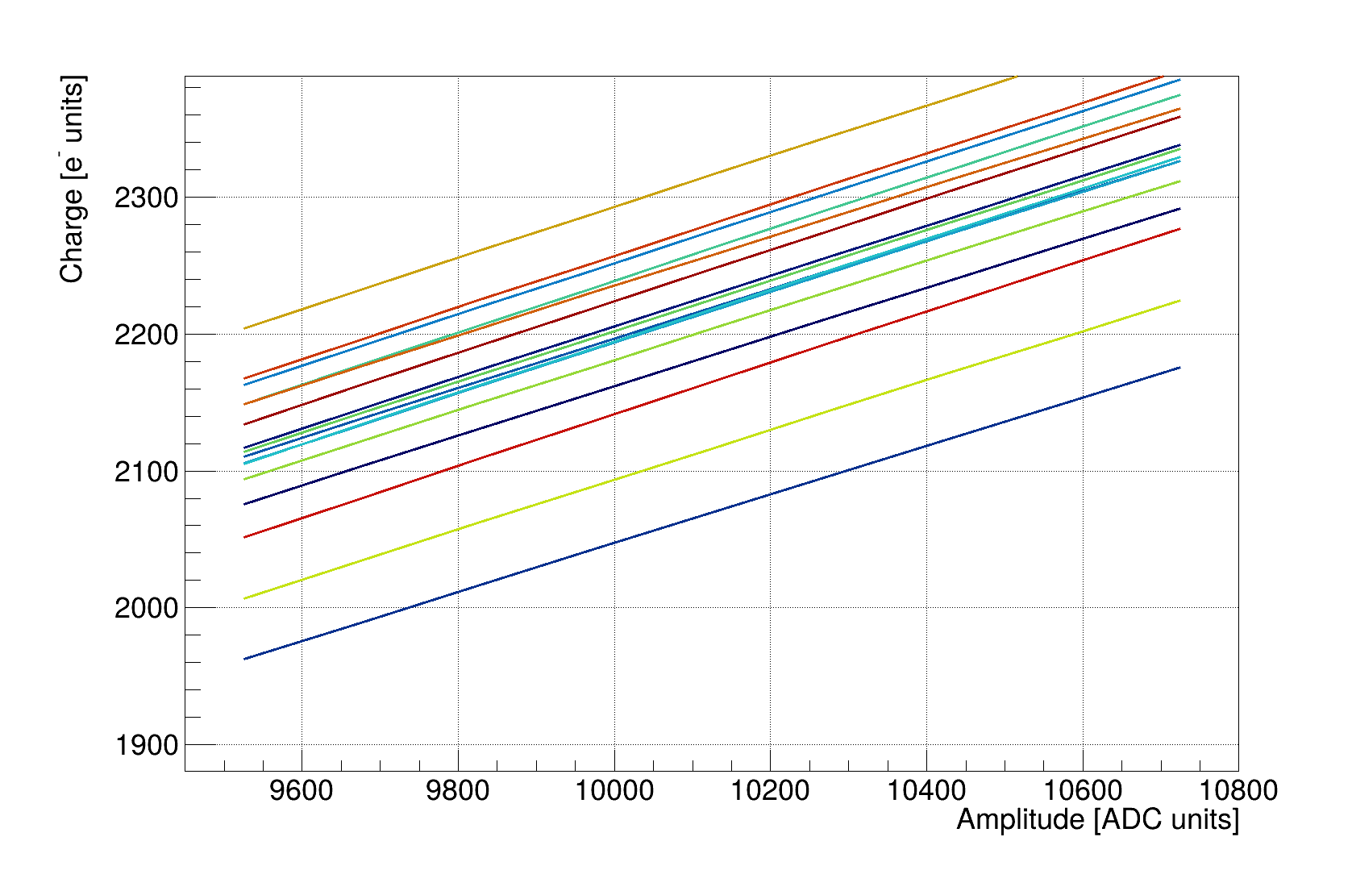

Calibration Curves of all the Pixels
Difference between Highest and Lowest
$$≈250 e^{−}≈11.5\% spread$$

Slide 16
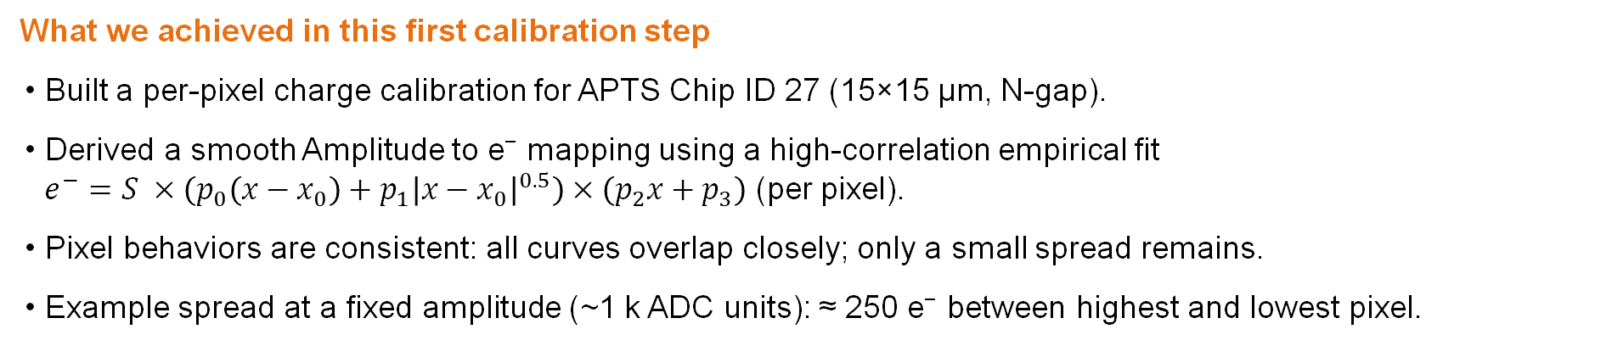
Conclusions
What we achieved in this first calibration step
Built a per-pixel charge calibration for APTS Chip ID 27 (15×15 µm, N-gap).
Derived a smooth Amplitude to e⁻ mapping using a high-correlation empirical fit $e^{−}=S ×\left(p_{0}\left(x−x_{0}\right)+p_{1}{\left|x−x_{0}\right|}^{0.5}\right)×\left(p_{2}x+p_{3}\right)$ (per pixel).
Pixel behaviors are consistent: all curves overlap closely; only a small spread remains.
Example spread at a fixed amplitude (~1 k ADC units): ≈ 250 e⁻ between highest and lowest pixel.
Next steps
Clustering & efficiency studies on the calibrated data.
Spatial resolution vs. charge sharing.
Verify the Efficiency
Compare with simulations
Progress on the test-beam studies

Slide 17
Thank you

Slide 18
Bibliography
Aglieri Rinella, G., Alocco, G., Antonelli, M., Baccomi, R., Beole, S. M., Blidaru, M. B., Buttwill, B. B., Buschmann, E., Camerini, P., Carnesecchi, F., Chartier, M., Choi, Y., Colocci, M., Contin, G., Dannheim, D., De Gruttola, D., Del Rio Viera, M., Dubla, A., Di Mauro, A., … Wittwer, R. B. (2024). Characterization of analogue Monolithic Active Pixel Sensor test structures implemented in a 65 nm CMOS imaging process. Nuclear Instruments and Methods in Physics Research Section A: Accelerators, Spectrometers, Detectors and Associated Equipment, 1069, 169896. https://doi.org/10.1016/j.nima.2024.169896
Vignola, G. (2025). Studies of a digital SiPM and MAPS prototypes as key technologies for future high-energy physics experiments (Doctoral dissertation, Rheinische Friedrich-Wilhelms-Universität Bonn). Bonndoc. https://doi.org/10.48565/bonndoc-546
R. D. Deslattes, E. G. Kessler Jr., P. Indelicato, L. de Billy, E. Lindroth, et al., X-ray transition energies (version1.2), accessed: 2025-08-28 (2005). URL http://physics.nist.gov/XrayTrans
Musa, L., & Beole, S. (2021, June 7). ALICE tracks new territory. CERN Courier. https://cerncourier.com/a/alice-tracks-new-territory/

Slide 19
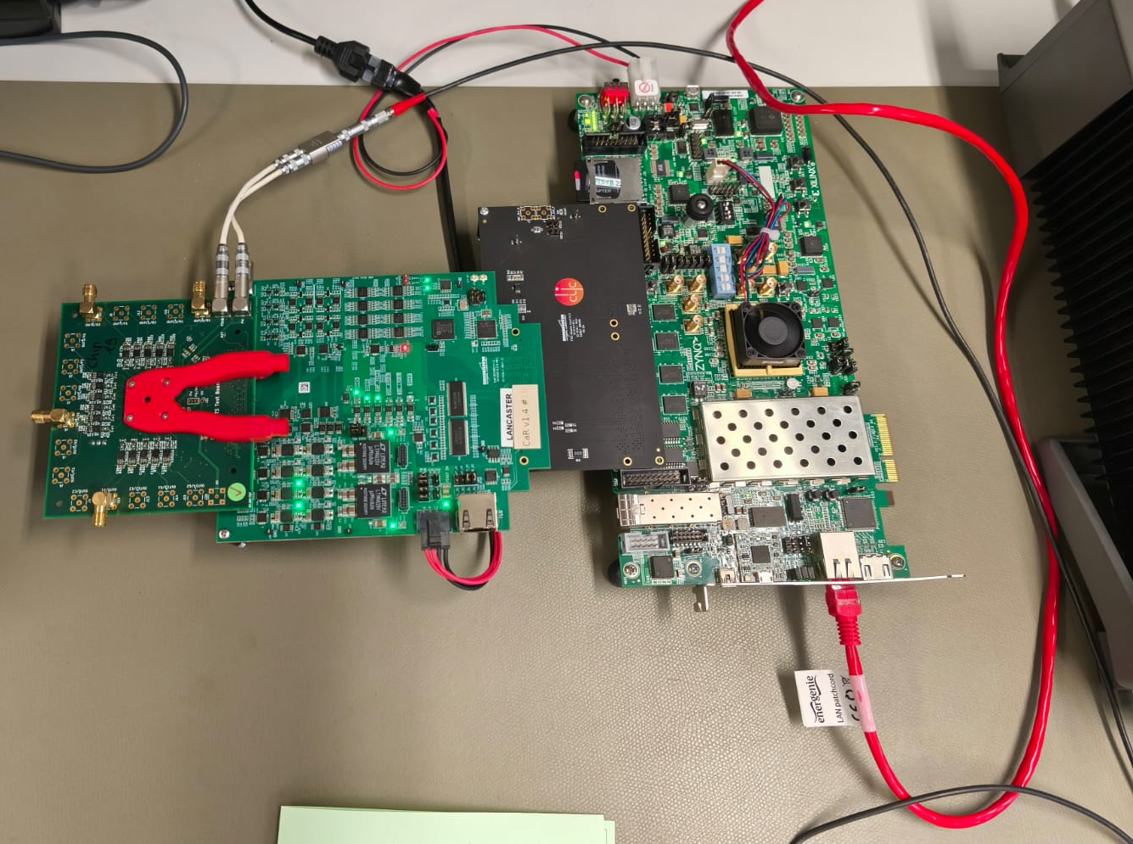
Data collection characteristics
Caribou DAQ chain & run conditions
Pixel board: Biases the sensor at −1.2 V and routes the analog pixel outputs.
Proximity board: Digitizes the analog outputs (ADC) and handles timing/bias control.
Adapter: Provides the interconnect between Proximity and DAQ boards.
DAQ mainboard: Runs firmware to control the scan and triggers, reads ADC data.
Voltage test-pulse scan: 0 → 1200 mV in 10 mV steps.
For each step, waveforms were recorded and the mean amplitude per pixel was computed.
Pixel board
Adapter
Proximity board
DAQ mainboard

