Slide 1




Optimization of the HALHF FFS
Vera Cilento, Rogelio Tomas, Richard D’Arcy

Slide 2
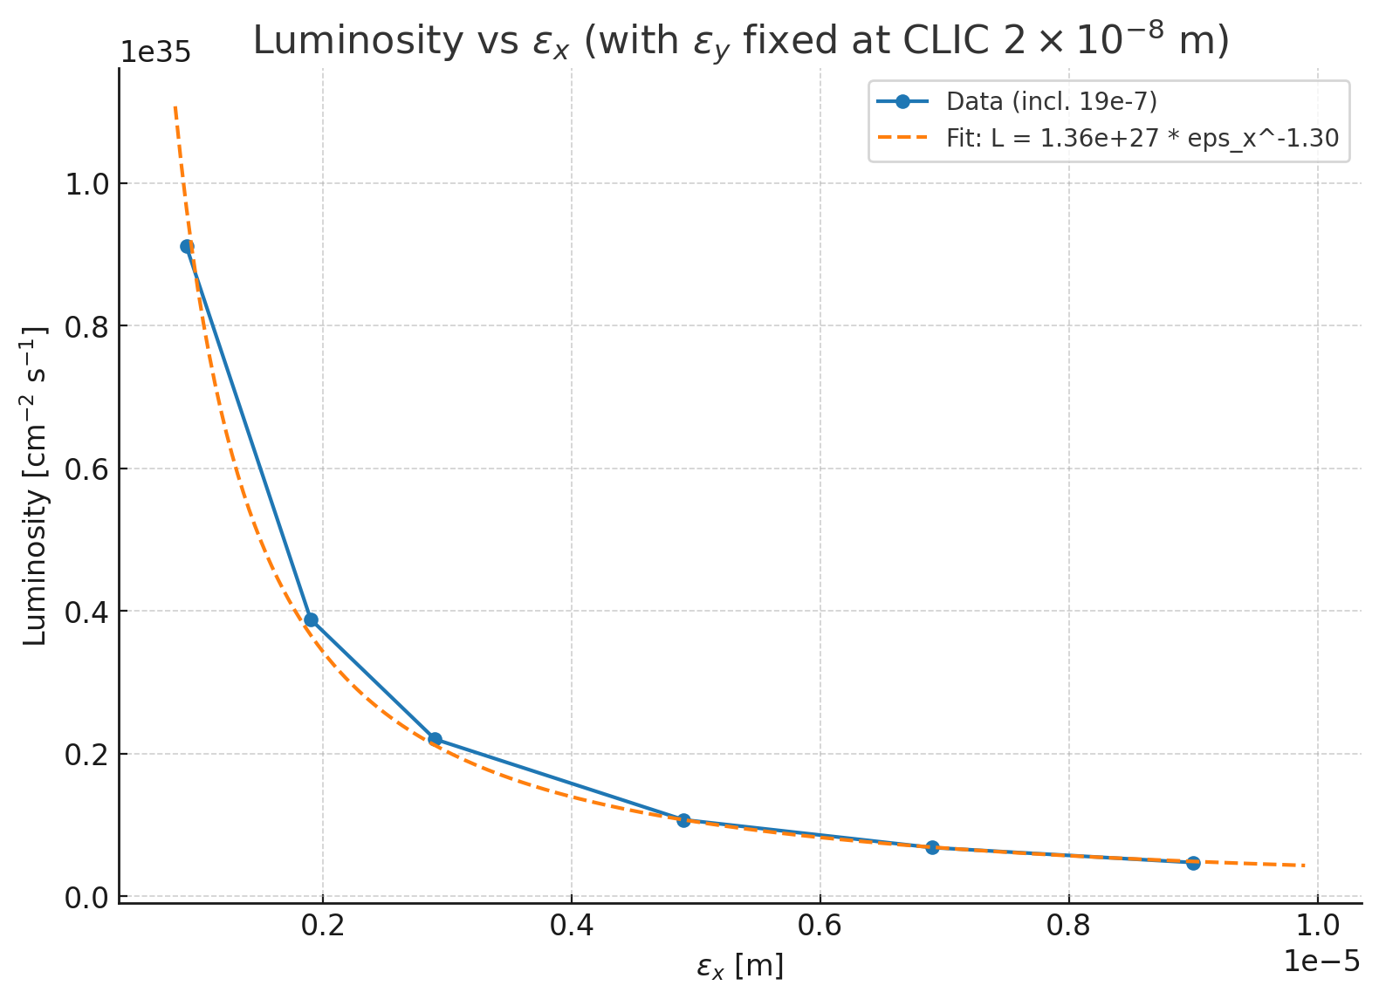
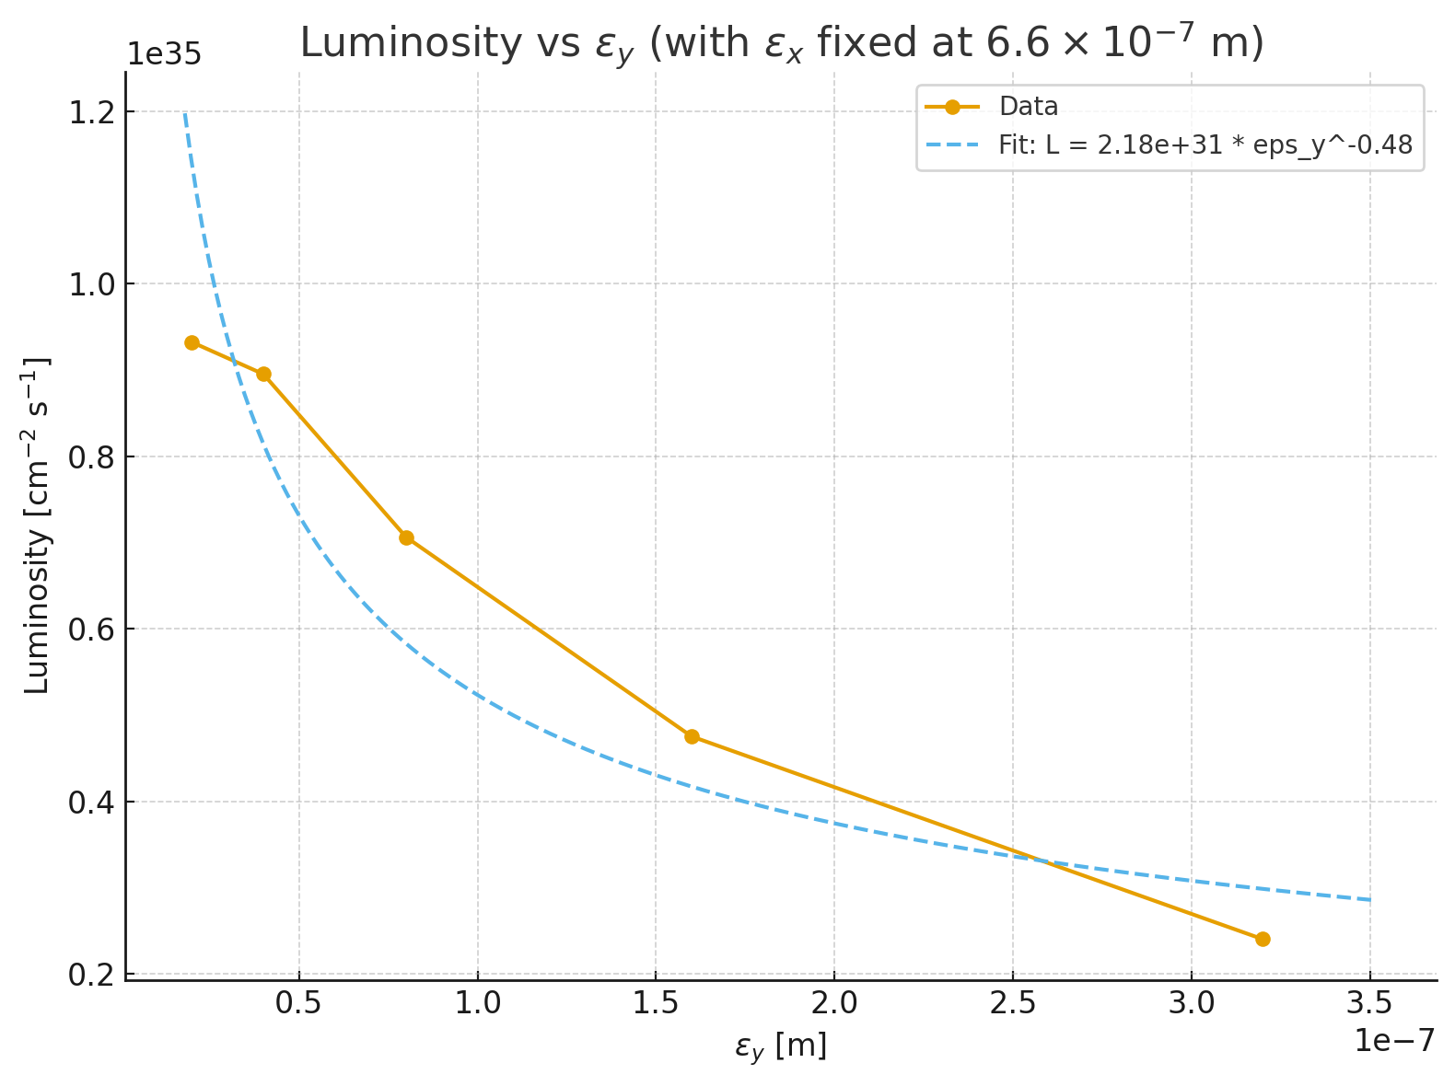
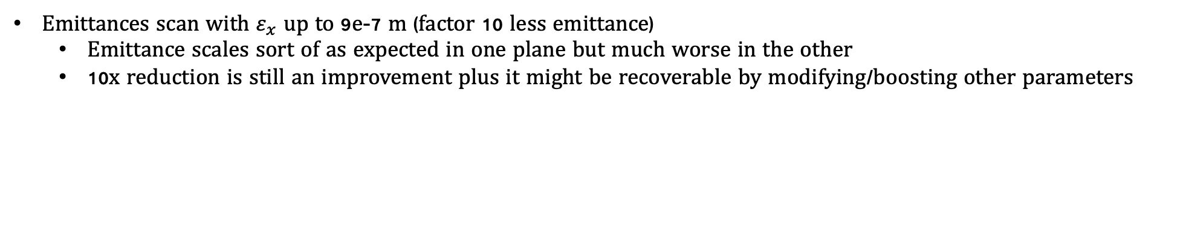
HALHF FFS Optimization
Emittances scan with $ε_{x}$ up to 9e-7 m (factor 10 less emittance)
  Emittance scales sort of as expected in one plane but much worse in the other
  10x reduction is still an improvement plus it might be recoverable by modifying/boosting other parameters
HALHF Monthly Meeting

Slide 3
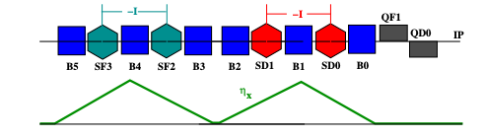
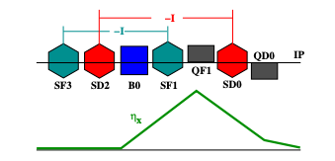
HALHF FFS Optimization
Traditional scheme vs Local correction scheme for the FFS design
Longer system (≈ 3× longer)
Better correction of geometric aberrations
Better performace with HALHF large emittances
Requires an ad hoc deisgn since we should minimize the number of sextupoles
Traditional Scheme
More compact (≈ 3× shorter)
Stronger sensitivity to geometric aberrations
Promising for HALHF with a factor 10 reduced emittances
Higher challenges for HALHF parameters
Local Scheme
HALHF parameters should in principle work for the traditional scheme but we want to use local scheme if possible due to the substantial length reduction
But this will mean a compromise in emittance

Slide 4
HALHF FFS Optimization
The CLIC 1.5 TeV FFS (L = 550 m) was used as a starting point due to its reduced aberrations
HALHF Monthly Meeting

Slide 5
HALHF FFS Optimization
Beam sizes for a factor 10 less emittances
  Luminosity with CLIC emittances → 9.3e34
  Luminosity with HALHF emittances reduced by a factor 10 → 3.75e33
Further optimization with sextupoles, octupoles and decapoles are envisaged
HALHF Monthly Meeting

