Slide 1
2. DPG-Herbsttagung, 9. Sept. 2025
100 Jahre Quantenmechanik
Symposium
Precise quantum detectors in space, time and energy – semi- and superconductors in particle and condensed matter physics

Slide 2
Norbert Wermes
Physikalisches Institut
Universität Bonn
Symposium Introduction: Semiconductor quantum sensors/detectors in Particle Physics – a success story
2. DPG-Herbsttagung, 9. Sept. 2025
100 Jahre Quantenmechanik

Slide 3
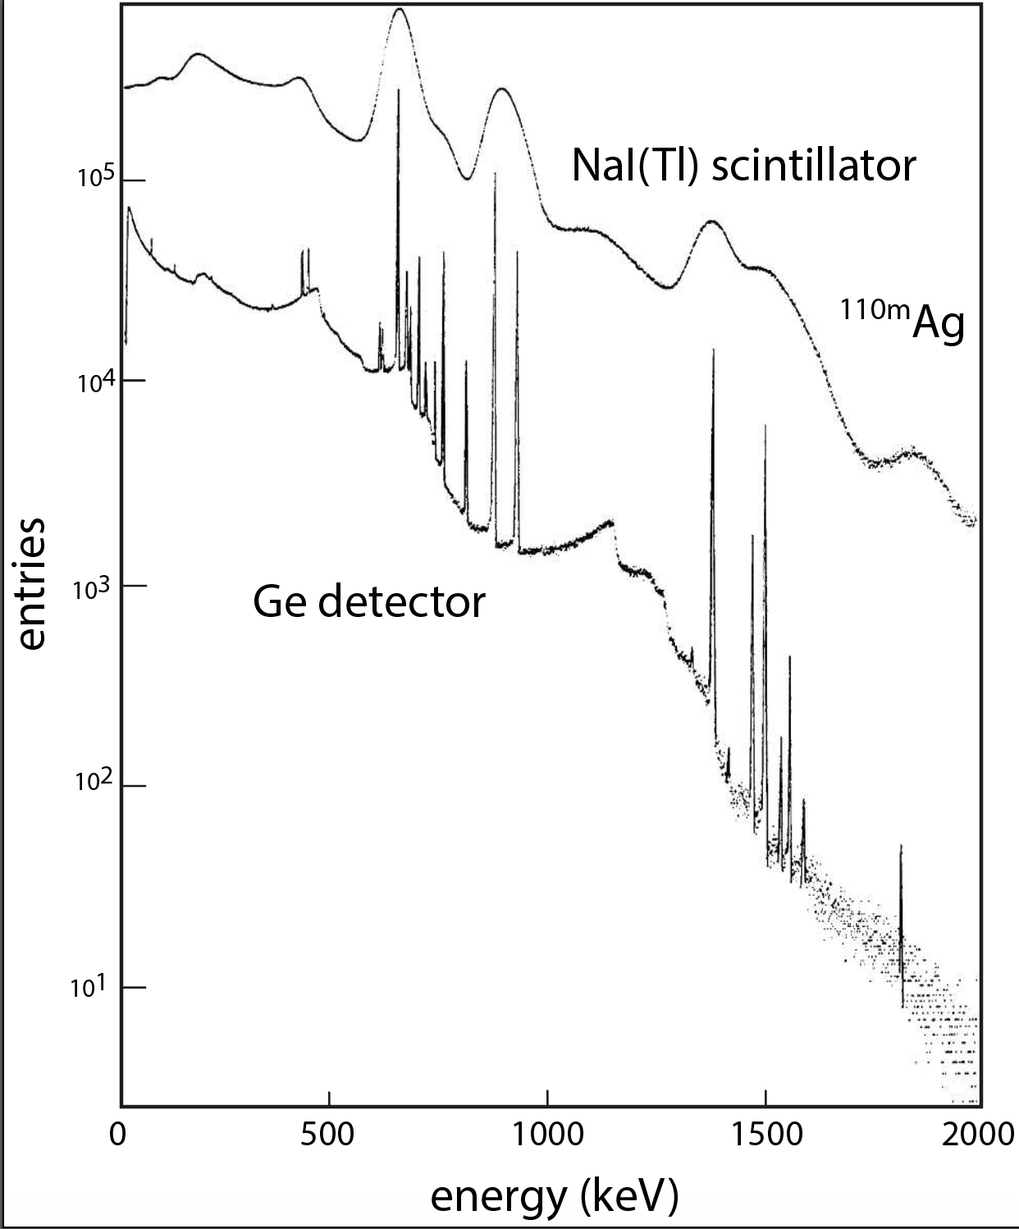
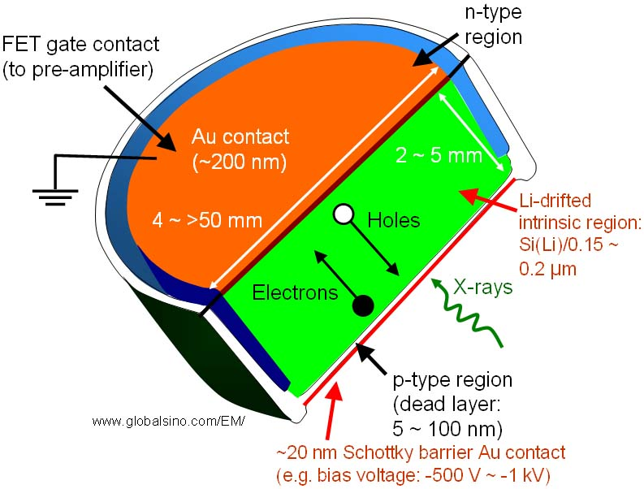
Short history - 1
It was clear since 1950’ies ... for particle detection need “thick” depleted Si with milliseconds free carrier lifetime
2-5 mm
X-ray or gamma
Ge (cooled)
better than Si
At first: metal on Si => surface barrier detectors -> preferred until about 1980 (no thermal processing needed)
Later: thermal diffusion of dopants through oxide windows, later ion implantation was introduced

Slide 4
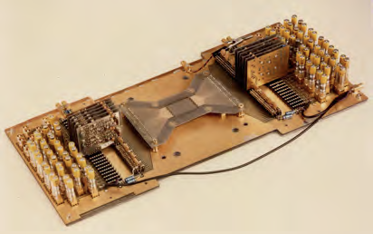
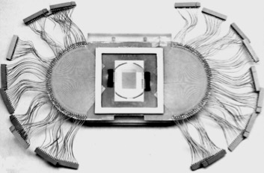
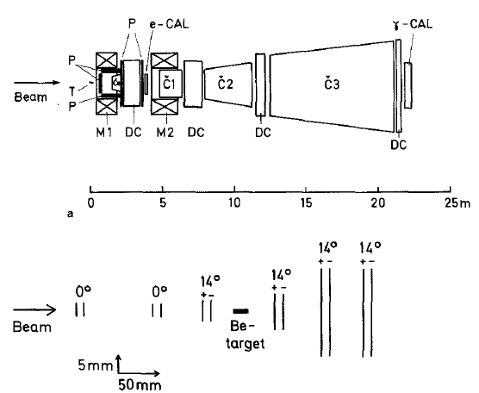
Short History - 1
In 1979: Josph Kemmer (MPI) showed that using MOS technology & ion implantation
=> e/h lifetimes ≈ O(ms) came in reach and in addition microstructuring was possible
NA11/CERN (H8)
1980
NA11/CERN
1980
birth of the microstrip
detector
Heijne, Hyams, Jarron, ...
surface barrier
Si implant
device
Klanner, Lutz & Kemmer
measurements of decay lengths (< mm) possible
=> lifetime measurements in ps-range
e.g. charmed mesons (1981-86)
NA11

Slide 5
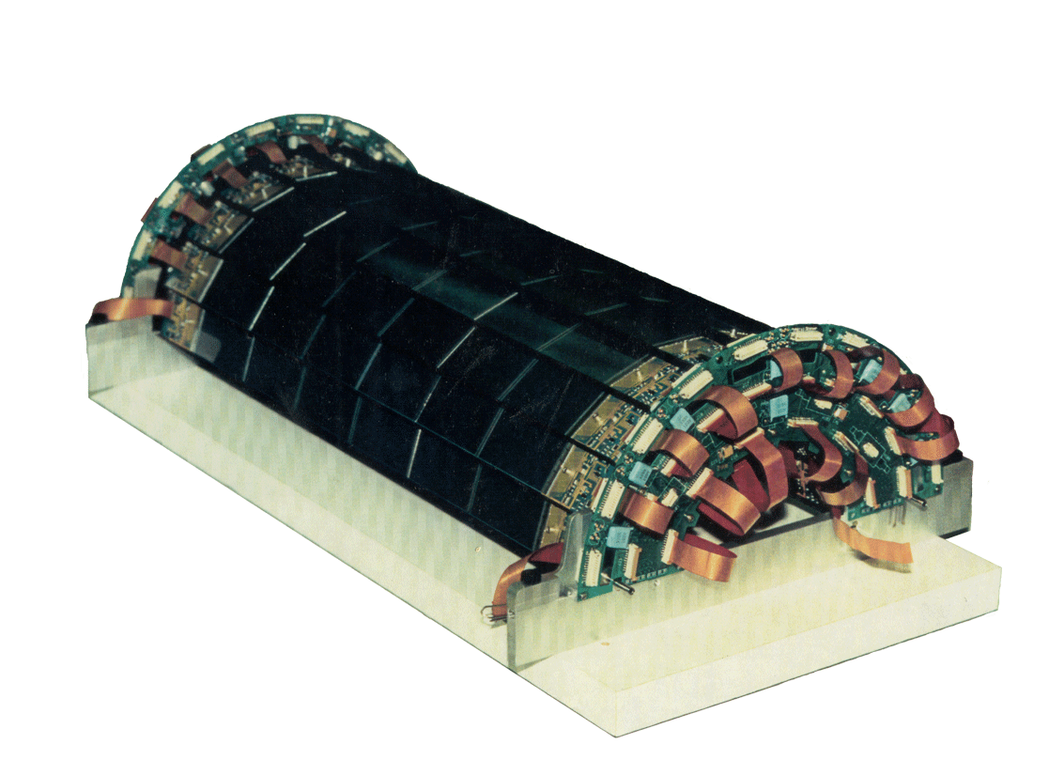
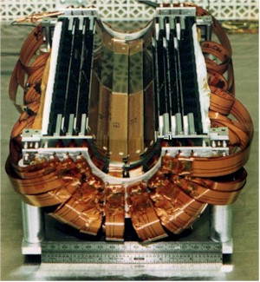
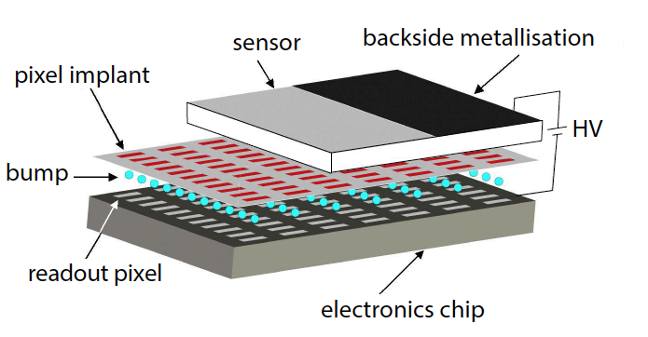
Short history (2) ... ~1982 – 2000 −> now
Silicon detectors became tremendously important for particle physics to detect heavy quarks/leptons
H1@HERA
microstrip BST
microstrips
CCD pixels
(hybrid) pixels
@ LEP, HERA, ...
and Tevatron, LHC
@ SLC
@ LHC
SLD@SLC
CCD vertex
detector
OPAL@LEP
identification of b, c and 𝜏
precise lifetime measurements (ps)
Z⁰ decay widths like Γ_{𝜏𝜏} , Γ_{bb}
discoveries:
top quark (t ➝ b)
H ➝ bb̄, 𝜏𝜏
hybrid pixels

Slide 6
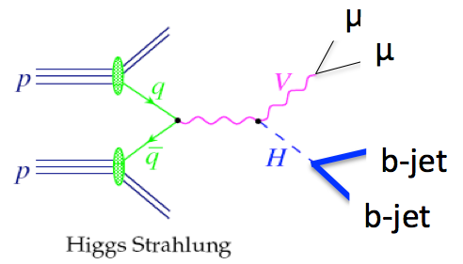
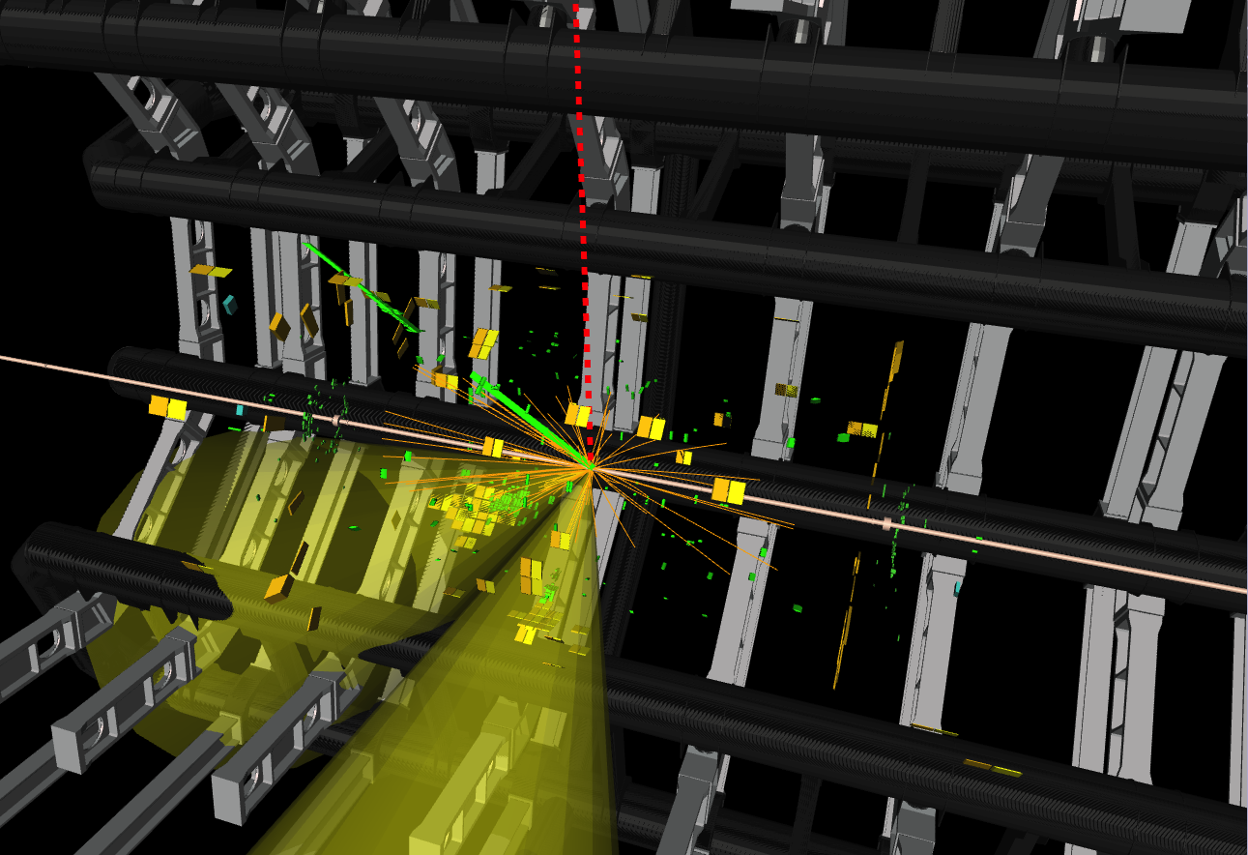
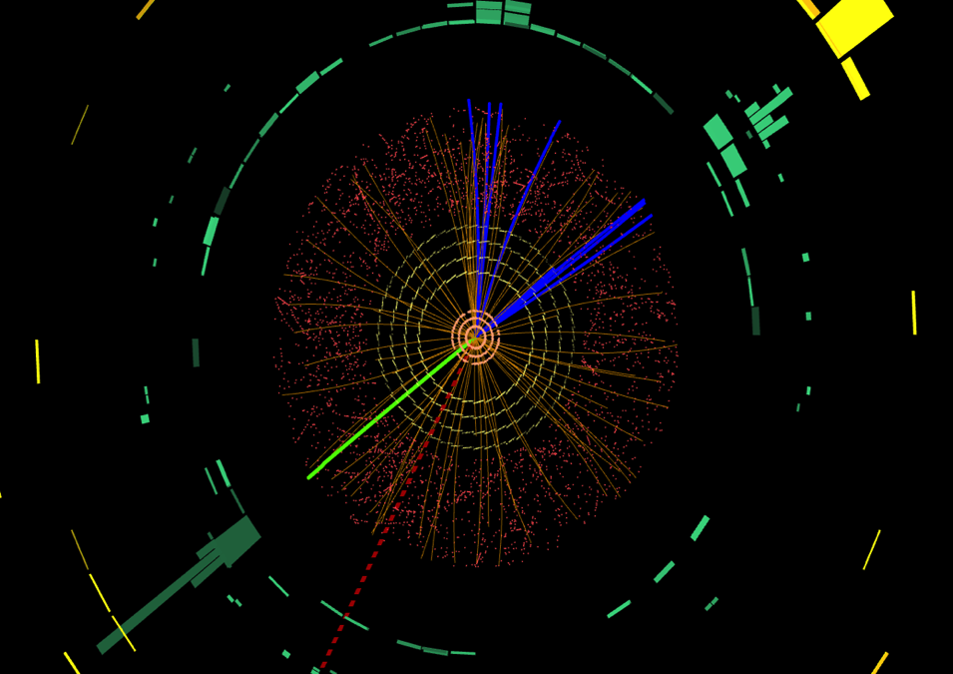
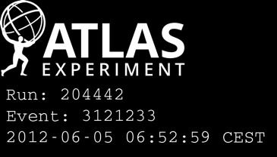
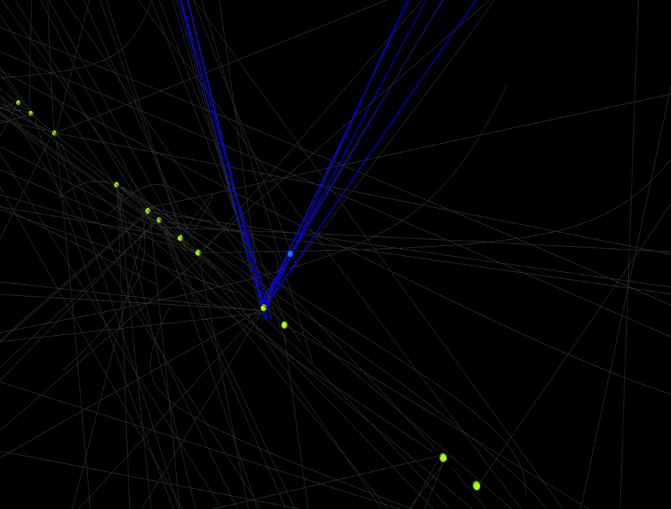
pp ➝ WH ➝ 𝜈e + bb̄
e
ν
secondary
primary
vertex
7 cm
22 collisions
piling up
Notes:
12 interactions ... currently about 40-50 ... in a few years about 200

Slide 7
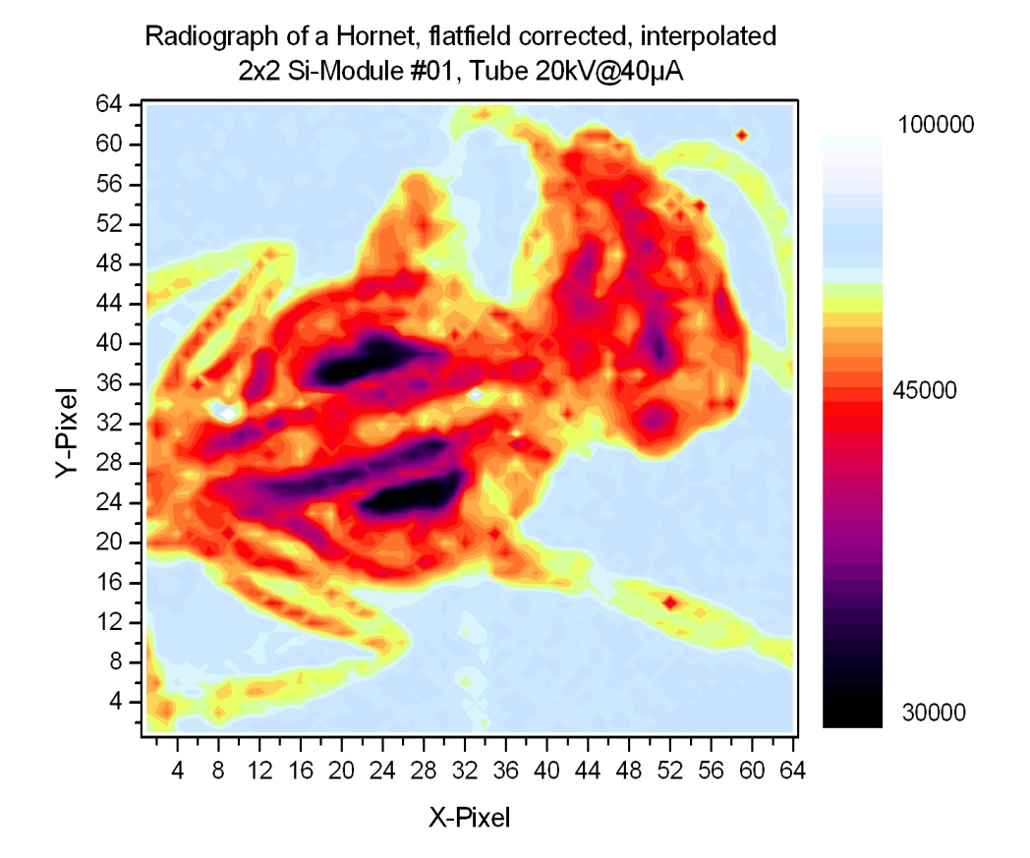
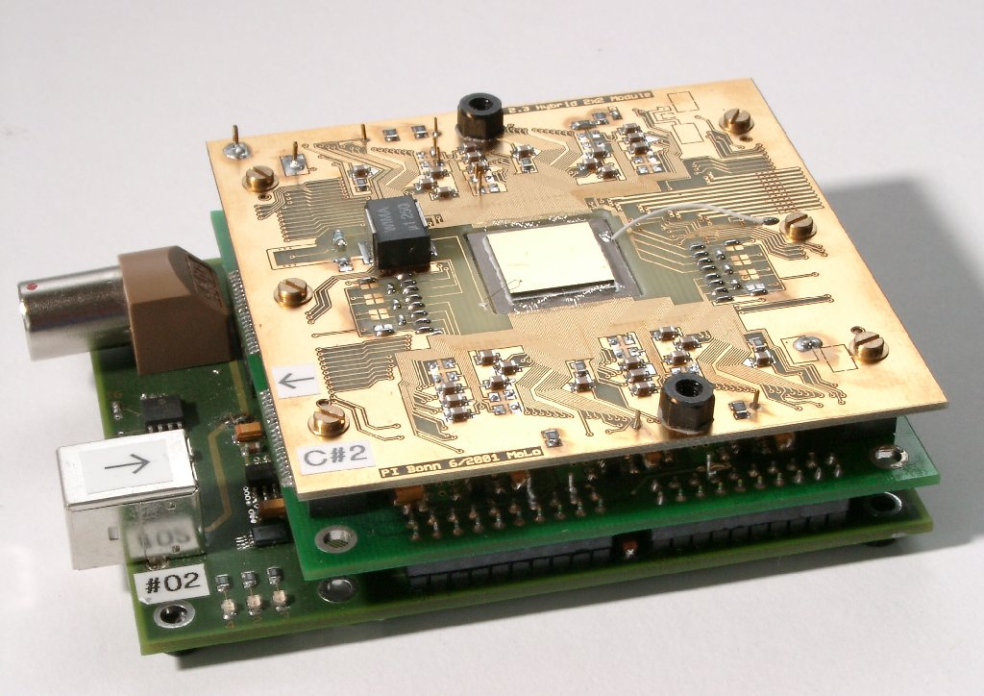
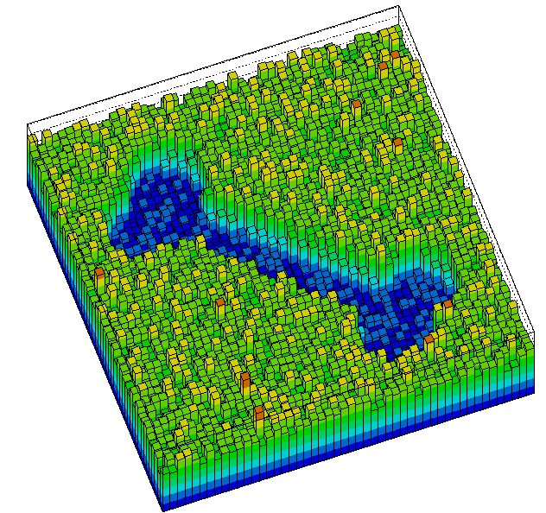
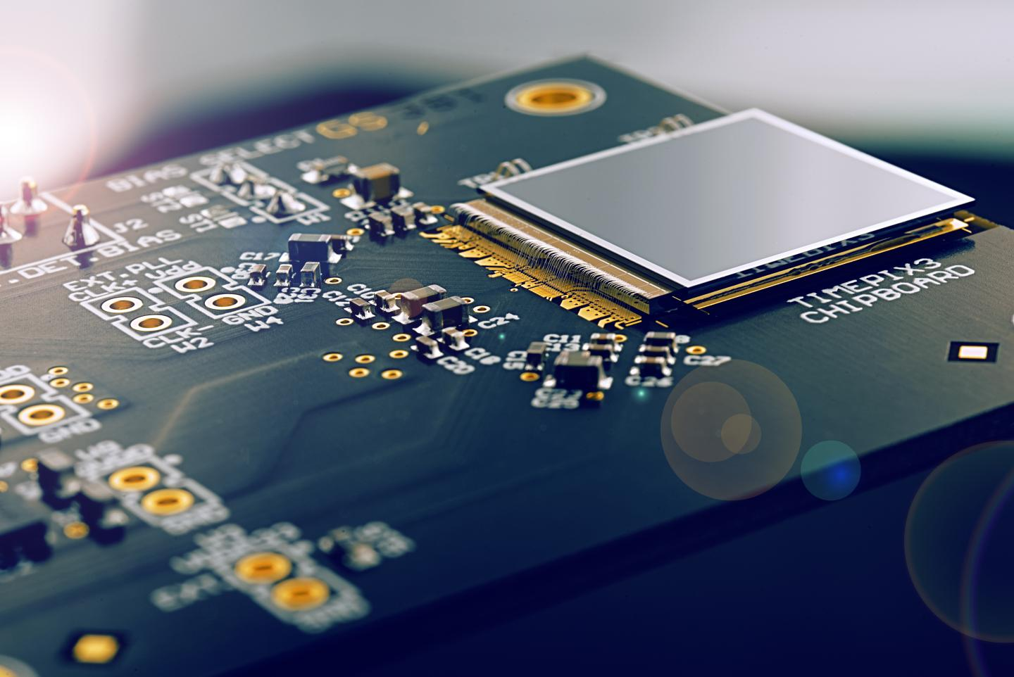
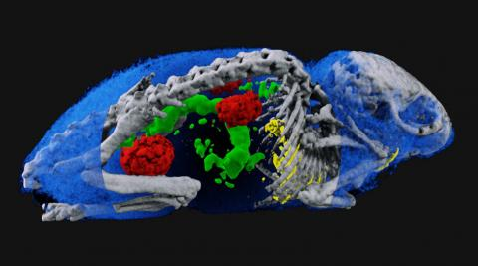
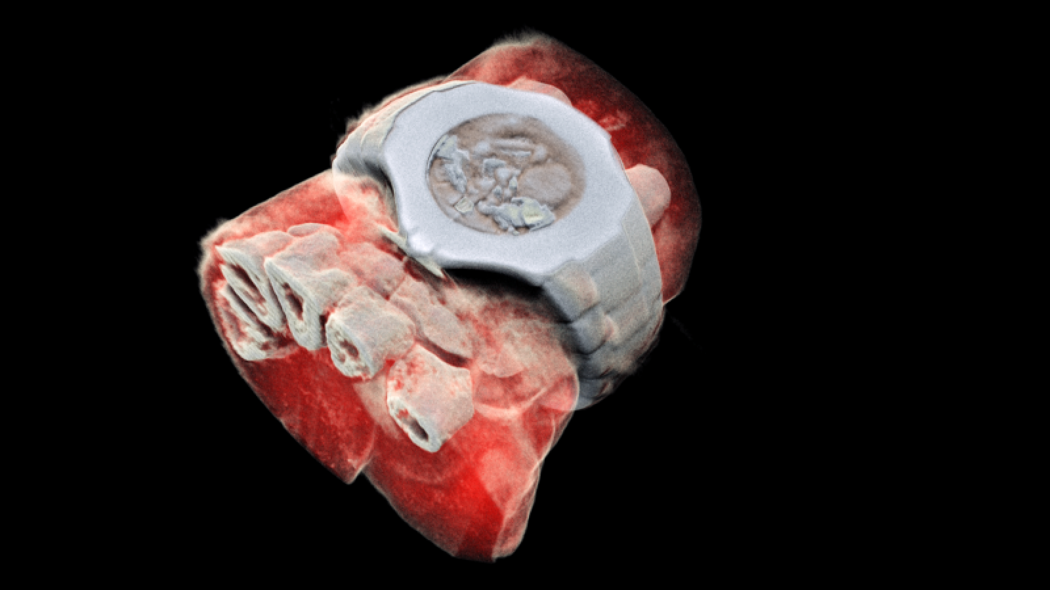
Spin-off to medical imaging: radiography with “counting” pixels
2x2 chips (CdTe) – 64 x 64 pixels
200x200 µm²
MPEC
1997 - 2001
1.3 x 1.3 cm²
M. Löcker, UBonn
Medipix Collaboration
1.4 x 1.4 cm²
2024/25
founded 1997
spectral imaging
3D image of a human wrist
Medipix3
256 x 256 pixels, 55 x 55 µm²
medipix.web.cern.ch/mars-bio-imaging
(Image: MARS Bioimaging Ltd)

Slide 8
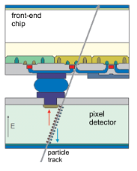
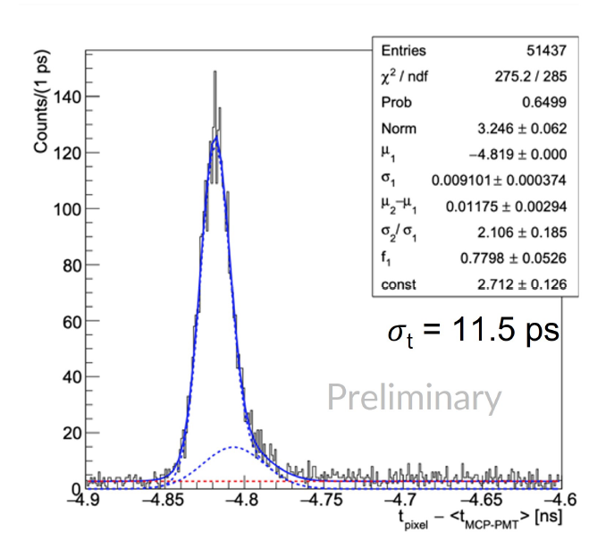
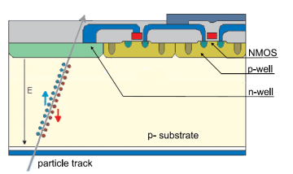
Current and new developments - 1
(a) Monolithic pixels
(b) Picosecond timing with silicon (pixels)
  hybrid pixel cell (one pixel)
Readout
Sensor
Lampis et al.,
JINST 18 (2023) 01, C01051
  (D)MAPS (depleted) monolithic active pixel sensors
presentation
Precision Timing with Silicon Detectors
Nicolò Cartiglia (Univ. di Torino)

Slide 9
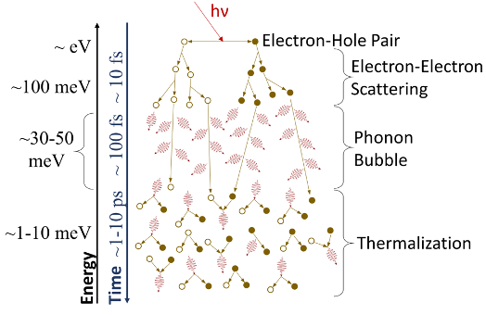
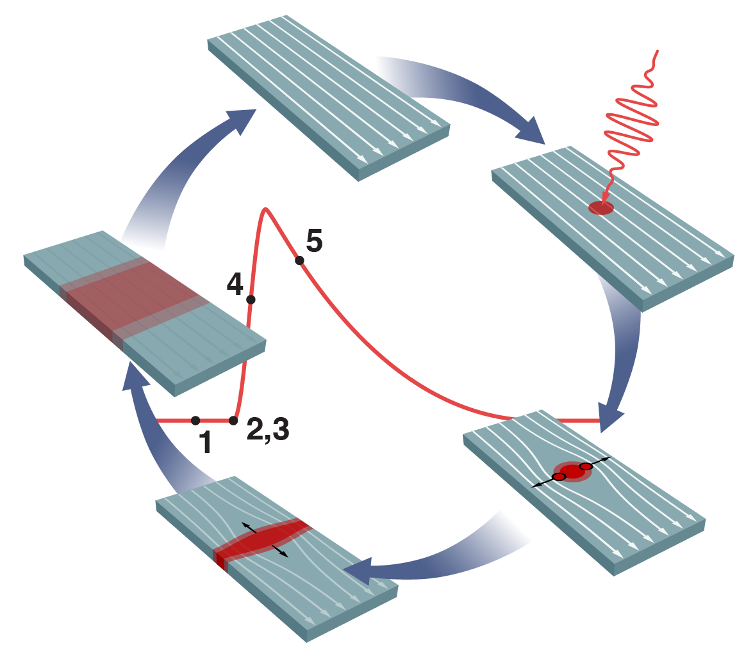
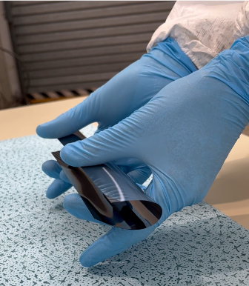
Current and new developments -2
(c) Devices operating at the single quantum level
(d) ”Ultra” ... in many aspects ...
like SNSPDs
monolithic, high spatial resolution, highly efficient
and ultra thin ...
1
2
5
Photon → Electron / Hole
Ion / molecule → Phonons at surface
Charged particle → Coulomb interaction with electrons or nuclei
3
4
presentations
Quantum sensor systems for enhanced precision particle detection
Michael Doser (CERN)
High-performance superconducting nanowire single photon detectors
Val Zwiller (KTH Stockholm)
presentation
ALICE ITS3
- the ultimate paper wrap pixel detector
Magnus Mager (CERN)
Notes:
SNSPD = Superconducting nanowire single photon detector

Slide 10
Symposium talks
Precision Timing with Silicon Detectors (25 min)
Nicolò Cartiglia (Univ. di Torino)
Quantum sensor systems for enhanced precision particle detection (25 min)
Michael Doser (CERN)
High-performance superconducting nanowire single photon detectors (25 min)
Val Zwiller (KTH Stockholm)
ALICE ITS3 - the ultimate paper wrap pixel detector (25 min)
Magnus Mager (CERN, Geneva)

