Slide 1
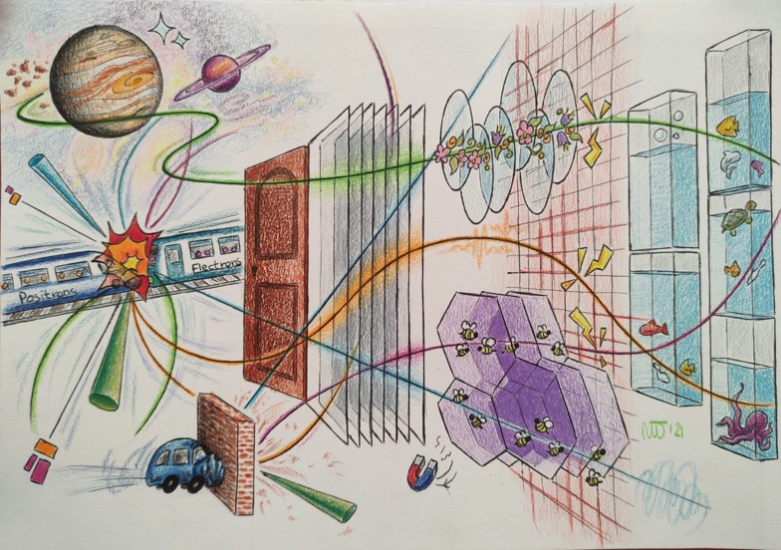
Precision timing with silicon detector
New trends in silicon sensors design
How an idea that did not work revolutionized a very mature detector technology
N. Cartiglia
INFN Torino

Slide 2
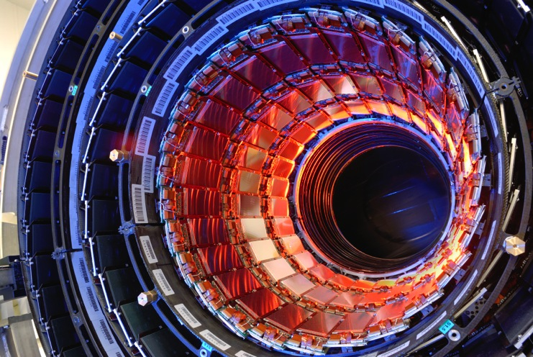
Silicon life in 2010
Very mature silicon systems, very large silicon trackers
Millions of channels, very reliable, very radiation hard
A nagging problem:
Radiation damage causes charge trapping, reducing the signal in heavily irradiated sensors.
A true statement:
Silicon sensors are not suitable timing detectors

Slide 3
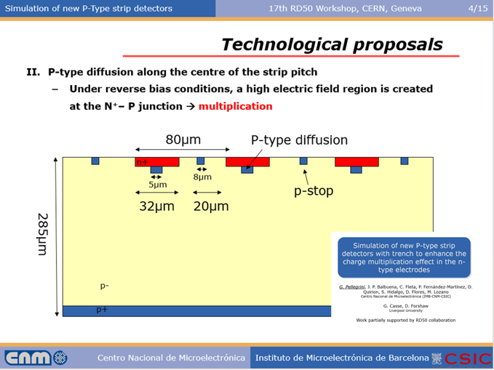
Solution to the nagging problem
Add moderate gain, “to control and optimize the charge multiplication effect, in order to fully recover the collection efficiency of heavily irradiated silicon detectors” [1]
[1] G.Pellegrini,et al., Technology developments and first measurements of Low Gain Avalanche Detectors (LGAD) for high energy physics applications, Nucl. Inst. Meth. A 765 (2014) 12.

Slide 4
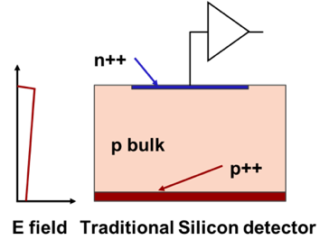
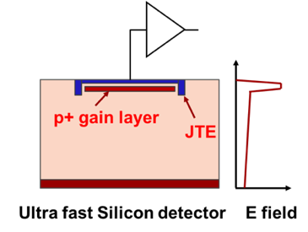
First design innovation: low gain avalanche diode (LGAD)
zoom
Drift area with gain
0.5 – 2 μm long
~1 μm
p+ gain implant
Traditional Silicon Detector
Low-gain avalanche diode
The gain layer:
a parallel plate capacitor with high field
In LGAD, a moderately p-doped implant creates a volume of high field, where charge multiplication happens.

Slide 5
First design innovation: low gain avalanche diode (LGAD)
zoom
Drift area with gain
0.5 – 2 μm long
~1 μm
p+ gain implant
Traditional Silicon Detector
Low-gain avalanche diode
The gain layer:
a parallel plate capacitor with high field
In LGAD, a moderately p-doped implant creates a volume of high field, where charge multiplication happens.
It turned out that the LGAD design does not solve the charge-trapping problem as the LGAD mechanism does not work well in high radiation environments (above 2-3E15 1-MeV n_{eq}/cm²)

Slide 6
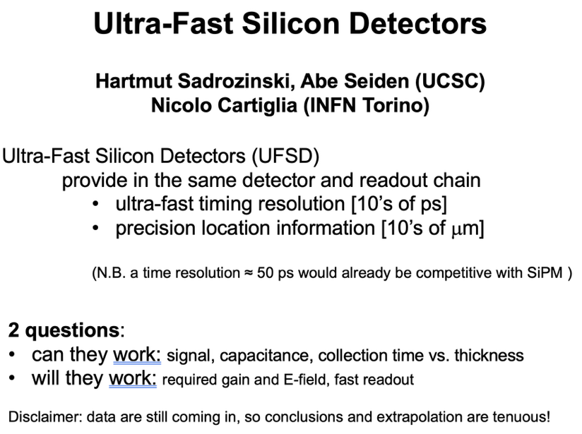
2012: Silicon sensors as timing detectors
RD50 June 2012, Bari

Slide 7
Why internal signal multiplication improves timing?
The electronics has a noise floor
The signal increases with gain
The signal noise increases with gain with steeper characteristics
The total noise is flat at low gain, and then it increases fast
Noise floor
Signal
Total Noise
Amplitude
Best S/N ratio
“Low gain” needs to be understood in connection with the noise of the electronics: it is the range of gain with an improved signal-to-noise ratio.
Noise
Noise floor, gain independent
The success of LGADs rests on the fact that the sensor noise is hidden by the electronic noise
10 100
Signal (gain)
Low gain

Slide 8
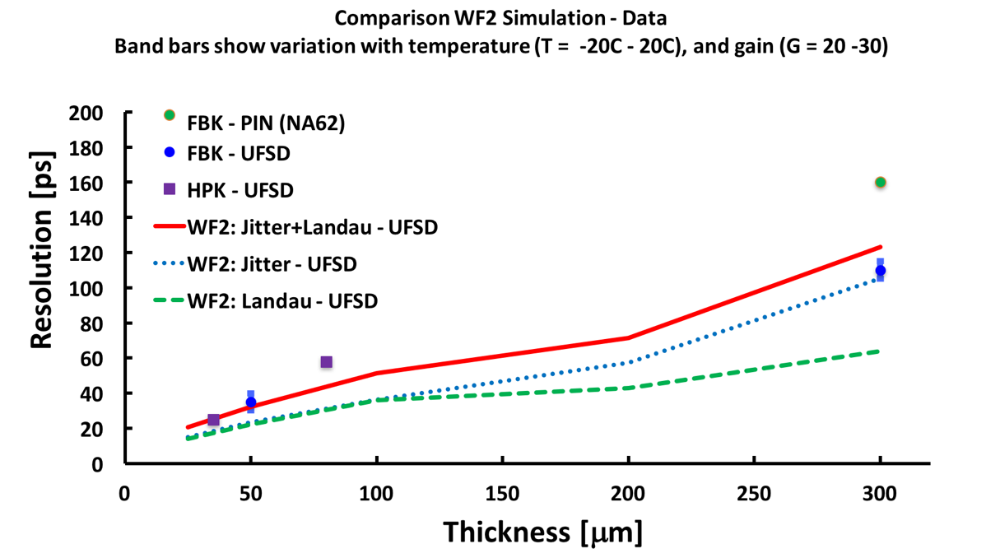
Temporal resolution vs sensor thickness
Silicon sensors have an intrinsic resolution that depends on the thickness
Resolution without gain
LGAD
LGAD
Intrinsic LGAD
LGAD
LGAD
Intrinsic LGAD
LGADs are now a commercial commodity, many foundries are producing them.
The combined CMS+ATLAS order exceeds 20 m² for a cost in excess of 5-6 million CHF
Both CMS and ATLAS have opted for 50 μm thick UFSD,
(intrinsic time resolution of about 30 ps)

Slide 9
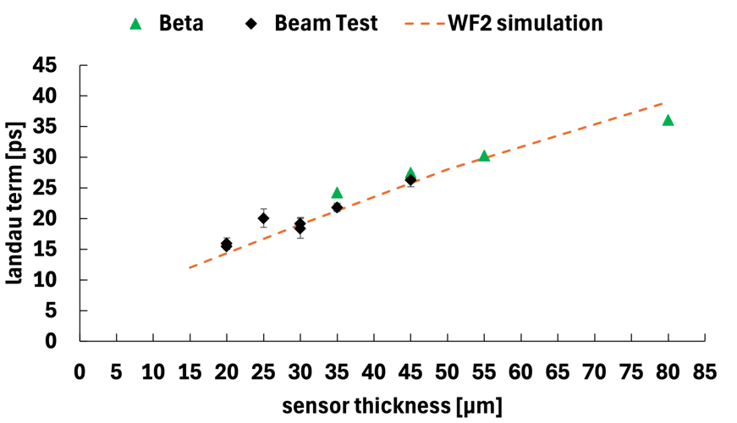
LGAD temporal resolution for thin sensors
LGAD intrinsic temporal resolution improves in thinner sensors:
==> reasonable to expect 10-20 ps for 10-20 μm thick sensors.
4 fC (gain = 20)
10 fC (gain = 20)

Slide 10
Timing layers and 4D tracking
By “4D tracking” we mean the process of assigning a spatial and a temporal coordinate to a hit.
Timing
Timing can be available at different levels of the event reconstruction:
Timing in a single point (timing layer ATLAS,CMS): 3+1 tracking

Slide 11
Timing layers and 4D tracking
By “4D tracking” we mean the process of assigning a spatial and a temporal coordinate to a hit.
Timing
Timing can be available at different levels of the event reconstruction:
Timing in a single point (timing layer ATLAS,CMS): 3+1 tracking
Timing at some points along the track

Slide 12
Timing layers and 4D tracking
By “4D tracking” we mean the process of assigning a spatial and a temporal coordinate to a hit.
Timing
Timing can be available at different levels of the event reconstruction:
Timing in a single point (timing layer ATLAS,CMS): 3+1 tracking
Timing at some points along the track
Timing at each point along the track: 4D tracking

Slide 13
Timing layers and 4D tracking
By “4D tracking” we mean the process of assigning a spatial and a temporal coordinate to a hit.
Timing
Timing can be available at different levels of the event reconstruction:
Timing in a single point (timing layer ATLAS,CMS): 3+1 tracking
Many timing coordinates per track yield better-performing detectors but require more complex read-out systems.
Some projects will be perfectly fine with having a limited set of timing points
Timing at some points along the track
Timing at each point along the track: 4D tracking

Slide 14
Why is timing needed at HL-LHC?
No temporal information:
protons
protons

Slide 15
Why is timing needed at HL-LHC?
No temporal information:
protons
protons
With temporal information:
protons
protons

Slide 16
Why is timing needed at HL-LHC?
No temporal information:
protons
protons
With temporal information:
protons
protons
HL-LHC situation:
the collisions are so dense that overlap in space
Timing allows to separate them

Slide 17
Combining spatial and temporal resolutions
In silicon sensors, the position resolution depends on the pixel size
Very good position resolution requires very small pixels
The pixel size determines the space available for the electronics
Good temporal resolution requires a sizable amount of power per electrode.
“Simply” adding timing capabilities to a pixel detector will not work in large systems, the cooling requirements are too high
ASIC
Sensor

Slide 18

Second design innovation: resistive silicon detector
n⁺⁺
n⁺
$$σ \sim pitch/√12$$
-------------
+++++++++
-------------
+++++++++
^{p++}
p-bulk
Standard silicon detector
Resistive silicon detector
(AC-LGAD, RSD, DC-RSD)
In resistive silicon detectors, instead of many p-n diodes, there is a single diode.
The n-doped implant is resistive and acts as a signal divider
Very uniform electric and weighing fields, perfect geometry for timing
Signal sharing is the key ingredient to excellent spatial resolution using large pixels

Slide 19




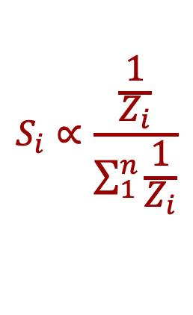




Signal sharing in resistive silicon detectors
The signal sees several impedances in parallel, and it is split according to Ohm’s law.
Each pad gets a share of the total signal, exactly as in a current divider
$$S_{i}∝\frac{\frac{1}{Z_{i}}}{\sum_{1}^{n}{\frac{1}{Z_{i}}}}$$
1
2
$$Z_{1}$$
$$Z_{2}$$
$$Z_{3}$$
$$Z_{4}$$
$$Z_{2}$$
$$Z_{1}$$
$$Z_{4}$$
$$Z_{3}$$
3
4

Slide 20
RSD principle of operation in motion

Slide 21
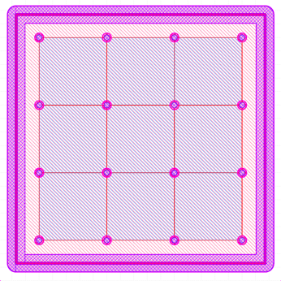
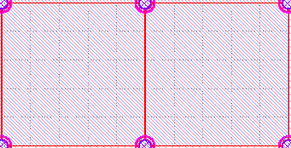
Example: square pixel, 500-micron pitch
DC-RSD pixel sensor
A particle hits the detector
The signal is shared among the 4 electrodes

Slide 22
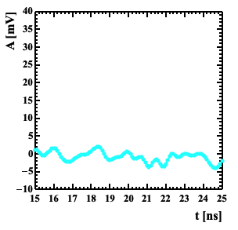
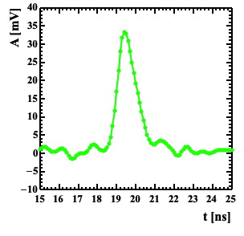
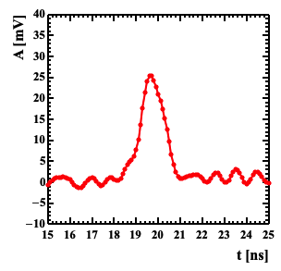
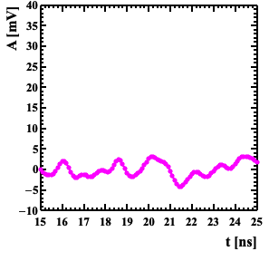
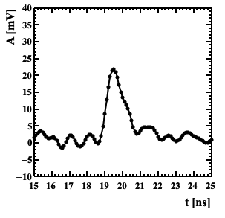
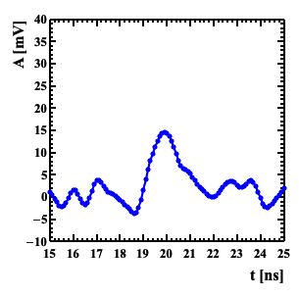
Signal shape: square pixel, 500-micron pitch
The picture shows the amplitude recorded by 6 electrodes,
  4 in the hit pixel
  2 in the adjacent pixel.
The signal is fast, same shape of a standard LGAD.
Perfect isolation: the signal is seen only in the electrodes belonging to the hit pixel.

Slide 23
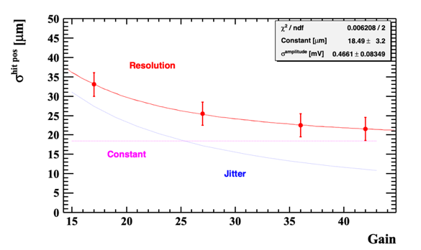
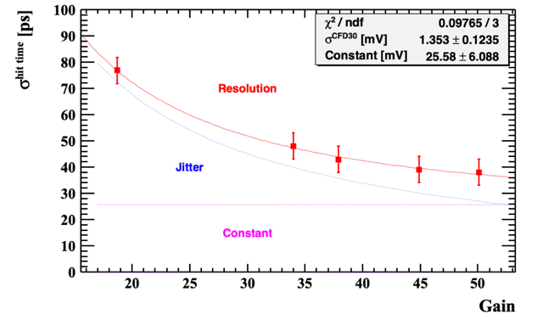
Spatial and temporal resolution, 500-micron pitch
RSDs achieve a spatial resolution of about 5% of the pitch,
and 30-40 ps temporal resolution

Slide 24
Standard vs RSD tracker
Pixel size
~ 25 x 25 μm²
Pixel size
~ 250 x 250 μm²
Electronics
~ 150 μm
Contacts
~ 50 μm
--
---
- --
+
++
+++
Resistive implant
Silicon bulk
Gain implant
Standard Tracker
RSD-based tracker
An RSD-based tracker has a factor of 100 less electrodes, provides the same spatial resolution and in addition has excellent temporal resolution

Slide 25
Standard vs RSD tracker
Pixel size
~ 25 x 25 μm²
Pixel size
~ 250 x 250 μm²
Electronics
~ 150 μm
Contacts
~ 50 μm
--
---
- --
+
++
+++
Resistive implant
Silicon bulk
Gain implant
Standard Tracker
RSD-based tracker
An RSD-based tracker has a factor of 100 less electrodes, provides the same spatial resolution and in addition has excellent temporal resolution
Several experiments are presently considering building an RSD-based tracker

Slide 26
Silicon sensors: a very intense R&D
Hybrid
Monolithic
ASIC
Sensor
Sensor
ASIC
Low-gain (LGADs)
No gain
Low-gain (LGADs)
No gain
Standard
Resistive
Planar
3D
Si/Diamond
BiCMOS
(SiGe)
BiCMOS
(SiGe)
CMOS

Slide 27
Silicon sensors: a very intense R&D
Sensors for 4D tracking
Hybrid
Monolithic
ASIC
Sensor
Sensor
ASIC
Low-gain (LGADs)
No gain
Low-gain (LGADs)
No gain
Standard
Resistive
Planar
3D
Si/Diamond
BiCMOS
(SiGe)
BiCMOS
(SiGe)
CMOS

Slide 28
Tracking in 4-dimensions: a very rich field
The present R&Ds in position-sensitive timing detectors is very diverse
Hybrid
ASIC
Sensor
Presented so far
Low-gain (LGADs)
Standard
Resistive

Slide 29
Tracking in 4-dimensions: a very rich field
The present R&Ds in position-sensitive timing detectors is very diverse
Hybrid
ASIC
Sensor
No gain
3D
Si/Diamond

Slide 30
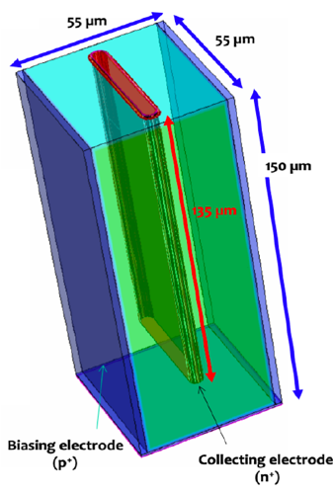
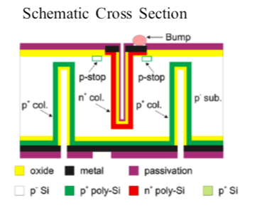
4D tracking at extreme fluence
3D sensors use vertical electrodes to achive very high radiation resistance
Hybrid
ASIC
Sensor
Two possible options:
Column
Trenches
The amount of charge is
controlled by the sensor
thickness (~1-2 fC)
Both requires small pixels to achieve good temporal precision
==> very good position resolution
No gain
3D
Si/Diamond

Slide 31
4D tracking using monolithic sensors
Monolithic
Sensor
ASIC
Low-gain (LGADs)
No gain
BiCMOS
(SiGe)
BiCMOS
(SiGe)
CMOS

Slide 32
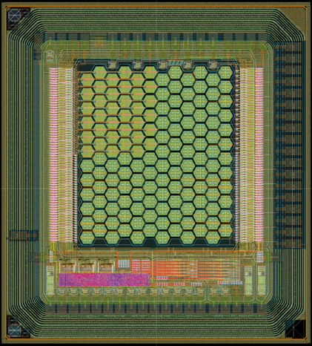
4D tracking using monolithic sensors
In this research path the best resolution has been obtained by using a SiGe front end and small exhagonal pixels (65 microns).
.
Monolithic
Sensor
ASIC
Low-gain (LGADs)
No gain
BiCMOS
(SiGe)
BiCMOS
(SiGe)
CMOS

Slide 33
4D tracking using monolithic sensors
In this research path the best resolution has been obtained by using a SiGe front end and small exhagonal pixels (65 microns).
.
Monolithic
Sensor
ASIC
Low-gain (LGADs)
No gain
BiCMOS
(SiGe)
BiCMOS
(SiGe)
CMOS
Studies have shown excellent results for prototypes with and without gains

Slide 34
Electronics: What is the best pre-amp choice?
Energy deposition in a 50 mm sensor
Current Amplifier
Fast slew rate
Higher noise
Sensitive to Landau bumps
Current signal in a 50 mm sensor
Charge Sensitive Amplifier
Slower slew rate
Quieter
Integration helps the signal smoothing

Slide 35
Read-out chips for LGADs
In the past 3-4 years, the ATLAS and CMS collaborations poured a considerable amount of resources into designing the read-out chips for their respective timing layers.
ATLAS: ALTIROC, TSMC 130 nm, 15x15 pads,
CMS: ETROC, CMOS 65 nm, 16x16 pads
For both: input load about 4 pF, jitter ~ 20ps at 10fC of input charge
Power:
ALTIROC ~ 3.5 mW/ch, 2-300 mW/cm²
ETROC~ 3 mW/ch
As a comparison, the RD53 readout chip for pixel detectors for tracking (i.e. no timing) at the HL-LHC with 50 x 50 um2 and 25 x 100 um² feature sizes is estimated to have a power density of about 1 W / cm²
A timing layer with large pixels needs less power than a layer of small traditional pixels

Slide 36
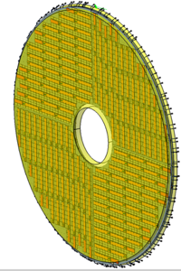
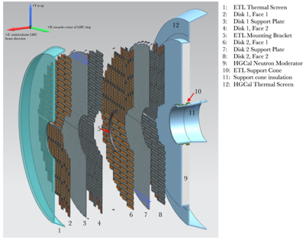
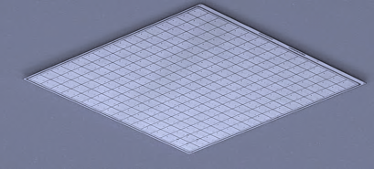
Present status of ATLAS-CMS timing layer
LGADs are available from many vendors: HPK, FBK, CNM, BNL
and several more are coming on line: Micron, NDL (China), IHEP (China)
ATLAS and CMS are planning to use ~ 20-30 m²
➔ Mature technology
Installation: 2026-2027
CMS: 2 layers, covering the full endcap 1.6 < eta < 3
ATLAS: 2 ½ - 3 layers, covering high rapidity 2.5 < eta < 4
CMS: 7 m² of sensors on each side
2.1 cm
HPK2
16x16 array

Slide 37
Wrap-up
4D tracking is a very young booming field, hybrid and monolithic approaches are yielding very good results
The paste of innovation is very fast (especially considering that silicon sensors is a very mature field)
Several demonstrators with temporal precision of about 30 ps are available. Not unreasonable to expect 10-15 ps in the next few years.
In my view, the most difficult part is in the design of the electronics.
Temporal resolution degrades very quickly if the whole system is not “perfect”
It is very difficult to combine very good position precision, <5 μm, with good temporal resolution using the “single-pixel design”. Charge sharing might be the key to solve this problem.

Slide 38
Wrap-up
4D tracking is a very young booming field, hybrid and monolithic approaches are yielding very good results
The paste of innovation is very fast (especially considering that silicon sensors is a very mature field)
Several demonstrators with temporal precision of about 30 ps are available. Not unreasonable to expect 10-15 ps in the next few years.
In my view, the most difficult part is in the design of the electronics.
Temporal resolution degrades very quickly if the whole system is not “perfect”
It is very difficult to combine very good position precision, <5 μm, with good temporal resolution using the “single-pixel design”. Charge sharing might be the key to solve this problem.
Thank you for your attention

Slide 39
Backup

Slide 40
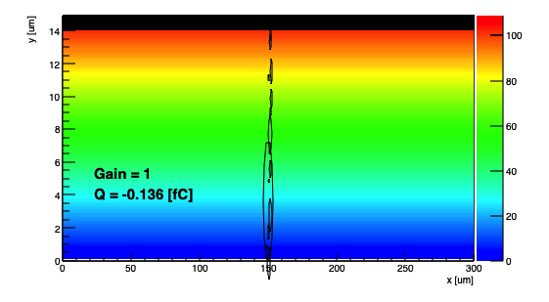
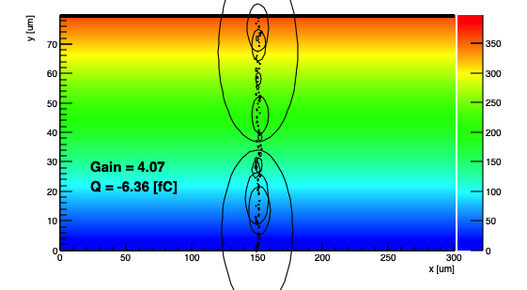
Intrinsic LGAD time resolution
Why do LGADs have an “intrinsic” time resolution?
Because the signal changes shape on an event-to-event basis
due to non-uniform energy deposition along the particle path
WF2 Simulated energy deposits
15-micron thick sensor
80-micron thick sensor
Large energy deposits are more likely in thicker sensors
The temporal resolution is degraded if one energy deposit is much larger than the average.
Thick sensors have worse temporal resolution because it is more likely that at least one energy deposit is much larger (local Landau fluctuation in the energy deposition)

Slide 41
Resistive Silicon Detector
(RSD, AC-LGAD, DC-RSD)
n⁺
Gain implant
30-50 μm
^{p++}
p-bulk
Resistive Silicon Detectors
combine low-gain and resistive read-out

Slide 42
Tracking in 4 Dimension
The introduction of timing allows separating collisions that happen in the same location

Slide 43
Why gain improves the temporal resolution?
Time is set when the signal crosses the comparator threshold
The timing capabilities are determined by the characteristics of the signal at the output of the pre-Amplifier:
Larger Signal/noise ==> better timing

Slide 44
Irradiation effects
Irradiation causes 3 main effects:
Decrease of charge collection efficiency due to trapping
Doping creation/removal
Increased leakage current, shot noise
The main effect in LGAD is “acceptor removal”, i.e., the reduction of the gain implant doping
The electric field due to the gain implant decreases ➔ Compensated with higher bias
Main technique to decrease acceptor removal: carbon implantation in the gain layer
Carbon spoils the properties of silicon sensors.
However, in the right amount and only on the gain implant, it increases the sensor rad. resistance by a factor of 3
carbon implantation

Slide 45
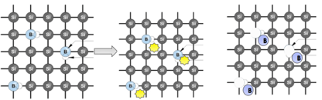
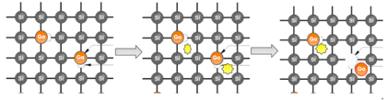
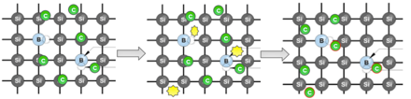
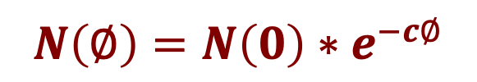
Acceptor removal
Unfortunate fact: irradiation de-activate p-doping removing Boron from the reticle
$$N\left(∅\right)=N\left(0\right)∗e^{−c∅}$$
Boron
Radiation creates Si interstitial that inactivate the Boron:
Si_i + B_s ➔ Si_s + B_i
Two possible solutions: 1) use Gallium, 2) Add Carbon
Gallium is substitutional
From literature, Gallium has a lower possibility to become interstitial
Carbon is substitutional
Interstitial Si interact with Carbon instead of with Boron and Gallium

Slide 46
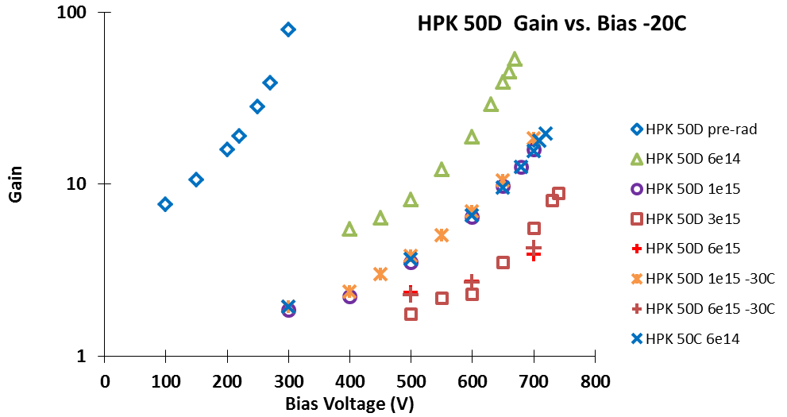
Effect of acceptor removal
Acceptor removal,
Gain layer deactivation
To some extent, the gain layer disappearance might be compensated by increasing the bias voltage

Slide 47
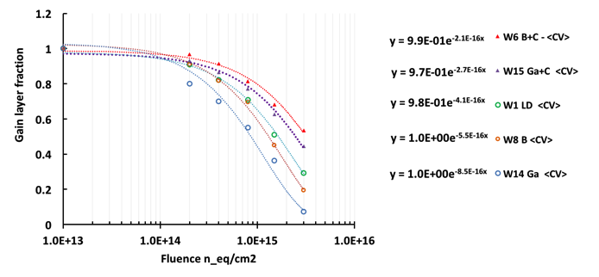
Impurity engineering of radiation resistance
more radiation resistance: B+C
less radiation resistance
Carbon addition works really well, increasing by a factor of 2-3 the radiation hardness
Gallium is actually is not more rad-hard than Boron

Slide 48
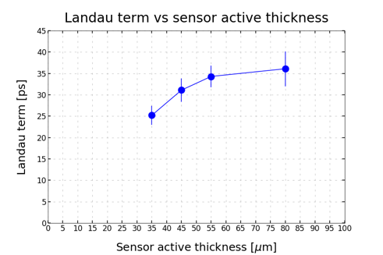
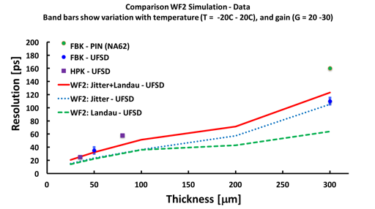
UFSD temporal resolution in thinner sensors
UFSD temporal resolution improves in thinner sensors:
==> reasonable to expect 10-20 ps for 10-20 μm thick sensors.
Be aware: very difficult to do timing with small signals… power consumption increases
Non uniform ionization:
Physical limit of UFSD sensors
FBK UFSD32 production

Slide 49
RSD spatial resolution
RSDs at gain = 30 achieve a spatial resolution of about 2-3% of the pitch size:
RSD:
1300 x 1300 mm²: σ_{x} ~ 40 μm
450 x 450 mm²: σ_{x} ~ 15 μm
Traditional standard pixel
1300 x 1300 mm²: σ_{x} ~ 920 μm
450 x 450 mm²: σ_{x} ~ 320 μm
gain = 30

Slide 50
RSD temporal resolution
The resolution depends mostly upon the signal size and weakly on the pixel size
RSDs at gain = 30 achieve a temporal jitter of about 20 ps
gain = 30

Slide 51
Why low gain? Shot noise in LGAD - APD
n++ electrode
I_{ds}
I_{dg}
I_{L}
+
-
+
-
gain layer p+
+
-
Bulk Leakage current
Signal current
Surface current
+
-
p++ electrode
Correction factor to the standard Shot noise,
due to the noise of the multiplication mechanism
k = e/h ionization rate
x = excess noise index
M = gain

