Slide 1
News and
Dates.
FC @ DESY Meeting
Benno List
19.9.2025

Slide 2


Dates
LCWS 2025, Oct 20-24, 2025, Valencia
https://agenda.linearcollider.org/event/10594/
FCC-ee workshop on vertex detector R&D, Pisa, Oct 30-31, 2025, https://agenda.infn.it/event/47923/
FCC-ee workshop on TDAQ, CERN, Nov 6, 2025, https://indico.cern.ch/event/1583755/
FCC-ee kick-off workshop on Flavours, CERN, Nov 19-21, 2025, https://indico.cern.ch/event/1588013/
FCC Physics Workshop, Munich/Garching, Jan 26-3, 2026
https://indico.cern.ch/event/1588696/
FCC Week 2026, June 8-12, 2026, Helsinki
KET annual meeting, Nov 20-21, 2025, Bad Honnef
next FC@DESY meetings: Oct 17, Nov 14

Slide 3
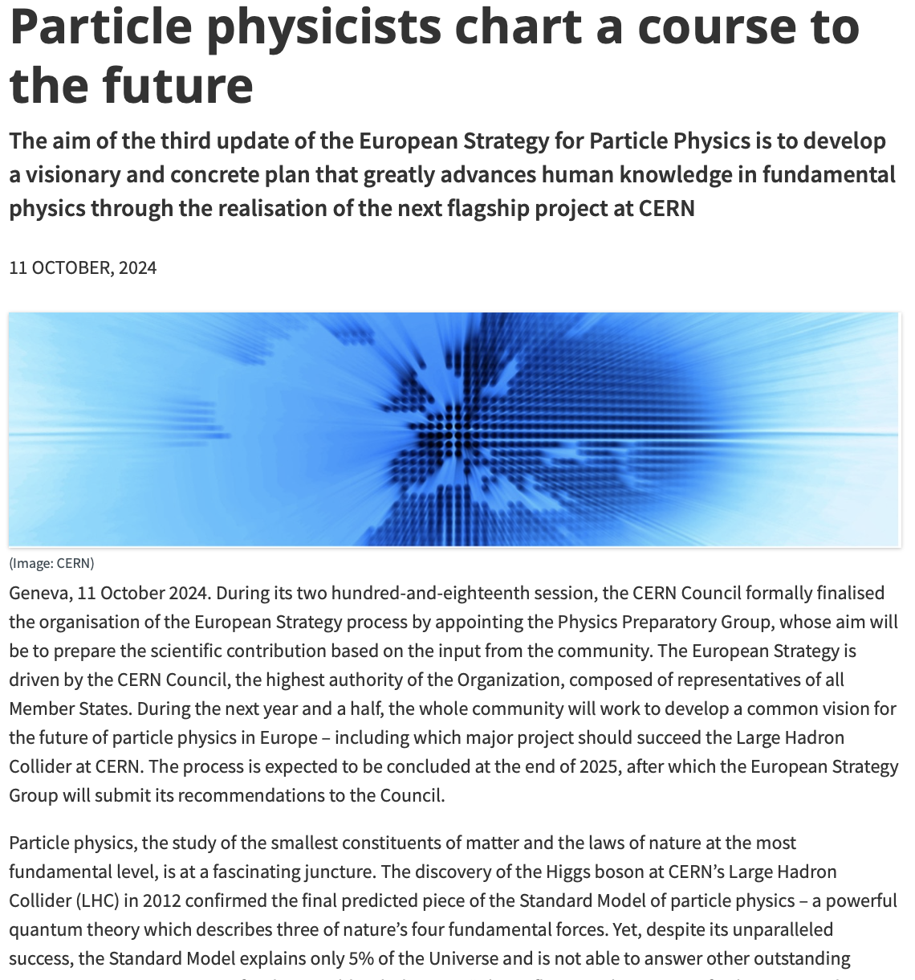
European Strategy Update 2026
Strategy group and physics preparatory group members announced
Physics Briefing Book in final editing stage, representatives of projects have received drafts for (urgent) comments, deadline Sep 22
-> publication: Sep 30
Strategy Working Groups taking over now
WG2a (Project Comparisons) reviewing all large project proposals for CERN
  Sent out questionnaires to projects
  Will make first results public by Oct 17
Last deadline for update of national inputs: Nov 14
  No plans for an update of German input (KET meeting Nov 20-21)
https://home.cern/news/press-release/physics/particle-physicists-chart-course-future

Slide 4
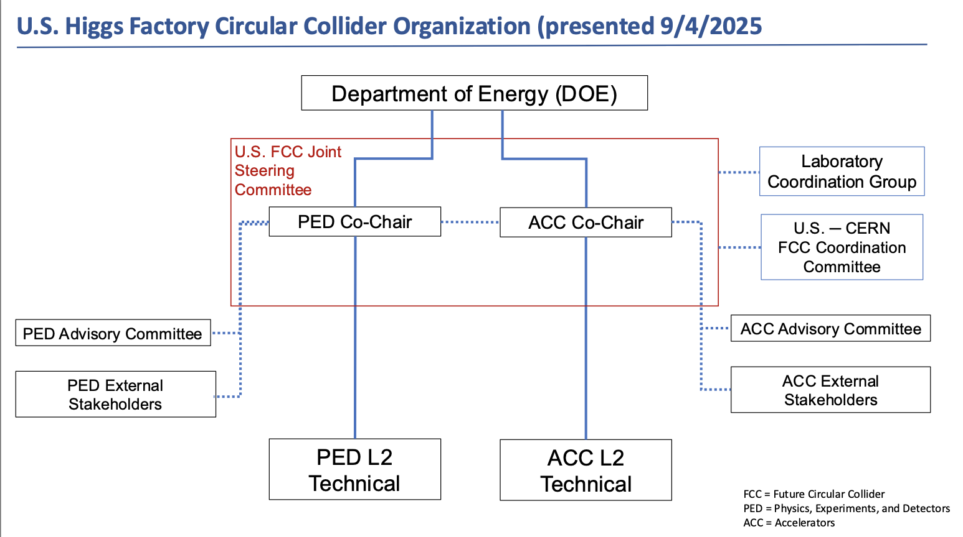
US Higgs Factory Circular Collider Organization
US Higgs Factory Coordination Consortium (HFCC) has been renamed to
US Higgs Factory Circular Collider Organzation
Follows a decision of DOE to fund only studies related to FCC
https://indico.global/event/14674/

