Slide 1
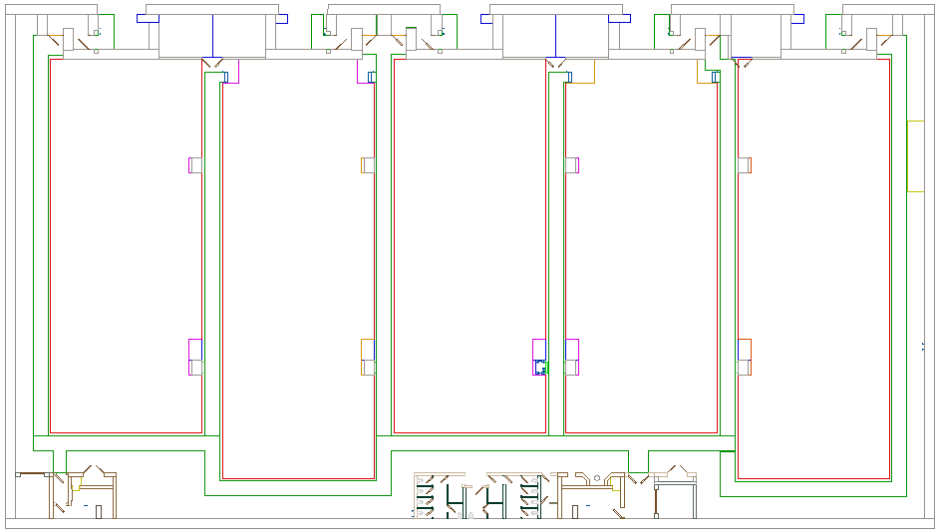
Conceptual floor plan for SASE 2 instruments
(work in progress)
HED
elec.
HED
ctrl
Crane
Area
~4 x 7 m²
HED
experiments
MID elec.
MID
ctrl
HED optics
MID
experiments
MID
optics
NNN
ctrl.
&
elec.
NNN
experiments
Optical laser
(~10x18 m²)
Some numbers (boxes 1x1 m²)
Total SASE 2 floor space: ~43x15 m² (2 x 1.4 m separation of incoming x-ray beams)
Control: ~18m², Electronics: 4x2 m2, optics: beam 50 cm from wall, 0.1 m x-ray wall thickness)

