Slide 1
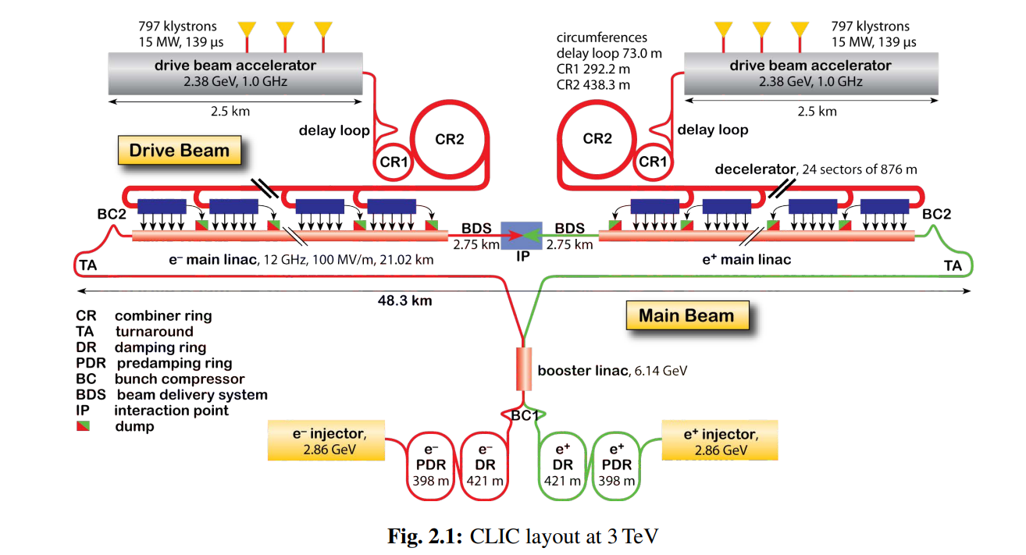
CLIC accelerator complex (2012)

Slide 2
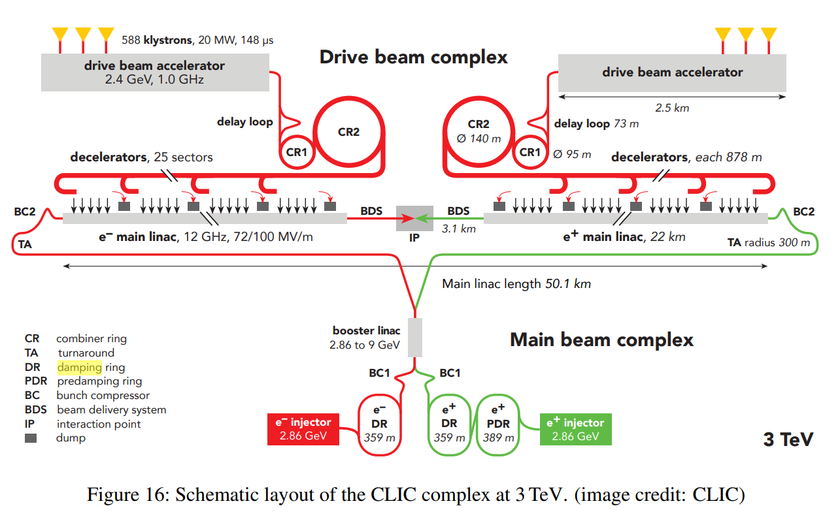
CLIC accelerator complex (2018)

Slide 3
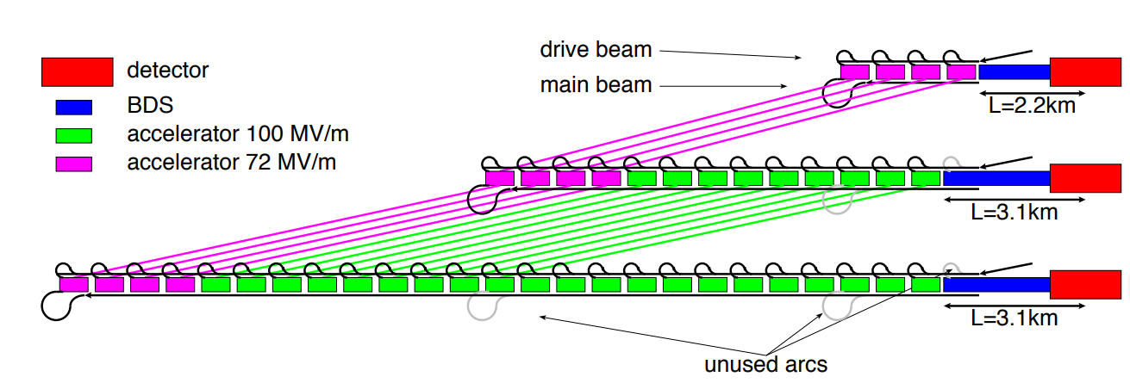
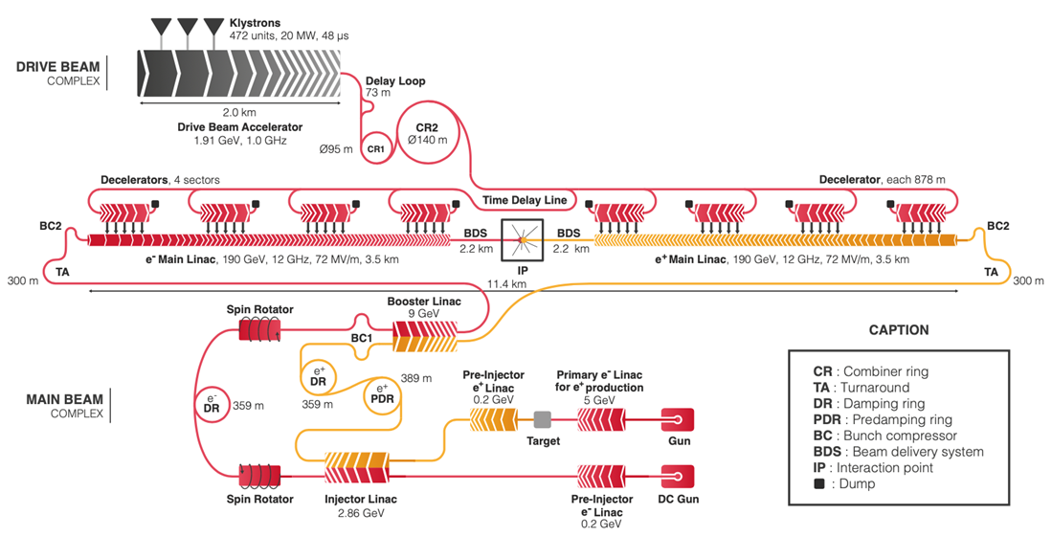
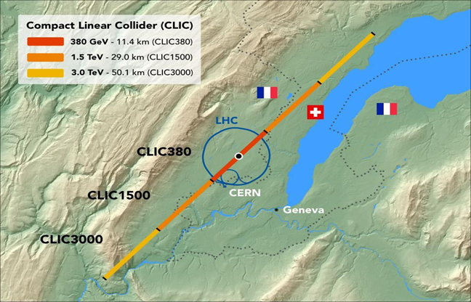
CLIC accelerator complex (380GeV)

Slide 4
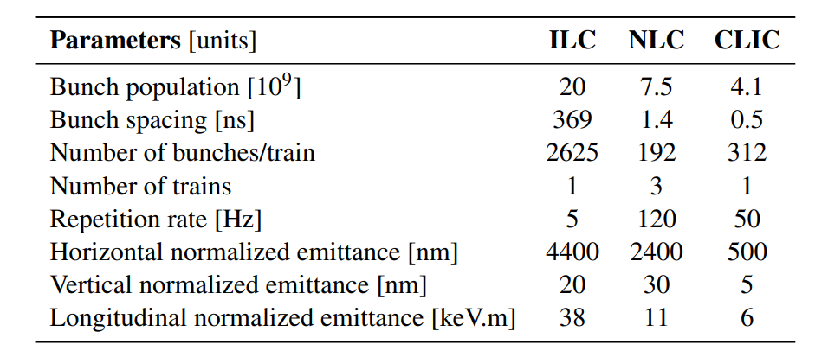
CLIC versus ILC and NLC parameters driving the damping ring design
Creation of ultra-low emittance beams

Slide 5
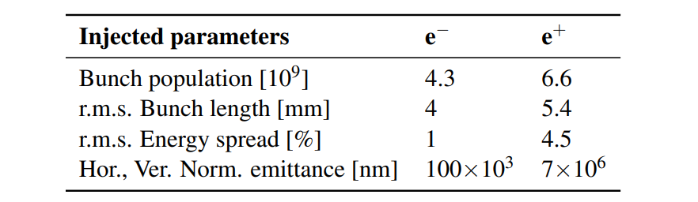
Beam parameters at the exit of the low energy linac and before injection to the pre-damping rings

Slide 6
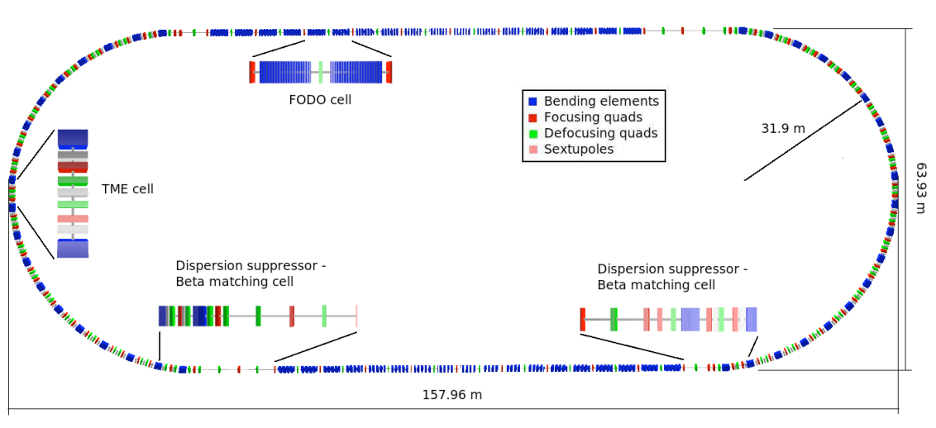
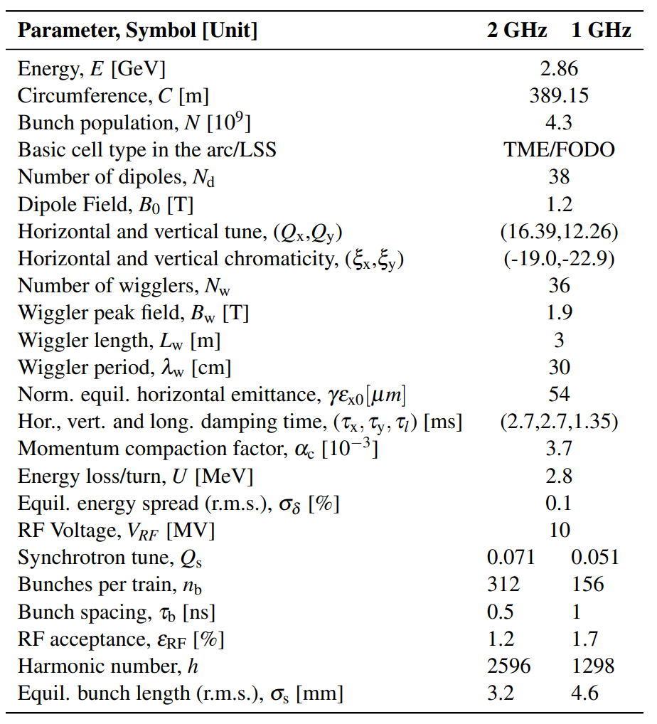
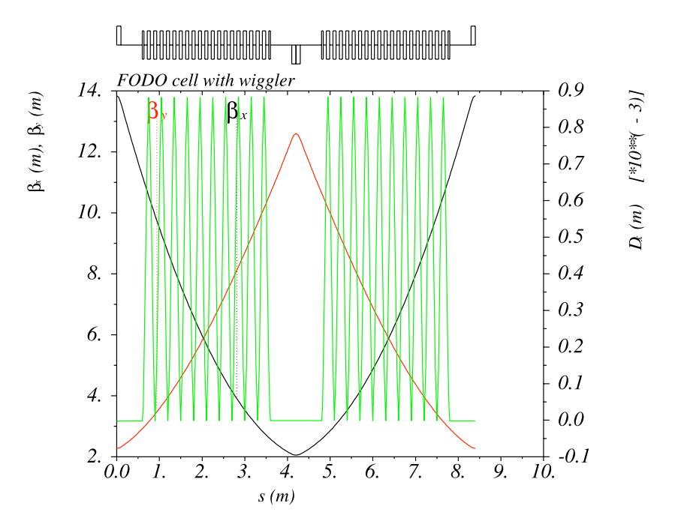
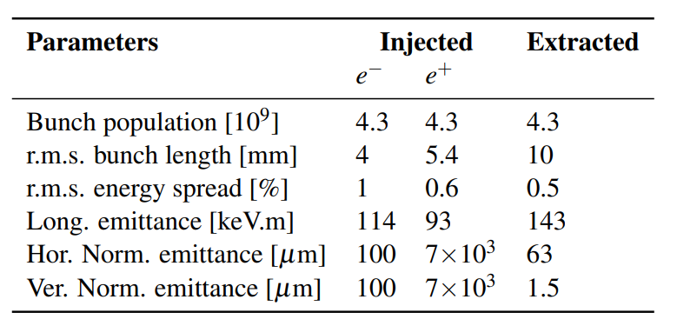
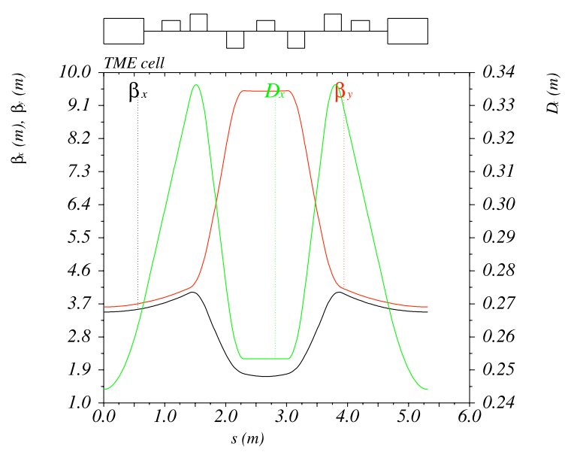
CLIC pre-damping ring
Wiggler FODO cell
TME arc cell

Slide 7
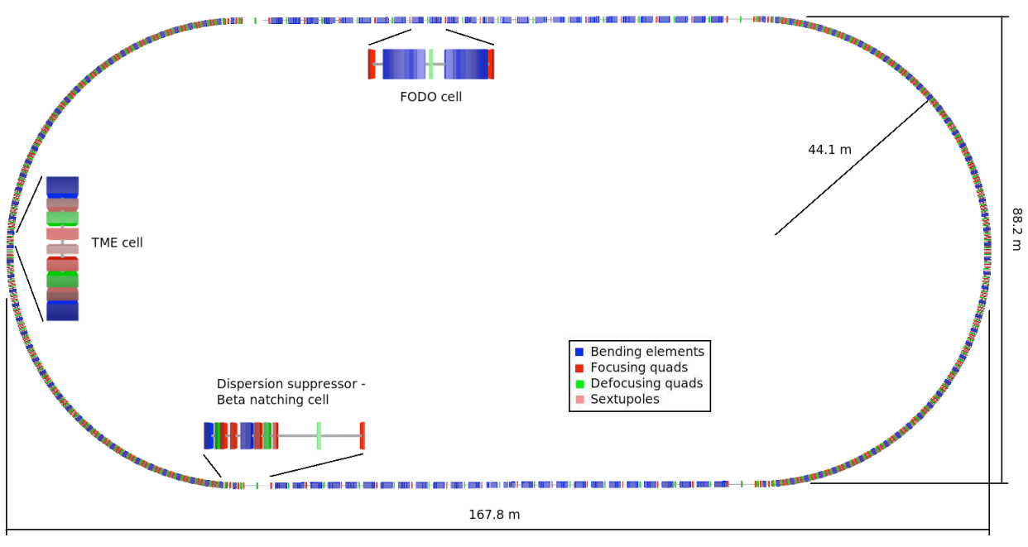
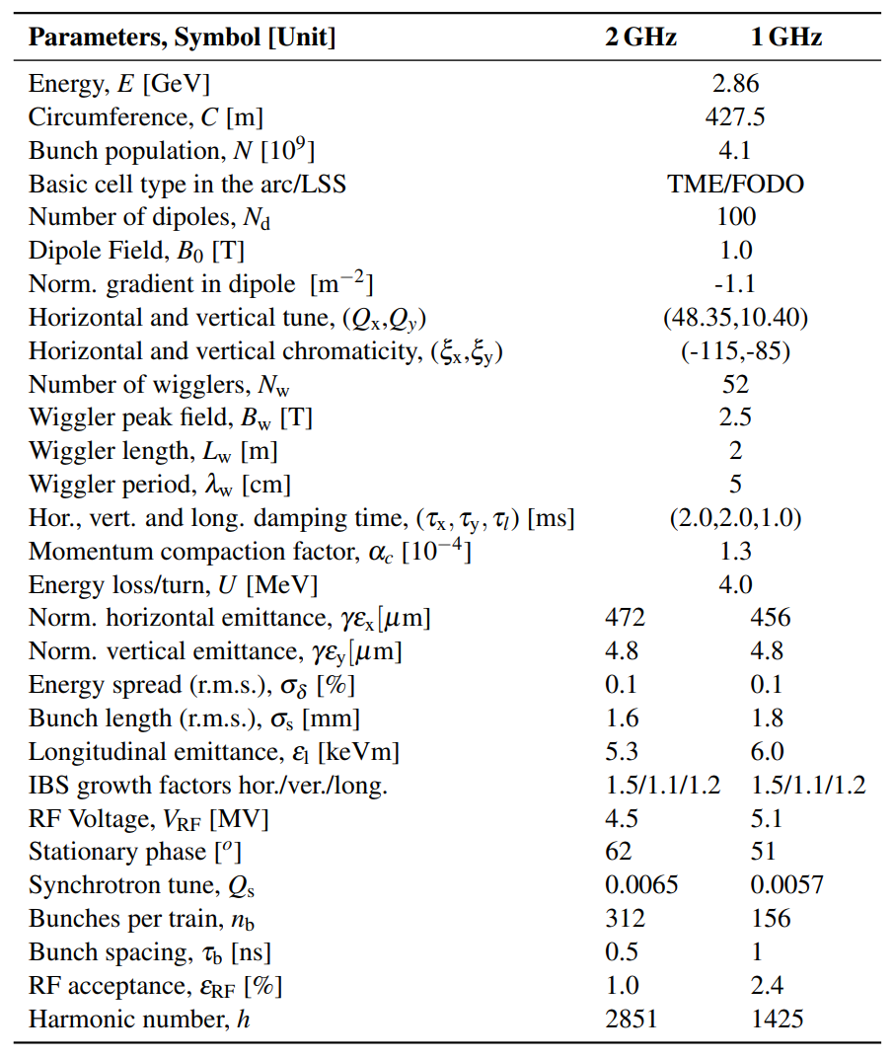
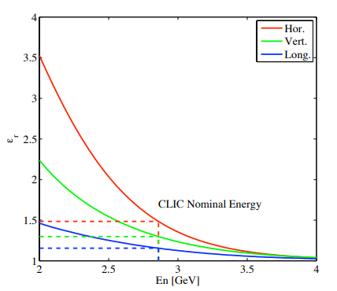
CLIC main damping ring
IBS growth factor
[nm]
[nm]
Challenges
Intra-beam Scattering (IBS)
Space-Charge(SC)
Coherent Synchrotron Radiation (CSR)
Transverse Mode Coupling Instabilities (TMCI)
Ion/electron cloud instability
Special TME with def. dipoles

Slide 8
Requirement for HALHF positron damping rings?
 | Injected | Extracted
Bunch population (10¹⁰) | 3
Number of bunches/train | 160
Bunch spacing (ns) | 16? | 16?
Repetition rate (Hz) | 100
Horizontal norm. emittance (um)
Vertical norm. emittance (um)
Bunch length (mm)
Energy spread (%)

