Slide 1
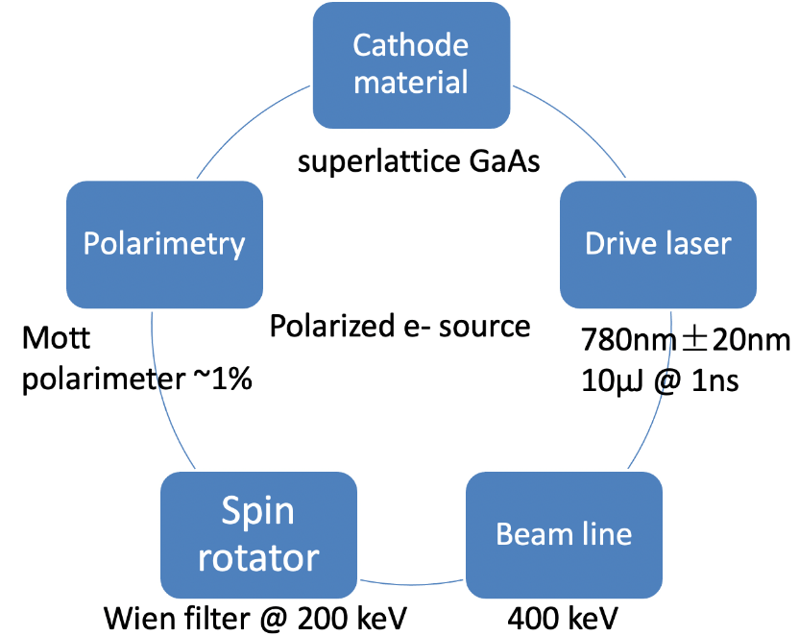
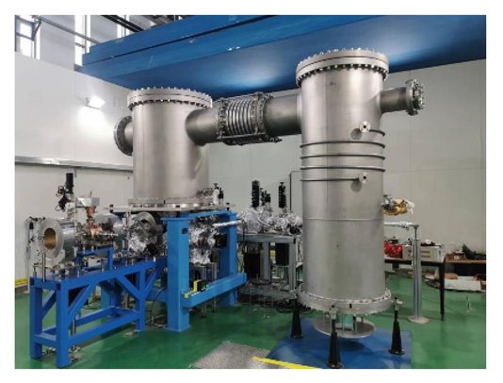
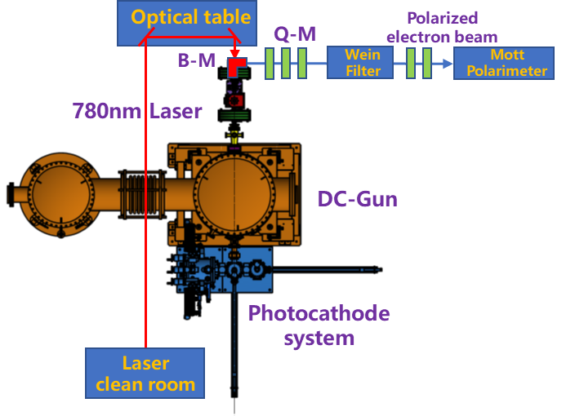
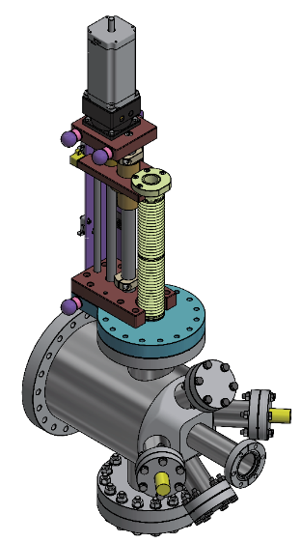
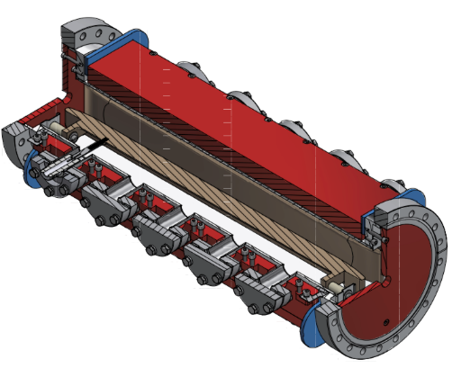
Polarized electron source R&D @IHEP
Polarized electron source R&D for CEPC at IHEP
Research goals: Generation of electron beams with high bunch charge (≥1nC) and high polarization (≥85%)
Based on a photocathode DC gun already developed by IHEP with an extremely high vacuum (10⁻¹⁰Pa)
Beam line setup and design of key components such as Wien filter and Mott polarimeter has been carried out
Expect beam commissioning scheduled in 2027
Wien filter
Mott polarimeter
A photocathode DC gun @IHEP
Scheme of PES R&D based on DC gun

Slide 2
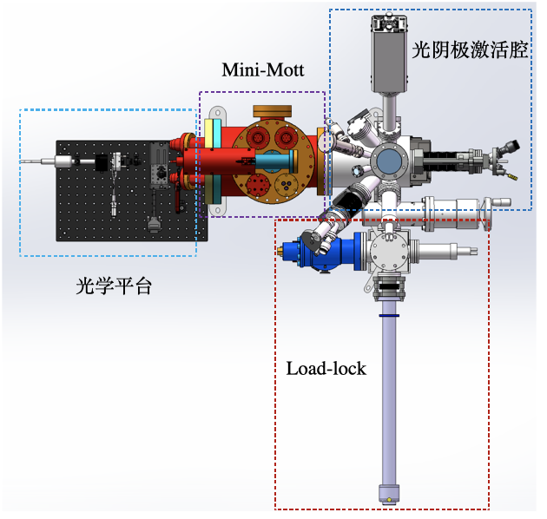
Polarized electron source R&D @IHEP
Domestic R&D on the superlattice GaAs cathode
Since the beginning of this year, we have been starting the R&D of the most important part for PES: Photocathodes
In collaboration with a domestic company Acken Optoelectronics Ltd. @ Suzhou
Superlattice GaAs photocathode will be produced by MBE: Polarization > 85%, QE > 1%
Build a platform for photocathode performance test (both pol & QE), this platform has been designed and is currently under development
The first photocathodes have been produced and will be tested soon
GaAs | 5 nm | p=5×10¹⁹ cm⁻³
GaAs/GaAsP SL | (4/3 nm) ×14 | p=5×10¹⁷ cm⁻³
GaAsP_{0.35} | 2750 nm | p=5×10¹⁸ cm⁻³
Graded GaAsP_{x} (x = 0~0.35) | 5000 nm | p=5×10¹⁸ cm⁻³
GaAs buffer | 200 nm | p=2×10¹⁸ cm⁻³
p-GaAs substrate (p>10¹⁸ cm⁻³)
Structure of Superlattice layers
Platform for cathode test: ESP & QE
Samples of superlattice GaAs/GaAsP

