Slide 1
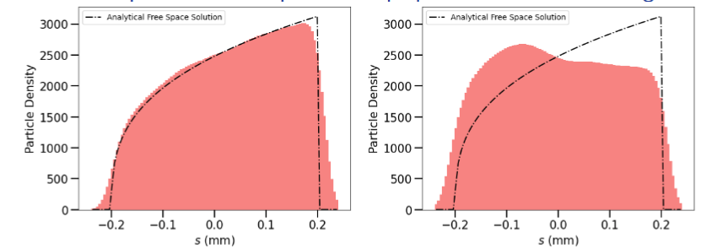
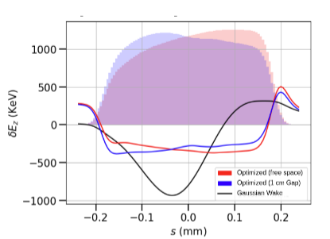
C7 Update- October 2025
Progress/ Immediate plans in SWFA linac design:
Scaled existing X-band structures
May need to operate in K-band or Ka-band for 1 GW peak power extraction and >300 MV/m geometrical acceleration gradient (based on AWA drive beam parameters)=> small beam aperture
Understand available drive beam parameters to the SWFA arm
Wakefield studies, tolerance studies, lattice simulations (synergy with SWFA design for 10 TeV)
Potential synergy with plasma linac design:
Dipoles, especially in later stages, may induce significant emittance growth
Understanding of coherent synchrotron radiation in complex beams (e.g. longitudinal shaped beams, flat beams out of damping rings) with shielding effects (code being developed by Dr. Omkar Ramachandran)
e.g. bunch shape optimization to balance wakefield excitation and CSR mitigation
Left: Free space, optimized profile agrees with free-space analytical solution
Middle: 1 cm shielding gap in the dipole chamber; optimized profile differs from free-space analytical solution
Right: On-axis energy change from CSR in Gaussian and optimized bunches

