Slide 1

Differentiable Physics-Based Feedback for Adaptive Laser Pulse Shaping
8th Round table on Deep Learning @ DESY
Denis Ilia^{1,2}, Ingmar Hartl¹, Christoph Mahnke¹, Federico Pressacco¹, Henrik Tünnermann¹
¹ Deutsches Elektronen-Synchrotron, Notkestrasse 85, Hamburg, Germany
² Universität Hamburg, Luruper Chaussee 149, Hamburg, Germany
Desy, Hamburg, 14/11/2025

Slide 2
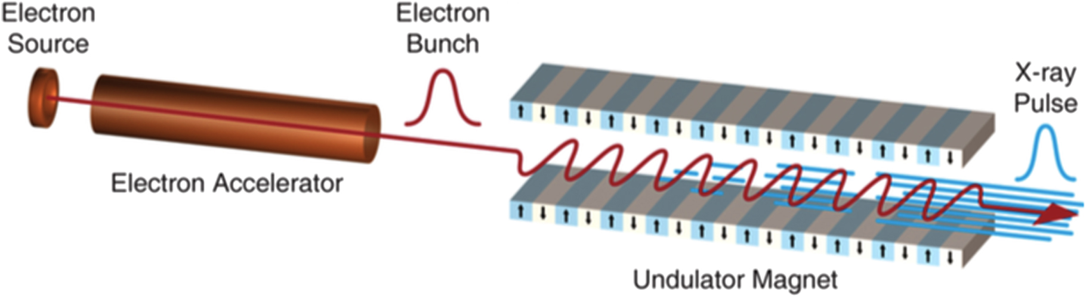

Expanding EuXFEL capabilities for new science
Laser pulse shaping for improved electron beam quality
EuXFEL mid\long term goals:
Higher photon energies > 25keV
Higher duty cycle (20% lower gun gradient)
Both require reduced emittance, which can be achieved by linearizing space charge forces through laser pulse shaping
UV Laser pulses
Photocathode
Electron bunches
$${\vec{E}}_{rf}=60 MV/m$$
Space-charge forces
Pellegrini, C., in Physica Scripta. T169. 014004. (2016)

Slide 3
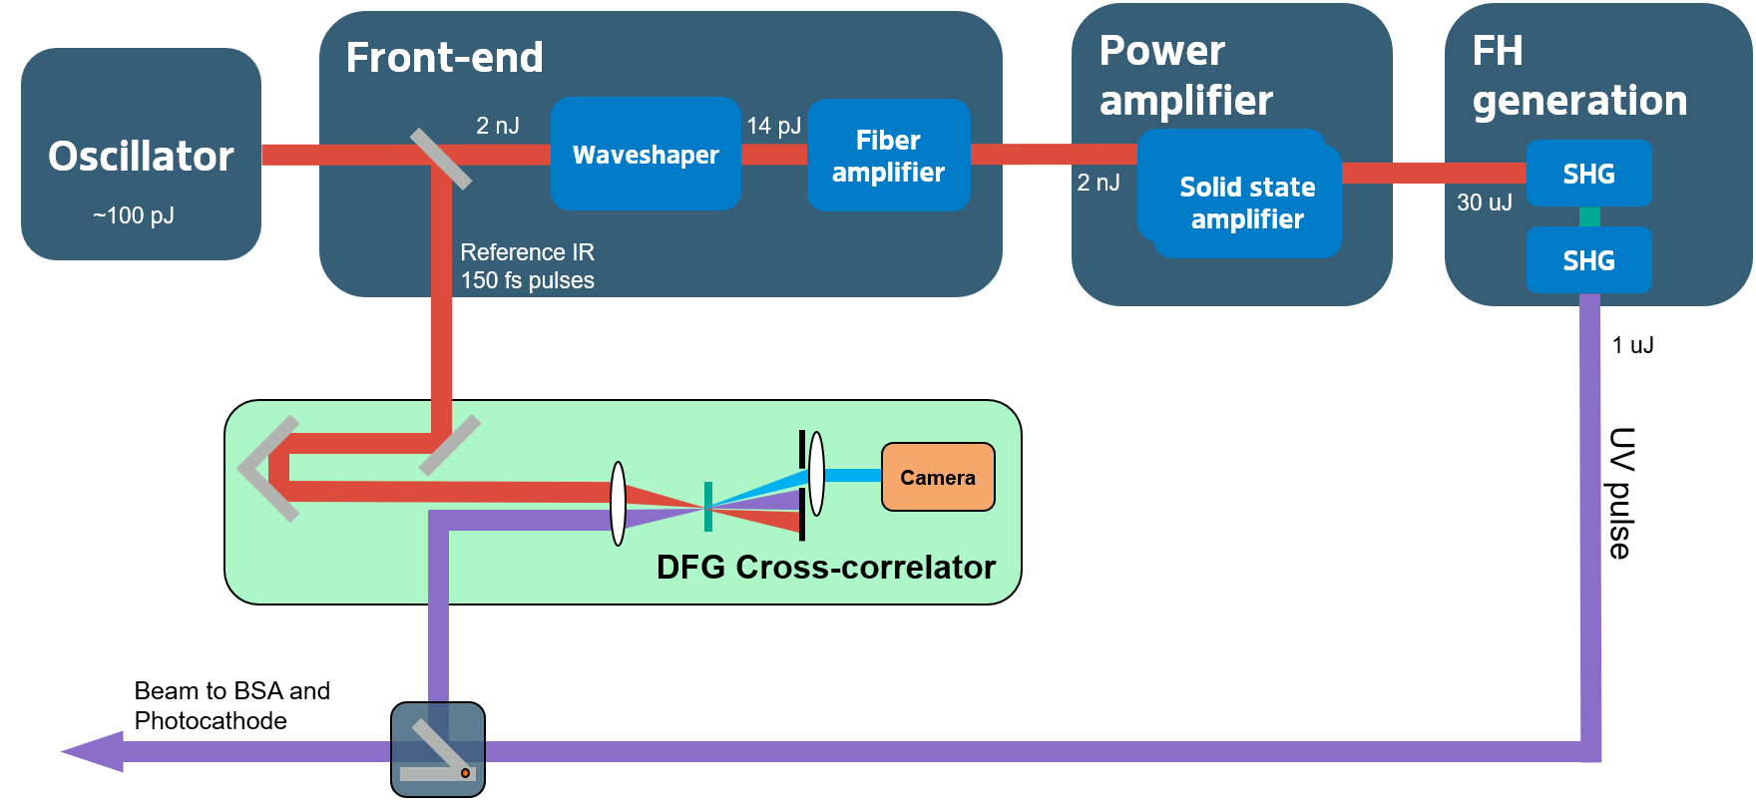


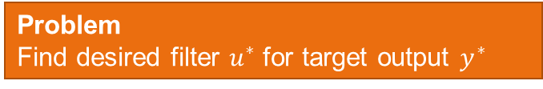
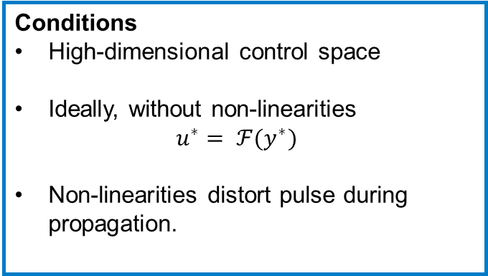
Temporal pulse shaping is challenging
NEPAL laser system
Spectral attenuation and phase control
Problem Find desired filter $u^{∗}$ for target output $y^{∗}$
Conditions
High-dimensional control space
Ideally, without non-linearities $u^{∗}= ℱ(y^{∗})$
Non-linearities distort pulse during propagation.
Approach
Physics-based differentiable model

Slide 4
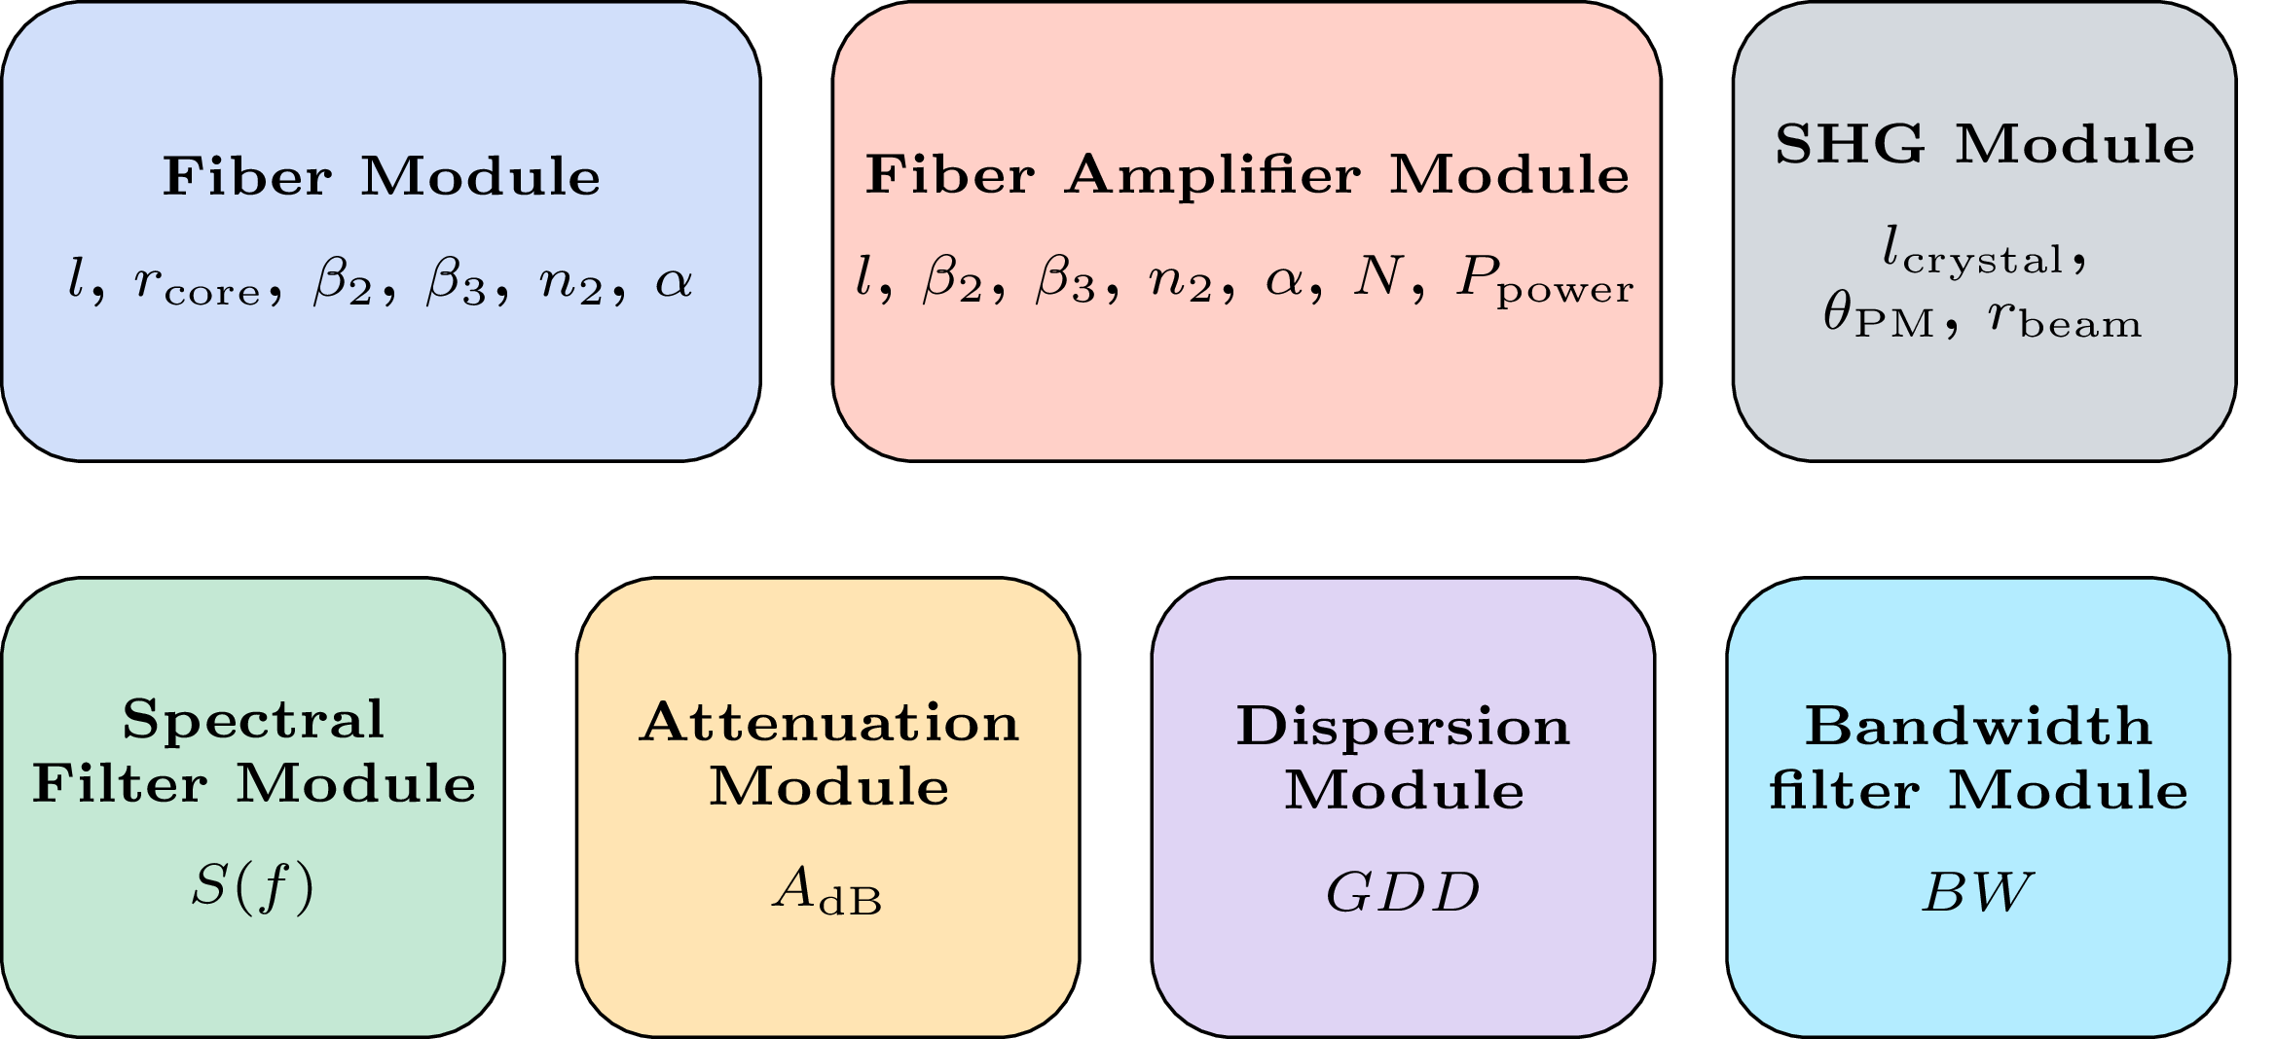
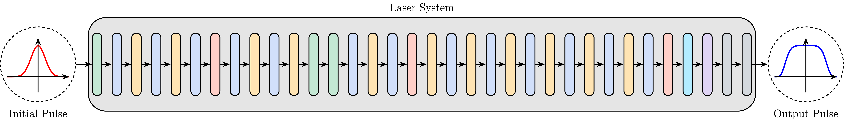
Physics-based differentiable model
A framework for ultrafast pulse propagation in fibers and laser systems
7 physics-based modules:
NLSE for pulse propagation (1D)
Coupled eqs. for SHG process (2D)
Rate equations for steady-state fiber amplifier
Implemented in PyTorch:
Fully differentiable
GPU accelerated
Fewer parameters than Neural Network models, but Split-step Fourier Method solver on large grids requires substantial memory.

Slide 5


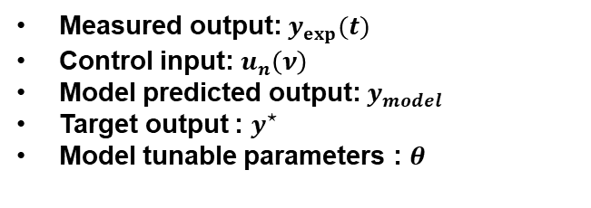




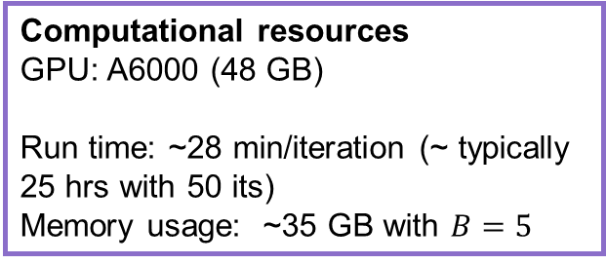
A gradient-based feedback method
From optimizing models to real-systems
Computational resources
GPU: A6000 (48 GB)
Run time: ~28 min/iteration (~ typically 25 hrs with 50 its)
Memory usage: ~35 GB with $B=5$
Measured output: $y_{exp}(t)$
Control input: $u_{n}\left(ν\right)$
Model predicted output: $y_{model}$
Target output : $y^{⋆}$
Model tunable parameters : $θ$
Sliding window with last B measurements
$$∇_{u}\left({\left\|y_{model}−y^{⋆}\right\|}_{2}^{2}+λR(u) \right)$$
Differentiable laser model
Real
Laser system
$$y_{n }^{exp}(t)$$
System Identification
Control optimization
$$u_{n}\left(ν\right)$$
$$u_{n}\left(ν\right)$$
$$\left(\begin{matrix}u_{n−4} \\ ⋮ \\ u_{n}\end{matrix} \begin{matrix}y_{n−4}^{exp} \\ ⋮ \\ y_{n}^{exp}\end{matrix}\right)$$
$$∇_{θ}\left({\left\|y_{exp}−y_{model}\right\|}_{2}^{2}\right)$$

Slide 6
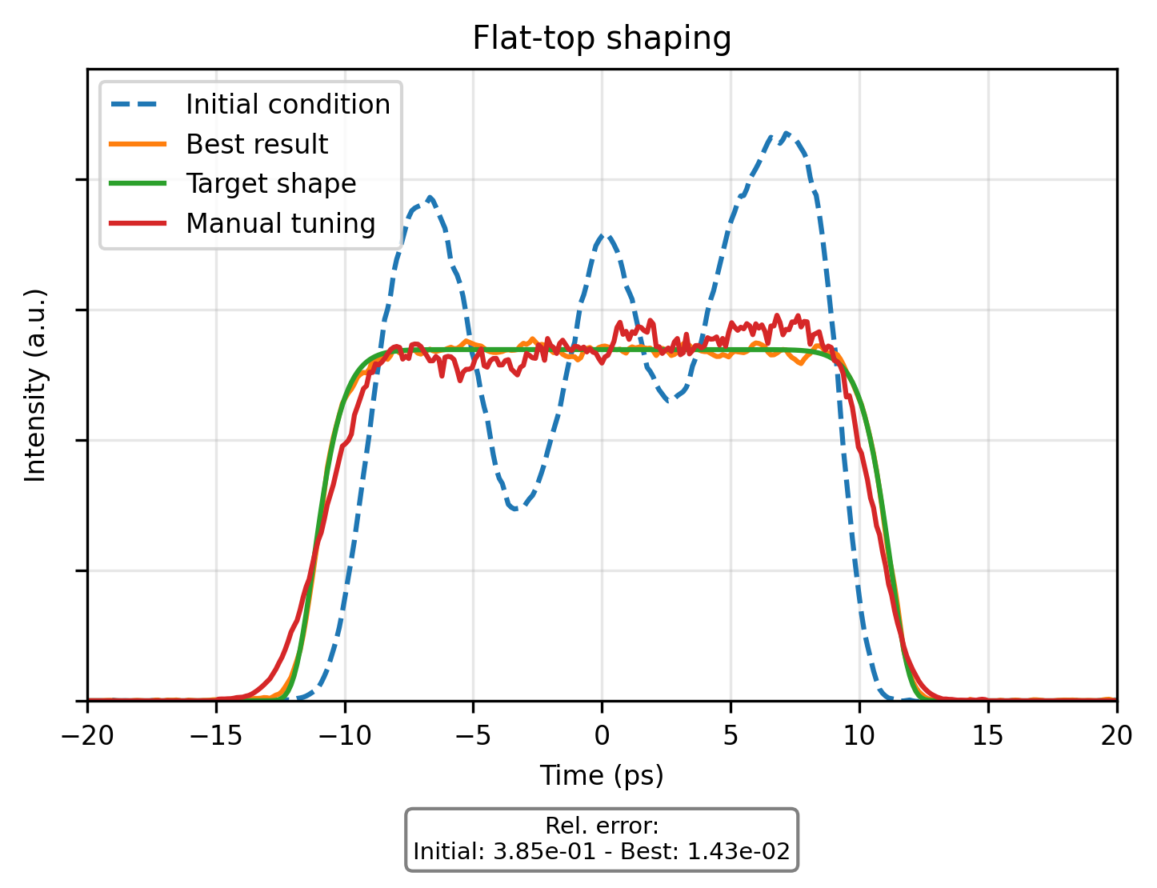
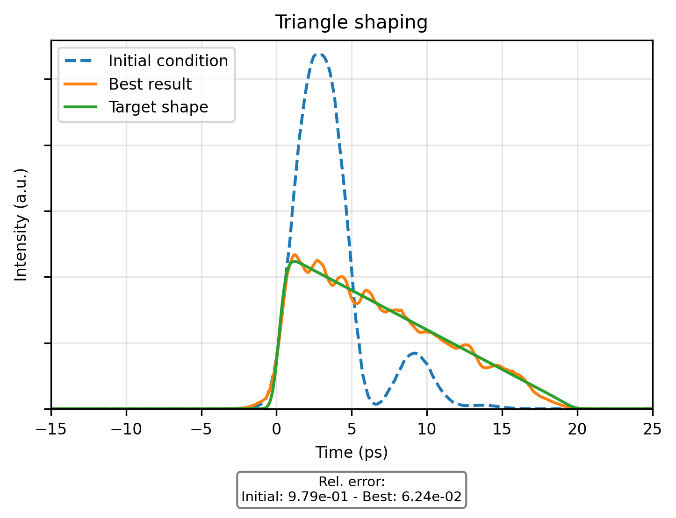
Experimental results
Front-end
Power amplifier
FH generation
Oscillator
WS
AMP
Solid state amplifier
UV
Solid state amplifier
Solid state amplifier
AMP
SHG
SHG
Shaping UV output of photoinjector laser
Convergence is reached after approximately 50 iterations, closely matching the target shape.

Slide 7
Conclusion and future works
Summary
Developed a gradient-based model for laser pulse shaping: fully functional, minor refinements ongoing
Next Steps
Development of laser shaping procedure for operations
Feedback algorithm requires good hardware with direct access to DOOCS control system (to our knowledge not easily possible with Maxwell).
Operational challenges due to long convergence time
Integration with NN-based approach for electron beam optimization
Physics-based models here scales unfavorably to exploit differentiability.

