Slide 1
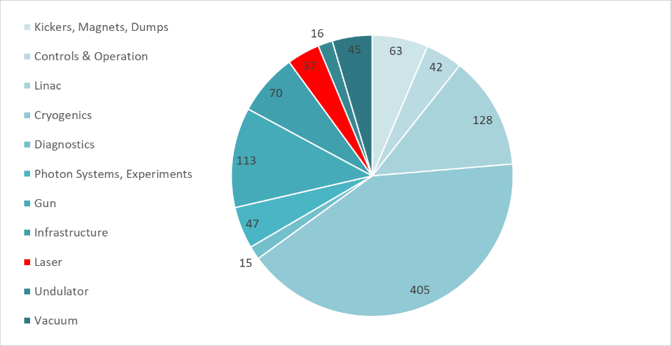


LLM-Powered Issue Analysis for High-Availability Laser Operations
Cumulated hours of down-time during user delivery at euXFEL
(2019 – 2023)
Afshin Karimi, Anne Lauscher, Ingmar Hartl, Frank Mayet, Henrik Tünnermann
Deutsches Elektronen-Synchrotron, Notkestrasse 85, Hamburg, Germany
Linac
Gun
Cryogenics

Slide 2
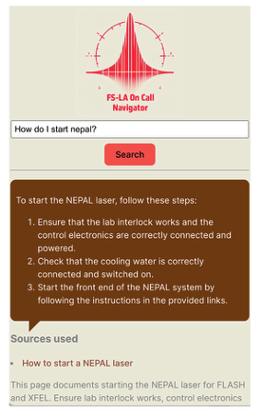
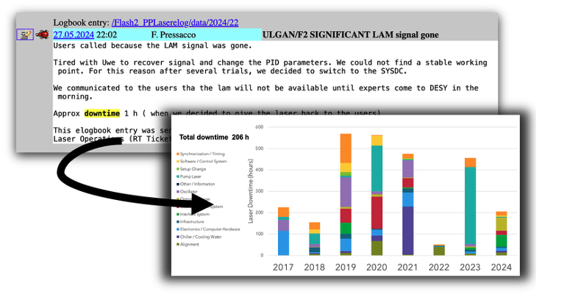
Can LLMs help to reduce Laser Downtime?
Transform unstructured Data (e.g. logbook entries) to create more detailed statistics and help guide R&D
Speed up interventions when problems happen

Slide 3
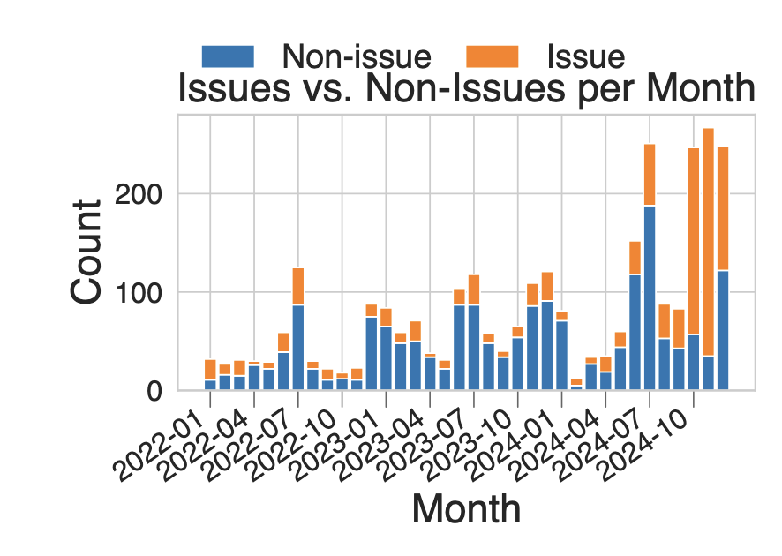
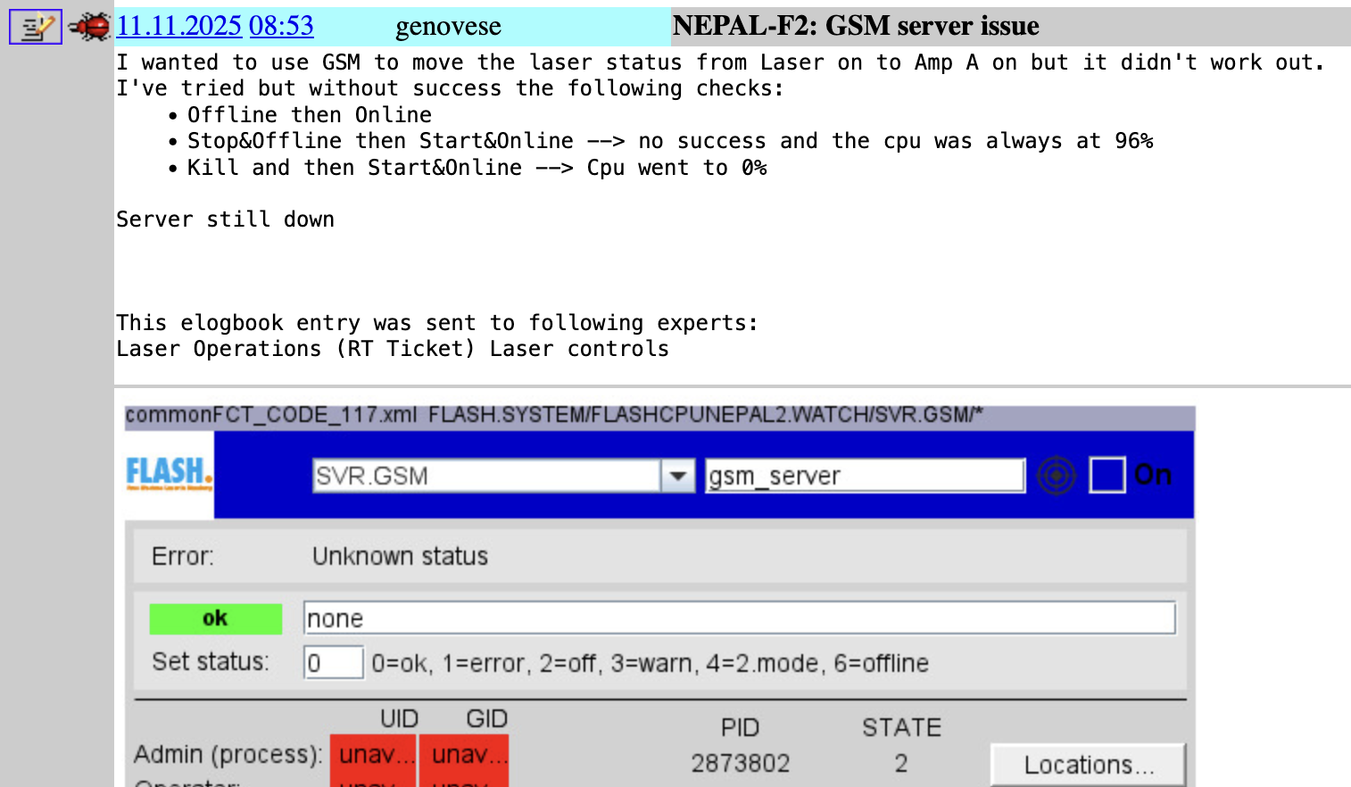
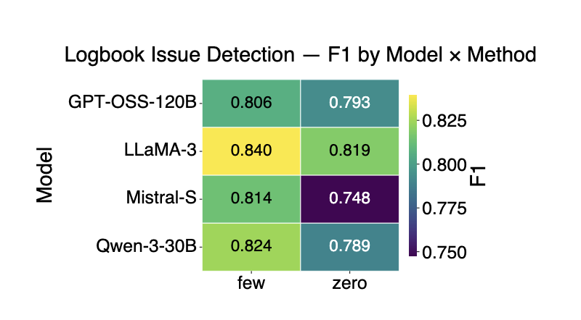
Datasets and Evaluations

Slide 4
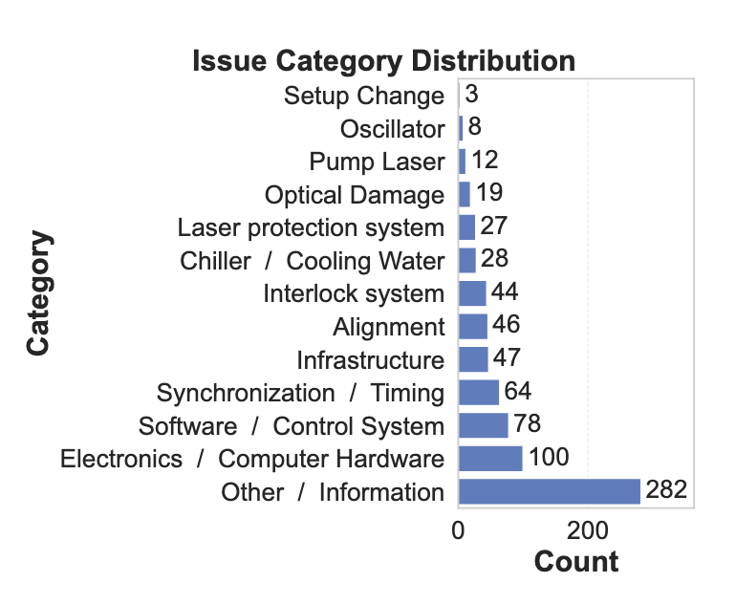
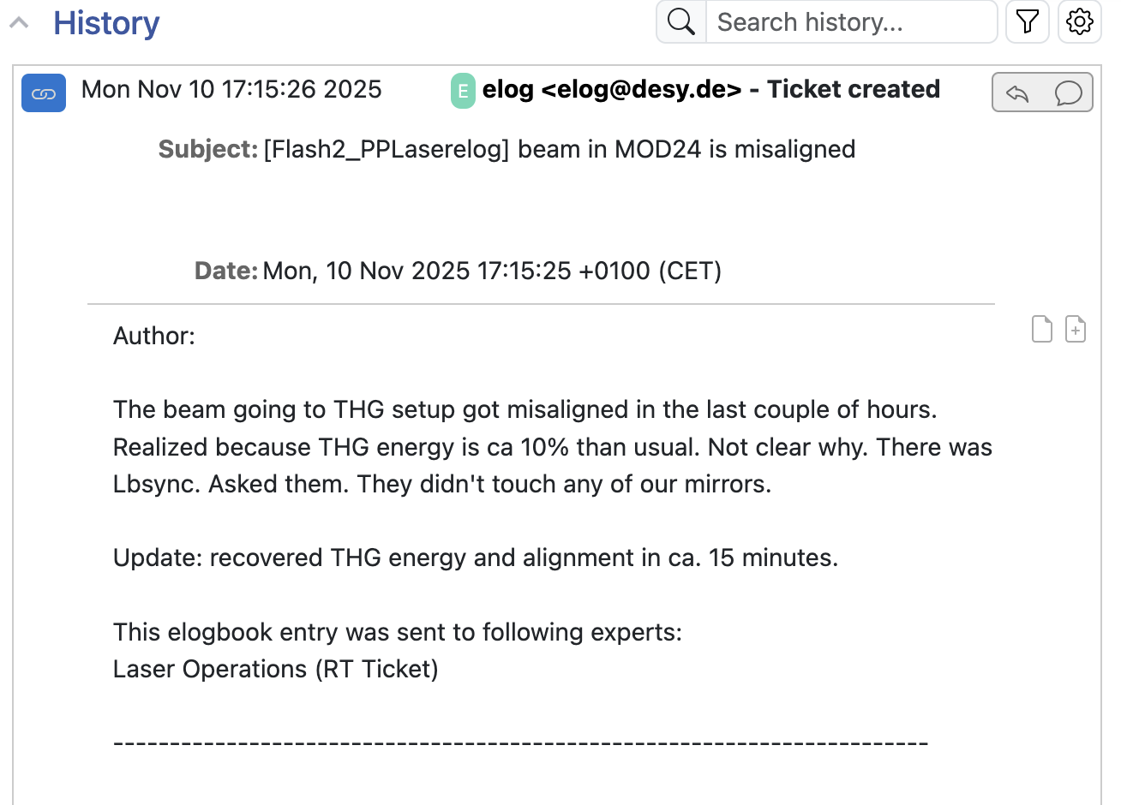
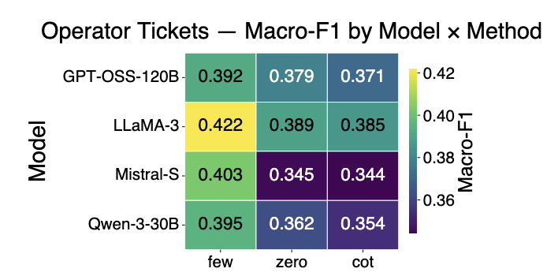
Datasets and Evaluations
Notes:
Change logbook entry

Slide 5
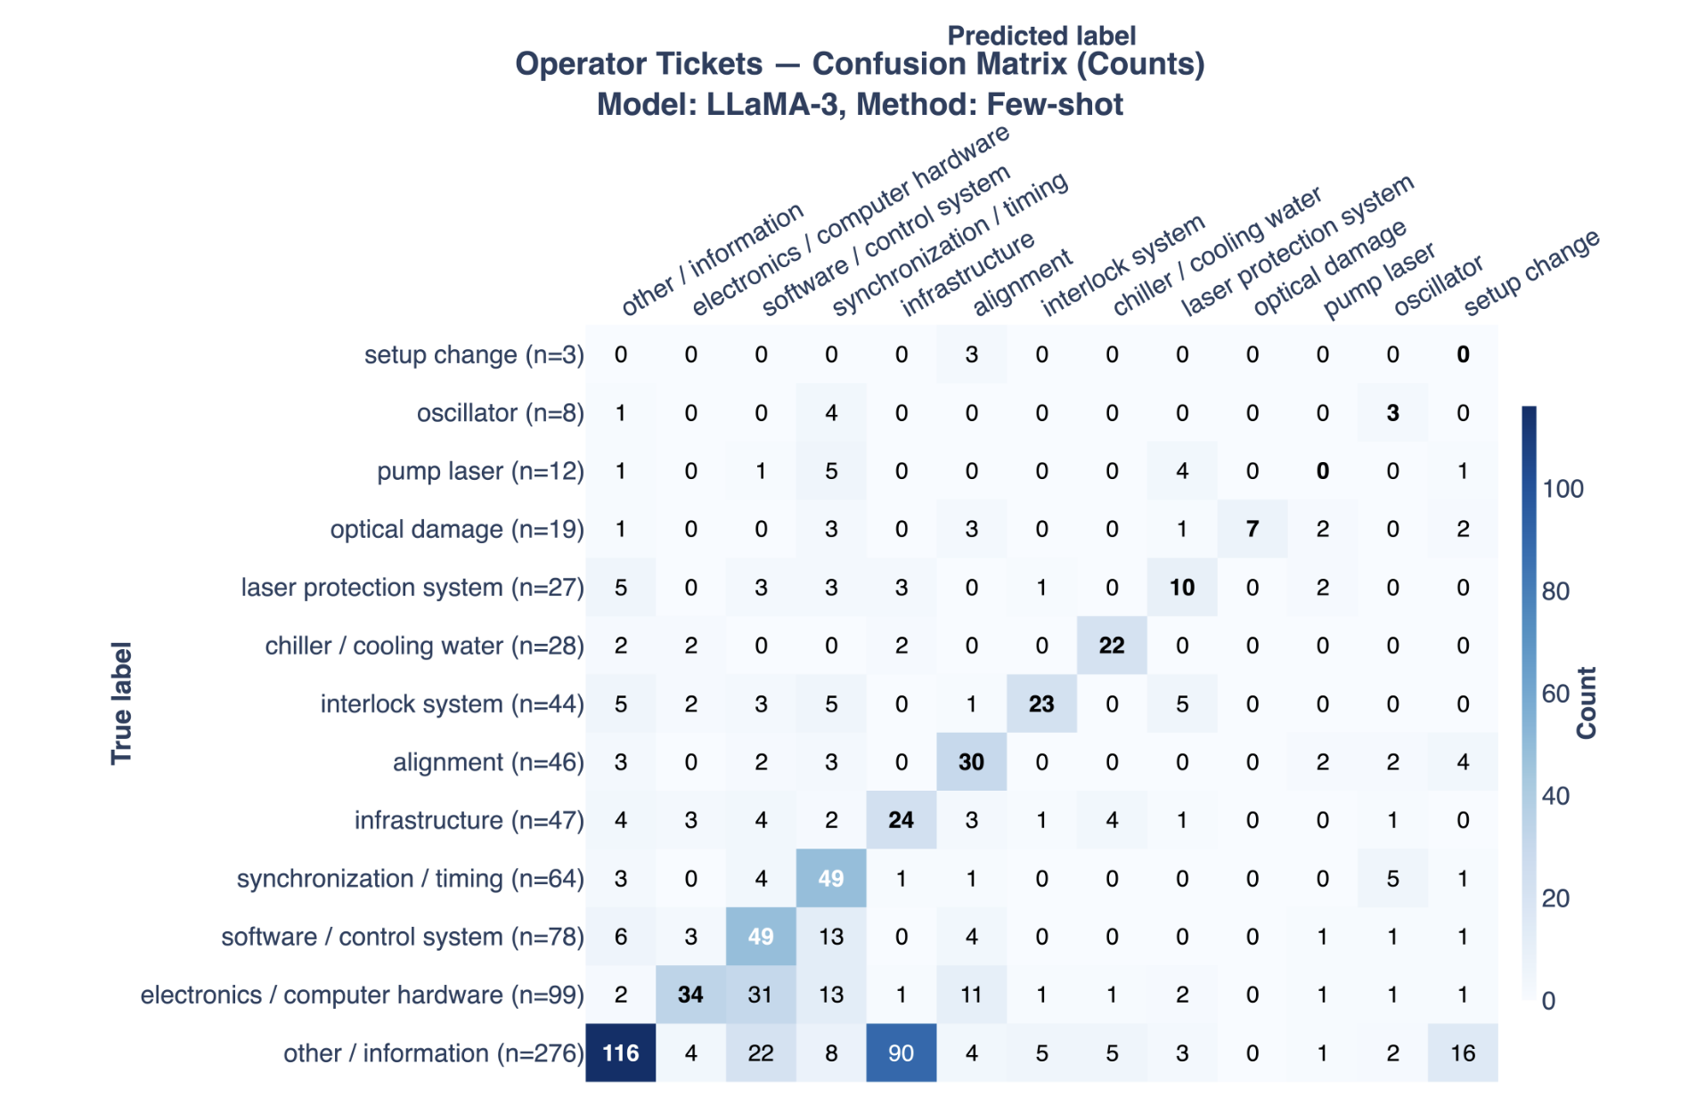
Category Confusion Matrix
[flash-major-incidents] [TTFelog] Powerglitch on all 3 Mainstations
Bezeichnung: Netzwischer/[PERSON] check your systems !
[PERSON] elogbook entry was sent to following experts:
FLASH major incident
----------------------------------------------------------------
Direct link to e-logbook entry:
[URL]
----------------------------------------------------------------
LLM: Infrastructure
Our Label: Other/Information

Slide 6
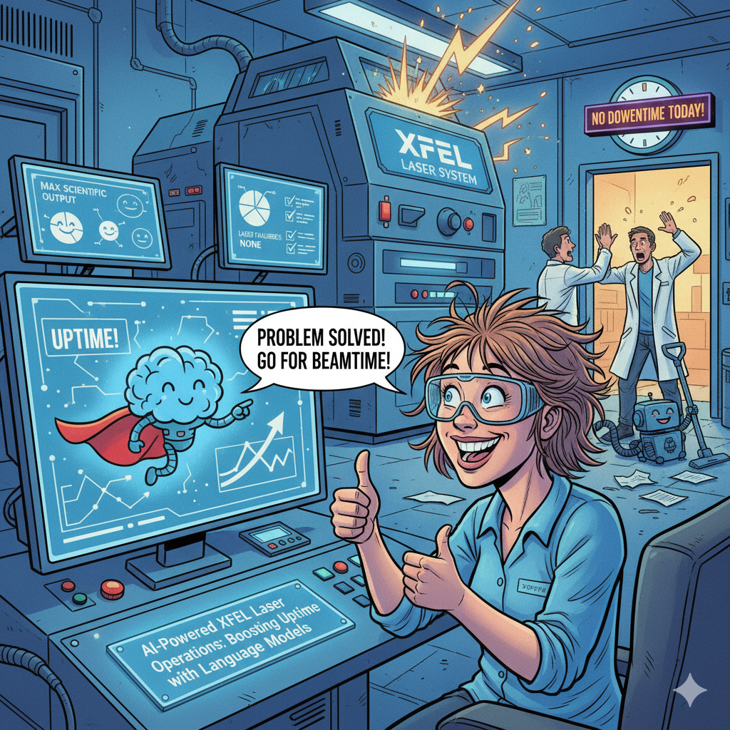
Conclusion
LLMs for Laser Operations
Issue Detection F1 0.84
Issue Category Detection macro F1 0.42
Developing an AI Co-Pilot for Laser Operations
Develop a Troubleshooting Assistant
Automate Reporting and Documentation
Build and Deploy a User-Centric Prototype

