Slide 1
A Differentiable Physics Model for Automated Inverse Design in Optics
Utsa Chattopadhyay^{1,2}, (….) , Ingmar Hartl², Christoph Heyl^{1,2}, Henrik Tünnermann²
¹ Institute for Data Science Foundations, Technical University of Hamburg, Blohmstraße15, 21079, Hamburg, Germany
² Deutsches Elektronen-Synchrotron, Notkestraße 85, 22607, Hamburg, Germany
8th Round table on Deep Learning @ DESY
Notes:
Good afternoon, everyone. My name is Utsa, I am a PHD student in….., I am a data scientist by profession but here I am working in an interdisciplinary field of physics and AI. Today I'm excited to present our work on a new AI-driven approach for optical thin film coatings optimization.

Slide 2
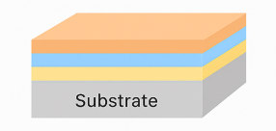
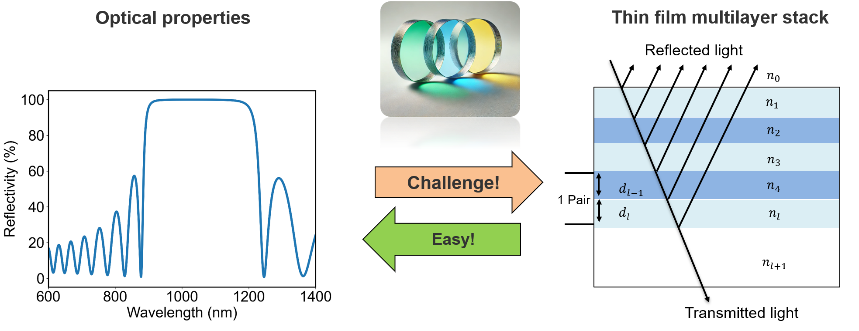
Impact of Optical Coatings
A Foundational Technology: Optical coatings are indispensable for controlling light in nearly every modern optical system
Huge potential for performance enhancements
The inverse problem:
  Forward Analysis (Easy)
  Inverse Design (Hard)
Limitations of traditional methods:
  Local Optimizers (e.g., Needle Algorithm)
  Global Optimizers (e.g., Evolutionary Algorithms)
  Slow, expertise-driven process
Notes:
Before we dive into the nitty-gr of our method, let’s take a moment about why this area is so important. Optical coatings are foundational technology, thus provides a huge potential for performance enhncemnts
So, what makes designing these coatings so difficult? Let's start with the easy part: the forward problem.
"If you give me a design—a stack of layers with known materials and thicknesses—calculating its optical performance is a solved problem."
Based on Fresnel eq,we’ll know how light reflects and transmits at each boundary between materials, and how much phase it accumulates while traveling through each layer."
"But here's the challenge." (Point to the "Inverse" arrow) "What if we have the desired output—the target performance—and we need to find the input? There is no simple reverse formula.“ and we depend of optimization scenario in these cases.
This is because the search space is enormous, non-convex, and we're often trying to satisfy multiple conflicting goals at once, like high reflectivity and specific dispersion
Current methods are powerful but have key limitations. They're either very dependent on a good starting guess from an expert, or they are incredibly slow. This creates a major bottleneck

Slide 3


Autoencoder-based optimization
Encoder
Decoder
Neural Network Model f_{θ}(x)
Multilayer stack characteristics
Forward Model $F_{\vec{n,}\vec{d}}$
Input
Optical Properties
Output
Optical Properties
Loss - $L$(θ)
Notes:
What have I shown is basic…now we go beyond that…
Here wgat I am showing is a Completely new, a noble architecture, applying it for coating
So, tackling the whole challenge outlined and also the generalization scenarios,

Slide 4


Autoencoder working principle
Encoder
Decoder
Neural Network Model f_{θ}(x)
Randomizing
data
Multilayer stack characteristics
Forward Model $F_{\vec{n,}\vec{d}}$
Input
Optical Properties
Output
Optical Properties
Loss - $L$(θ)
Notes:
avoiding local minima, not for one specific but randomize around the target area, which brings essential …

Slide 5
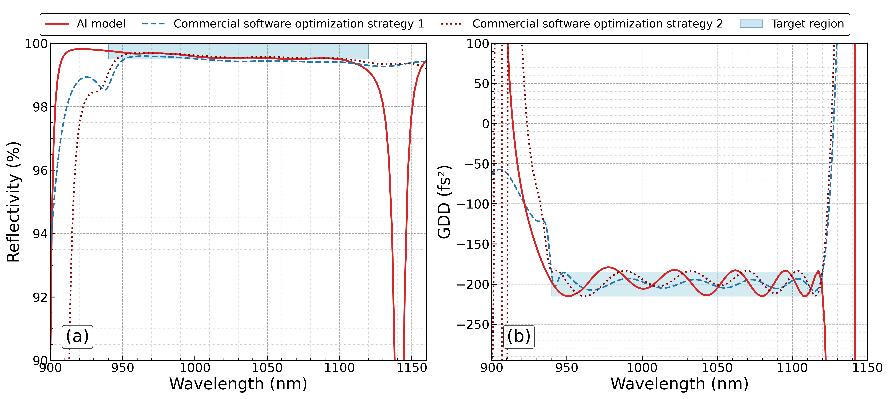
Experimental results – Complex Designs
Notes:
Similar perf, but compl new tech..
Fast
No trianng data (synthetic)
No expert know
From scratch

Slide 6


Summary & Future Outlook:
Key Achievements:
Developed a novel AI framework: Physics-informed autoencoder for inverse design
Eliminated need for prior data and expert knowledge: Our model designs from first principles (physics)
Achieved state-of-the-art performance: Successfully designed a complex, multi-objective chirped mirror matching the performance of expert-driven commercial software.
Future Directions:
Incorporate Advanced Physical Constraints:
  Including Laser-Induced Damage Threshold (LIDT), Manufacturing Tolerances & Material Stress

Slide 7

Thank You For Your Attention!
Please find our paper in this link!

