Slide 1
Early experiences with agentic generative AI for EuXFEL operations support
Specifically, LLMs
F. Sohn & S. Hauf
14.11.2025
8th Round Table on Deep Learning @ DESY

Slide 2
Examples of LLM usage at EuXFEL
This presentation
Highly tuned
Agentic LLMs for workflow automation
Knowledge Assistants
Application Specificity
Coding Assistants
Text Generation
Fully Generic
Early Prototypes
Production Use
Readiness Level

Slide 3
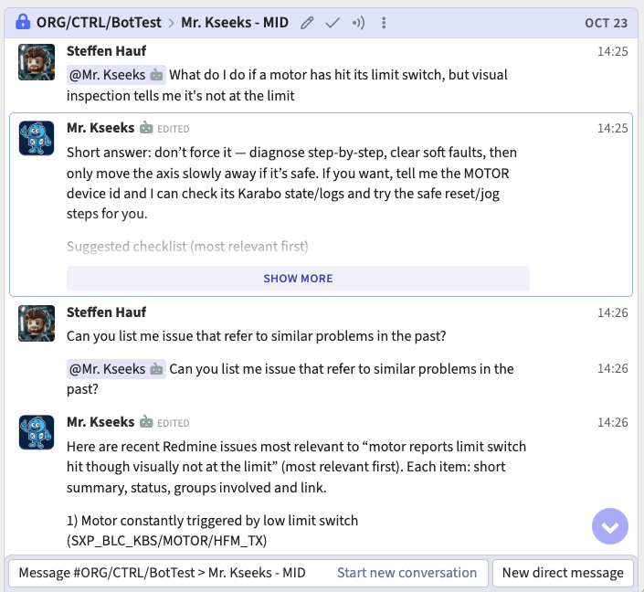
Knowledge Assistants
Knowledge Assistants extend the general knowledge of the LLM with domain specific context, often through Retrieval Augmented Generation (RAG)
(Tested) applications at EuXFEL include administrative guidelines (travel, staff notes) and technical knowledge (DOC tickets, Data Analysis documentation)
Readiness Level: TRLs 5-6: development and demonstration

Slide 4
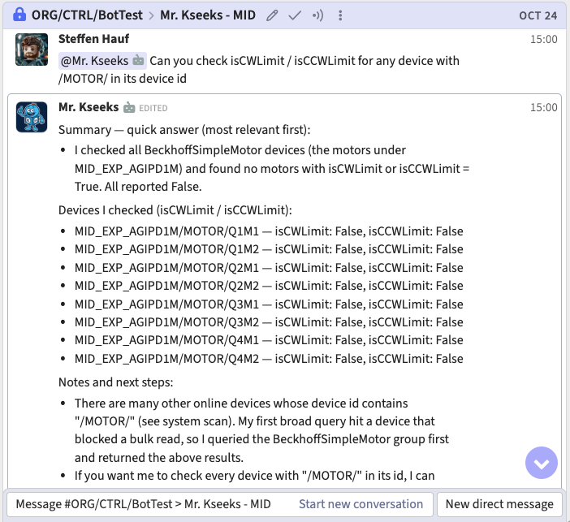
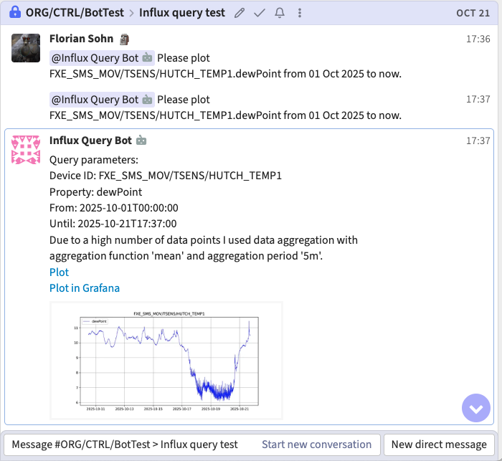
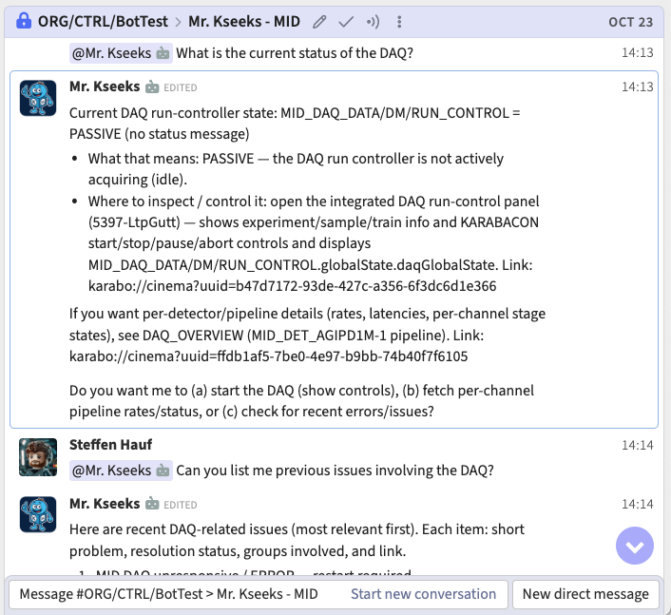
Agentic LLMs for workflow automation
Agentic capabilities extend the model towards performing actual tasks.
Look up (or modify) operation parameters
Produce a script that can steer an experiments
Iterate with the user to a solution, then help implement it
Most specific, and most challenging to ensure AI output is “safe” for the experiment
Readiness Level: TRLs 3-4: feasibility studies and development

Slide 5

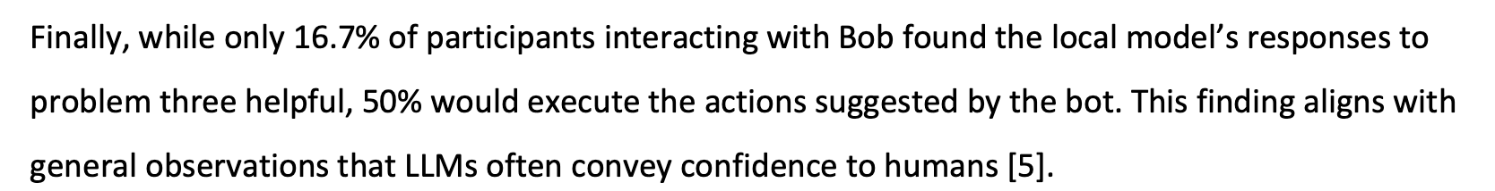
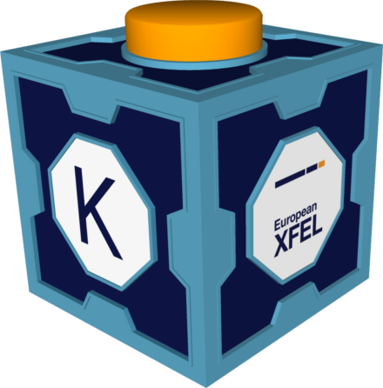
Next Steps & Outlook
Interactive frontends
RAY
Ongoing work towards a common technology stack for RAG and agentic AI:
Evaluating use of Model Context Protocol (MCP)
Use community libraries like FastMCP, and mcp_use
Provide common tools for ingesting content into a vector database (currently QdrantDB)
Zulip MyLog as a frontend for Operation Agents
Plans to evaluate if the RAG foundation can be made accessible to RAY as well
A lot of work is still explanatory, but the plan is to roll out prototype RAGS and agents to gather user feedback
Operation
Agent
DA User Support
Admin procedure RAG
MCP tools
MCP Karabo integration
Vector DB
DOC issues
DA docs
Staff notes
Travel docs
Common ingestion toolchain
Redmine
Alfresco
Gitlab
Web

