Slide 1



8th Round Table on
Deep Learning and AI
at DESY
14.11.2025

Slide 2
Schedule
9:30 – 11:00 Introduction & Keynote
11:00 - 11:15 Short break
11:15 - 12:15 LLMs in science at DESY and XFEL
12:15 - 12:45 Coffee break
12:45 - 14:35 Deep Learning & AI in science

Slide 3

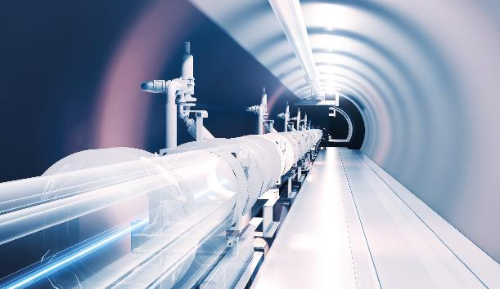
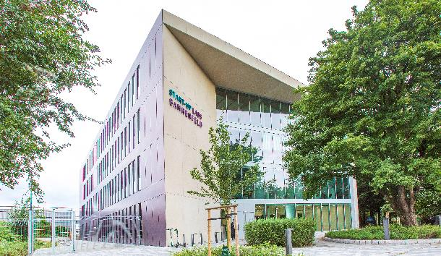
HPC Gateway
AI & Innovation in Hamburg
  DESY – supported by Helmholtz
  Goal: Enable industry access to state-of-the-art High-Performance Computing (HPC) for AI and other applications
  Vision: Regional innovation ecosystem connecting science and industry for joint AI/HPC solutions
Key Capabilities
  8 HPC nodes with 4x NVIDIA H200 each (+ expanding infrastructure)
  Connected to Helmholtz data platforms and beamline facilities
  Technical and legal framework for public-private AI/HPC projects
Pilot Cases
  CrystalsFirst: AI-driven drug discovery
  Pinktum: AI-based learning platforms
  Hi-Acts innovation platform integration

Slide 4
HPC Gateway
Currently ongoing:
Identification of the next round of projetcs!
Are you already in a collaborative R&D project with industry, and in need of HPC resources usable by the industry partner?
Get in touch with me:
philipp.heuser@desy.de
Pilot Cases
  CrystalsFirst: AI-driven drug discovery
  Pinktum: AI-based learning platforms
  …

Slide 5
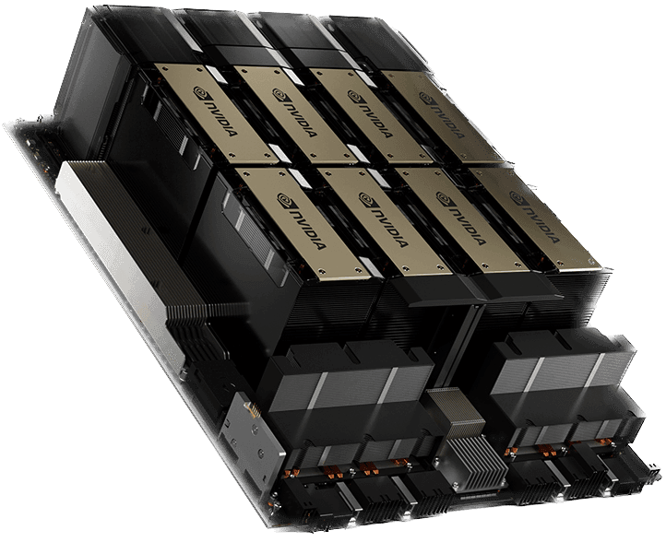
… new GPU Hardware in Maxwell
HPC Gateway Project to foster collaboration between research and industry, particularly in the fields of AI, …
  8 nodes each equipped with 4xH200nvl 141GB, 1.5TB ram (5kW)
Integrated into Maxwell
  Partition: comgpu – everyone can use the partition like allgpu
  Limits: max 2 nodes per job, max 2 concurrent job, max runtime 4 days
Special setup
  Nodes are configured allowing also commercial projects (hence comgpu)
  Software excluding commercial use is NOT available (e.g. matlab and alike)
Preemption
  Jobs in comgpu are subject to preemption (like allgpu) by jobs of industrial project partners
  Not much traffic so far, so risk is still quite low

Slide 6
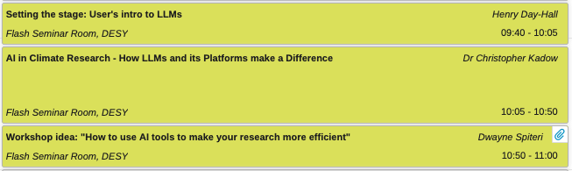
Schedule

Slide 8
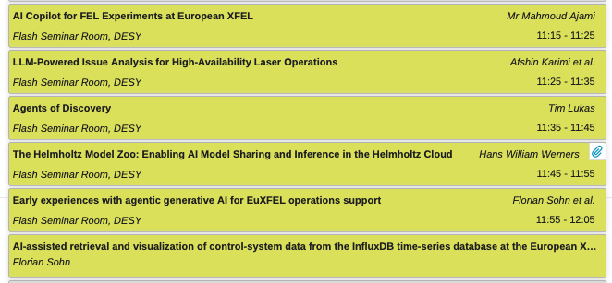

Schedule

Slide 10
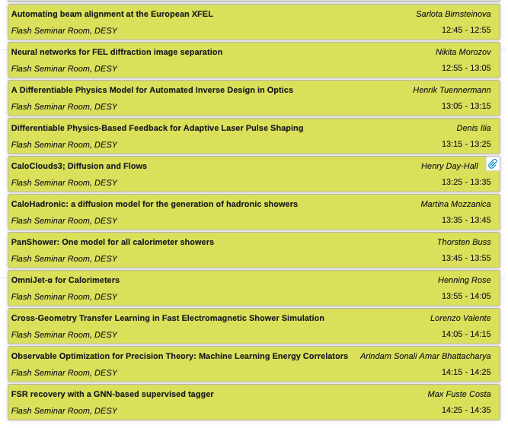
Schedule

