Slide 1
SH in REANA
06.10.2025
AKh

Slide 2
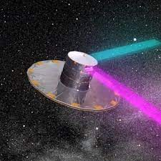
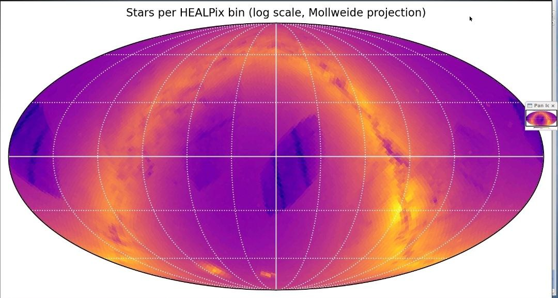
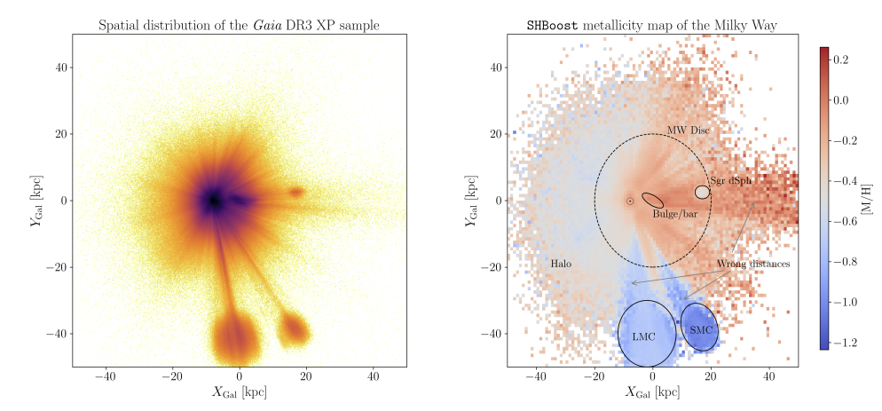
Extracting our homeland galaxy properties
1.7Bln
>G18.5
400Mln
The Gaia mission has provided an invaluable wealth of astrometric data for almost two billions of stars in our Galaxy.
The synergy with the Bayesian isochrone-fitting code StarHorse, allowed to derive additional stellar properties, like distance and dust extinction (Anders+2021, Queiroz+2023).
Then a regression technique, xgboost, trained with spectroscopically derived data from a variety of stellar surveys, was used to determine additional stellar parameters: extinction, effective temperature, metallicity, surface gravity, and mass (Khalatyan+2024).
Starhorse

Slide 3
SH big run
12288x2 files to analyze
Parquet or fits files
Located in S3
Total 50GB
Single file 1MB-100MB
Per file 2min-50 hours depend on Galaxy region(Bulge is most expensive)
Cache file for warmup/run ~2GB*2
Located on S3
RUN HW requirements:
With 6 cores 16GB RAM is minimum

Slide 4
REANA
bash run_job.sh ????
????: 0-12288 x2

Slide 5
Snakemake?
JOB_IDS = range(0, 4) # Change to range(0, 12288) for full scale
rule all:
input:
expand("results{hp}.tar.gz", hp=JOB_IDS)
rule prepare_and_run:
output:
"results{hp}.tar.gz"
container:
"astro-ml:latest"
resources:
c4p_additional_requirements='regexp("gridka",Target.TardisDroneUuid)',
compute_backend="compute4punch",
c4p_memory_limit="40G",
c4p_cpu_cores="16"
shell:
"""
touch results{wildcards.hp}.tar.gz
sync
sleep 5
"""
rule check_all:
input:
expand("results{hp}.tar.gz", hp=JOB_IDS)
shell:
"""
echo "=========================================="
echo "Job completed successfully"
echo "Output size: $(du -h results*.tar.gz | cut -f1)"
echo "Time: $(date)"
echo "=========================================="
"""
c4p
S3
AIP

Slide 6
Problems: snakemake
Jobs was running
Environment is not propagated to c4p backend
If we define on Snakefile multiple jobs: do they run in parallel?
How to handle failed jobs?

Slide 7
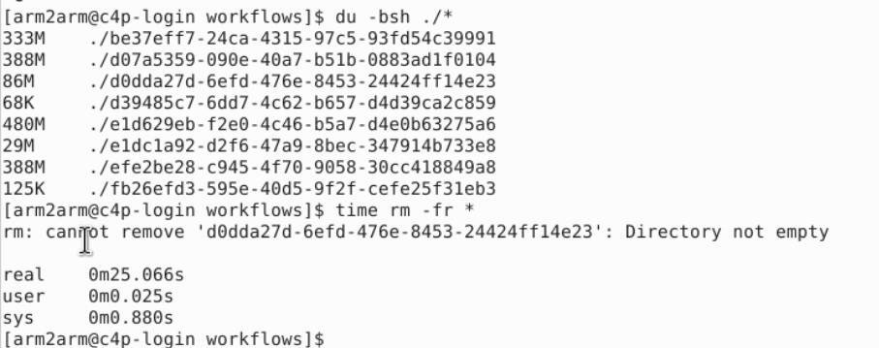
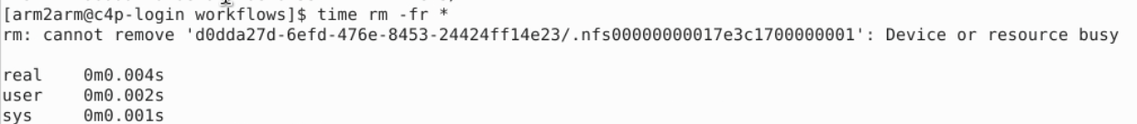
S4P is very slow

Slide 8
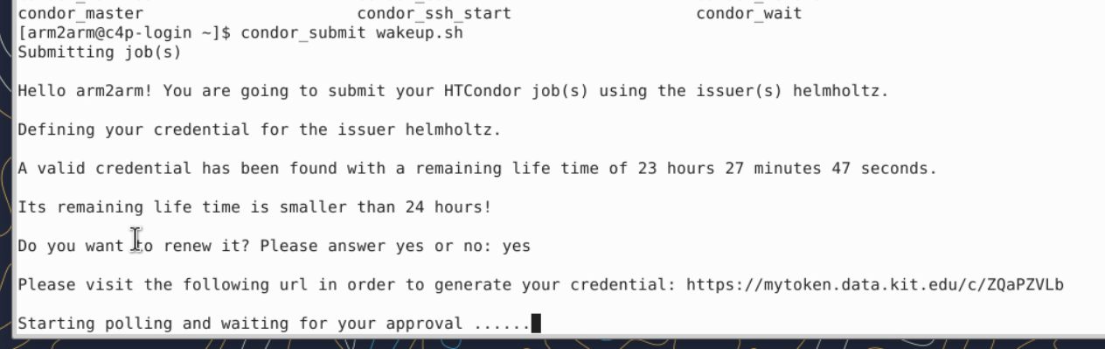
WakeUp!

Slide 9
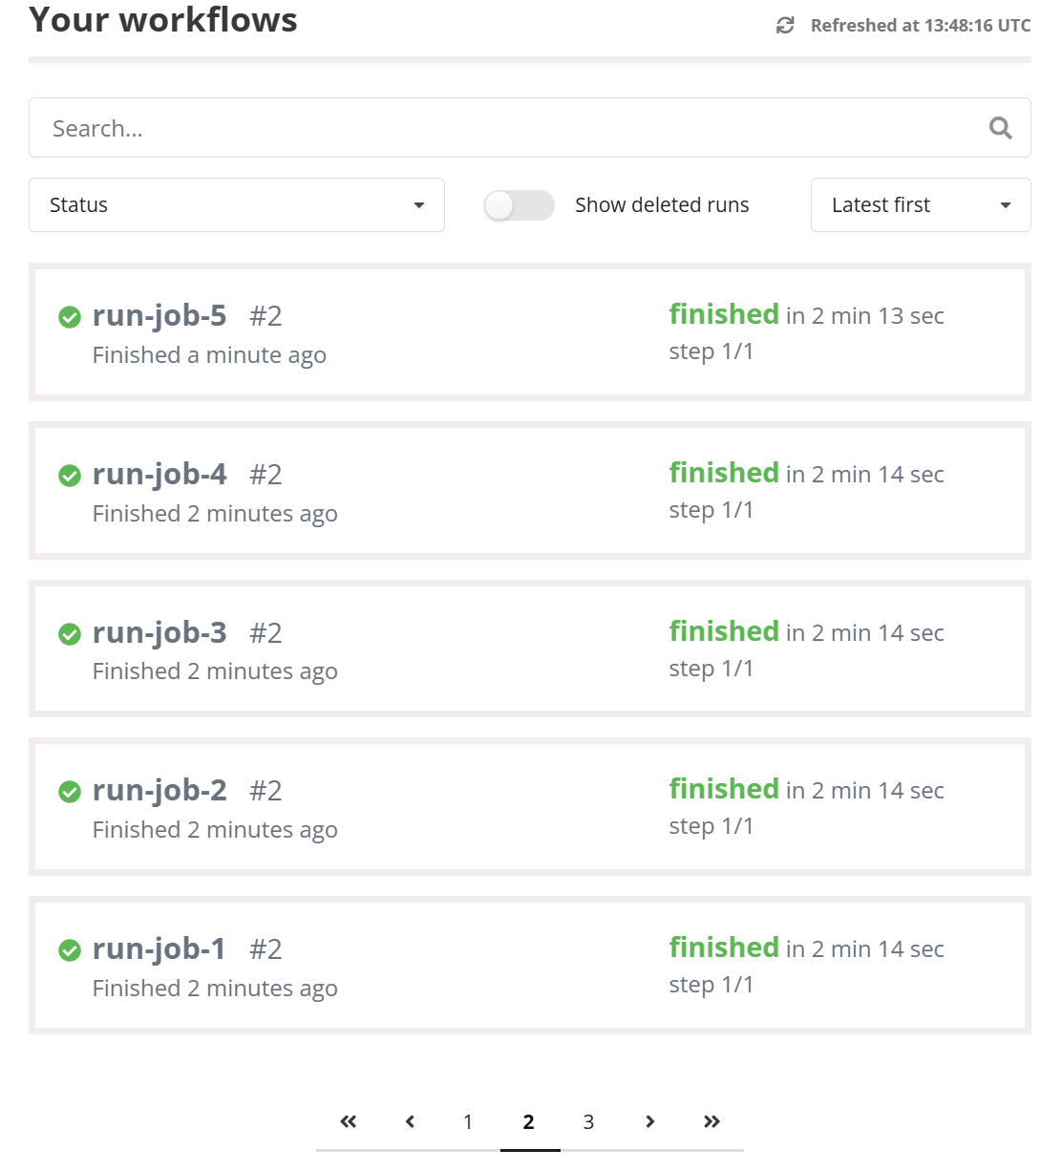
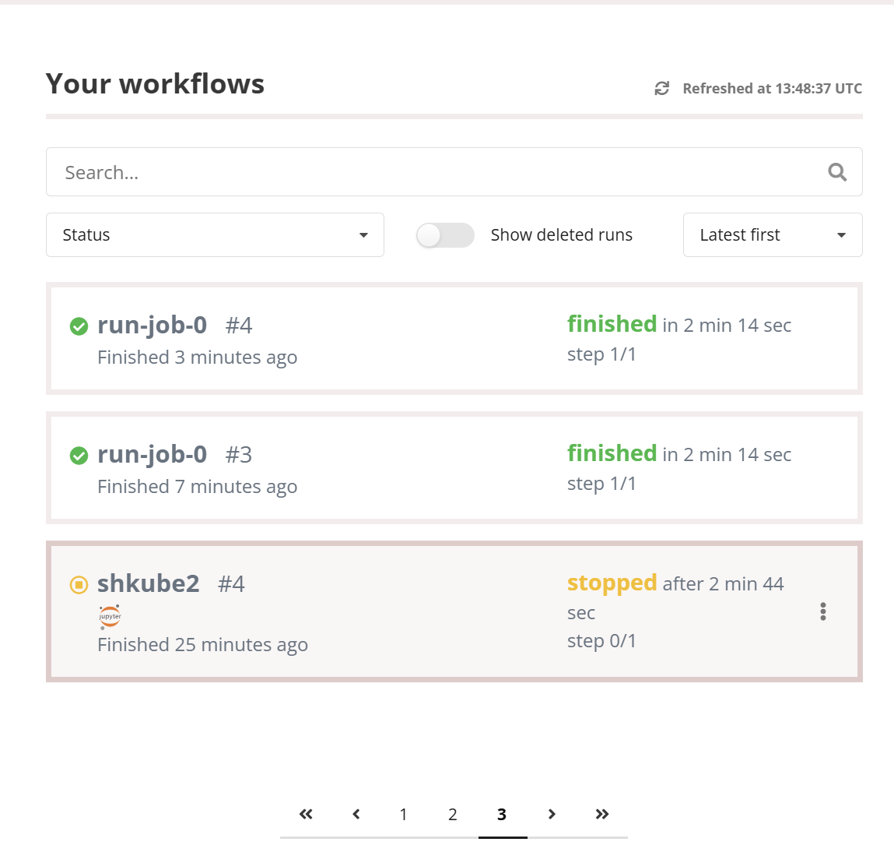
First light with serial jobs

Slide 10
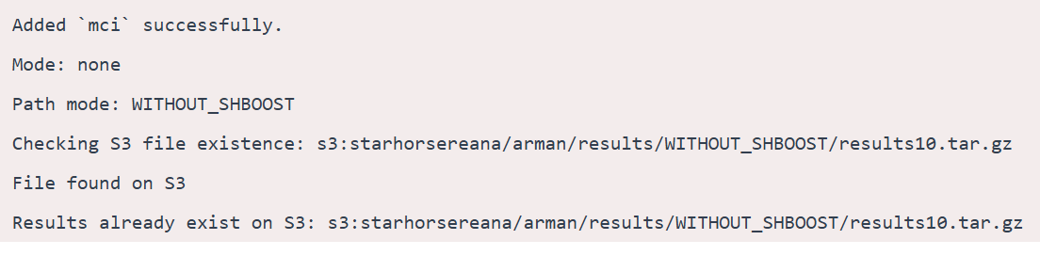
The data curation: S3->c4p->S3 works!

Slide 11
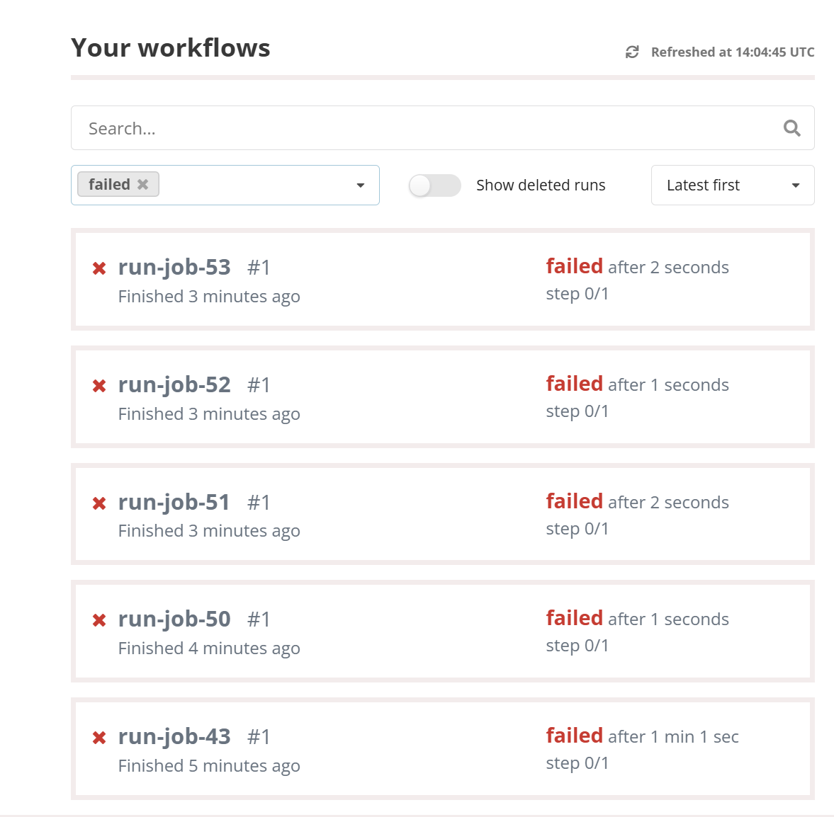
LDAP/connection random failure

Slide 12
steps.sh
chmod +x *.sh
env
bash prepare.sh
bash run_job.sh ${1}
bash cleanup.sh

Slide 13
REANA Script: array.yaml
inputs:
parameters:
hp_index: 0
files:
- steps.sh
- run_job.sh
- prepare.sh
- cleanup.sh
- git-clone.sh
- templates/param_template.ini
- templates/config_template.ini
- templates/config_withshboost_template.ini
- templates/param_withshboost_template.ini
workflow:
type: serial
specification:
steps:
- name: starhorse
environment: 'astro-ml:latest'
compute_backend: "compute4punch"
c4p_memory_limit: "40G"
c4p_cpu_cores: "16"
c4p_additional_requirements: 'regexp("gridka",Target.TardisDroneUuid)'
commands:
- bash steps.sh ${hp_index}

Slide 14
Pushing limits
reana-client run --skip-validation -w run-job-$1 -f array.yaml -p hp_index=$1
seq 151 1000 | xargs -P16 -I{} ./many.sh {}

Slide 15
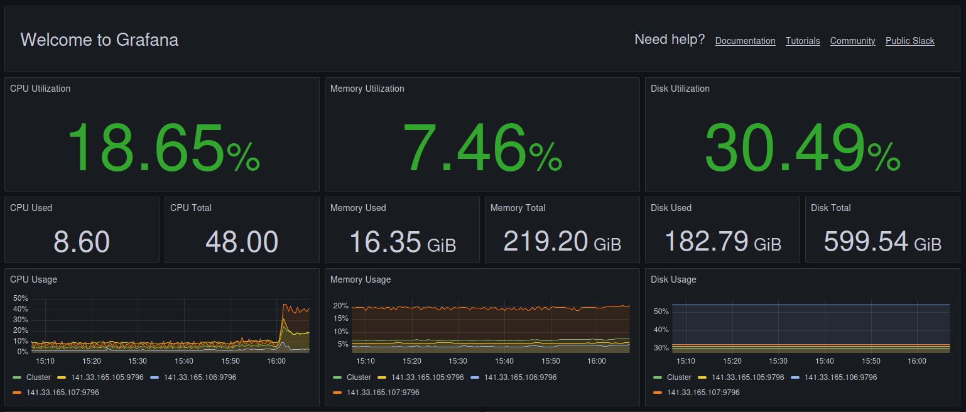
Load… is ok

Slide 16
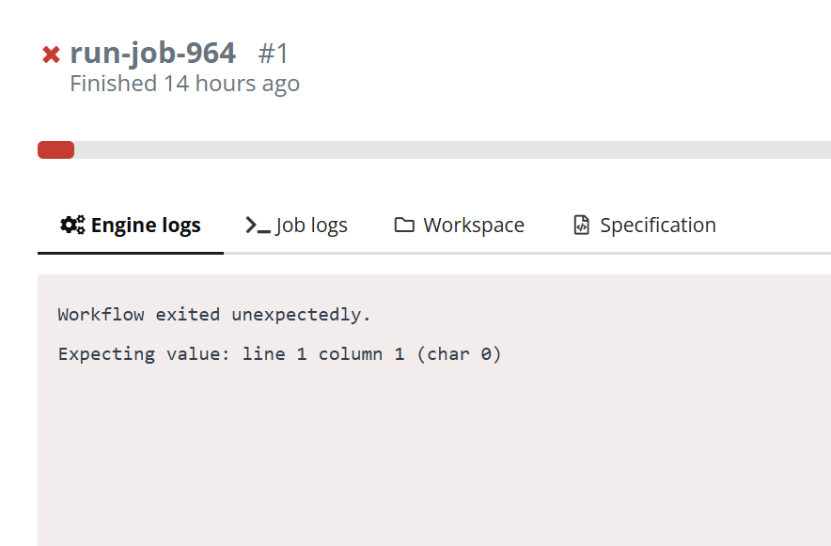
AUTH/Ldap, Striking again ☹

Slide 17
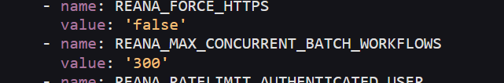
REANA limits

Slide 18
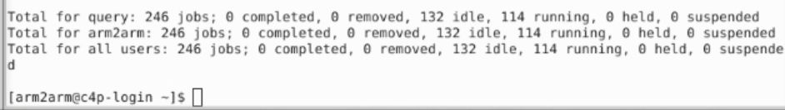
More fair share policy from GridKa for C4P
1,824 vCORES, 4.5TB RAM

Slide 19
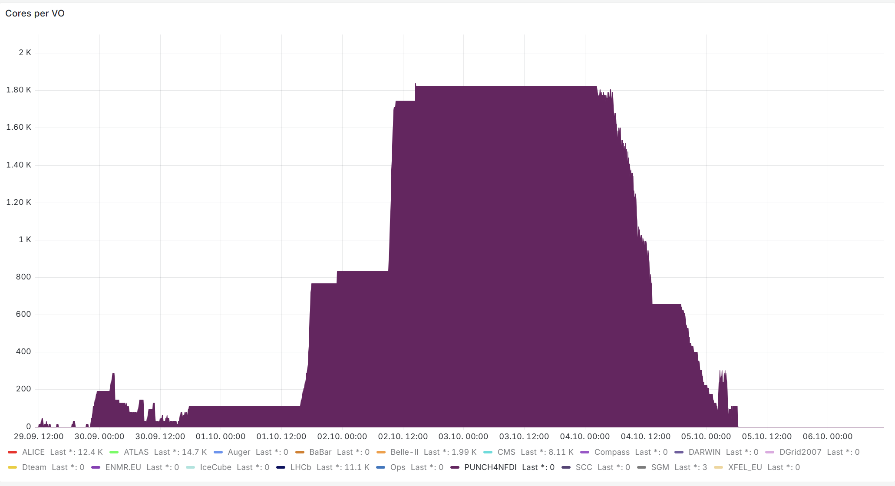
Scaling jobs.

Slide 20
LIMITS for C4P
REANA:
Max Concurrent Batch Workflows: 10000
C4P
Type of nodes available:
8 vCores 20GB RAM
16 vCores 40GB RAM
compute_backend: "compute4punch“
c4p_additional_requirements: 'regexp("gridka",Target.TardisDroneUuid)'
Number of nodes available
Unknown, dynamic
Max RUNtime: <5d ( at least at gridka )

Slide 21

Current Situation
2 groups of runs:
12K with SHBoost 200M
12K without SHBoost 200M
12000 – with SHBoost
5178 done
12000 – without SHBoost
1792 done
1000 on C4P

Slide 22
Next steps
Making more robust against failures and network outages
Check Git pull networks outages
Check S3 outages
Make jobs smaller:
20K Stars – 5h
8Cores 20GB Ram
Try to go more

Slide 23
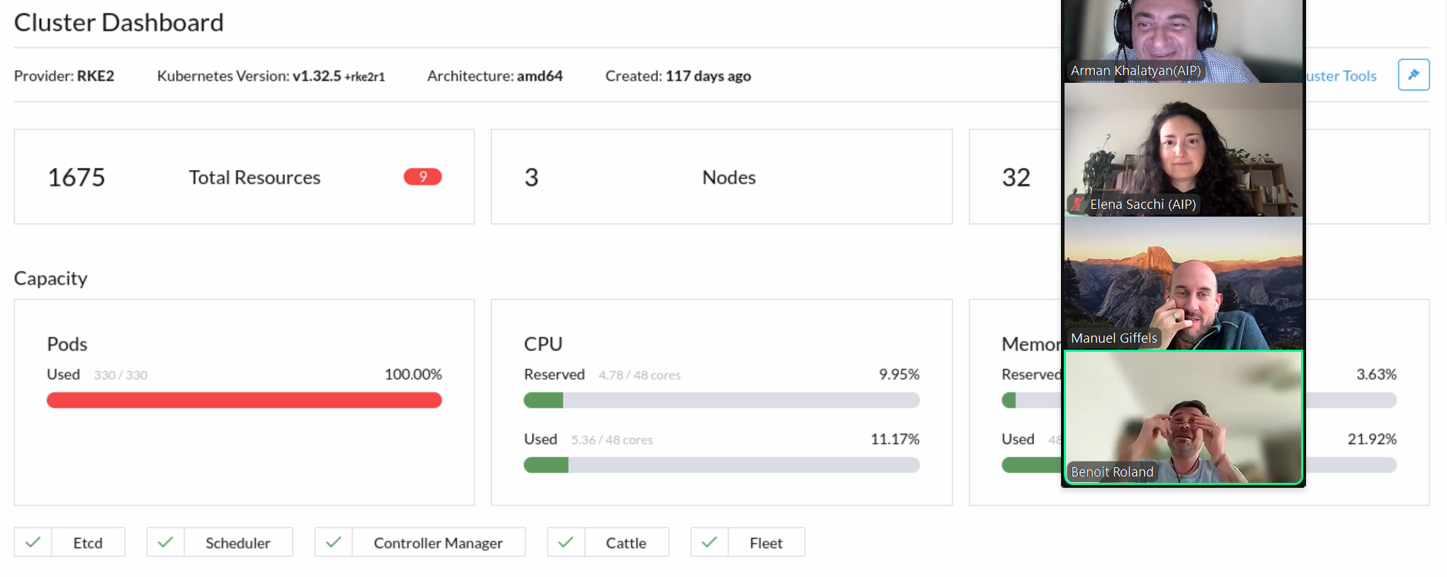
Kubernetes limits for scheduler(Benoit)
The maximum jos are not going more than 200-300
Every job is one pod for monitoring

Slide 24
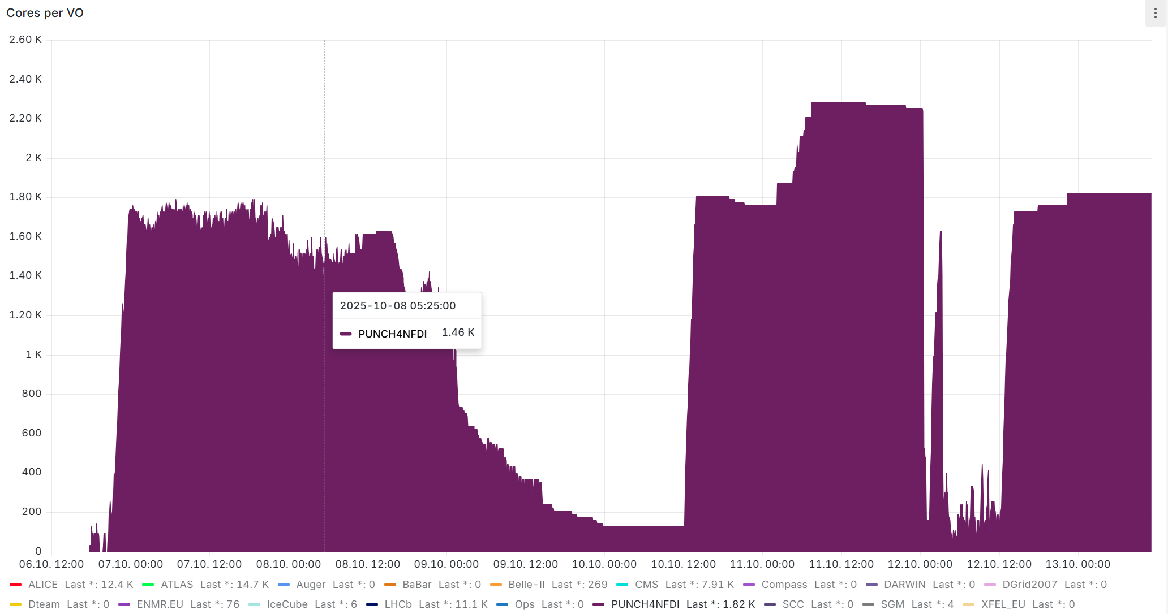

Status: 13.10.2025
Last 7days
Good news
Still running
Many bugs are fixed
We hit Max: 2290 Cores
Black areas still calculating

Slide 25

Open questions
MONITORING
BUG
Container: gridk or goegrid
Laptop/AIP
COMPUTE4PUNCH
Maybe BUG?
Babysitting 25K jobs is hard, many cli scripts to find the really failed jobs
The jobs are running/hold/idle : REANA thinks it is still RUNING
Some jobs are failed on REANA-FAILED but condor_q- running/hold/idle
Monitoring on c4p-login node: here is no feedback on jobs logs
User need to login to running container and show status
BIG BUG on login failed with “LDAP”- SOLVED?(more questions @Benoit)

