Slide 1
Features of SciCat
and resulting work ro make them useful.
work-in-progress
Regina Hinzmann, IT-InFa
2025-10-27
SciCat Technical meeting
Content overview
Status DOIs for entire beamtimes
Status Pilot scicat for beamlines

Slide 2

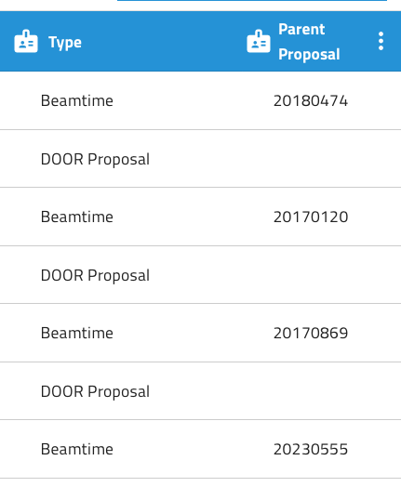
Status: DOIs for entire beamtimes
Where are we here?
What we have:
Can use two types for DESY proposals: parent proposal as DOOR proposal ID and child proposal as beamtime ID.
In SciCat, one can look at all datasets of one beamtime: proposals view, then datasets. If the information would be written correctly such that the type of the proposal is correctly put. DEMO.
Work to be done:
Get proposal IDs right at ingest. Me with Stefan Dietrich.
Get DOOR proposal info. People down the chain (BL staff).
Get mechanism into proposals to attribute a DOI for it – if required?

Slide 3
SciCat at DESY for general DOI minting
Status of pilot in more detail.
External service code is now in gitlab and runs as a container in the cluster.
Part that is done:
We assume a scicat dataset of a certain structure, as agreed by FS; Linus and Nicolas.
it copies all associated datafiles and attaches them to the original dataset.
it creates the copy on fsdata.
A test job was successfully created and submitted that talks to our service.
What’s next (W44):
Trigger custom job from frontend.
Complete workflow: add email notification with the new url of the user in fsdata (add another action to the job)
Make code robust.
Test with other datasets.
Handover.
scicat.desy.de
fsdata.desy.de
doi.desy.de
internal
scicat
external serivce
external scicat
landing page of external scicat

Slide 4

Outlook
Status summary
Still in hot phase of external service development
  translate local script to app that runs as service ✓
  finalise workflow
Need to follow up support of SciCat issues/features like ✓
  correct implementation of relation of beamtime and proposal IDs
  deployment of new releases w/ fixes (Max took over Martins PR and works on it)

