Slide 1
Timing System & Bunch Pattern Server
Or: What you never wanted to know about the timing system but were forced to find out.
x2timer & Bunch Pattern
Beam Distribution at the XFEL
Virtual XFEL Demo

Slide 2
x2timer & Bunch Pattern

Slide 3
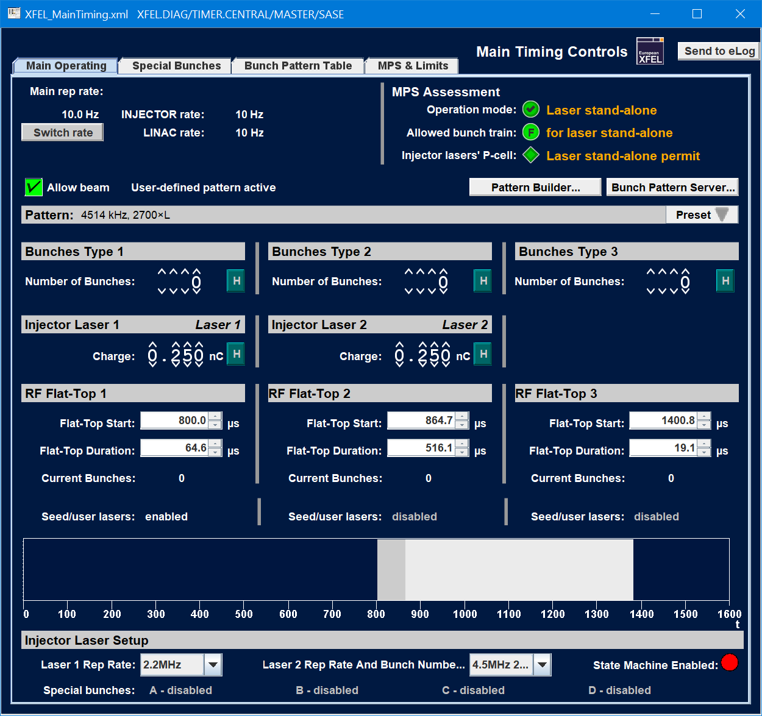
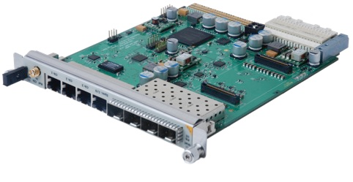
The x2timer Timing Board
Generating the heartbeat for our facilities
Generates precision clocks and triggers
Can be transmitter or receiver (multi-star topology) or stand-alone
Present in most MTCA crates
Main DOOCS interface: x2timer server (Arthur Aghababyan, Olaf Hensler)

Slide 4
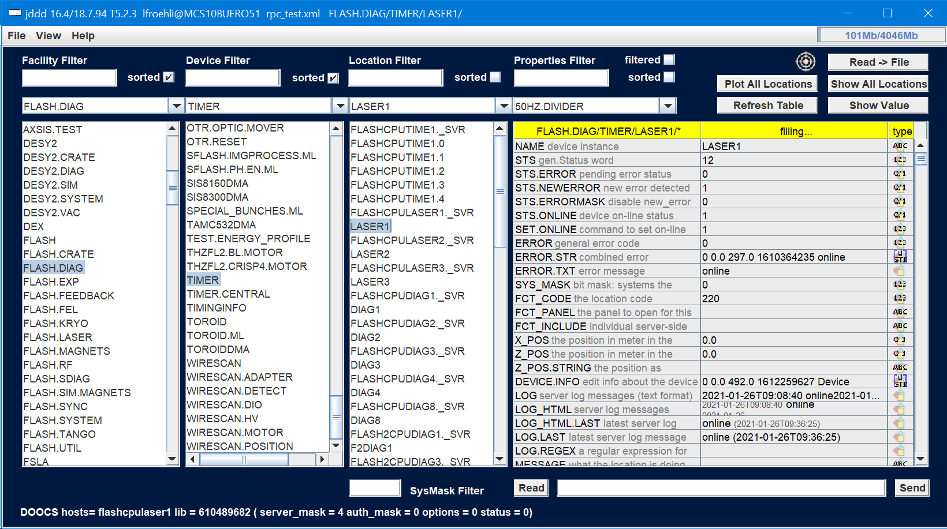
x2timer Servers in the DOOCS Namespace
Where to find x2timers in DOOCS
x2timer servers are ubiquitous:
SINBAD.DIAG/TIMER
SINBAD.DIAG/TIMER.CENTRAL
FLASH.DIAG/TIMER
FLASH.DIAG/TIMER.CENTRAL
XFEL.DIAG/TIMER
XFEL.DIAG/TIMER.CENTRAL
XFEL_SIM.DIAG/TIMER
XFEL_SIM.DIAG/TIMER.CENTRAL
KALDERA.DIAG/TIMER
TEST.DIAG/TIMER
TEST.XFEL/TIMER
LAB.*/TIMER
…

Slide 5
x2timer Legacy Mode
Up to three beam regions
Up to three beam regions (“flat-tops”)
Between the beam regions, the LLRF may change amplitude & phase freely
Bunches are only possible inside the beam regions
Only one type of bunch per beam region (same injector laser, destination, charge, …)
Simple → Can be used directly from x2timer server
No longer supported
bunch charge
time
RF amplitude
time

Slide 6
x2timer User-Defined Mode
Maximum flexibility
(Almost) arbitrary number of beam regions
Bunch types, lasers, destinations, and beam regions are decoupled
Programmed via a huge pattern table
New pattern tables are sent to the x2timer at 10 Hz by the bunch pattern server
Used at FLASH, XFEL, PITZ, KALDERA, …
bunch charge
time
RF amplitude
time

Slide 7
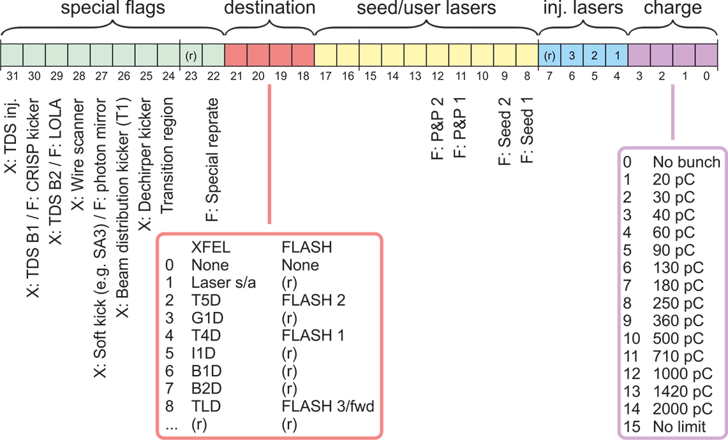
The Timing Pattern in Detail
An array of 7222 “timing words”.
Timing Pattern
idx 0
idx 7221
The timing pattern is an information block that is distributed by the timing system before each macropulse.
Timing boards generate triggers from it.
Hard- and software uses it to classify bunches/pulses.
Table with 7222 [8192] entries
9.028 MHz raster (110.8 ns step)
Covers a time span of 800 µs [910 µs]
Each entry is described by a 32-bit integer (“timing word”)
700 µs
1500 µs
Timing Word

Slide 8
Beam Distribution at the XFEL

Slide 9
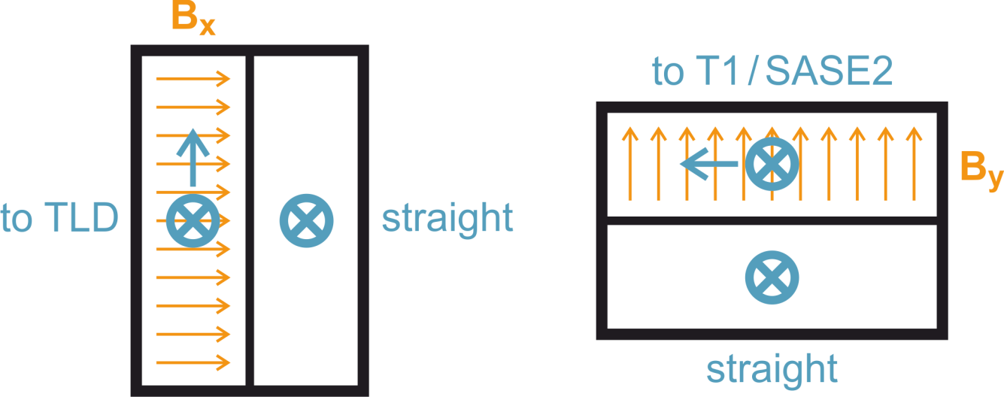
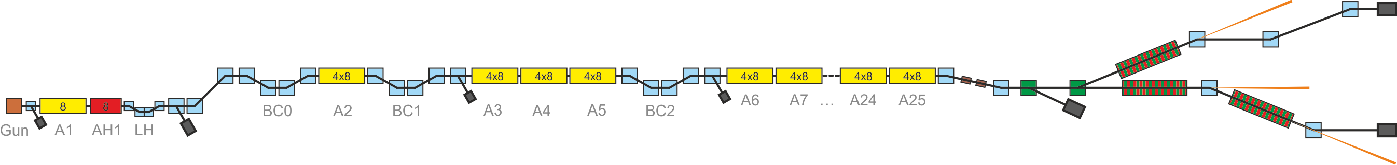
Beam Distribution Scheme
TLD Kicker
Fast (4.5 MHz)
Horizontal kick (left)
Lambertson Septum
Vertical deflection (up)
Beam Distribution Kicker
Slow (tens of µs)
Vertical kick (up)
Lambertson Septum
Horizontal deflection (left)
SASE2
T5D
SASE1
T4D
TLD
SASE3

Slide 10
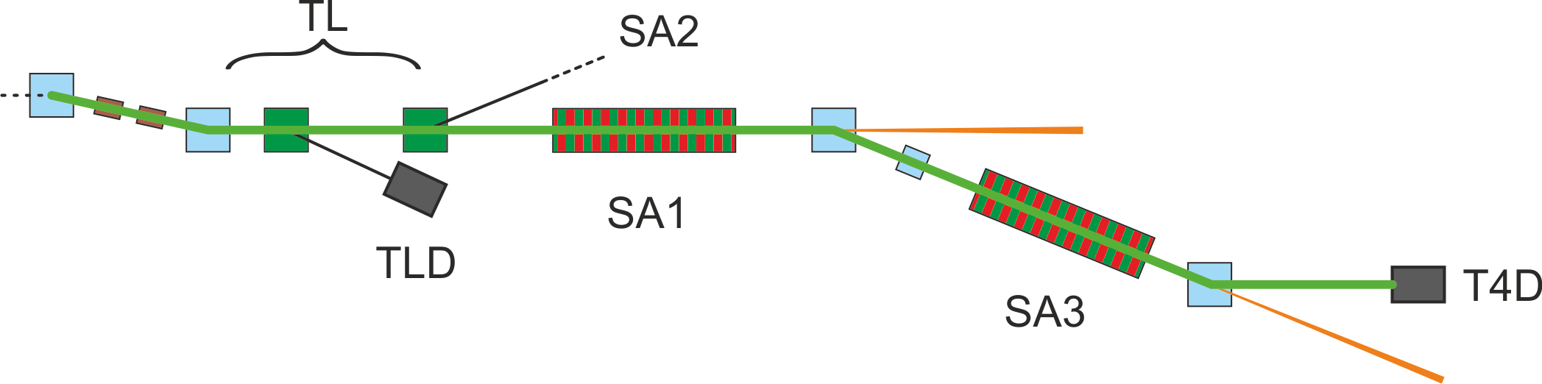
Fresh Bunch Mode: Implementation
Lasing in SA1 induces energy spread => less or no lasing in SA3
Lasing can be suppressed
on individual bunches
by exciting a trajectory oscillation with a fast kicker (soft kick).

Slide 11
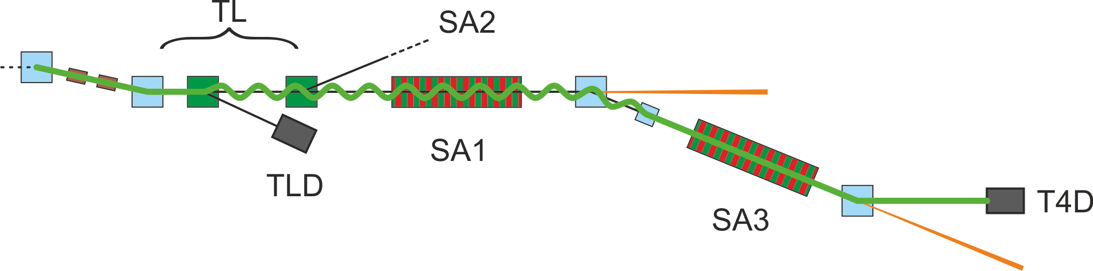
Fresh Bunch Mode: Implementation
Lasing in SA1 induces energy spread => less or no lasing in SA3
Lasing can be suppressed
on individual bunches
by exciting a trajectory oscillation with a fast kicker.
Horizontal kick
Static horizontal correction

Slide 12
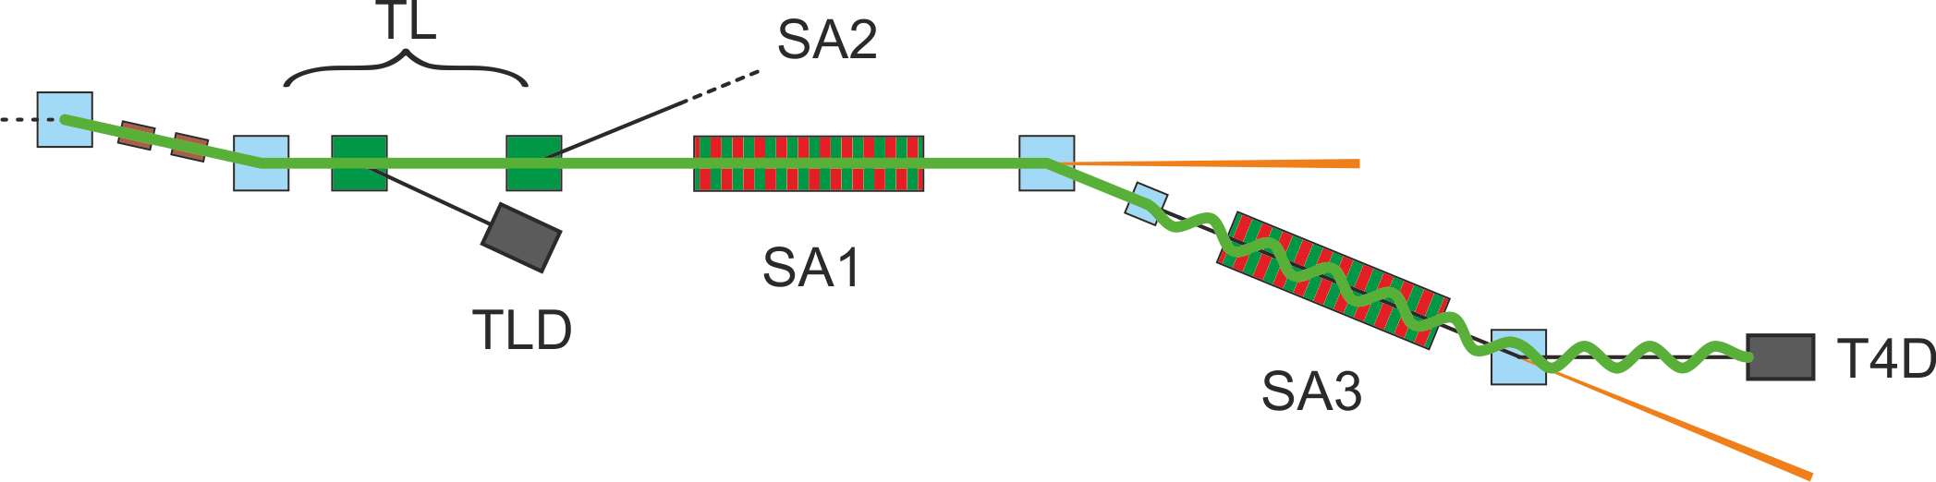
Fresh Bunch Mode: Implementation
Lasing in SA1 induces energy spread => less or no lasing in SA3
Lasing can be suppressed
on individual bunches
by exciting a trajectory oscillation with a fast kicker.
Static horizontal correction

Slide 13
Fresh Bunch Mode: Additional Kick in T4
There is a “TLD-type” kicker in the T4 section, in front of SA3.
It is fired for SA1 bunches to increase the oscillation amplitude in SA3.
Horizontal T4 kick
Static horizontal correction

Slide 14
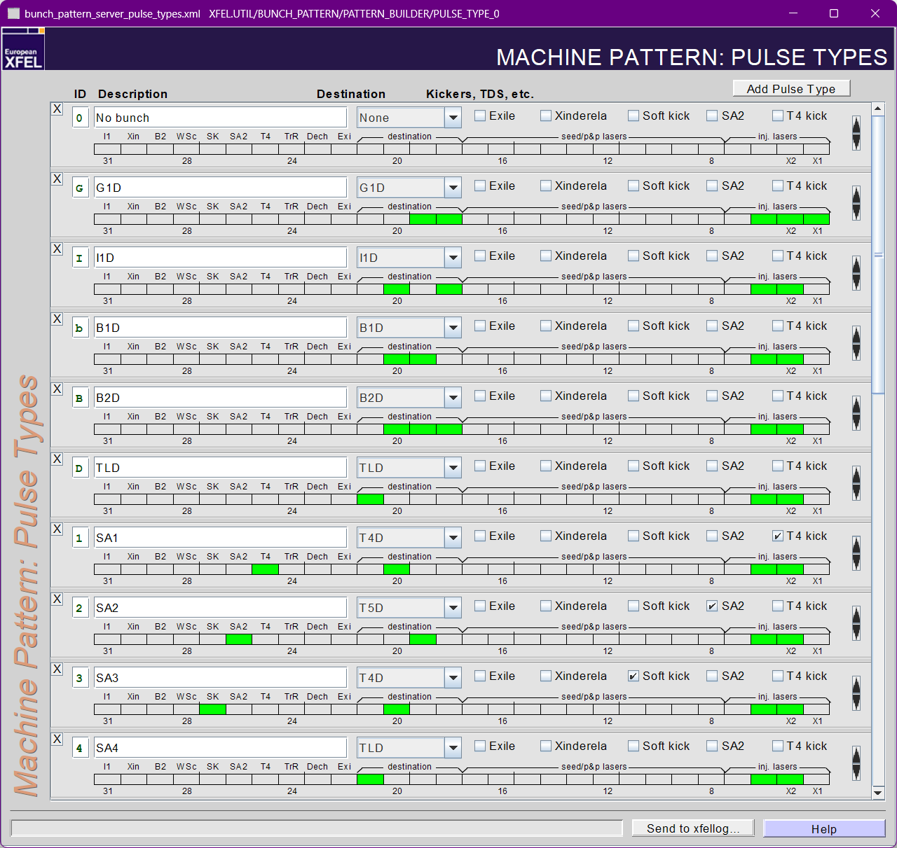
Beam Distribution: Get Your Kicks
(All four of them)
Four types of kicks can be triggered by the timing system:
Kick to TLD (fast) Destination: TLD
Kick to south branch/SASE2 (slow) Destination: T5D or Bit: “SA2”
Soft kick (fast, one of the TLD kickers) Bit: “SK” (Soft Kick)
T4 kick in front of SASE3 (fast) Bit: “T4”

Slide 15
Live from the Virtual XFEL

Slide 16
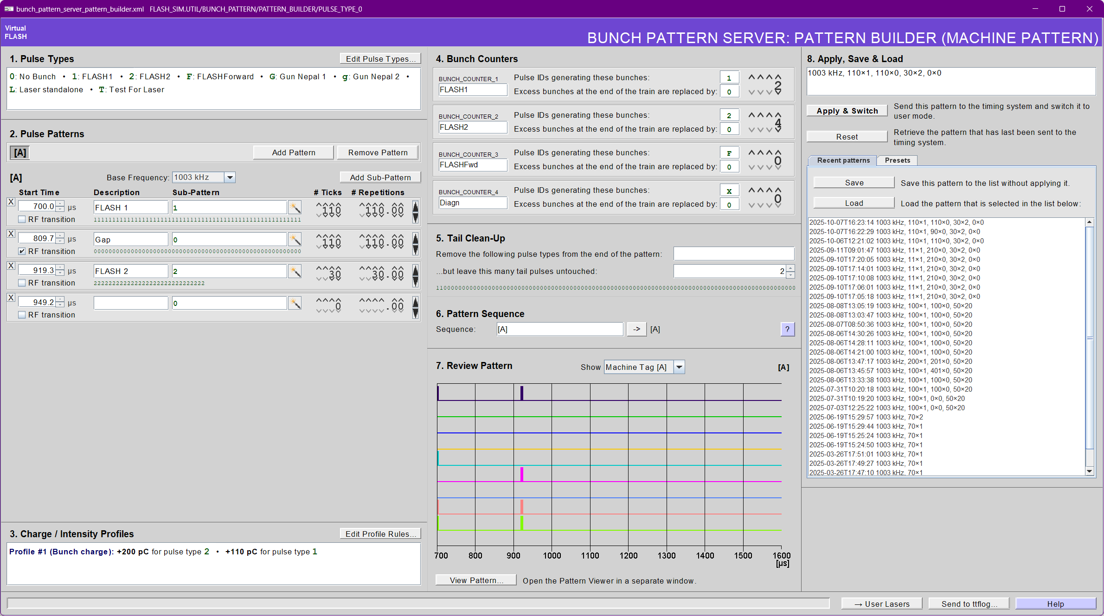
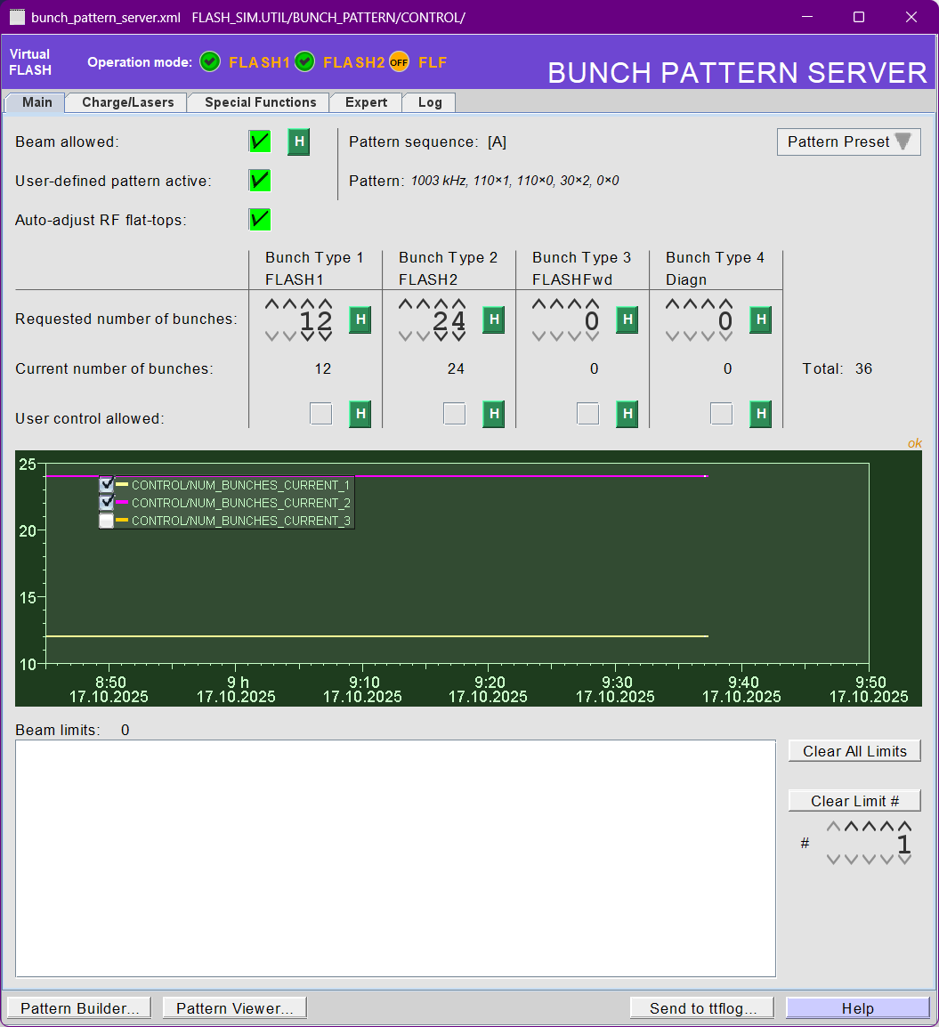
Live from the Virtual XFEL

Slide 17
Subtrains – Reflecting the Pattern in the Control System
A subtrain is the set of all bunches in a macropulse that share some common feature. Seven of them are defined at FLASH.
They appear mainly in property names:
X.FLASH2.TRAIN.MEAN_PKPK the mean value and peak-to-peak variation over all bunches of subtrain FLASH2
ALL contains all bunches.
FLASH1 contains all bunches with destination FLASH1
FLASH2 contains all bunches with destination FLASH2.
FLASH3 contains all bunches with destination FLASHfwd.
LASER1 contains all bunches produced by the first injector laser
LASER2 contains all bunches produced by the first injector laser
LASER3 contains all bunches produced by the fhird injector laser

