Slide 1

High-Speed Links
Tobias Flick
Bergische Universität Wuppertal
15.3.2012
5th Detector Workshop of the Helmholtz Alliance "Physics at the Terascale", Bonn

Slide 2
Outline
Why high speed links?
What is on the market?
Special Requirements for Detector Readout
Versatile Link Project
Fast Link Test Bench
Conclusion

Slide 3
Why High-Speed Links?
Today:
100 Mb/s
Higher Lumi:
1Gb/s
Combined Links:
5-10 Gb/s
Track Trigger:
100 Gb/s -1Tb/s
Higher luminosity
  Higher occupancy
  Larger dead-time
  Pile ups in FE-electronics
Finer granularity
  More front end channels
  Need of more readout channels or combine channels a faster readout channel
More information
  Trigger farms can handle more information
  Need of transferring data faster to the trigger system for better trigger decisions
  → Track Triggering

Slide 4
Reliable Linking
TX/RX
TX/RX
TX/RX
TX/RX
Redundancy
  only possible for not too many links
    Ranges from: no hardware redundancy at all
    Over: Add a spare link per bunch of links (i.e. 1-2 per optical array)
    To: implement each link doubled
Transmission check features
  Implemented in transmission protocol
  Needs overhead in bandwidth
Use techniques which are robust, common in industry, and can be adopted to the harsh environments they need to survive in
This is bought by adding material and reducing usable bandwidth

Slide 5
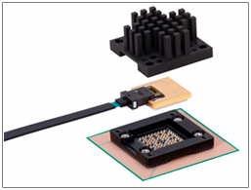
What is on the market?
Picture by Furukawa
Transmitters (single channel / array)
  Multi mode VCSEL (vertical surface
  emitting laser)
  Single mode EEL (edge emitting laser)
  Bandwidth up to several 10 Gb/s
    First products at over 100 Gb/s
  Single channel and arrays
Receivers and fibres to fit the transmitters
Transmission techniques
  Single wavelength signals as well as several wavelengths per fibre possible
  Wavelength combinators and extractors
  Active optical cables integrating the optical components into the cable assembly and offering electrical connectors
Furukawa array:
840 mW at 120 Gb/s

Slide 6
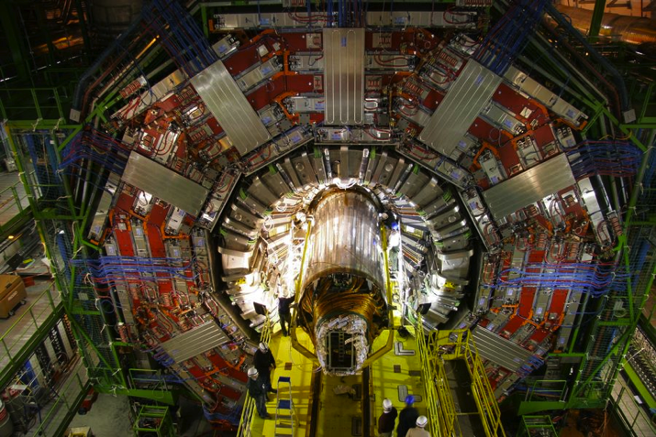
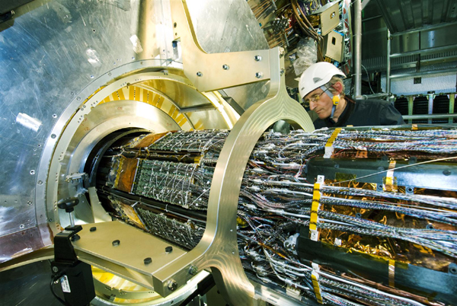
Special Requirements for Detector Readout
CMS
The usual requirements for
components inside the
detector regions:
  Low mass
  Low power
  Radiation hardness
  Robustness in usage over many years
The current strategy is to use links with high bandwidth in the outer regions (muons or even trigger) and with getting closer to the beam pipe to reduce bandwidth
  Trigger: several Gb/s
  Calorimeter: 1 Gb/s
  Tracker: < 0.5 Gb/s
ATLAS
For example

Slide 7

Two projects in more detail
Versatile Link
  A joint project involving ATLAS and CMS started in 2007/2008
Test bench for fast optical links
  A Helmholtz Alliance Project carried out by DESY, University Heidelberg (incl. ZITI) and University Wuppertal

Slide 8
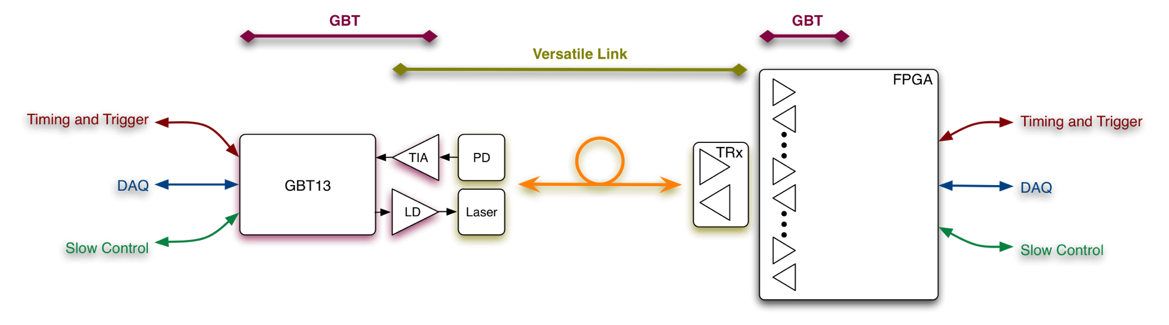

Versatile Link Project
F. Vasey et al
Optical Physical layer linking front- to back-end
Bidirectional, ~5Gb/s
Versatile
  Multimode (850nm) and Singlemode (1310nm) versions
  Point to Point and Point to Multipoint architectures
Front-end pluggable module
Joint Project Proposal submitted to ATLAS & CMS upgrade steering groups in 2007 and endorsed in 2008
Project Kick-off: April 2008
  Phase I: Proof of Concept (18mo)
  Phase II: Feasibility Study (18mo)
  Phase II: Consolidation (6mo)
  Phase III: Pre-production readiness (18mo)
On-Detector
Custom Electronics & Packaging
Radiation Hard
Off-Detector
Commercial Off-The-Shelf (COTS)
Custom Protocol

Slide 9
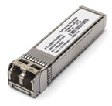
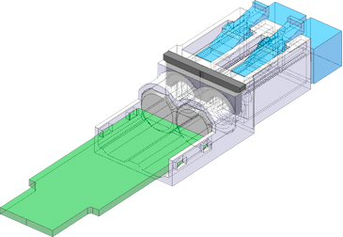
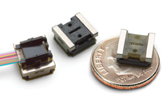
Versatility
F. Vasey et al
Front-End VTRx | Fibre | Back-End TRx
EE laser, 1310nm | SM | LR-SFP+ TRx
VCSEL, 1310nm |  | SNAP12’like Rx
InGaAs PIN, 1310nm |  | Opto Engine Rx
VCSEL, 850nm | MM | SR-SFP+ TRx
GaAs PIN, 850nm |  | SNAP12’like Tx,Rx, TRx
InGaAs PIN, 850nm |  | Opto Engine Tx, Rx, TRx

Slide 10
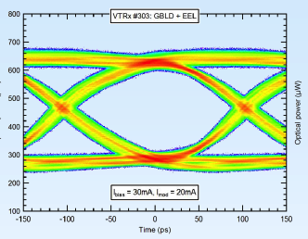
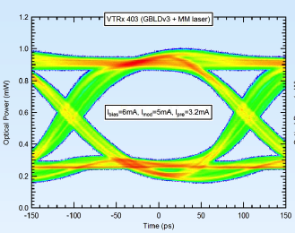
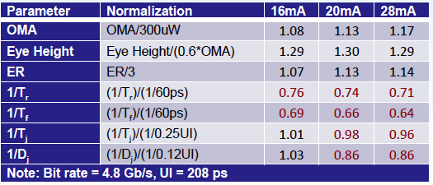
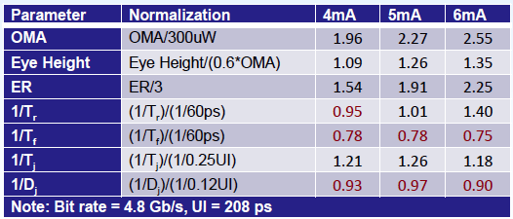
Laser Performance
C. Soos et al.
Single Mode EEL
Multi Mode VCSEL
Bandwidth 4.8 Gb/s

Slide 11
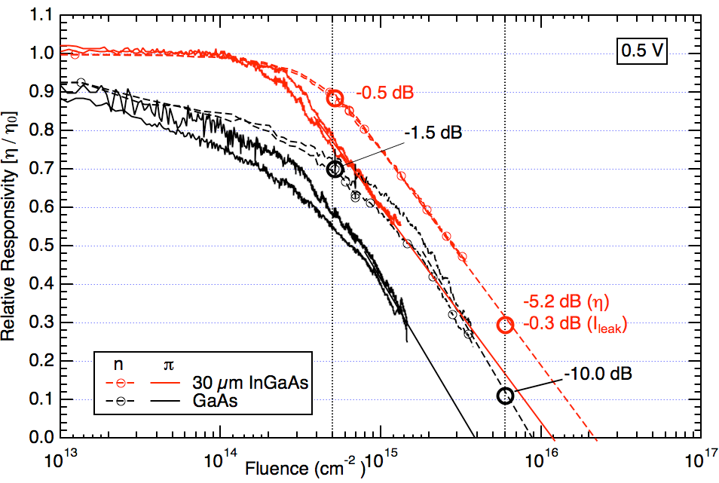
Pin Radiation Induced Responsivity drop
J. Troska et al
Calorimeter
Tracker

Slide 12
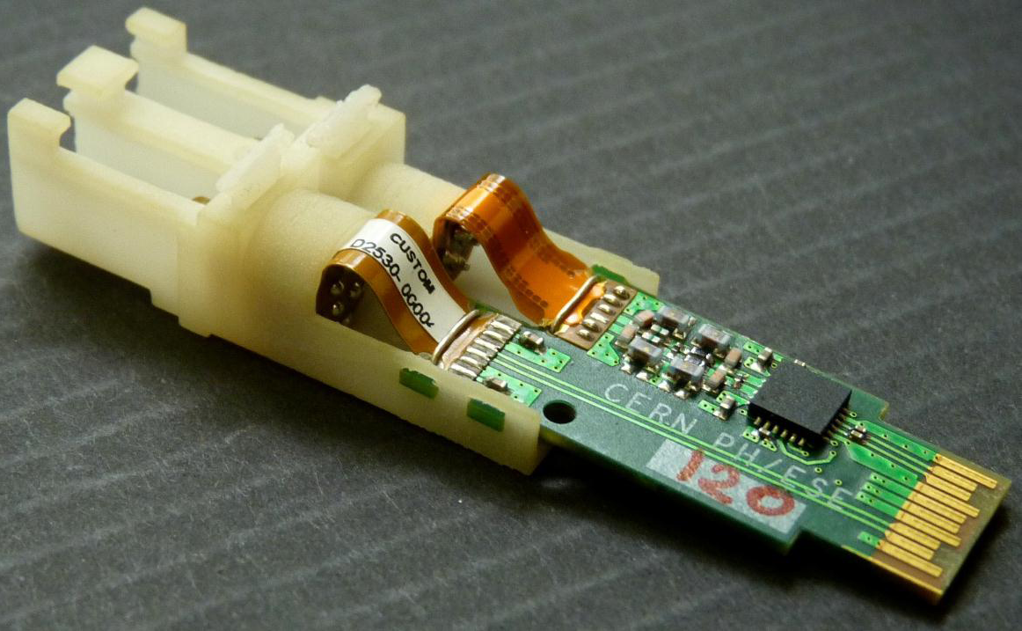
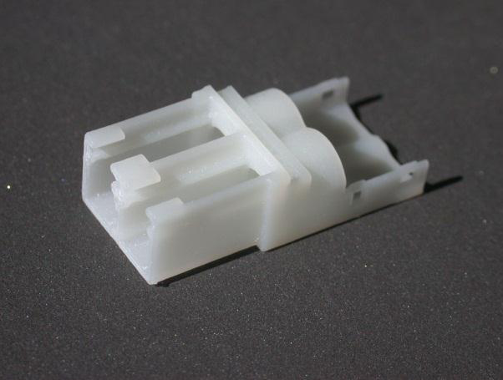
VTRx prototype demonstration
Optical connector interface designed and fabricated using rapid 3D prototyping
  Different materials
  Different designs
Several VTRx prototype versions built and tested
  SM, MM

Slide 13
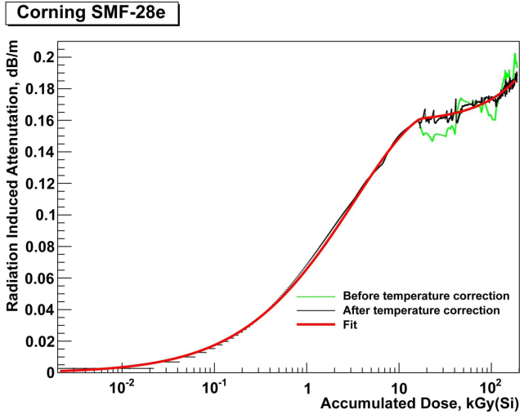
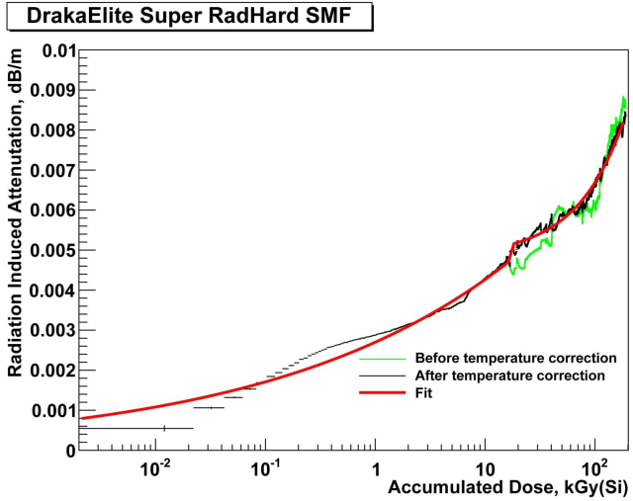
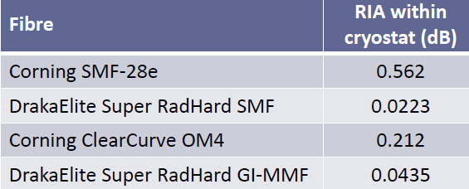
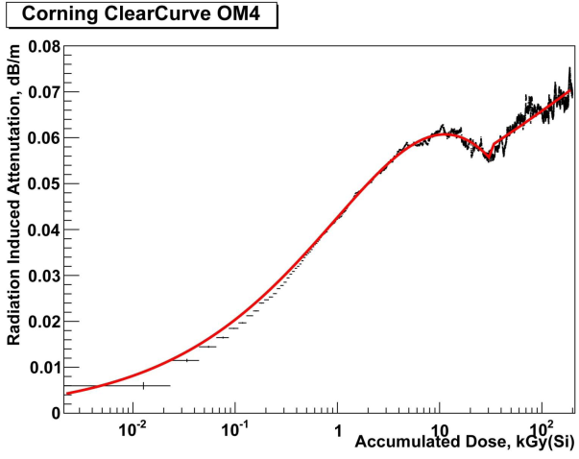
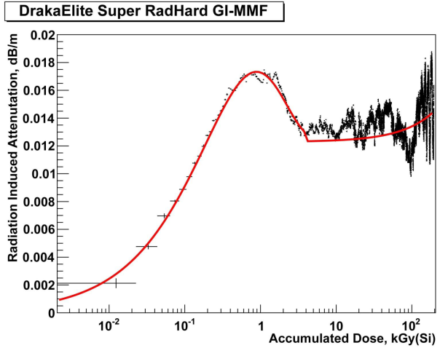
Radiation-Induced Attenuation in the cold
Optical Fibres radiation damage depends on operating temperature
Cold operation is the worst case as charge carriers are cold trapped
Last tests showed, that one can find fibres operating well under radiation at cold temperatures for up to HL-LHC levels (Tracker)
A fibre is qualified if its total RIA (radiation induced attenuation) is less than 1 dB
SM
SM
  Dose Rate:
  0.66 kGy(Si)/hr
MM
MM
D. Hall et al

Slide 14
Versatile Link Conclusions
Optical links as we know them currently can be used for HL-LHC like experiments even in the inner trackers with a transmission bandwidth up to around 5 Gb/s
SM and MM links are available already now (not final designed for detectors yet)
Laser (VCSEL / EEL), PiN Diode (InGaAs / GaAs), and Fibres fit the environmental requirements
GBT (not covered in this talk) can serve as the electronics part
Further improvements in speed are expected up to around 8-10 Gb/s

Slide 15




Fast Link Test Bench
Device under Test
Driver / Receiver
FPGA board
Pattern Generator
Ext. Devices
Seria-lizer
Optical or electrical transmitter
Data
Generator
Fast Scope
PC
BERT
De-Seria-lizer
Receiver
Opt./electr.
Link
Reference
FPGA board
Complete Transmission Line

Slide 16
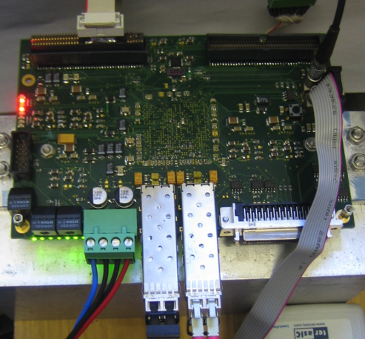
Transceiver Card
In Heidelberg an FPGA based transceiver card has been developed in context of their projects
Supports 3.125 Gb/s
Use of radiation hard qualified components
With this irradiation studies on SFP components can be done (foreseen for the next possible beam test)
Upgraded versions with higher bandwidth (6.375 Gb/s) and more channels underway
This is a possible test bench for SFP
single channel transmitters

Slide 17
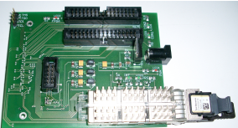
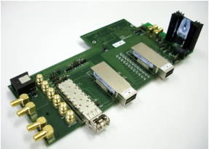
Adaptor Boards for Optical Arrays (W)
In Wuppertal several adaptor boards have been designed to support laser and PiN diode arrays.
QSFP packaged arrays can be attached
SNAP12 Receiver and Transmitter can be placed together with an SFP package

Slide 18
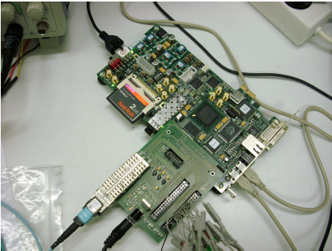
FPGA based Test Bench
Commercial FPGA boards serve as development platform
A BERT has been implemented for multi channel tests
Optical signal measurements done with a slow scope at the moment
Need of bandwidth increase
Modular setup to control different
Optical devices separately using the same mainframe.

Slide 19
Test Bench Outlook
Since most development in this project have been driven or gone in parallel with the experiment projects of the different labs, this year a dedicated board is envisaged.
The experience of the different groups on the particular research fields will be brought together.
  High speed (up to 10 Gb/s) boards
  Modular adaptor kids for single channel and multi channel links
  Irradiation experiences
For this we kept a big fraction of the funding to be spent to the development and production of the aimed boards using high speed FPGAs and high bandwidth optics for reference.

Slide 20
Conclusion
High speed transmission links for the tracking systems (worst environmental requirements to fulfil) can serve already several Gb/s
Standard optical techniques are used successfully
The Versatile Link project developed an optical link to be used in inner tracker at HL-LHC running at 5 Gb/s
The Helmholtz Test Bench project will be built serving bandwidth capabilities in the 10 Gb/s range
Aiming at even higher bandwidth >10 Gb/s further effects might show up influencing the light transmission
  Polarisation Mode Dispersion for wavelength division multiplexed transmissions (stochastic dispersion, see research work of TU Darmstadt on PMD compensators)
  Fibre non linearity
  …

