Slide 1
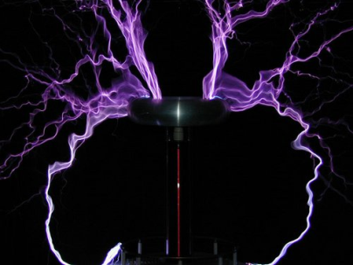
Novel Powering Schemes
Katja Klein
1. Physikalisches Institut B
RWTH Aachen University
5th HGF Detector Workshop, Bonn
March 15th, 2012

Slide 2
Outline
Motivation
DC-DC conversion
Buck converters
CMS pixels
CMS strips
ATLAS strips
Switched capacitor converters
CMS strips
ATLAS pixels
Serial powering
[ATLAS pixels → covered in Laura‘s talk]
ATLAS strips
Summary

Slide 3
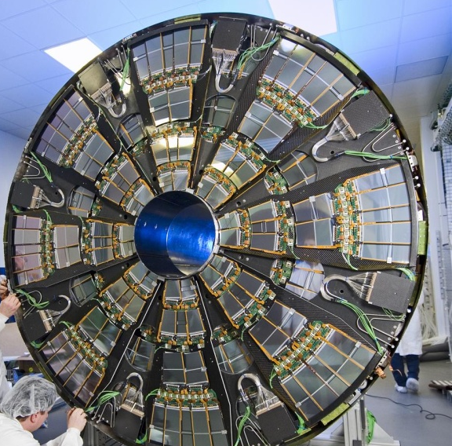
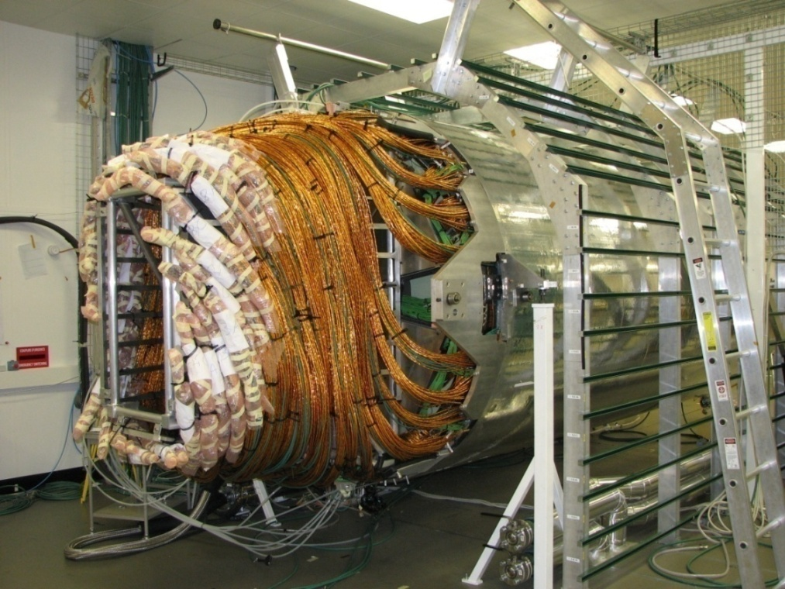
Tracker Power Distribution
CMS end cap before cabling
CMS strip tracker after cabling
Silicon trackers need a lot of power: e.g. CMS strips 33kW, CMS pixels 3.6kW
Power is supplied via ≈ 50m long cables from power supplies (PS) on balconies ⇒ Power loss P_{loss} = R_{cab}⋅I² in cables amounts to about 50-60% of total power
Future trackers will need even more power (more channels, more functionality)

Slide 4
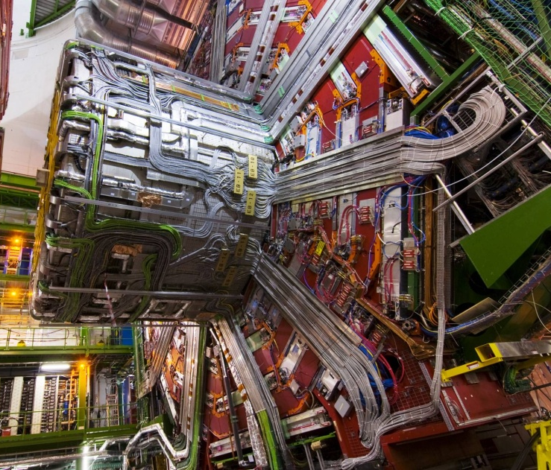
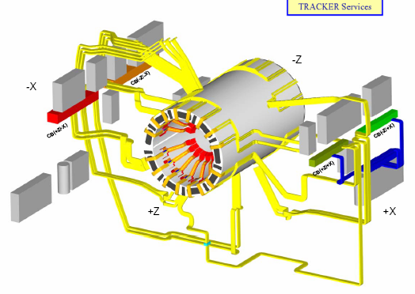
Tracker Power Distribution
CMS Tracker cable routing
Complex routing of services → exchange for HL-LHC (still) not considered an option
Cable channels full and maximal total current limited (e.g. CMS strips ~ 15kA)

Slide 5
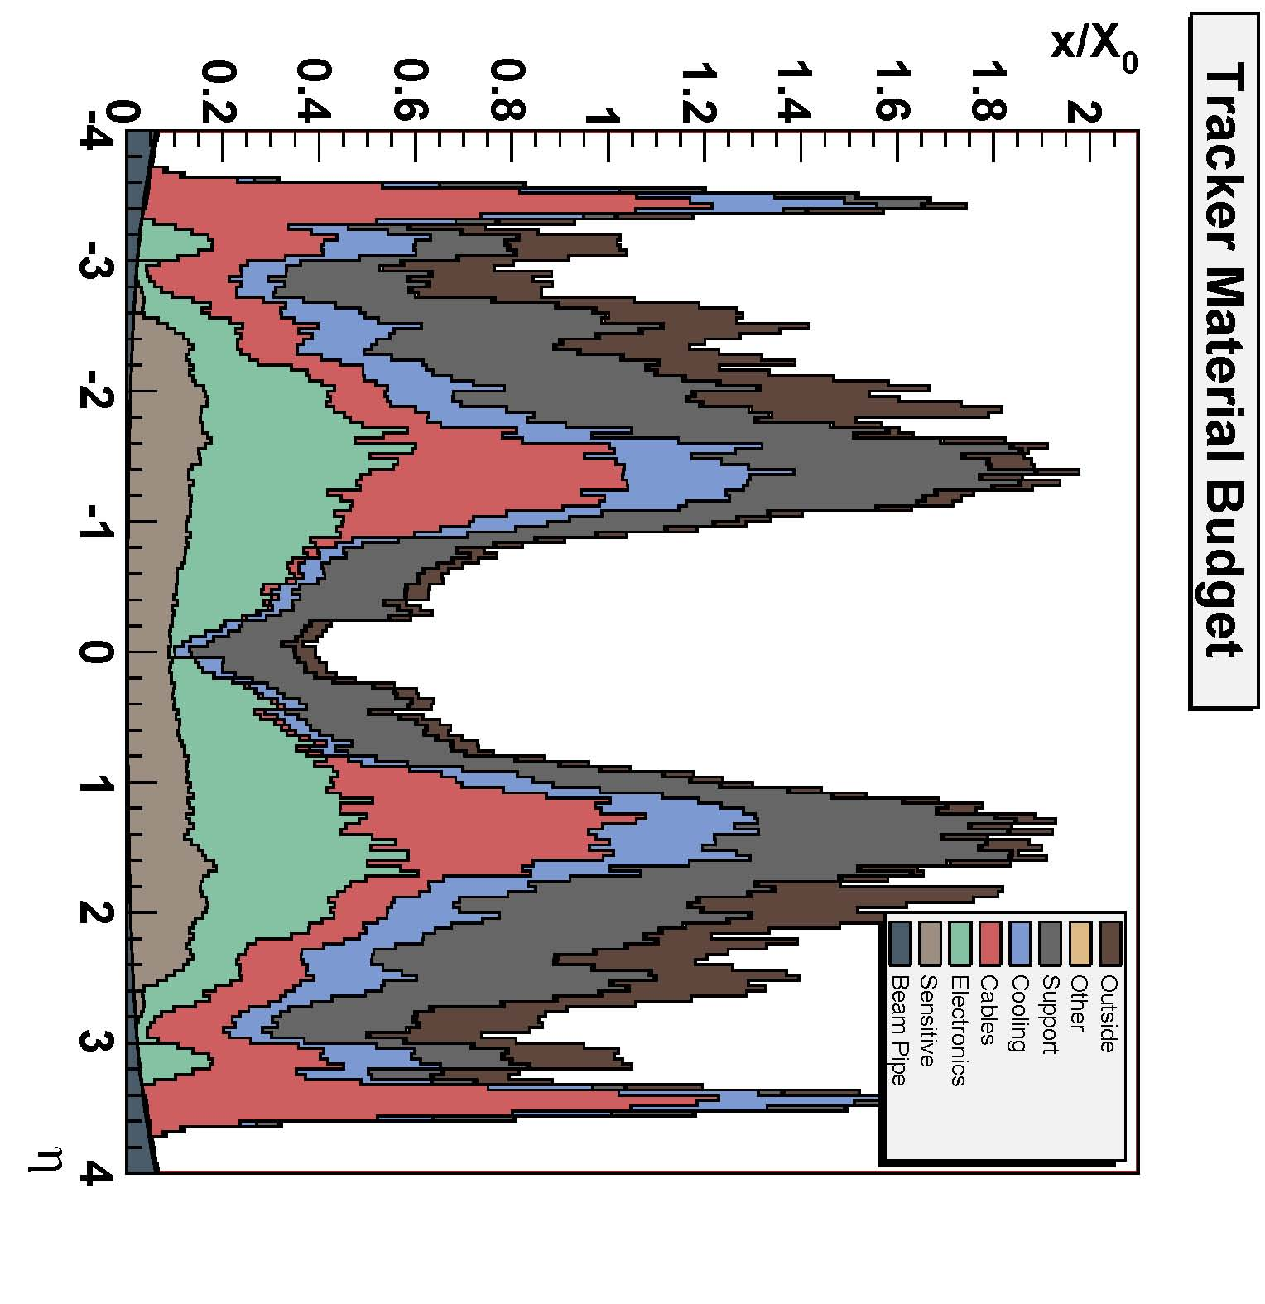
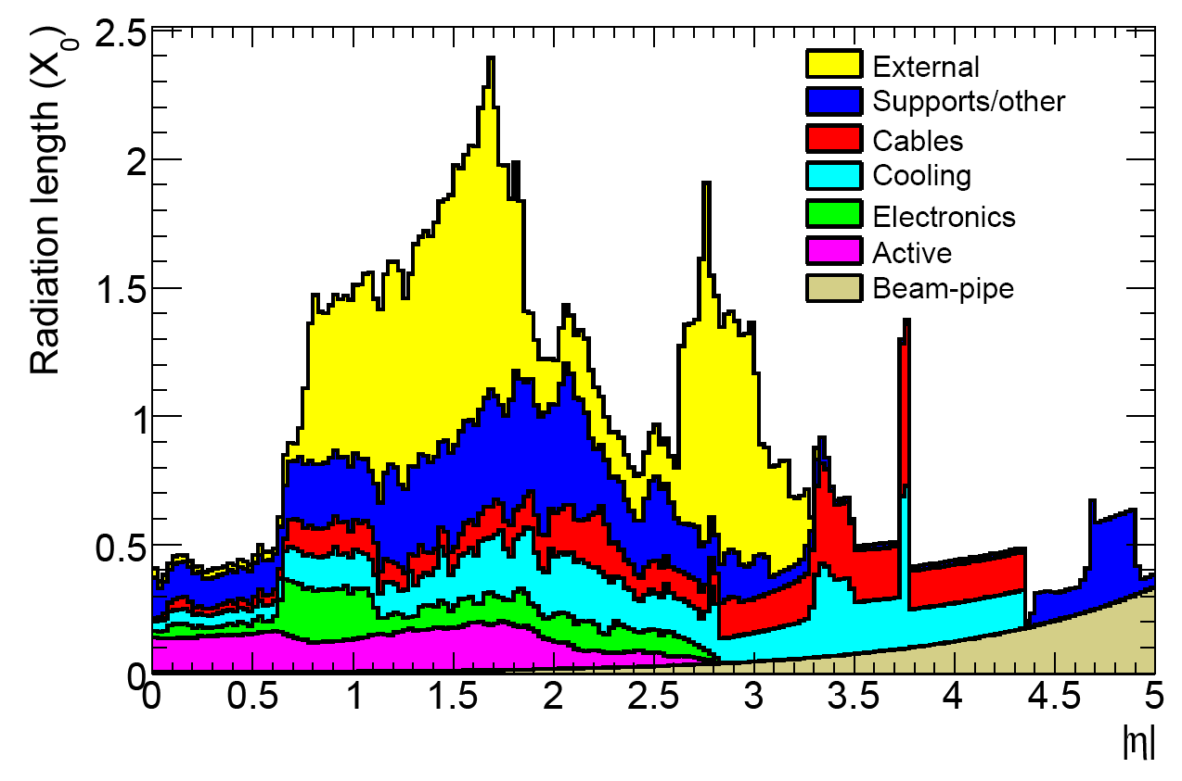
Tracker Power Distribution
ATLAS Tracker material budget
CMS Tracker material budget
Power related contribution to material budget is significant (Category “Cables“, but also hidden in “electronics“, “support“, “cooling“)
Strategy to reduce power-related material contributions:
Reduce front-end power consumption (difficult)
Reduce supply currents by applying novel powering schemes

Slide 6
Powering Schemes
Independent powering (ATLAS today)
Parallel powering (CMS today)
PS
D
PS
D1
Dn
Serial Powering (ATLAS upgrade ?)
DC-DC conversion (CMS upgrade, ATLAS upgrade ?)
PS
D1
D2
Dn
Low current
DC-DC
Converter
PS
D
Large
current
Basic idea:
Provide power at higher voltage and lower current, convert back on-detector
Basic idea:
Reduce current by “recycling“ it
Effect in both cases: lower Ohmic losses and lower voltage drops → less / thinner cables required off-detector, less copper required in tracker volume

Slide 7
DC-DC Conversion
Short cables (cm)
Long cables (~ 50m)
DC-DC
Converter
E.g. r = 4
10V → 2.5V
Detector module
PS
E.g. 10V, 0.5A
Detector module
E.g. 2.5V, 2A
Idea: Deliver P = U⋅I as (rU)⋅(I/r) with conversion ratio r >> 1
Reduce losses P_{loss} = R⋅I² in input cables by factor r²
Many different working principles and layouts → cover here buck converters & switched capacitors (main areas of tracker R&D)
Pro:
Standard system design (grounding, communication)
Con:
Switching with MHz frequencies → switching noise
Trade-off between high efficiency and low mass
Was main argument for CMS
to move to this scheme!

Slide 8
DC-DC Buck Converters
Phase 1
Duty cycle D = t_{1,on}/T; r = V_{in}/V_{out} ≈ 1/D
Phase 2
Pro:
Can supply large currents (< 3-4A)
Regulation of output voltage, based on Pulse Width Modulation
High conversion ratio possible (V_in < 10V)
Con:
Radiation tolerance of high-voltage transistors
Several discrete components: coil, capacitors, shield → additional material
Saturation of ferrites in > 2.5T field → air-core coil → massive, high resistance, radiation

Slide 9
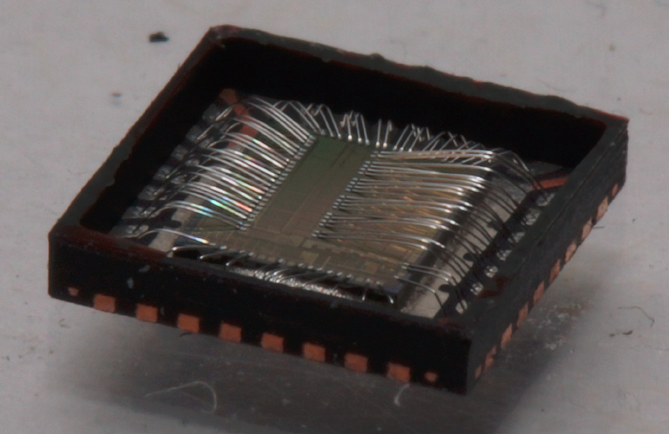
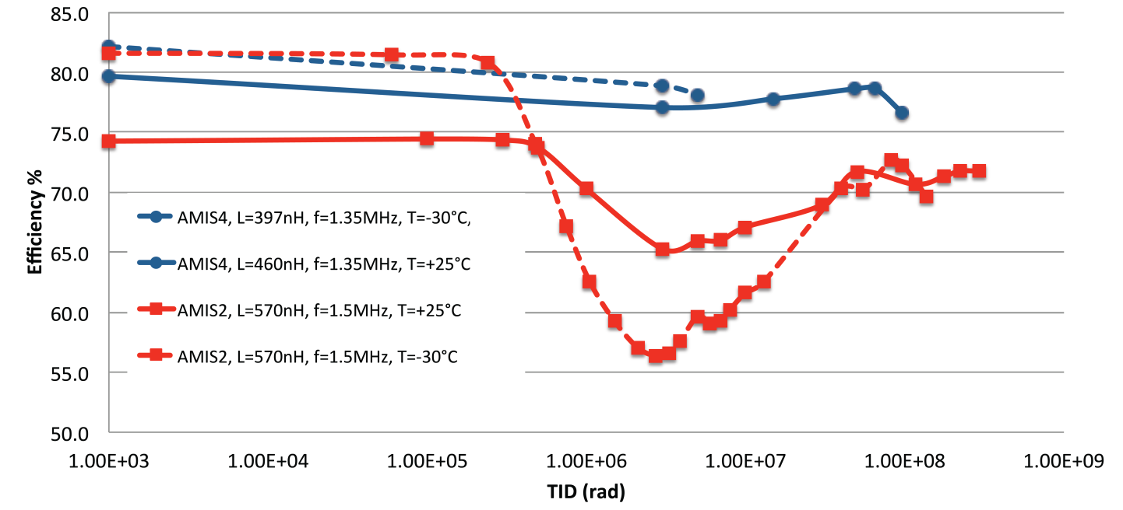
DC-DC Buck Converters: The ASIC
ASIC includes transistors and voltage regulation circuit (PWM)
Custom radiation-tolerant ASICs by CERN-PH-ESE (Faccio et al.) since 2008
Latest prototype in AMIS I3T80 0.35µm CMOS (ON Semiconductor, US)
AMIS4 operating parameters:
V_{in} < 10V
I_{out} < 3A (4A @ -30°C)
f_{s} = 1-3MHz
L = 200-500nH
AMIS4 Features (not exhaustive)
Bandgap and linear regulators integrated
Dead time handling with adaptive logic
Triplication and logic against SEU
Over-temperature protection
Input under-voltage protection
Soft start
“Power good“ status signal
AMIS4
Efficiency [%]
AMIS2
2012 JINST 7 C01072
Total Ionizing Dose (TID)

Slide 10
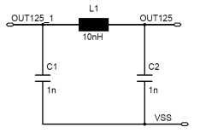
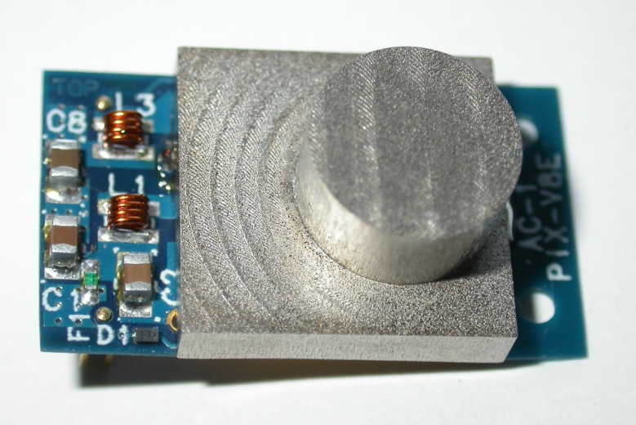
DC-DC Buck Converters
Buck conv. with AMIS4 are developed by CERN (for ATLAS) & Aachen (for CMS)
V8 E: 2.6cm x 1.5cm; 1.5 -1.6g
ASIC: AMIS4 by CERN
V_{out} = 3.3V or 2.5V
f_{s} = 1.5MHz
2-layer PCB
Toroidal plastic core inductor L = 450nH
Pi-filters at in- and output
Why is a shield required?
to shield the magnetic emissions
as cooling contact for the coil
to segregate “noisy“ parts from output filters
PoS (Vertex 2011) 041

Slide 11
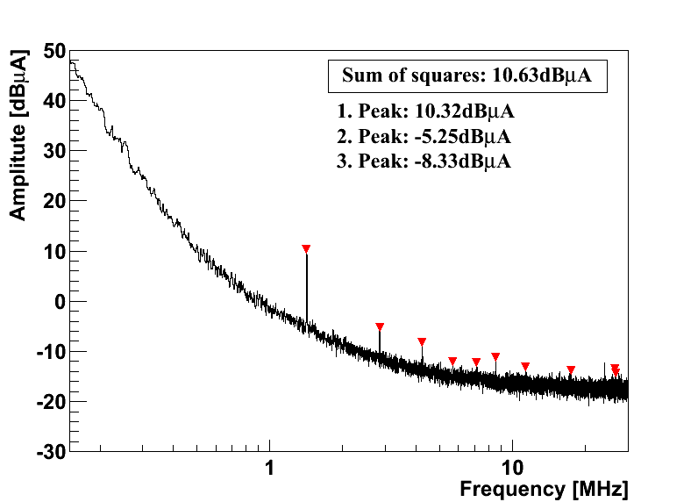
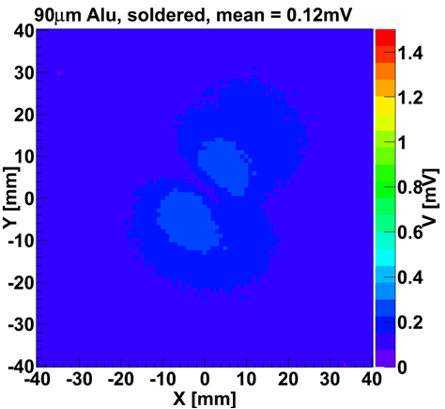
Buck Converter Performance
Efficiency around 80% for r = 3-4
Both ripple and Common Mode noise sufficiently low
Shield reduces magnetic field to negligible level
→ Performance is good
Magnetic field
above DC-DC
converter
Differential mode
= “Ripple“

Slide 12
Buck Converter Material Considerations
Contributions from chip (negligible), PCB, coil, shield, passives
Coil: Aluminium (CCA with 10% Cu) instead of copper
For same L, mass reduced by ~ 2, material budget by ~ 3
Resistance increased by 38% → 2% lower efficiency
Shield: Metal-coated plastic versus full Aluminium
90µm Alu (+ 15µm Ni + 15µm Cu for solderability)
Plastic body (e.g. rapid prototyping) with 2 x 30µm Cu
Reduce area (actually for space constraints)
Both work fine; coated version has 56% larger MB, but is cheaper
Passives: filter caps etc.
Reduce size → noise still low
Reduce number? Silicon caps??

Slide 13
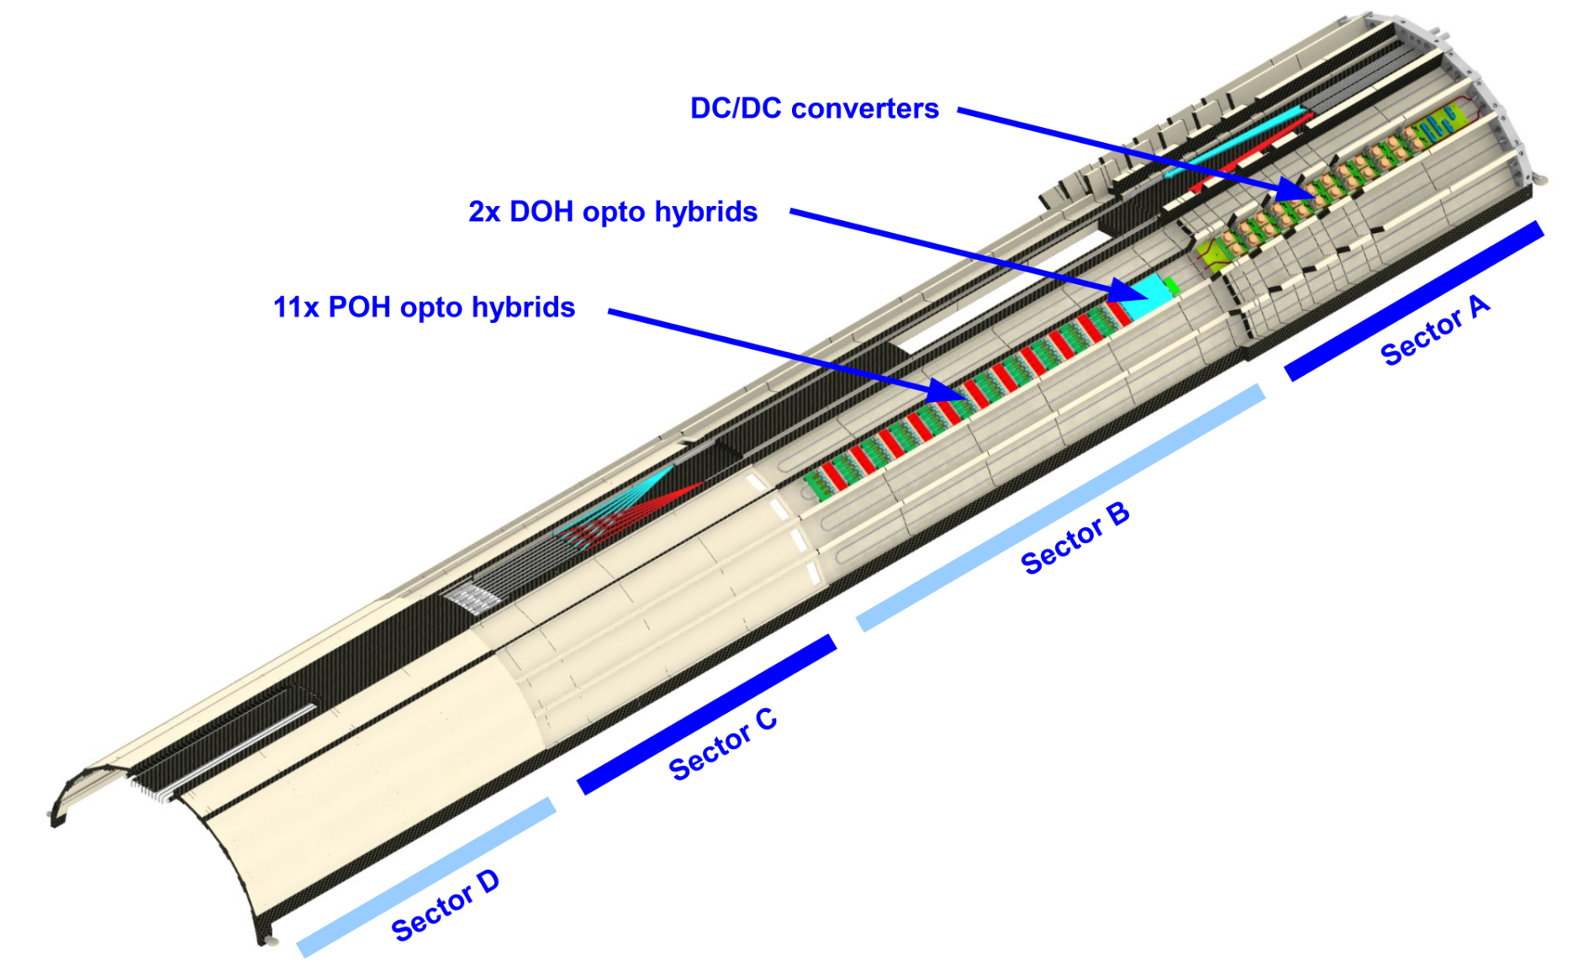
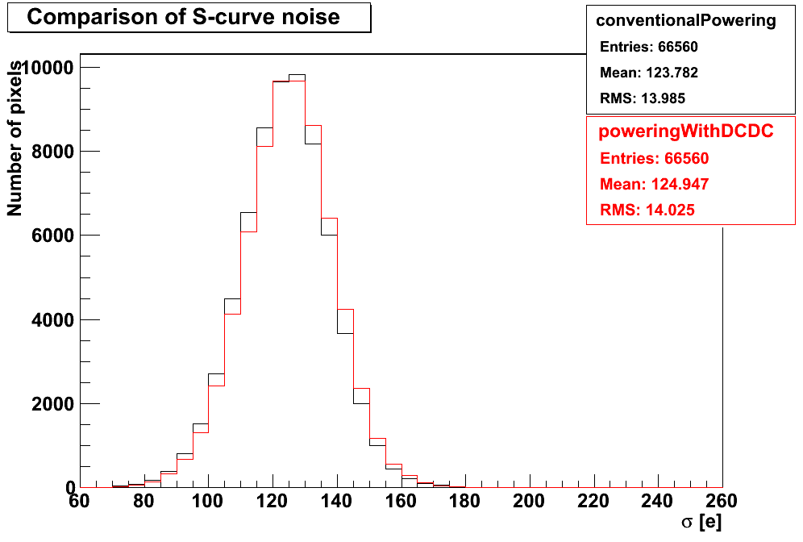
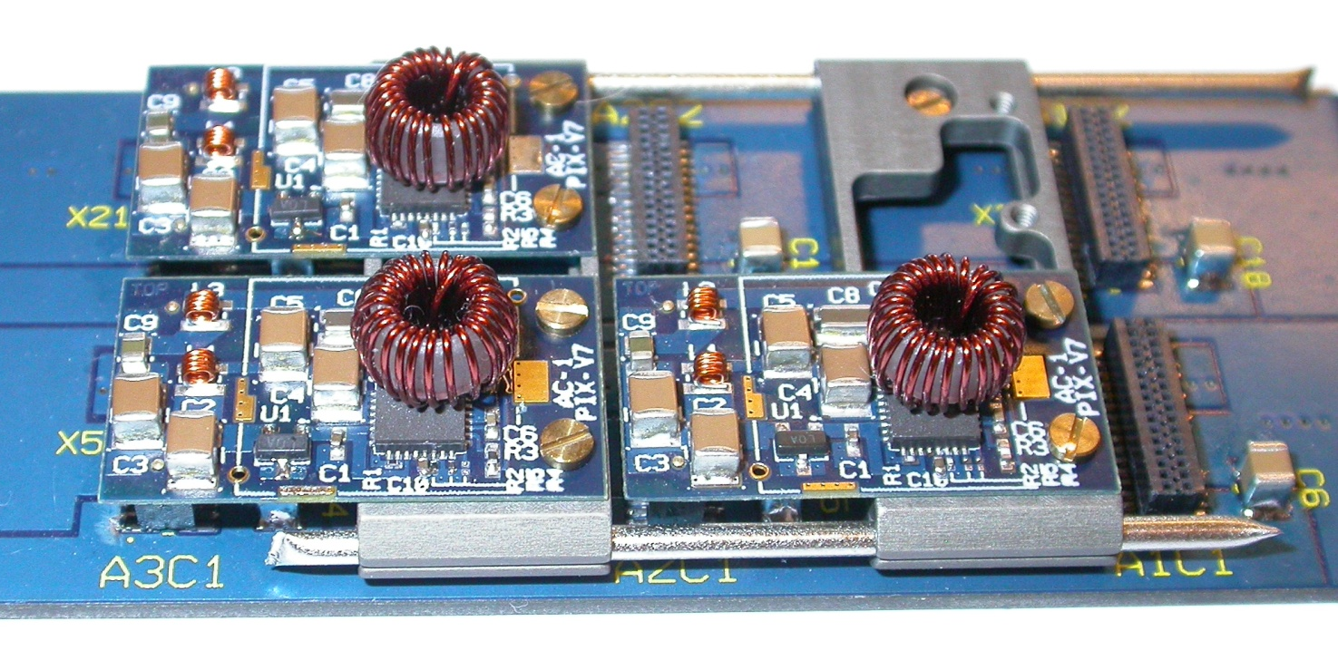
Buck Converters for CMS Pixel Upgrade
Phase-1 pixel detector needs factor ~ 2 more power
Buck converters with conversion ratio of 3-4
Converters located at η ~ 4
Goal is NOT to reduce material in tracking volume, but to be able to power the detector!
No increase of pixel module noise
2000 buck converters required by 2014
DC-DC converters
z
2m
Noise from all pixels
Conventional powering
Mean 123.8
DC-DC conversion
Mean 124.9
x
IP

Slide 14
Buck Converters for CMS Strip Upgrade
Outer tracker (r > 60cm):
Modules with 2 strip sensors
p_{T} discrimination → trigger
CMS Binary Chips (CBC) – on top side only
Lower sensor connected through vias in hybrid
Data
concentrator
r
90µm
Pass
Fail
2 x 5 cm strips
1mm
⊗ B
Buck converter
rφ
“Low-power GBT“
Buck converter could be placed on “service hybrid“
Estimate 2.1W at 1.2V per module → fits well with capabilities of buck converter
Converter very close to module → noise interference is a concern

Slide 15
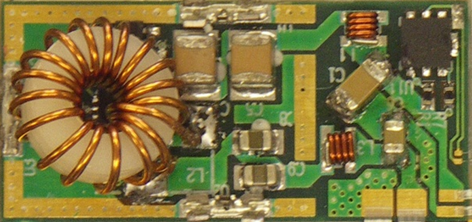
Buck Converters for ATLAS Strip Upgrade
Studied in parallel to serial powering
Stavelet with 4 modules equipped with buck converters
I = 5A per hybrid → CERN-board with commercial chip
100µm copper shield
ENC depends on converter hook-up configurations (star, independent, backplane connections, …)
With best configuration up to 31 ENC excess noise wrt single module measurement – deemed acceptable
ABCN-25
STV-10 converter
2012 JINST 7 C02028

Slide 16
Switched Capacitor DC-DC Converter
In simple step-down layout: capacitors charged in series and discharged in parallel
→ I_{out} = n⋅I_{in}, with n = number of parallel capacitors (“charge pump“)
Phase-1: charge
Phase-2: discharge
E.g. 2:1
e.g. 1µF
e.g. 200nF
Pro:
Can be part of readout chip
Only cap(s) are external → very low material budget
High efficiency (90%)
Con:
Standard CMOS → conversion ratio low (2:1)
Low output currents (50mA - 1A)
Might inject noise into chip substrate
No regulation of output voltage

Slide 17
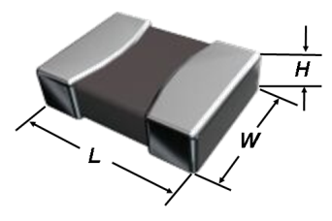
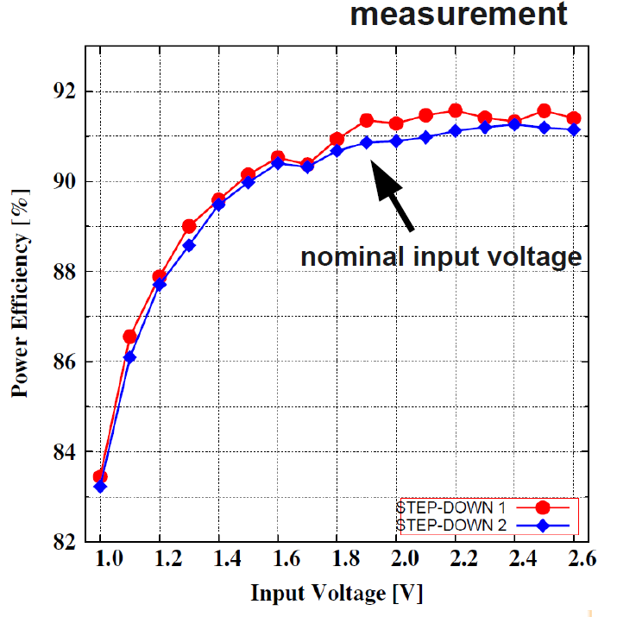
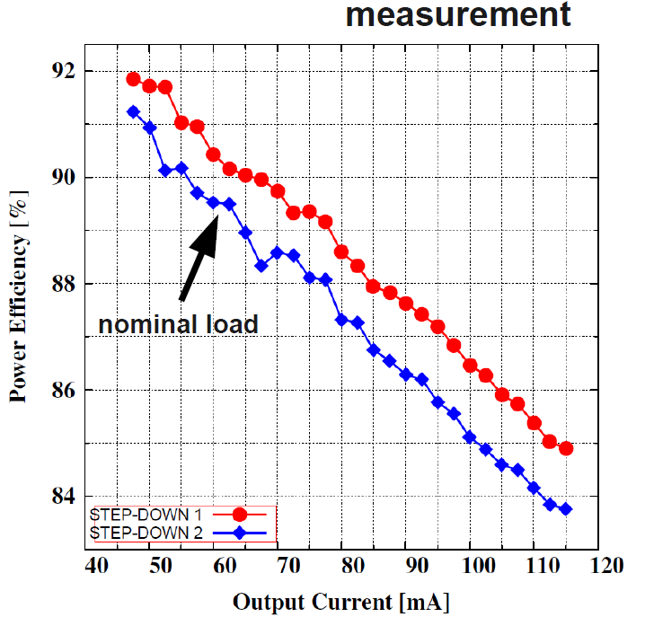
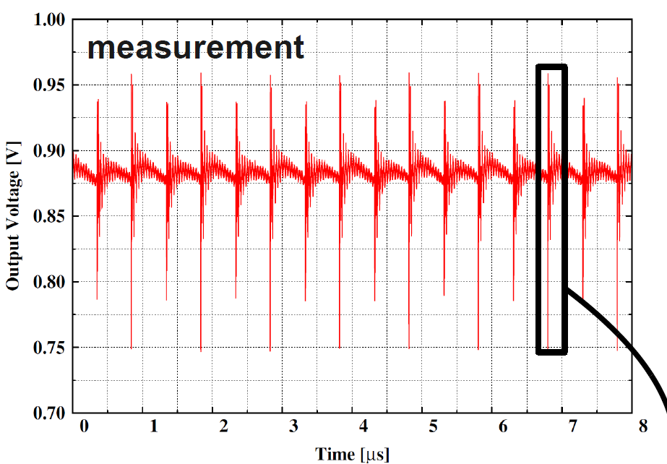
Switched Capacitor DC-DC Converter
Two chips (rather blocks) have been developed in our community
From CERN (Iout = 60mA), used by CMS in CMS Binary Chip
From LBNL (Iout = 500mA), used by ATLAS in FE-I4
Both with f = 1MHz
Both „divide-by-two“ → 1 external capacitor (1µF → L x W = 0402 or 0603)
Both chips do work
Ripple large
Efficiency lower than in simulation but still ~ 90%
2010 JINST 5 C12031
CERN converter

Slide 18
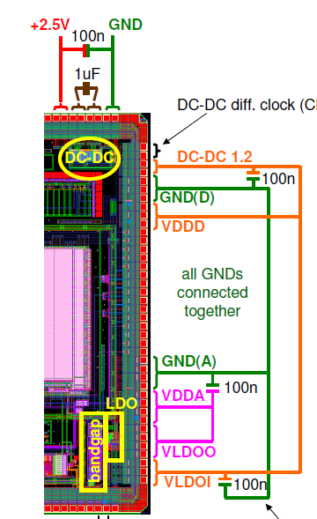
Switched Capacitor in CMS Strips Upgrade
Switched capacitor converter by CERN is part of 130nm CMS Binary Chip (= prototype readout chip for strip tracker)
Used to convert 2.5V into 1.25V
Could be combined with buck converter → large r
Works well, with efficiency of ~90%
Spurious charge injected by transients → increase of noise, but only for high input capacitance
Chip will be part of next, bump-bonded CBC
1.78pF
5.79pF

Slide 19
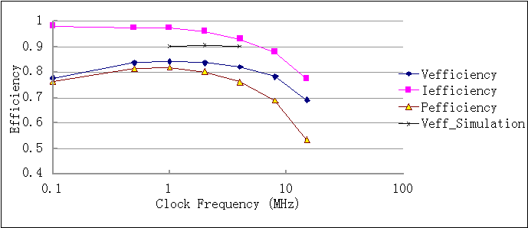
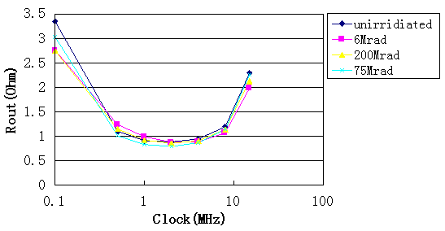
Switched Capacitor in ATLAS Pixel Upgrade
FE-I4 includes (optional) switched capacitor converter (LBNL)
Efficiency of 84%, radiation-hard
Noise increase even if running but not connected, depends on details of external configuration
Want to have higher conversion ratio → need more capacitors → move to on-chip capacitors
Might be investigated in a future versions of readout chips

Slide 20
Serial Powering
I₀
0V
Regulator
Detector module 1
1⋅V₀
PS
Regulator
Detector module 2
Regulator
Detector module n
n⋅V₀
Idea: Recycle current → need to deliver current I₀ of a single module only
Reduce losses P_{loss} = R⋅I² in input cables by factor n²
Each module is on a different ground potential
AC coupling of communications
Power supply = constant current source
Digital and analog supply voltages derived locally by shunt and linear regulators
Con:
Implications on system design (grounding …)
Current fixed to highest current needed by any member of chain → local inefficiency can be high
Pro:
n can be very large
Few additional components

Slide 21
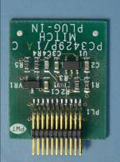
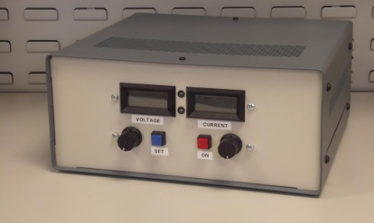
Serial Powering in ATLAS Strips
Serially powered stavelet developed and under study
Development of custom circuitry far advanced
Basic functionality good
Concentrate on ENC and occupancy
2012 JINST 7 C02028
M-shunt plugin
Custom Current Source
Power
Protection
Board
0-6A, 80V
0V
2.5V
5V
7.5V
10V
12.5V
15V
17.5V
20V

Slide 22
Serial Powering in ATLAS Strips
Single triggers: ENC 619-678, compared to 600-665 from reference measurement
Double Trigger Noise Test: send two triggers with adjustable spacing → probe the occupancy increase due to readout of first event
Large occupancy in every second hybrid
Improvement by routing currents through shunt PCBs and braids, or by powering both hybrids of a module in parallel → ENC ≈ 630-750
# of hits
Row of chips

Slide 23
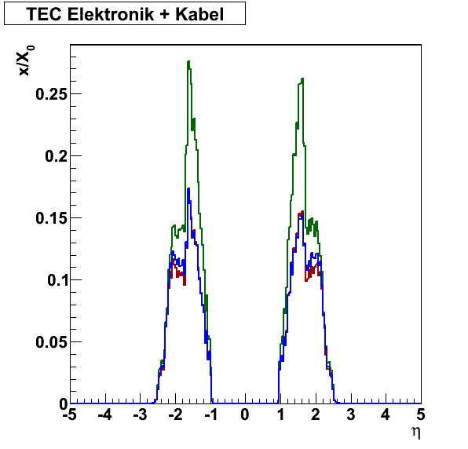
Material Budget
Contribution of buck converter to material budget, compared to CMS strip pT modules (1 converter per module): 15.4% and 9.9% for standard and low-mass versions of buck converter
Contribution of buck converter, compared to ATLAS stave (1 converter per hybrid) 21.8%, 10.4% and 6.0% for standard, low-mass and ultimate buck versions
Serial powering (shunt, control and protection circuitry): 5.6% of stave
→ Powering circuitry itself might contribute with ~ 10% to module material budget
Full case study: current CMS tracker end caps powered with buck converters (r = 8) or in series (whole petal) → ~ 30% material reduction in both cases
Electronics + Cables
Original version
DC-DC: -30.9%
SP: -29.0%
2011 JINST 6 C11035

Slide 24
Summary
Novel powering schemes have to be employed for tracker upgrades:
Serial powering & DC-DC conversion
CMS has chosen DC-DC conversion
ATLAS is investigating both schemes
Both schemes have been shown to work (in principle)
R&D focusses now on system issues
Both schemes can reduce the material budget, with an advantage for Serial Powering

Slide 25
Back-up Slides

Slide 26
DC-DC Buck Converters
I_{L}
4A
I_{L}
1
2
1
2
U_{L}
10V
0A
Duty cycle D = t_{1,on}/T; r = V_{in}/V_{out} ≈ 1/D
t_{1,on}
T
Phase 1
Phase 2
U_{L}
0V
Pro:
Can supply large currents (< 3-4A)
Regulation of output voltage, based on Pulse Width Modulation
High conversion ratio possible (V_in < 10V)
Con:
Radiation tolerance of high-voltage transistors
Several discrete components: coil, capacitors, shield → additional material
Saturation of ferrites in > 2.5T field → air-core coil → massive, high resistance, radiation

Slide 27
Serial Powering in ATLAS Pixels
R&D focused on development of regulation concept: Shunt-LDO in FE-I4
Voltage regulation loop (LDO): provides constant Vout
Current regulation loop (shunt):
Keep current through regulator constant, independent of load (shunt mode)
Set minimum current limit (reduces transients) (partial shunt mode)
See Talk by Laura Gonella
Input
 |  | Partial shunt mode | LDO mode | Shunt mode
V regulation loop
I regulation loop | ON
 | OFF
Input | V
 | I
V regulation loop
Ref voltage
Output
1.5V / 1.2V
I regulation loop
Shunt circuitry enable
Ground
IBL
Serial
Powering,
Phase-1

Slide 28
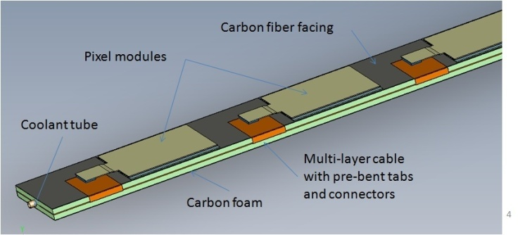
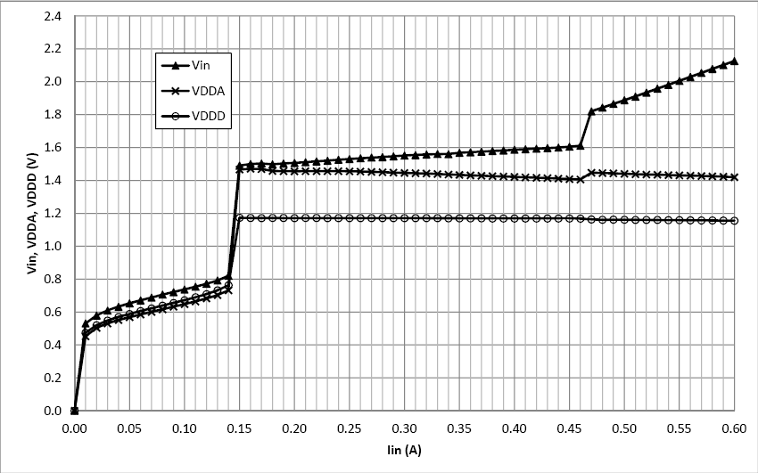
Serial Powering in ATLAS Pixels
Phase-1 outer layer staves = 32 – 40 modules
Per module: 2 x 2 FE-I4 chips
Serial powering unit: 1/4 stave = 8 – 10 modules
Prototyping of SP stave started with 2 x 1 modules
Efficiency = 68-77% for Vin = 1.6V and I = 600mA
AC-coupling & protection circuitry under development
FE-I4
FE-I4
1.5V
1.2V
1.5V
1.2V
I_{in}
Shunt-LDO
Shunt-LDO
Shunt-LDO
Shunt-LDO
Shunt-LDO
Shunt-LDO
Shunt-LDO
Shunt-LDO
I_{out}
1.5V
1.2V
1.5V
1.2V
FE-I4
FE-I4
See Talk by Laura Gonella
Vin
Vana
Vin, Vout [V]
Vdig
2012 JINST 7 C01034
Iin [A]

Slide 29
Material Budget
Contribution of buck converter, comp. to CMS modules (1 converter per module)
 | Standard DC-DC X₀ [%] ¹ | DC-DC / module | Minimized DC-DC X₀ [%] ¹ | DC-DC / module
Todays module | 0.06 | 8.8% | 0.04 | 5.9%
Pixelated trigger | 0.16 | 16.1% | 0.11 | 11.1%
Strip trigger | 0.14 | 15.4% | 0.09 | 9.9%
Stereo module | 0.14 | 9.9% | 0.09 | 6.3%
Contribution of buck converter, compared to ATLAS stave (1 converter per hybrid)
 | Standard DC-DC X₀ [%] ¹ | DC-DC / stave | Minimized DC-DC X₀ [%] ¹ | DC-DC / module | Ultimate DC-DC X₀ [%] ¹ | DC-DC / stave
Stave | 0.1168 | 21.8% | 0.056 | 10.4% | 0.032 | 6.0%
Serial powering (shunt, control and protection circuitry): 0.03% of X₀
→ Powering circuitry itself might contribute with 5-10% to module material budget
¹ normalized to respective module or stave area

Slide 30
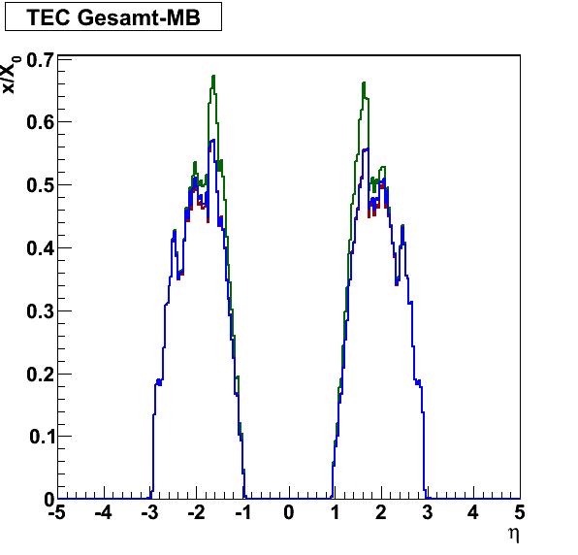
Material Budget
Full case study: current CMS tracker end caps (TEC) powered with buck converters (r = 8) or in series (whole petal)
Similar assumptions for allowed voltage drops etc.
→ Savings in material budget are rather similar
TEC Electronics + Cables
Old geometry
-30.9% (DCDC)
-29.0% (SP)
TEC Total Material Budget
Old geometry
-8.0% (DCDC)
-7.5% (SP)

