Slide 1
Overview of the HPK-campaign
20 December 2011
Joachim Erfle
University of Hamburg
Notes:
1

Slide 2
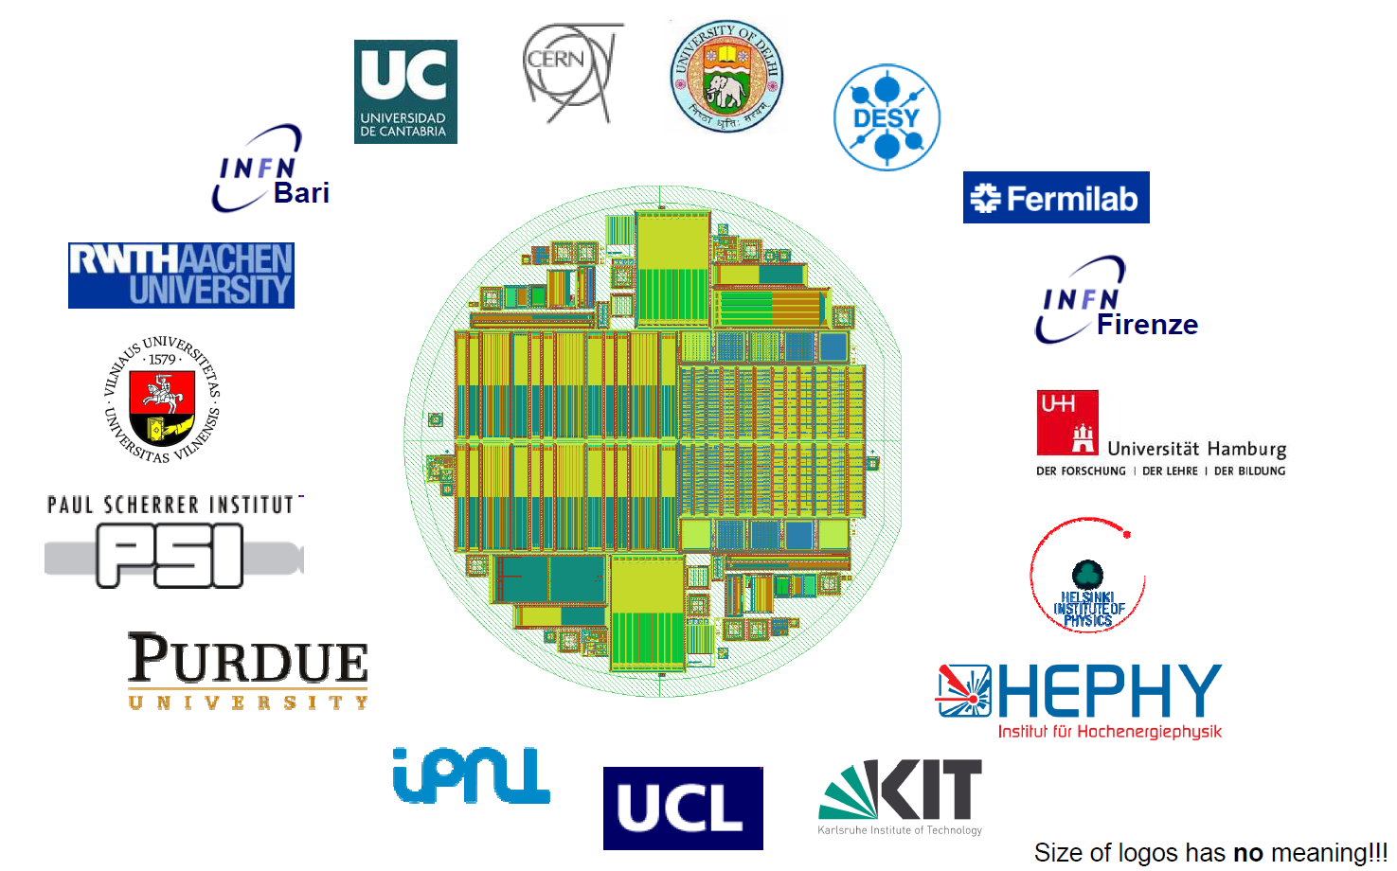
Overview
Introduction to the HPK-campaign
    Devices
    Materials
    Measurements and irradiations
Results of first irradiations
    Dark current
    Effective doping concentration
    Signal collection
Conclusions
17 institutes involved
courtesy of A. Dierlamm, KIT
Notes:
2

Slide 3
Goals of the HKP-campaign
The main challenges for the tracker at the HL-LHC will be:
    Higher radiation dose
    Higher occupancy
The current tracker would not withstand the radiation and also develop occupancy problems
→ Find best best suitable silicon material and layout for a future tracking detector
To achieve that we investigate a large variety of materials:
    Different oxygen, carbon,… content
    Different bulk doping (n and p)
Test sensor geometries and layouts
Irradiations with neutrons or/and protons to simulate HL-LHC radiation dose

Slide 4
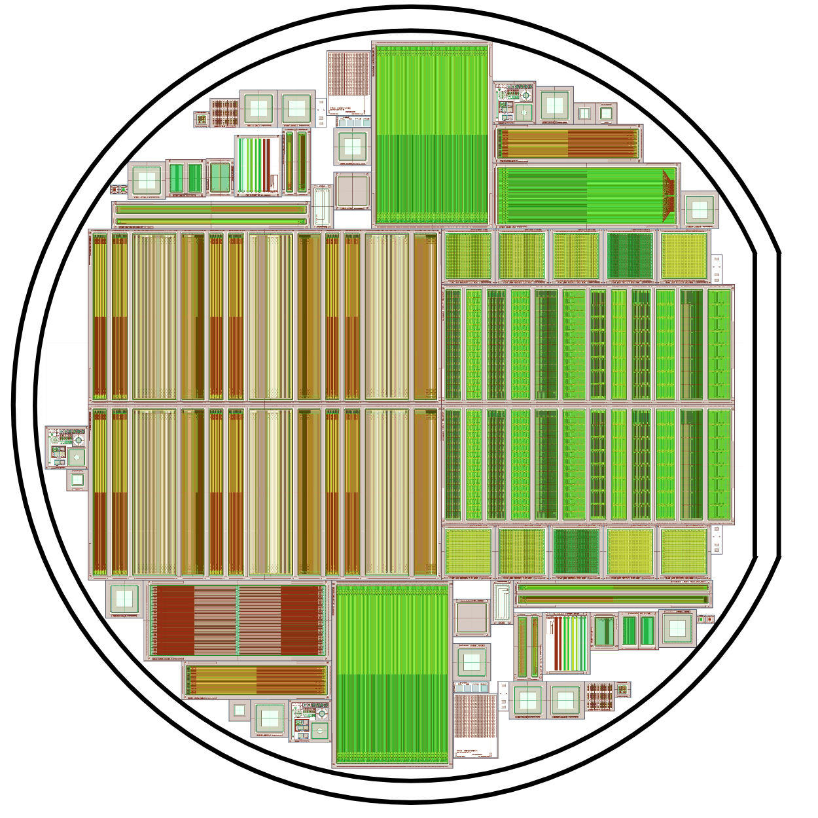
Wafer overview: HPK-campaign
structure | to study
pad diodes | material
baby strip sensor | reference design / material
baby strip sensor with integrated pitch adapter | design
pixel sensor | reference Design / material
multigeometry pixel | layout parameters
multigeometry strips | layout parameters
baby strixel | design
test-structures | process parameters
Notes:
4

Slide 5
Silicon material
material | thinning method | active thickness | physical thickness
FZ | deep diffusion | 120,200,300 μm | 320 μm
FZ | --- | 200 μm | 200 μm
FZ | handling wafer | 120 μm | 320 μm
MCz | --- | 200 μm | 200 μm
Epi | handling wafer | 50,100 μm | 320 μm
Of each material there are 3 different types:
  n-type (N)
  Two different strip isolation technologies for p-bulk:
  p-type with p-stop (P)
  p-type with p-spray (Y)

Slide 6
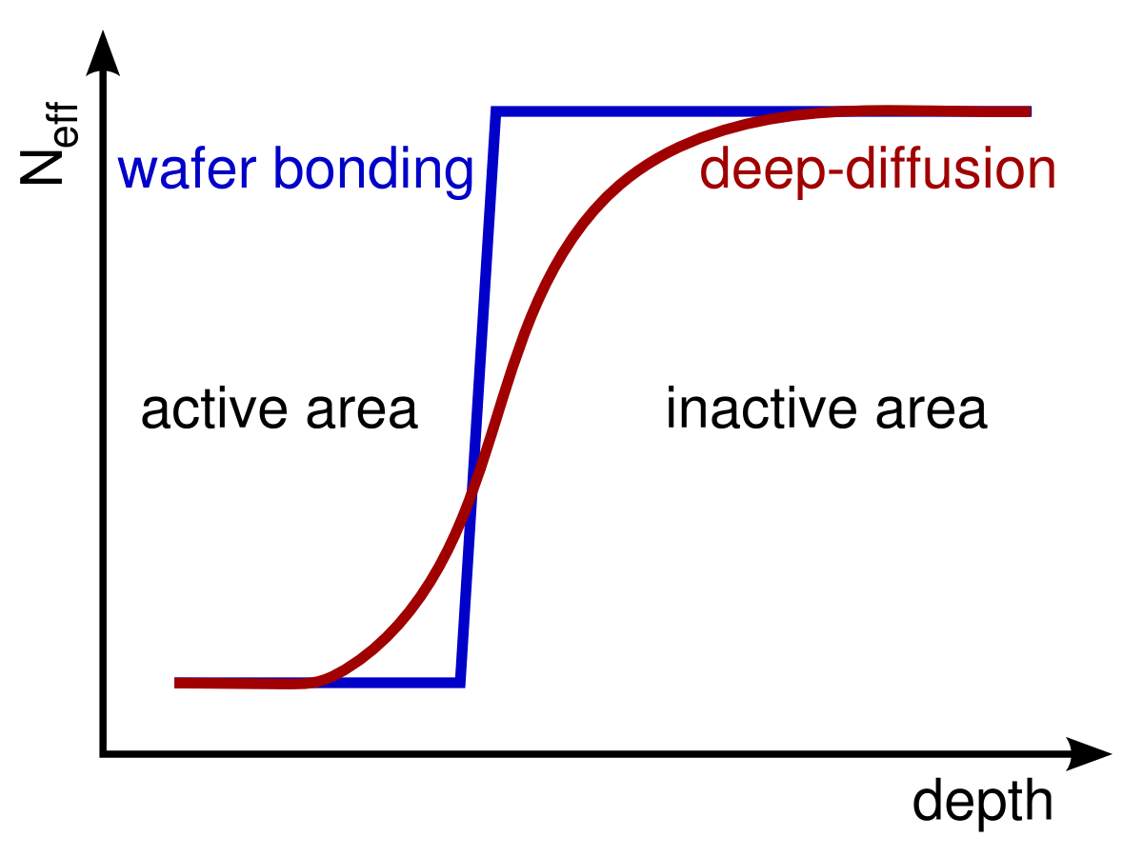
Wafer-Processing (deep diffusion)
At high irradiation thick sensors not fully depletable
Mean free path of charge carriers severely reduced due to trapping for highly irradiated sensors
→ In thin sensors less charge is trapped and
voltage needed for full depletion is lower.
Standard method for thinning: wafer bonding of Si to Si-substrate (low ohmic)
  Well known process
  Relatively expensive
New method: deep diffusion
  Active volume of a 320μm wafer reduced by diffusing high doping from the back.
active volume
inactive volume
active thickness
pn-junction
physical thickness
Notes:
6

Slide 7
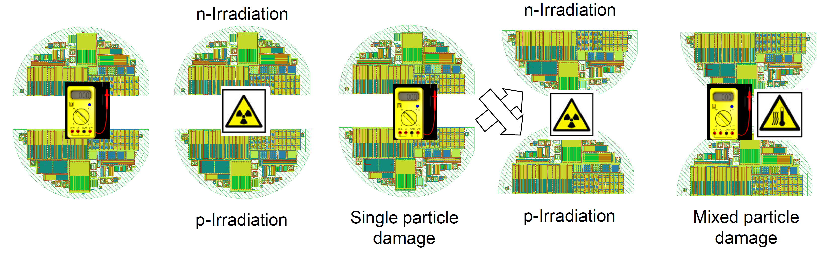
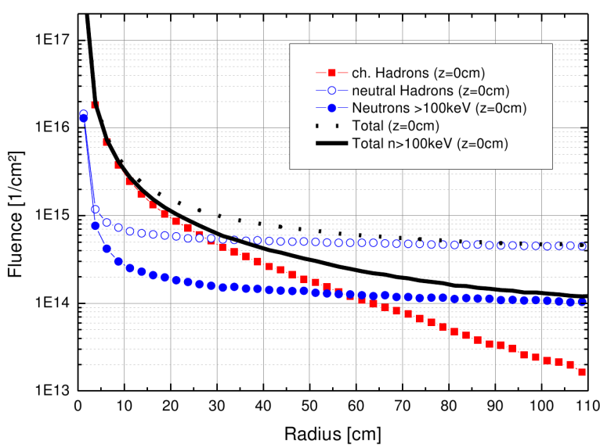
Sequence of Measurements and irradiations
courtesy of A. Dierlamm, KIT
HL-LHC: L_{int}=3000 fb⁻¹
Pre qualification
First irradiation
Single irradiation qualification
Second irradiation
Measurements and time development
of defect (annealing) studies
courtesy of S. Müller, KIT

Slide 8

Irradations
HL-LHC: L_{int}=3000 fb⁻¹
Neutrons: 1 MeV (TRIGA Reactor Ljubljana)
Protons: 23 MeV (Karlsruhe cyclotron)
courtesy of S. Müller, KIT
radius | protons Φ_{eq} [cm⁻²] | neutrons Φ_{eq} [cm⁻²] | total Φ_{eq} [cm⁻²] | active thickness
40 cm | 3 ∙ 10¹⁴ | 4 ∙ 10¹⁴ | 7 ∙ 10¹⁴ | ≥ 200 μm
20 cm | 1 ∙ 10¹⁵ | 5 ∙ 10¹⁴ | 1.5 ∙ 10¹⁵ | ≥ 200 μm
15 cm | 1.5 ∙ 10¹⁵ | 6 ∙ 10¹⁴ | 2.1 ∙ 10¹⁵ | ≥ 200 μm
10 cm | 3 ∙ 10¹⁵ | 7 ∙ 10¹⁴ | 3.7 ∙ 10¹⁵ | ≤ 200 μm
5 cm | 1.3 ∙ 10¹⁶ | 1 ∙ 10¹⁵ | 1.4 ∙ 10¹⁶ | < 200 μm

Slide 9
Involvement of DESY and UHH
Doris Eckstein, DESY | Coordination of diode measurements
Georg Steinbrück, UHH | Central European Consortium Project leader
Joachim Erfle, UHH | IV/CV diode measurements Setting up ALiBaVa station for CCE measurement of strip sensors Initiating transfers, tracking parts and checking DB consistency
Thomas Pöhlsen, UHH | TCT/CCE diode measurements
Alexandra Junkes, UHH | Microscopic defect measurements IV/CV diode measurements
Peter Buhmann, UHH | Technical support
Coralie Neubüser, UHH | IV/CV diode measurements
Christian Scharf, UHH | IV/CV diode measurements
Henning Wenck, UHH | IV/CV diode measurements
Evangelos Nagel, UHH | TCT/CCE diode measurements

Slide 10
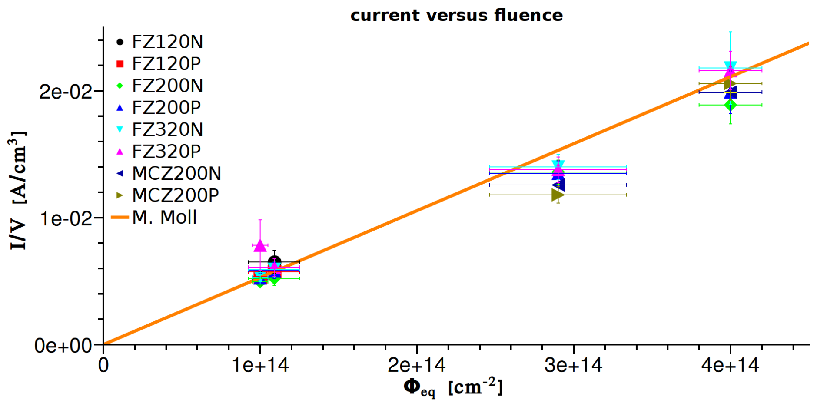
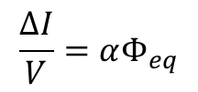
Volume current versus fluence
$$\frac{ΔI}{V}=αΦ_{eq}$$
protons
neutrons
neutrons
protons
currents are measured after annealing of 10 min@ 60°C at 0°C and scaled to 20°C
J. Erfle, UHH
Currents match expected value from M.Moll‘s thesis within the uncertainties.
-> dose measurements are ok.

Slide 11
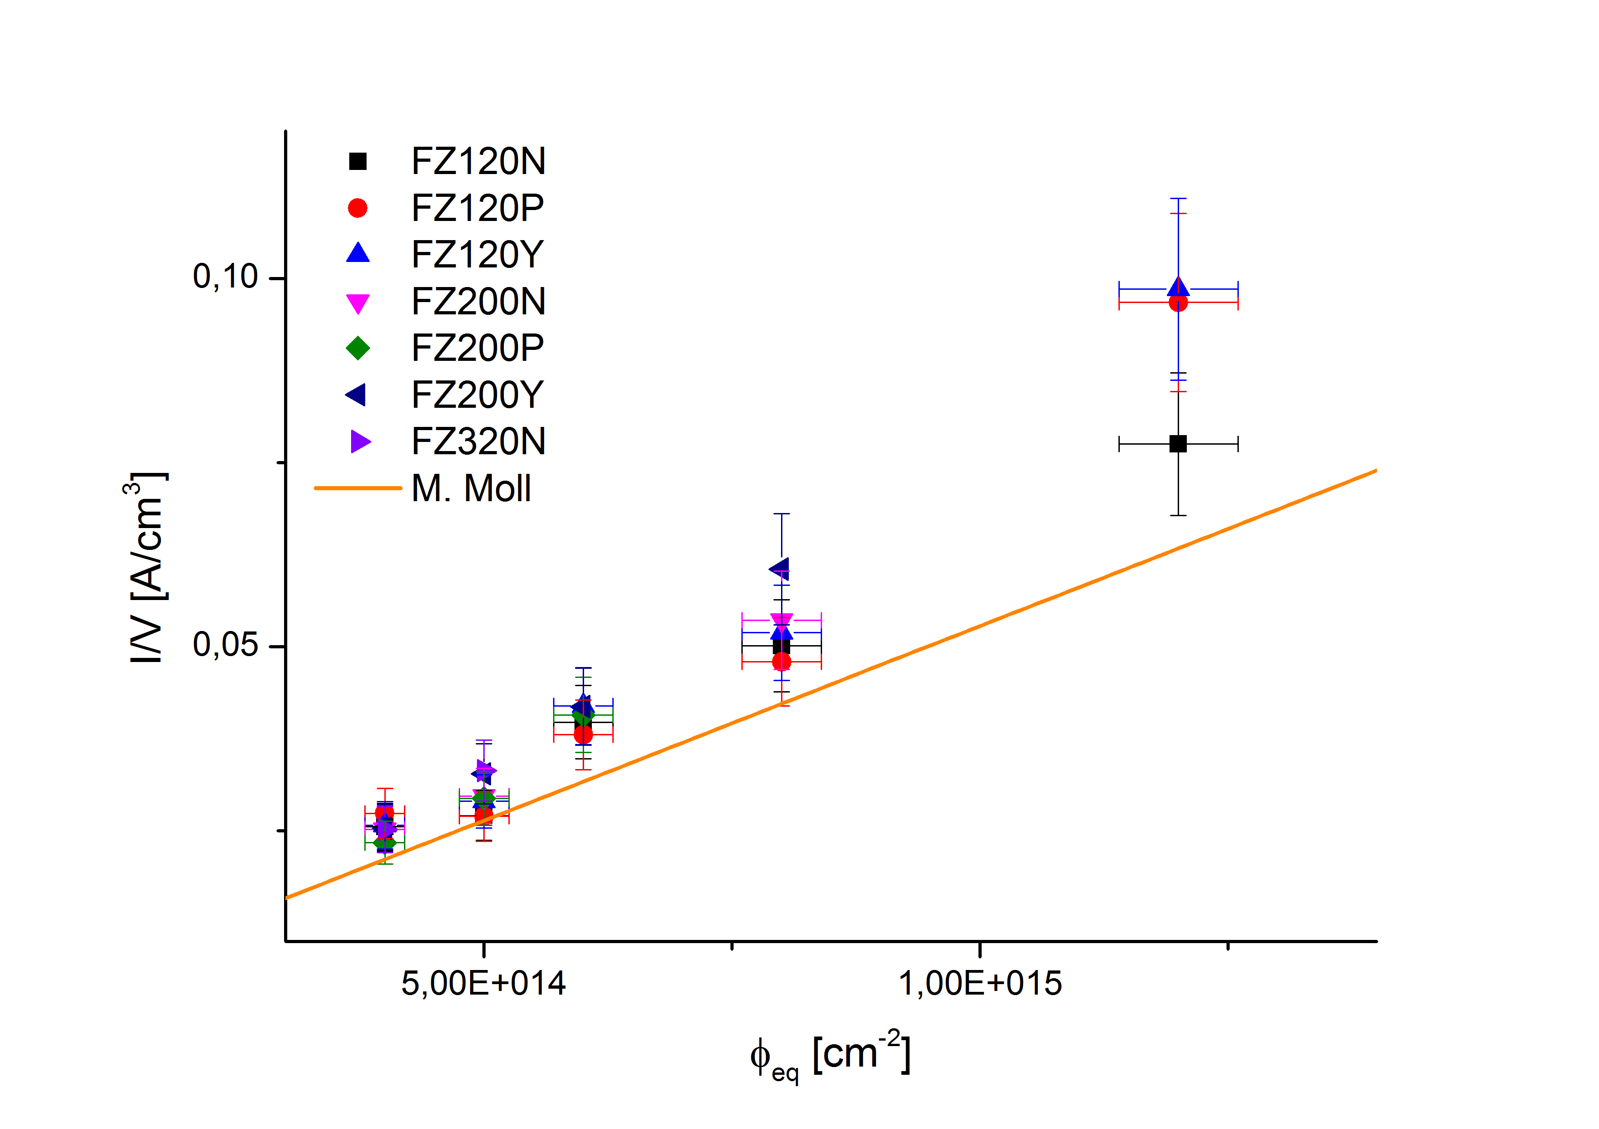
Volume current versus fluence:
Baby sensors
neutron irradiated Baby sensors
First Baby sensors show higher currents than expected from volume current (M. Moll)
-> maybe a surface effect or internal gain?
Expected volume current (M. Moll)
currents are measured after annealing of 10 min@ 60°C at -20°C and scaled to 20°C
courtesy of A. Nürnberg, KIT

Slide 12
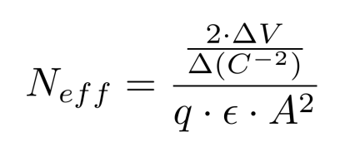
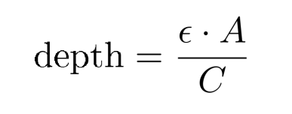
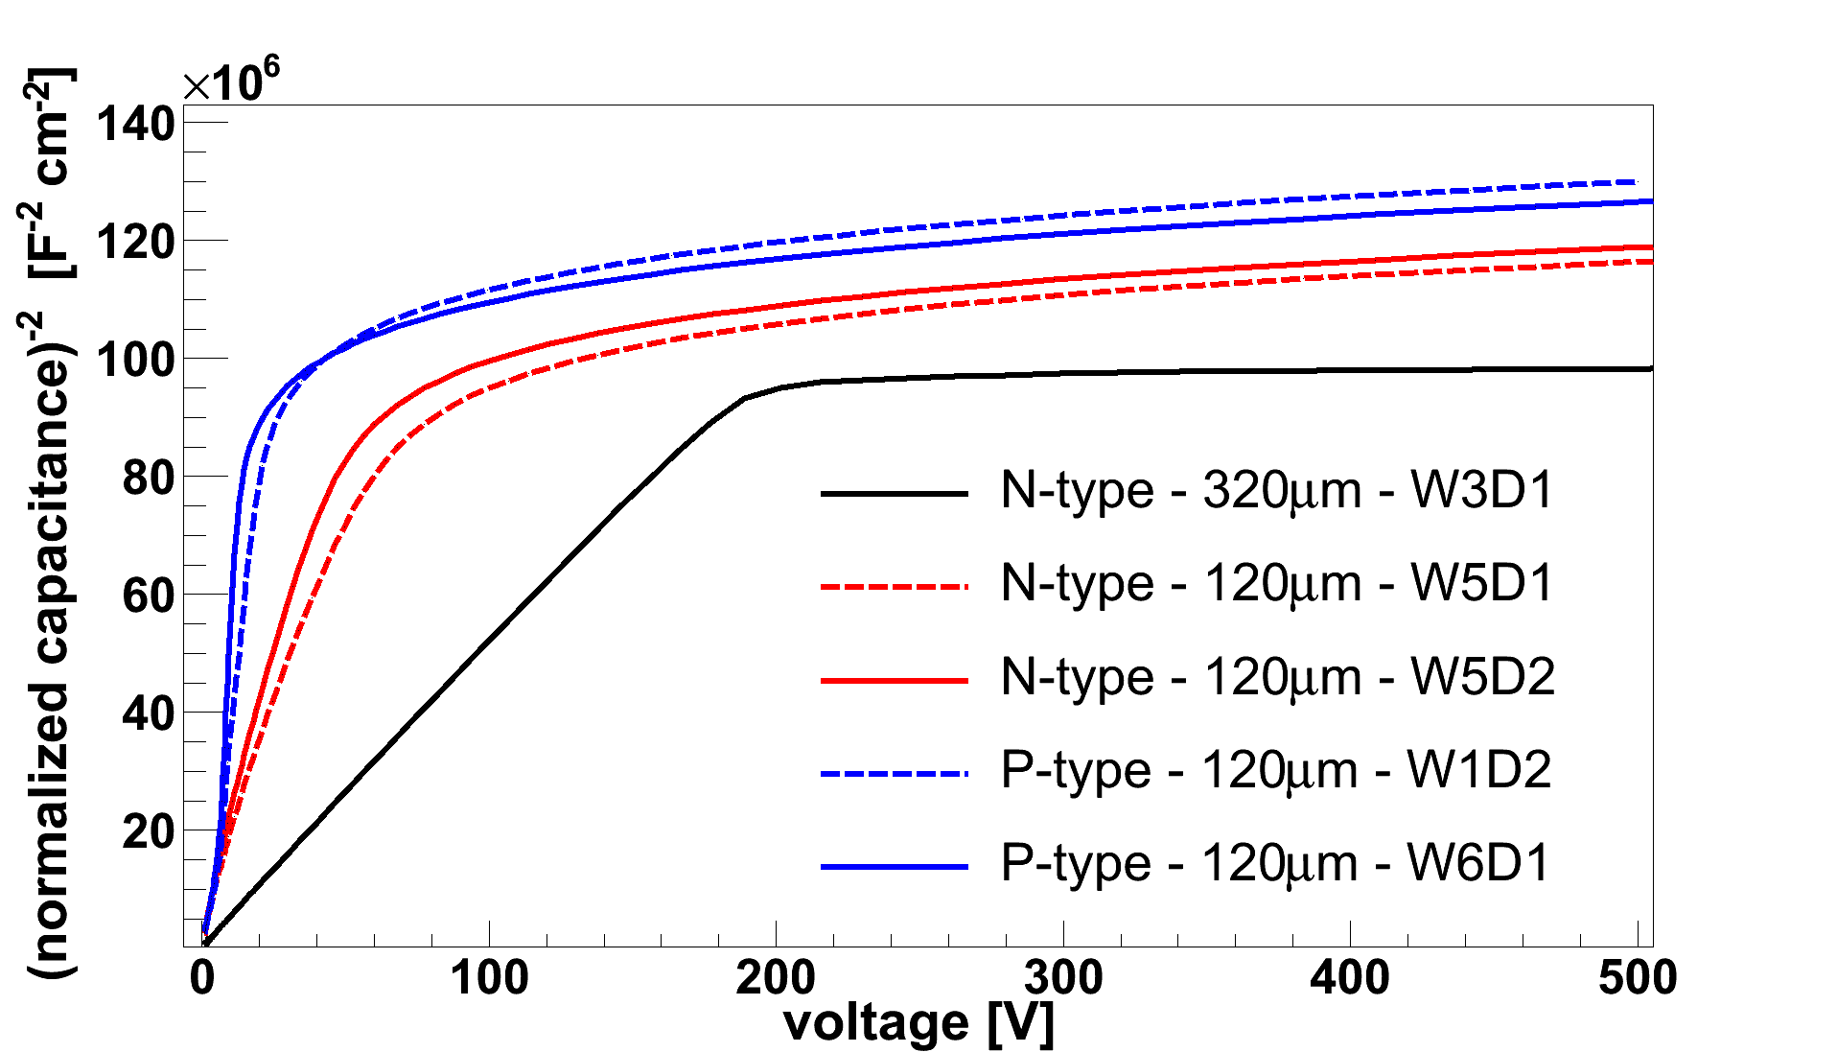
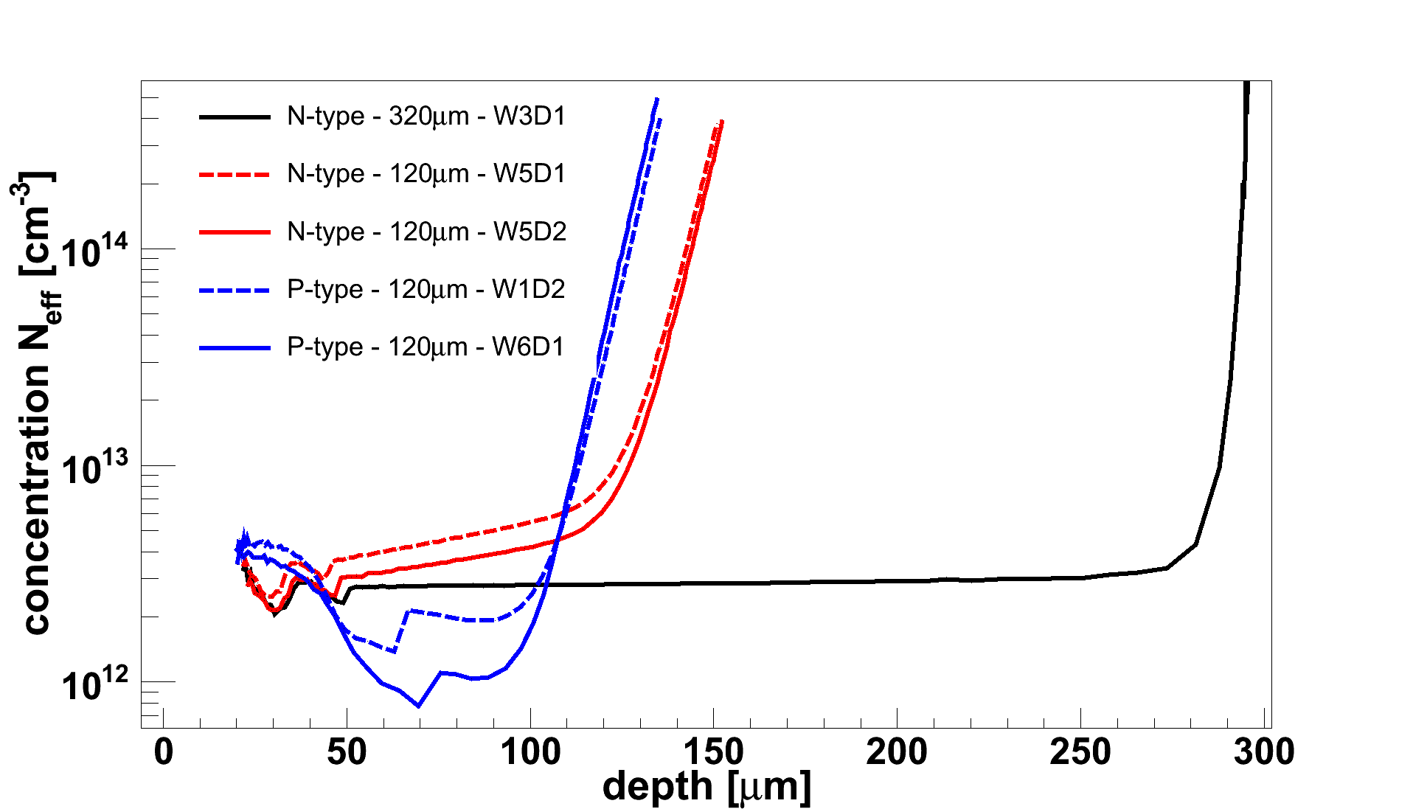
Material characteristics of thin FZ: deep diffusion before irradiation
Concentration profile from CV-curve:
120µm P
120µm P
320µm N
J. Erfle, UHH
Diodes behave like parallel-plate capacitors
→ measure capacitance vs voltage to determine depletion depth and charge carrier concentration
front
J. Erfle, UHH
Deep diffusion influences effective doping

Slide 13
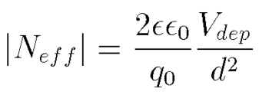
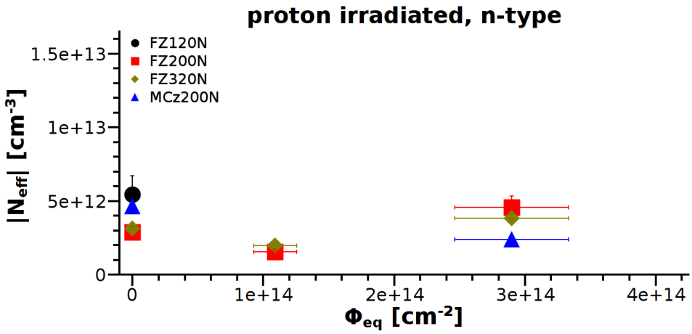
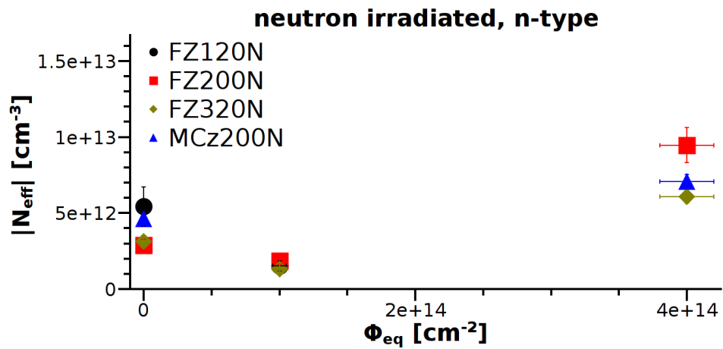
N_{eff} for different materials / irradiations
n-type
protons
J. Erfle, UHH
neutrons
J. Erfle, UHH
capacitances are measured at 0°C, 1kHz after annealing of 10min@60°C
All measured n-type materials (FZ and MCz) are type-inverted after neutron or proton irradiation.

Slide 14
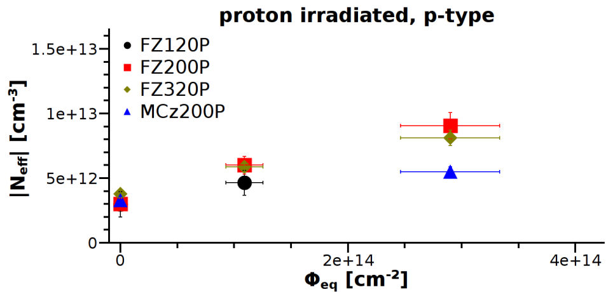
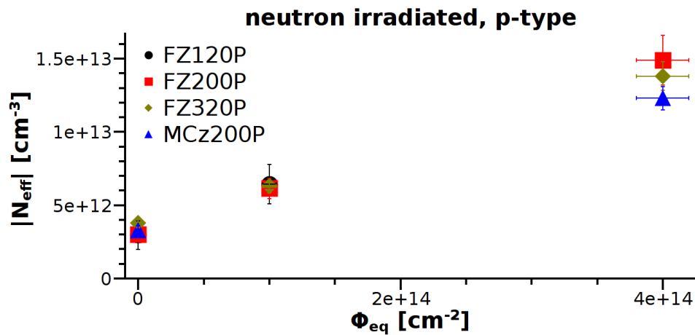
N_{eff} for different materials / irradiations
n-type
p-type
protons
J. Erfle, UHH
J. Erfle, UHH
neutrons
J. Erfle, UHH
capacitances are measured at 0°C, 1kHz after annealing of 10min@60°C
J. Erfle, UHH
All n-type materials undergo type inversion
No p-type material undergoes type inversion
All p-type materials show a steep increase in N_{eff} and therefor depletion voltage

Slide 15
Comparison to non-HPK materials
N-type materials, 23 GeV proton irradiated
Type inversion for 100 μm FZ ✔
No type inversion for 100 μm MCz ✔
No type inversion for 50 μm FZ ✗
Radiation damage is always the same,
oxygen high for MCz and 50 µm FZ!
We need to know:
Differences for n- and p-type material
Influence of N_{eff,0}, [O] (and [C], [H], [N])
courtesy of A. Junkes, UHH

Slide 16
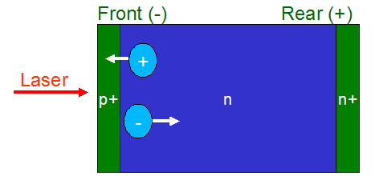
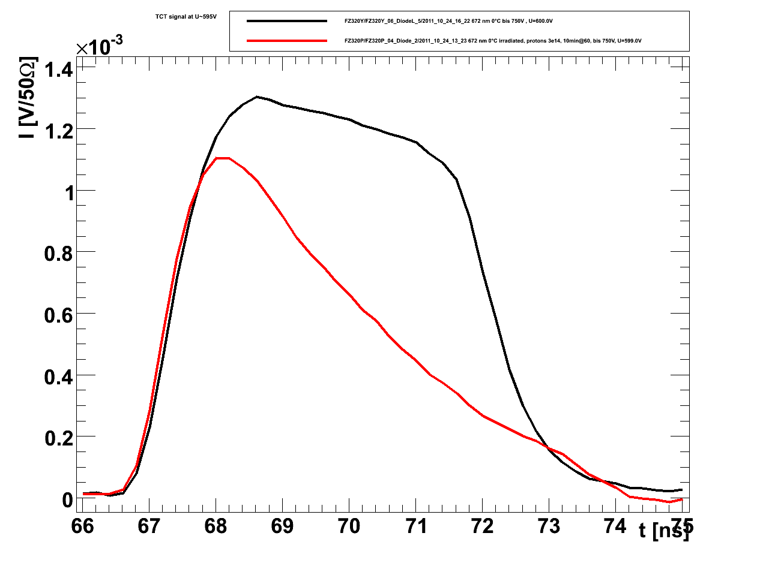
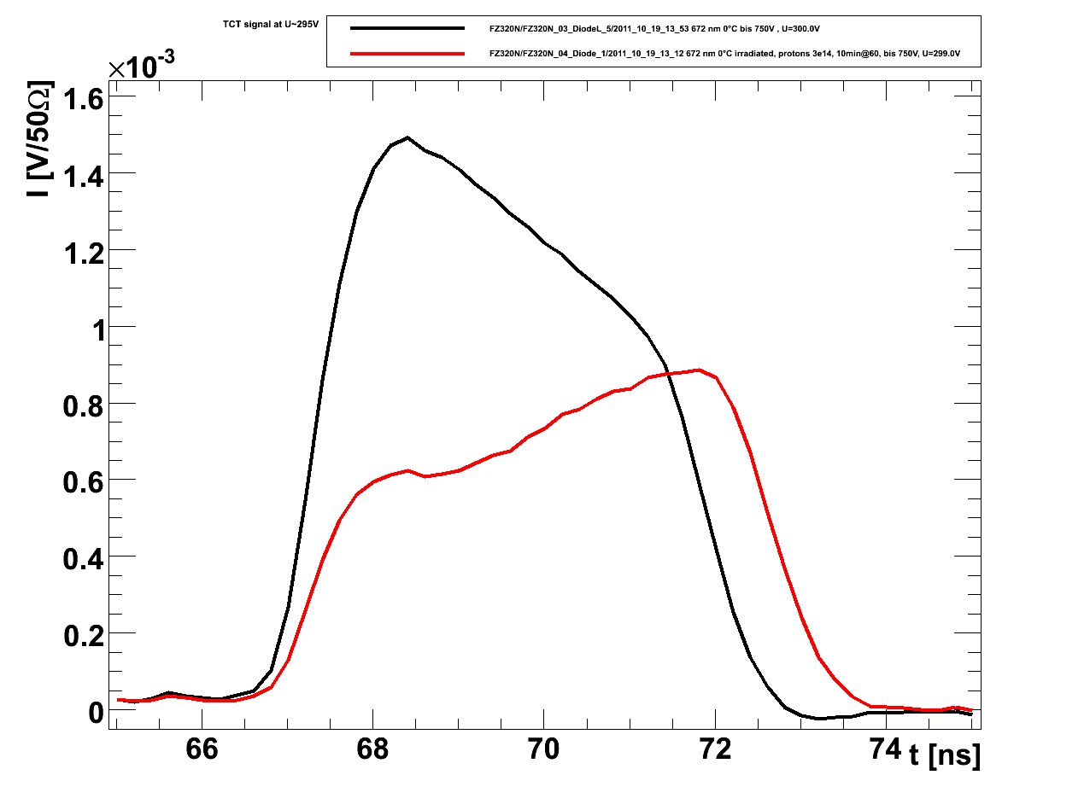
Time resolved charge collection measurement with TCT shows type inversion
Front
Rear
E
red
depth
FZ320P
- holes
FZ320N
- electrons
courtesy of J. Lange
unirradiated
p@3E14
Laser: 672 nm, red
3µm penetration depth
courtesy of T. Pöhlsen, UHH
courtesy of T. Pöhlsen, UHH
not type inverted
U=600V
type inverted
U=300V
type inversion of FZ and MCz n-type materials is confirmed by TCT.
Signals are measured at 0°C, after annealing of 10min@60°C

Slide 17
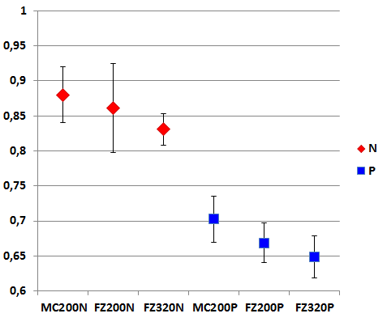
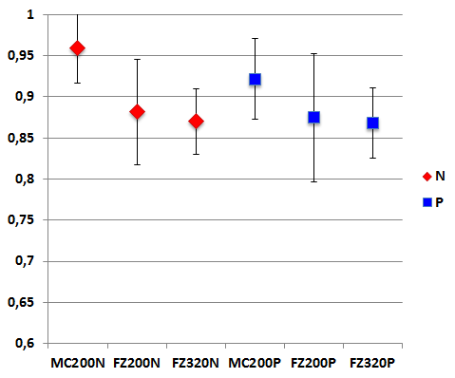
CCE of diodes, after p@3E14
infrared
red laser, front injection
infrared laser
courtesy of J. Lange
unirradiated
p-type:
hole
collection
n-type:
electron
collection
n-type
p-type
courtesy of T. Pöhlsen, UHH
courtesy of T. Pöhlsen, UHH
measurements are performed at 0°C and 600V, with 20ns integration time
infrared laser: CCE is about 90%
Electrons only: CCE ~ 85%, holes collection only: CCE ~ 67%
Electron readout performs better

Slide 18
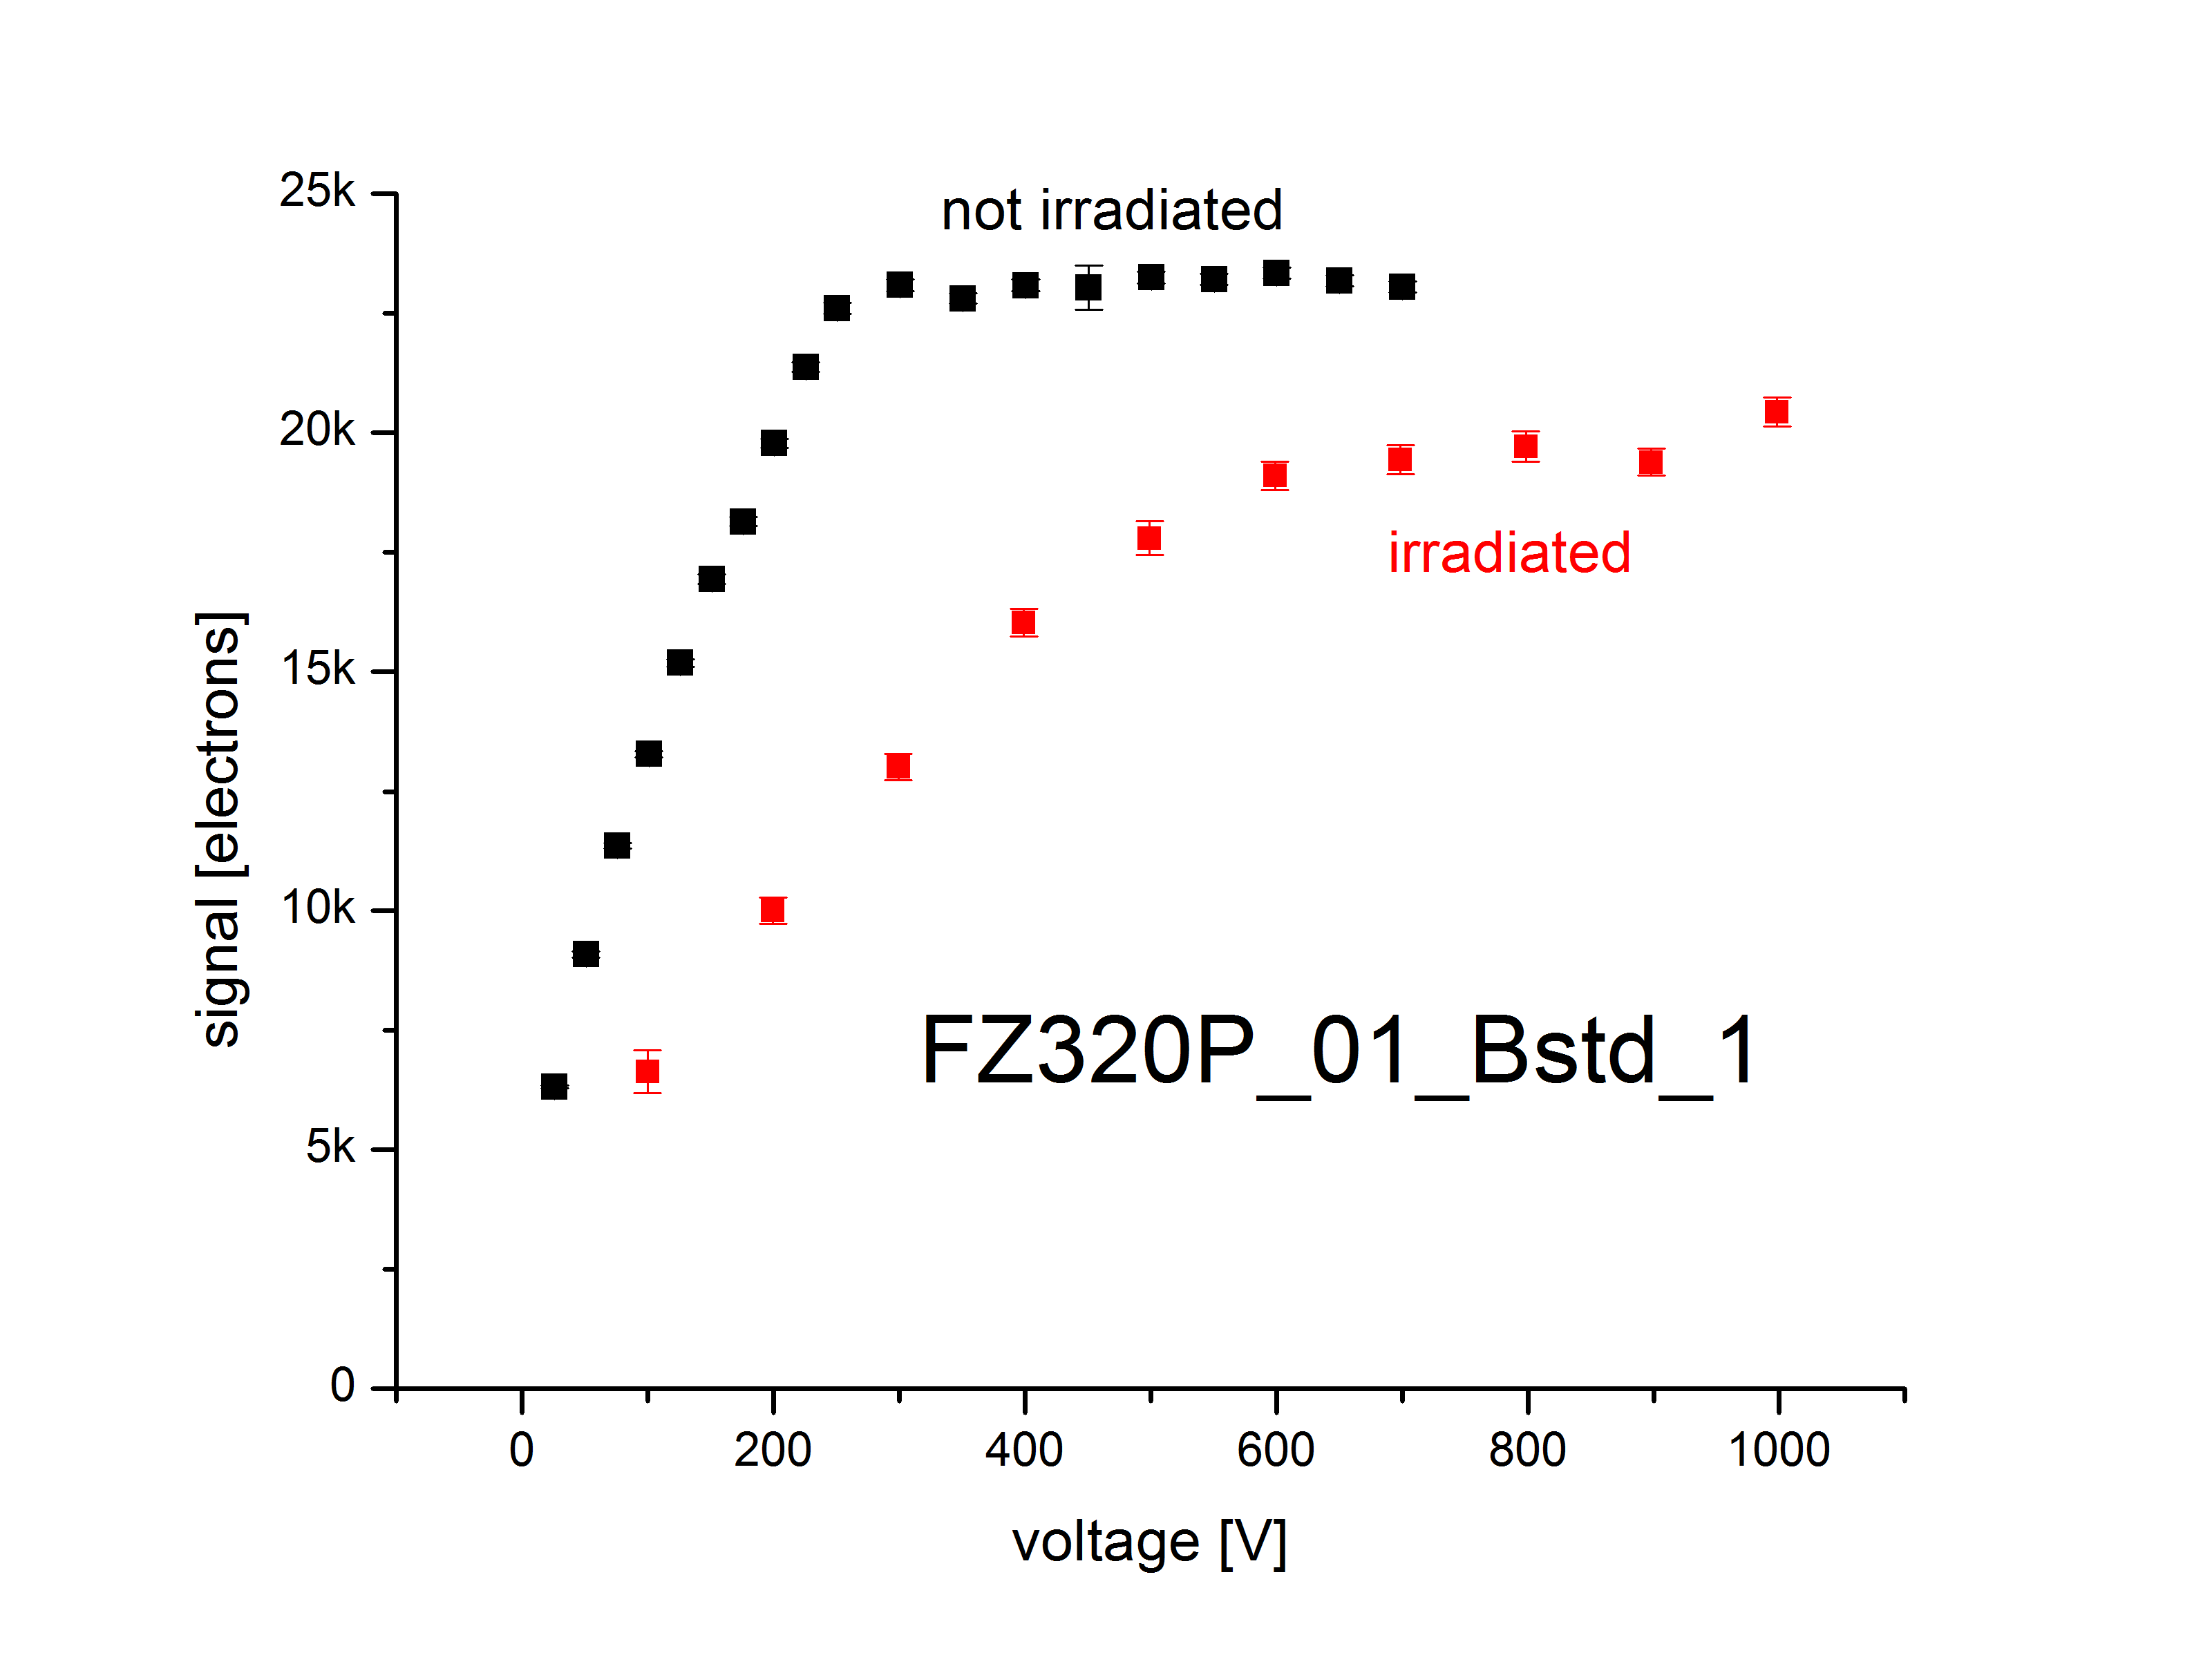
Signal of FZ320P baby sensor, after p@3E14
Signal induced by a ⁹⁰Sr source, readout by ALiBaVa
V_{depl}
CCE of FZ320 p-type is about 87% at p@3E14, compared to non-irradiated
courtesy of K. Hoffman, KIT
measurements are performed at -20°C

Slide 19
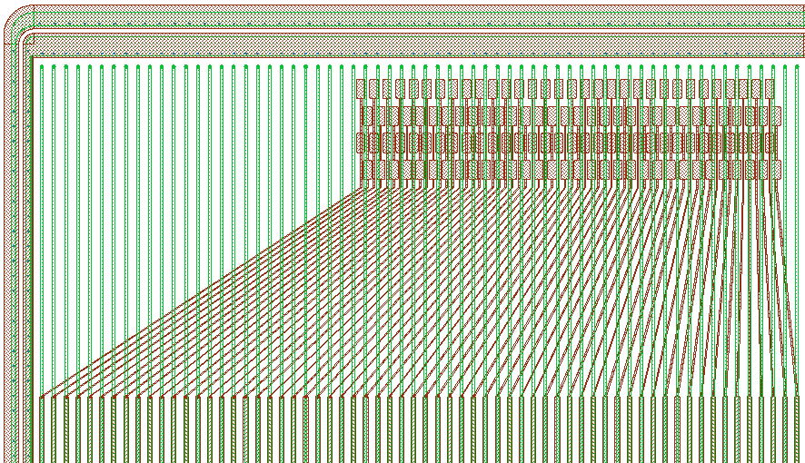
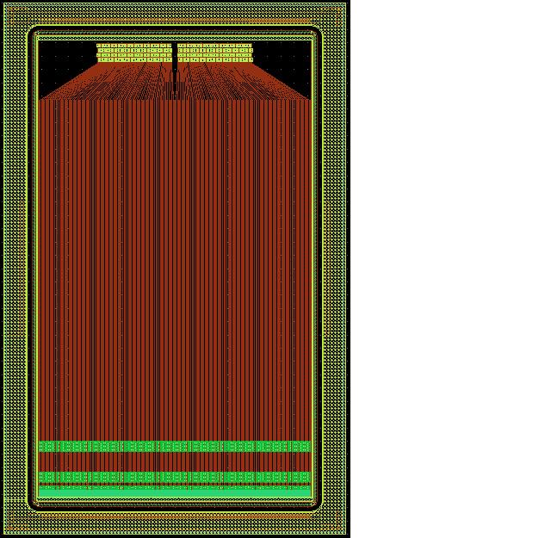
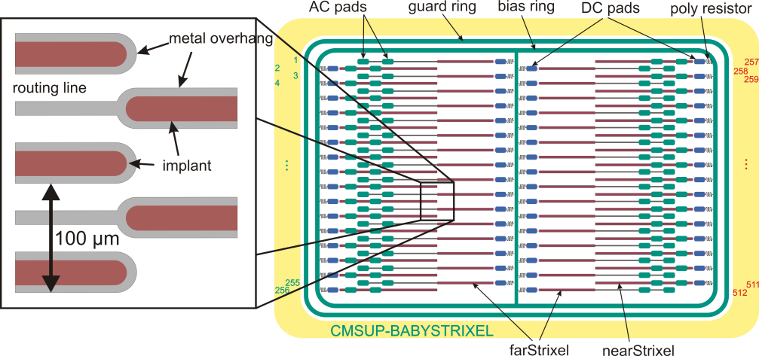
Some experimental structures
Strip-sensor with integrated Pitchadapter in the first metal layer
Strixel-sensor
Idea to reduce occupancy and increase resolution
To be able to read out from the sides, inner strips are routed out in the first metal layer
Pitchadapter needed for readout-chip connection
Is it possible to integrate it on the sensor without loosing active area?
courtesy of A. Kornmayer, KIT

Slide 20
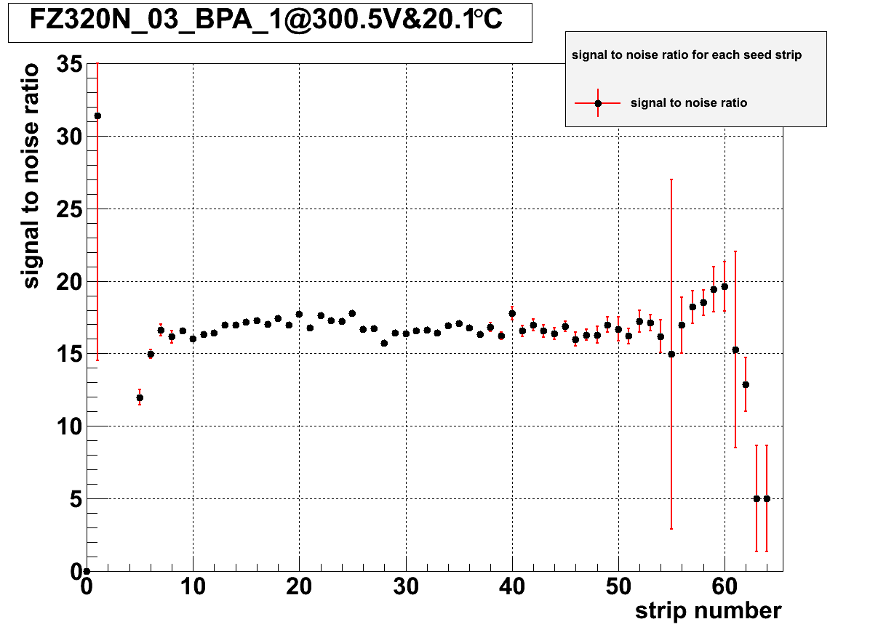
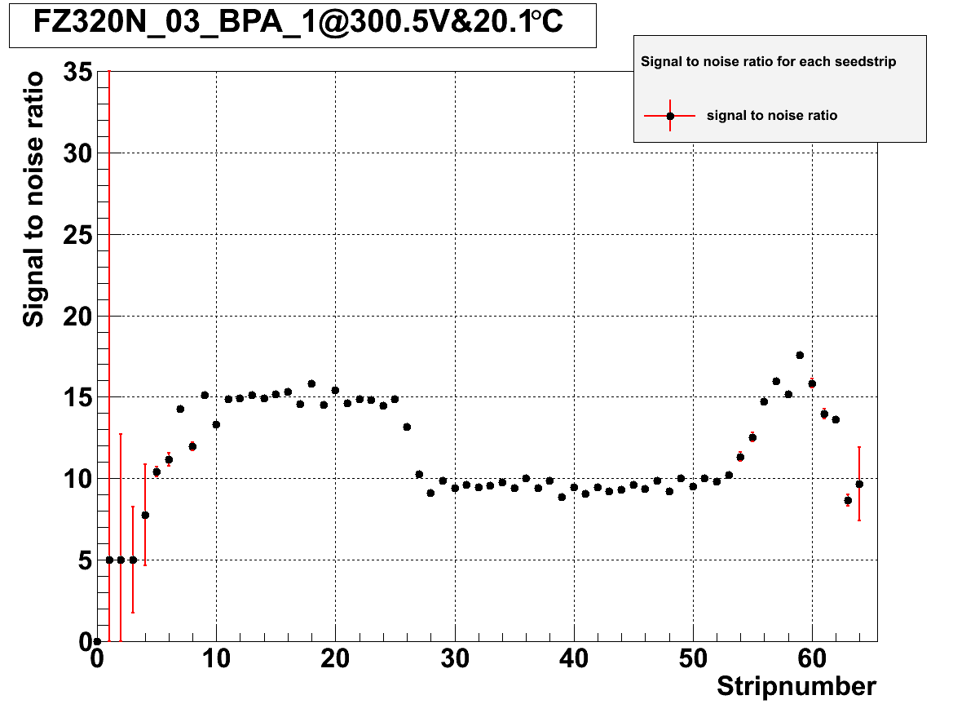
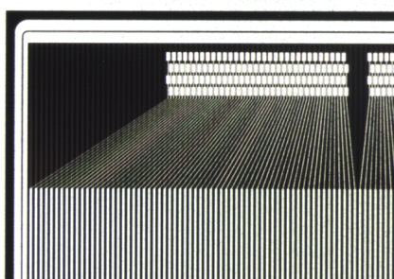
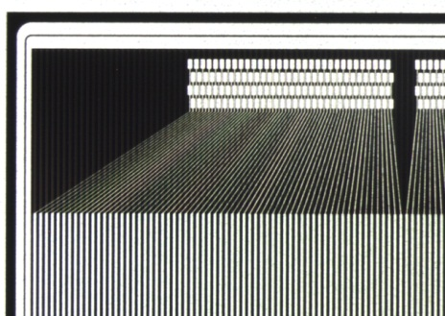
First results for integrated pitch adapter
courtesy of A. Kornmayer, KIT
courtesy of A. Kornmayer, KIT
Electron from a Sr⁹⁰-source
at different positions
Flat S/N in standard region of about 17
Reduced S/N in PA-region, noise stays constant
Silicon Sensor Developments for the CMS Tracker Upgrade
Notes:
20

Slide 21
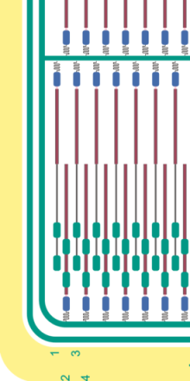
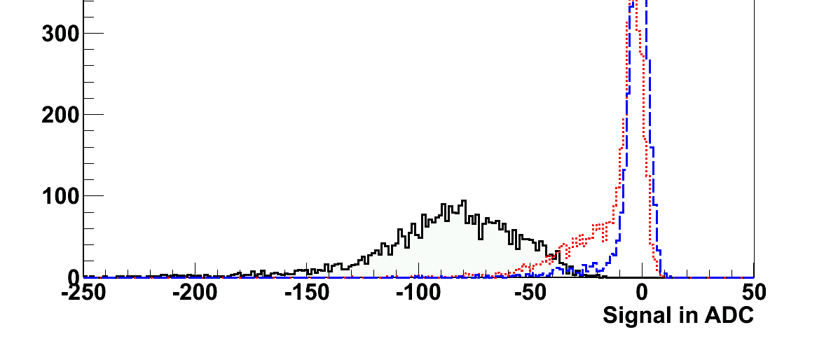
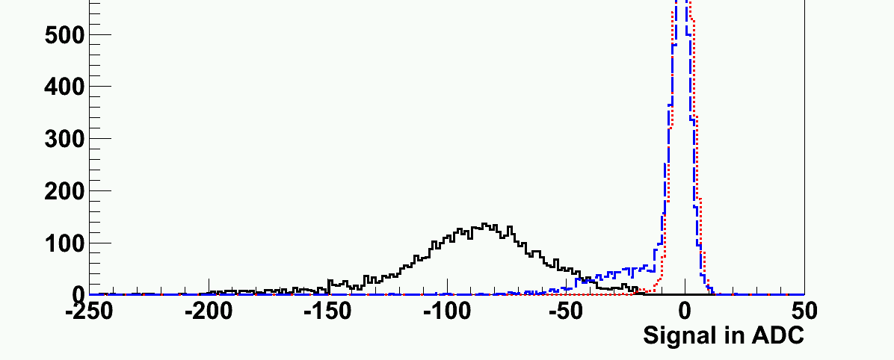
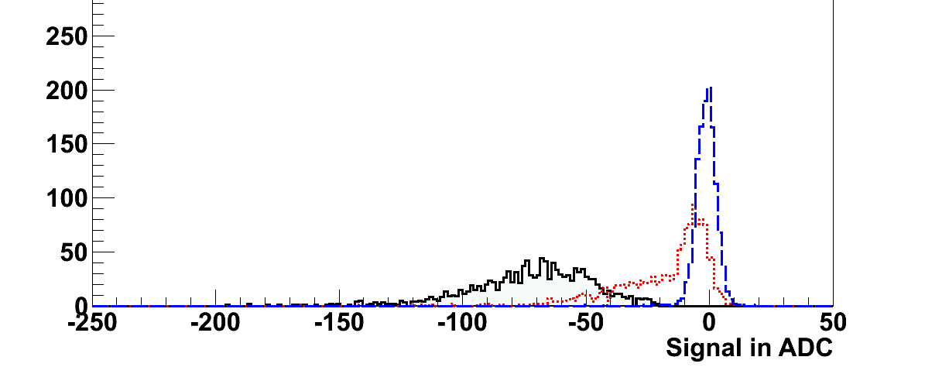
First results for strixel sensors
Electron from a Sr⁹⁰-source at near area
Electron from a Sr⁹⁰-source at far area
1. far neighbour
1. near neighbour
1. near neighbour
1. far neighbour
Seed strip (near)
Seed strip (far)
1. near neighbour
Signal in the far area only measured on strips in the far area.
Signals in near area appear also on far strips
1. far neighbour
courtesy of A. Kornmayer, KIT
Seed strip (far)
Silicon Sensor Developments for the CMS Tracker Upgrade
Notes:
21

Slide 22
Conclusions and outlook
HPK-campaign is making progress
Diode currents at low fluencies as expected
Baby sensors at high fluencies have additional current
N_{eff} develops not as expected: - type inversion for all n-type
                - no type inversion for p-type
                - steep increase for p-type
CCE with baby sensors and diodes reduced to ~90% after 3E14 proton irradiation
More irradiations to come (irradiations with 20cm equivalent fluence finished, radiation clearance measurements have to be done)
Trying to understand material properties in detail
Full annealing studies to be done
Notes:
22

Slide 23
Backup

Slide 24
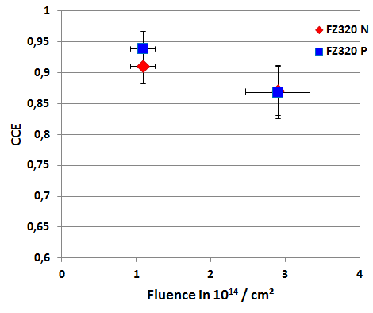
CCE of FZ320 after proton irradiation
courtesy of T. Pöhlsen
measurements are performed at 0°C

Slide 25
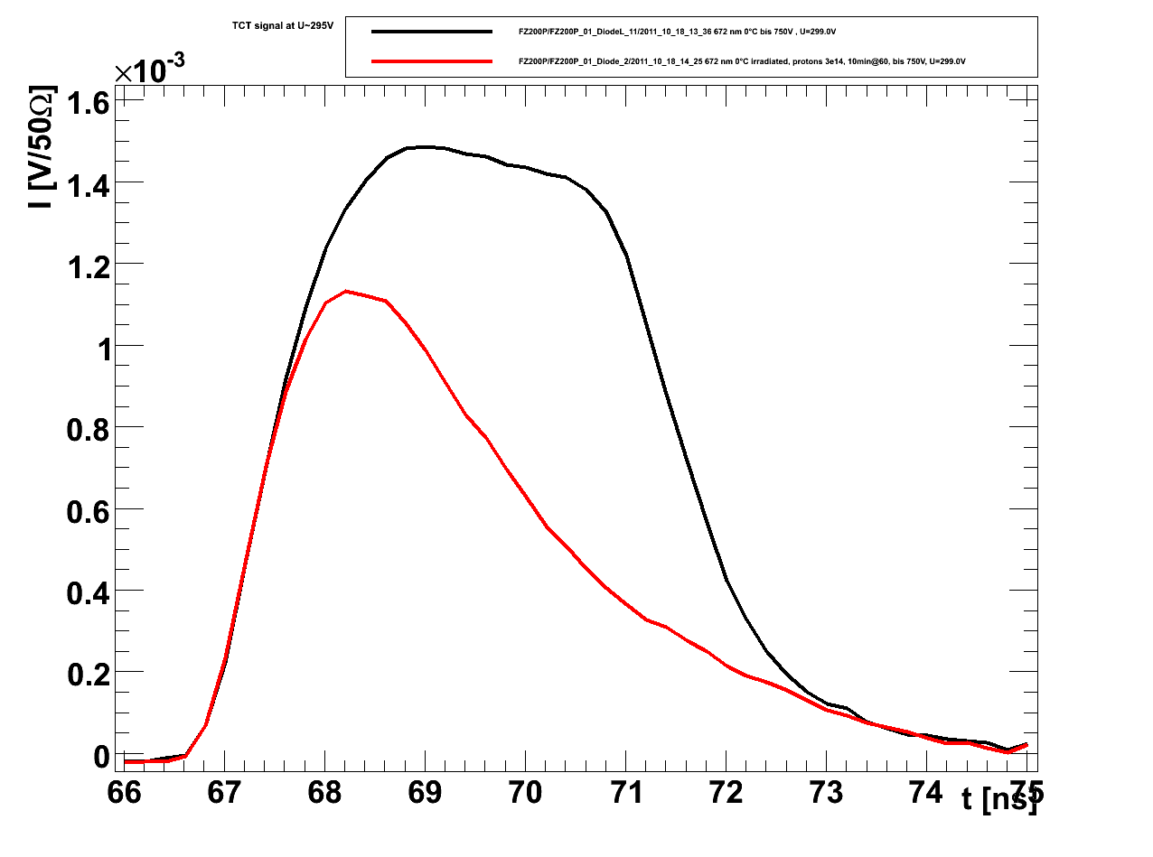
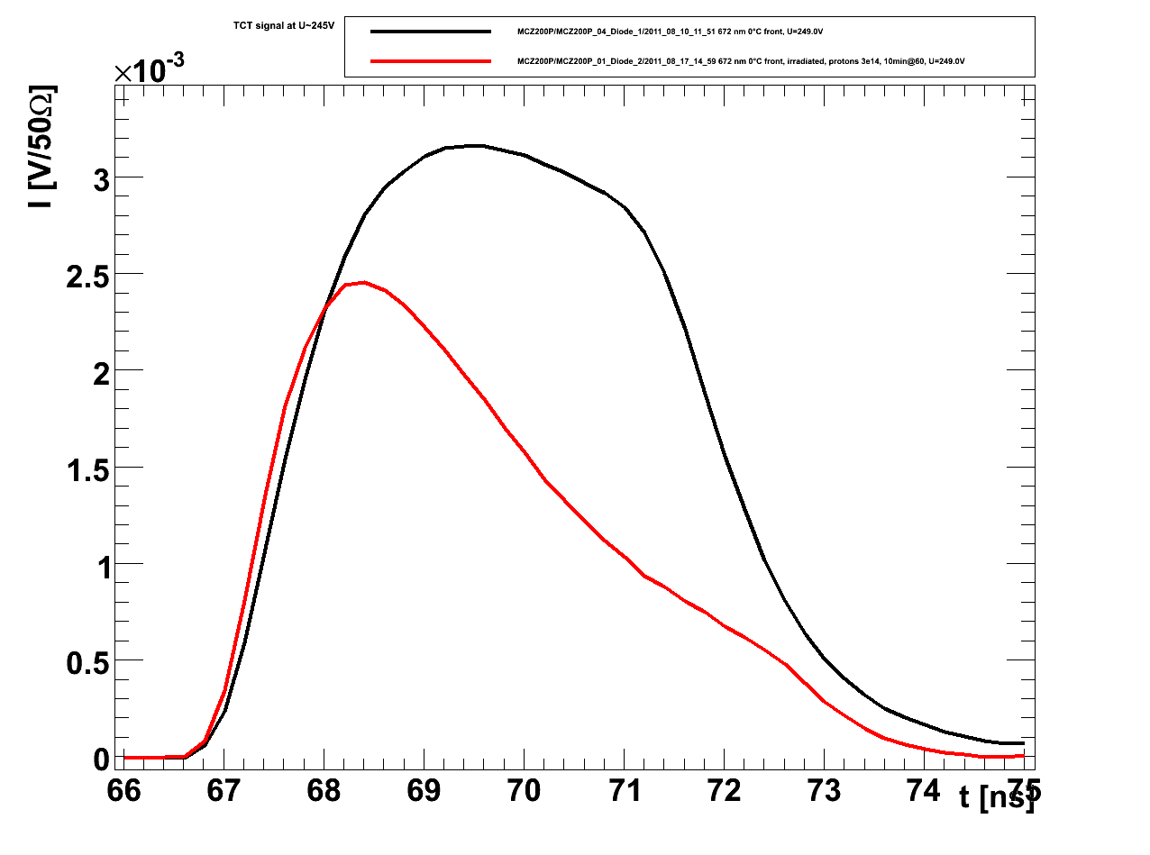
TCT pulses – p-type
FZ200P
FZ320P
MCZ200P
courtesy of T. Pöhlsen
courtesy of T. Pöhlsen
courtesy of T. Pöhlsen
300V
600V
250V
measurements are performed at 0°C, using a red laser
not type inverted

Slide 26
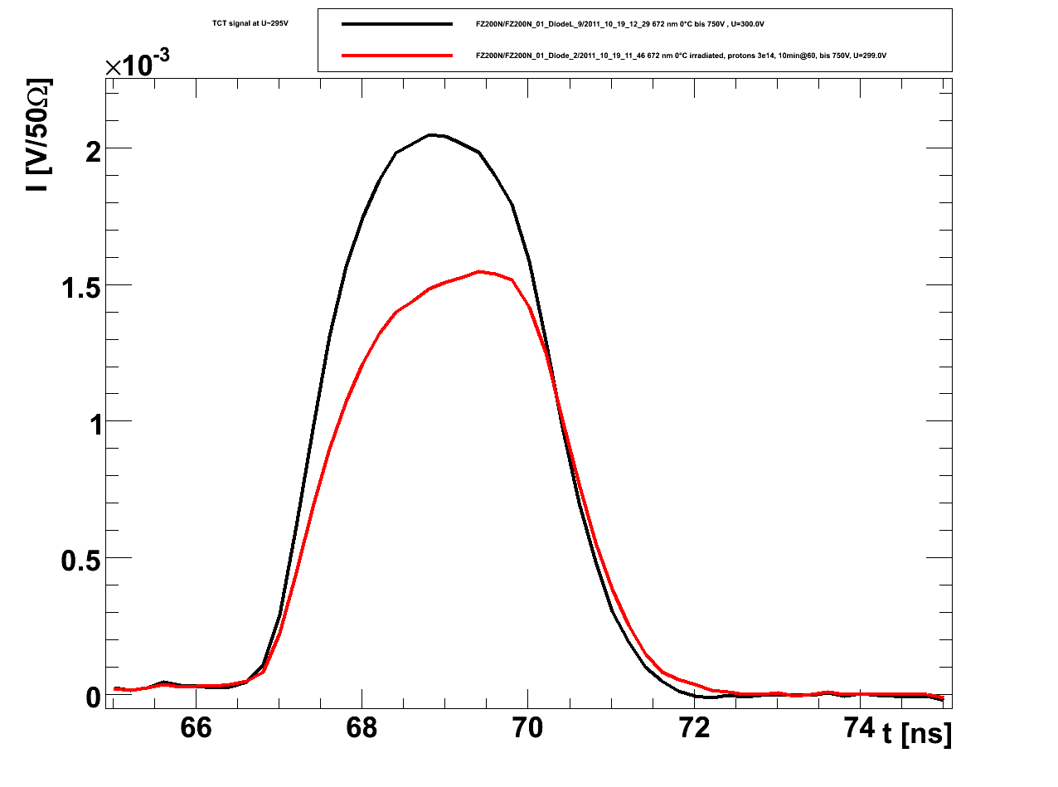
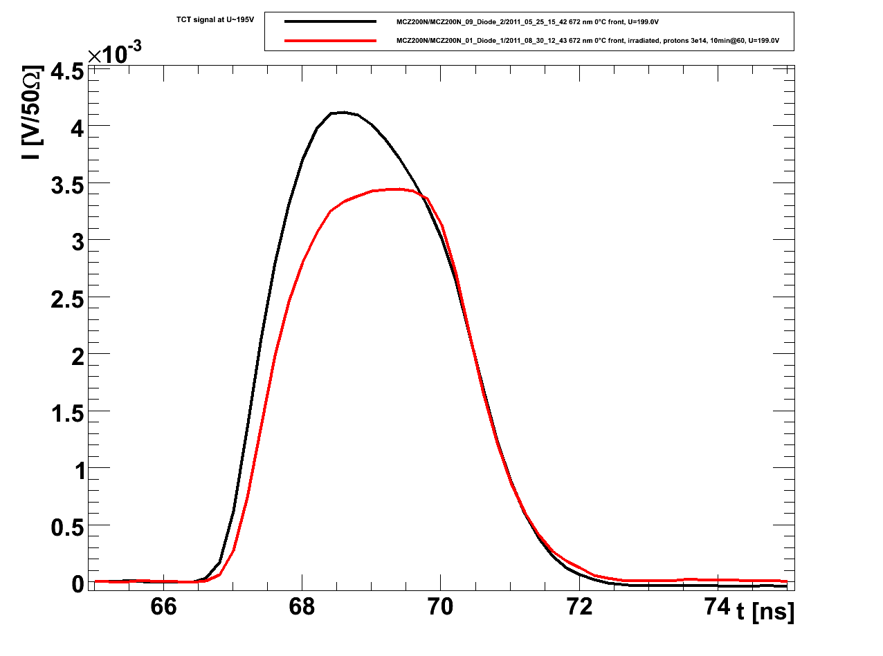
TCT pulses – n-type
FZ200N
FZ320N
MCZ200N
courtesy of T. Pöhlsen
courtesy of T. Pöhlsen
courtesy of T. Pöhlsen
300V
300V
200V
measurements are performed at 0°C, using a red laser
type inverted

Slide 27
oxygen content
material | bulk resistivity | oxide concentration
FZ320P | 3-8 | 3,50E+016
FZ200P | 3-8 | 3,00E+017
FZ120P | 3-8 | 5,00E+017
FZ320N | 1.2-2.4 | 1,80E+016
FZ200P | 1.2-2.4 | 3,00E+017
FZ120P | 1.2-2.4 | 5,00E+017
MCZ200P | >2 | 3,75E+017
MCZ200N | >0.5 | 3,00E+017

