Slide 1
C-band cool copper parallel coupling accelerating structure
Jingru Zhang
IHEP
2025.12.10

Slide 2
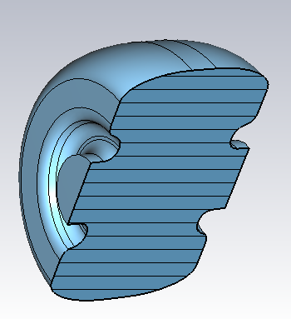
Cavity design
Single cell parameters
RF Parameter | value | Unit
Temperature T | 77 | K
Frequency f₀ | 5712 | MHz
Working mode | π | ----
Aperture 2a | 5.25 | mm
Diameter 2b | 39.687 | mm
Nose distance D | 18.13 | mm
Cell length p | 26.243 | mm
Copper conductivity | 2.7*2.7*5.8*10⁷ | S/m
Quality factor Q₀ | 34289 | ----
Shunt Impedance | 324.7 | MΩ/m
Rs*p /Q₀ | 248.5 | Ω
Filling time T_{f} （0.9） | 2.3 | us
Ep/E₀ | 2.26 | ----
Rsurf | 7.3*10⁻³ | Ω
G=Rsurf*Q₀ | 232 | Ω
Single cavity parameters

Slide 3

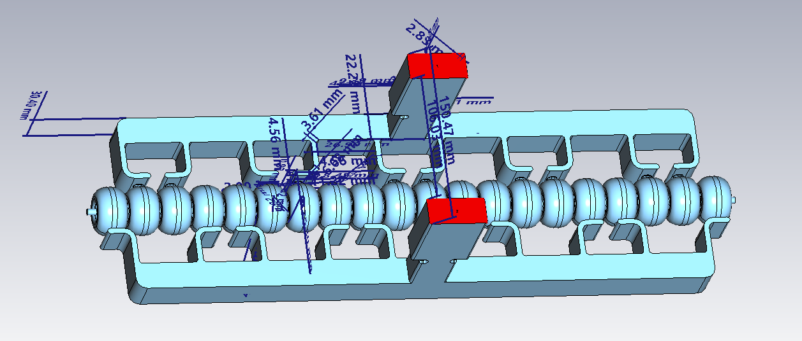
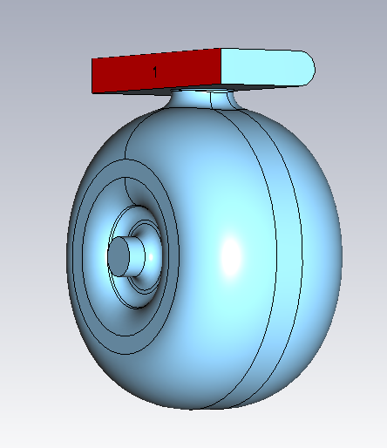
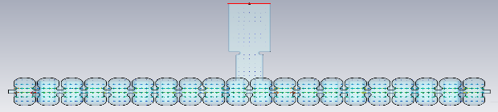
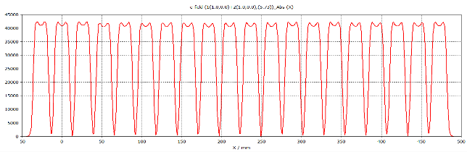
Cavity design （@77K）
The whole structure parameters
RF Parameter | value | Unit
Temp T | 77 | K
Frequency f₀ | 5712 | MHz
Working mode | π | ----
Cavity numbers n | 20 | ----
Total length L | 525 | mm
The gradient of the total cavity | 24.8
The parameters with coupler
RF Parameter | value | Unit
Coupling coeficient β | 1
Quality factor with coupler Q_{0total} | 34079 | ----
Efficient shunt Impedance with coupler Rs | 323 | MΩ/m
Filling time T_{f} （0.9）with coupler | 2.3 | us
maximum surface magnetic field with coupler Hcoup/Hp | 1.2 | ----
Hcoup*Z₀/E₀ | 1.46 | ----

Slide 4
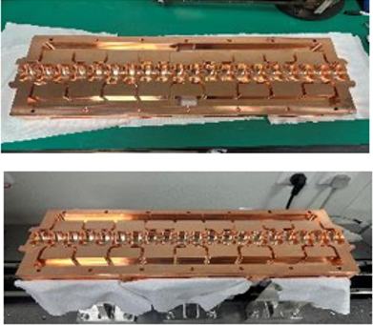
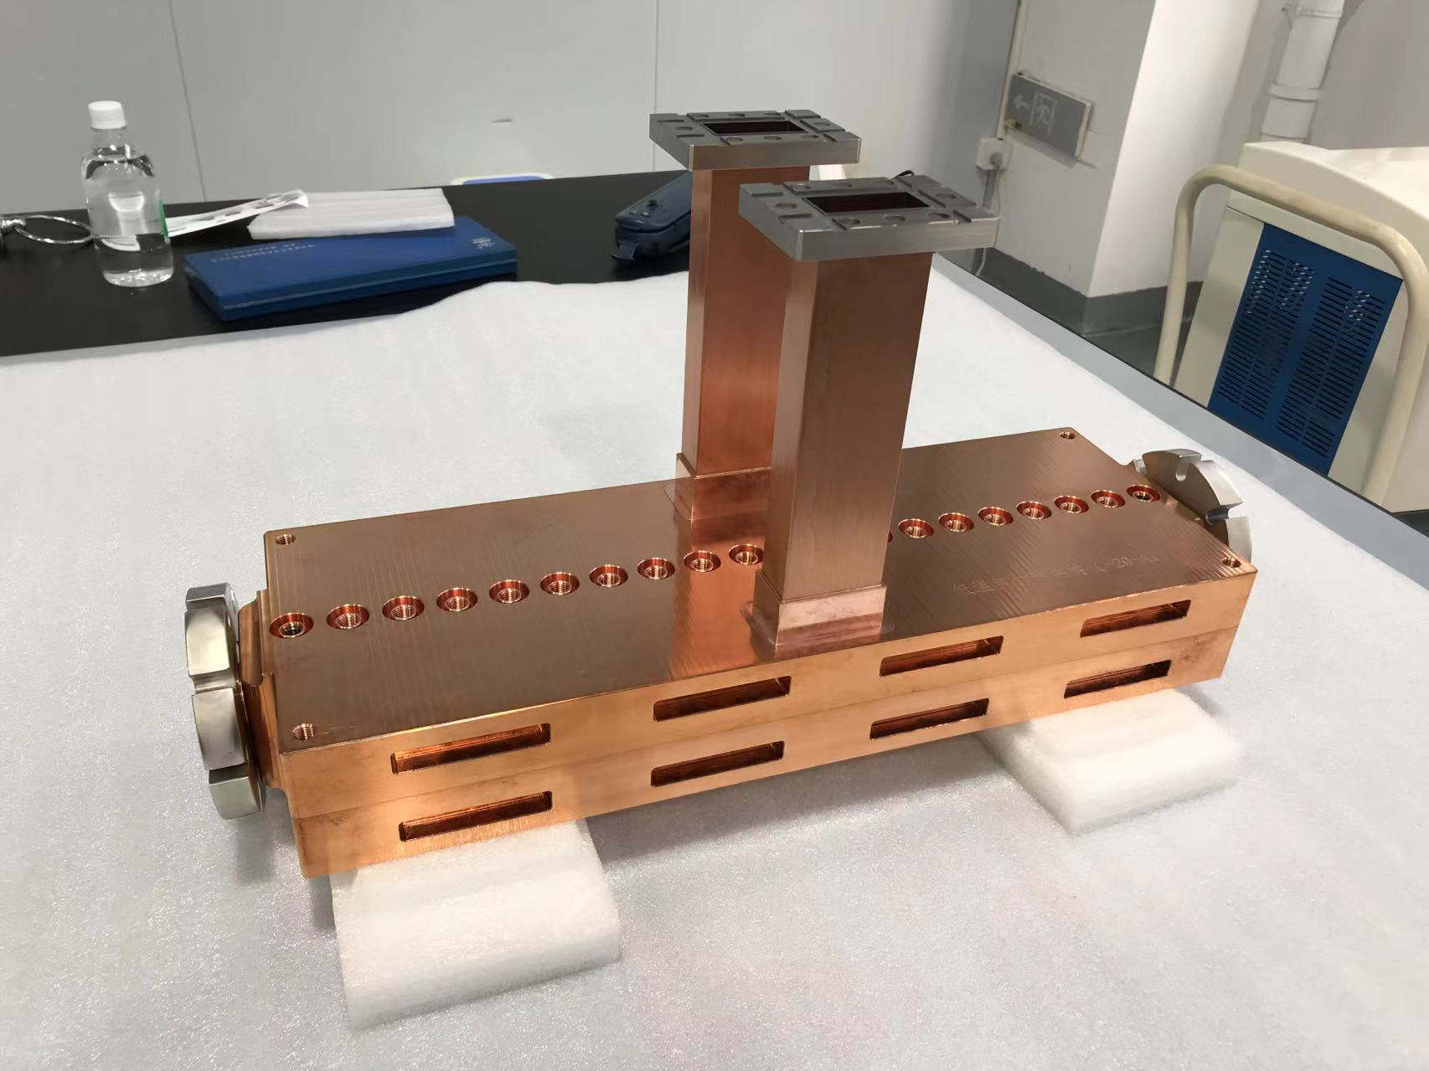
20 cells structure
The equivalent Q value of the whole structure is 31387 @77K

Slide 5
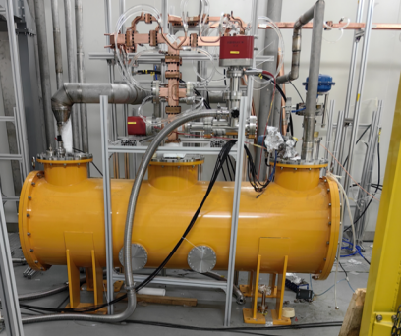
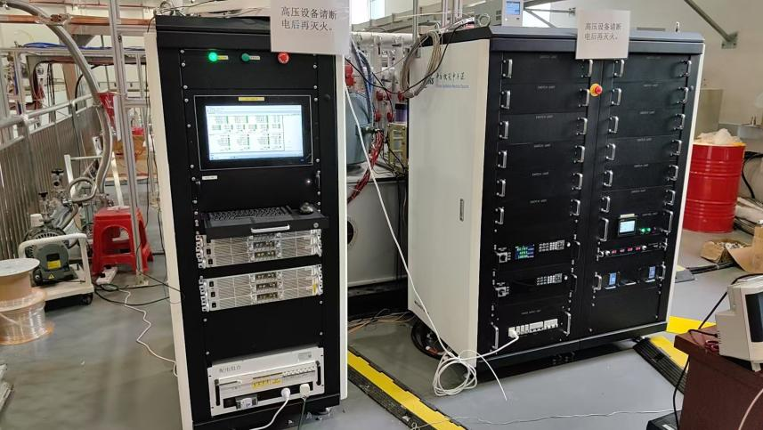
High power test bench
Low-Temperature Module
Modulator & Klystron

Slide 6
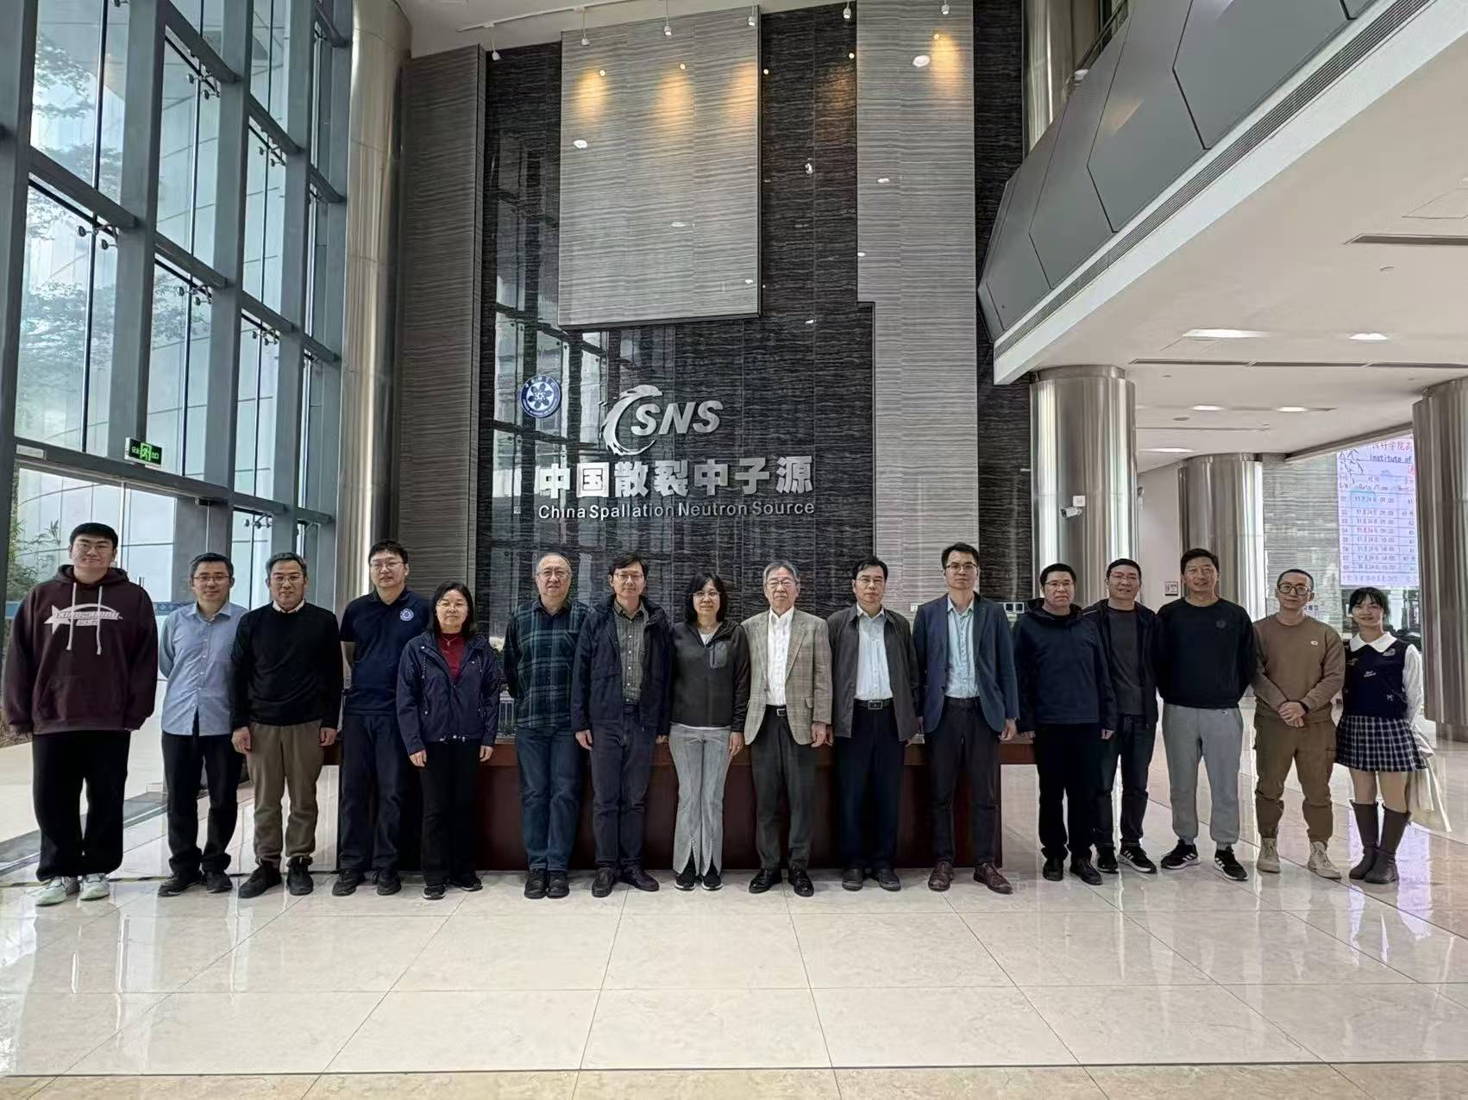
20 cells high power test results
On Nov. 24, 2015, we conducted the test acceptance
The power into the cavity is 32.45 MW and the pulse width is 2.5μs
The high-power test results achieved an accelerating gradient of 128.5MV/m
Personnel participating in the test

