Slide 1
SESAME kickoff meeting
HZB project status
Oliver Kugeler
DESY
12.1.2026

Slide 2
Role of HZB within SESAME
No funds for HZB
No milestones or deliverables for HZB
Matching interests to support SESAME goals and benefit from the collaboration:
QPR measurements
Continued commissioning of RASTA (NOVALIS)
Flux expulsion studies with CRAFT and TraMaFlux
Laser treatment of Nb3Sn samples (Wuppertal)
  application to electrodeposited Nb3Sn-on-Cu layers from HZB
Defect density measurements (HZDR, ELBE)

Slide 3
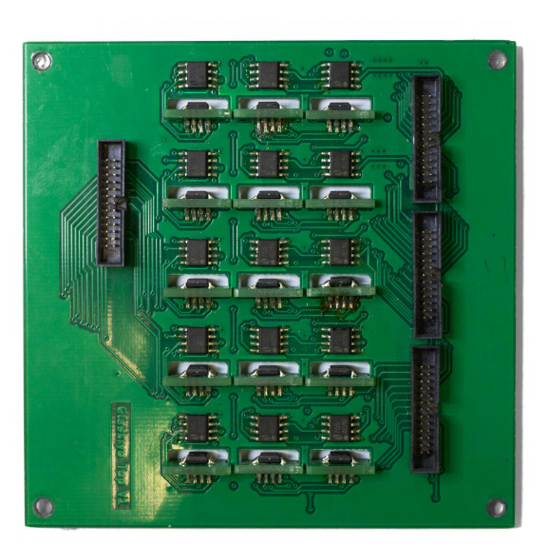
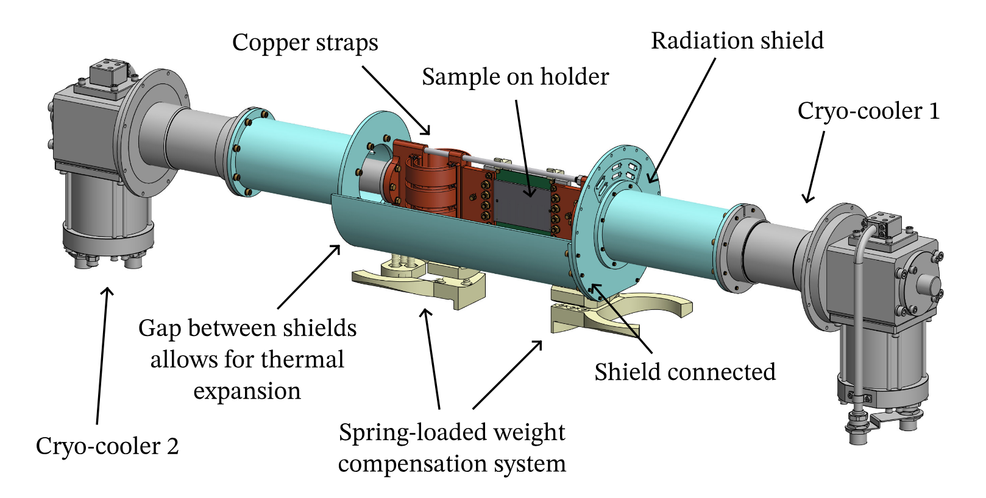
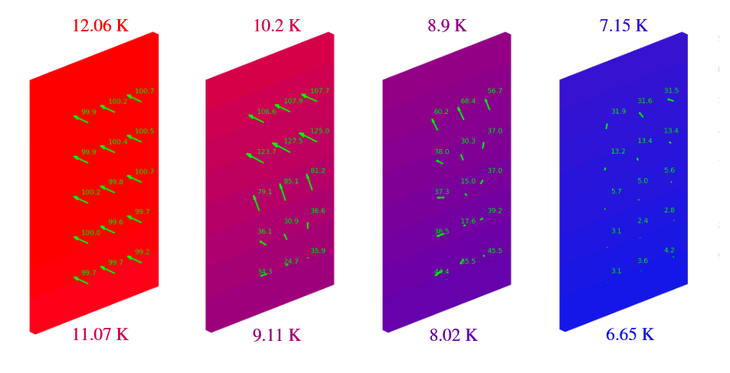
CRAFT (CRyo-cooler based Analysis of Flux Trapping)
operated with two cryocoolers
apply arbitrary spatiotemporal temperature gradients
apply uniform external B-field with Helmholtz coils
investigate flux trapping and vortex dynamics
Courtesy: Alex Cierpka
(Master thesis complete and
paper submitted to RSI)
B-mapping with
AMR sensor array
field progression during sc transition

Slide 4
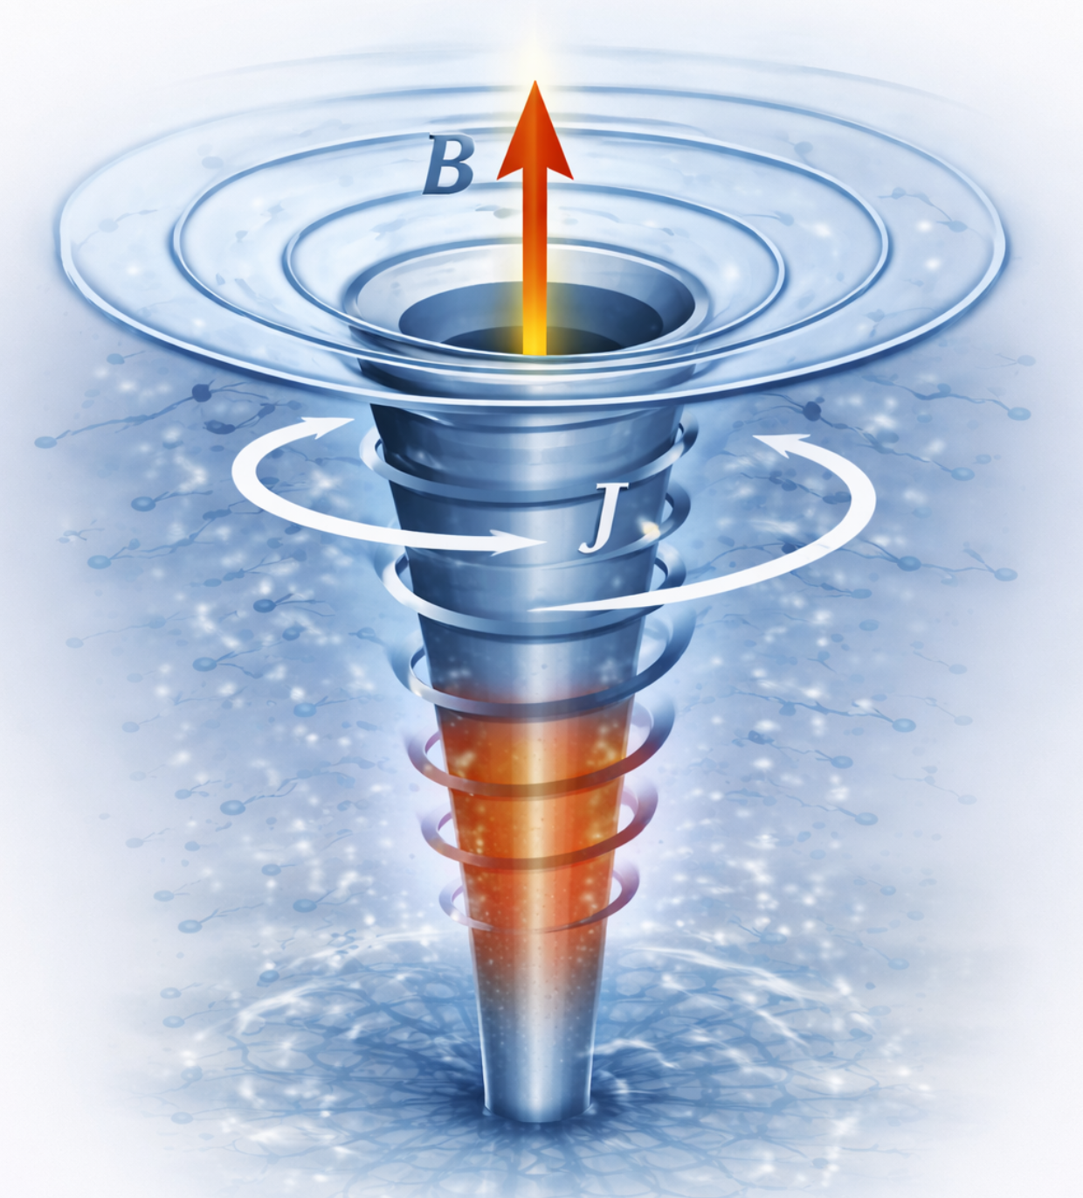


Investigation of vortices
Trapped flux contributes to the RF surface resistance and causes dissipation in cavities.
We cannot measure vortices directly – only their impact on the outside B-field
Equation of vortex motion during cool-down based on Mattis-Bardeen theory
Consider forces on vortex segment, neglect AC terms:
Vortex velocity
normal fluid velocity
vortex viscosity
Lorentz force by
thermocurrents
entropic
thermal force
Pinning force
Vortex-Vortex
repulsion
$j_{th}\sim ∇T$
how measured ?
variation of $\frac{∂T}{∂t}$
variation of spatial T gradients
Note: forces perpendicular
utilize CRAFT 3d mapping of B
defect density
(PAS@HZDR)
variation of
external field
deviations from
linearity between
B_{ext} and B_{trap}

Slide 5
HZB personnel
CRAFT: Alex Cierpka, Felix Kramer
QPR/RASTA: Felix Kramer, Sebastian Keckert
Bronze route: Ming Lu

