Slide 1


Welcome to Hamburg
ChatGPT
Notes:
Top superconductor sees majority of rf field → Surface resistance improves
Insulating layer creates more interfaces → More counter currents
Layers must be thinner than λ_{L,Top} → RF field is affected by counter currents
❑ Superconductor (S) layer:
provide magnetic screening
❑ Insulator (I) layer:
stabilizes coating
prevents global vortex penetration

Slide 2
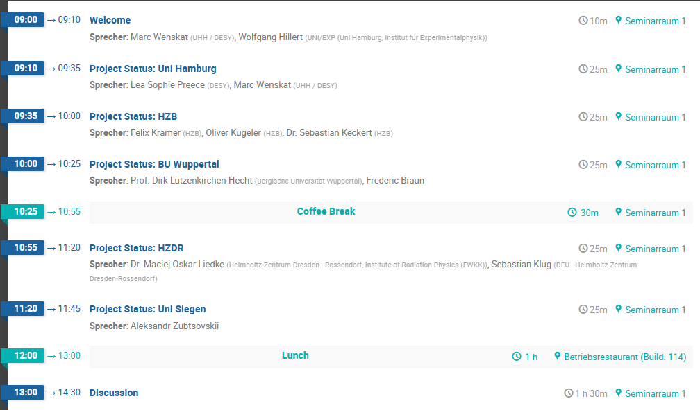
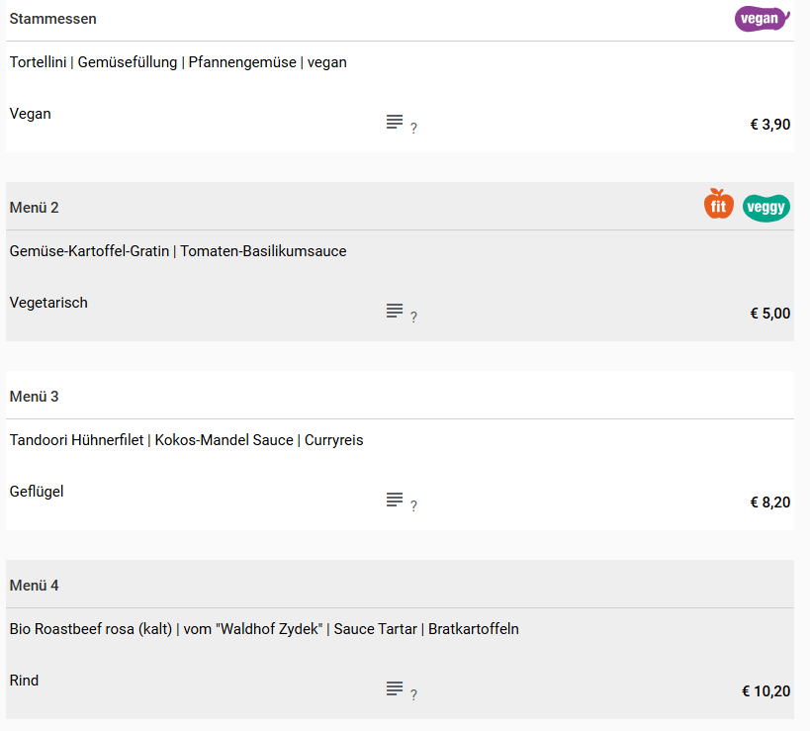
Plan for Today
DESY Canteen
Interest in „sight seeing“ afterwards?
e.g. AMTF, HiGrade Lab
Notes:
Top superconductor sees majority of rf field → Surface resistance improves
Insulating layer creates more interfaces → More counter currents
Layers must be thinner than λ_{L,Top} → RF field is affected by counter currents
❑ Superconductor (S) layer:
provide magnetic screening
❑ Insulator (I) layer:
stabilizes coating
prevents global vortex penetration

Slide 3

Organizational Things
Kooperationsvereinbarung is signed
First report requested for 2025 – Deadline 30.4.2026
Only virtual report – no „offline“ document
We will check if a separate document for “Kooperationsübersicht” is required

Slide 4
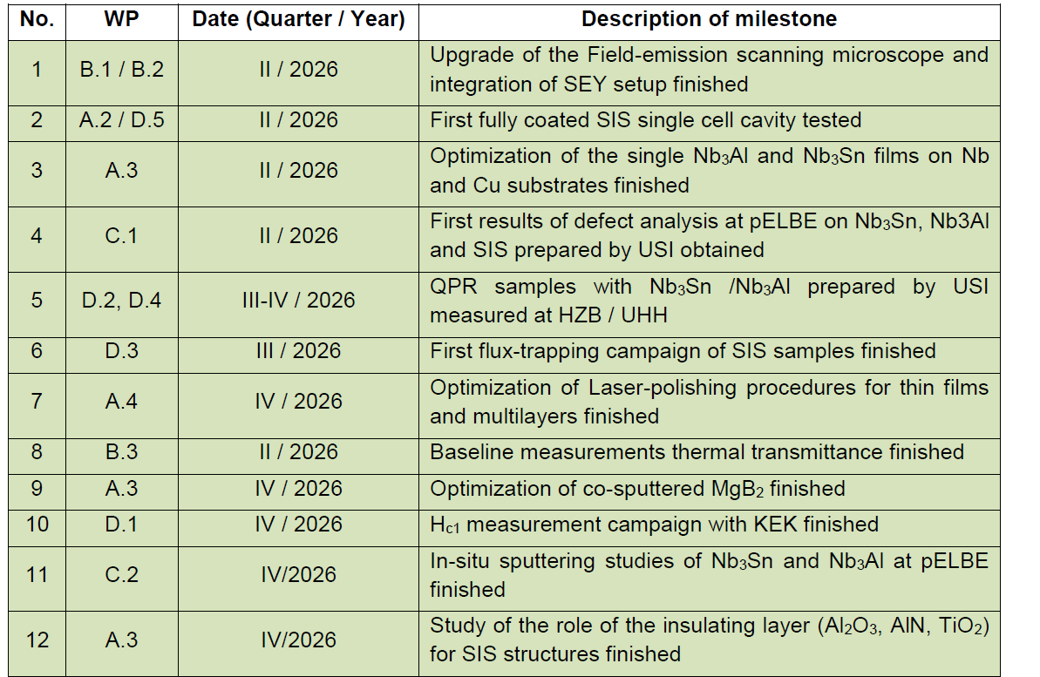
Milestones for 2026
Work Packages / Tasks:
A: Film production and treatment
A1: Sample preparation
A2: PE-ALD coating of cavities
A3: Sputtering studies of new materials
A4: Laserpolishing
B: Microstructure characterization
B1: Material characterization
B2: Measurement parasitic FE and SEV
B3: Thermal transmittance studies
C: e⁺ spectroscopy of thin film structures
C1: Depth resolved defect analysis at ELBE
C2: In-situ sputtering studies
D: SC characterization of samples
D1: Magnetometry of samples
D2: RaSTA testing
D3: Flux-Trapping studies
D4: RF testing of QPR samples
D5: Cavity testing
Notes:
Top superconductor sees majority of rf field → Surface resistance improves
Insulating layer creates more interfaces → More counter currents
Layers must be thinner than λ_{L,Top} → RF field is affected by counter currents
❑ Superconductor (S) layer:
provide magnetic screening
❑ Insulator (I) layer:
stabilizes coating
prevents global vortex penetration

