Slide 1
SESAME KickOff Meeting @DESY, Hamburg
Project Status: HZDR - Sebastian Klug 12.01.2026
Institute of Radiation Physics · Department of Nuclear Physics · Sebastian Klug · s.klug@hzdr.de · www.hzdr.de

Slide 2
Content
Beamtime proposals at pELBE
Own proposal
Collaboration proposals
Research
Updates on AIDA-II Sputtering Chamber
Nb₃Sn Studies
Strategic Overview for Nb₃Sn
Outlook
Next Studies

Slide 3
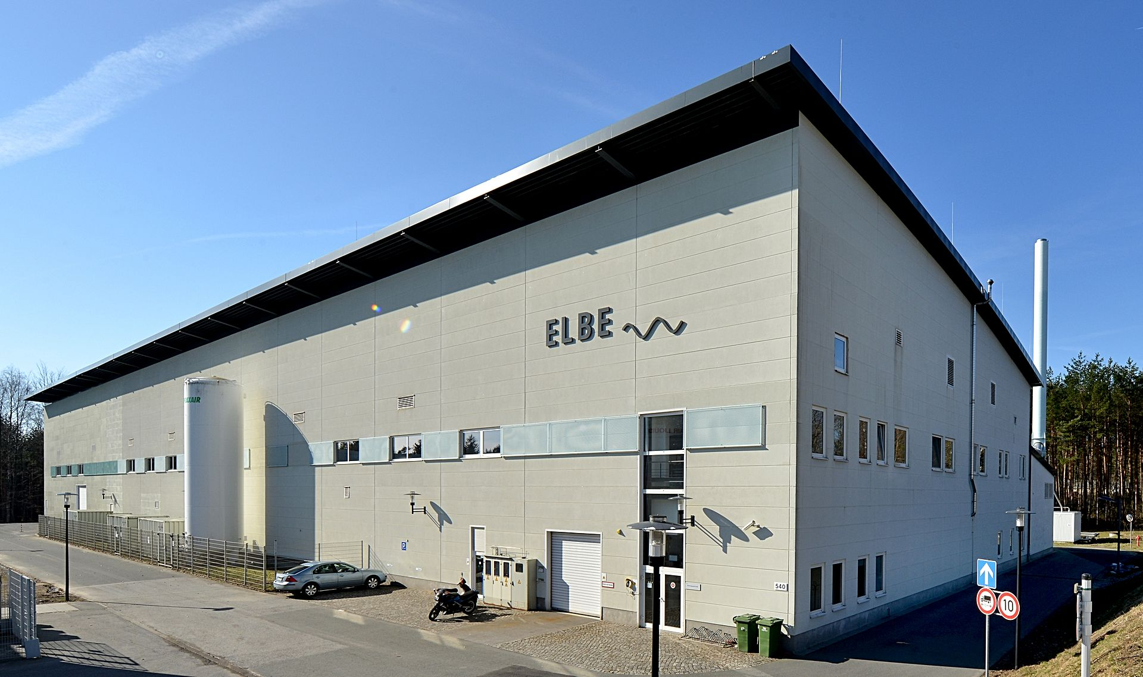
Beamtime proposals at pELBE
Own proposal
25203827-SebastianKlug
2025/2 beamtime proposal
Study of DCMS and HiPIMS Nb₃Sn on Si and YSZ
Lost beamtime of ~ 1 shift (12 hrs)
Power and pressure study HiPIMS Nb₃Sn
sadly not measured with PALS yet
What was done?
Annealing study (In-situ and ex-situ)
DCMS on YSZ → different orientations

Slide 4


Beamtime proposals at pELBE
Collaboration proposals
25203794-BharathVenkata
DCMS and HiPIMS NbTiN as well as SIS Nb/AlN/NbTiN multilayer
Data fitted and sent to Bharath, he should be able to plot the data now
Discussion needed (soon)
25203804-OliverKugeler
Nb3Sn thin films with different recipes
Could be interesting to compare with my own samples
Data fitted
Plotting and Discussion needed (soon)

Slide 5
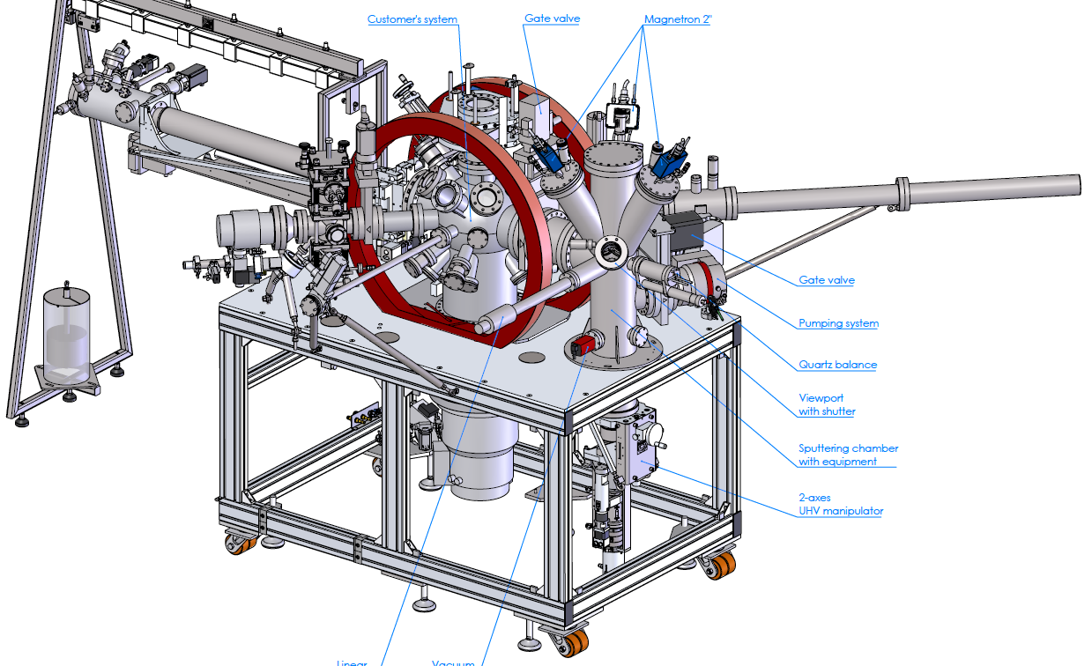
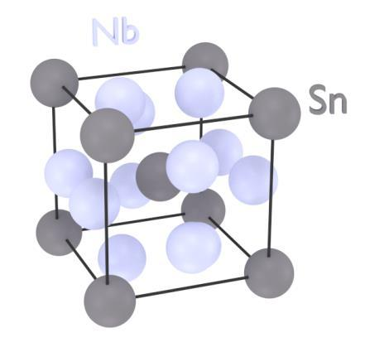
Updates at AIDA-II Sputtering Chamber
Technical difficulties
Inconsistence with sample transfer between chambers
Issure with Magnetrons (Nb target)
No substrate bias applicable atm
In-situ PALS
Issues with positron beam quality
More time needed for optimization
Thin film growth
Material: Nb₃Sn
DCMS and HiPIMS
Tc up to ~ 14 K atm
More film quality improvements needed

Slide 6
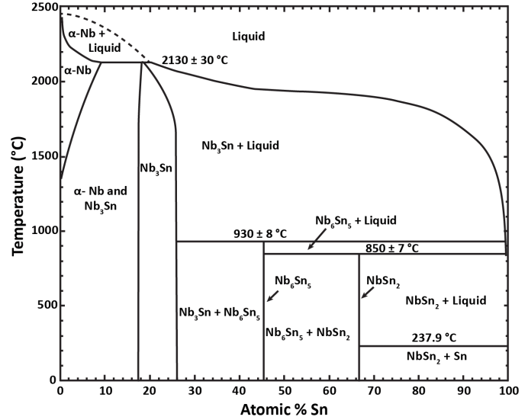

Slide 7
Nb₃Sn Studies
Annealing study (in-situ)
Impact of DC deposition power (RT, 30min)
Variation of power between 30W and 90W
Int1 is dominant
Saturation for AD 30W and 45W
Less Int1 for higher power
No clear trend for defect sizes
Combination with phase changes
AD 60W and 90W show lower LTs
Reduction of defect sizes and lowering of defect concentration (Int1)

Slide 8
Nb₃Sn Studies
Nb₃Sn on YSZ
Usage of different substrates
YSZ with different orientations:
(100), (110), (111)
Good Nb₃Sn phase development
(200), (210), (211) → expected from literature
Tc still not good enough, more improvements needed
HiPIMS method
Already started sample series
but: atm problem with applying substrate bias

Slide 9
Strategic Overview for Nb₃Sn
 | Phases | Defects | Superconductivity | Surface
Higher Power | Promising | Good | ??? | Good
Substrate heating | Bad (Si) | Promising | ~ 14.2 K | Problematic (Si)
UHV Furnace annealing | Not good, but promising | Promising | < 12 K | Good
YSZ substrates | Good | Promising | ~ 14.5 K | ???
General useful
General useful
Needs additional time. Only to improve already good recipes!
Promising results compared to Si → Al₂O₃ and AlN should work better !
Si is main problem for bad phases
→ solvable
Significant influence on LT1,2 and I1,2
More measurements needed, but direction is clear
Bad surface connected to Si-substrate at high temperatures

Slide 10



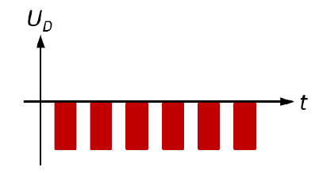
Outlook
Next Studies
Remain focus on Nb₃Sn films
Combine multiple treatment methods
Other substrates Al₂O₃ and AlN
Systematic HiPIMS studies:
Substrate bias
Pulse width, frequency, etc… (HiPIMS-specific parameter)
----------------------------------------------------------------------------------------
Later: Multilayered films with deposited insulating layer
Nb₃Sn
Insulating layer
Nb
Cu or Si

Slide 11


Acknowledgements
Chair of Surface and Materials Technology, University of Siegen, Germany
Bharath Reddy Lakki Reddy Venkata
Aleksandr Zubtsovskii
Xin Jiang
Institute of Experimental Physics, University of Hamburg, Germany
Lea Preece
Marc Wenskat
Institute of Radiation Physics, HZDR, Dresden, Germany
Maik Butterling
Andreas Wagner
Eric Hirschmann
Ahmed G. Attallah
Zhiwei Hu
Maciej Oskar Liedke

Slide 12
Backup slides

Slide 13
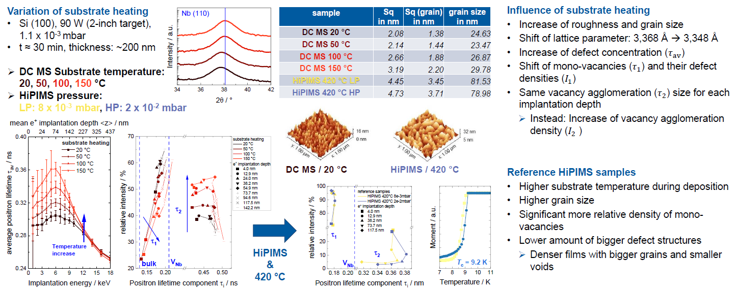
Short summary of my Ph.D. project
SRF2025
Nb and Nb3Sn on Si 1/2
Poster: Point defects in Nb-based superconducting films probed by positron annihilation spectroscopy

Slide 14
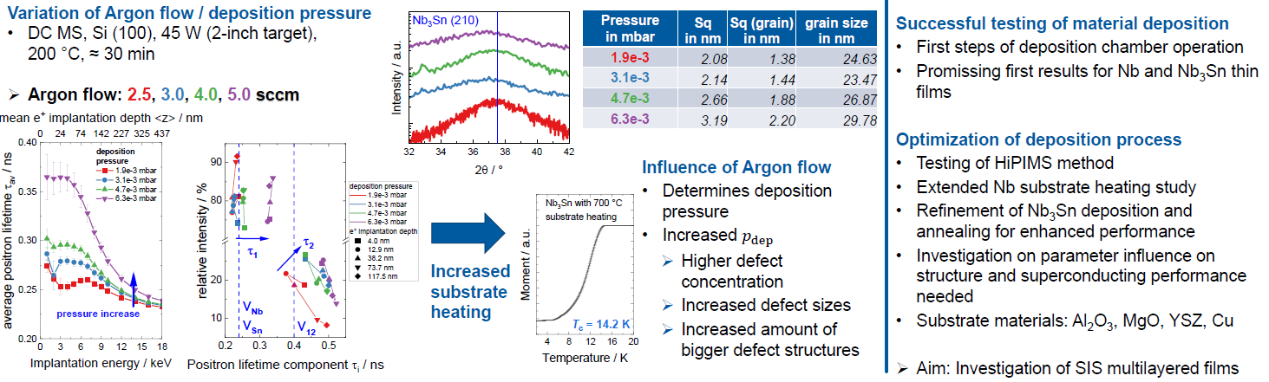
Short summary of my Ph.D. project
SRF2025
Nb and Nb3Sn on Si 2/2
Poster: Point defects in Nb-based superconducting films probed by positron annihilation spectroscopy

Slide 15
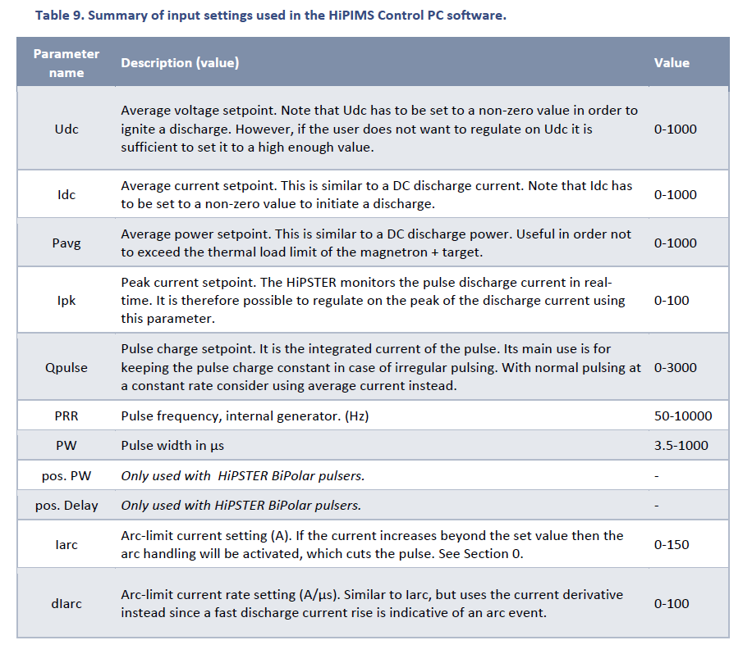
HiPIMS parameter list

