Slide 1
Report from the Workshop on Higher Order Modes in Superconducting Cavities (HOMSC2025) Hamburg, 6 – 8 Oct. 2025
Nicoleta Baboi , DESY
DESY-TEMF Collaboration Meeting
Hamburg, 11 Dec. 2025
Photo by Sergey Tomin

Slide 2

Overview
Workshop series
Previous workshops
HOMSC2018, Cornell University
https://indico.classe.cornell.edu/event/185/
HOMSC16, Warnemunde (University of Rostock)
https://indico.cern.ch/event/465683/
HOMSC14, FNAL
https://indico.fnal.gov/event/7942/timetable/#20140714
HOMSC12, Cockcroft University
(the webpage apparently does not exist anymore)
HOM10, Cornell University
https://www.classe.cornell.edu/Events/HOM10/Agenda.html
HOMSC 2007, DESY

Slide 3
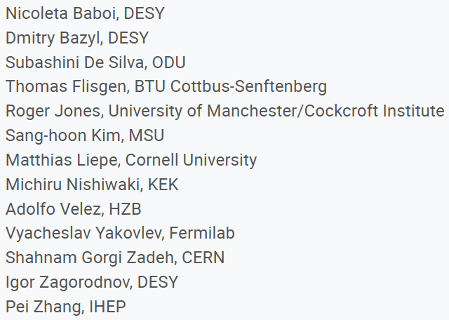
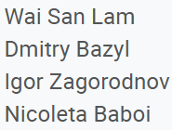
Overview
Participants, Programme
42 participants
2 supported PhD students
Many could not come due to financial reasons
Hybrid format -> worked relatively well
Scientific Programme Committee
local |  | online
22 | Europe | 2
6 | Asia | 4
3 | US | 5
Local Organising Committee

Slide 4
Workshop Programm: 4 Working Groups
Program
indico.desy.de/e/homsc2025
2.5 days, followed by visit to AMTF and the European XFEL
37 contributions
HOM Damping Requirements for Future Facilities
Organizers: Dmitry Bazyl, Vyacheslav Yakovlev, Pei Zhang
Numerical Simulations for SRF Cavities
Organizers: Thomas Flisgen, Igor Zagorodnov
Design of SRF Cavities and HOM Damping Schemes
Organizers: Sang-hoon Kim, Subashini De Silva, Adolfo Velez, Shahnam Gorgi Zadeh
Operation of SRF Facilities
Organizers: Roger Jones, Matthias Liepe, Michiru Nishiwaki

Slide 5
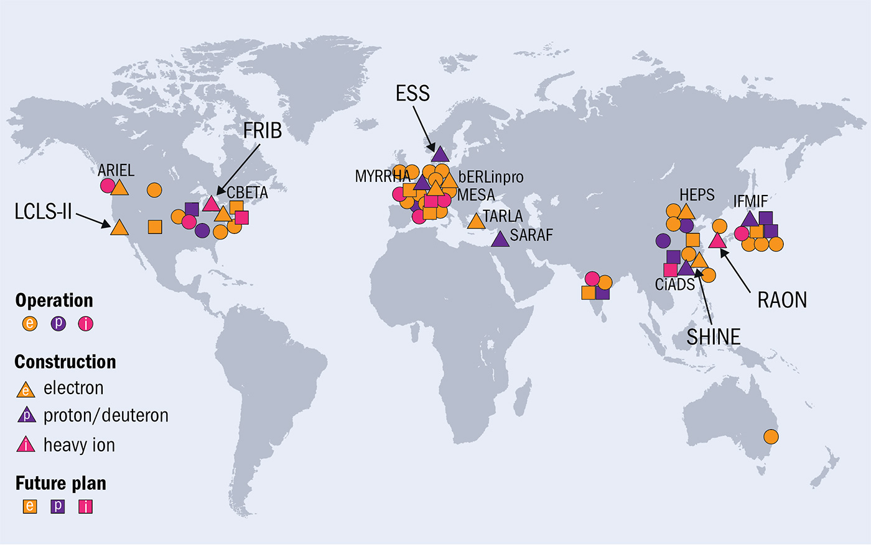
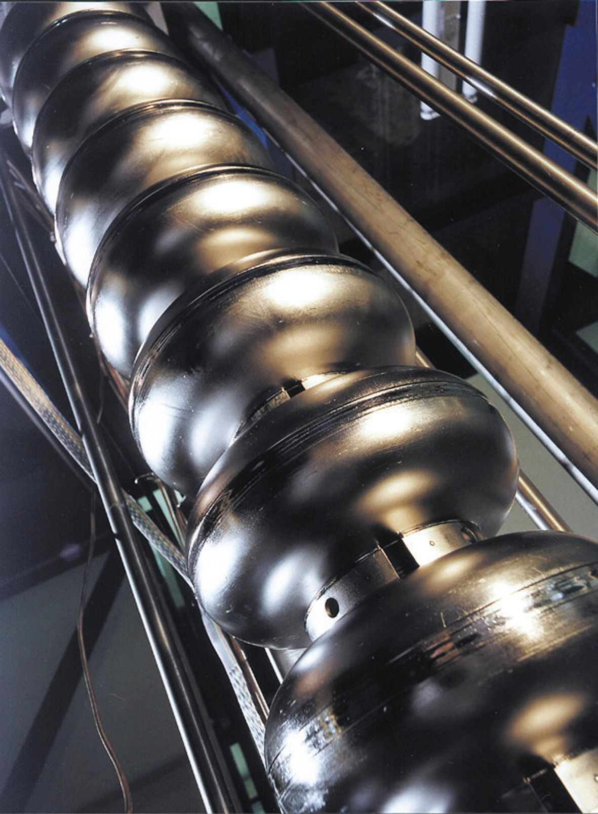
Overview of SRF Facilities
Ref: CERN Courier 10 Nov. 2020 https://cerncourier.com/a/teslas-high-gradient-march

Slide 6
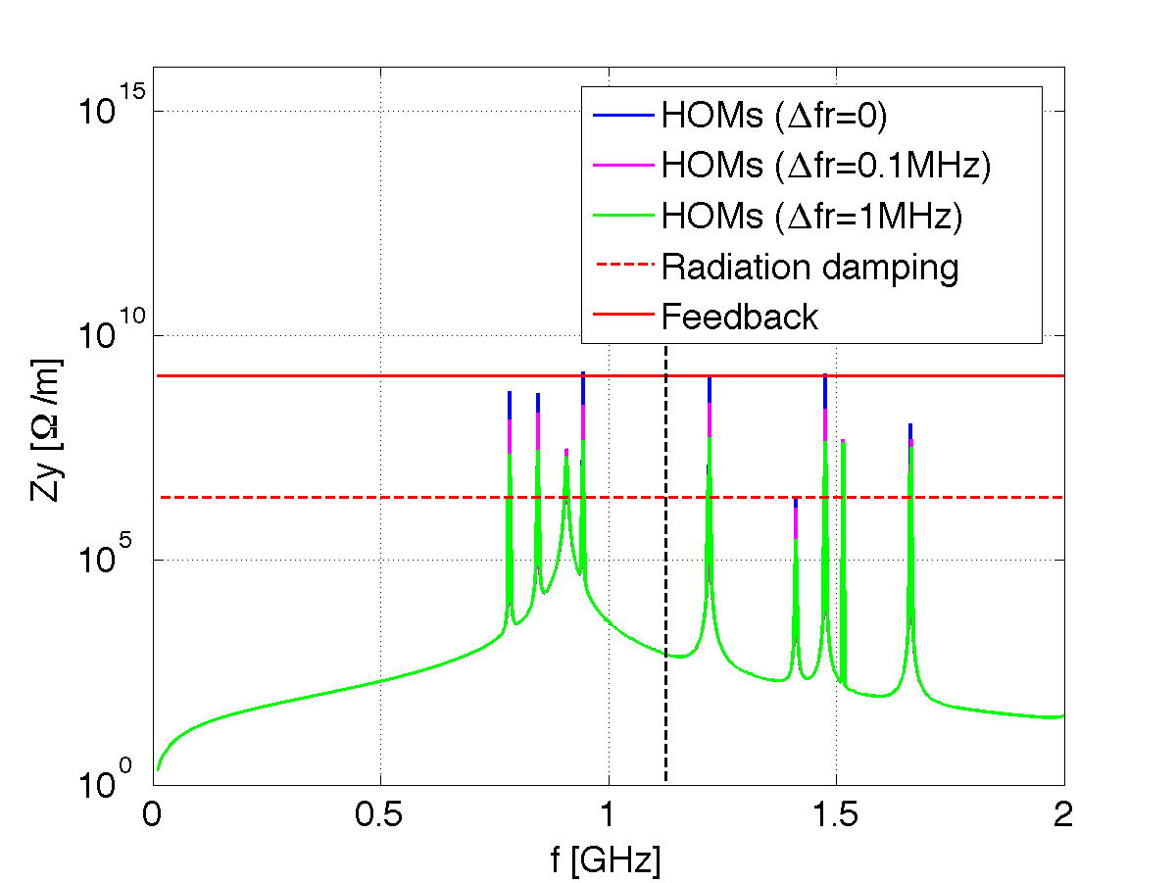
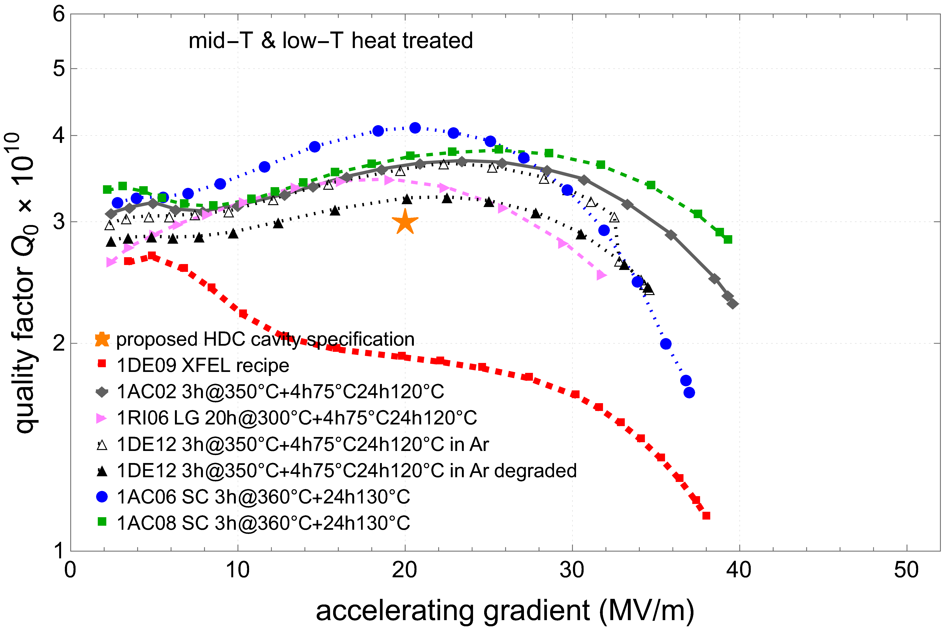
WG1: HOM Damping Requirements for Future Facilities (1)
New Projects in China, Pei Zhang (IHEP, CAS)
Impressive number of new projects, most with SRF technology
DESY SRF R&D towards a possible high duty cycle upgrade of the EuXFEL, Hans Weise (DESY)
New SRF technologies are being developed
Promising results of cavity treatment
HOM Damping Requirements for New Circular Accelerators, Na Wang (IHEP, CAS)
Study for both e-p circular colliders and Synchrotron radiation facilities
Effect of detuning on impedance
EuXFEL Recipe

Slide 7
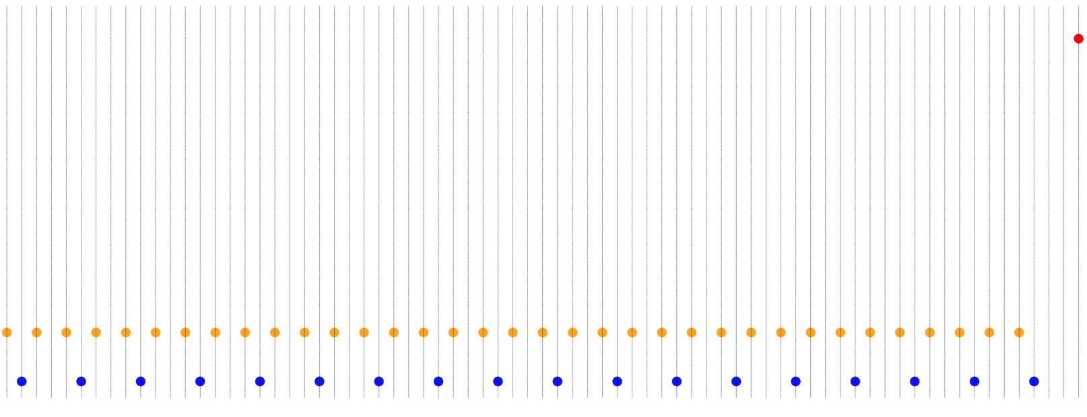
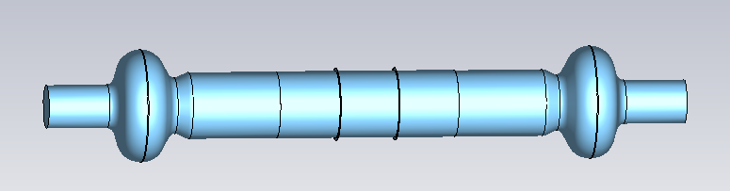
WG1: HOM Damping Requirements for Future Facilities (2)
HOM Damping Strategies for the FCC-ee SC Cavities, Shahnam Gorgi Zadeh (CERN)
2-cell 400 MHz and 6-cell 800 MHz cavities have been analysed, including e.g. multipacting at HOM couplers
Dipole wakefields and beam dyna-mics simulations for the UK XFEL, Anthony Gilfellon (STFC)
Benchmarked tracking codes (ELEGANT, PLACET); emit. growth simu-lated for simple and composite beams
Beam Stability in the EIC ESR, Alexei Blednykh (BNL/EIC)
Contribution of the 2-cavity 591 MHz string analysed
longitudinal damper is required; transverse one under investigation
Two back to back cavities
test bunch
composite beam

Slide 8
WG2: Numerical Simulations for SRF Cavities (1)
Concatenation Methods, Thomas Flisgen (BTU)
an important tool to determine HOMs in cavity chains, but sometimes difficult to get a good description of individual segments
Status of the ECHO Code, Igor Zagorodnov (DESY)
for accurately modeling wake fields and impedances in diverse accelerator geometries
highlighted recent developments, capabilities, and applications in complex component analysis
https://www.echo4d.de
Numerical Analysis of HOMs in SRF Resonators for Particle Accelerators, Andrei Lunin (Fermilab)
Model the spread of HOM parameters caused by mechanical imperfections in superconducting cavities, enabling prediction of resonant RF losses and informing design for stable, efficient operation of high-current accelerators
ILC Crab Cavity

Slide 9
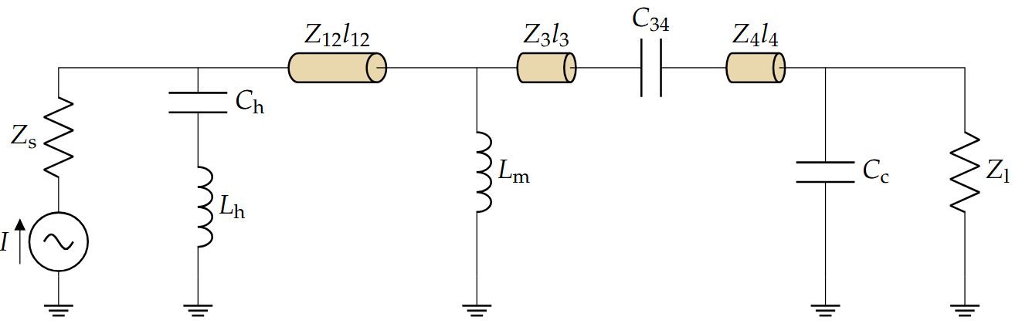
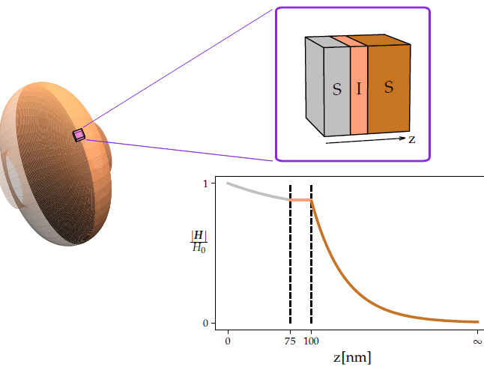

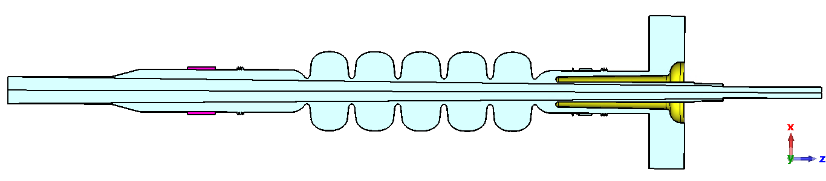
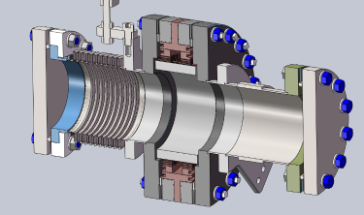
WG2: Numerical Simulations for SRF Cavities (2)
Numerical Analysis of HOM Couplers, Sosoho-Abasi Udongwo (BTU)
Numerical simulation methods for analyzing HOM couplers in TESLA-type SRF cavities using S-parameter analysis (3D model and circuit model), optimization, and multipacting studies
HOM Power Calculation of SHINE, JieXi Zhang (ShanghaiTech Univ.)
dielectric properties of absorber materials are a critical issue
Surface Impedance of Multilayered
Superconducting Cavities, Aaron Gobeyn (TU Darmstadt)
SIBC approach for a multilayer superconductor-insulator-superconductor as a cost-effective and higher-performing alternative to bulk niobium SRF cavities
HOM Damping for Conduction-Cooled 915 MHz SRF Cavities in High-Power 𝒆⁻ Beam Accelerators, Alex Castilla (JLAB)
Assessment of HOMs in 915 MHz SRF cavities for industrial linacs, showing that stable, high-current operation is achievable without in-cell HOM couplers, enabling simpler, more efficient cavity designs for high-power applications

Slide 10
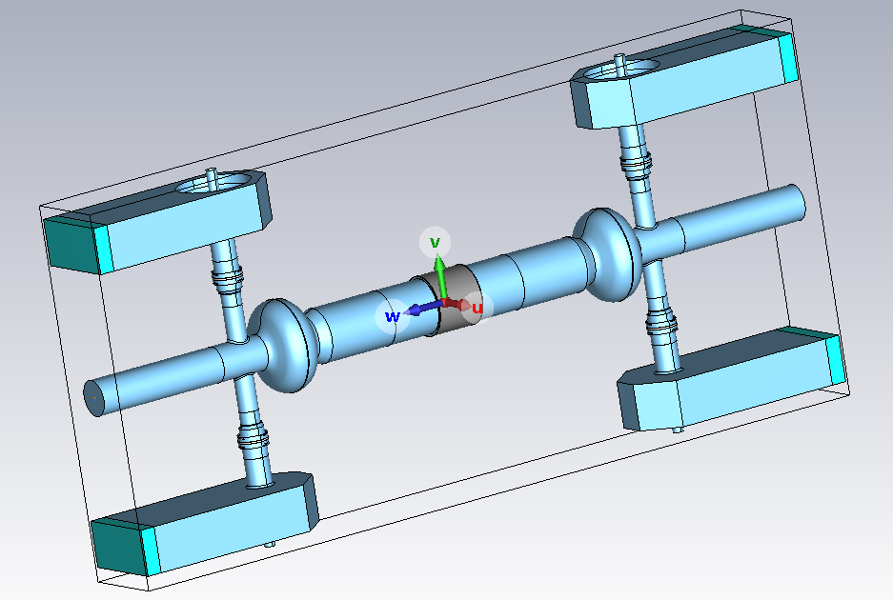
WG3: Design of SRF Cavities and HOM Damping Schemes (1)
RF absorber development at IJCLab, Akira Miyazaki (CNRS/IN2P3/IJCLab)
Studies on material choice and possible vendors for the BLA in PERLE cavities at IJCLab (operating at 40 K) and the underlying theory of dielectric loss
Design of HOM damped SRF Cavities for CW Operation in Storage Rings, Andranik Tsakanian (HZB)
HOM power distribution analysis and the importance of integrating HOM damping early in the cavity design stage, illustrated with examples from the BESSY VSR cavity design
HOM damping for the EIC ESR SRF Cryomodule, Jiquan Guo (JLAB)
Latest updates on the EIC cavity design, from single- to two-cavity module, addressing impedance limitations and BLA design for kW-level HOM power

Slide 11
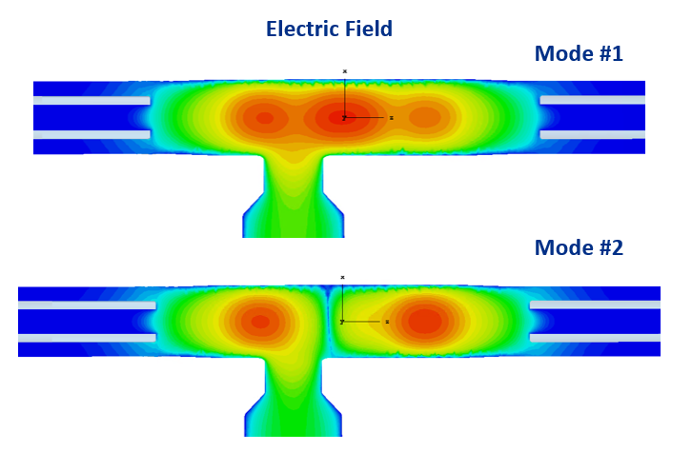
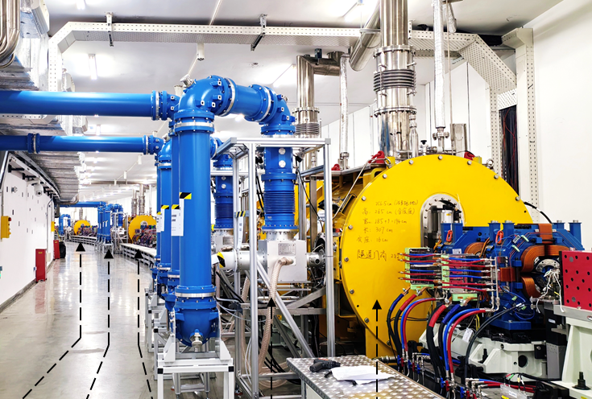
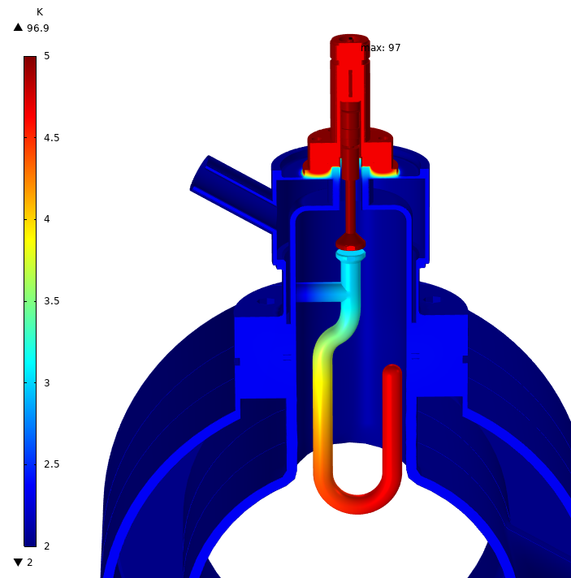
WG3: Design of SRF Cavities and HOM Damping Schemes (2)
Compact Coaxial HOM Damper for SRF Cavities, Andrei Lunin (Fermilab)
A new compact HOM damper based on a radially sectioned coaxial design was proposed, providing effective and compact HOM suppression especially for low frequency cavities
Progress of HOM couplers for PERLE SRF cavities, Patricia Duchesne (CNRS/IN2P3/IJClab)
A summary of the thermomechanical analysis for SC coaxial HOM couplers, focusing on the hook-type coupler for PERLE cavities
HOM Damping in 166MHz beta=1 QWR for High Energy Photon Source, Hongjuan Zheng (IHEP)
HOM damping in 166.6 MHz cavities using large-radius ferrite absorbers, addressing challenges such as brazing, ferrite tile peel-off
SOMs
T° in nominal condition
HEPS: beam current reached 100 mA on Sep. 23, 2025
all heat loads
= 100 mW + 150 mW
Liquid helium
Cavity @2K
4.8K
EIC 394 MHz Crab Cavity

Slide 12
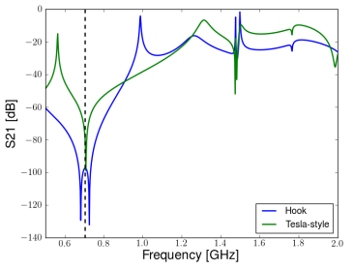
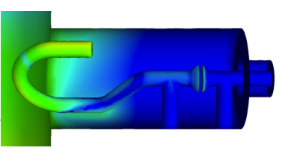
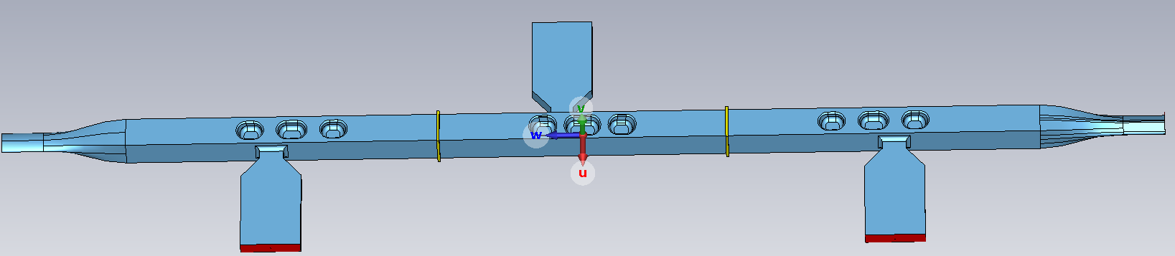
WG3: Design of SRF Cavities and HOM Damping Schemes (3)
Evanescent mode coupling in coaxial HOM filters, Kai Papke (DESY)
Overview of coaxial HOM coupler design theory and a systematic design approach from filter function to 3D structure
HOM Damping for EIC Crab Cavities, Binping Xiao (BNL)
Recent progress on HOM impedance threshold calculations and HOM damping design for the 197 MHz and 394 MHz EIC crab cavities
QMiR Cavities RF Analysis, Nuaman Shafqat (Elettra)
QMiR 3.0 GHz and 3.25 GHz crab cavities for Elettra 2.0 designed without HOM couplers, with challenges from high-Q, low-R/Q HOMs trapped in the beam pipe
Followed by discussion
394 MHz Cavity
R. Ainsworth, in Proc. IPAC2012, WEEPPB008

Slide 13
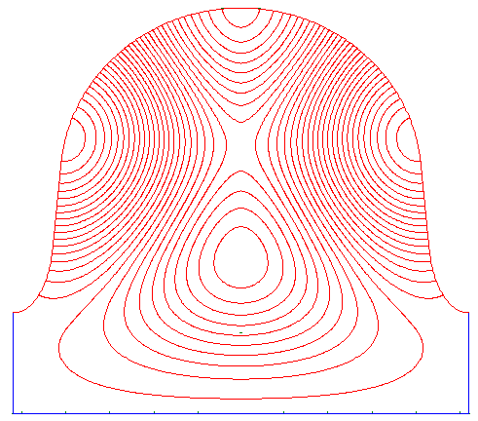
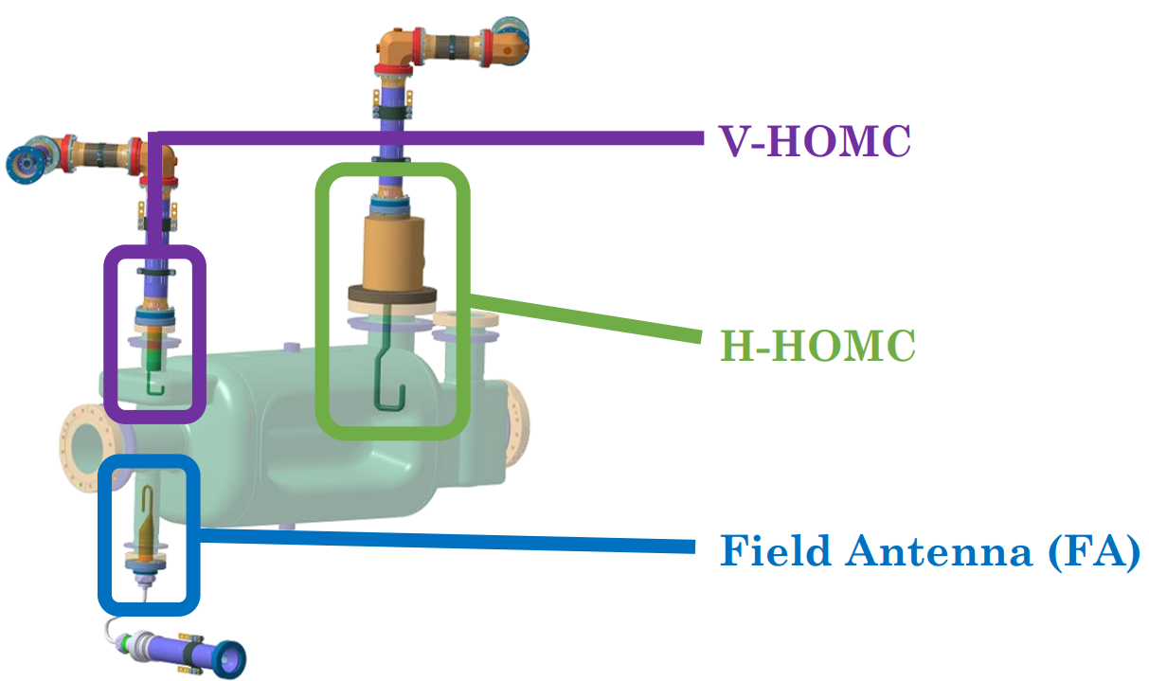
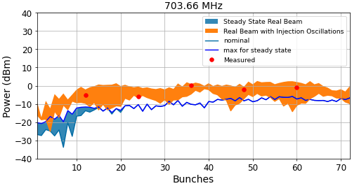
WG4: Operation of SRF Facilities (1)
Interaction of degenerate HOMs in periodic accelerating structures, Andrei Lunin (Fermilab)
Phenomenon of degenerate HOMs interaction in the PIP-II HB650 cavity can lead to flat passbands which should be avoided
Cold Testing and HOM Coupler Qualification for HL-LHC Crab Cavity Systems, Amelia Edwards (CERN)
HOM couplers for HL-LHC crab cavities well into production stage and being integrated into cavities and modules
Developing a Beam Spectrum for Transient Beams in the CERN Double Quarter Wave Crab Cavities, Conor McFarlane (Lancaster University)
There were large discrepancies between measurements of crab cavities and the predictions
=> Transient beam conditions should be considered for HOMs!
Mode mixing in elliptical multicell cavities

Slide 14
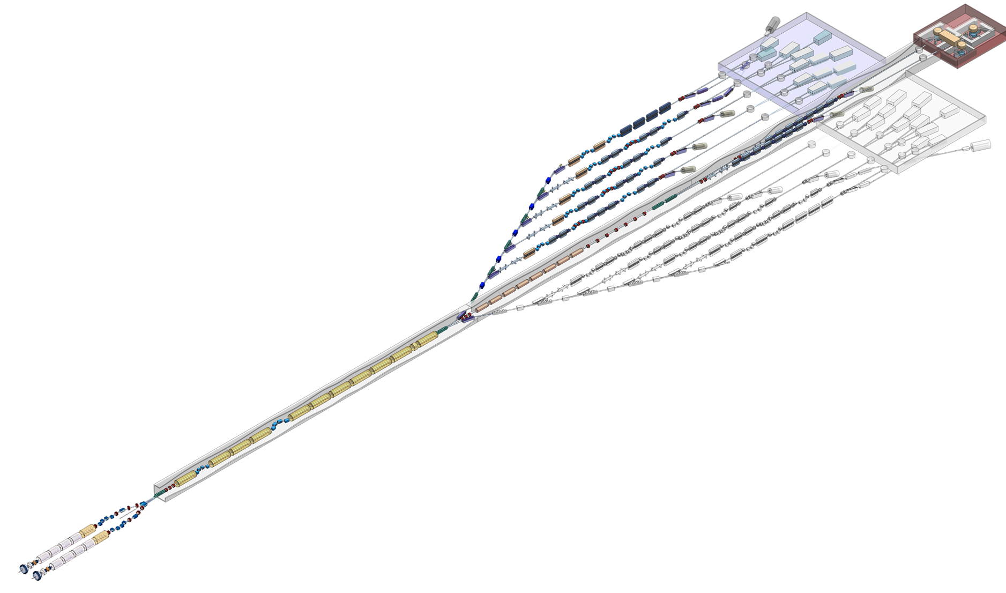
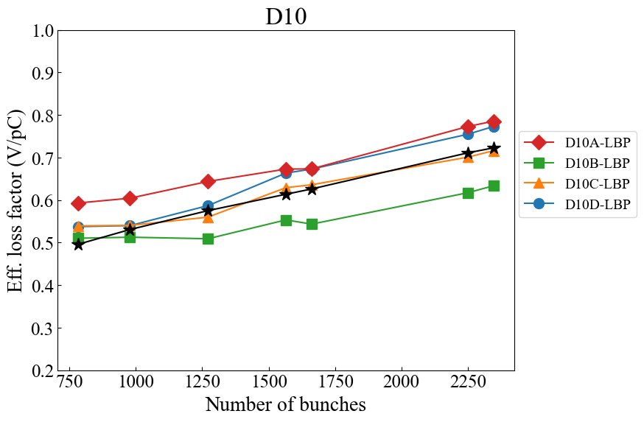
WG4: Operation of SRF Facilities (2)
Observation and simulation on the fill-pattern dependence of HOM power in the SuperKEKB SC cavity, Takaaki Yamaguchi (KEK)
An advanced method for evaluating HOM power
the EM fields inside materials are directly used
The UK XFEL project: conceptual design, Anthony Gilfellon (STFC)
Nice overview!
CW operation characteristics of the spare Eu-XFEL 3rd harmonic module, Karol Kasprzak (DESY)
A modified design of HOM Couplers is required for the CW upgrade

Slide 15
Conclusion
There is an increasing number of facilities using superconducting RF
There is a clear need of discussion in the field of HOMs in superconducting cavities
The workshop was a place for exchange, for looking for answers for challenges
The hybrid format worked well, but in-person participation is preferable
Hopefully the community can meet soon at the next HOMSC Workshop!
Should take place in 2028 (avoid years when an SRF conference takes place)
Continue in 2 year rhythm (as before the pandemics)

