Slide 1
Test Beam 2025
Gap Analysis
8 Decembe 2025
Ben Talmor

Slide 2

Motivation
Relation between X position and energy measurement in Gap
Correct the energy loss to determine the full deposited energy of the particle
Properties
Channel size – $5.5 [mm^{2}]$
Distance between channels – $10 [μm]$
Gap size (Distance between towers) – 2 [mm]

Slide 3
Contents
Telescope and Dead Channels Reconstruction
Gap Data Loss

Slide 4
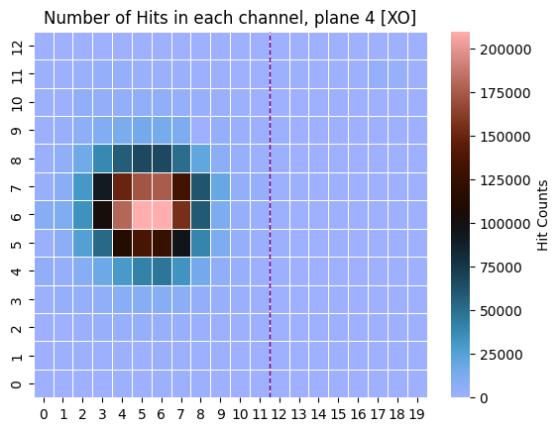
Dead Channel reconstruction
Run 1093 (8 XO)
Plane 4
Channel (5,5) = 105

Slide 5
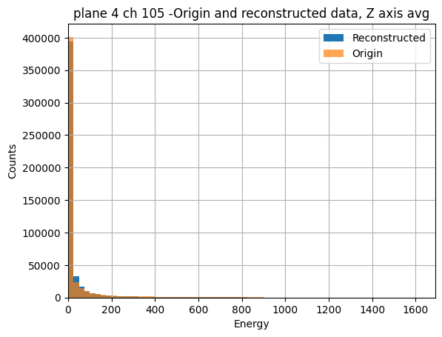
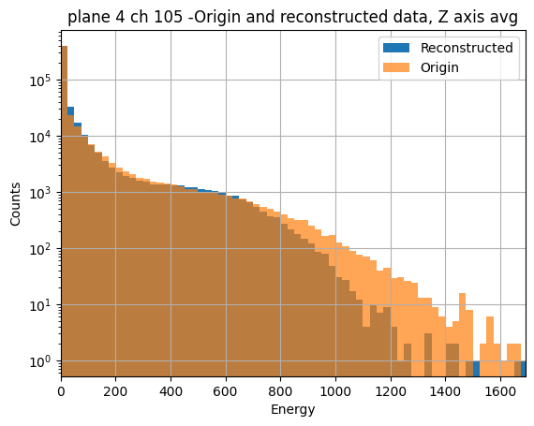
Energy deposition histogram plane 4, channel 105
normal Scale
Log Scale

Slide 6
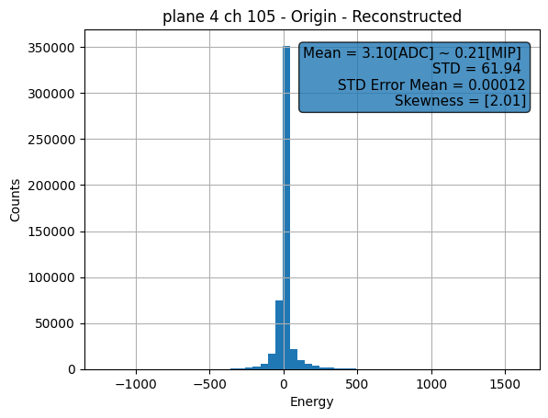
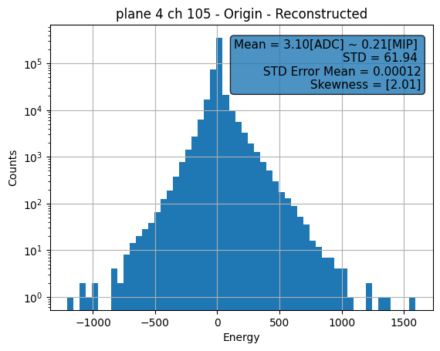
Origin – reconstructed histo
Normal Scale
Log Scale

Slide 7
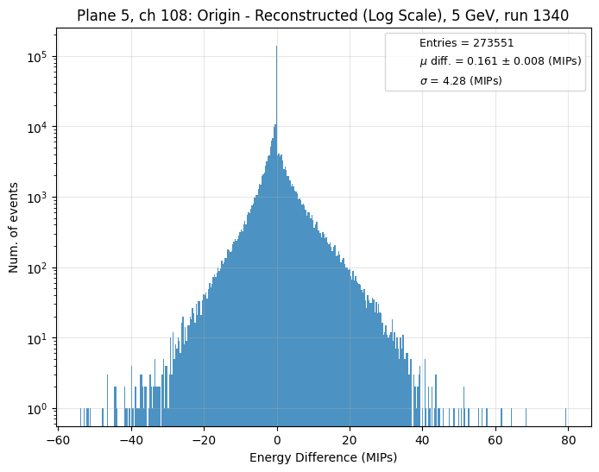
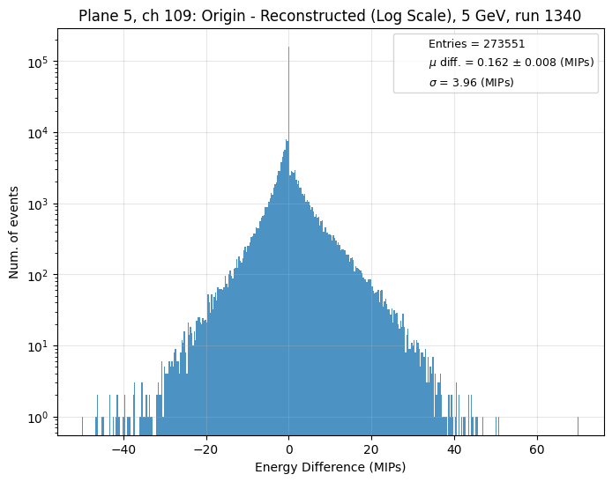
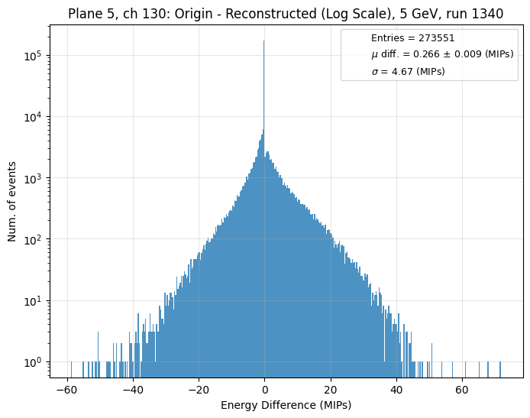
Roni’s results run 1340 11 layers of XO

Slide 8
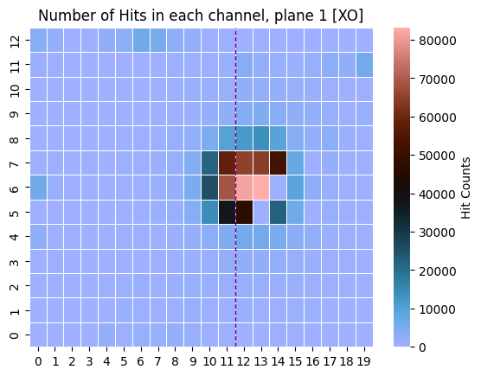
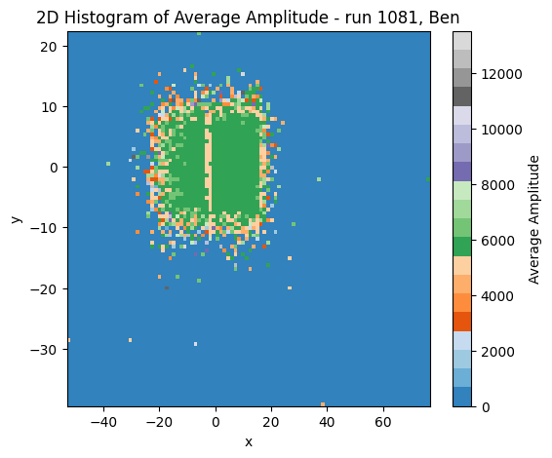
Run 1081 8 layers of XO
Amount of hits per pad in the first plane
Average shower energy for telescope

Slide 9
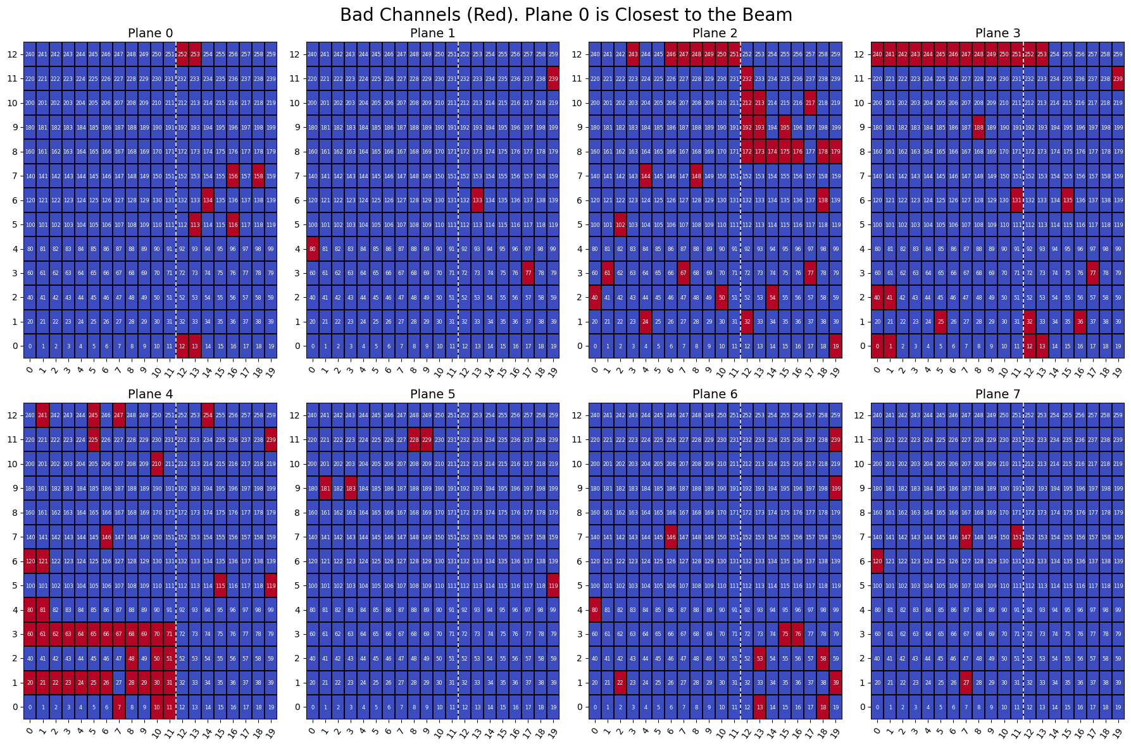
Dead channels run 1081

Slide 10
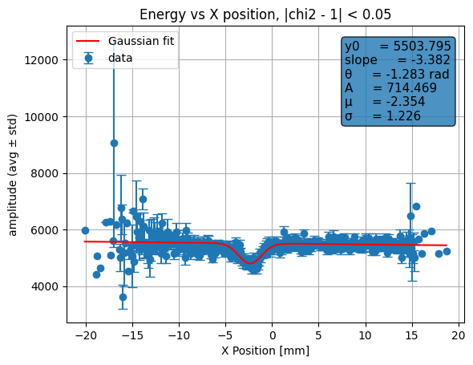



Energy lost around the gap

Slide 11
Overlook
Apply pad correction to data
Check the drop in energy for various runs

Slide 12
Thank you!

