Slide 1
Can we move the side branch to 2.4 m distance?
9.12.2011
Harald Sinn WP73

Slide 2
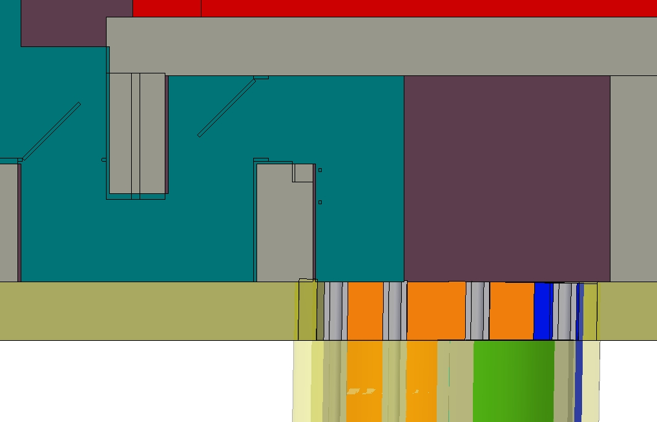

Slide 3
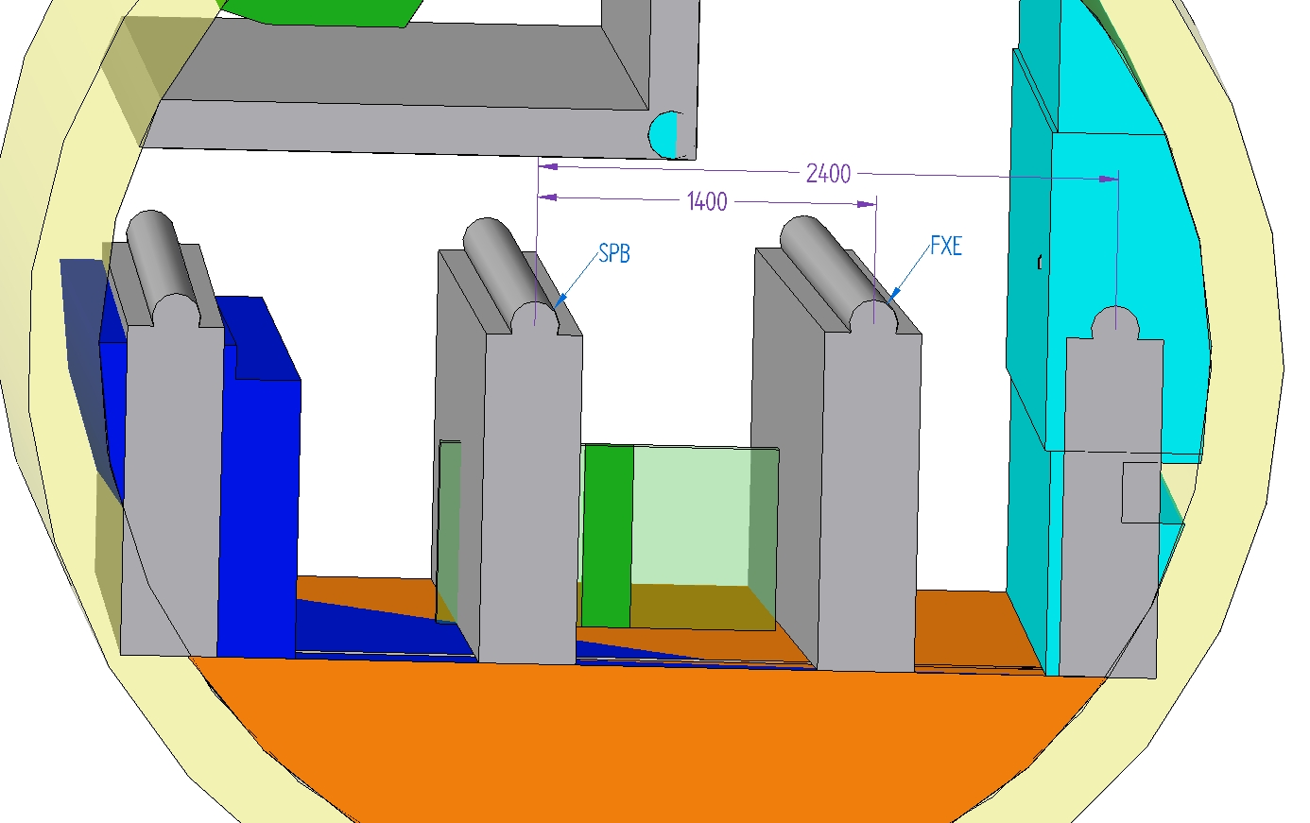
survey&alignment
placeholder

Slide 4
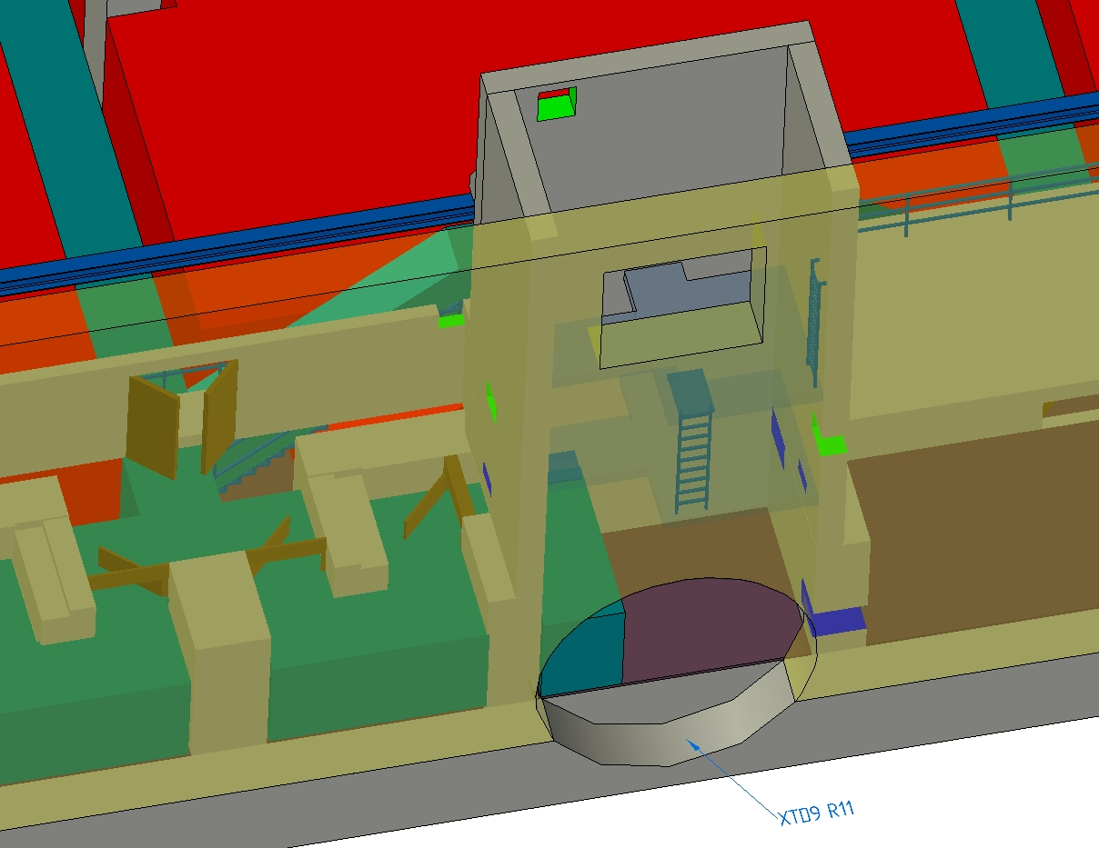
escape&transport
placeholder

Slide 5
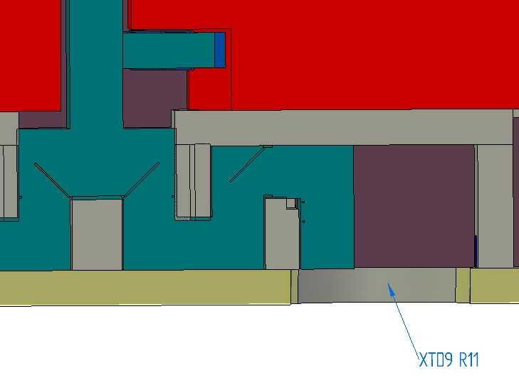

Slide 6
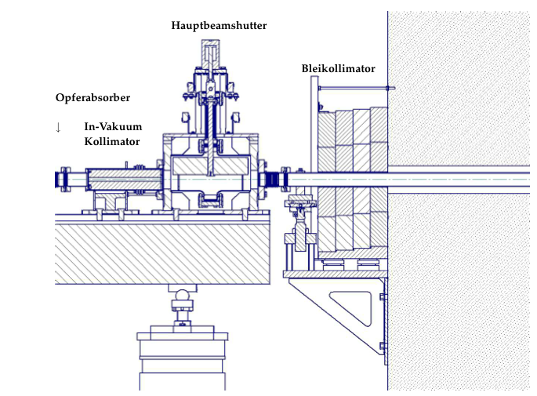

Slide 7
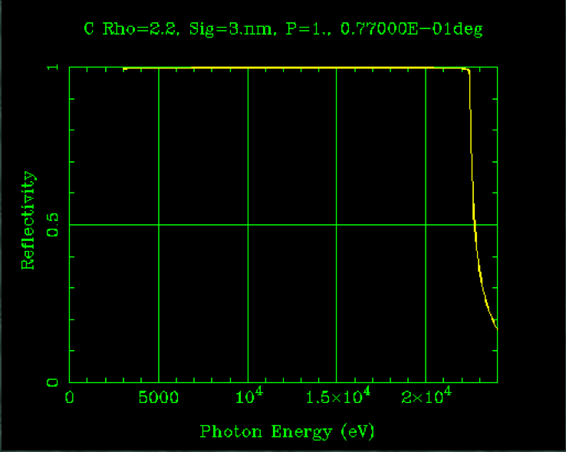
C- coating, 1.4 m distance

Slide 8
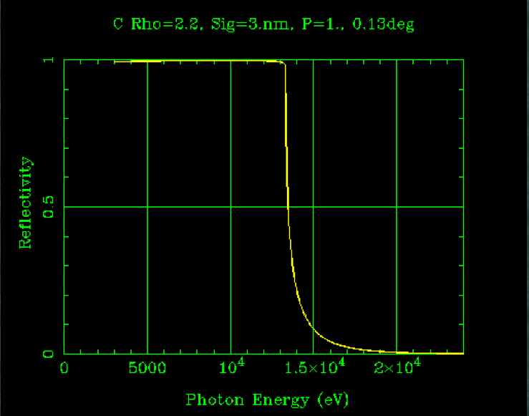
C-coating, 2.4 m (2.2 mrad)

Slide 9
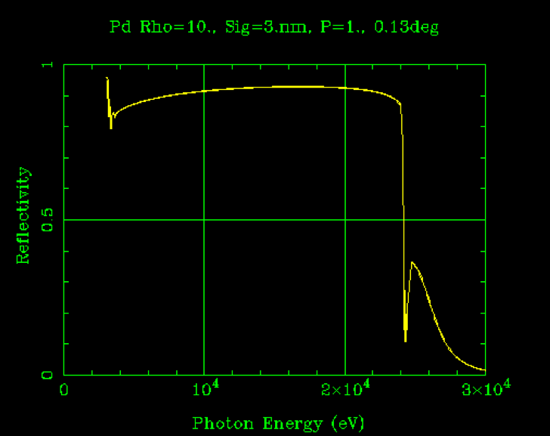
Pd, 2.2 mrad

Slide 10
Damage?
Here KB mirrors, offset Pd coating will be similar

