Slide 1
Working Group on XFEL Commissioning
3rd Meeting
13.01.2012
Notes:
How to edit the title slide
Upper area: Title of your talk, max. 2 rows of the defined size (55 pt)
Lower area (subtitle): Conference/meeting/workshop, location, date, your name and affiliation, max. 4 rows of the defined size (32 pt)
Change the partner logos or add others in the last row.

Slide 2
Agenda
High Level Milestones - Definition
Consolidated Commissioning Sequence
Next Meeting
Notes:
Before you start editing the slides of your talk change to the Master Slide view: Menu button “View”, Master, Slide Master:
Edit the following 2 items in the 1st slide: 1) 1st row in the violet header: Delete the existent text and write the title of your talk into this text field 2) The 2 rows in the footer area: Delete the text and write the information regarding your talk (same as on the Title Slide) into this text field.
If you want to use more partner logos position them left beside the DESY logo in the footer area Close Master View

Slide 3
High Level Milestones
First Beam through Linac
A 17.5 GeV beam is transported through the linac to the TLD dump.
Control: Charge, peak current, energy and trajectory are controlled by slow feedbacks.
First Beam to TD4 (SASE1 and SASE3)
A 17.5 GeV beam is transported through the linac to the T4D dump.
Electron beam based trajectory alignment in undulator
First Lasing in SASE1
First lasing is observed at 0.16 nm
Commissioning of photon diagnostics & beam line with spontaneous radiation
Photon based alignment of undulator gap and phase shifter setting
SASE search

Slide 4
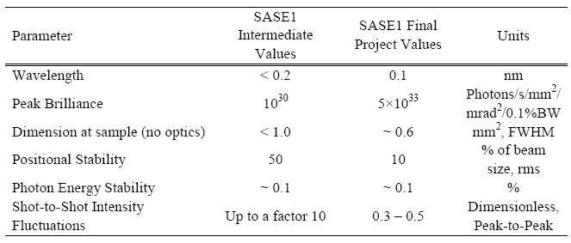
High Level Milestone 4: End of Construction Phase 1

Slide 5
Initial Beam Parameters
17.5 GeV
0.5 nC to 1nC
Higher charge eases diagnostics tasks
Compression to 5 kA, 70 fs FWHM electron bunch
1 to several tens of bunches
Eases machine protection issues
Start with SASE1 / SASE3 beam line
Straight beam path little easier
Allows parallel commissioning of 2 photon beam lines
If no sase at short wavelength in SASE1, lasing at longer wavelength in SASE3 might help to diagnose problem
SASE1 at lowest gap (λ= 0.16 nm) with about factor of two excess undulator length

Slide 6
X-ray Diagnostics

Slide 7
High Level Milestones cont.
Following commissioning steps can vary in sequence and can be pursuit parallel to initial user operation
Lasing in SASE 3
Multi-bunch operation
Fast Feedbacks
Quasi- simultaneous operation of SASE1 and SASE2 beam line
Bunch pattern control by fast switching elements
Lasing in SASE 2
Flexibility in wavelength and bunch length
change bunch length/bunch charges
change photon wavelength by changing energy/undulator gap
Commissioning of each of the initial experimental stations
…..

Slide 8
Organizational Matters
ToDos:
Next Meetings:
Friday, February 10, 15:00 (?), 30b/459

Slide 9
Questions
Requirement to x-ray diagnostics during e-beam/SASE commissioning (this probably includes priorities/time-table)
Rough time-table for taking e-beam/SASE/x-ray into operation (at least up to ‘end of construction milestone’)
Once SASE is achieved how to continue (emphasize on user runs, machine development, additional beam lines, …)
When to do fast e-beam switching, pulse train operation, pulse duration, etc.

