Slide 1
AIDA Infrastructure for very forward calorimeters
10/28/2011
Designers: In collaboration with:
Eric David François-Xavier Nuiry
Christophe Bault Andrea Catinaccio

Slide 2
Overview
PH-DT collaboration
AIDA very forward calorimeter design
→Mechanical frame
→Tungsten support
→Si detector support
Tungsten procurement
Mechanical frame machining

Slide 3
PH-DT collaboration
Francois-Xavier Nuiry
Engineering support
Andrea Catinaccio
Engineering support
Eric David
Designer
Christophe Bault
Designer

Slide 4
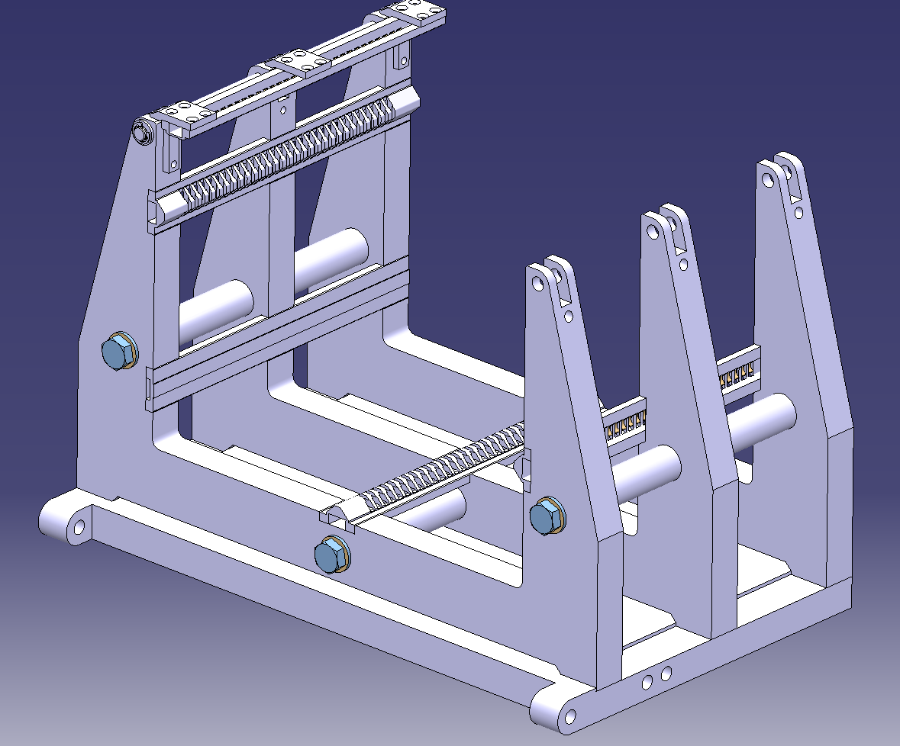
Calorimeter mechanical design
Multi-parts structure ST0372459
Able to work with 2mm and 1mm gap between tungsten plates
212mm
255mm
368mm
200mm

Slide 5
Calorimeter mechanical design
Stainless steel frame
3 spacers
3 Comb slots
Plan support slot
Mechanical frame
3 holders

Slide 6
Calorimeter mechanical design
Combs
250mm
25mm
Left comb
Top comb + spring (x2)
Left plan
Right comb + spring
Bottom comb

Slide 7
How to mount tungsten plates
Open 2 top combs
Insert the first Tungsten
Insert all Tungsten + Si detectors
Close the 2 top combs

Slide 8
C=2mm between each tungsten
→ We work with an offset of 5.5mm
Electronic board
Electronic board
Electronic board
~10.5
~10.5
~10.5
A=3.5
~2.5
~2.5
~2.5
BEAM
Sensor
Sensor
Sensor
Tungsten plate 125*145
C=2
C=2
Gap=5.5
Gap=5.5
Gap=5.5
Gap=5.5
Gap=5.5
Gap=5.5
Gap=5.5
No sensor In this gap
No sensor In this gap
No sensor In this gap
No sensor In this gap

Slide 9
C=1mm between each tungsten
→ We work with an offset of 4.5mm
Electronic board
Electronic board
Electronic board
New set of combs!
~10.5
~10.5
~10.5
A=3.5
~2.5
~2.5
~2.5
BEAM
Sensor
Sensor
Sensor
Tungsten plate 125*145
C=1
Gap=4.5
Gap=4.5
Gap=4.5
Gap=4.5
Gap=4.5
Gap=4.5
Gap=4.5
Gap=4.5
Gap=4.5
No sensor In this gap
No sensor In this gap
No sensor In this gap
No sensor In this gap
No sensor In this gap

Slide 10
Mechanical frame: overview
Horizontal beam
Vertical beam
The black box around will be designed soon.
This box will also hold services.

Slide 11
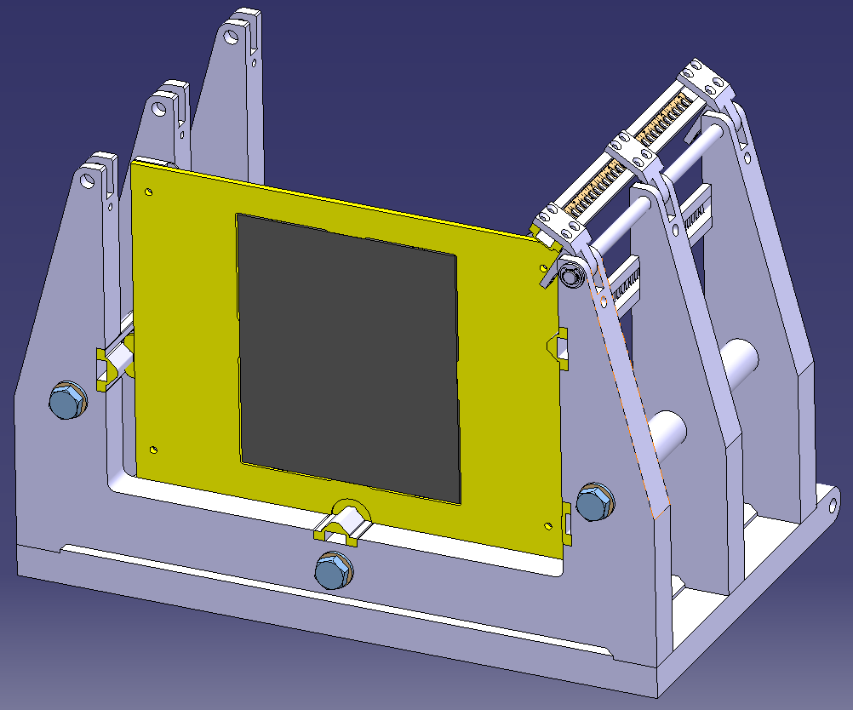
The tungsten holder
Permaglas frame
Glass fibres in epoxy resin
Tungsten
Combs

Slide 12
The tungsten holder
Ground
Spring

Slide 13
Tungsten + permaglas assembly
W
W
J=C+D-(A+B)
A=3.5 +/-25μm
B=2 +/-2μm
C=5.5 +/-20μm
D=2 +/-2μm
Jmax = 5.520+2.002-3.475-1.998=2.049mm
J
A
3.5
B
D
C
J=B-A
A min=3.475mm
A max=3.525mm
B min=5.480mm
B max= 5.520mm
J max= 5.520-3.470= 2.05mm
J min= 5.480-3.530= 1.95mm
W
W
J
A
3.5
B

Slide 14
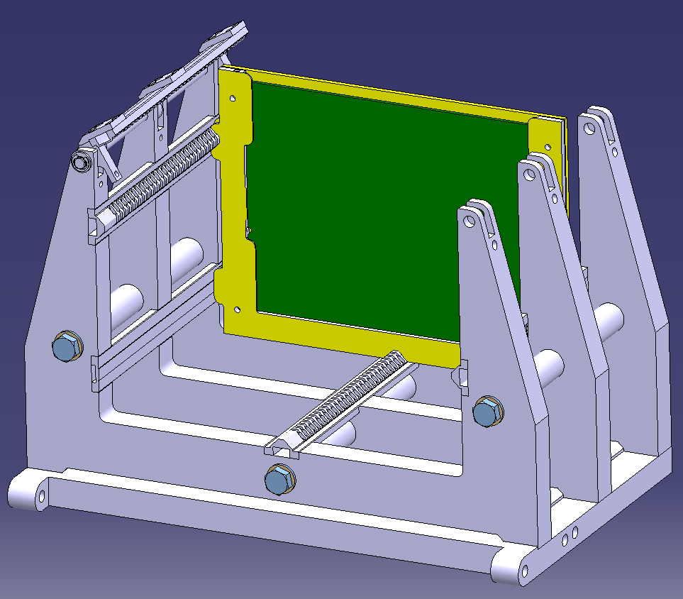
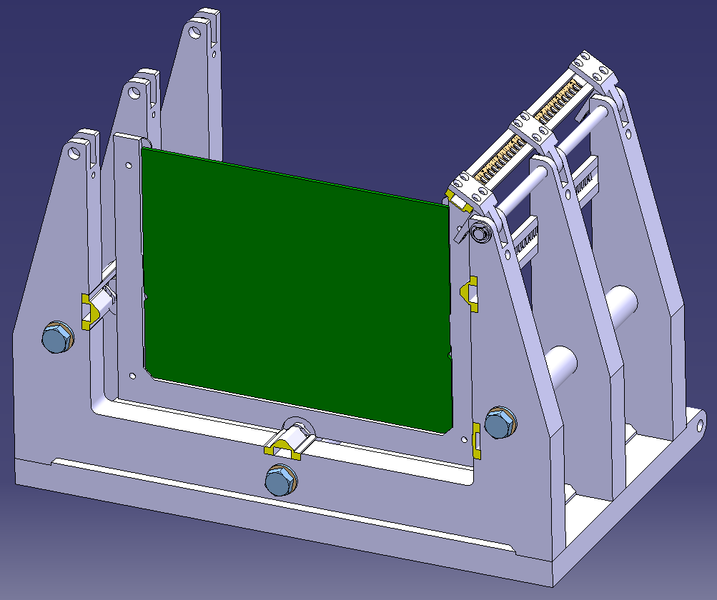
The existing electronic board, is inserted in the Permaglas frame [RESARM company]
Permaglas frame
PCB Board
Comb

Slide 15
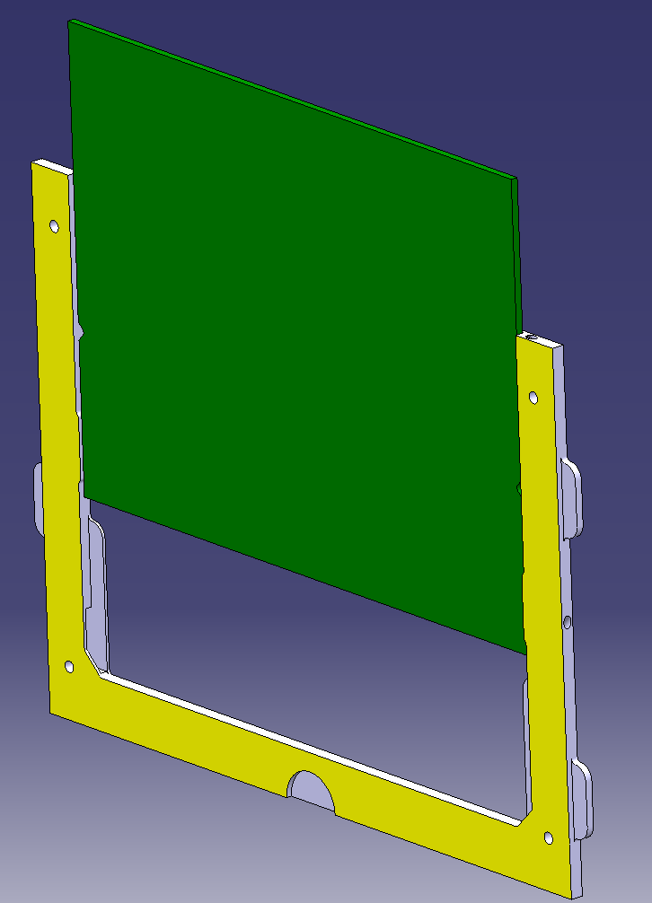
The existing electronic board, in the Permaglas frame
The PCB should be machined before loading the Si detector

Slide 16
Tungsten procurement
Main supplier: Cime Bocuse (Plansee) (France)
 | Tungsten min W 99.97% | Densimet W min 90% | Inermet W min 90%
Magnetism | Paramagnetic | Ferromagnetic | Paramagnetic
Other components |  | Ni + Fe | Ni + Cu (0%Fe)
ρ | 19.3 | from 17 to 18.8 | from 17 to 18.0
Ability to machine | Hard | Nearly like steel | Good machinability
Cost / Kg | ~770€(standard plate) ~15510 € for 30 plates | ~220 € Only rod shapes, no plates | Not available
Cost after machining At CERN
Cost after machining At Cime Bocuse | 3500€ for 1 machined plate 45000€ for 30 machined plates | 3492€ for 4 machined plates | Waiting for a new quote, very soon!
Tungsten alloys are 4 time cheaper than pure tungsten

Slide 17
Tungsten procurement
Other supplier: (USA)
 | SD185 W min 97%
Magnetism | Ferromagnetic
Other components | Ni (2.1%) + Fe (0.9%)
ρ (g/cc) | 18.5
Ability to machine | Quite good
Cost / Kg | ~500 $ / plate ~500$ / kg
Cost after machining At CERN | -
Cost after machining | ATI cannot machine it for us We would need to machine it at CERN

Slide 18
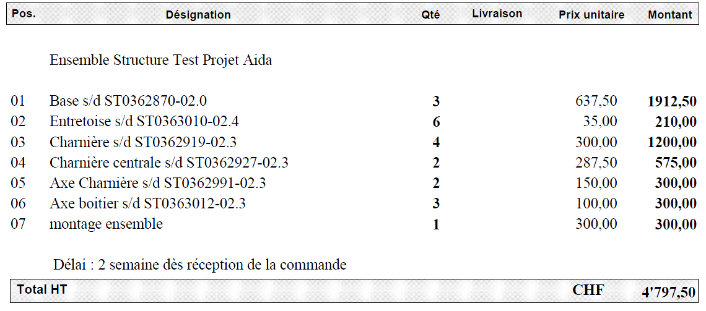
Mechanical frame manufacturing
Different quotations:
Structural frame Permaglas machining Springs Combs
Potential suppliers:
Leman Avionics SA (~5000CHF) [Structural frame]
Resarm (answer week 44) [Permaglas machining]
Call for tenders done buy the CERN Main Workshop (answer week 44) [For all quotes]
Structural frame only

Slide 19
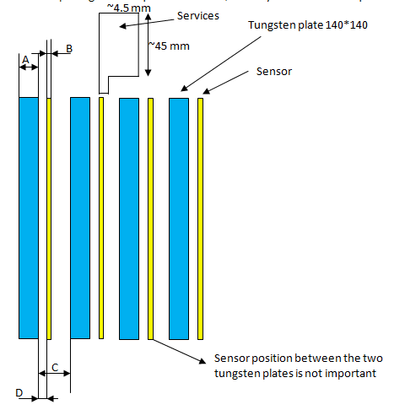
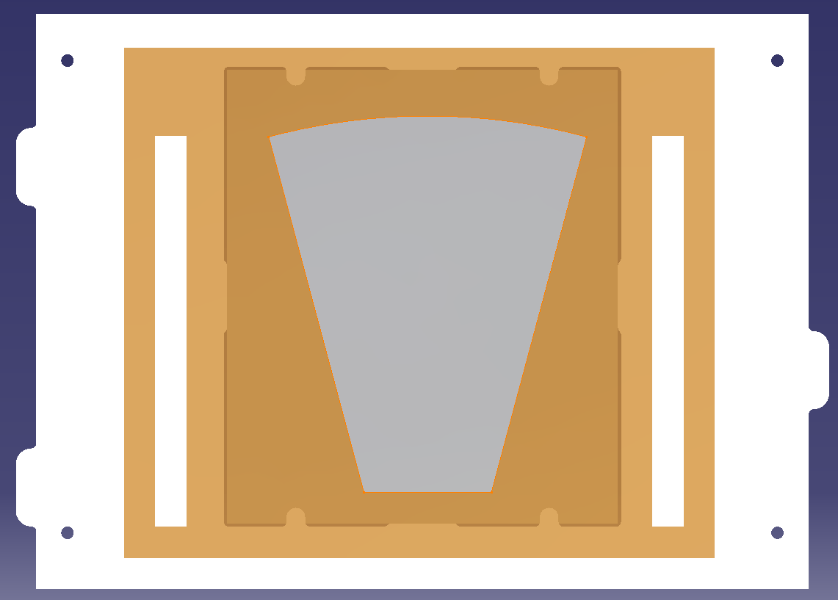
Next Step...C=0.5mm
The idea:
We use the same tungsten plates
We could use the same Permaglas frame (in white in this picture)
We glue the Si detector + the read-out on the Permaglas frame
We could realise a sliding kinematic between each tungsten plate, in order to reach the 0.5mm gap between each W plate.
A new mechanical frame is mandatory

Slide 20
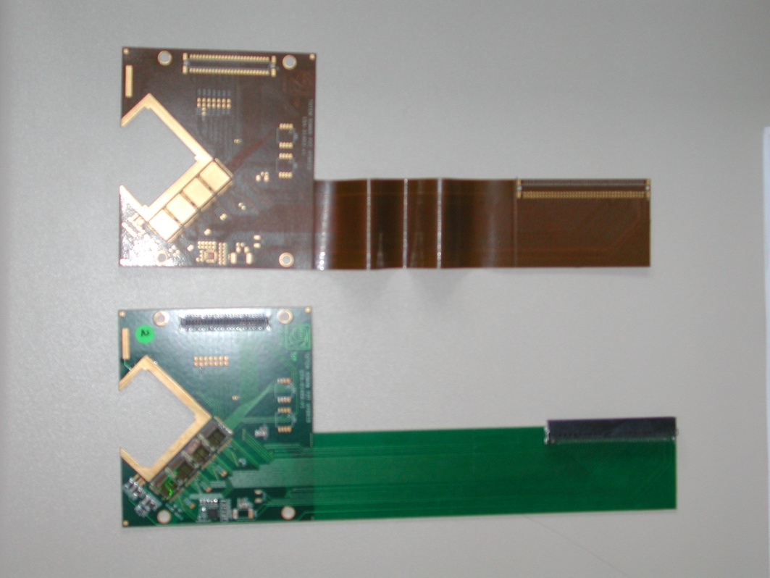
Next Step...C=0.5 mm
The most important for us:
Realising a flexible link between the sensor and the read out.
Something similar to this example:
Silicon sensor
Connector for the read out
Flexible part
Rigid part (PCB)

Slide 21
Summary
The C=2 solution is designed.
The C=1 solution is designed.
The black box around have to be designed.
(the concept is founded→ Standard structure used for electronics racks)
We will soon determined the total price of this detector (W + frame)
[First Approx ~ 40 KEuros].

Slide 22
Appendix 1: Additional information about the frame
C=2mm
→ We work with an offset of 5.5mm
C=1mm
→ We work with an offset of 4.5mm
A=3.5
A=3.5
Distance before next
tungsten
Distance before next
tungsten
BEAM
C=2
Tungsten plate 125*145
C=1
Tungsten plate 125*145
Gap=5.5
Gap=4.5

Slide 23
Appendix 2: Additional information about the frame
What we can do with C=2mm:
→ We work with an offset of 5.5mm
Electronic board
Electronic board
Electronic board
Electronic board
~10.5
~10.5
~10.5
A=3.5
~2.5
~2.5
~2.5
BEAM
Sensor
Sensor
Sensor
Tungsten plate 125*145
C=2
Gap=5.5
Gap=5.5
Gap=5.5
Gap=5.5
Gap=5.5
Gap=5.5
Gap=5.5
Gap=5.5
No sensor In this gap
No sensor In this gap
No sensor In this gap
No sensor In this gap

