Slide 1
Standard Model @ Hadron Colliders III. Electroweak (cont.)
P.Mättig
Bergische Universität Wuppertal

Slide 2
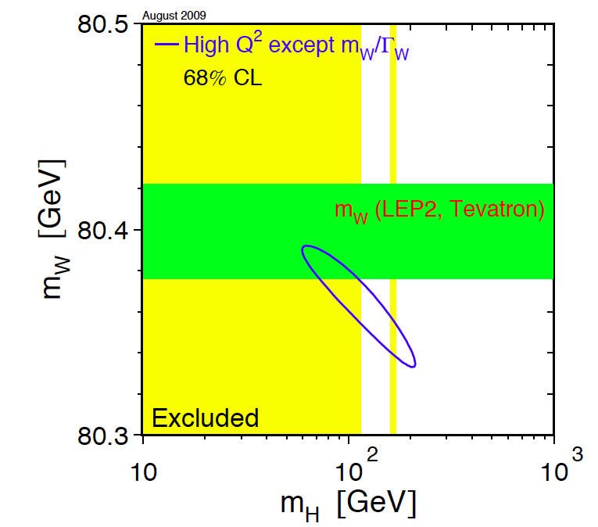
The W mass
Fundamental parameter of the Standard Model
Radiative corrections
sensitivity to mass of
Higgs boson
Precise measurement @ LEP:
80.376 ± 0.033 GeV

Slide 3
Mass determination at hadron coll.
Determination with electron/muon and neutrino
But:
How well is the energy scale e/μ known?
... and what is the energy and direction of ν?
Use well known M_{Z} to calibrate energy scale
consider only transverse momentum of ν
identify with ‚missing transverse energy‘

Slide 4
Jacobian peak
Relation mass ⬅➔ transverse momentum
Cross section section ➔ pole at p_{T} = M_{w}/2
damped by natural width of W - boson
Notes:
D\sigma ➔ polarisation: (1 – cos theta*)^2

Slide 5
W mass at hadron coll.
Reflects phase space in spherical decay:
Largest if decay perpendicular to flight direction
angle wrt beam in W rest system
max p_{T} = M_{W}/2

Slide 6
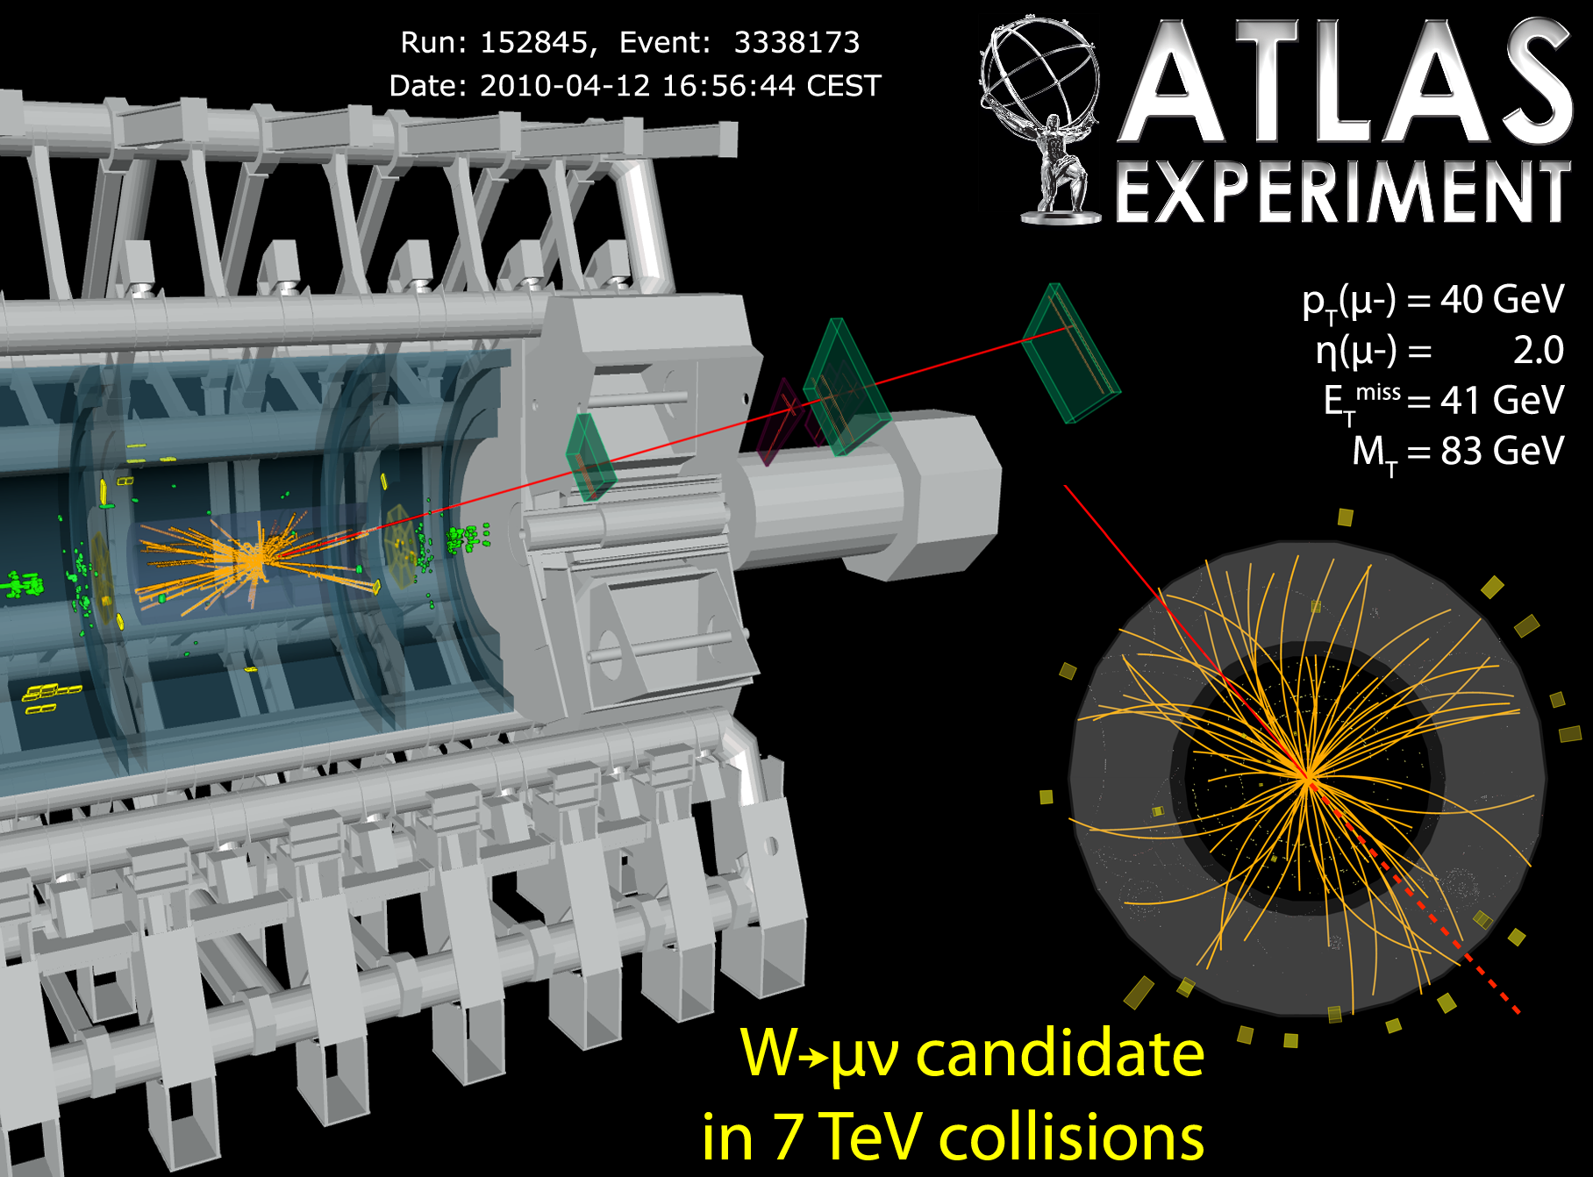
W mass at hadron colliders
μ
Unbalanced transverse momentum
Observed missing transverse momentum not only due to ν:
mismeasurements
additional jets/underlying ev.
Very similar in well known Z⁰ events ➔ X - check

Slide 7
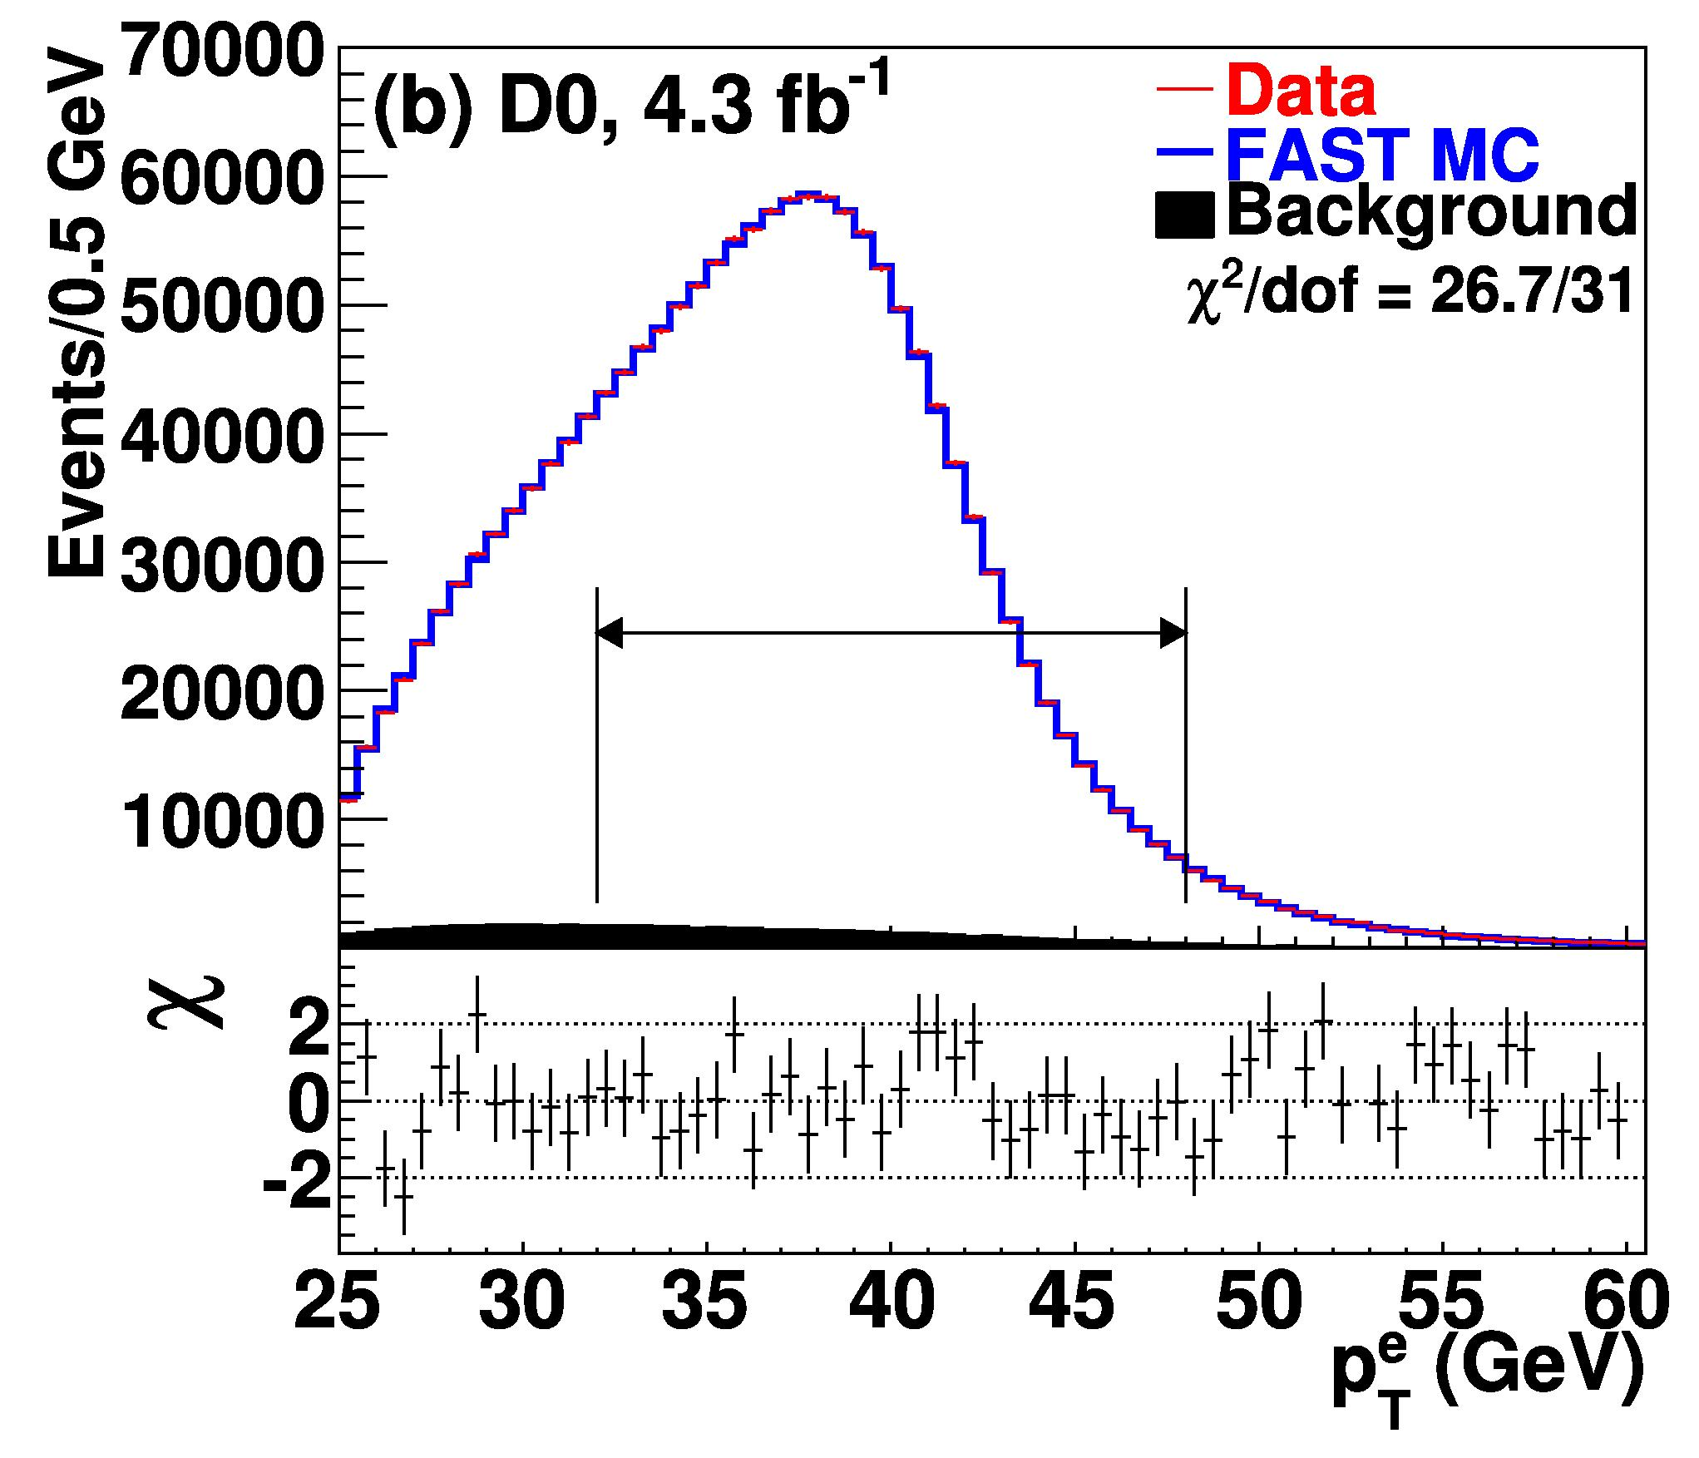
Reality: Jacobian peak smeared out
Fast drop around M_{W}/2 but
smeared out
W – boson: Γ ~ 2 GeV
QCD effects
detector distortions
M_{W} = 80.342±0.014 GeV

Slide 8
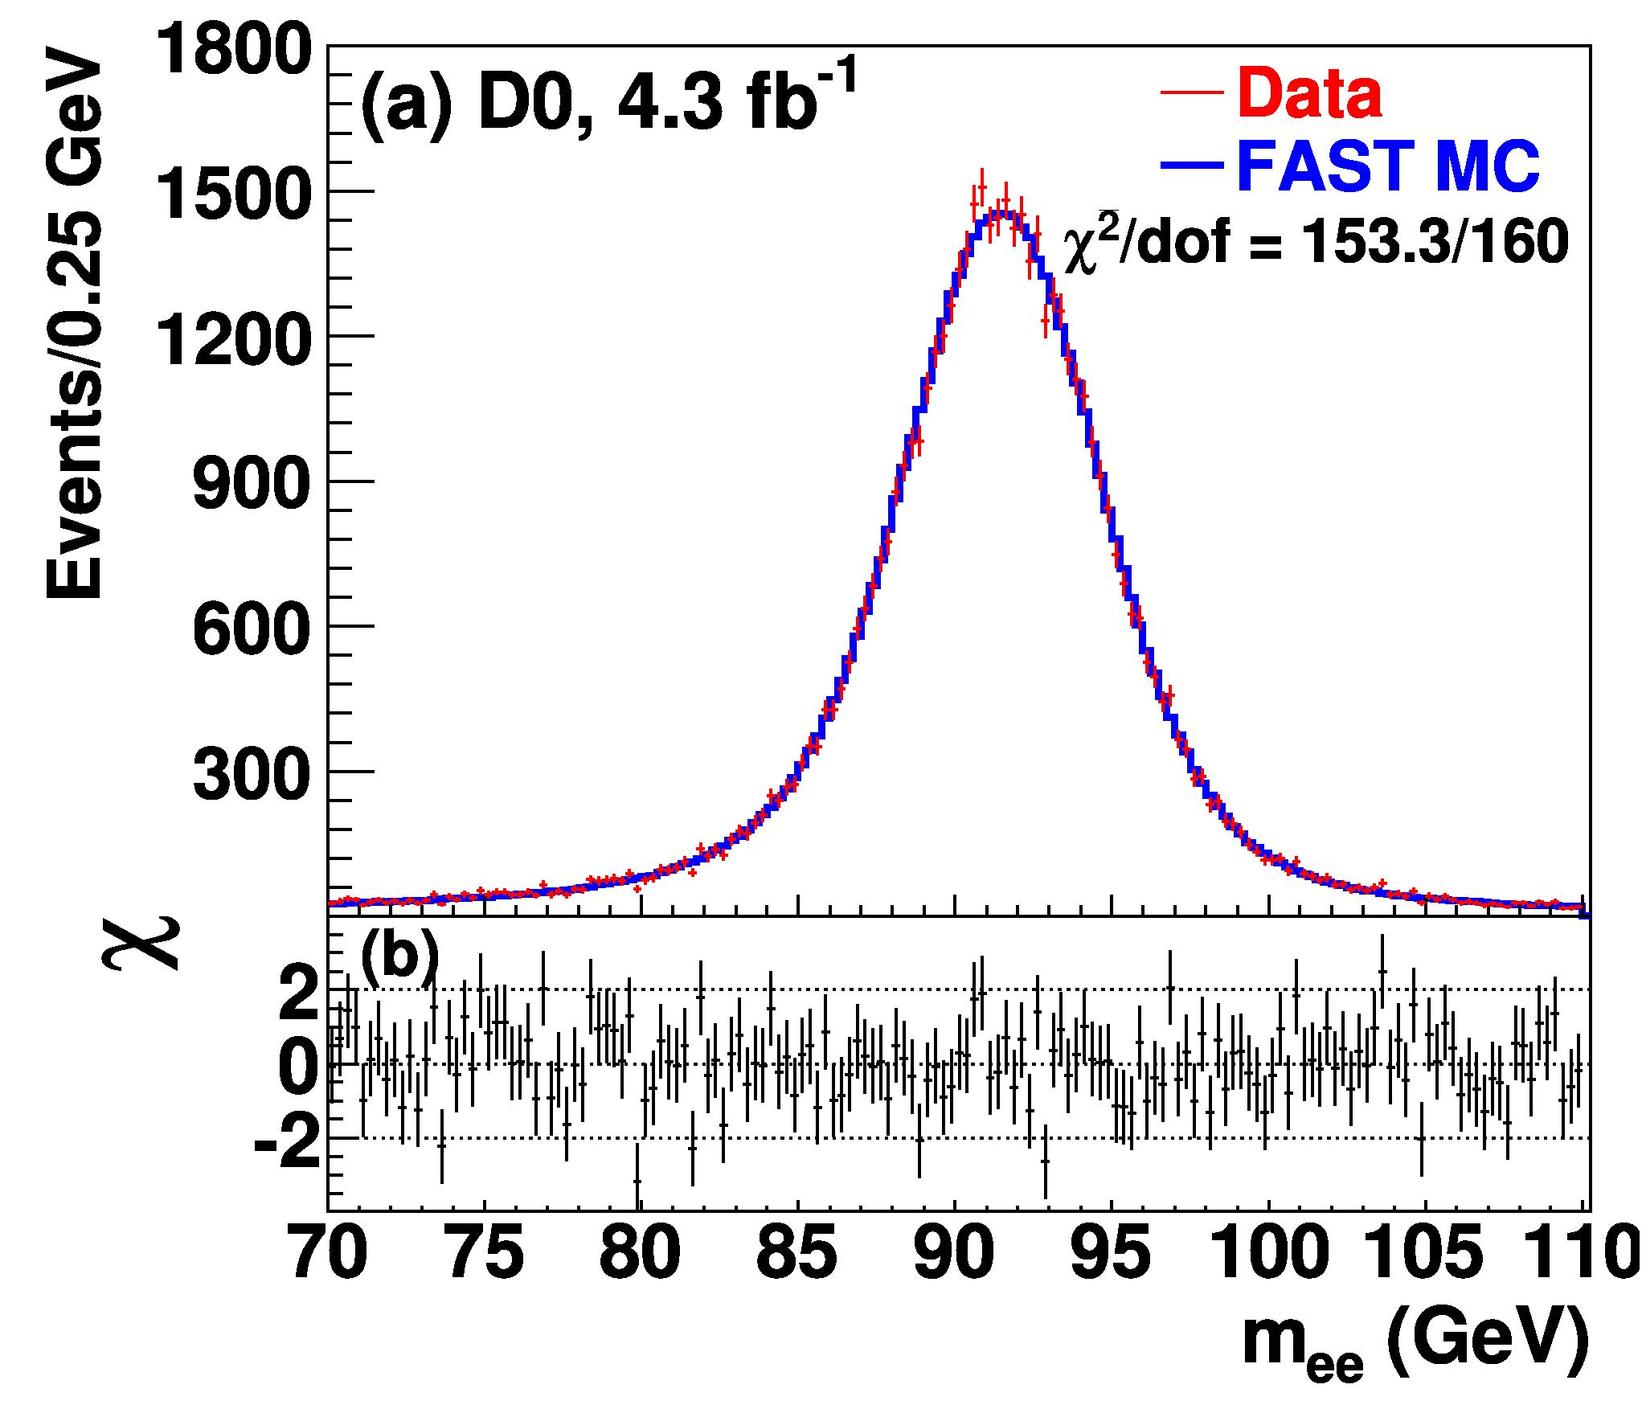
Source of uncertainty: energy scale
How well does one know the ‚true‘ energy ?
Electron energy calibration via Z⁰
Peak at M_{Z}

Slide 9
Source of uncertainty: energy resolution

Slide 10
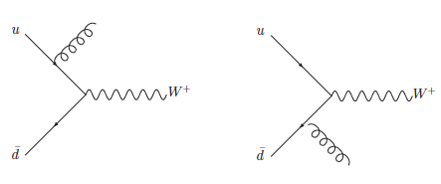
Source of uncertainty: p_{T} of W - boson
p_{T}(W) ~ p_{T} (Z)
But different couplings, (small) sensitivity to pdfs

Slide 11
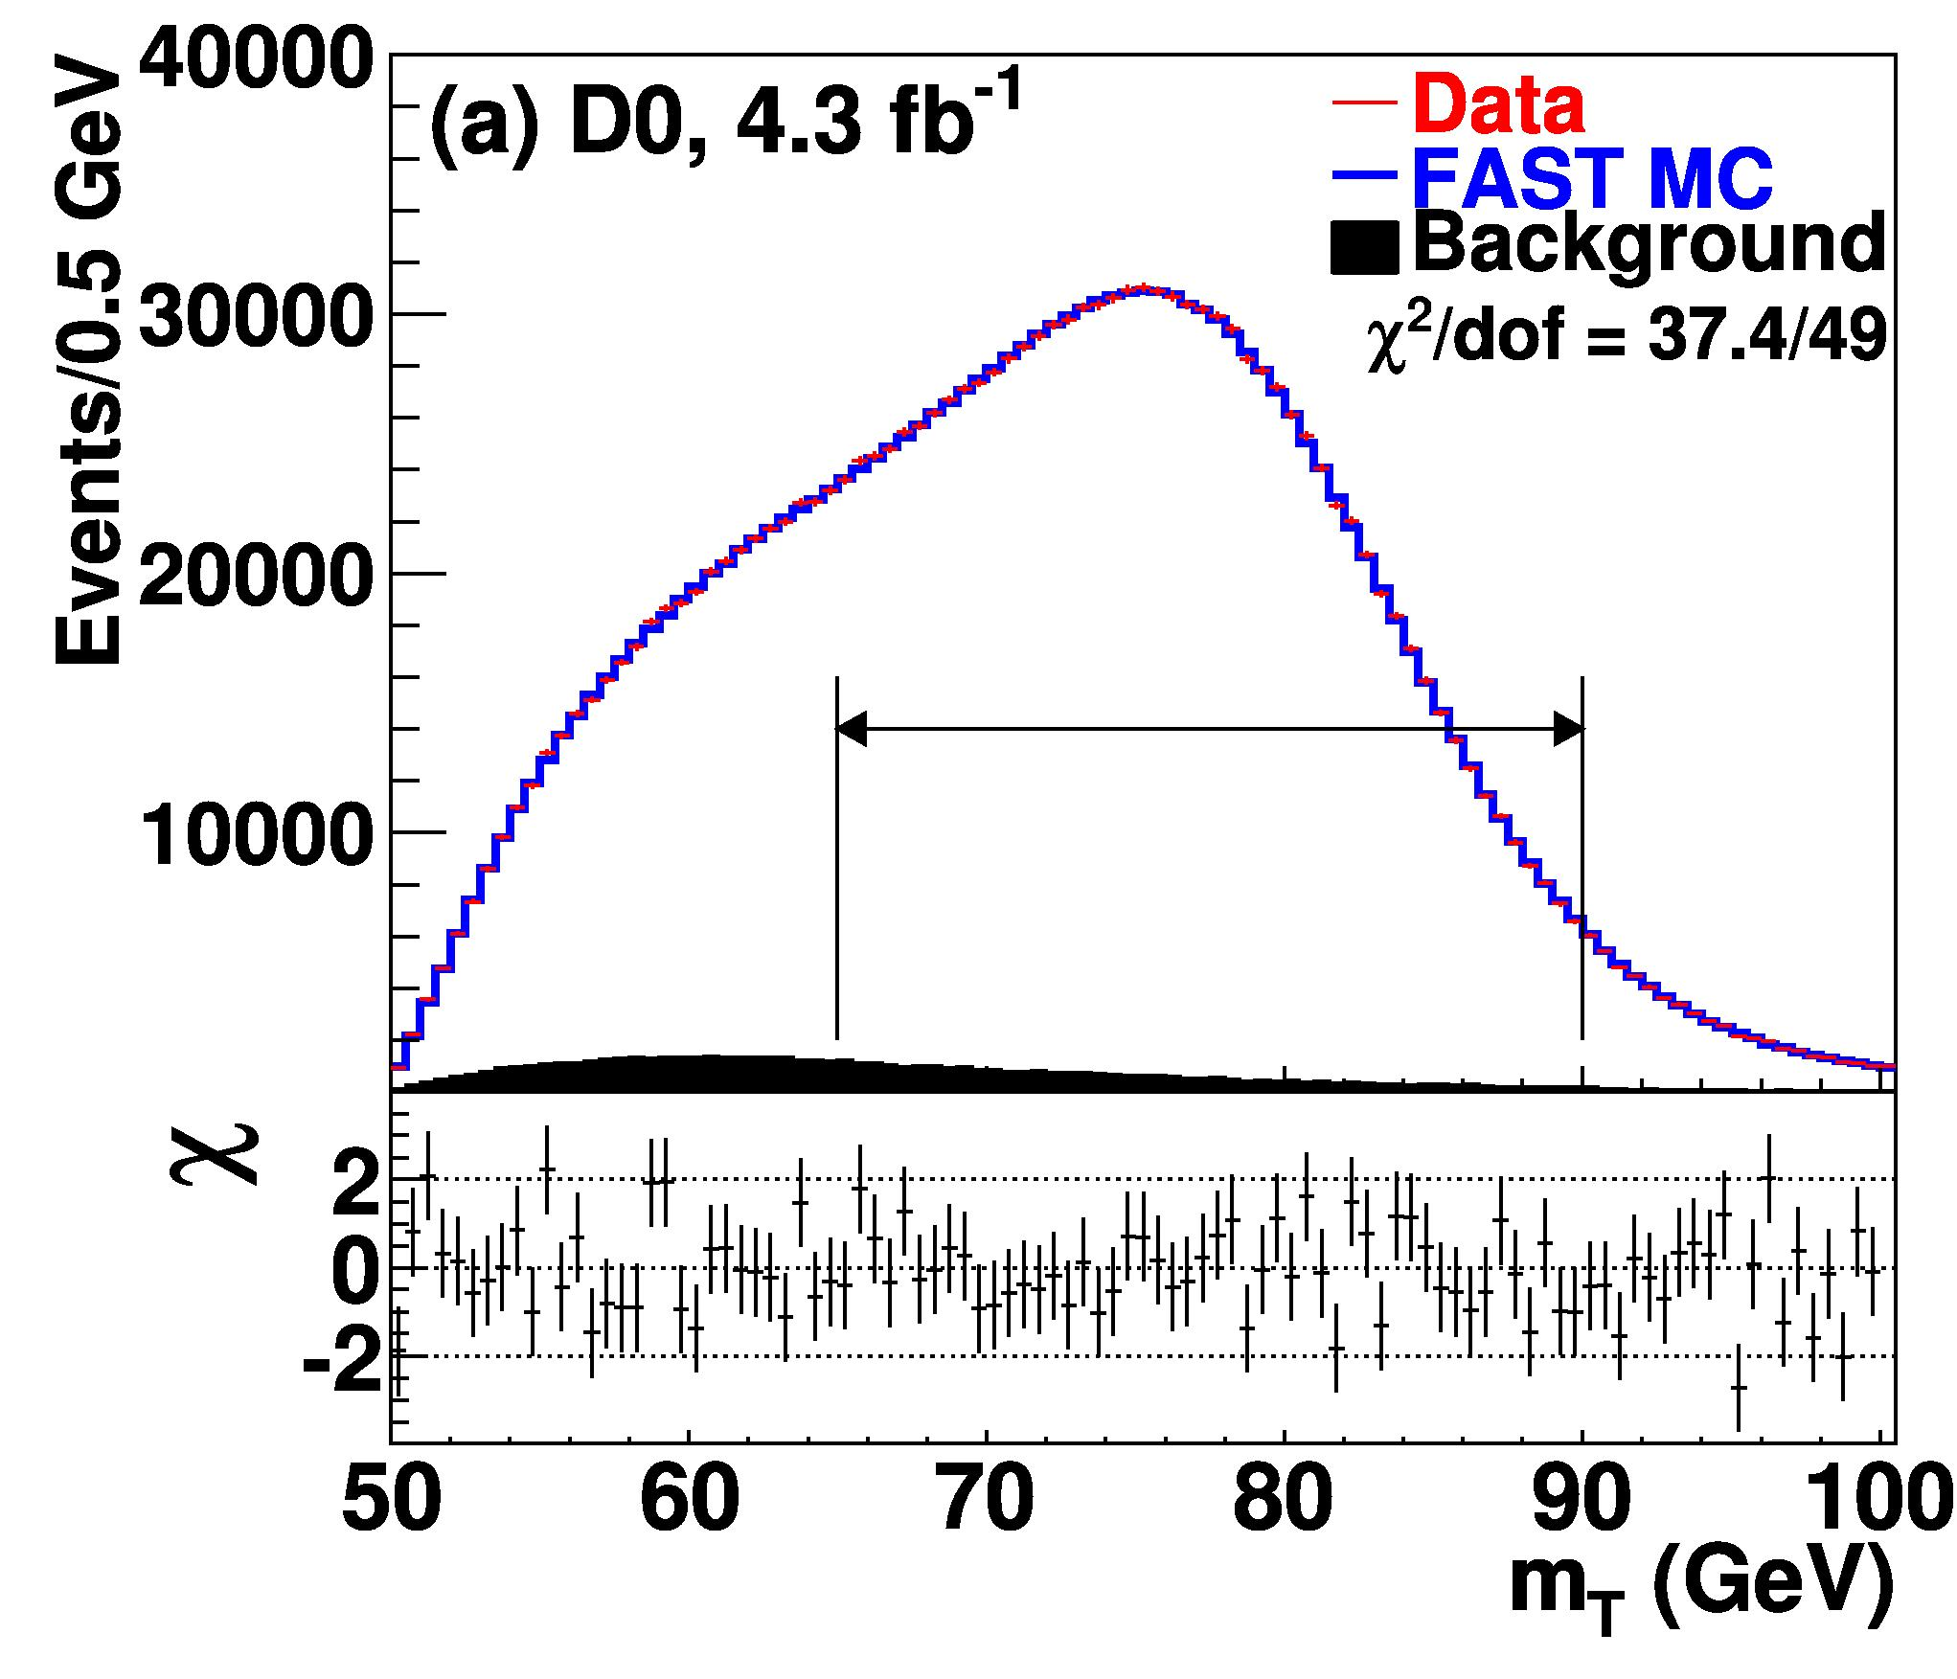
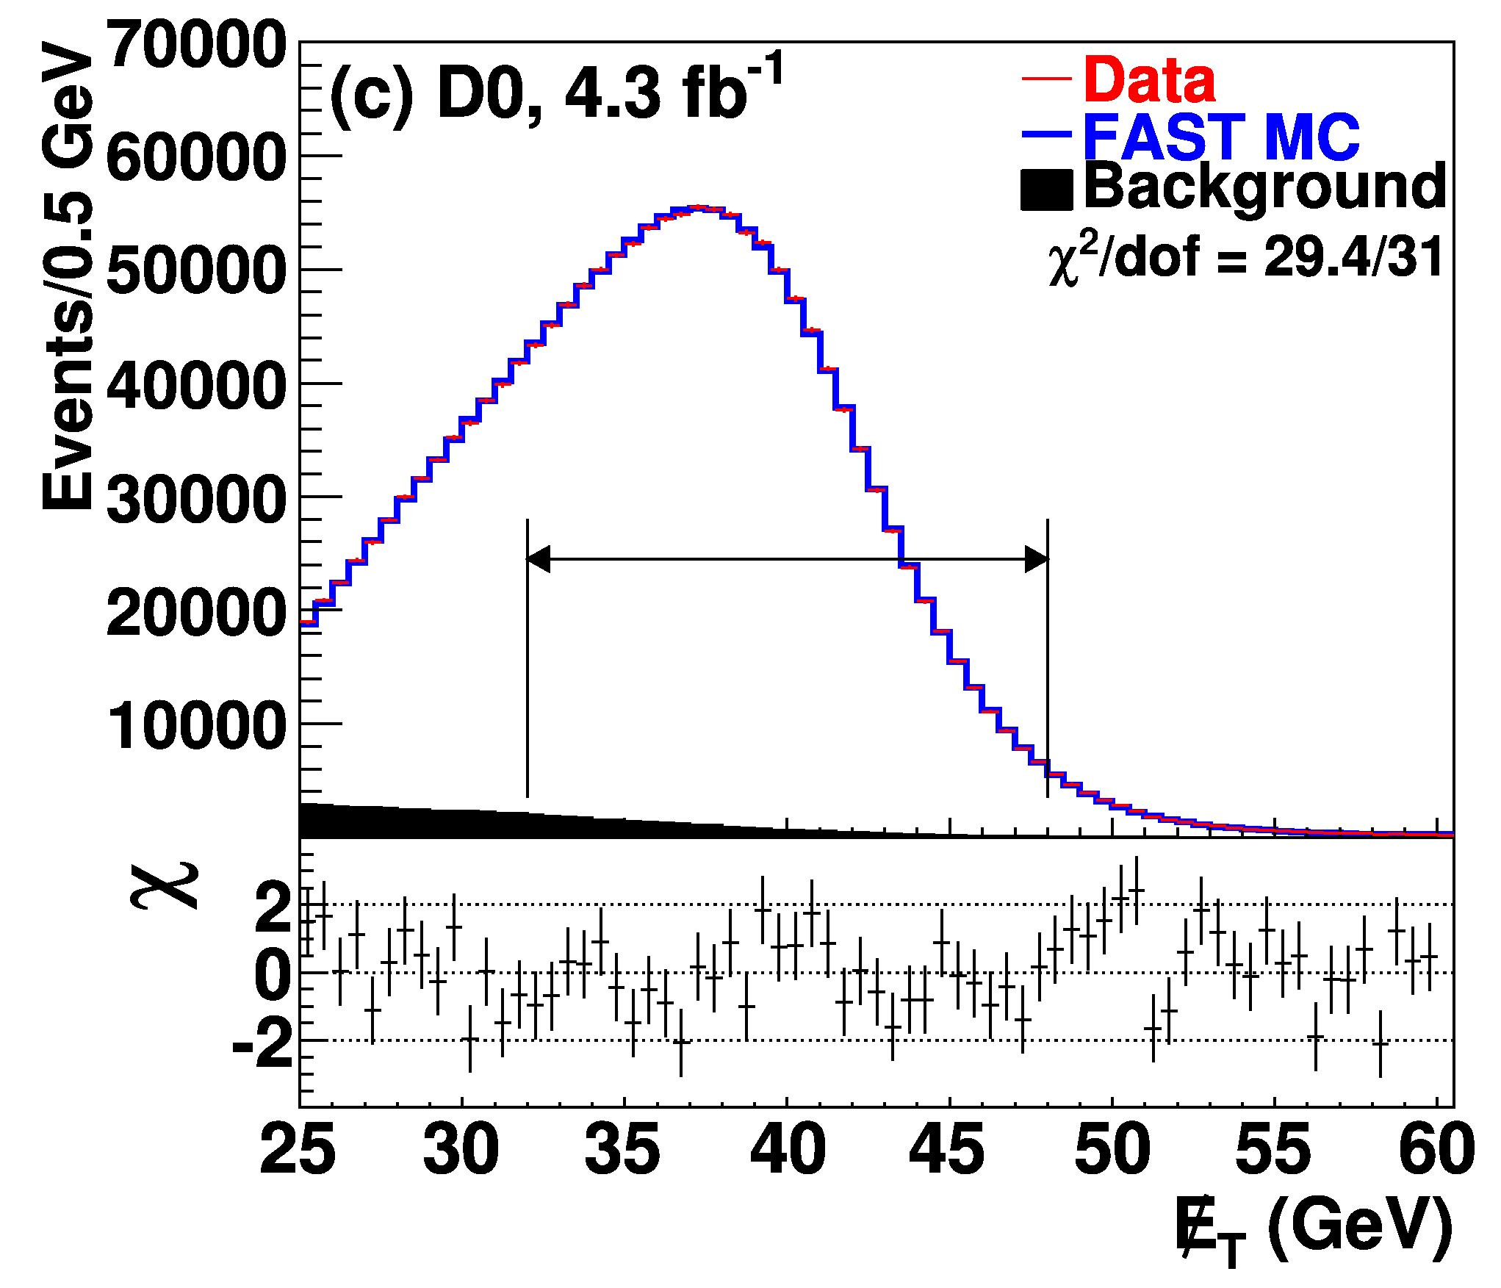
Two other methods
80.371±0.013 80.355±0.015

Slide 12
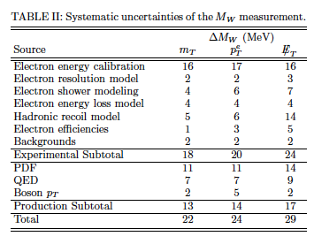
Knowing the shape & scale ➔ M_{W}
Models used to estimate the transfer Z ➔ W
Note:
Measurements are
to ~ 74% correlated
D0 measurement M_{W} = 80.375 ± 0.023 GeV

Slide 13
W mass result
D0 measurement same precision as previous world average
It‘s been a long way!
Highly precise measurement
Strong constraint on Standard Model!

Slide 14
What can the LHC contribute?
More W – bosons
More Z⁰ to calibrate
Better detectors
self – calibration of pdf‘s (e.g. via V + jets)
much larger pile – ups ➔ affecting MET
Challenging, but possible

Slide 15
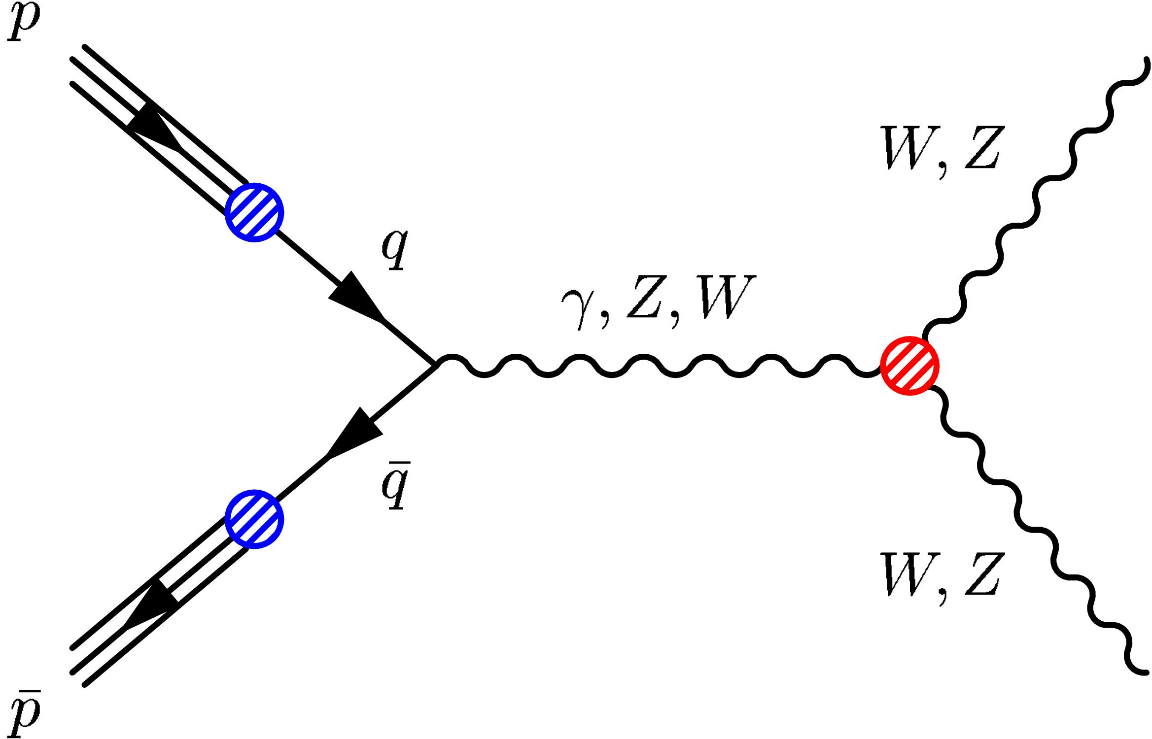
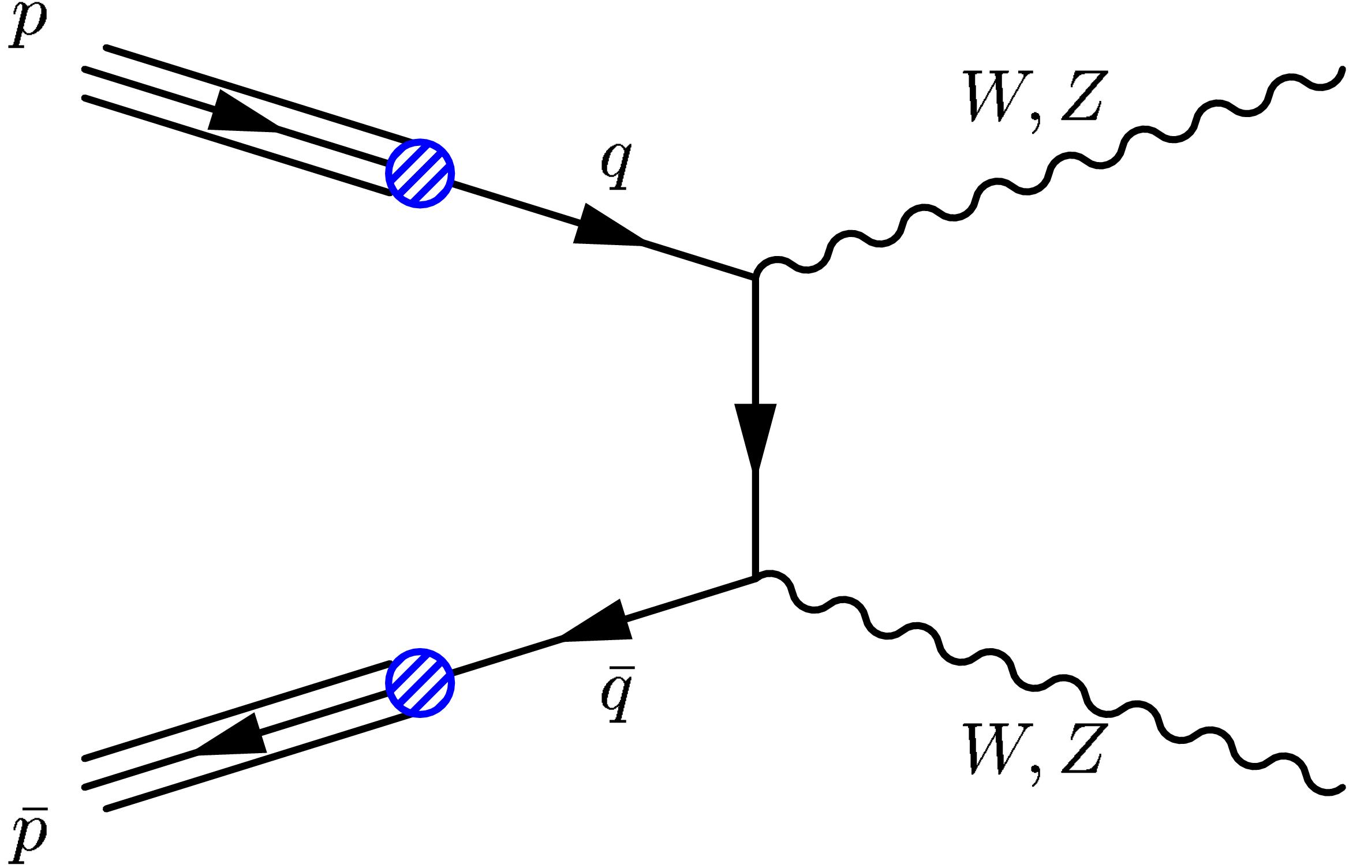
Looking for TGVs
(Triple Gauge Boson Vertices)
Vector Boson self interaction due to electrically and weakly
charged bosons
Boson pairs also due to other
Processes
Theoretically NEEDED to cancel
divergencies

Slide 16
Gauge Boson production in e⁺e⁻
Without Z⁰: cross section infinite
Early motivation to introduce Z⁰
(N.B. general & succesfull recipe: postulate new particles to avoid infinities)
Links boson + fermion couplings ➔ local gauge theories

Slide 17
But are couplings as predicted?
Modify g₁, κ, λ and see if prediction agrees with data
Potential deviations of g₁, λ grow with M²_{WW}
Potential deviations of κ grow with M_{WW}
High mass reach at hadron colliders:
special sensitivity to g₁, λ

Slide 18
LEP legacy
Note:
in e⁺e⁻ → W⁺W⁻
no discrimination between
γ and Z coupling!

Slide 19
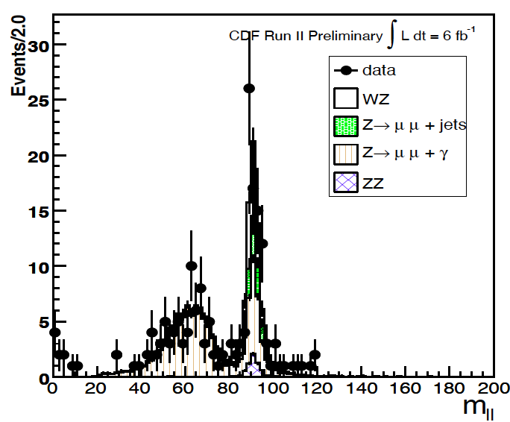
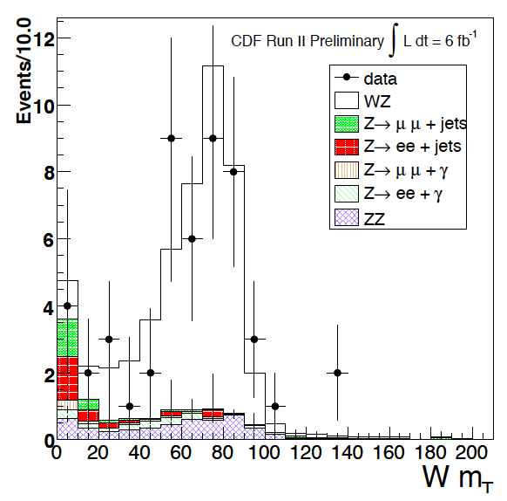
Selecting ZW events
Step 1:
select Z⁰ ➔ e⁺e⁻, μ⁺μ⁻
Step 2:
in residual event:
lepton & missing energy
➔ W - mass

Slide 20
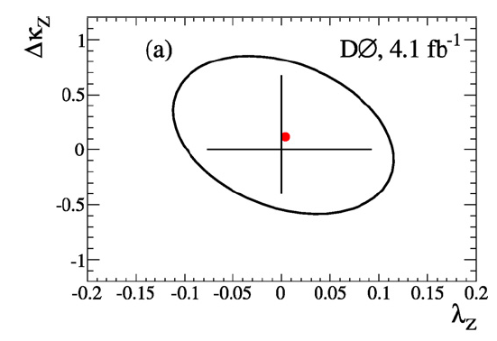
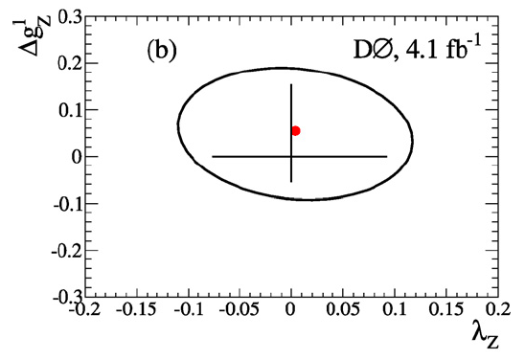
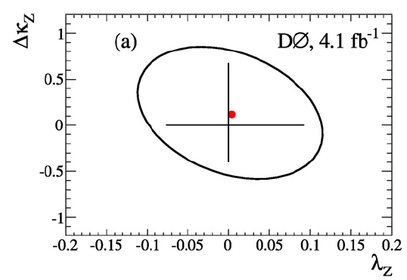
Test at hadron collider
Search for correlated deviations in
parameters
No deviation from Standard Model observed!
Results from Tevatron

Slide 21
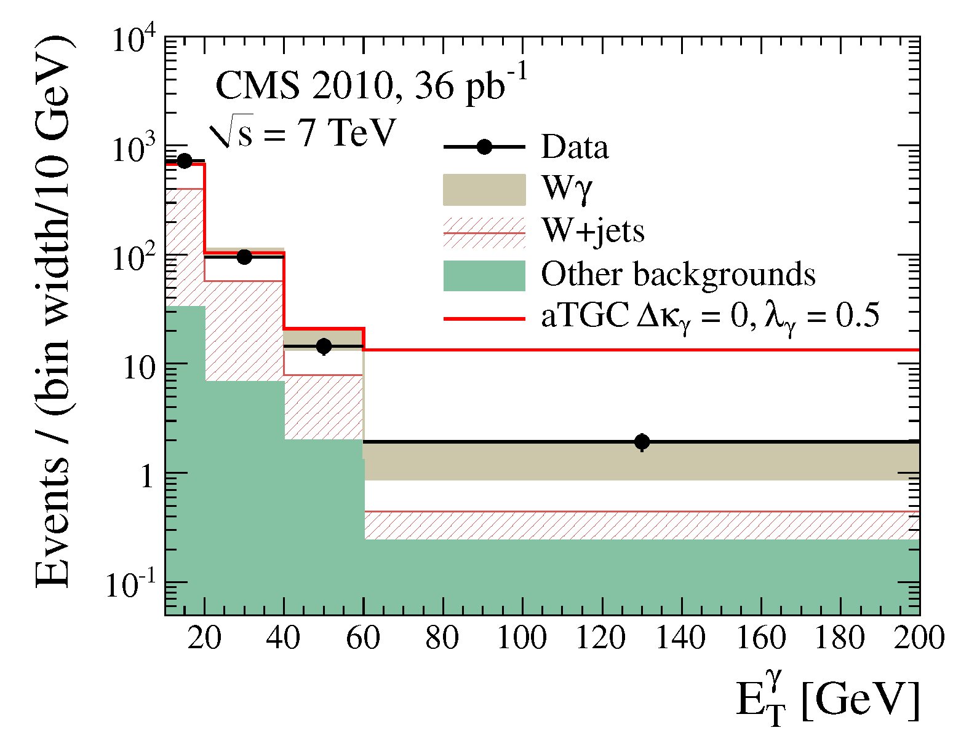
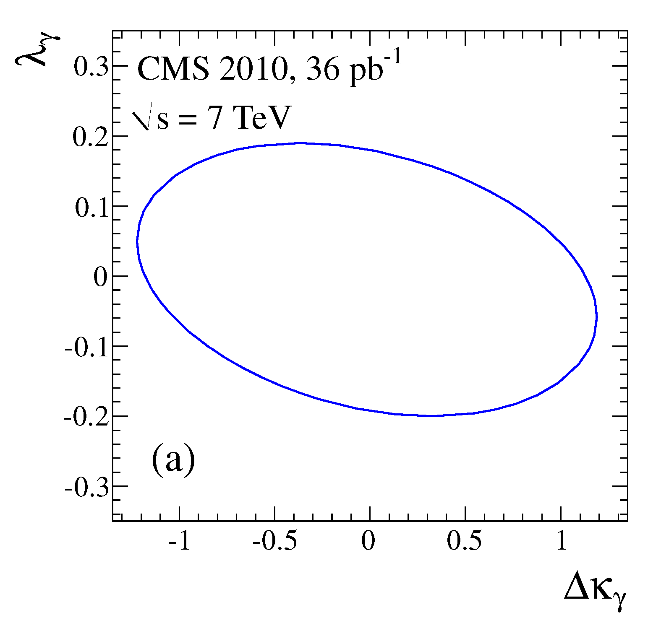
LHC entering the game
Study of Wγ production
W→ Wγ
High p_{T} photons:
sensitivity to λ_{γ}
Eventually higher LHC energy
➔ significant improvement

Slide 22
Physics with W, Z @ hadron colliders
Millions of Z⁰ and W± at the LHC
Precise tool to constrain parton distribution
functions
Precision measurement of fundamental M_{W}
Three – Boson coupling probed to highest energies

Slide 23
Standard Model @ Hadron Colliders IV. Top Quark
P.Mättig
Bergische Universität Wuppertal

Slide 24
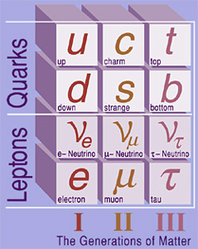
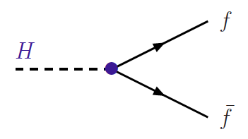
The mysterious top quark
Top quark: no internal structure
but heavy as a gold atom
i.e. coupling strength to
Standard Model Higgs Boson
λ_{t} = 1
Does the top quark have a special role in particle physics?

Slide 25
A brief history of the top quark
Known to exist since 1973
Phenomenological prejudice: around 15 GeV
(N.B. (ss) = 1 GeV, (cc) = 3.1 GeV, (bb) = 9.4 GeV, .......)
(Partly) motivating aim for several accelerators:
e⁺e⁻: PETRA/PEP, TRISTAN, LEP, .... pp: SppS
No signature found!
Observed in 1995 at Tevatron
Up to now a few thousand tt events
LHC currently produces ~ 5000 tt events/day
When default energy/luminosity reached: close to 1M/day

Slide 26
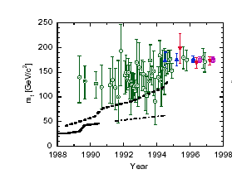
A brief history of the top quark II
Electroweak quantum fluctuations at percent level:
top must be very heavy
Precision measurements & theory in 1994

Slide 27
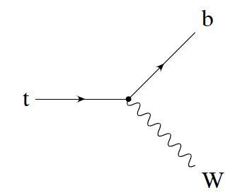
Phenomenology of heavy top
t
competing interactions:
t
g
b
b
For lighter quarks: strong interaction >> weak interactions
➔ colour neutral hadrons
For top quark: strong interaction < weak interactions
➔ no top hadrons! ‚free quark‘
top quarks decay before hadrons formed

Slide 28
Phenomenology of heavy top
Decay properties of top quark unambigously predicted by SM
tt ➔ (only) 6 quarks
largest fraction, very high background
tt ➔ 4 quarks, charged lepton, neutrino
Some 30% ‚usable‘, low background
FAVOURED channel
tt ➔ 2 quarks, 2 charged l, 2 neutrinos
Only 5% ‚usable‘, very low
background, difficult to reconstruct
Decay fractions largely determined by fractions of W - decay

Slide 29
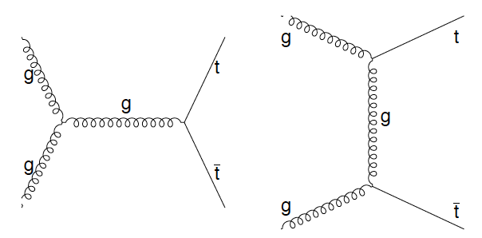
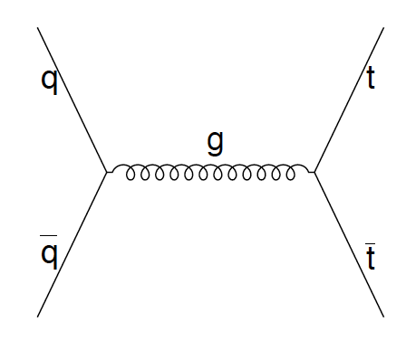
Production of top quarks
What x required for top production?
0.18 at Tevatron
0.05 at LHC (0.025 @ 14 TeV)
Dominant at LHC for low M_{tt}
Suppressed @ Tevatron
Relevant at LHC for high M_{tt}
Dominant @ Tevatron

Slide 30
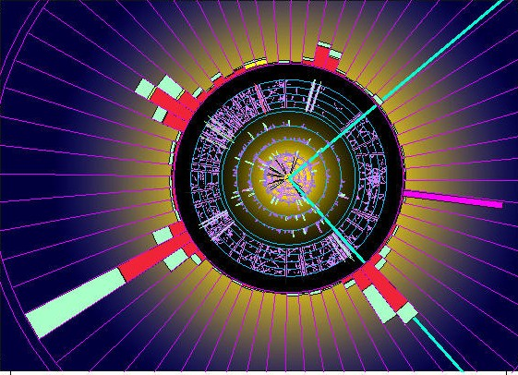
A semileptonic tt event

Slide 31
Is the top quark a normal fermion ?
A rich experimental program:
precise determination of mass
inclusive and differential cross sections
decay distributions
decay branching ratios
.... and signatures beyond the Standard Model
(particles decaying into tZ, tW, tb, .......)

Slide 32
How to measure tt cross section
(Why should we?):
Sensitive to gluon –tt couplings
Test of QCD with massive quarks
Select events:
4 jets with p_{T}> 25 GeV
isolated electron,muon p_{T}>20 GeV
missing transverse energy > 20 GeV
Luminosity:
How many proton-collisions?
What fraction of tt events are retained after selection

Slide 33
Cross section determination
Experimental precision depends on how well
- background, efficiency, luminosity can be controlled
Key issue determine efficiency
Largest uncertainties:
Jet energy scale
Background yield
Jets from QCD
selection efficiency
e, μ, .....
Log σ
Selected p_{T} range
True jet p_{T}
Observed p_{T}
wrong energy scale
Jet pt
Experimental uncertainty ~ 9%

Slide 34
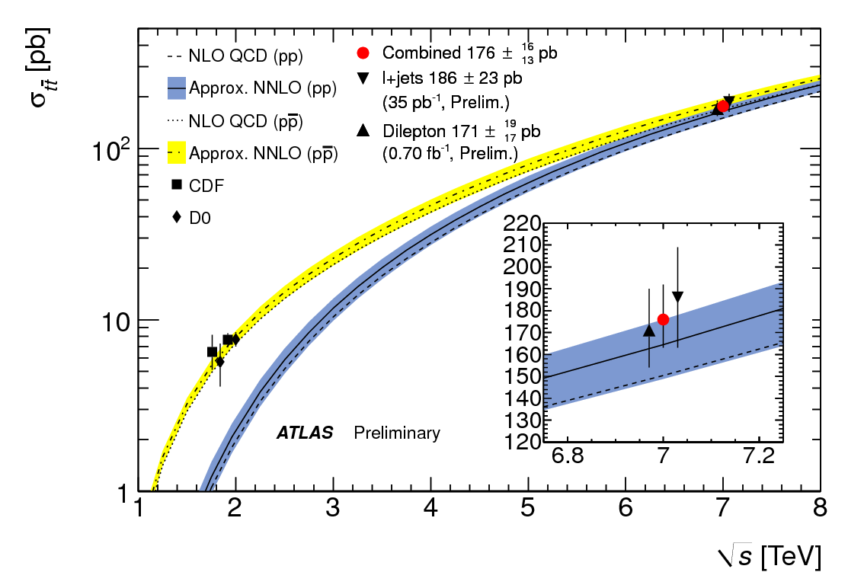
Cross section measuremnt
Theoretical uncertainty 7-10%
partly NNLO
Very good agreement between data and expectation

Slide 35
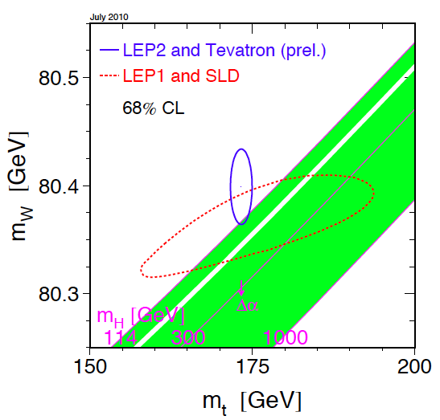
Remember: constraints on SM

Slide 36
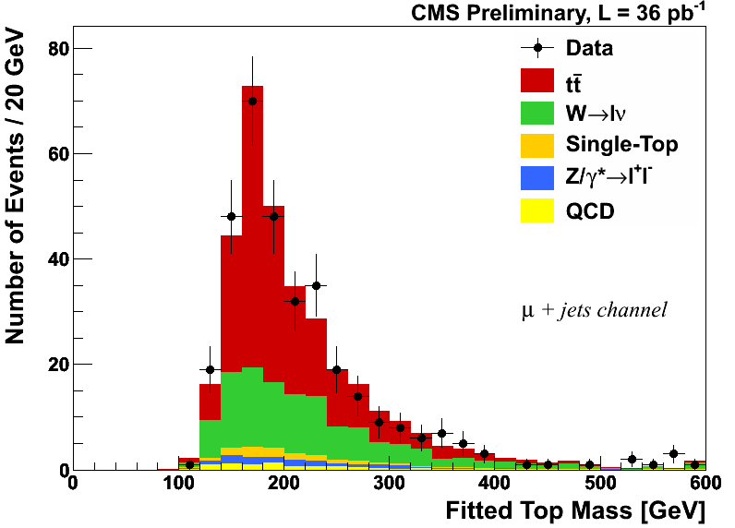
Top mass from l+jet decays
Favoured topology: tt ➔ 4 Jets (2 b –jets) + e/μ + ν
The problems:
How to get the z – component of ν
Out of 4 (or more) jets: which jet belongs to which top?
What is the energy scale of jets (and electrons)

Slide 37
Problem 1: p_{z}(ν)
Constraint from W - mass
Note: ν – mass completely negligible
Quadratic equation ➔ 2 solutions
physics: in 70% the solution with smaller p_{z} correct

Slide 38
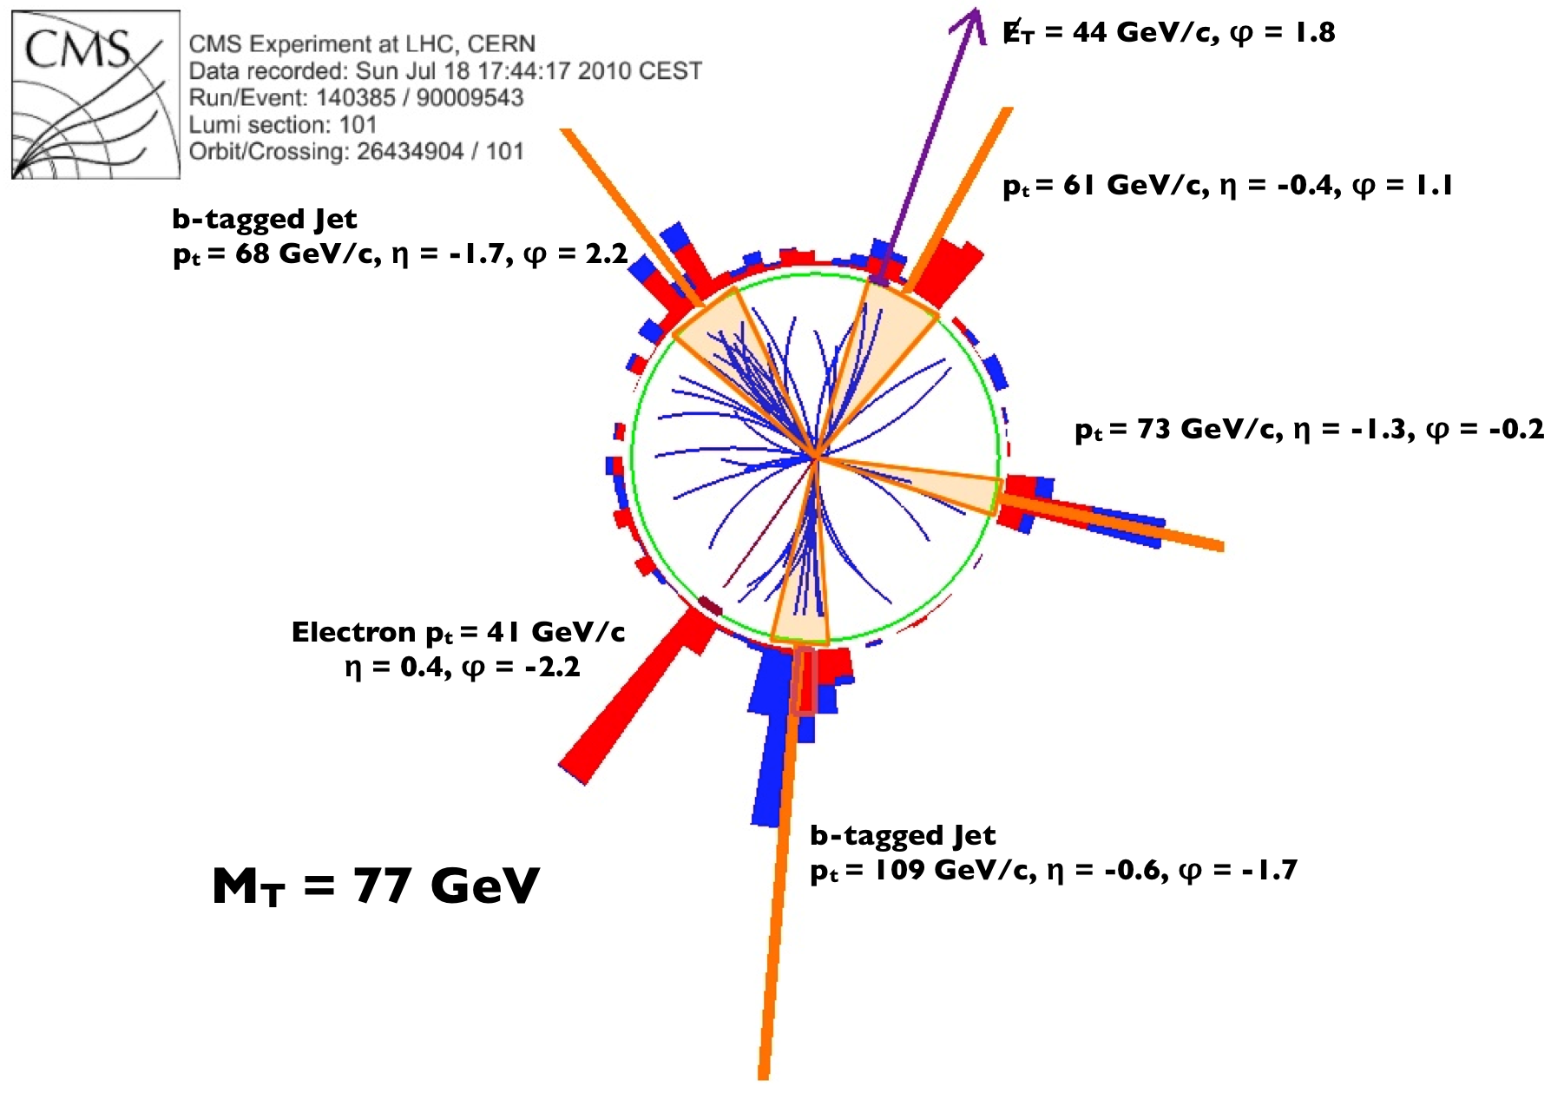
Problem 2: which jets?
Two facettes:
if more than 4 jets (initial state rad.)
mostly jets with highest p_{T}
if exactly 4 jets: which belongs to
which top quark?
4 jets ➔ 4 possible assigments
(j_{A}j_{B}J_{C}/j_{D}, j_{A}j_{B}j_{D}/j_{C,} ....)
Note: if b – jets identified, reduced to 2 possibilities
Important constraints
mass (jjj) = mass(jlν) (= M_{t})
mass (jj) = M_{W}

Slide 39
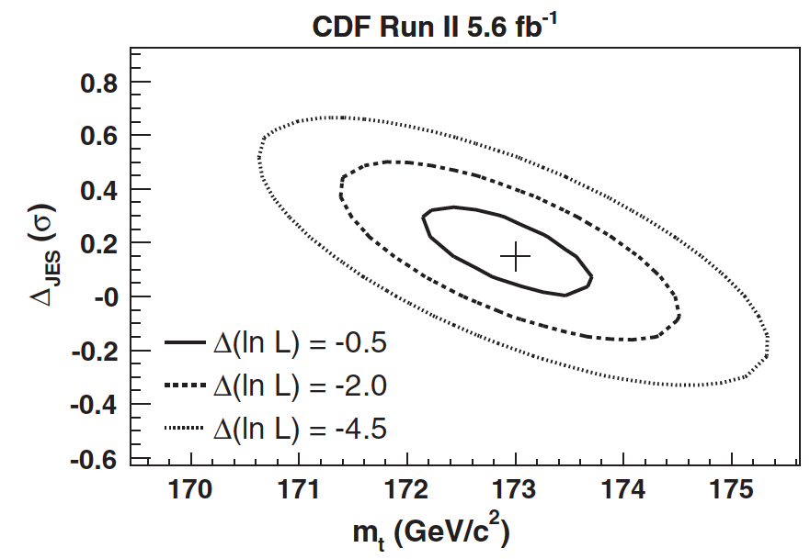
Problem 3: jet energy scale
Measure signals in calorimeter ➔ derive jet energy
Implies uncertainty!
➔ relates directly to top mass
Top – quarks offer ‚self calibration‘
M(jj) has to be equal M_{W}
➔ change JES such that fulfilled
Still the (slightly) dominant uncertainty of M_{t}

Slide 40
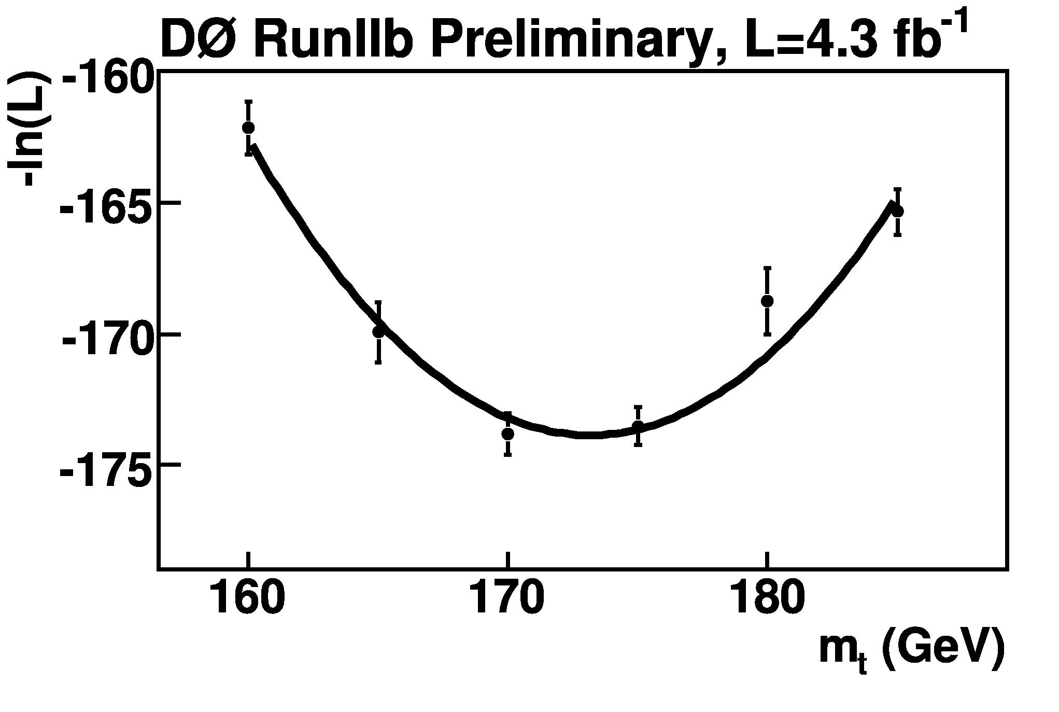
Use all information
Theoretical pred with
M₁(top)
Convolute with experimental effects
w₁
Theoretical pred with
M₂(top)
w₂
Sum over all events and find combine weights
......
Find M(top) with maximum weight

Slide 41
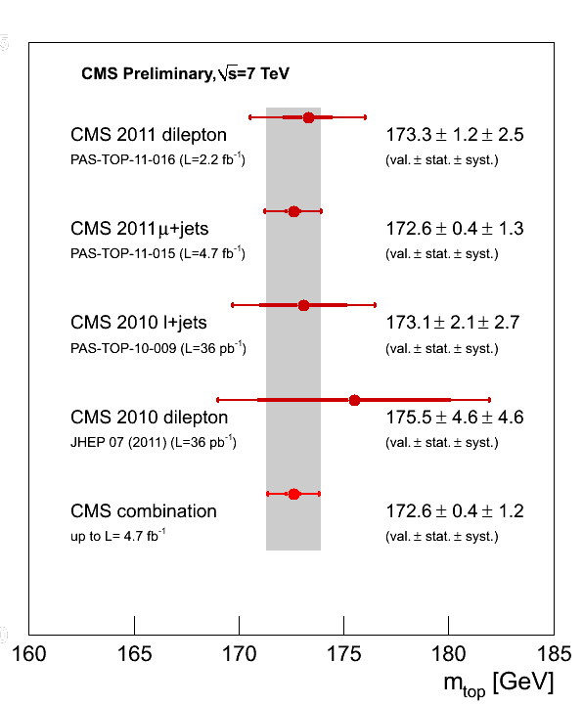
Mass of the top quark
A fundamental parameter of the Standard Model
A broad spectrum of decays and methods
Even today‘s LHC results same precision as Tevatron
Note: first time a quark mass can be measured directly

Slide 42
Top properties
Weak t coupling (V-A)
CKM – elements
Electric charge
Top mass
gtt couplings
spin correlations
tt - resonances

Slide 43
A tt resonance at last?
Many BSM models new particles X➔tt

Slide 44
Production properties
M.Mechtel
Dominant for small M_{tt}
Becomes dominant at M_{tt} > 2.5 TeV

Slide 45
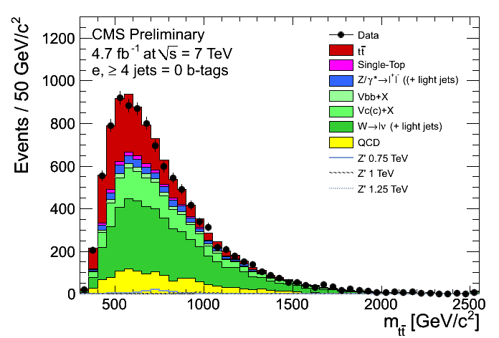
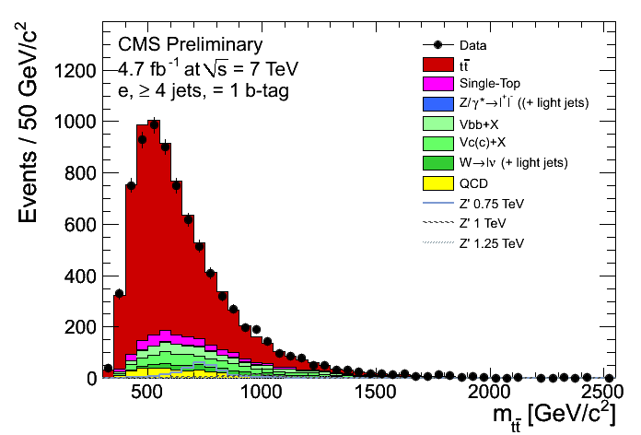
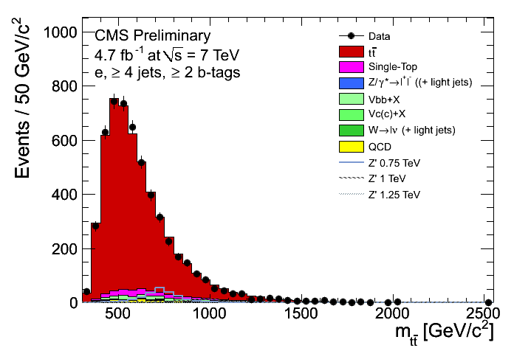
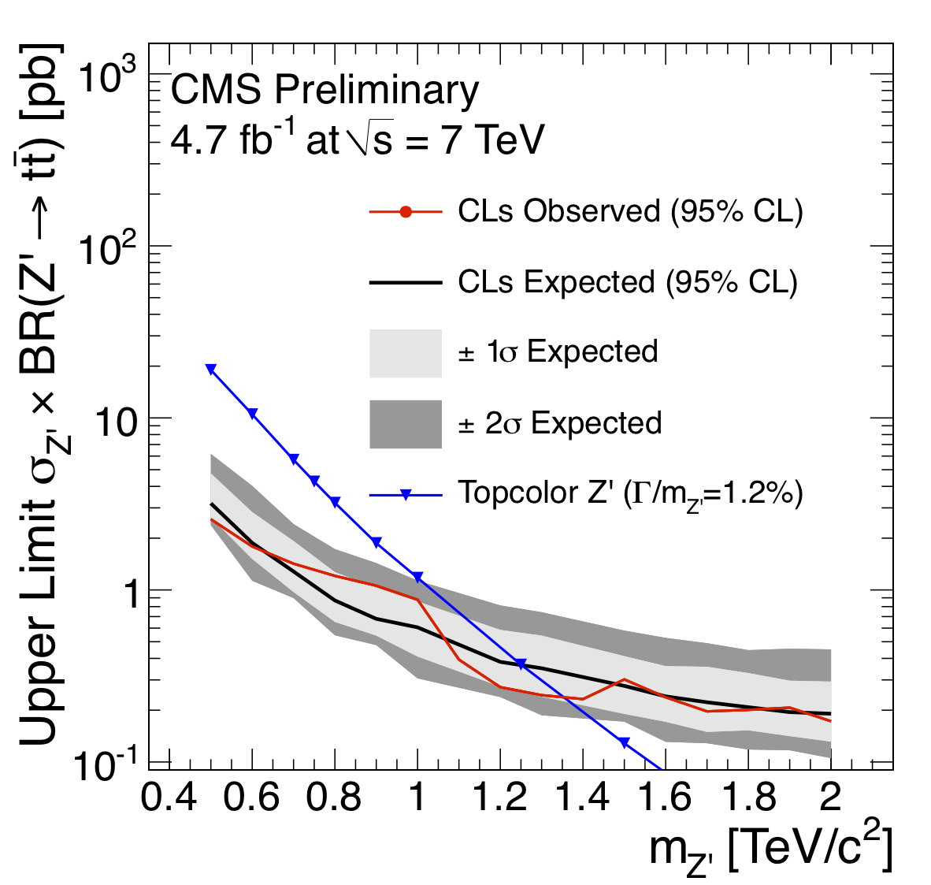
LHC: reaching into the TeV scale
CMS: combine different channels
Limit on Z‘
Limit on Kaluza – Klein excitation

Slide 46
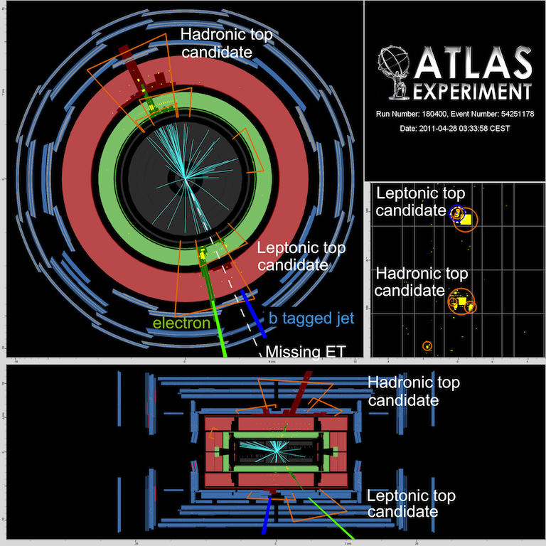
High p_{T} top jets
N.B. High p_{T} top quarks:
jets merge!
New algorithms required

Slide 47
Tevatron fwd-bkw asymmetry
‚Forward‘
hemisphere
‚Backward‘
hemisphere
Count
top quarks in forward hemi N_{fwd}
top quarks in backward hemi N_{bwd}

Slide 48
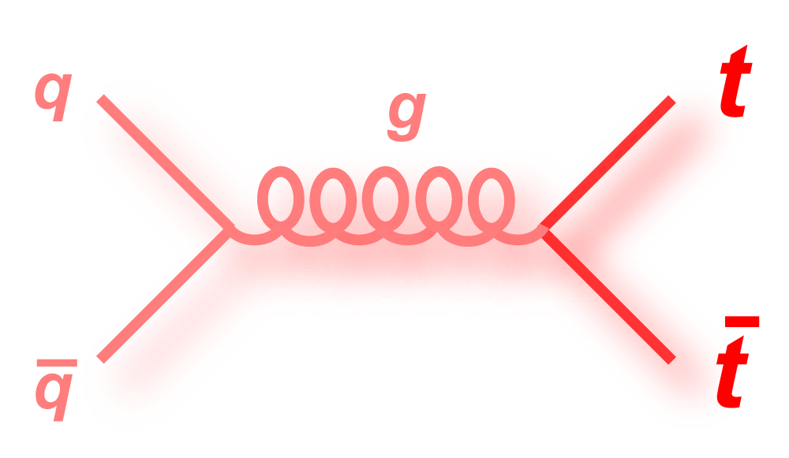
Standard Model: small asymmetry
Dominant production @ Tevatron
charge direction ‚lost‘
LO: no asymmetry in Standard Model
NLO: Interference ➔ small A_{C}
Standard Model: (4.8+-0.5)%

Slide 49
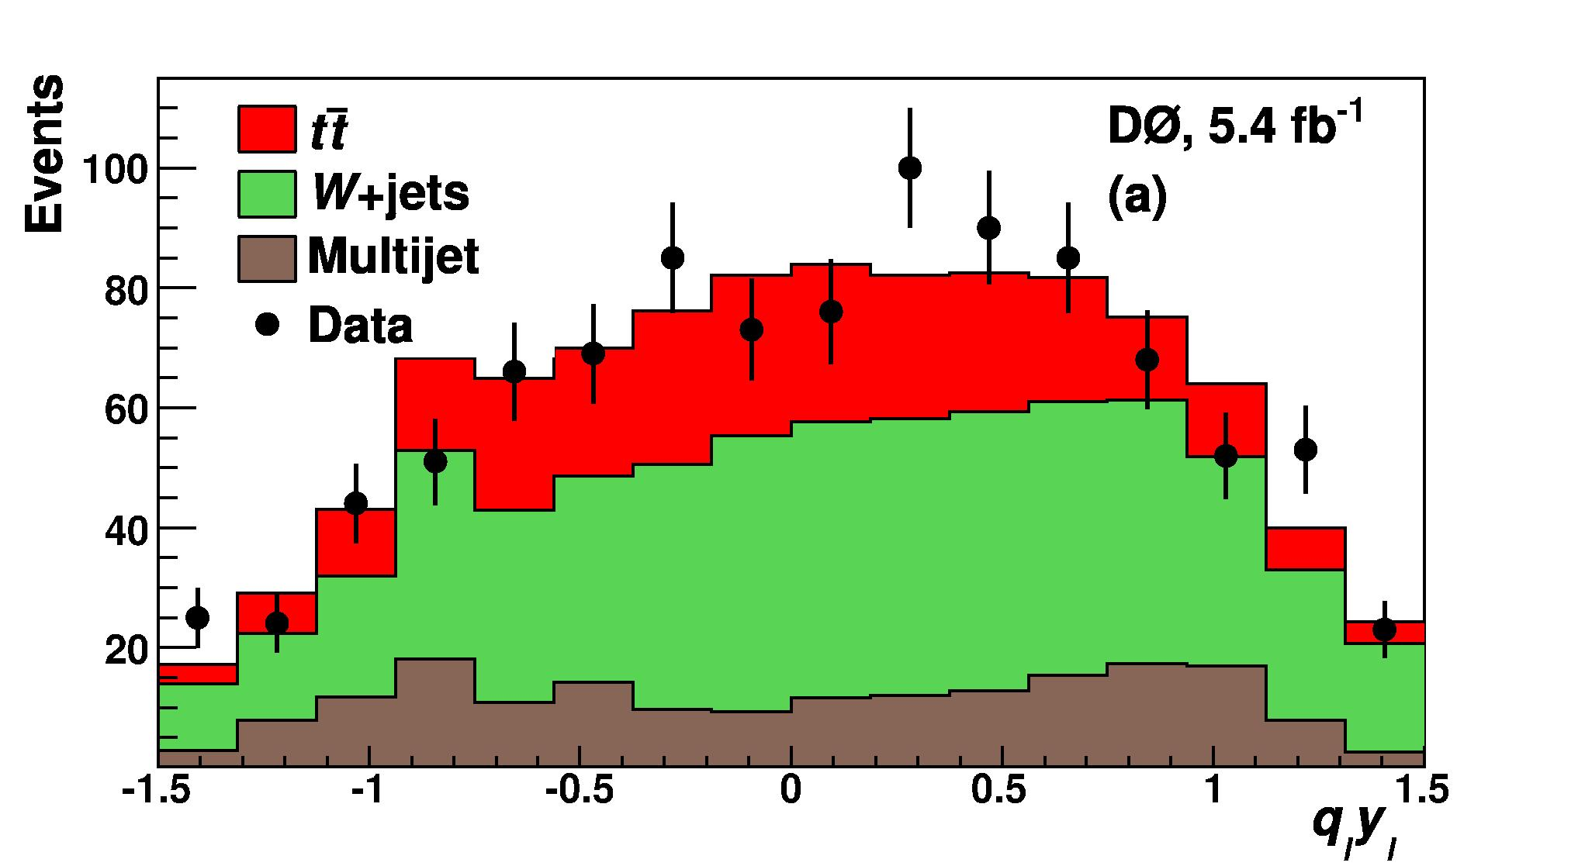
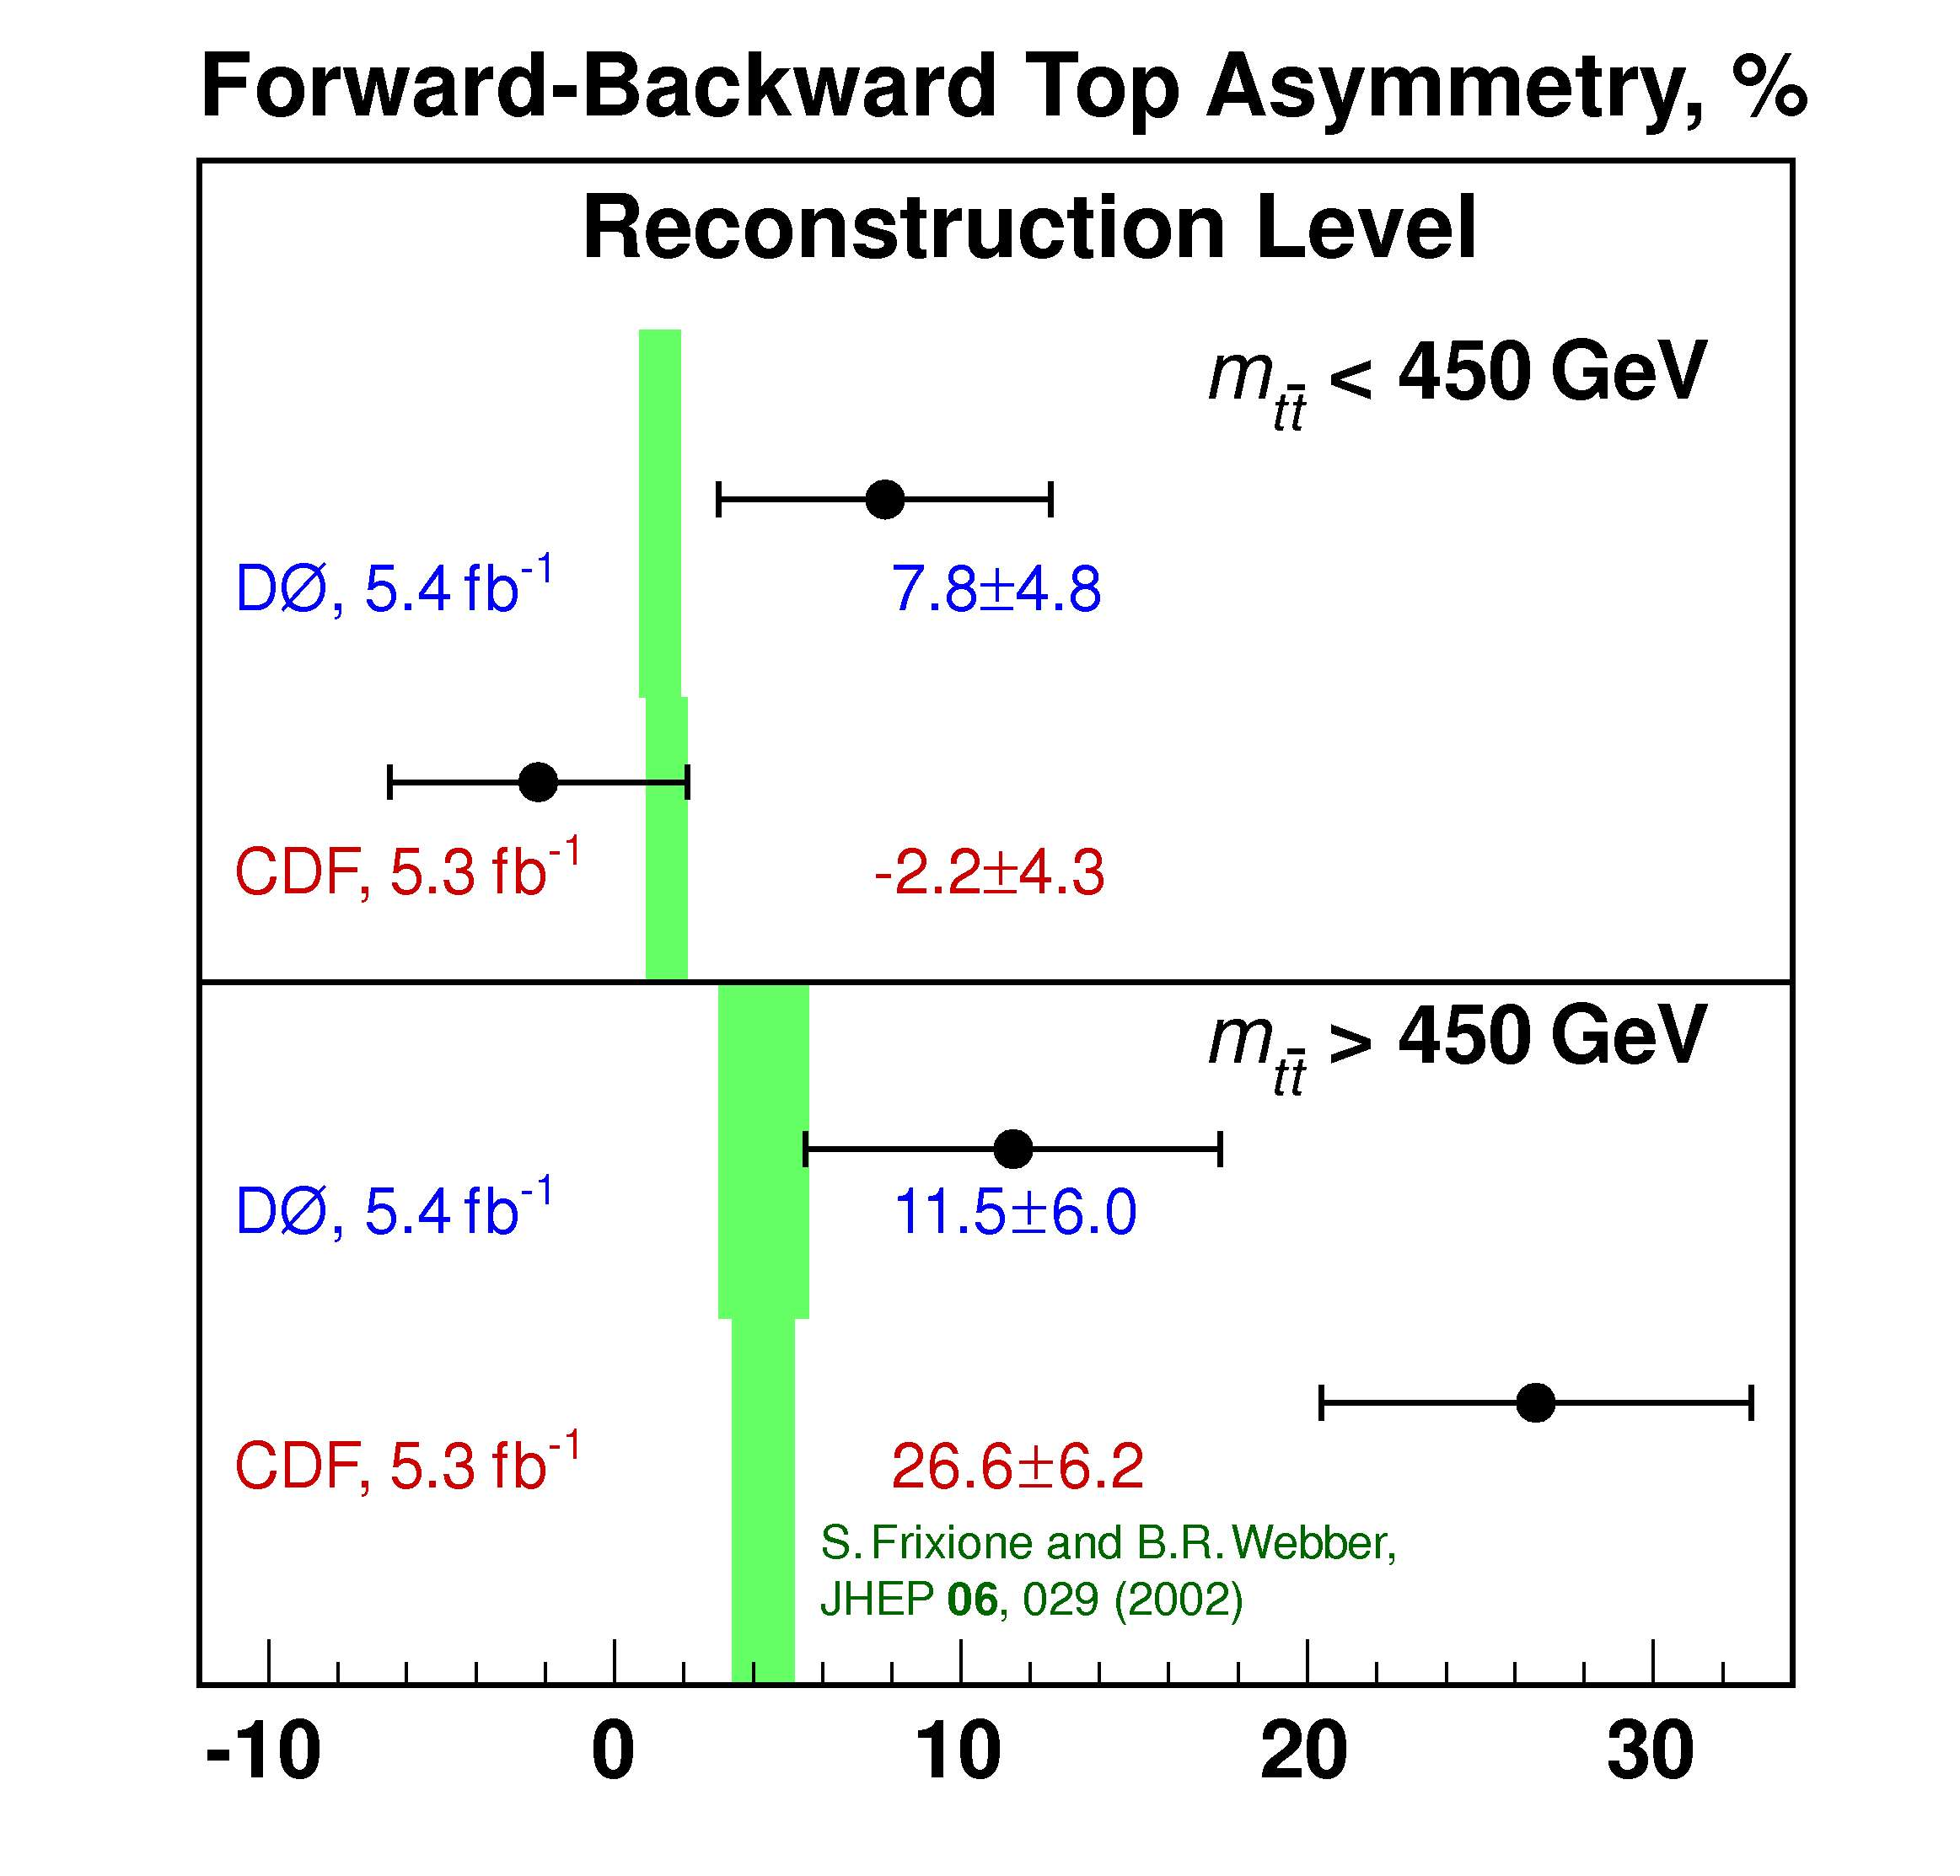
Tevatron: larger asymmetry
More events with
q_{top}· y_{top} > 0
CDF
Low mass:
consistent with Standard Model
Masses > 450 GeV
3 – 4 σ deviation from expectation

Slide 50
A glimpse of multi – TeV physics?
BSM interpretation:
asymmetry due to interference high mass particle + Standard Model
Type 1:
Gluon with
axial coupling
Type 2:
t –channel
Colour neutral
vector
with FCNC
Type 3:
t –channel
coloured scalar
with FCNC
Such massive particles should become visible @ LHC

Slide 51
tt – asymmetries @ LHC
Differences: pp – collider, Dominant:
symmetric initial state gg → tt instead of qq→tt
Enhance qq production by large Δy
high x valence quark on
low x sea anti-quark

Slide 52
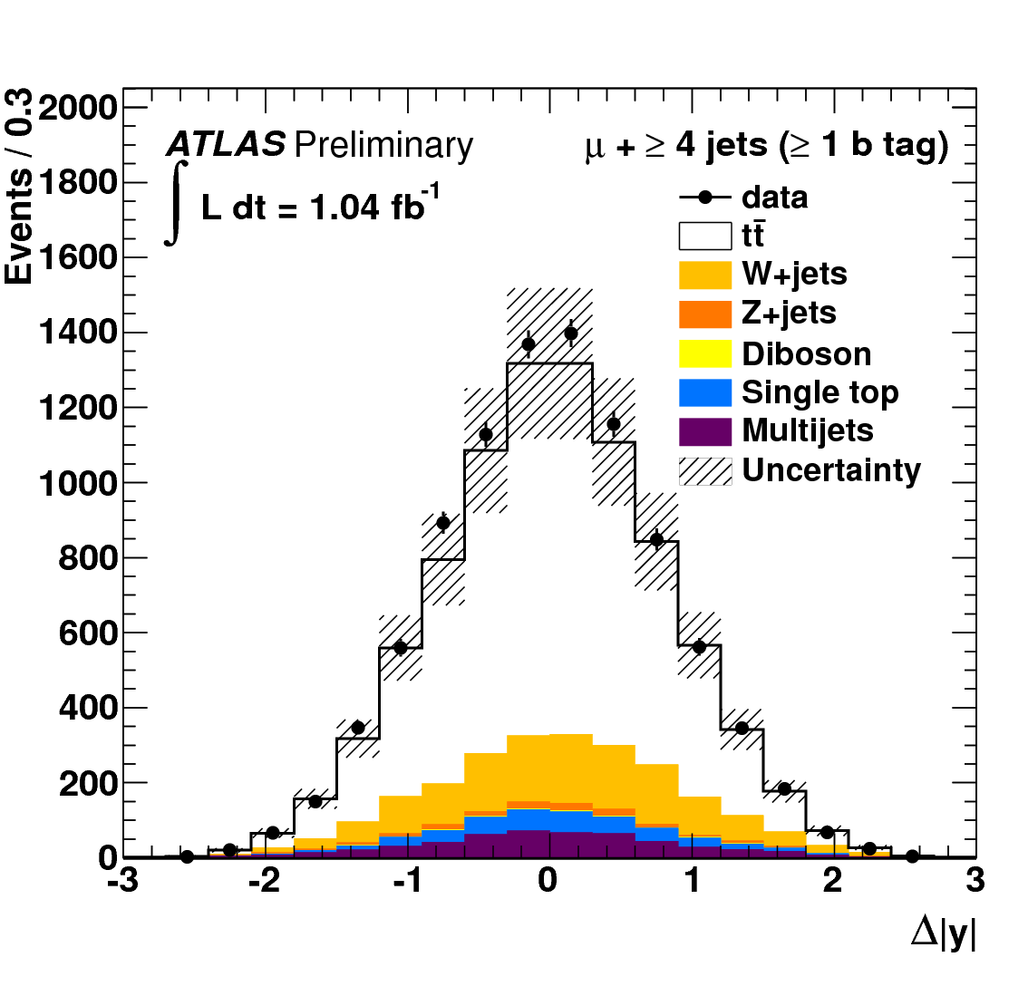
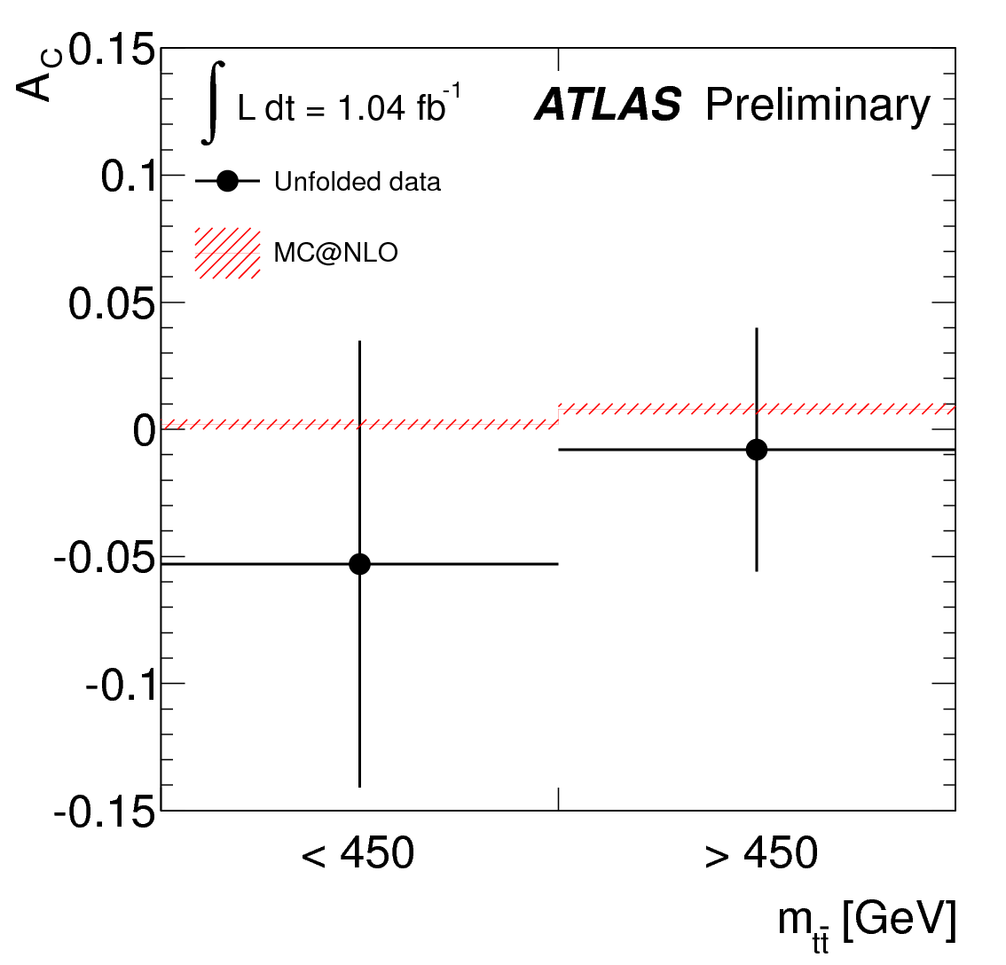
tt – asymmetries @ LHC

Slide 53
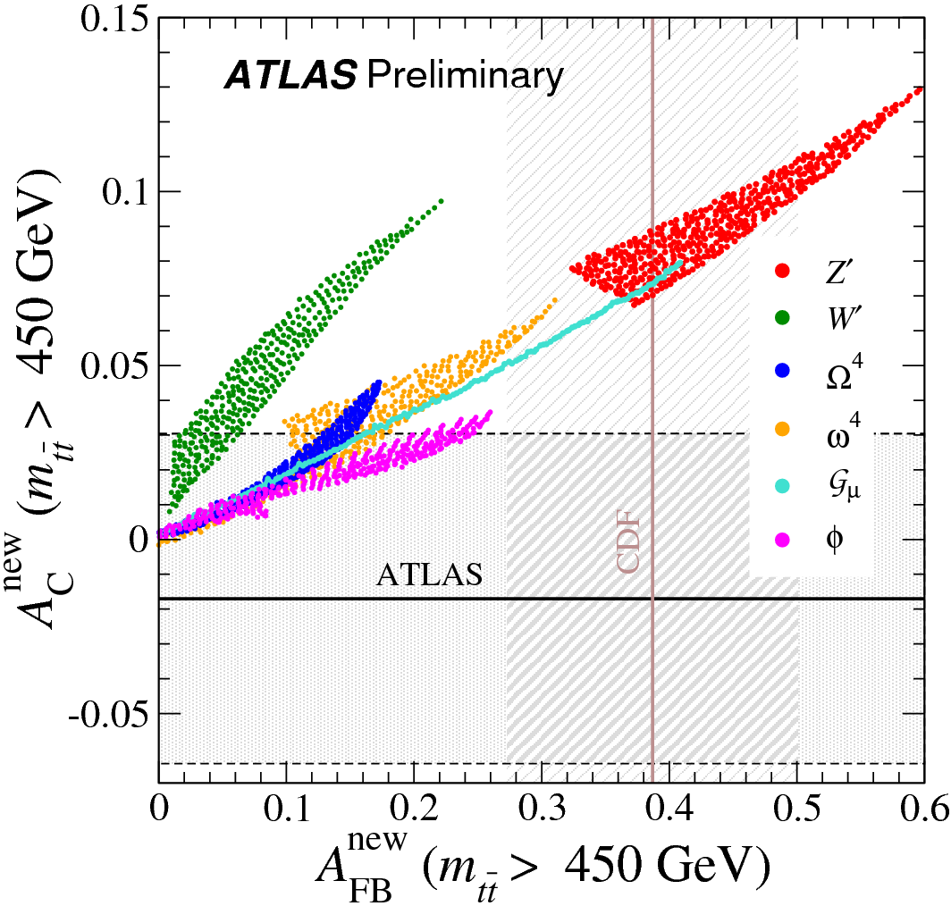
Interpretation in models
Notes:
Asymmetry in tt transformed to parton level

Slide 54
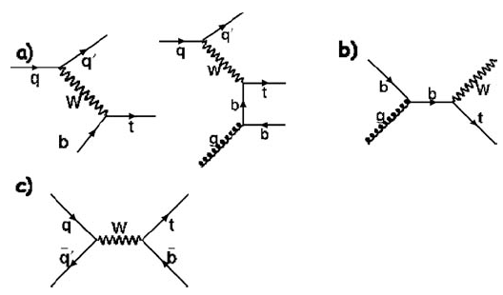
Single top production
top pairs due to strong coupling,
weak coupling ➔ single top quarks
Dominant
σ_{t-channel}(7 TeV) = 65 pb
σ_{Wt}(7 TeV) = 15 pb
Σ_{s-channel}(7 TeV) = 4.6 pb
Remember:
W± couples to fermion doublets

Slide 55
Single top production
Allows detailed studies of the weak coupling of top quarks
How often does W➔tb (and not ts, td, or something else?)
Does the top couple completely left handed to the W?
(as all other fermions do)
Example:
Spin direction
Momentum
Forbidden in weak interactions
new particles, additional couplings ........

Slide 56
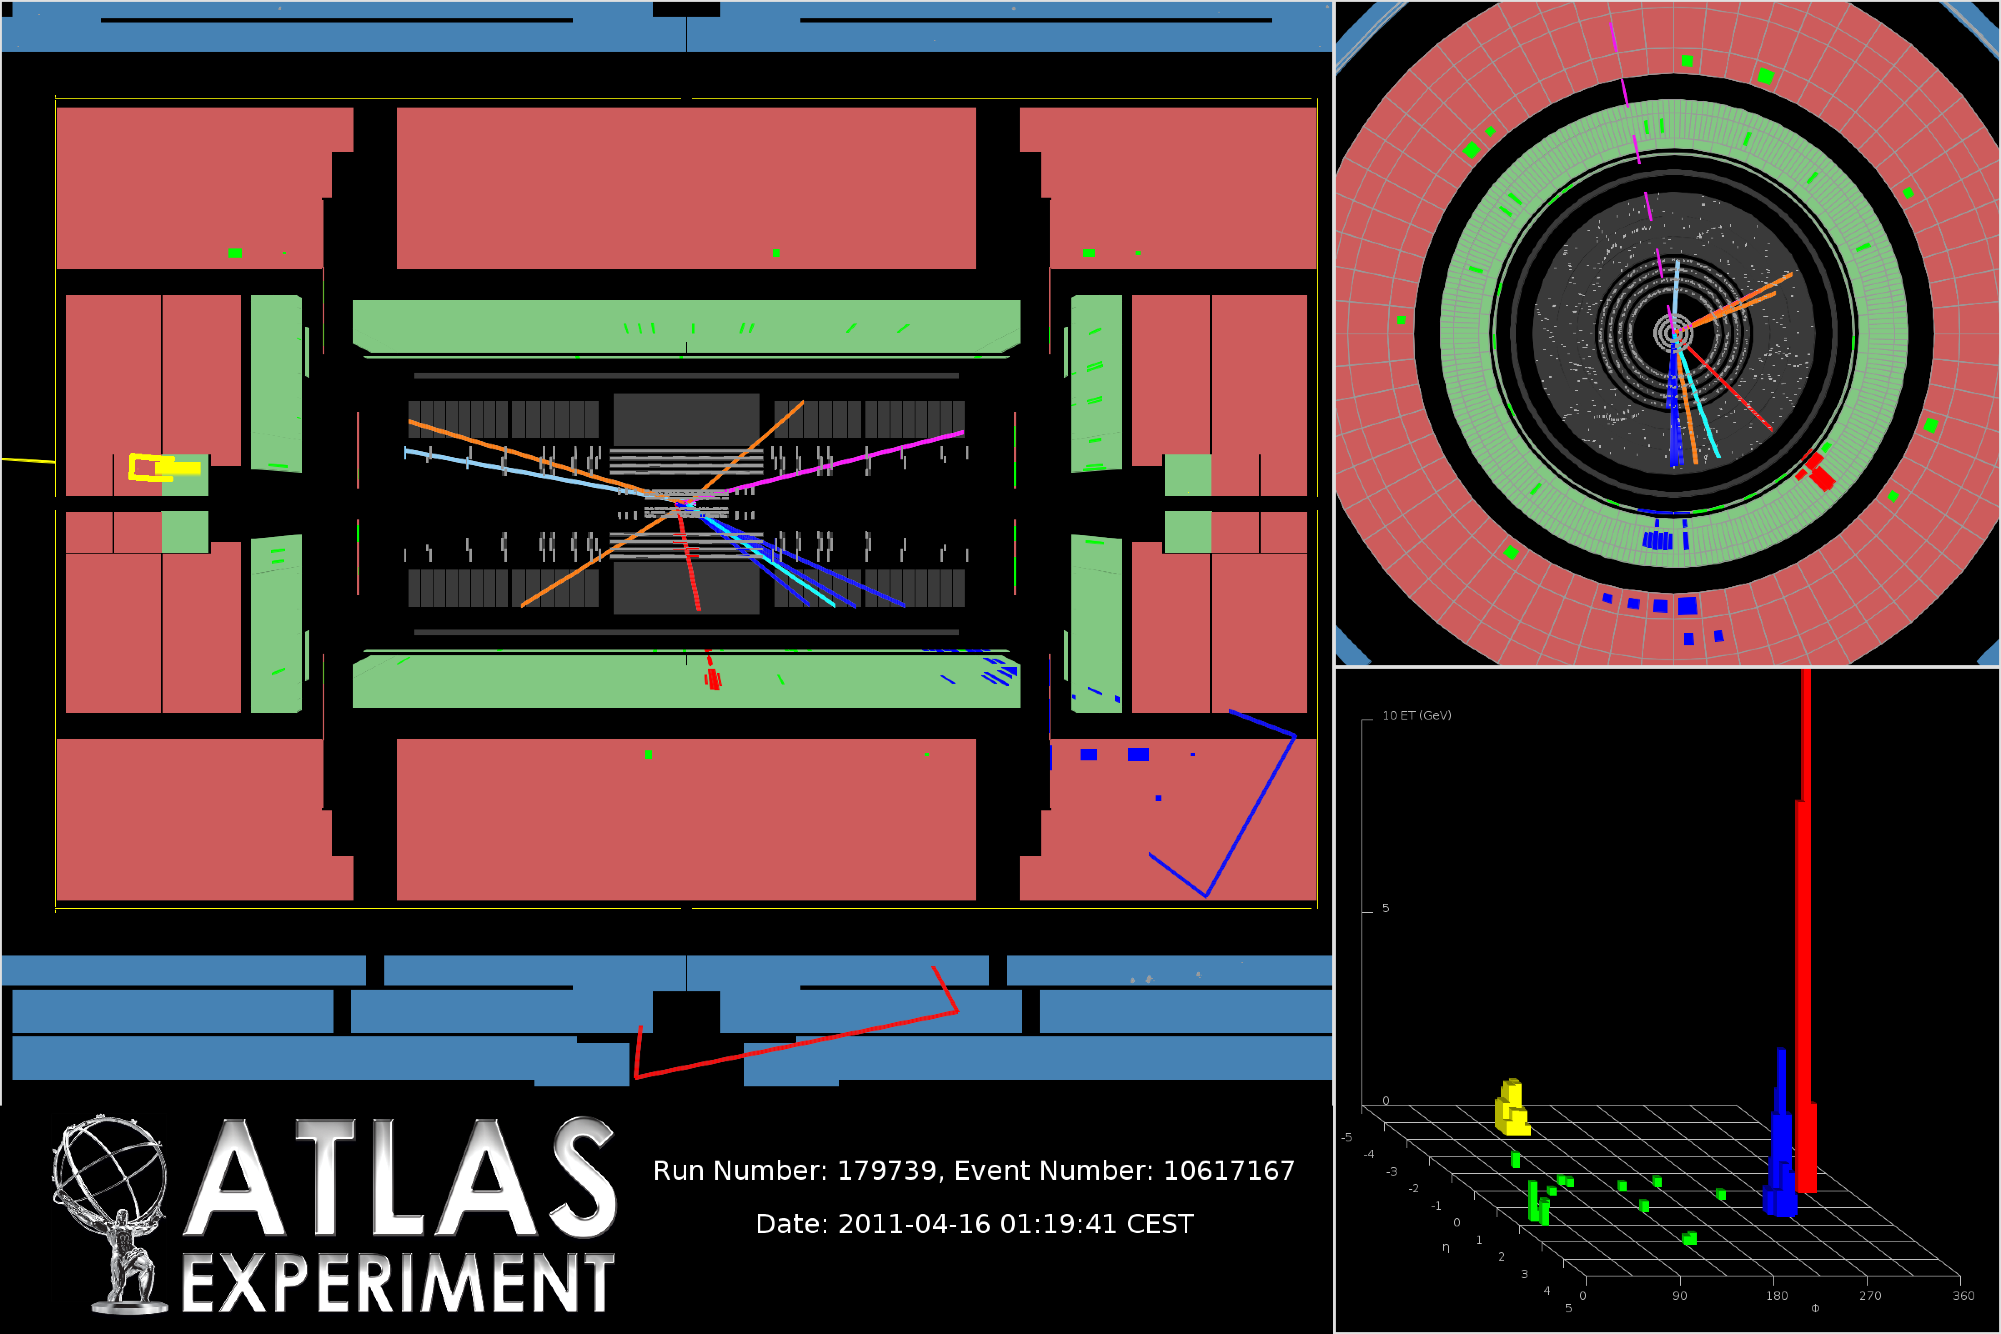
Fighting substantial background
After selection (in 700 pb⁻¹ pb LHC data)
Expect ~ 950 signal events
~10000 background events
Require:
2 jets
1 isolated lepton
missing energy

Slide 57
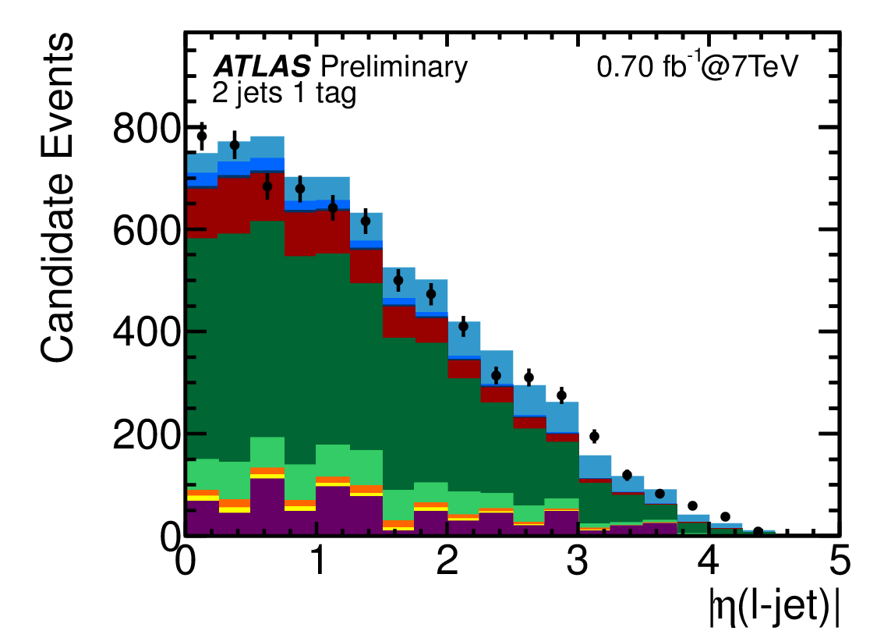
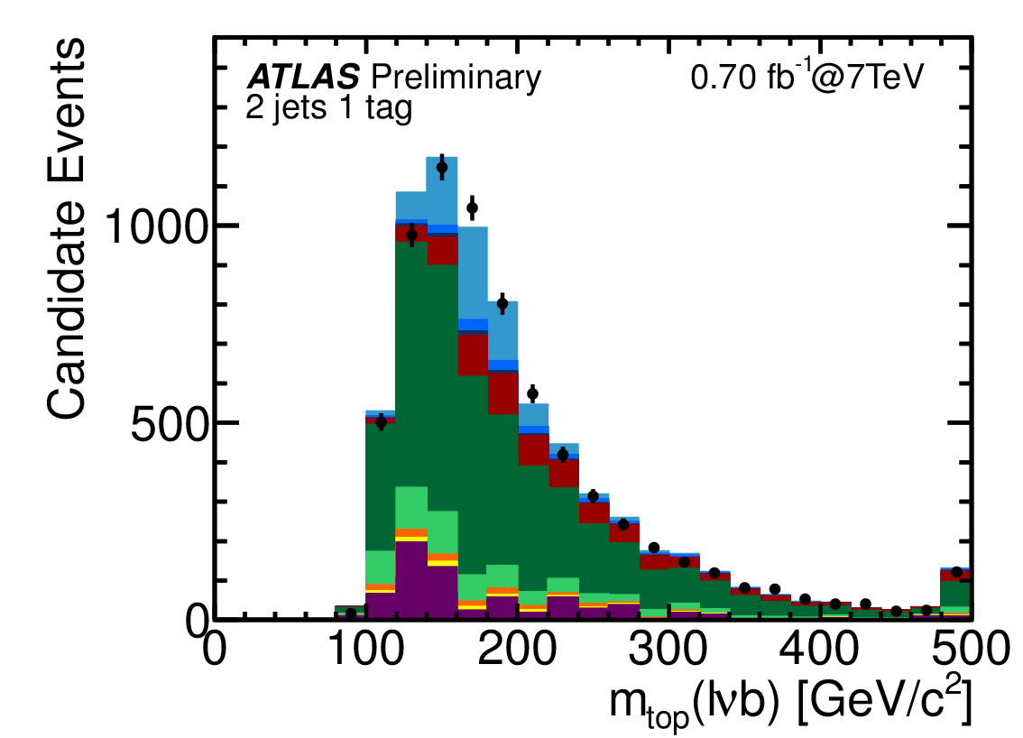
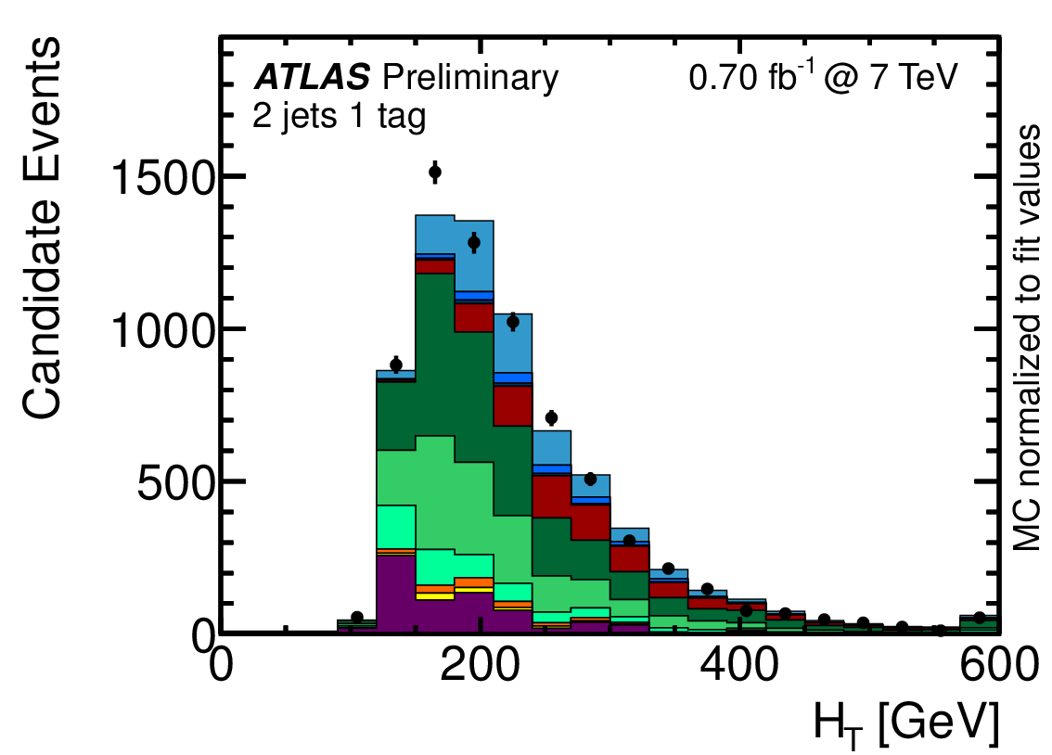
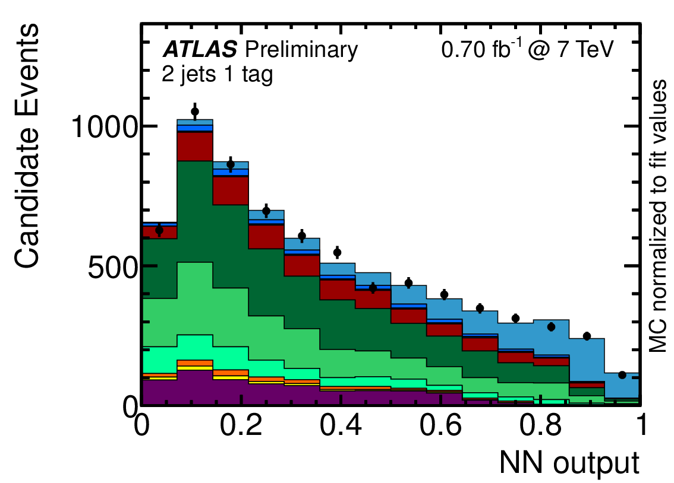
Combine observables
.......
Several observables with
moderate sensitivity:
combine all information
likelihood

Slide 58
Measurements
σ(7 TeV) = 90 (+32, -22) pb
Observation of single top production
Precision measurements to follow

Slide 59
Top Quarks @ hadron colliders
Top quark heaviest known particle
LHC will be a ‚top – factory‘
Top mass to~ 1% known ➔ input to SM fits
(Differential) cross section: search for new resonance
Decay properties tested
Single top a window to weak top couplings

