Slide 1
Warm Vacuum System of the
European XFEL
presented by
Sven Lederer
Notes:
How to edit the title slide
Upper area: Title of your talk, max. 2 rows of the defined size (55 pt)
Lower area (subtitle): Conference/meeting/workshop, location, date,
your name and affiliation,
max. 4 rows of the defined size (32 pt)
Change the partner logos or add others in the last row.

Slide 2
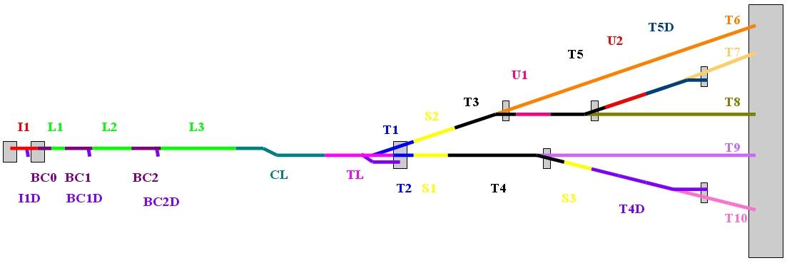
What covers the warm vacuum system?
The complete vacuum system for the electron machine except the superconducting modules!
Overall length about 3200 m

Slide 3
Specifications
    High Level Specifications for Alignment and Surface Properties of Vacuum Components (EDMS D00000001914751)
    Specifications for the Vacuum Sections of the European XFEL (EDMS D00000001975641)
    Roughness / oxide layer requirements
    RF-shielding requirements
    Magnetic permeability requirements
    Particle cleanliness requirements
    Pressure to be achieved
    Pump type approximate distance in-between
    Specifications of flanges, stainless steel quality, gaskets
MVS-ZM stamp
  Each vacuum component to be installed into an DESY accelerator must fulfill special requirements in terms of cleanness and general vacuum suitability. This holds for the European XFEL too.
    To be checked by MVS. Without this installation prohibited.
    http://spez.desy.de

Slide 4
Specifications
 |  | Material properties |  |  | alignment |  | RF shielding | Vacuum
 |  | conductivity | rel. permeability | R + 50*O | max. step at flanges | max. longitudinal gap | Flanges, bellows, pumps, valves | Particle free | Average pressure
 |  | μΩcm |  | nm | mm | mm |  |  | mbar
RF-gun (up to L0) | I1 | 75 | <1.01 | - | - | - | - | YES | < 10⁻¹⁰
Injector | I1 | 3 | 1.01 | 1250 | 0.2 | 0.5 | YES | YES | < 2 10⁻⁸ *
Inj. Dump | I1D | 3 | 1.05 | 2000 | 0.2 | 0.5 | NO | YES | < 2 10⁻⁸
BC0 | I1 | 3 | 1.01 | 1250 | 0.2 | 0.5 | YES | YES | < 2 10⁻⁸
BC1,2 | B1,B2 | 3 | 1.05 | 1250 | 0.2 | 0.5 | YES | YES | < 2 10⁻⁸ *
BC1,2 chicane | B1,B2 | 3 | 1.01 | 1250 | 0.2 | 0.5 | YES | YES | < 2 10⁻⁸
BC1,2 dump | B1D, B2D | 3 | 1.05 | 2000 | 0.2 | 0.5 | NO | YES | < 2 10⁻⁸
L3 Temp. beam line | L3 | 3 | 1.05 | 1250 | 0.2 | 0.5 | YES | NO** | < 2 10⁻⁸ *
Collimation | CL | 3 | 1.05 | 1250 | 0.2 | 0.5 | YES | NO*** | < 2 10⁻⁸
Switch Yard | TL | 3 | 1.05 | 1250 | 0.2 | 0.5 | YES | NO | < 2 10⁻⁸
Undulators | SA1-3, UN1-2 | 3 | 1.01 | 550 | 0.1 | 0.5 | YES | NO | < 2 10⁻⁷
Beam transport | T1-T5 | 3 | 1.05 | 1250 | 0.2 | 0.5 | YES | NO | < 2 10⁻⁸
Main dumps | TLD, T4D, T5D | 3 | 1.05 | 2000 | 0.2 | 0.5 | NO | NO | < 2 10⁻⁸
*) close to module < 10⁻¹⁰ ; **) except 30 m close to last module; ***) first 30 m have to have the ability of being particle free
More details in “High Level Specifications for Alignment and Surface Properties of Vacuum Components” and “Specifications for the
Vacuum Sections of the European XFEL”
Exceptions (diagnostic or other special components like kickers and main collimators) to be agreed by MLC

Slide 5
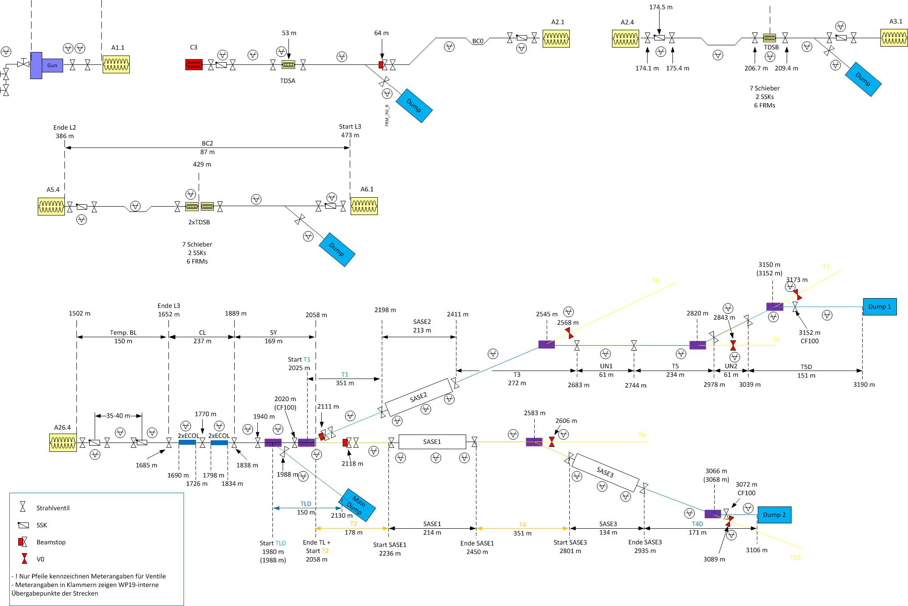
Vacuum system layout:
Segmentation by Valves - overview

Slide 6
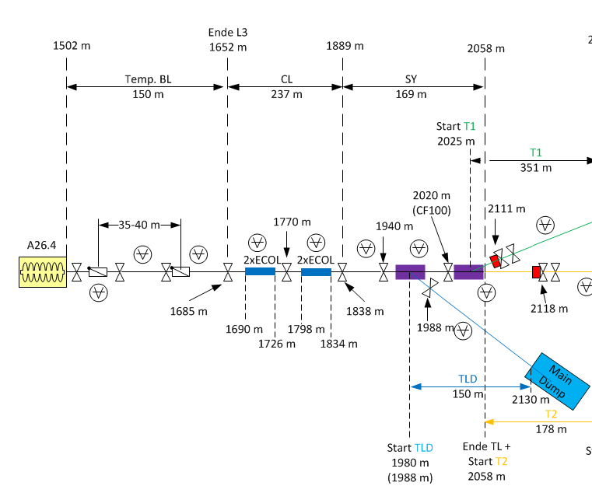
Vacuum system layout:
Segmentation by Valves – general ideas
Segmentation needed for
  Assembly and repair:
    Reduction of pump-down time
    Leak searches
    Separation of critical components (eg. RF Structures)
    Avoidance of particle migration
  Operation
    Different machine modes possible: Injector, Linac, SASE 2, SASE 1 and 3, everything
  Protection of the superconducting linac
    Additional fast shutters where reasonable
Consequence
  Roughly 50 valves
  8 fast shutters
  PLC-based valve control

Slide 7
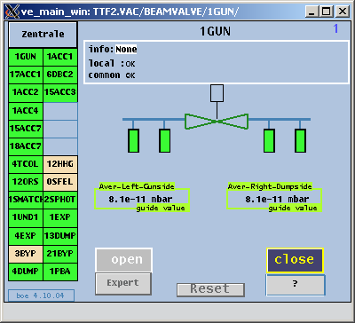
Experience from FLASH is very encouraging
  Different operation modes are possible
  Robust, no problems during operation
Experience from PETRA III is very encouraging
  Repetitive sections can be treated in a simpler, localized system
  Robust, no problems during operation
XFEL is a large (and long) system
  Many input and out put channels needed e.g.
    Pressure readings, valve control signals
    MPS: Which operation mode is allowed?
    Photon lines: Machine system o.k.?
Consequences
  Hierarchical system:
    PLC
      Overriding logic
      Interface to MPS, Photon systems etc.
    PETRA III system
      Repetitive sections like the cold linac can be pre-conditioned
      Reduces the need of many analog input channels significantly

Slide 8
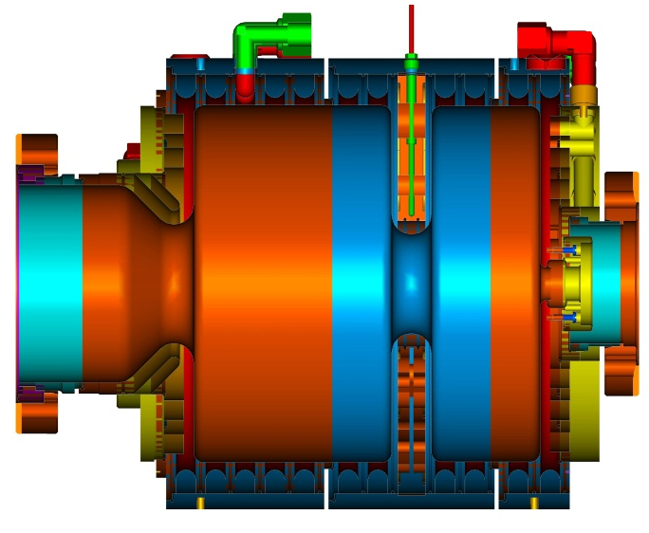
Sections:
RF-gun
Photocathode load-lock system
RF-gun
  1.3 GHz, 1.5 cell normal conducting cavity
Section up-to first superconducting module
  Extremely condensed
  p < E-10 mbar
  Particle free
  Beam pipe diameter 34 mm

Slide 9
Sections:
Injector
Particle free, p_{av} < 2E-8 mbar, at modules p < 1E-10 mbar
Straight sections
  Standard 40.5 mm beam pipe
  CFX50 flanges
  Copper tubes
special parts:
  High component density between 3.9 GHz module and laser heater
  Beam stop
  Dogleg
  BC0 chicane with collimators (In-kind BINP)

Slide 10
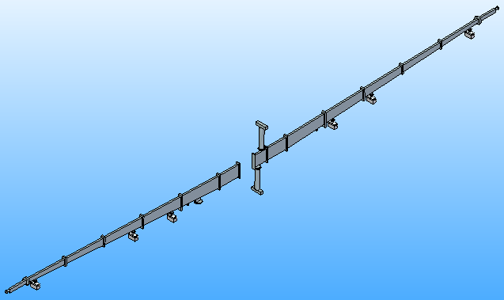
Sections:
Bunch compressors BC1 and BC2
Particle free, p_{av} < 2E-8 mbar, at modules p < 1E-10 mbar
Length
  BC1about 58 m
  BC2 about 85 m
Straight sections
  Standard 40.5 mm beam pipe
  CFX50 flanges
  Copper tubes
Chicanes + collimators
  Rectangular chambers (horizontal 40.5 mm, vertical up to 400 mm)
  In-kind contribution BINP
  Special diagnostic components to be defined in advance

Slide 11
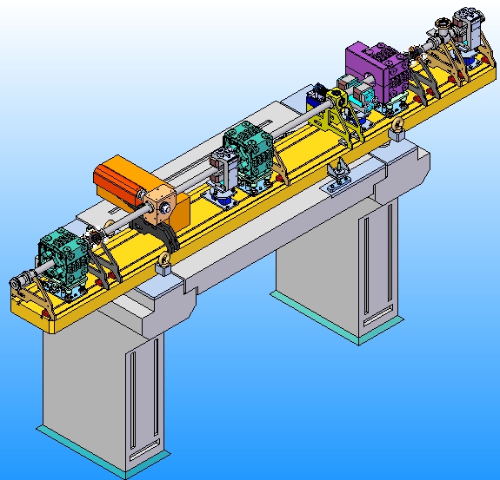
Sections:
Bunch compressors BC1 and BC2
Girders
  Each girder (9 for BC1 and 12 for BC2) assembled in clean room
  Assembled girders connected inside the tunnel by means of small local clean rooms

Slide 12
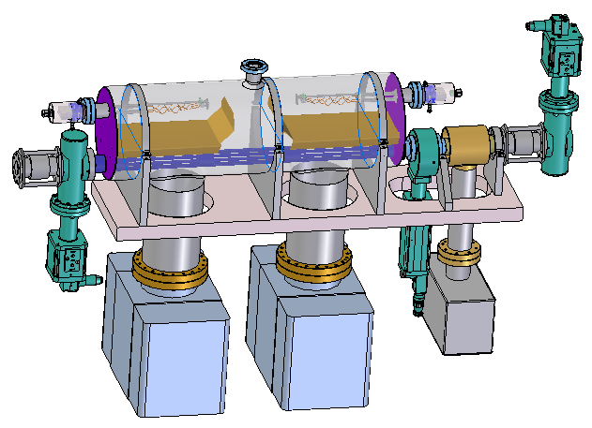
Sections:
Bunch Compressors - Warm-cold transition
Special module to:
  Reduce pressure from 2E-8 mbar to E-10 mbar within a short distance
  Integration of fast shutter and gate valves to protect superconducting modules
Consist of:
  2 TSPs
  2 300 l/s SIPs
  1 55 l/s SIP
  2 all metal gate valves
  1 fast shutter

Slide 13
Sections:
Temporary beam line
Particle free NO
  except first 30 m behind last module
p_{av} < 2E-8 mbar
  at superconducting module p < E-10 mbar, achieved by warm-cold transition module
One additional fast shutter to protect particle free area
Overall length about 450 m
In-kind BINP

Slide 14
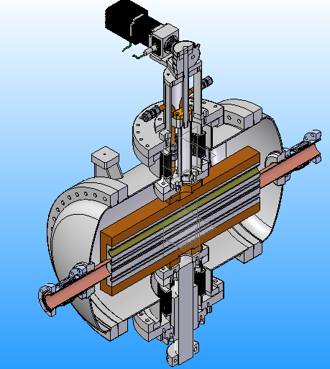
Sections:
Collimation
Particle free: NO
  first 30 m need to be particle-free and < E-10 mbar in case of an extension with superconducting modules
p_{av} < 2E-8 mbar
Overall length about 240 m
Main Collimators
  4, 6, 8, and 20 mm
  4 units
  In-kind contribution BINP

Slide 15
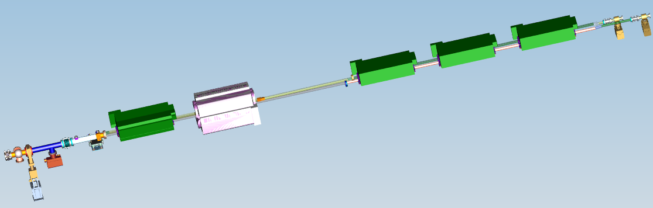
Sections:
Switch Yard
p_{av} < 2E-8 mbar
Particle free: NO
Overall length about 170 m
Special components
  Septa
  High number of kicker
    Standard kicker with ceramic tubes
    In-vacuum kickers

Slide 16
Sections:
Beam distribution
Particle free: NO
p_{av} < 2E-8 mbar
Overall length about 1600 m
In-kind BINP
Special items
  Chambers to separate electron and photon beam
  Two beam-stops

Slide 17
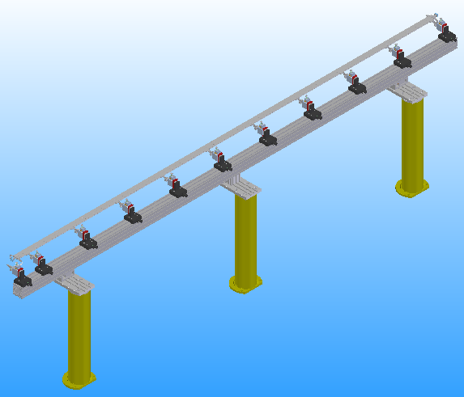
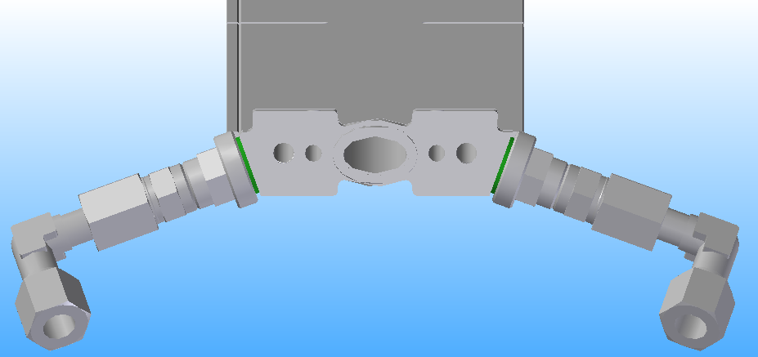
Sections:
SASE1-3
p < 10⁻⁷ mbar, not particle free, μ < 1.01, R + 50xO < 550 nm
Undulator chambers
  Extruded aluminum
  Length about 5.5 m
  Aperture 15 x 8.8 mm
  2x 5 mm bores for water cooling
  2x 4 mm bores for air coils
  Threaded holes for air coil connectors
  10 pockets for TLDs, 6 of them with the ability of carrying sensors for online dose measurement system
  10 supports for horizontal, vertical and angular adjustment

Slide 18
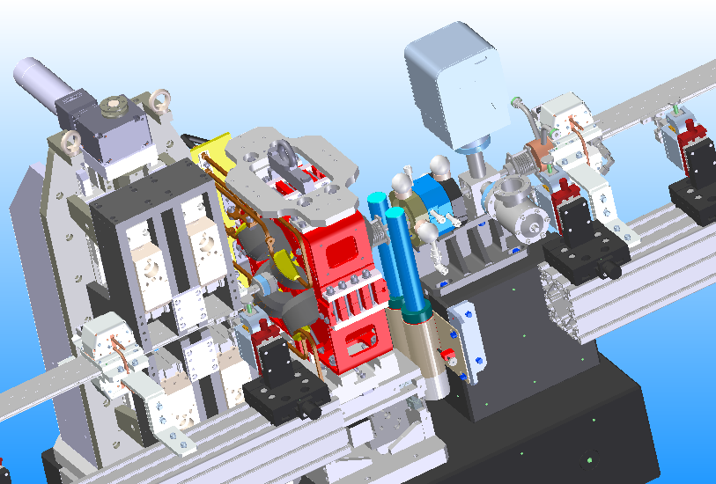
Sections:
SASE1-3
Intersections
Extremely condensed area
In-kind BINP

Slide 19
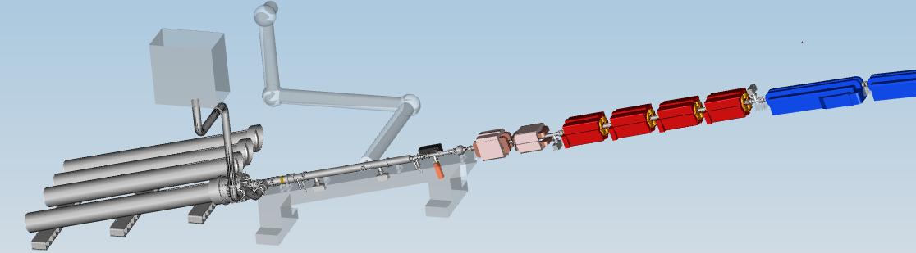
Sections:
Main dumps
p_{av} < 2E-8 mbar
Particle free: NO
Three main dump lines with length of
  Main dump in XS1 about 150 m
  Main dump 1 (XDU1) about 40 m
  Main dump 2 (XDU2) about 25 m
Last part of the section before dump window is the same for all three dumps
Last part of the section before dump window is mounted on one movable girder to make dump exchange easier
Dump vacuum (after window)

Slide 20

Interface to photon vacuum system
Electron vacuum
Photon vacuum
V0
PLC
Pressure downstream V0
Status V0
Vacuum OK electron side
Vacuum OK photon side
Status SSK
V0
Status
Control (open/close)
PLC
Status V0
Control V0
Vacuum OK electron side
Vacuum OK photon side
Status SSK
Control SSK
SSK
Status
Control (open)

Slide 21
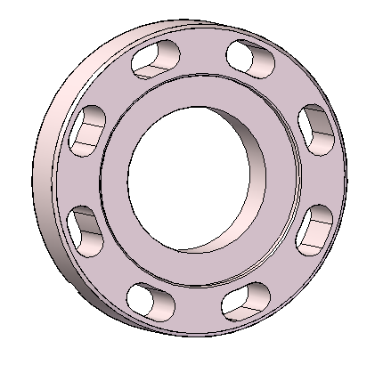
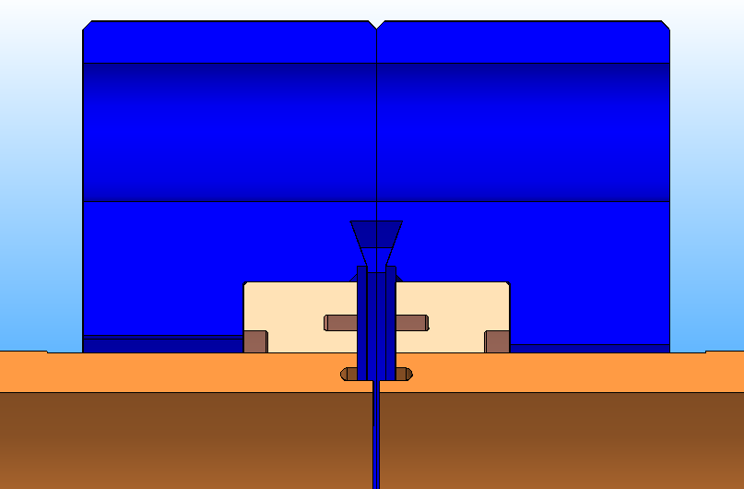
Components:
Standard beam pipe and flange
Cu pipes
  ID 40.5 mm, OD 45.5 mm
  Cheaper than Cu coated StSt pipes
  Required roughness achievable by extrusion process
Special DN50 flanges (http://spez.desy.de)
  With “RF-nose” to ensure max longitudinal gap
  Tighter tolerances to ensure max vertical step
  No rotational flanges, only long bores to compensate for small angular mismatches between components
RF-noses with 0.2 mm gap
Sealing edges
Flange 1
Flange 2

Slide 22
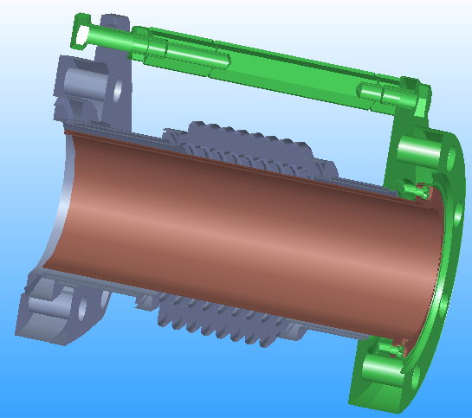
Components:
Standard bellow
Cu insert to ensure beam dynamic requirements
Nominal gap 4 mm
  Except BC-girders, where 6 mm are needed

Slide 23
Components:
Pumps - Sputter Ion Pumps (SIPs)
  Properties:
    a long life time (more than 50000 hours at pressures in the 10⁻⁶ mbar region) without necessary maintenance
    vibration free operation
    production of clean vacuum (no contaminations with hydrocarbons)
    ability to directly read the pressure
    Cost efficiency.
    Relatively big size
    Permanent magnetic field
  Diodes with Fischer/Varian HV (+safecon) connector
  Connected to beam pipe either by means of pump cross or TSP pump
  Mainly used in RF-gun (75 l/s), Injector (55 l/s & 75 l/s), Bunch compressors (55 l/s & 300 l/s) and Intersections of undulators (20 l/s)

Slide 24
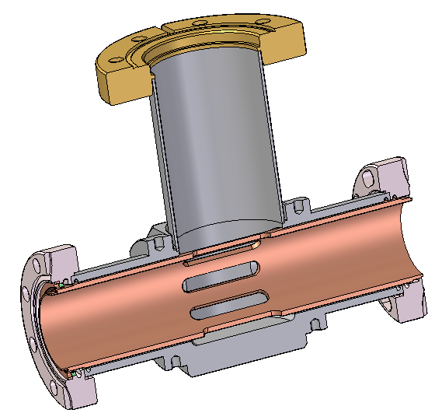
Components:
Standard pump crosses
Stainless steel body
Slotted Cu-pipe insert to fulfill material parameters
Distance of inlet port of SIP to beam axis 130 mm
  Agreed by MLC, magnetic field at beam axis small enough
  Nevertheless pumps will be equipped with additional shielding to further decrease magnetic field

Slide 25
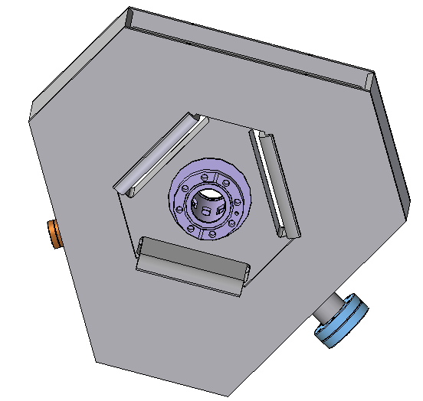
Components:
Pumps - In-line SIP
  Standard pump for 40.5 mm beam pipes in Temporary Beam line, Collimation, SwitchYard, Beam Distribution, and Main dump lines
  Pumping speed tested at HASYLAB
    “Doppeldom Fischer-Mommsen“, DIN 28429
  Magnetic field on electron beam axis (around 0.1 mT) fine for beam dynamics
  Advantages:
    Higher pump speed than standard SIP + pumping cross
    More compact
    Costs comparable to standard SIP + pumping cross
  Approx. 400 pieces needed
CFX50 flanges
adjustable
magnetic shielding

Slide 26
Components:
Pumps - power supplies and read out
Power supplies
  in house development with continuous improvements over decades
  Analogue read out of pump current (pressure) either by voltage or by current
    Delivery of signals for RF-interlocks
  For XFEL upgrade of latest PETRA III type
  Added safety contact
Hardware read out system
  PETRA III
    Micro controller supporting up to 18 power supplies
    Communication to user interfaces via Ethernet

Slide 27
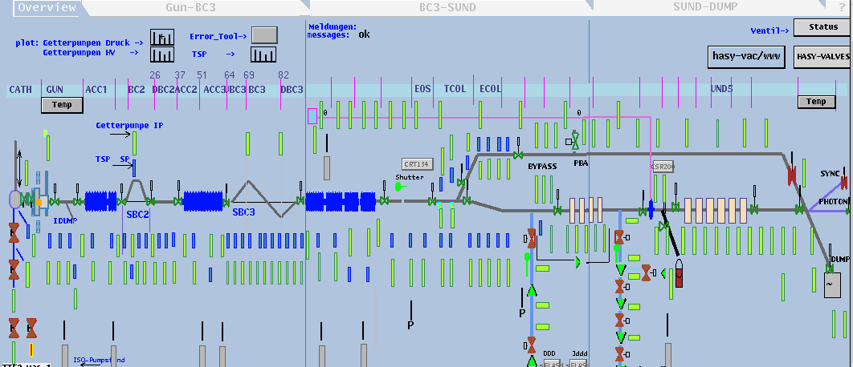
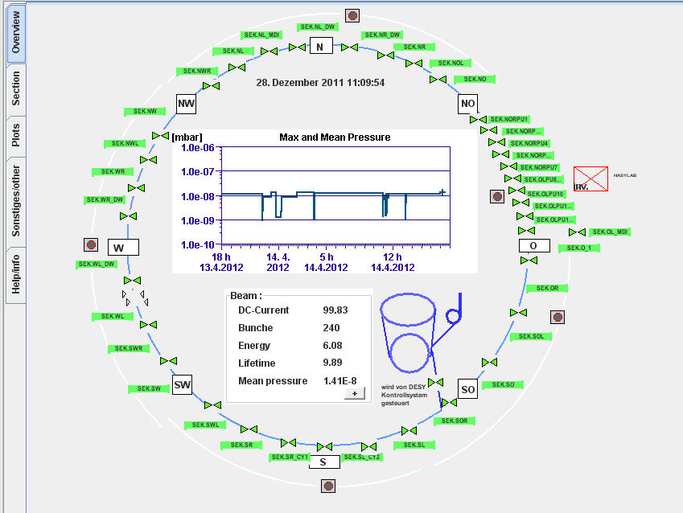
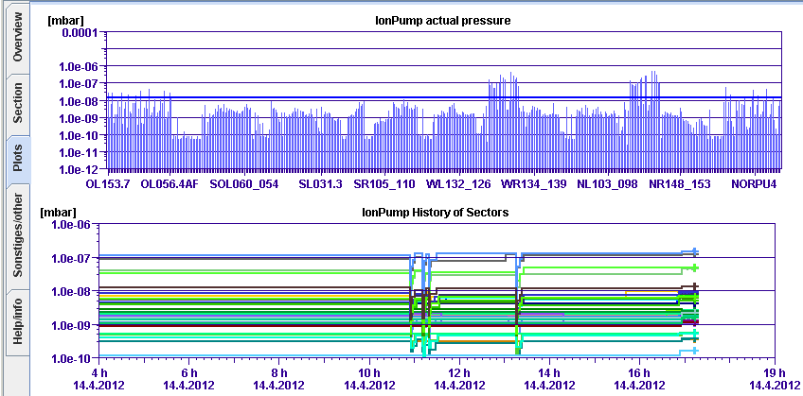
Control system
Experience from FLASH
High degree of segmentation
SSK
Experience from PETRA III
About 400 pumps

Slide 28
Mobile Equipment:
Venting unit
There will always be particles inside the cold and warm vacuum!
  Pumping / venting unit will not reduce number of particles, BUT stop transport of them.
  Idea is to control the mass transport during time to constant 3 l/s of nitrogen or argon, by means of mass flow controllers.
  In addition concept will not only vent to normal pressure (1000 mbar) but to 1100 mbar, to ensure always to have a small over pressure (known conditions).
  Units will be used in AMTF, Saclay, XFEL installation

Slide 29
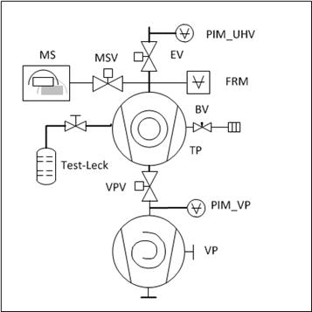
Mobile Equipment:
Pump cards
  Pumping is combination of Scroll pre-vacuum pump and Turbomolecular pump
    In comparison to old stations TP only 80 l/s since overall pump speed limited by the bellow connecting pump station with recipient.
  No special unit for leak detection
  RGA with SEV
    Quality check of components in terms of contaminations
    Performs leak detection
  Local control only one button ON / OFF
    Self check
    All properties in DOOCS

Slide 30
Thank you!

