Slide 1
High level services and feedbacks
1st Meeting of the European XFEL
Accelerator Consortium
Raimund Kammering, DESY
WP 28

Slide 2
Overview
Knowing what you need:
Needed high level software @ the E-XFEL
What we have:
Some examples: High level software @ the FLASH
Strategies:
Lessons learned: From the FLASH to the E-XFEL
Summary
Notes:
… will not talk about technical details of the architecture!

Slide 3
High level software @ the E-XFEL
Envisioned high level software
(control system CDR 2009)
Notes:
Estimate of needed HL services (also automation) for CS CDR 2009

Slide 4
High level software @ the E-XFEL
Status of the high level software
at the FLASH
Notes:
Evaluation of existing and missing HLS at FLASH 2011

Slide 5
High level software @ the E-XFEL
List of required
high level software for the E-XFEL
Courtesy of T. Limberg, S. Meykopff, J. Wilgen
Notes:
List assembled in the HLS working group of T. Limberg et al

Slide 6
High level software @ the E-XFEL
Many servers have been envisioned with many different names
It all boils down to a similar list of high level services one needs → roughly two dozens of services (or servers)
Overall architecture will be three layered with the high level services residing in the middle layer
All processes in need of bunch synchronized data will need to attach to the DAQ
we have APIs allowing easy access to this data
we gathered already a lot of experience using these APIs
Notes:
Estimate of needed HL services (also automation) for CS CDR 2009

Slide 7
High level software @ the E-XFEL
Courtesy of T. Limberg

Slide 8
High level software @ the E-XFEL
Java
Matlab
Middle layer / DAQ
C++
SASE
BLM
RF
RF
Orbit
Charge
Orbit
Energy
Energy
Machine
Notes:
… one can have many views of the picture, but finally we need to monitor and control …
… using languages like …
as an example -> FLASH FBs

Slide 9
High level software @ the FLASH
The slow RF FB – or slow longitudinal FB
beam based FB
arrival time, compression and energy → RF
5 monitors to 5 modules
directly attached to the DAQ
panels written in jddd
development started October 2011
status: running in standard operation

Slide 10
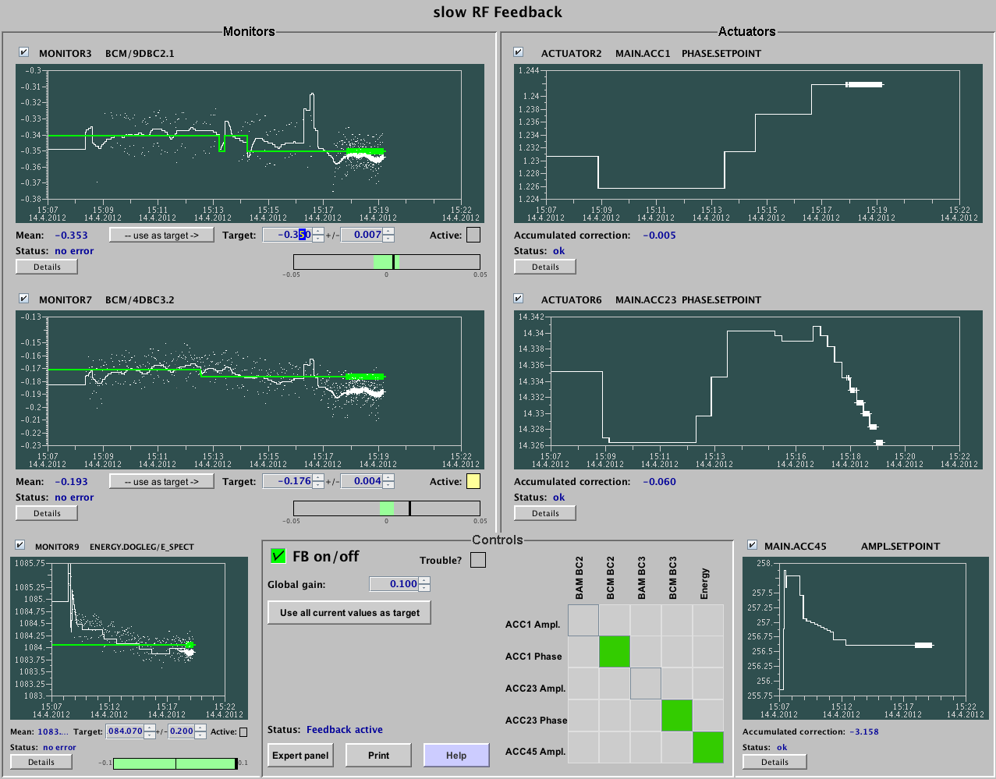
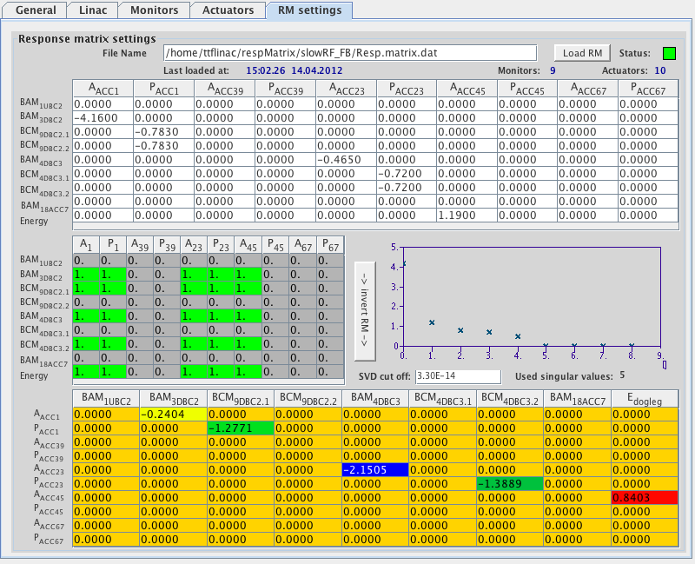
High level software @ the FLASH
Complex GUIs
using jddd

Slide 11
High level software @ the FLASH
The slow orbit FB
global beam based FB
able to use any BPM/steerer
uses external provided response matrix
not directly attached to the DAQ (but reading data from orbit server)
status: running but still expert operation

Slide 12
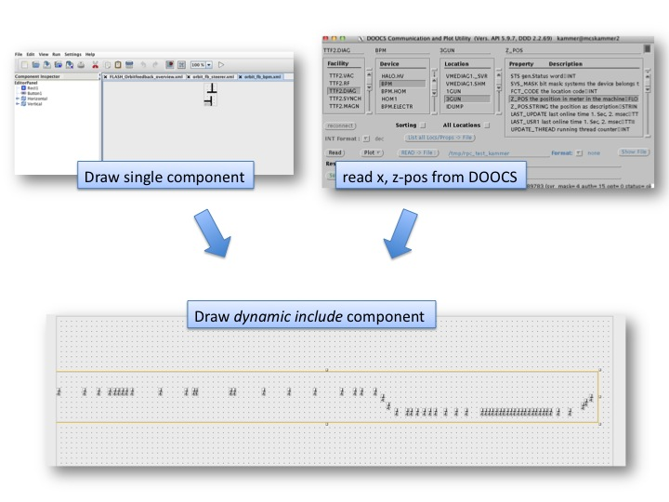
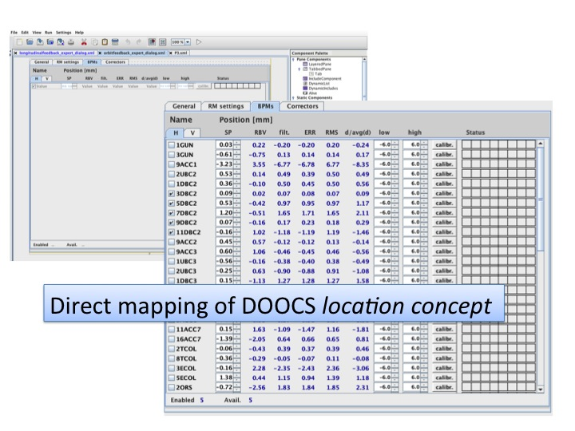
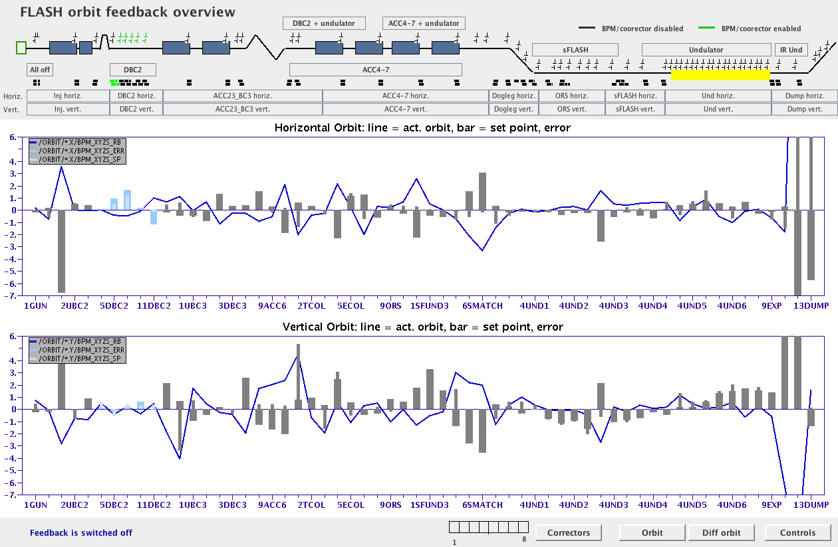
High level software @ the FLASH

Slide 13
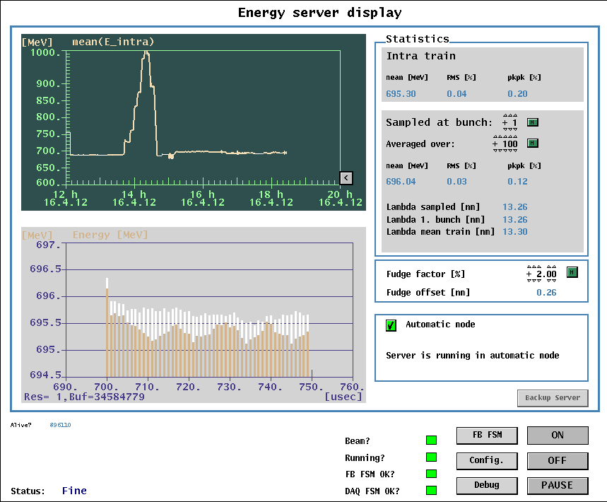
High level software @ the FLASH
The energy server
orbit based energy measurement
3 BPMs define angle + pos → ∆E
using DAQ (so called FBM library)
uses Matlab code to calculate beam transport
status: running in standard operation (since years!)

Slide 14
from the FLASH to the E-XFEL
well debugged APIs for bunch synchronized data exist (allowing also complex calculations)
DOOCS server + jddd panels allow to realize (nearly) any request in terms of UI
These HL servers nicely integrate in between the front-end and GUI layer
be prepared to have mismatch between theoretical model and machine
harden and extend exception handling later
commissioning is a large percentage of the work
have the needed software at needed point of time

Slide 15
Summary
we have the needed toolsets at the hand
existing HLS shows concepts work
jddd allows creation of (needed) complex user interfaces
verify performance and reliability of chosen concepts for high data rates!
Do not under estimate commissioning effort for HLS
the amount of work is high
have the concepts right and …
concentrate on realistic basis of services
FLASH II will cause much work load in terms of HLS

Slide 16
Thank you for your attention!

