Slide 1
The XFEL PBS control system as part of the homogenous software environment
Burkhard Heisen for WP76
1st Meeting of the European XFEL Accelerator Consortium
17 April 2012
Notes:
How to edit the title slide
Upper area: Title of your talk, max. 2 rows of the defined size (55 pt)
Lower area (subtitle): Conference/meeting/workshop, location, date,
your name and affiliation,
max. 4 rows of the defined size (32 pt)
Change the partner logos or add others in the last row.

Slide 2
Overview
What is WP76 doing in terms of software?
  Functional requirements
  Application programming interface (API) requirements
A homogenous in-house framework as the solution
  The big picture (Devices & Device-Servers)
  Devices (Communication, Configuration, Flow-Control)
  Device-Servers (Plugin-Mechanism, Parallelization)
  Controllers (Console, Composite Devices, GUI)

Slide 3


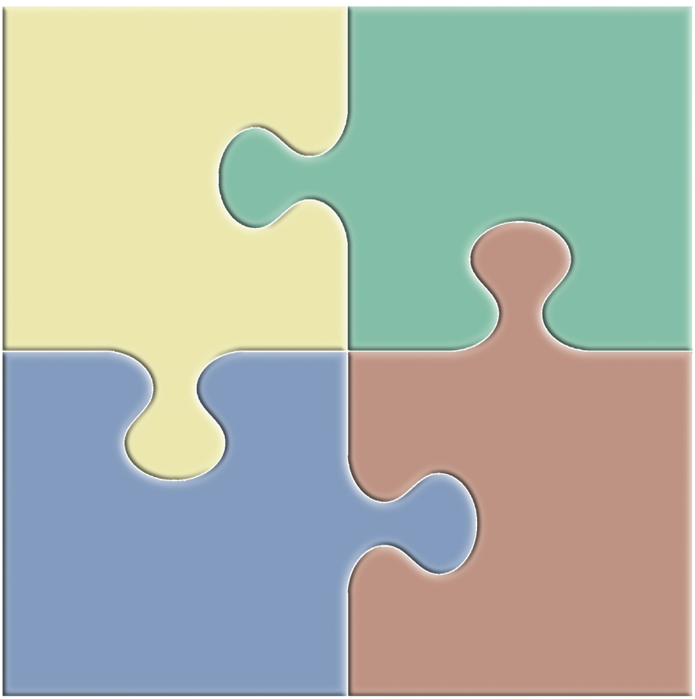
Functional requirements
A typical use case:
Control
drive hardware and complex experiments
monitor variables & trigger alarms
DAQ
data readout
online processing
quality monitoring (vetoing)
Sample Injector
allow some control & show hardware status
Accelerator
Undulator
Beam Transport
show online data whilst running
DM
storage of experiment & control data
data access, authentication authorization etc.
setup computation & show scientific results
DAQ
Control
SC
processing pipelines
distributed and GPU computing
specific algorithms (e.g. reconstruction)
DM
SC
Tight integration of applications
Notes:
In order to understand what software we need image a prospective user wanting to conduct an experiment at XFEL in 2015!
300 images per train = 1.000.000 images after 5 min 30 s
512 image per train = 1.000.000 images after 3 min 15 s
~ 4 TB dataset
Tuning means:
Visualize whether any sample get hit. Re-configure injector.
Start, stop acquisition etc…
Starting experiment means:
Get detector, injector etc. ready to go (control)
Prepare storage system for sinking data with 10 GB/s

Slide 4
API requirements
Enable communication and fast data exchange between applications of any category (Control, DAQ, Data Management, Scientific Computing)
Provide a unified interface to all equipment (hide details of hardware) and to all algorithms involved in data storage or processing
How can we achieve that?
Make integration/development of new components simple, intuitive and unambiguous
Hide the network, be location transparent
Simple deployment and maintenance including third-party resources

Slide 5
Standardization of applications
Proper standardization results in modular, scalable and homogeneous software
It must however be guaranteed that all needed flavors of specialized applications can be developed within the standardized frame
Identified components common to all software requirements
  memory/object management, configuration, logging, network services,
  error handling, data IO, python binding, databases, GUI,
  plug-in mechanism, cross-platform building and installation systems
  Decided to use C++ / Boost / Python / PyQt as core technologies
Do not re-invent the wheel, use high quality libraries under the hood
Boost (shared_ptr, any, msm, function, asio), PyQt, OpenMQ, Log4cpp, CImg, etc.

Slide 6


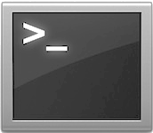
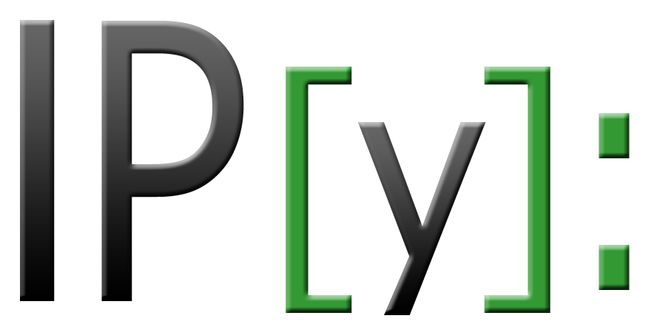
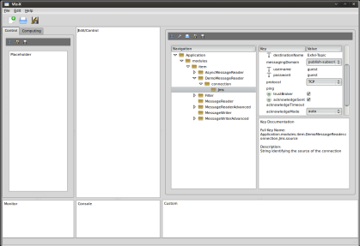
The big picture – Device-Servers run devices
Device Instance
Device-Server
Application
APD
HV
Pump
Store
Message Broker
(Event Loop)
Camera
Disk
Storage
Load
Cali-
brate1
Simulate
Sequ-
encer
Gateway
Cali-
brate2
Terminal
Master
Job
Control
Adapter
RDB
GUI

Slide 7
The big picture – Flexible device assignment
APD
HV
Pump
Store
Message Broker
(Event Loop)
Camera
Disk
Storage
Load
Cali-
brate1
Simulate
Sequ-
encer
Gateway
Cali-
brate2
Terminal
Master
Job
Control
Adapter
RDB
GUI

Slide 8
Definitions
What is a Device?
  Functionally: A logical unit that is individually configurable and controllable. Can be regarded as a small application performing a specific task (e.g. steering a motor or filtering an image)
  Technically: A class that (finally) inherits the device base class
  Architecturally: A device is typically compiled into a shared library (.so/.dll)
What is a Device-Server?
  Functionally: A generic executable that is able to load and run zero or more device instances (plug-in mechanism)
  Technically: A class equipped with functions for parsing configurations(command-line, file, DB), loading shared-libraries at runtime (devices), constructing and destructing device instances, etc.
  Architecturally: The device-server is compiled into an executable (main)

Slide 9
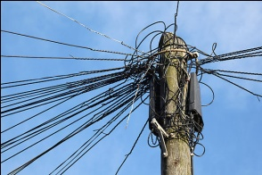

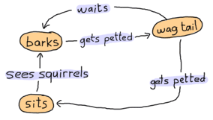
The Device – Three main ingredients
Communication
  Controller to Motor-Left: “Move 5 cm!”
  Compute-A to Compute-B: “I have an processed image available”
Configuration and Self-description
  Motor-Right: “Hello, I am Motor-Right and my default velocity is 2 m/s.”
  T1: “I am a PC-Layer device, will process exactly one train of frames.”
Flow-Control
  Slit: “If Motor-Right also stops moving, I can report the new gap size.”
  Compute-B: “Whilst I am processing, I can not read a new frame.”

Slide 10
Communication – Basic design issues
Separation between broker based (less frequent, smaller data size) and point-to-point (frequent, large data size) communication
  Broker based: Highly available full N x N communication between devices of any category (Control, SC, DAQ, DM) via broker
  Point-to-Point: Transient (run-time) establishment of direct (brokerless) connections between devices, high performance for huge data
Separation of transport layer implementation from communication API
  The broker based communication is currently run by a Message-Oriented-Middleware (MOM) based on the OpenMQ implementation of the Java messaging system (JMS) specification
  The point-to-point communication is currently implemented using the boost::asio library
  Transport layers can easily be extended (e.g. ZMQ) and the choice be given as configuration parameter at device-instance time

Slide 11
Broker based communication – “Chat Rooms”
APD
HV
Motor
Store
Message Broker
with two topics
Camera
Disk
Storage
Load
Cali-
brate1
Simulate
Sequ-
encer
Gateway
Cali-
brate2
Master
Terminal
Adapter
GUI
RDB

Slide 12
Broker based communication – High availability
APD
HV
Motor
Store
Clustered
Message Broker
Camera
Disk
Storage
Load
Cali-
brate1
Simulate
Sequ-
encer
Gateway
Cali-
brate2
Master
Terminal
Adapter
GUI
RDB

Slide 13
Broker based communication - API
Communication happens between ordinary (member, or free-standing) functions
Functions on distributed instances are identified by a pair of strings, the instanceId and the functionName
The instanceId uniquely identifies a (e.g. device-)instance connected to a specific topic of the broker
The functionName uniquely identifies an ordinary function registered under a given instanceId
Functions of any signature (currently up to 4 arguments) can be registered to be remotely callable
Registration can be done at runtime without extra tools
Function calls can be done cross-network, cross-operating-system and cross-language (currently, C++ and Python, Java will follow)
The language’s native data types are directly supported as arguments
A generic, fully recursive, key to any-value container is provided as a data-type for complex arguments

Slide 14
Broker based communication – Three Patterns
Signals & Slots
  SLOT ( function, [argTypes] )
  SIGNAL ( funcName, [argTypes] )
  connect ( signalInstanceId, signalFunc, slotInstanceId, slotFunc )
  emit ( signalFunc, [args] )
SLOT(onFoo, int, std::string);
void onFoo(const int& i, std::string& s) { }
SIGNAL(“foo”, int, std::string);
connect(“Device1”, “foo”, “Device2”, “onFoo”);
connect(“”, “foo”, “Device3”, “onGoo”);
connect(“”, “foo”, “Device4”, “onHoo”);
emit(“foo”, 42, “bar”);
SLOT(onGoo, int, std::string);
void onGoo(const int& i) { }
Device2
Notify
Device3
Device1
Notify
Emit
Device4
SLOT(onHoo, int, std::string);
void onHoo(const int& i, std::string& s) { }
Notify

Slide 15
Broker based communication - Patterns
call(“Device2”, “onFoo”, “bar”);
SLOT(onFoo, std::string);
void onFoo(const std::string& s) { }
Direct Call
  call ( instanceId, funcName, [args] )
Device1
Call
Notify
Device2
Request / Reply
  request ( instanceId, funcName, [reqArgs] ).timeout( msec ).receive( [repArgs] )
int number;
request(“Device2”, “onFoo”, 21).timeout(100).receive(number);
SLOT(onFoo, int);
void onFoo(const int& i) { reply( i + i ); }
Device1
Request
Notify
Device2
Notify
Reply

Slide 16
Communication: Event-Driven vs. Scheduled
Device
2
Event-driven communication
“Push Model”
A minimal set of information is passed
System is scalable (maintains performance)
Failure is harder to detect
Notify
Device
3
Device
1
Notify
Emit
Device
4
Notify
Device
2
Scheduled communication “Poll Model”
Direct feedback on request
Nodes may be spammed (DOS)
Growing systems loose performance
Typically, lots of extra traffic is generated
Device
3
Device
1
Request
Response
Device
4

Slide 17

Main ingredients of a distributed system
Communication
  Controller to Motor-Left: “Move 5 cm!”
  Compute-A to Compute-B: “I have an processed image available”
Configuration and Self-description
  Motor-Right: “Hello, I am Motor-Right and my default velocity is 2 m/s.”
  T1: “I am a PC-Layer device, will process exactly one train of frames.”
Flow-Control
  Slit: “If Motor-Right also stops moving, I can report the new gap size.”
  Compute-B: “Whilst I am processing, I can not read a new frame.”

Slide 18
Configuration – Basic design ideas
The framework provides a plug-able, industry-strength factory for object creation
As is possible with usual constructors, also factorized objects can be given parameters during instantiation time
The factory provides a mechanism for letting a class describe its expected initialization parameters in static context (i.e. any factorizable class can describe itself)
The description may also contain information about parameters being subject to re-configuration or even for reading-only whilst an instance is already existing.
The configuration mechanism supports the regular polymorphism and composition patterns in OOP (e.g. expected parameters can be inherited)
The Device class is a factory base class. It for example expects the mandatory parameter “instanceId” at initialization-time. Thus, any specific Device sub-class must be given an “instanceId” in the parameter list.

Slide 19
Configuration - API
Motor Device
static expectedParameters {
FLOAT_ELEMENT().key(“velocity”)
.description(“Velocity of the motor”)
.unitSymbol(“m/s”)
.assignmentOptional().defaultValue(0.3)
.maxInc(10)
.minInc(0.01)
.reconfigurable()
.allowedStates(“Idle”)
.commit();
INT32_ELEMENT().key(“currentPosition”)
.description = “Current position of the motor”
.readOnly()
[…]
SLOT_ELEMENT().key(“onMove”)
.description = “Trigger this slot to move the motor”
.allowedStates(“Idle”)
[…]
}
// Called once at initial construction
configure { […] }
// Called at each (re-)configuration request
onReconfigure { […] }
An input mask for any device can be automatically created before instantiation time
No need for device developers to validate any parameters. This is internally done taking the expectedParameters as white-list
We distinguish between attributes and commands (signals/slots), both can be expressed within the expected parameters function
Configuration descriptions are generated as XSD. Input configurations are typically generated from XML. Allows for command line, config-file, interactive or DB configuration

Slide 20
Main ingredients of a distributed system
Communication
  Controller to Motor-Left: “Move 5 cm!”
  Compute-A to Compute-B: “I have an processed image available”
Configuration and Self-description
  Motor-Right: “Hello, I am Motor-Right and my default velocity is 2 m/s.”
  T1: “I am a PC-Layer device, will process exactly one train of frames.”
Flow-Control
  Slit: “If Motor-Right also stops moving, I can report the new gap size.”
  Compute-B: “Whilst I am processing, I can not read a new frame.”

Slide 21
Flow-Control – Basic Concepts
Signal-Slot communication is asynchronous and event-driven
  - Any slot may be called at any time
  - Different slots may be even called concurrently
Sometimes we need some sequencing or synchronous behavior
  - E.g. The motor should move first to target position before I want to reconfigure the velocity
  - E.g. The experiment should only start if every device signals to be in “Ready” state
We use industry-standard finite state-machines from boost to define the possible logical flows any device
Event Driven
Signals & Slots
Request /
Response
Event Driven Asynchronous
Event Driven Synchronous
The state machine is an integral (however optional) part of the device
Asynchronous
Synchronous
The key idea is making the events into a state-machine remotely callable (i.e. make them slots!)
Scheduled Asynchronous
Scheduled Synchronous
Data
Polling
Periodic
services
Scheduled

Slide 22
Flow control – Finite state machines
Compute Device State Machine
AllOkState
reconfigure
ErrorState
ReadyState
reset
compute
pause
errorFound
RunningState
PausedState
compute
abort
endError
FinishedState
AbortedState
Source State | Event | Target State | Action | Guard
ReadyState | ReconfigureEvent | None | ReconfigureAction | IsValidReconfiguration
ReadyState | ComputeEvent | RunningState | ComputeAction | None
RunningState | PauseEvent | PausedState | PauseAction | None
RunningState | FinishedEvent | FinishedState | FinishAction | None
AllOkState
Source State | Event | Target State | Action | Guard
AllOkState | ErrorFoundEvent | ErrorState | ErrorFoundAction | none
ErrorState | EndErrorEvent | AllOkState | EndErrorAction | none
StateMachine

Slide 23


Summary – Life cycle of a Device
Write a class that derives from Device (or a pre-build state-machine)
Compile it into a shared library (say “libMyDevice.so”)
Select a running Device-Server or start a new one
Copy the “libMyDevice.so” to the plugins folder of the Device-Server
The Device-Server will emit a signal to the broker that a new Device-Class is available, it ships the expected parameters as read from static context of the MyDevice class
libMy
Device.so
plugins
signalNewDeviceClassAvailable( xsd )
GUI

Slide 24

Summary – Life cycle of a Device
Given the mask of possible parameters the user may fill a valid configuration and emit an instantiate signal to the broker
The configuration will be validated by the Device factory and if valid an instance of “MyDevice” will be created
The configure method of the device class will be called
The run method will be called which starts the state-machine and finally blocks by activating the event-loop
The device will asynchronously listen to allowed events (slots) guided by the internal state machine
factory: create(“MyDevice”, xml)
MyDevice1
plugins
signalInstantiate(“MyDevice”, xml)
Master
RDB
GUI

Slide 25
Conclusions
The distributed system is device-centric (not attribute-centric), devices inherently express functionality for communication, configuration and flow control
The provided services focus on solving general problems like data-flow, configuration, project-tracking, logging, parallelization, visualization
XFEL.EU software will be designed to allow simple integration of existing algorithm/packages
The ultimate goal is to provide a homogenous software landscape to allow fast and simple crosstalk between all computing enabled categories (Control, DAQ, Data Management and Scientific Computing)

Slide 26

Thank you for your kind attention.

Slide 27
Slides with more details

Slide 28
What I have not talked about
Details of data management (privacy, aggregation, hdf5, etc.)
User identification, role base locking systems (e.g. one controller at a time)
Software packaging & installation, dependency maintenance, code&build@home
Data provenance (i.e. record what has happened at each stage)

Slide 29
Pipelining of devices – Event driven data transport
Data flow is controlled in an event driven manner
signalDataAvailable
slotDataAvailable
Device 1
Device 2
[…]
Device 3
slotSendData
signalSendData
Allow for flowing (streaming) data on a per image basis to minimize memory footprint
Streaming modules can cache data on output channel
  Provides failover if next module does not finish correctly
  Provides fast re-execution of pipeline subsets
Have possibility of collecting data for applications that need all data at once
Have “adapter devices“ to integrate 3rd party applications “as is”

Slide 30
Parallelization as a design consequence
Device 2
Device 1
Device 2
Device 3
Device 2
Device level parallelization, thus transparent to developer
Devices on same machine: CPU threads
Devices on different machines: Distributed programming

Slide 31
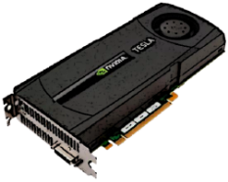
Image processing framework plans
Integrate building process for Nvidia CUDA into the framework
Image classes for both CPU and GPU
Implementation of standard processing routines
Provide templates for writing specific code on CPU or GPU
“1 pixel per GPU thread”
Fully functional also under Python
Notes:
Image – Image, Image x Vector

Slide 32
Communication API: Signals and Slots
Motor 1
offset
Slit
Motor 2
offset
onMove
gap
gap
Slit
onMove
moveLeft
moveRight
Motor 3
onMove
Motor 1
Motor 2
Motor 4
Motor 3
Motor 4
onMove
Signal: declares a command-name and the possible associated instructions
Connect: connects one signal of a specific source to one slot of a specific target
Slot: declares a command-receiver and the possibly receivable instructions
Emit: executes a previously declared command with a specific instruction

Slide 33

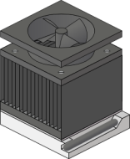
Performance = parallelism = e.g. GPU usage
33
Experimental data
Train n
n + 1
n + 2
1. Level: Nodes (Computers)
“1 train per node”
2. Level: CPUs
“1 frame per CPU thread”
3. Level: GPUs
“1 pixel per GPU thread”

Slide 34
Interesting devices: The kernel device
User DB
First device to be started in the system
Connected to one ore more DBs (user, cable, etc…)
Serves as a name server for all other device-servers registering into the system
Tracks all connects/disconnect requests:
a) allows for user-based access control on devices (e.g. locking mechanisms)
b) serves as watch-dog for lost connections, issues notifications/re-connects
c) can be queried to provide selected connect information (e.g. for graphical displays)
Knows the geographical location of each device-server (through cable DB)
Keeps history about all information of the (control-)system
May technically split into sub-devices for load balancing reasons
Kernel
Cable DB

Slide 35

Integrating Beckhoff into the control system
Motor1
Motor2
Pump1
“Motor1”, “signalPlcWrite” --- “ComDev”, “slotPlcWrite”
Com
Dev
“ComDev”, “signalPlcRead” --- “Motor1”, “slotPlcRead”
Gather/Scatter
Beckhoff PLCs can run several hardware “pieces”
Communication is limited to a single entry point (PLC server)
Modularity of different PLC setups should be reflected and easily implemented on C++ side
Tcp
PLC
Motor1
Motor2
Pump1

Slide 36
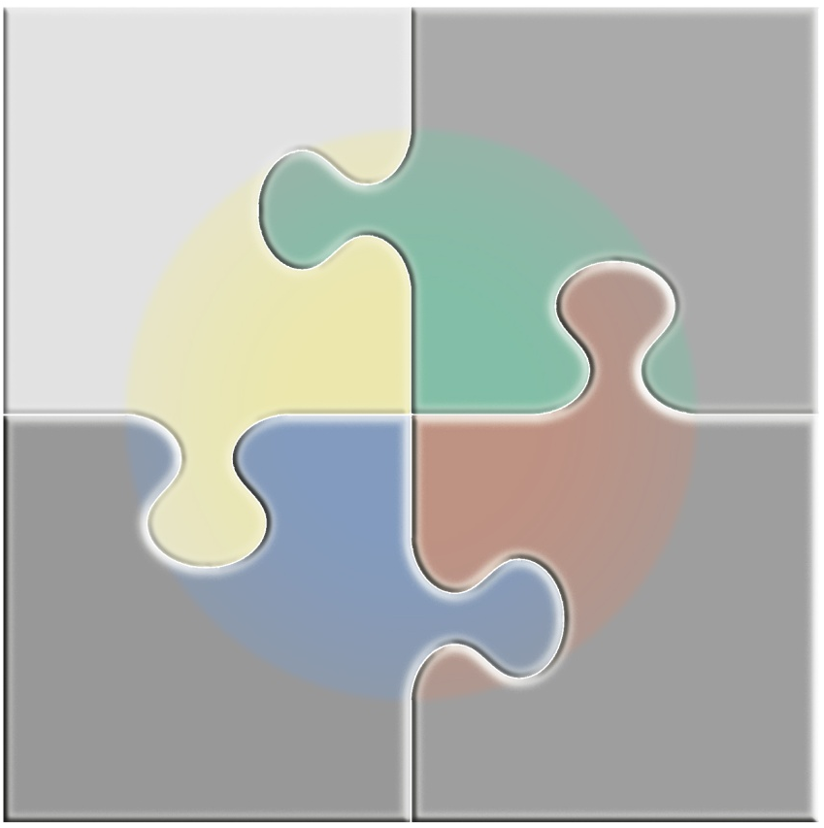
The Device – A standardized application
static expectedParameters:
Developer defines needed/available attributes (input/output channels, program parameters)
He decides when attributes can be used (startup only, interactively*) and how (read/write flags)
For each attribute/command the developer adds as much additional description as possible
static programFlow*:
Developer defines how the application can behave if used interactively
He defines states, events, actions, and a flow-table showing what happens when
configure:
This function is called only once at startup
Provides (validated) access to all above described attributes
run:
This function is called once after configure
Procedural: Write any code and it will execute here
Interactive: Start the programFlow which blocks the application here, custom code must be written above defined state entries/exits or actions
onStateA_Entry** (onStateA_Exit**):
Hook as defined in programFlow
onActionX**:
Hook as defined in programFlow

Slide 37
Current status of the toolkit
Factories
Type introspection
Configurations
Logging
Plugins
Network services
Messaging
Signal/slot
IO interfaces
FSM
Python integration
GUI
Databases
Image processing
Not implemented
Implemented

Slide 38
Flow-Control – Again, reusing a very successful concept
Structure program flow using Boost’s: MSM (meta-state-machine)
State Machine: the life cycle of a thing. It is made of states, transitions and processes incoming events.
State: a stage in the life cycle of a state machine. A state (like a submachine) can have an entry and exit behaviors
Event: an incident provoking (or not) a reaction of the state machine
Transition: a specification of how a state machine reacts to an event. It specifies a source state, the event triggering the transition, the target state (which will become the newly active state if the transition is triggered), guard and actions
Action: an operation executed during the triggering of the transition
Guard: a boolean operation being able to prevent the triggering of a transition which would otherwise fire
Transition Table: representation of a state machine. A state machine diagram is a graphical, but incomplete representation of the same model. A transition table, on the other hand, is a complete representation

