Slide 1
Personnel Interlock Systems
B. Racky, WP-38
Notes:
How to edit the title slide
Upper area: Title of your talk, max. 2 rows of the defined size (55 pt)
Lower area (subtitle): Conference/meeting/workshop, location, date, your name and affiliation, max. 4 rows of the defined size (32 pt)
Change the partner logos or add others in the last row.

Slide 2
Overview
The personnel interlock system is an active safety systems for the protection of persons at
beam operation (accelerator and experiments)
cavity operation (dark current)
magnet current operation
Subsystems: area search procedures, warning systems (acoustics, optics), procedures for controlled access, tunnel emergency off system…
High safety level signal paths in hardwired 60 V technology; reaction time ~ms
Connection to controls (accelerator, experiments): TINE interface; GUI
Notes:
Before you start editing the slides of your talk change to the Master Slide view: Menu button “View”, Master, Slide Master:
Edit the following 2 items in the 1st slide: 1) 1st row in the violet header: Delete the existent text and write the title of your talk into this text field 2) The 2 rows in the footer area: Delete the text and write the information regarding your talk (same as on the Title Slide) into this text field.
If you want to use more partner logos position them left beside the DESY logo in the footer area Close Master View

Slide 3
Accelerator interlock areas
22 interlock areas
42 interlock doors
5 interlocked lifts
XTD6
660m
L
L
XTD7
XSDU1
141m
XTD5
1
XS2
L
XHEXP1
1
XS4
200m
XTD3
267m
361m
XTD8
480m
1
1
L
XSIN
XSE
XS1
XTD1
L
XTIN2
XTIN1
XS3
XTL
1
XTD2
544m
XTD9
1050m
1050m
594m
1
L
L
1
L
1
1
L
1
L
XTD4
XSDU2
50m
1
300m
XTD10
L
1
XHM
220m
L
Media shafts or labyrinths
1: first door to set at search
L: last door to set at search
door can be opened if both neighbouring areas are searched

Slide 4
Beam operation modes
Nr. | Beam in interlocked tunnels | Beam dump
1 | XTIN1 | dump1 XSE
2 | XTIN2 | dump2 XSE
3 | XTL (RF operation cold modules) | commissioning dump XS1
4 | XTIN1 or 2, XTL | commissioning dump XS1
5 | XTIN1/2, XTL, XTD1-3-5-7 XTIN1/2, XTL, XTD1-3-5-7, XTD6 XTIN1/2, XTL, XTD1-3-5-7, XTD8 (+ XTD6) | main dump XSDU1
6 | XTIN1/2, XTL, XTD2-4-10 XTIN1/2, XTL, XTD2-4-10, XTD9 | main dump XSDU2
7 | Combinations of 5 and 6 | XSDU1 / 2
Notes:
Before you start editing the slides of your talk change to the Master Slide view: Menu button “View”, Master, Slide Master:
Edit the following 2 items in the 1st slide: 1) 1st row in the violet header: Delete the existent text and write the title of your talk into this text field 2) The 2 rows in the footer area: Delete the text and write the information regarding your talk (same as on the Title Slide) into this text field.
If you want to use more partner logos position them left beside the DESY logo in the footer area Close Master View

Slide 5
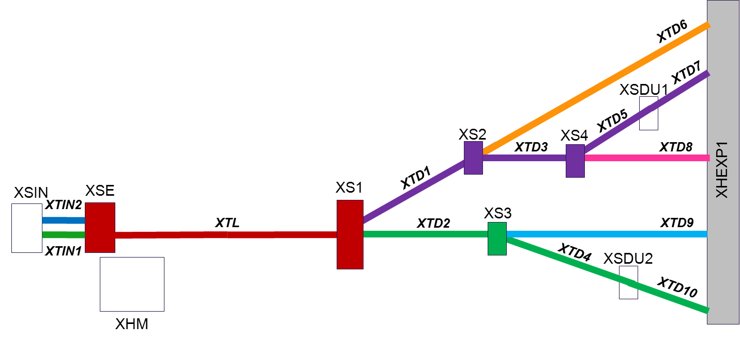
Beam operation modes
8 beam warning sections
If the beam operation permission of the PI is cancelled, the klystron modulatores are switched off
5 beam dumps
Notes:
Before you start editing the slides of your talk change to the Master Slide view: Menu button “View”, Master, Slide Master:
Edit the following 2 items in the 1st slide: 1) 1st row in the violet header: Delete the existent text and write the title of your talk into this text field 2) The 2 rows in the footer area: Delete the text and write the information regarding your talk (same as on the Title Slide) into this text field.
If you want to use more partner logos position them left beside the DESY logo in the footer area Close Master View

Slide 6
Access during partial beam operation
Required safety components in the personnel interlock:
Beamshutters and protecting absorbers
Beam shutters serve as shielding against bremsstrahlung but may not be hit by the beam
The absorbers protect the beamshutters, in case of steering the beam on an absorber a damage of the vacuum system might occur
Some bending magnets
Permanent dipole magnets
passive safety equipment in photon beamlines
Movable PD in TD2 beamline interlocked
Special safety precautions for controlled access procedures to searched areas have to be foreseen!

Slide 7
Interlocked accelerator safety components
Beamshutters, Absorbers (BS, ABS)
Magnets
Movable permanent magnet
BS & ABS TD6
Magnets to XSDU1 (XTD3)
Magnets to XSDU1
XTD6
BS & ABS TD8
Magnets to XSDU1 (XTD5)
Magnets to dump1 XSE
BS & ABS I1
Magnet combination to
dump XS1, XTD1, XTD2, (XTD20)
( DTLD, DTD1, MTD1, MDT2 (..))
XTD7
XSDU1
Magnets to dump2 XSE
BS & ABS I2
XTD5
XS2
XS4
BS & ABS TD1
XTD3
XTD8
XTD1
XHEXP1
XSIN
XSE
XS1
XTIN2
XTIN1
XS3
XTL
XTD2
XTD9
XTD4
XSDU2
BS & ABS TD9
Magnets to XSDU2 (XTD4)
XTD10
XHM
BS & ABS TD2
PTD2 (movable permanent magnet for TD2 beamline )
Magnets to XSDU2

Slide 8
Magnets in beam distribution XS1
Safe magnet status for access:
Access to | Beam in | DTLD | DTD1 | MTD1 | MTD2 | PTD2
XTD1 | TLD, T2 |  | off | off
XTD2 | TLD, T1 |  | on! |  | off | in
XTD1, 2 | TLD | on! | off | off | off | in
XTD1
MTD1
XTL
[KTLD]
DTLD
[KTD1]
DTD1
MTD2
PTD2
XTD2
[MTLD]
Dump XS1
8

Slide 9
Signal exchange PI / accelerator components
PI deliveres (and cancels) operation permission signals for
klystron modulators XTIN, XTL
Gun, Cold structure,TDS
steering beamshutters/absorbers
I1,I2, TD1,TD2, TD6, TD8, TD9
TD1/2 distribution magnets
DTD1, DTD2, MTD2
Motion of permanent magnet PTD2
Power supplies of all magnets (Magnetstromfreigabe)
Safety signals as input for the PI
Positions of beamshutters and absorbers
Bending magnets
to the 5 dumps on
to XTD3, XTD5, XTD4 on
Distribution magnets
DTLD,DTD1on; DTD1,MTD1,MTD2 off
Permanent magnet PTD2 in TD2 beamline
Notes:
Before you start editing the slides of your talk change to the Master Slide view: Menu button “View”, Master, Slide Master:
Edit the following 2 items in the 1st slide: 1) 1st row in the violet header: Delete the existent text and write the title of your talk into this text field 2) The 2 rows in the footer area: Delete the text and write the information regarding your talk (same as on the Title Slide) into this text field.
If you want to use more partner logos position them left beside the DESY logo in the footer area Close Master View

Slide 10
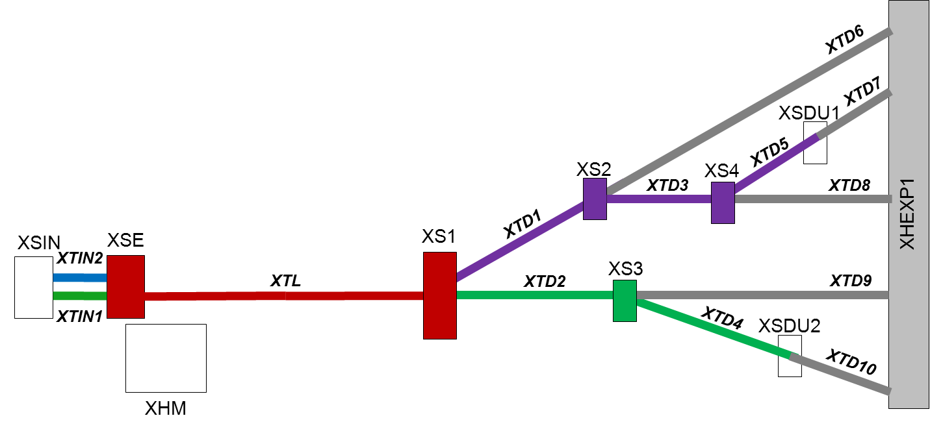
Magnet current operation modes
operation clearance for magnet power supplies
5 operational sections defined
controlled access for experts during operation

Slide 11
Interfaces with machine/equipment protection system?
Interface personnel interlock / klystron interlocks
Soft shutdown by klystron interlock (µs) before hard shutdown by personnel interlock (ms) occurs
Steering of beamshutters by personnel interlock; input for EPS foreseen to close beamshutters if needed
?
Tasks not provided by the personnel interlock
Survey of the beam power hitting the dumps
Avoid missteering of the beam
?

Slide 12
The End
Thank you for your attention

Slide 13
Doors for controlled access
12 accelerator interlock doors are equipped for Controlled Access (camera, intercom,…)
CA
CA
CA
CA
CA
CA
CA
CA
CA
CA
CA
CA
Notes:
Before you start editing the slides of your talk change to the Master Slide view: Menu button “View”, Master, Slide Master:
Edit the following 2 items in the 1st slide: 1) 1st row in the violet header: Delete the existent text and write the title of your talk into this text field 2) The 2 rows in the footer area: Delete the text and write the information regarding your talk (same as on the Title Slide) into this text field.
If you want to use more partner logos position them left beside the DESY logo in the footer area Close Master View

Slide 14
Controlled Access
Problem: Controlled access to searched accelerator interlock areas during beam operation other sections
Standard safety equipment for entering a searched interlock area: interlock keys (1 per person entering)
Usually all interlock keys of a DESY- accelerator stop any beam operation of the accelerator
Danger of entering an area with the wrong key!
Solution:
Measure1 (technical): matching locks near the interlock doors to enable the access procedure
Measure2 (organisational): only 1 person may enter per access procedure (observed by control room staff)
Measure3 (technical): if any access key is missing no new beam warning is possible in the entire accelerator complex

Slide 15
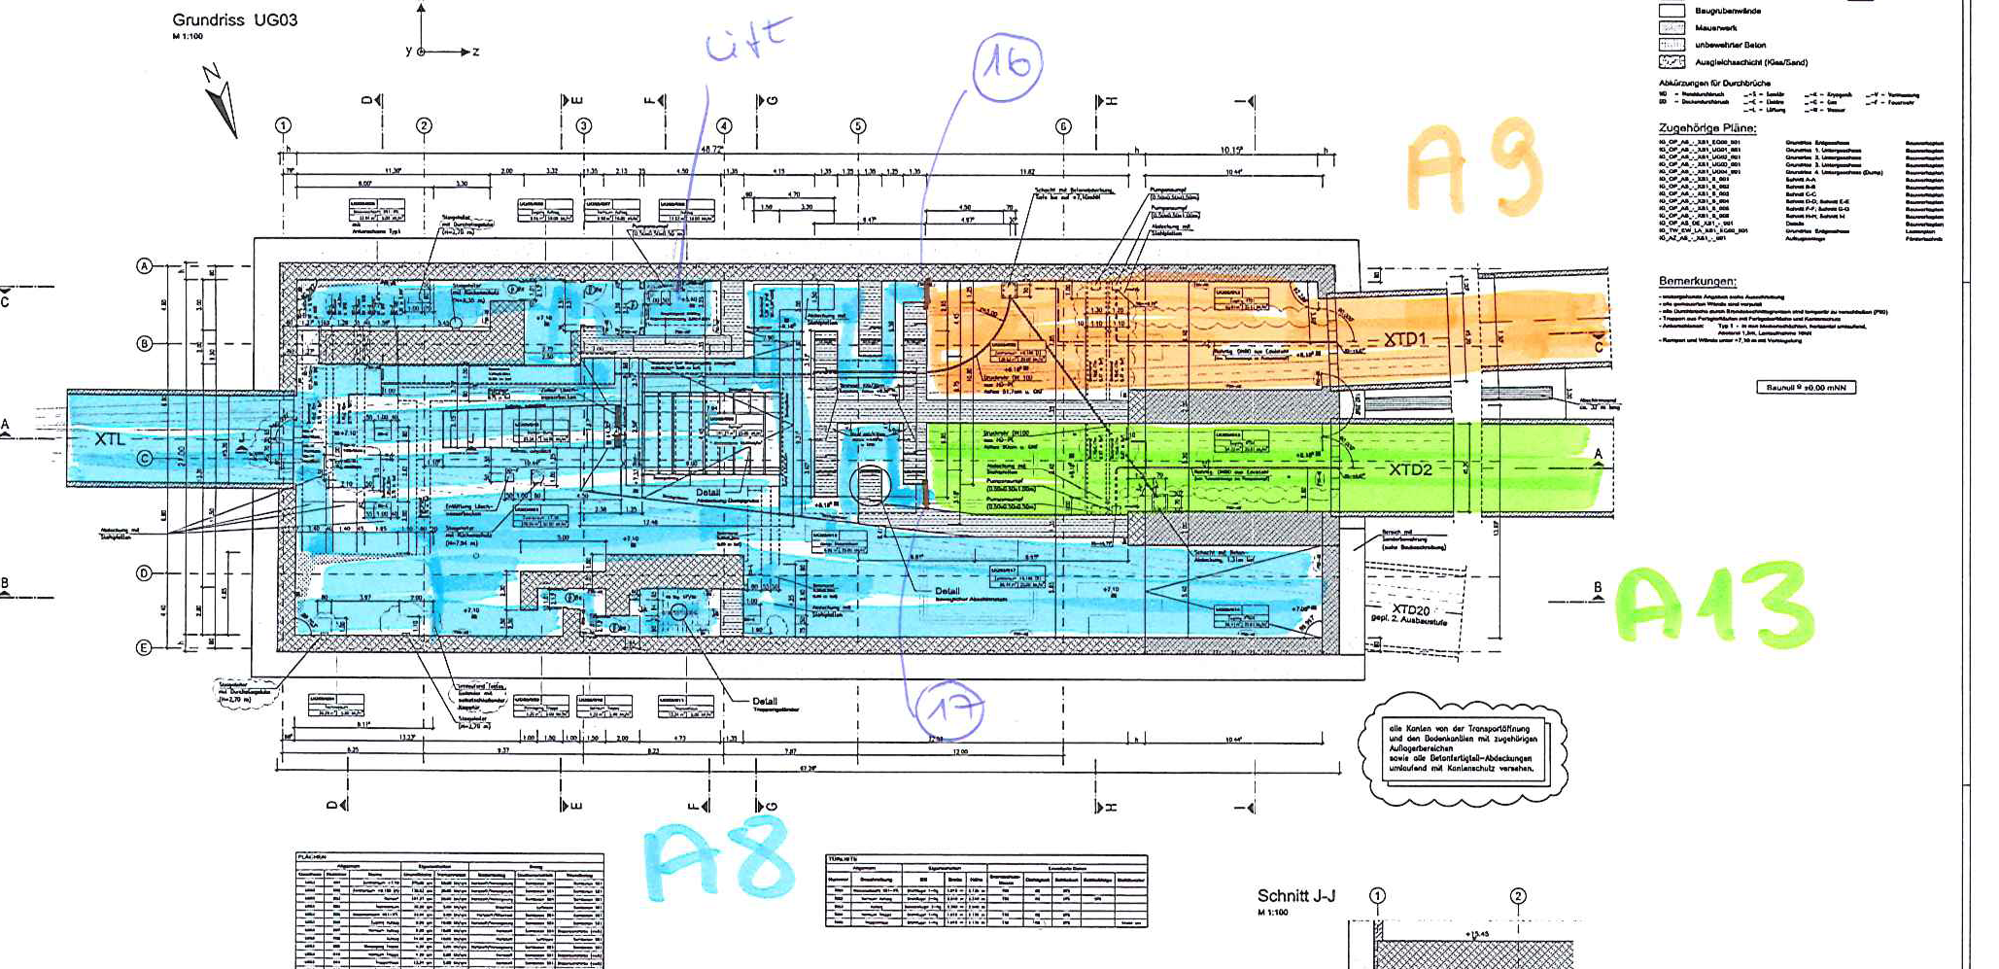
Interlock areas at XS1

Slide 16
List of RF stations
XTIN1 (same for XTIN2)
No. | purpose | structure | position of modulator | operation modes at open tunnel | responsible
1 | gun mod. | warm | XHM | absorber | WP1/ MHFp
1 | sc module | cold | XHM | abs. /warm module | WP1/ MHFp
1 | ACC3H1 | cold | XTIN UG03 | (absorber) | WP /MIN
1 | TDS | warm | XSE UG05 | - | WP /MSK
XTL
No. | purpose | structure | position of modulator | operation modes at open tunnel | responsible
25 | sc modules | cold | XHM | abs. /warm module | WP1/ MHFp
2 | TDS | warm | XSE UG05 | - | WP / MSK

Slide 17
HF-Interlock; Geometrie im XTL
Personnel interlock
systems klystrons
HV Modulator 1
XHM
Preamp. / RF filter
Klystron 1
XTL, XTIN
Shortcut plates with contacts for the personnel interlock (2 contacts on each plate)
Module 1
(8 cavities)
Module 2
(8 cavities)
Module 3
(8 cavities)
Module 4
(8 cavities)
Absorber 1
Absorber 2
Notes:
Before you start editing the slides of your talk change to the Master Slide view: Menu button “View”, Master, Slide Master:
Edit the following 2 items in the 1st slide: 1) 1st row in the violet header: Delete the existent text and write the title of your talk into this text field 2) The 2 rows in the footer area: Delete the text and write the information regarding your talk (same as on the Title Slide) into this text field.
If you want to use more partner logos position them left beside the DESY logo in the footer area Close Master View

Slide 18
Klystron operation modes
Operation modes
(1) tunnel open
RF absorbers
(2) tunnel open
RF warm modules
(3) tunnel closed
RF cold modules
Klystron interlocks
Contacts short cut plate 1
Contacts short cut plate 2
Cryo: sc modules warm
LLRF: RF filter inserted
Key mode: linac warm
XTL / XTIN beam permission
Emergency off
Feedback „modulator Off“
&
>=1
&
&
HV klystron modulator

