Slide 1
European XFEL Photon Vacuum System
Martin Dommach (WP-73)
Notes:
How to edit the title slide
Upper area: Title of your talk, max. 2 rows of the defined size (55 pt)
Lower area (subtitle): Conference/meeting/workshop, location, date,
your name and affiliation,
max. 4 rows of the defined size (32 pt)
Change the partner logos or add others in the last row.

Slide 2
Overview
More than 3 km of beam transport have to be installed
Installation starts in fall 2013
Installation order: SASE3, SASE1, SASE2
roughly 9 months installation time per beamline
Notes:
Start with SASE3 because the tunnel XTD10 will be the first which is ready for installation
Overlapping installation

Slide 3
Mechanical design
All main vacuum parts made of stainless steel
Standard length for vacuum pipes will be 6m
Only use of CF-flanges with copper gaskets
Hydrocarbon free, particle free areas ±30m around mirrors
All-metal valves between air and vacuum (roughing and venting valves)
Viton sealed valves to separate different vacuum sections
75l/s Ion pumps (star cell type) roughly every 20m and bigger ones on optical and diagnostics elements
For details: UHV Guidelines for X-Ray Beam Transport Systems (TN-2011-004, http://xfel.eu/documents/technical_documents/)
Notes:
Detail see UHV-Guidelines

Slide 4
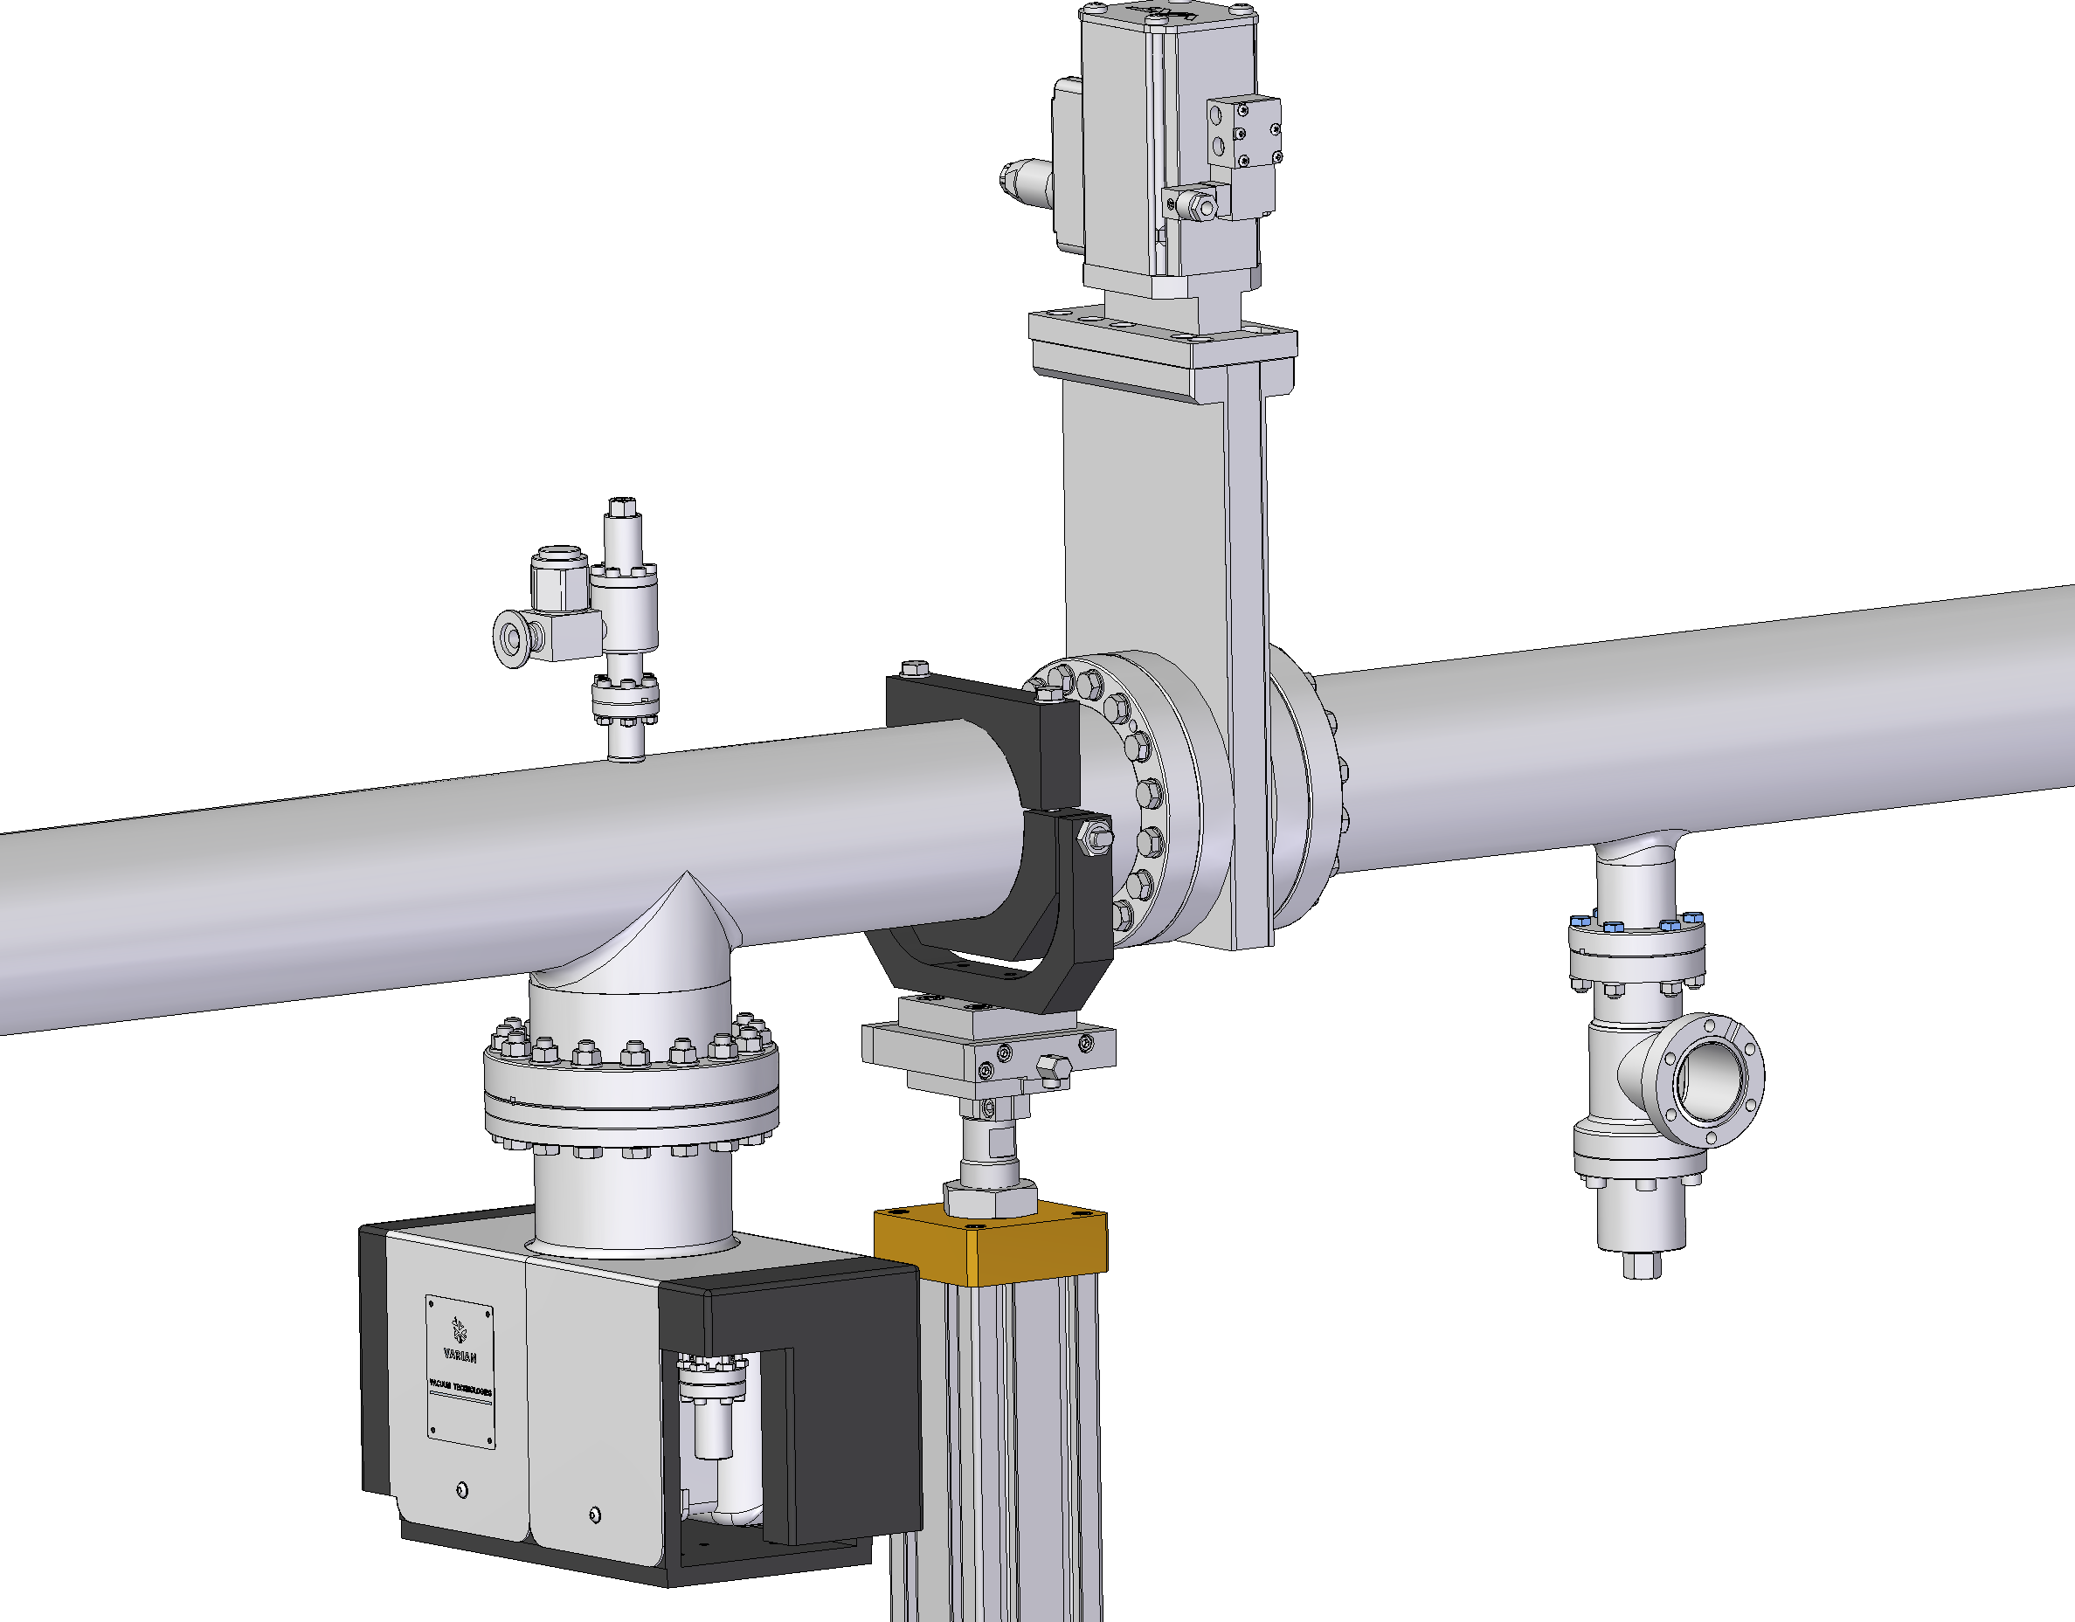
Main components
Connection to optical or diagnostic elements
DN100 gate valve
DN16 all metal venting valve
with particle filter
DN100 vacuum pipe
DN40 all-metal rough pumping valve
75l/s ion pump
tube support
Notes:
Main components for beam transport
Long tubes

Slide 5
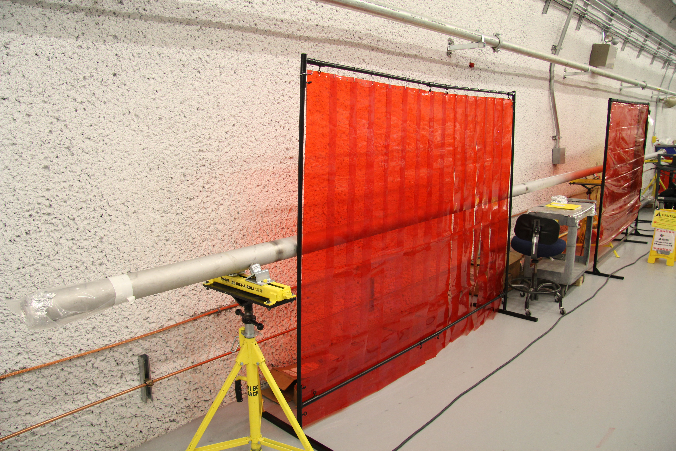
Orbital welding
For long distances, at SASE2 several 100m
18m sections made of three 6m prefabricated parts
Purchase pipes cleaned and sealed in foils, ready for orbital welding in the tunnel
Good experience at LCLS
  Used for beam transport
  between near and far hall
  Less potential leaks
  Less installation work
  Less expensive
LCLS, May 2011

Slide 6
Failure analysis - assumptions
Example: straight section of 180m
Stainless steel tube, inner diameter 100mm (DN100)
CF-flanges, metal gaskets
Outgassing assumption 1.3 x 10⁻¹⁰ (value taken from LCLS)
10 ion pumps 75l/s, one pump every 18m
At 10⁻⁶mbar the pump lifetime will be 80000h (≈ 9years)
What happens if one or more pumps break?
Calculations made with CalcVac software (M. Hoffmann, M. Seidel, DESY)

Slide 7
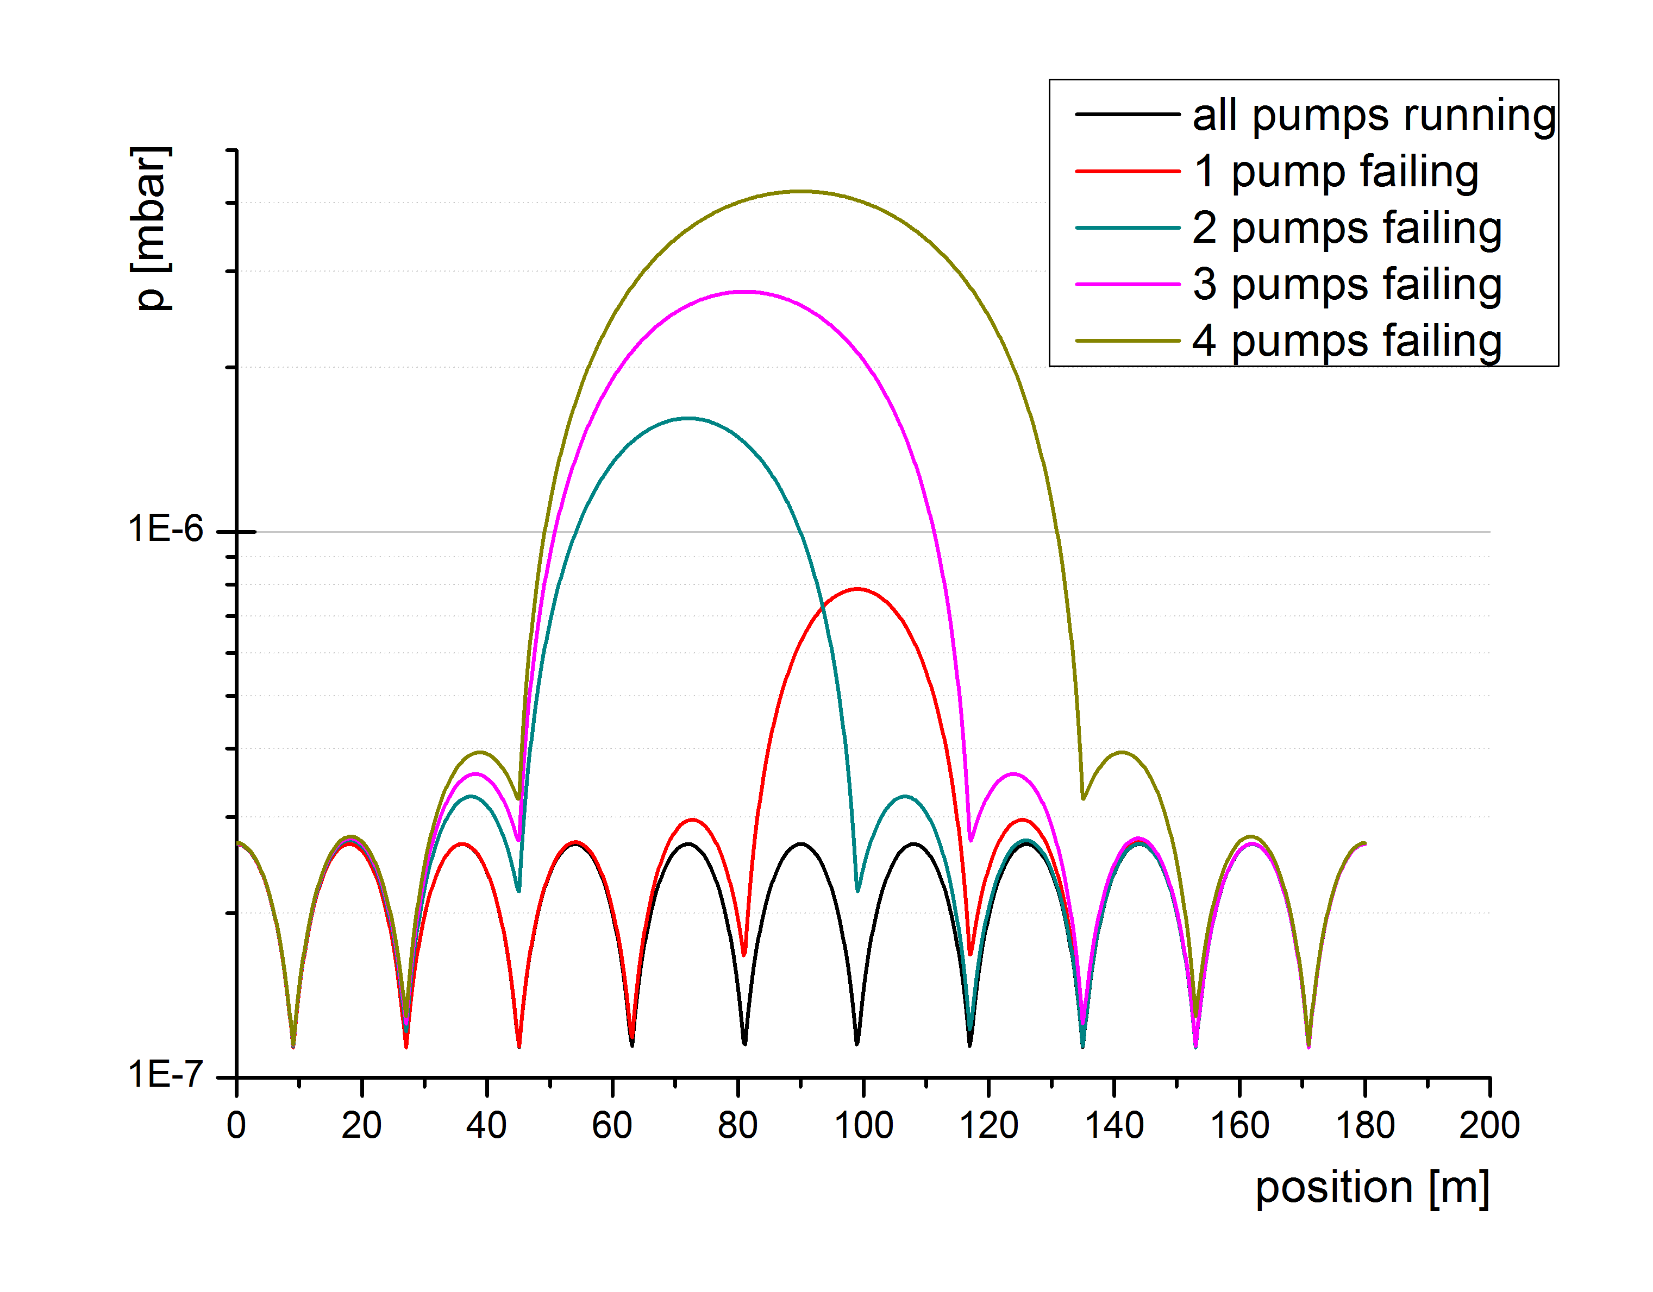
Failure analysis – pressure profiles

Slide 8
Failure analysis - summary
Worst case included: failure of four pumps
Only the pumps adjacent to the failed pumps experience an increase in pressure, but the pressure will be still in the 10⁻⁷ mbar range
They can be used like this at least for a few months
Exchange of the faulty pumps can be shifted to next maintenance period
Mobile pumping stations can be connected to the beam pipe as a backup
Assumptions on achievable end pressure will be tested in HERA south lab

Slide 9
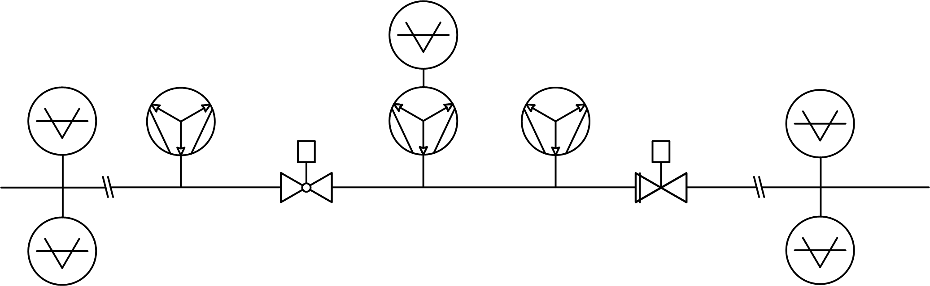
Interface to WP-19
WP-19
WP-73
Getter pump and
Vacuum gauge WP-19
Redundant pair of cold cathode vacuum sensors
≈100m away from safety valve
Redundant pair of cold cathode vacuum sensors
≈100m away from safety valve
Getter Pump WP-19
V0 all-metal gate valve
Operated by WP-73
Two sets of limit switches
Getter Pump WP-73
DN40 Fast Safety Valve
Fast safety valve controller
Notes:
Line represents the vacuum pipe
V0 – valve as a hand over position
Interface to instruments have to be defined

Slide 10
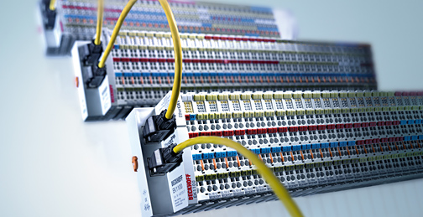
Vacuum control system
Based on Beckhoff PLC:
  EtherCAT technology
  Ring topology
  Modular system, easy to extend
Racks in the tunnels every 80m, provided by WP-76:
PLC software & user interface by WP-76
Interfaces to
  Scientific instruments,
  Machine vacuum system,
  Machine protection system

Slide 11
Thank you for your
attention!

