Slide 1
Overview European XFEL
X-ray Systems
Hamburg, 16 April 2012
Thomas Tschentscher, European XFEL
thomas.tschentscher@xfel.eu

Slide 2
FELs reach beyond synchrotron radiation
Investigation of dynamic processes
  ultrafast, pico- & femtosecond phenomena govern many physical, chemical and biological processes
Investigation of nano-scale, disordered, non-crystalline matter
  geometrical structures of particles and bio-systems
  properties of matter at un-common length scales
Investigation of highly excited matter
  x-ray excitation and non-linear phenomena
  measurement of extremely short-living states
Often combination of these techniques are required
⇒ X-Ray Free-Electron Laser sources open new scientific possibilities

Slide 3
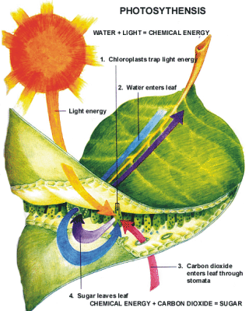
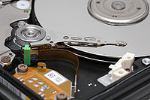
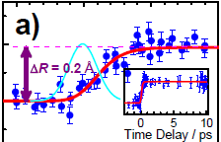
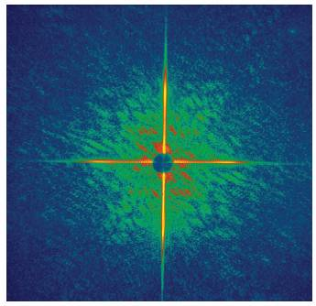

Benefit of large infrastructures
Nuclear pore
complex
X-rays & neutrons are ideal probes to deepen our understanding
Large x-ray (storage rings & FELs) and neutron user infrastructures
Notes:
How large x-ray infrastructures can contribute: Energy : 1. deepen understanding of fundamental processes; 2. develop new media
Health : discover structures – understand function – develop drugs
New materials : study complex materials - discover new functions – create new materials

Slide 4
Where European XFEL excels
Super-conducting electron accelerator
  high average brilliance, higher stability, distribution to many instruments
X-ray beam transport
  extraordinary mirrors to transport coherent beam
  extreme power optics (~2 kW)
  innovative optics (thin-crystal diamond monochromator, beam-splitter)
Scientific instruments
  provide state-of-the art instrumentation offering new science
  equipped for high rep. rate
Instrumentation
  suite of ancillary instrumentation required for FEL experiments running at high rep. rate
    lasers,
    sample exchange & injection schemes,
    area & line detectors,
    data aquisition,
  user facility mode

Slide 5
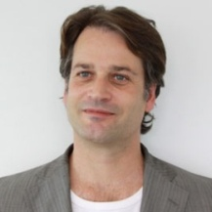
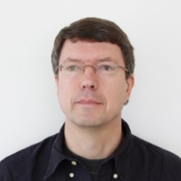
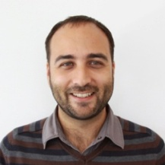
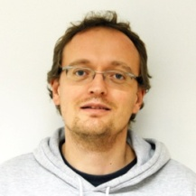
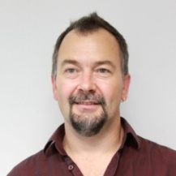
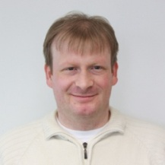
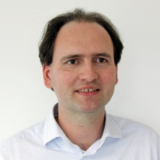
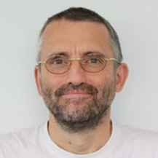
Scientific instruments, optical lasers, detectors, sample environment and data acquisition
Femtosecond X-ray Experiments (FXE)
  Time-resolved investigations of the dynamics of solids and liquids
Small Quantum Systems (SQS)
  Investigation of atoms, ions, molecules and clusters in intense fields & non-linear phenomena
Single Particles and Biomolecules (SPB)
  Structure determination of single particles: atomic clusters, bio-molecules, virus particles, cells.
Materials Imaging & Dynamics (MID)
  Structure determination of nano-devices and dynamics at the nanoscale.
High Energy Density Matter (HED)
Spectroscopy and Coherent Scattering (SCS)
Optical lasers
  MHz repetition delivery of mJ-fs class pulses
Detector development
  MHz frame rates, high dyn. range, low noise
Samle environment
  MHz sample replenishment
Data acquisition
  MHz data collection, transfer & storage
Christian Bressler
Michael Meyer
Adrian Mancuso
Anders Madsen
Max Lederer
Markus Kuster
Joachim Schulz
Chris Youngman

Slide 6
Femtosecond X-ray Experiments – FXE
Ultrafast dynamics of liquids and solid matter
Combination of spectroscopic & scattering techniques
  Collect scattering in forward direction (energies up to ~20 keV, large q)
  Spectrometer for XES & RIXS type measurements
  Very precise timing (diagnostics & synchronization)
<60°
Monochromator
(10⁻⁴)
Focusing optics
(1-100 µm)
Sample stage
w. environments

Slide 7
Single Particle & Biomolecule – SPB
Coherent diffraction imaging from single particles
  reproducible samples: molecules
  non-reproducible samples: cells, molecular assemblies
  nano-crystals
  2 focii to match sample size and flux requirements
  placing samples in/outside focal plane → wavefront issues
  place detector at different distances
  UHV setup
  Diagnostics: pulse & sample properties
0.2 - 10 m
Foc. optics
(~1 µm)
Foc. optics
(~0.1 µm)
Sample delivery
(jets, injector, ..)

Slide 8
Materials Imaging & Dynamics – MID
Coherent diffraction imaging from nano-structured samples
X-ray photon correlation spectroscopy of nanoscale dynamics
Use of 20-40 keV coherent x-rays for imaging applications
Use of very hard radiation (> 80 keV)
  possibility to place detector at different distance and up to large angles
  additional 2m diffractometer for Bragg spots and WAXS
  detector pixel size (MHz: 200 µm, 10 Hz: 50 µm)
10 m
~40-50°
Monochromator
(10⁻⁴, 10⁻⁵)
Focusing optics
(1-100 µm)
Sample stage
w. environments
Split-Delay

Slide 9
High Energy Density Science – HED
Ultrafast dynamics of highly excited matter (Solids, WDM, HDM)
Combinations of scattering, diffraction and spectroscopy techniques
  use of various pump sources to excite samples (OL, XL, ext. fields)
  additional laser systems foreseen (TW-Hz class, possibly beyond)
  high flexibility of experimental geometry, but under vacuum conditions
  special needs to accommodate high energy laser
  repetition rate for HE laser experiments reduced to Hz level
Monochromator
(10⁻⁴)
Focusing
optics
(1-100 µm)
Sample stage
w. environments

Slide 10
Small Quantum Systems – SQS
Ultrafast dynamics of atoms, ions & clusters
Combination of spectroscopic & coherent scattering techniques
  2 chambers for UHV (particle spec.) & HV (scattering) setups
  Electron & ion spectrometers (ToF, ReMi, VMI, etc.)
  Pixel detector
  Very precise timing (diagnostics & synchronization)
Monochromator
(10⁻³ - 10⁻⁴)
Focusing optics
(1-10 µm)
AQS
(Atoms, small
mol., UHV setup)
NQS
(Nano-sized
particles)

Slide 11
Spectroscopy and Coherent Scattering – SCS
Ultrafast dynamics of complex solids
  strongly correlated systems
  magnetic structures
Combination of high resolution inelastic spectroscopy & coherent scattering techniques
  use one beam delivery system and sample stage
  use detector at different distance and up to large angles
  sample damage is an issue for resonant absorption (magnetic studies)
~140°
~3 m
Sample stage
w. environments
Split-Delay
Monochromator
Focusing optics

Slide 12
… and how to build this

Slide 13
European XFEL – Basic parameters (2011)
Electron beam
  Electron energy 10.5 – 17.5 GeV
  Bunch charge 0.02 – 1 nC
  Norm. Emittance 0.3 – 1.0 µm rad
  Bunch length 7 – 180 fs
Photon beam
  Photon energy 0.26 – 24 keV
  Pulse energy 1 – 4000 µJ
  Peak brilliance 0.1 – 10 ×10³³
  Pulse duration 2 – 107 fs
Instrumentation
  FELs 2 for hard x-ray, 1 for soft x-ray, (2 further slots)
  gap tunable
  Instruments 4 for hard X-ray, 2 for soft x-ray, (6 – 9 further slots)
  Lasers 3 systems (4.5 MHz, fs/mJ), 1 system (100 TW)
  Sample solids (fast manipulators), liquid & aerosol jets, gases

Slide 14
New x-ray design
2 hard x-ray undulators and beam transport with 4 instruments
1 soft x-ray undulators and beam transport with 2 instruments
 | Center | Side | Comments
SASE 1 | SPB | FXE
SASE 2 | MID | HED | Enable propagation of 25-36 keV radiation; possibly even 60-100 keV
SASE 3 | SQS | SCS | Center: Pink beam Side: Monochromatic beam

Slide 15
Undulator ħω ranges
Carbon K-edge:
284 eV
Nitrogen K-edge:
410 eV
Oxygen K-edge:
543 eV
12.4 keV
20 keV
SASE 3
(68 mm)
SASE 1/2
(40 mm)
17.5 GeV
0.73 – >3 keV
6.4 – >25 keV
Electron energy sets
14.0 GeV
0.47 – ~3 keV
4.1 – >20 keV
10.5 GeV
0.26 – ~2 keV
2.3 – >15 keV
200 eV
1 keV
10 keV
updated layout, Feb 2011

Slide 16
Some examples for status
71 Undulators Pre-series
72 FEL concepts Development of operation & extension schemes
73 X-ray optics Conceptual Design Report
74 X-ray diagnostics Conceptual Design Report on-going
75 Detectors All 3 projects entered prototype phase
76 DAQ/Data CDR / First hardware / lots of interfaces now
78 Lasers ‚CDR‘ / prototyping on-going
79 Sample environm. Selection on-going
81 FXE instrument CDR, preparing TDR
82 HED instrument concepts exist, search for lead scientist
83 SPB instrument CDR, preparing TDR
84 MID instrument CDR, preparing TDR
85 SQS instrument CDR, preparing TDR
86 SCS instrument concepts exist, search for lead scientist

Slide 17
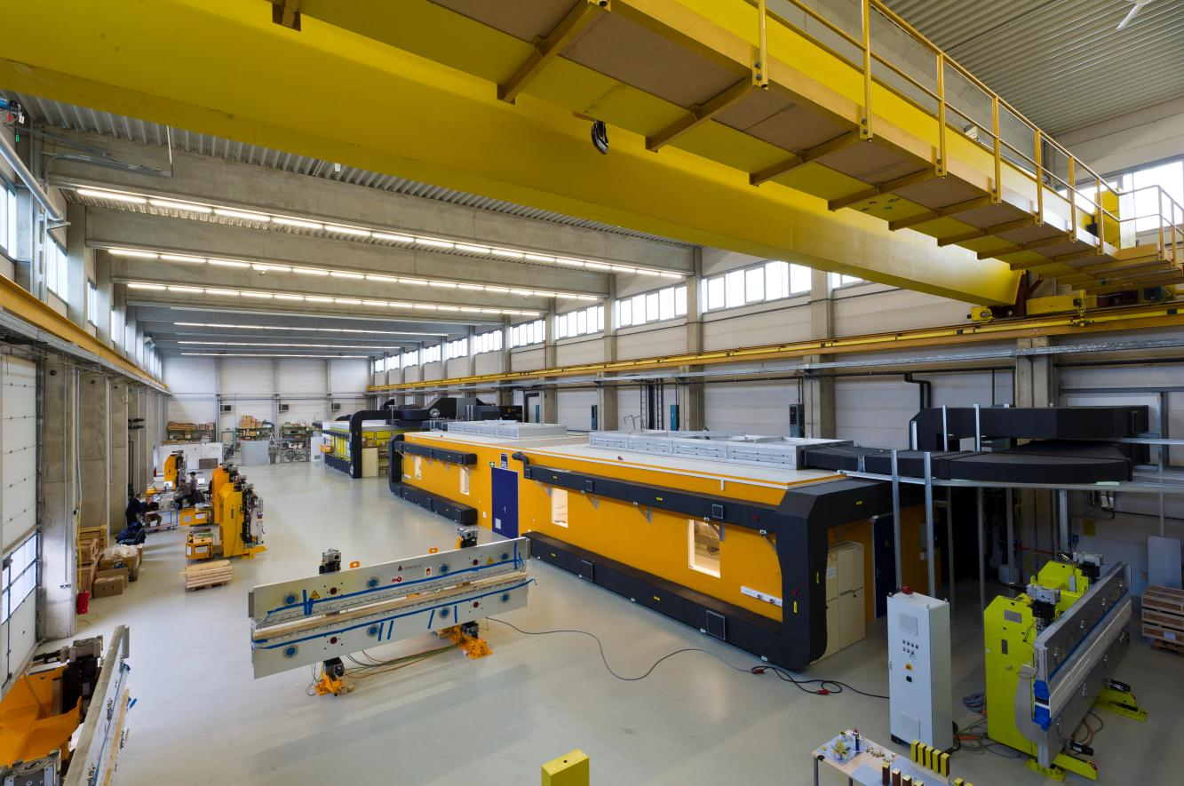
Magnetic measurements laboratories

Slide 18
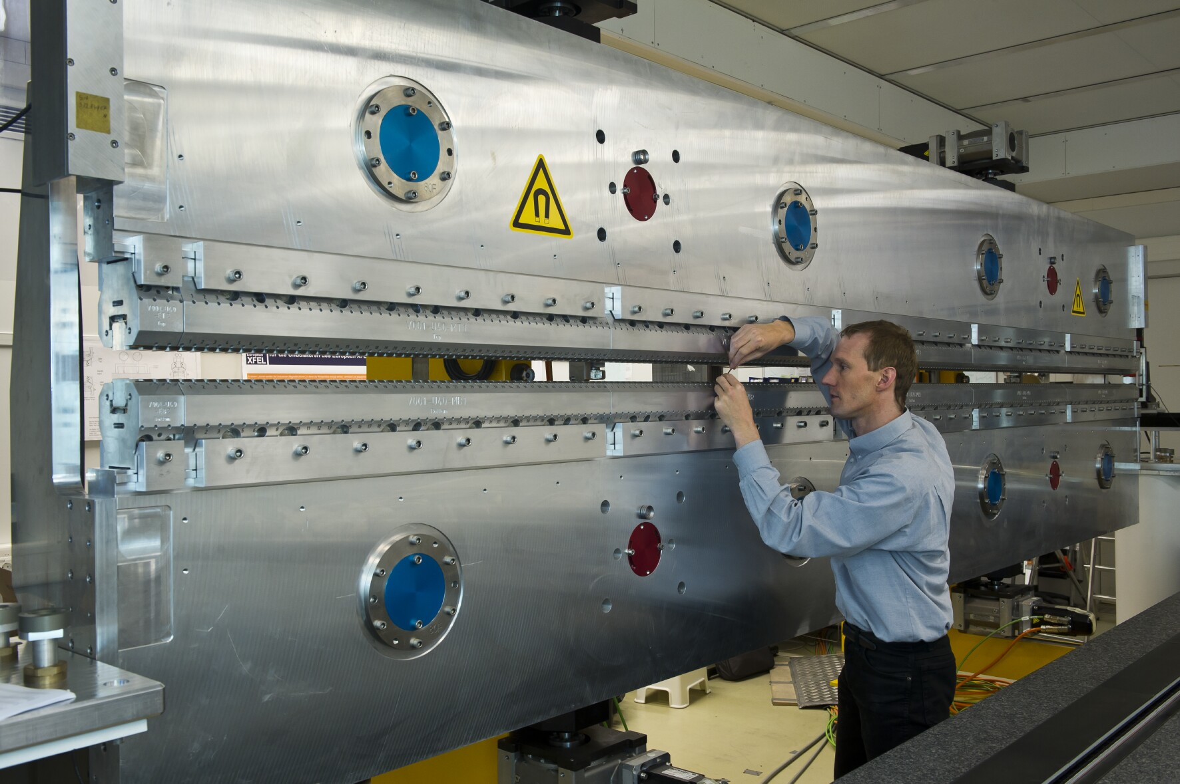
Undulator pre-series devices

Slide 19
Layout XTDs - X-ray optics and transport
  offset mirrors → surpression of bremsstrahlung & higher harmonics
  deflection mirrors → distribution to 3 instruments in XHEXP
  all reflections in horizontal plane
  Extreme grazing angles → acceptance 6σ of beam divergence

Slide 20
X-ray transport mirrors
Development of extremely flat and long mirrors
  Coherence/wavefront preservation → flatness of better 2 nm (PV)
  High reflectivitiy for low Z coating (due to damage) → 800 mm length
  Beam steering and collimation → positioning & bending
  Flatness & stability → horizontal scattering geometry
  High power by FEL beam → water cooling
  Setting up and controling → optical interferometer
indium-foil
water cooled copper bar
coating
silicon substrate
kinematical mount

Slide 21
X-ray diagnostics in beam transports
E
λ
SASE1
2.offset
mirror
T
E
Slits +
Solid Att
E
1.offset
mirror
(U33)
187-202
224-239
0m
12
151
203
210
216
223
240
242
247
257
258
262
322
354
900
distance [m] from
FEL source point
(not to scale)
XTD2
XS3
XTD9
XHEX
E
λ
SASE2
2.offset
mirror
T
E
Slits +
Solid Att
E
1.offset
mirror
(U33)
188-203
223-238
0m
12
152
202
209
215
222
239
241
245
277
290
300
302
305
938
distance [m] from
FEL source point
(not to scale)
XTD1
XS2
XTD6
XHEX
E
λ
SASE3
2.offset
mirror
T
E
Slits +
Gas Att
E
1.offset
mirror
(U20)
184-199
258-273
0m
12
151
169
193
200
207
250
257
275
277
281
284
286
289
414
distance [m] from
FEL source point
(not to scale)
XTD4
XSDU2
XTD10
XHEX
values from: Component_list_122011_NK.xls (EDMS Nr. *2629421, released 19.12.2011 by N.Kohlstrunk)

Slide 22
Symbols & Devices
XBPM
XGMD
2D Imager
Timing
Polarization Monitor
PES
Diamond I₀-monitor
Diamond PSD
Backscattering Monitor
PSD
E-MCP
2D Imager
Timing
Polarization Detector
Single-Shot Spectrometer
Wavefront Sensor
K-Monochromator
online
gas-based
E
E
invasive
T
T
λ
λ
E

Slide 23
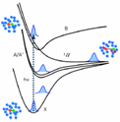
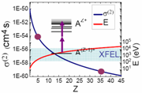
The suite of instruments
FXE Femtosecond
X-ray
Experiments
SASE 2
MID
HED
HED High Energy
Density Science
U 2
SPB Single Particle &
Biomolecules
U 1
SPB
FXE
MID Materials Imaging &
Dynamics
SASE 1
SQS Small Quantum
Systems
SASE 3
SQS
SCS
SCS Spectroscopy &
Coherent Scattering

Slide 24
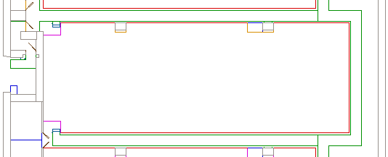
Layout XHEXP - SASE 1 instruments
SPB & FXE & MMM scientific instruments
Optical laser (~16.5x6 m²)
lock
MMM
ctrl
MMM
experiments
Sync
PP-laser
Prep, service, spare
SPB racks
SPB
optics
KB1
Jet
Jet
KB2
FXE optics
FXE
experiments
racks
SPB experiments
FXE racks
FXE
ctrl
Staging
area
SPB
ctrl
(preliminary)

Slide 25
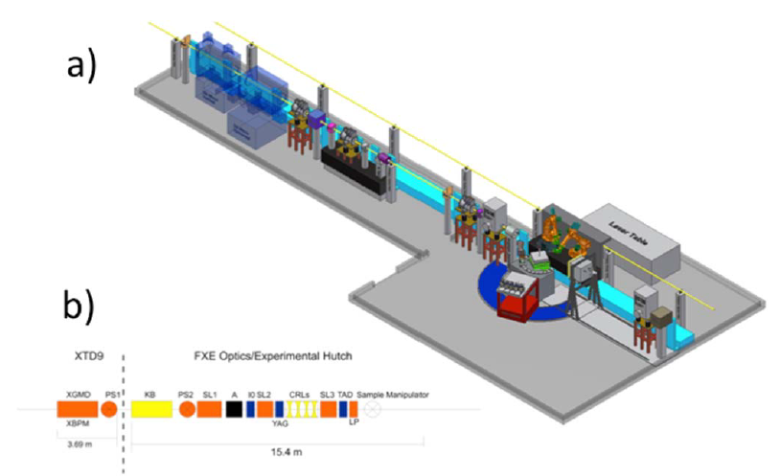
Scientific instruments – Conceptual design stage
FXE – preparing for Technical Design Report

Slide 26
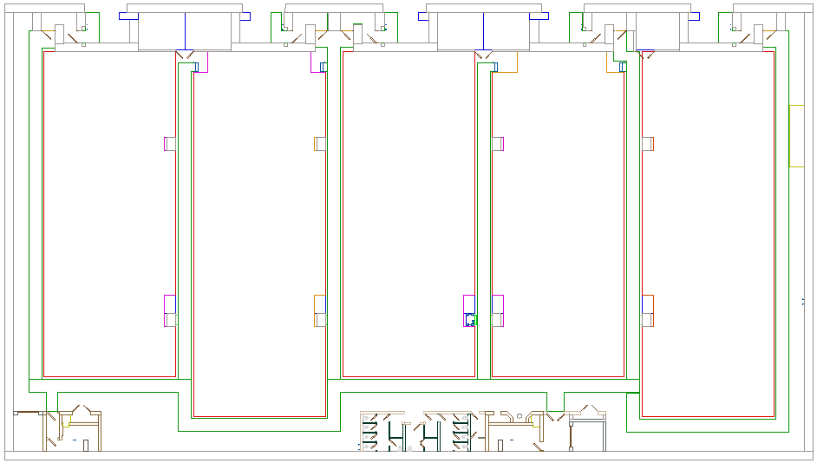
Layout XHEXP - SASE 2 instruments
MID & HED & NNN scientific instruments
MID
elec.
Crane
Area
~4 x 7 m²
NNN
ctrl/
elec.
MID
ctrl
HED
ctrl/elec.
NNN
experiments
MID
experiments
MID
optics
HED optics
Laser prep.
HED
experiments
PP
Laser
100TW-class
Laser
lock
(preliminary)

Slide 27
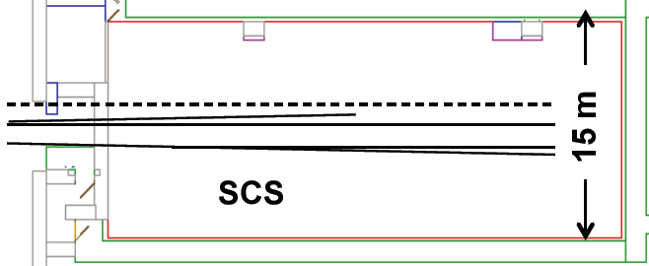
Layout XHEXP - SASE 3 instruments
SQS 1 & SCS & SQS/SCS 2 scientific instruments
lock
PP-laser
ctrl.
Prep, service, spare
SQS
SQS/SCS 2
exp.
1.4 m
1.4 m
SCS
ctrl.
ctrl.
182 m²
(preliminary)

Slide 28
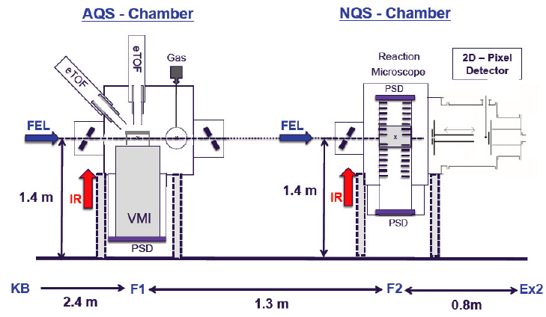
Small Quantum Systems – SQS

Slide 29
Optical lasers at the European XFEL
e-dump
Experiments
Electron gun
Accelerator
Undulator
1. Photo-injector laser
3. X-ray
seed laser
4. pump-probe and other lasers
2. Synchronisation
Photo-Injector laser
  few-ps-laser, UV, 1nC charge, 5-10µJ on CsI cathode, 266nm,
  ideally top-hat in time and space
Synchronization & timing
  1.5 µm fs-laser, sub-10fs jitter, clock dist. via drift-compensated fibre link
X-ray seeding or e-beam manipulation (future upgrade)
Experiments lasers

Slide 30
Laser Advisory Committee
Advice to the research, development, and construction of the high repetition rate burst-mode laser systems to be implemented as scientific infrastructures at the FLASH and European XFEL facilities.
  the development of a burst-mode fs-laser system for seeding and pump-probe experiments at the FLASH facility with a 1 MHz repetition rate during the burst, and
  the development of a burst-mode fs-laser system for pump-probe experiments at the European XFEL facility with a 4.5 MHz repetition rate during the burst.
  G. Cerullo, Politecnico di Milano (ultrafast, NOPA)
  P. Georges, Institut d’Optique, Palaiseau (high power diode pump)
  U. Morgner, Univ. of Hannover (uf, high power, NOPA)
  W.E. White, SLAC, Palo Alto (uf, hp, facility implementation)
  A. Leitenstorfer, Univ. of Konstanz (ultrashort pulse fibre laser)
  W. Schoenlein, LBL Berkeley (uf, laser-beam interaction)

Slide 31
High repetition rates issues

Slide 32
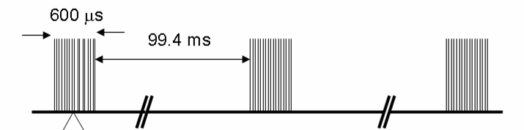
High repetition rate electron beam delivery
Time pattern
  due to pulsed RF
  27.000 bunches/sec
Dedication of bunches to undulators
  distribution to 2 beamlines & dump line
  surpression of FEL process
BL2 & Inst
BL1 & Inst
feedback

Slide 33
X-ray delivery patterns for scientific instruments
99.4
ms
Single pulses (0 – 10 pl/s)
  1 x-ray pulse per train
Few pulses (60 – 6000 pl/s)
  6/60/600 x-ray pulses per train
  Groups of pulses
  Specific time pattern (e.g. ln)
Full pulse train (27000 pl/s)
  2700 x-ray pulses per train
e-beam distribution to 2 beamlines
  Split train / maintain patterns
  Time for feedback & switching
0.6 ms
1/10/
100 µs
0.01 – 0.3 ms

Slide 34
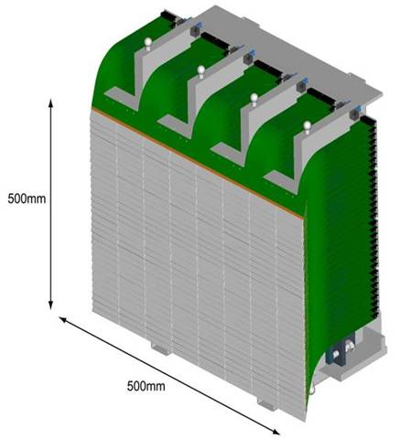
High repetition rate challenge
Sample delivery
match repetition rate
positioning
X-ray optics
withstand repetition rate
exhibit high accuracy
Photon diagnostics
on-line & single-shot
match repetition rate
Detectors
match frame rate
large data amounts
Optical laser
match repetition rate
provide ~mJ excitation energy

Slide 35
Conclusions
European XFEL construction is advancing at high speed.
With first beam in 2015 and first experiments in 2016 decisions and actions are due in many areas.
Still R&D is on-going for major photon components (OL, x-ray optics, x-ray diagnostics, sample delivery, x-ray area detectors, …) and results must be communicated and conceptual design updates be realized without delays.
THANK YOU FOR YOUR ATTENTION

