Slide 1
Installation Schedule and Status
Markus Hüning
European XFEL Accelerator Consortium Meeting
Notes:
How to edit the title slide
Upper area: Title of your talk, max. 2 rows of the defined size (55 pt)
Lower area (subtitle): Conference/meeting/workshop, location, date, your name and affiliation, max. 4 rows of the defined size (32 pt)
Change the partner logos or add others in the last row.

Slide 2
Outline
Facility Layout and Names
Global Schedule
Project Integration Timeschedule (PIT)
Injector Schedule
XTL Schedule
XTDs Schedule
XHM Status
XTL Status
Pictures of the Facility so far

Slide 3
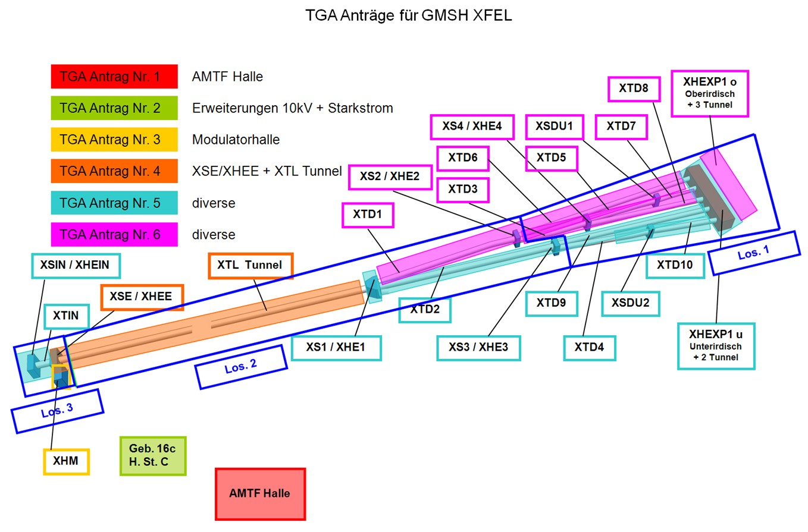

Slide 4
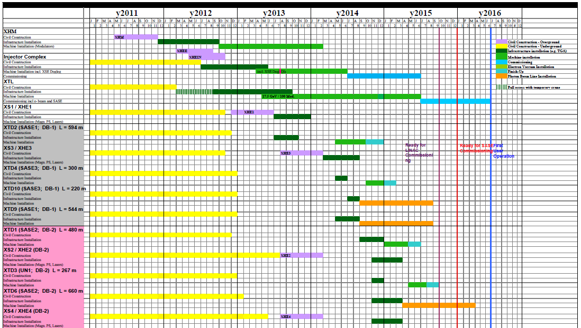
Construction, Installation, Commissioning
Notes:
Before you start editing the slides of your talk change to the Master Slide view: Menu button “View”, Master, Slide Master:
Edit the following 2 items in the 1st slide: 1) 1st row in the violet header: Delete the existent text and write the title of your talk into this text field 2) The 2 rows in the footer area: Delete the text and write the information regarding your talk (same as on the Title Slide) into this text field.
If you want to use more partner logos position them left beside the DESY logo in the footer area Close Master View

Slide 5
Project Integration Timeschedule (PIT)
Covers Installation and Technical Commissioning of the Accelerator Complex and Experimental Area
Represents major tasks by time slots
Detailed planning and resource planning still covered by WPs
Satellite plans to schedule pre-integration activities
Milestones from WPs
Global Project Schedule
Intermediate Milestones
First Beam
Project Integration Time Schedule (PIT)
Pre-Integration Plans
„Ready For Installation“ Milestones
WPx
WPy
WPz

Slide 6
The PIT and Milestones
Global Schedule and PIT define the schedule – once planned – Top-Down
Dates agreed with external contributors and contractors cannot be shifted easily
Shifts within one WP must not alter the overall planning
The delayed task must be accomodated without affecting others
Frequency of updates must be weeks rather than quarters
This is a minor clash with the usual Milestone follow-up
More on Milestones, Schedule Follow-up and the conclusion for the PIT in the working group tomorrow (9:00h, Sem Rm 4b/Bldg 1b)
www.industriedenkmal.de

Slide 7
Installation Readiness Review (IRR)
Two months prior to scheduled begin of installation campaign
Answer a small number of questions concerning
Availability of Material & Personnell
Known Delays
Safety Assessments
Safety Training
Registration of workers
No documents need to be provided, assuring their existence is sufficient
Review will be performed during installation meeting (every 2nd Tuesday), estimated duration 5 min. (an attempt to do this by mail and questionaire may be called failure)

Slide 8
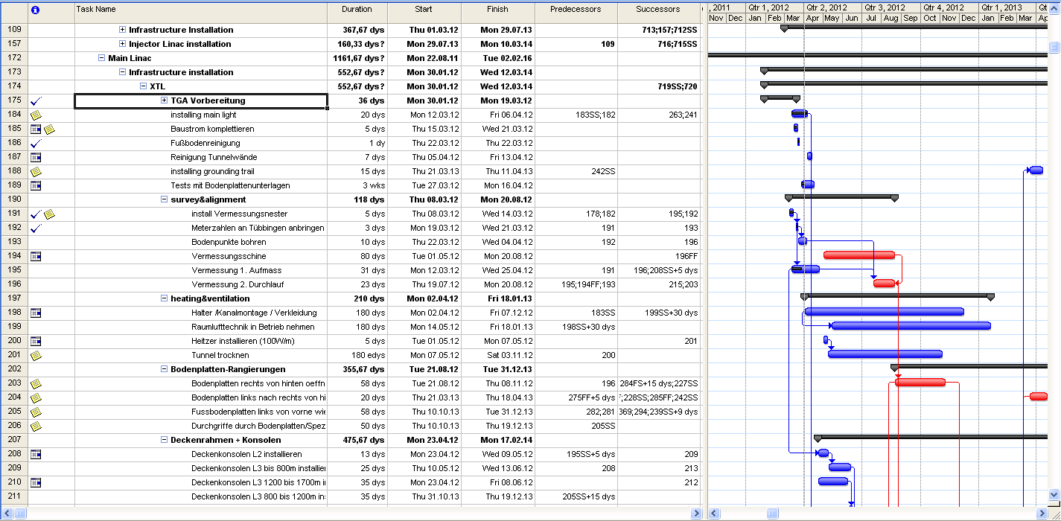
Schedule, PIT

Slide 9
Injector Schedule (In Parts Tentative)
 | 2012 |  |  |  |  |  |  |  |  |  |  |  | 2013 |  |  |  |  |  |  |  |  |  |  |  | 2014
XSIN
XTIN 1-2
XTIN 3
XTIN 4
XTIN 5
XTIN 6-7
XSIN Shaft
XTIN Shaft
XSE Md Sh
XSE 1-5
XSE 6-7
Water inst. | Klystrons/RF |  |  |  |  |  | Harm. Module |  |  |  |  |  | Survey |  |  |  |  |  | Transport
Electr. Supplies | Cryo Supplies |  |  |  |  |  | e-Beamline |  |  |  |  |  | Dump |  |  |  |  |  | Electronics
Vent/AC | ACC Module |  |  |  |  |  | Laser |  |  |  |  |  | LLRF
Tunnel closed

Slide 10
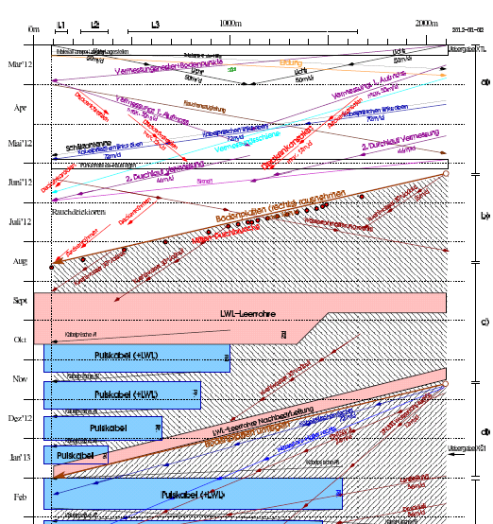
XTL Infrastructure Installation
Path-Time diagram to visualize what is done where and when
A handful of defining tasks:
Survey
Opening the floor
Pulling Cables
So far planning assumes 1shift per day/5 days a week

Slide 11
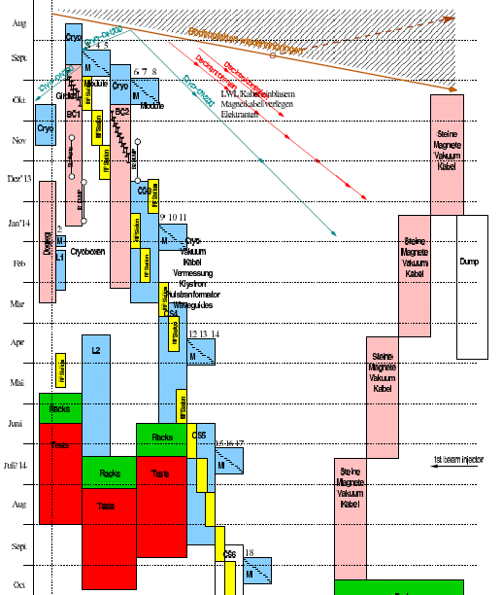
XTL Machine Installation
Planning status less mature
Next iteration on detailing starts now
Installation sequence to large extend dictated by availability of modules

Slide 13
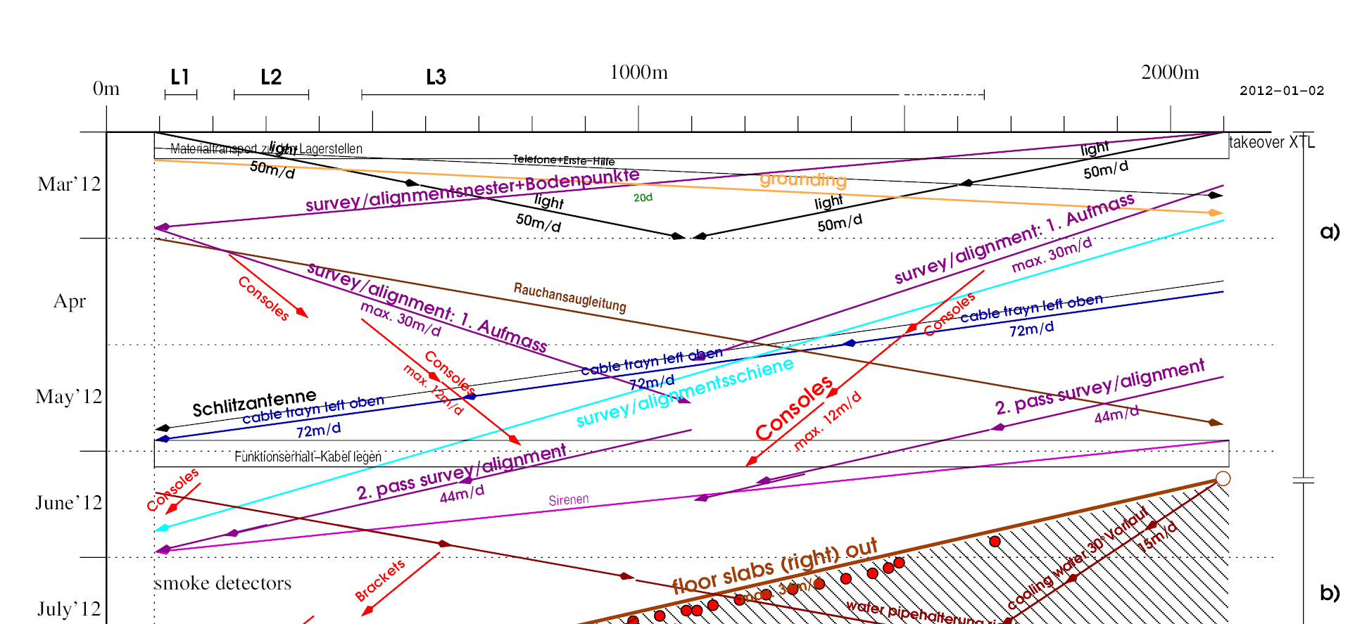
Schedule, PIT
We are here
Lighting finished (as of today)
Survey progressing, Rail for 2nd survey delayed, can be accomodated
Consoles heavily delayed, need special precautions

Slide 14
Next Steps
Rail for survey equipment early May, second survey immediately afterwards
Moving of floor plates to start in June
Water piping follows along
Provisional transport platform in XSE stays until end of May
Movable Platform to be installed in June (interference with tunnel access for very short periods)
Installation of cable trays in shaft end of April

Slide 15
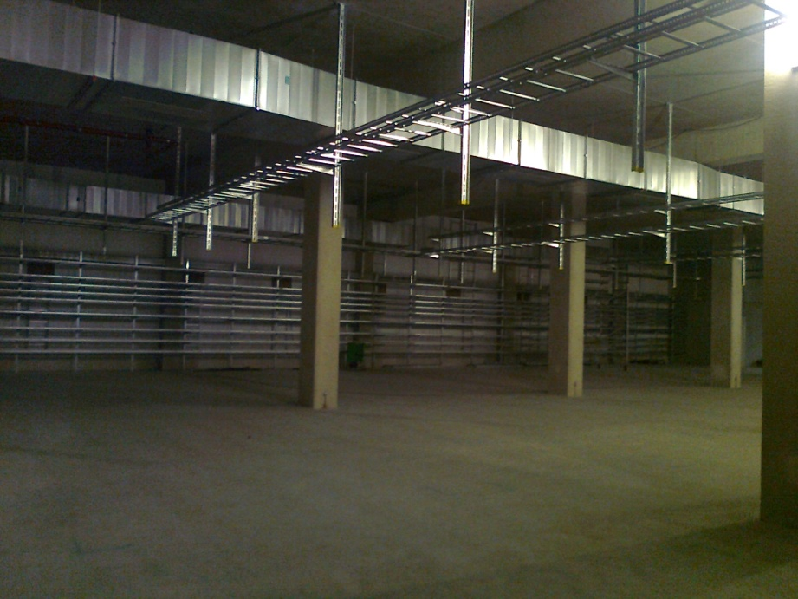
XHM Modulator Hall
Infrastructure installations of the modulator hall XHM
All contracts have been placed and construction work started
Cable trays and air channels are installed in the basement
Construction work is in
time schedule
Picture of the basement where the modulators will be placed
Notes:
Before you start editing the slides of your talk change to the Master Slide view: Menu button “View”, Master, Slide Master:
Edit the following 2 items in the 1st slide: 1) 1st row in the violet header: Delete the existent text and write the title of your talk into this text field 2) The 2 rows in the footer area: Delete the text and write the information regarding your talk (same as on the Title Slide) into this text field.
If you want to use more partner logos position them left beside the DESY logo in the footer area Close Master View

Slide 16
Injector Area over Ground

Slide 17
Injector Area
Elevator promised end of April (cabin missing)
Transport shaft available

Slide 18
Injector Area
Hand-over of the whole injector complex is scheduled for July 1st

Slide 19
Tunnel Entrance
Tunnel access only
For people with a recent (less than 6 months) safety training
With a valid work order
Registration at tc.xefl@desy.de

Slide 20
Parking Area at Tunnel Entrance
We have 1.8 ton fork-lifts
Flatcars
Crane for floor plates
Aerial platforms
bicycles

Slide 21
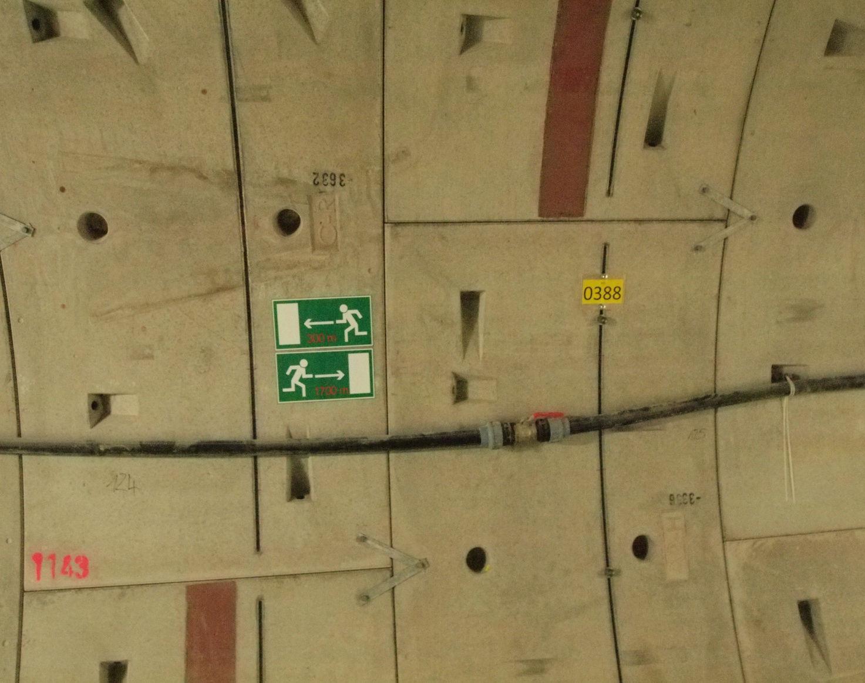
XTL

Slide 22
Survey
Initial Survey ongoing (1. Aufmaß)
As of Friday 1112m reached
2nd iteration requires installation of a rail for the equipment which is promised for beginning of May

Slide 23
Loose Floor Plates
We received complaints about noise from floor plates
This is caused by bouncing of floor plates when traversed
Tested rubber dampers to silence the transport path (success with railway dampers)
Test glue to stabilize machine foundation (fallback: bolt down)

Slide 24
Conclusion
Installation and Integration Planning evolving
Project Integration Timeschedule established
Installation in XHM progressing according to schedule
Installation in XTL progressing with certain delays which can be compensated
Injector Installation starts in July
Many thanks to M. Hoffmann, T. Haas, J.-P. Jensen for providing me with material

