Slide 1


Summary
Timing, Electronics &FPGA Developments
Holger Schlarb & Patrick Gessler
Notes:
How to edit the title slide
Upper area: Title of your talk, max. 2 rows of the defined size (55 pt)
Lower area (subtitle): Conference/meeting/workshop, location, date,
your name and affiliation,
max. 4 rows of the defined size (32 pt)
Change the partner logos or add others in the last row.

Slide 2
Talks
7 Presentation with > 50 participants
XFEL Timing System,
HIDVEGI, Attila (Stockholm University)
Electronic developments, concepts and applications for the machine, REHLICH, Kay (MCS4)
MicroTCA.4 crate development for LLRF,
JEZYNSKI, Thomasz (MSK)
Electronic developments and concepts for the LLRF,
LUDWIG, Frank (MSK)
Electronic developments, concepts and applications for the Experiments and Photon Beam Line DAQ
GESSLER, Patrick (European XFLEL GmbH)
FPGA Group, Framework developments and concepts,
GESSLER, Patrick (European XFLEL GmbH)
Developments of the LLRF firmware
SCHMIDT, Christian (MSK)

Slide 3
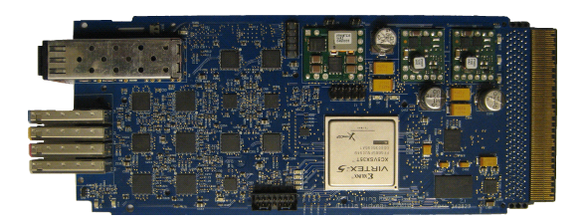
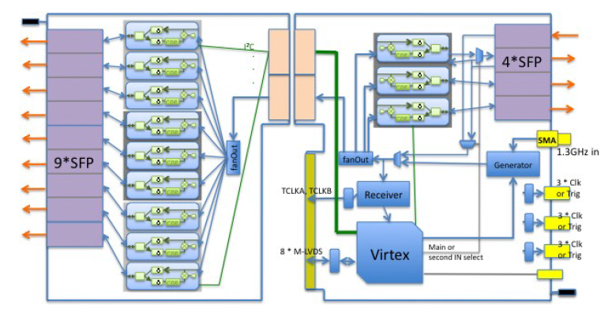
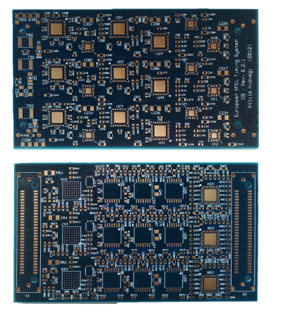
XFEL Timing System
central clocking and trigger unit for facility
used 1.3 GHz from Master oscillator
drifts along fibers are compensated
jitter specs < 5 ps rms
macropulse & individual
bunch information are distributed
central unit for further developments
expected delivery for final version ~ Q2/Q3 2012
First single width prototype
Daughter boards for final layout

Slide 4
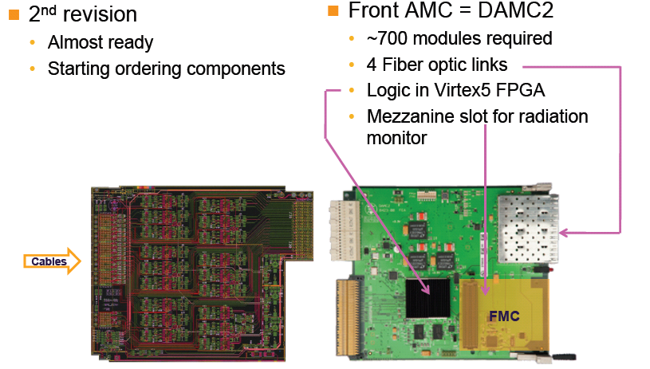
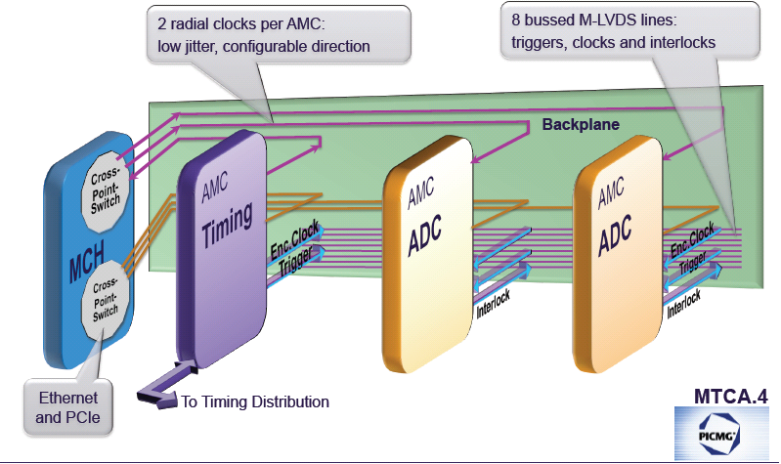
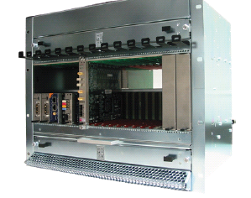
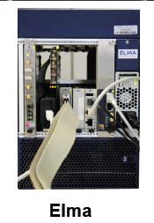

Electronic development for Machine
Modular system with re-usage of developed board (reduce total numbers)
Support timing, clock and interlock signals (within standard)
Sophisticated Crate management system
Recently released by PICMG = PCI Industrial Computer Manufacturers Group
Serial link allows both high precision analog & high power digital processing
Well received by industry …

Slide 5
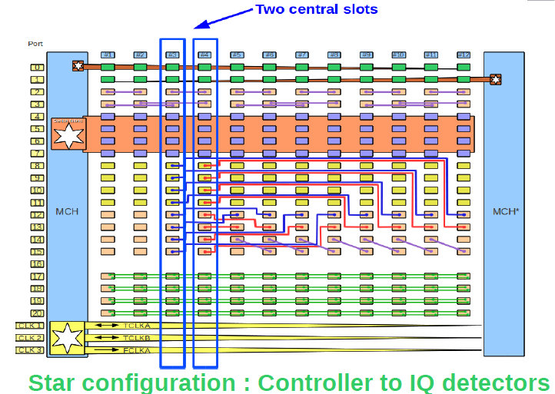
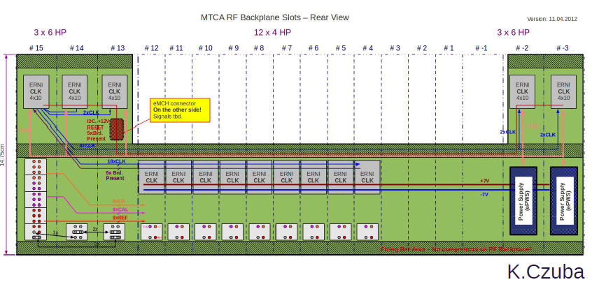
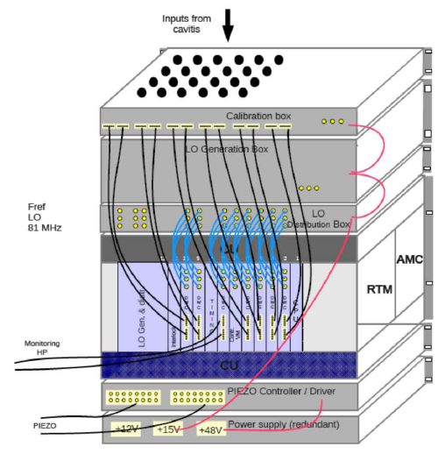

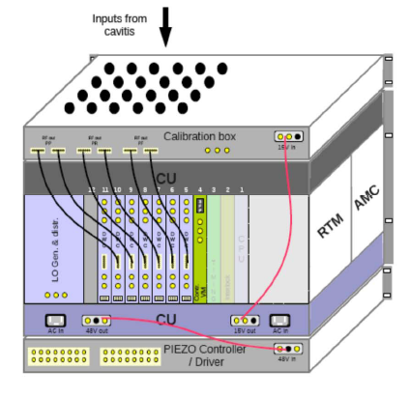
MTCA.4 Crate developments
Modification of crates for LLRF
  AMC backplane with two central slot with start configuration (within MTCA.4)
  Adding uRF Backplane for signal transport < 10fs accuracy
X 2 reduction, reliability!!!

Slide 6
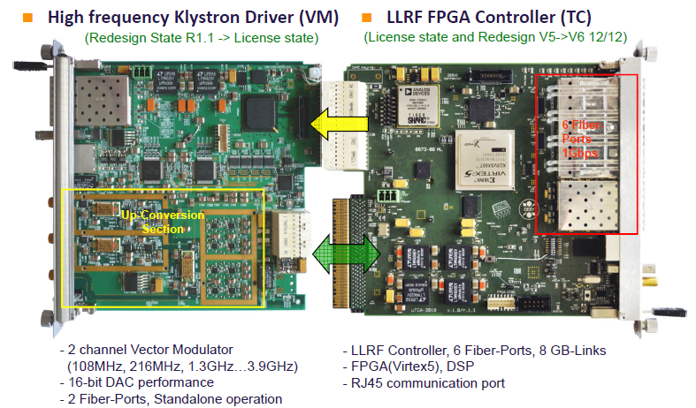
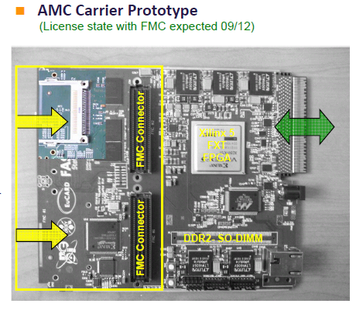
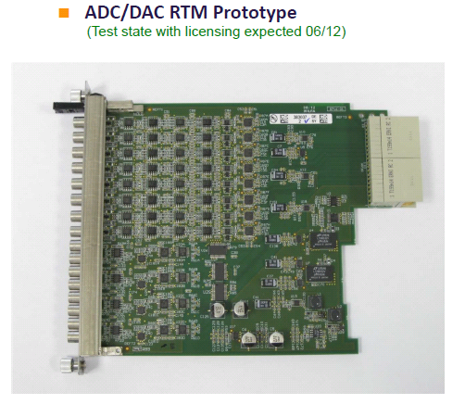
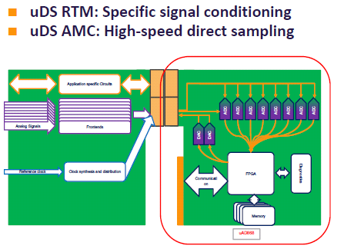
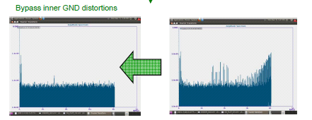
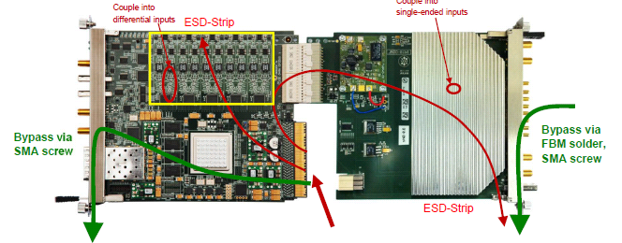
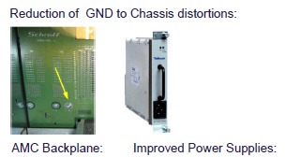
Electronic developments & concept
Overview on board developments within MSK (for WP02/WP18) ~ 10
Approximately 5 multifunctional boards
Signal integrity and noise investigations -> PS developments / crate modif.

Slide 7
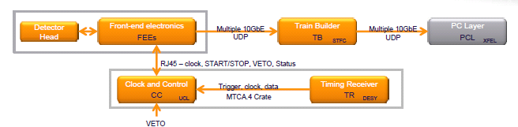
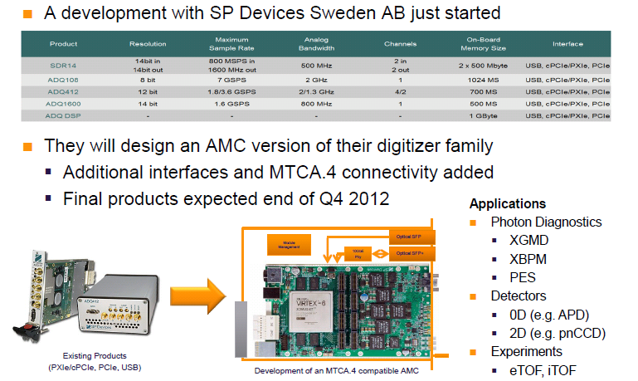
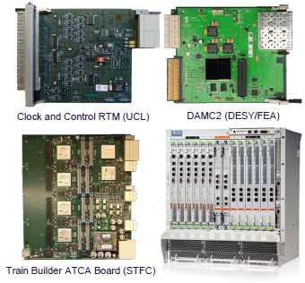
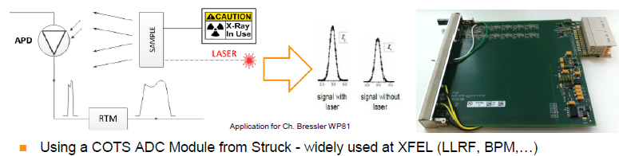
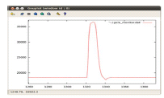
Electronic developments Experiments
Main challenges are appropriate data reduction => Veto system
& DAQ management
High sampling device for fast pulses (SP device 3.6Gsps/7Gsps)
First measurements using COFS production

Slide 8
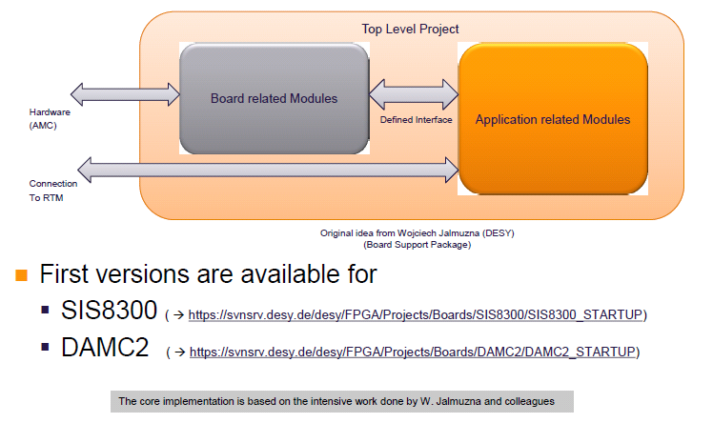
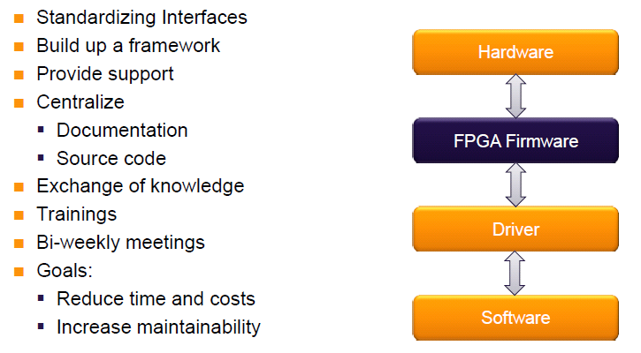
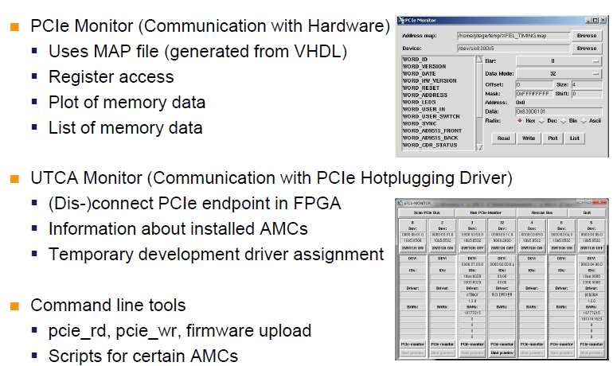
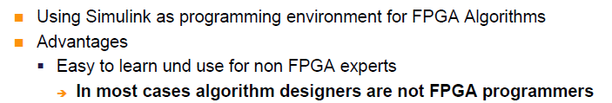
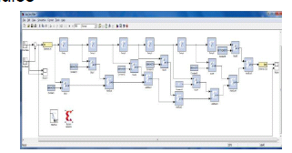
FPGA expert group

Slide 9
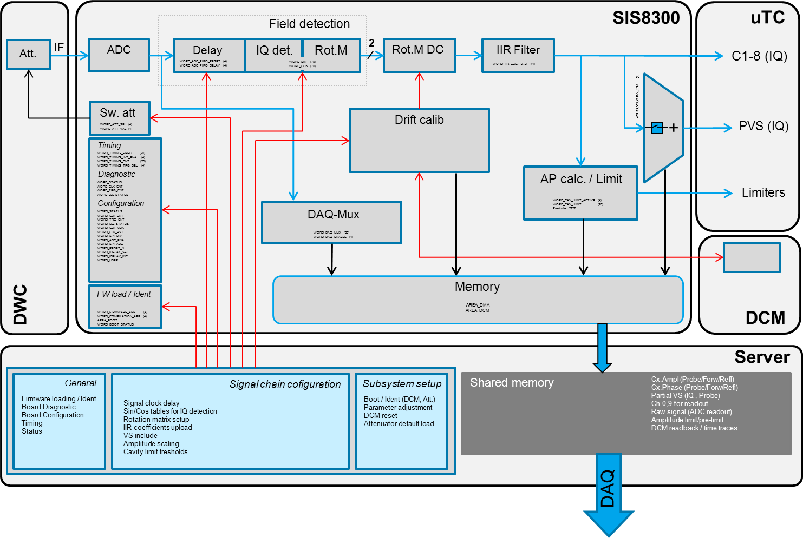
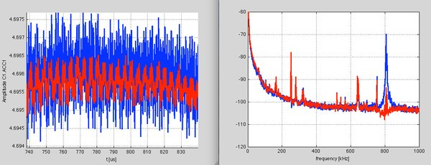
Overview firmware bocks LLRF
Filtering of 8/9 pi mode

