Slide 1
Instrument requests to the delivery of x-ray pulses
Operations working group
European XFEL collaboration meeting Apr 17, 2012
Thomas Tschentscher
thomas.tschentscher@xfel.eu
Notes:
How to edit the title slide
Upper area: Title of your talk, max. 2 rows of the defined size (55 pt)
Lower area (subtitle): Conference/meeting/workshop, location, date,
your name and affiliation,
max. 4 rows of the defined size (32 pt)
Change the partner logos or add others in the last row.

Slide 2
Outline
  short description of European XFEL user facility and its operation
  high repetition rate operation issues
  a ‚prototypical‘ experiment
  requirements to quasi-simultaneous operation of many instruments

Slide 3
User facility and its operation
Mission
  Provision of x-ray FEL radiation and instrumentation for experimental investigations in variety of scientific domains
  Users receive experimental time following successful peer-review
  Experiments are complex and therefore require substantial support by facility staff
  Enable efficient conduct of experiments with maximum availibility of x-ray beam (→ accelerator; minimal interference by other instruments) and ancillary instrumentation (→ samples, opt. Lasers, detectors, DAQ & data analysis)
Some numbers
  ~4000 hrs accelerator operation in user mode
  typically 3 instruments take beam (simultaneous/quasi-simultanous)
  other 3 instruments prepare/set-up
  ~1000 user visits per year
  Extend in future (5 beamlines, 10 instruments, higher rate of sim. operation)

Slide 4
Layout x-ray facility
  2 e⁻-beamlines
  3 (5) undulators
  6 (10-15) instruments
MID
HED
SPB
FXE
SQS
SCS
Boxes only placeholders !

Slide 5
Layout XTDs - X-ray optics and transport
  offset mirrors → surpression of bremsstrahlung & higher harmonics
  deflection mirrors → distribution to 3 instruments in XHEXP
  all reflections in horizontal plane
  Extreme grazing angles → acceptance 4σ of beam divergence

Slide 6
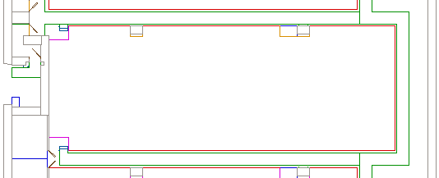
Layout XHEXP - SASE 1 instruments
SPB & FXE & MMM scientific instruments
Optical laser (~16.5x6 m²)
lock
MMM
ctrl
MMM
experiments
Sync
PP-laser
Prep, service, spare
SPB racks
SPB
optics
KB1
Jet
Jet
KB2
FXE optics
FXE
experiments
racks
SPB experiments
FXE racks
FXE
ctrl
Staging
area
SPB
ctrl
(preliminary)

Slide 7
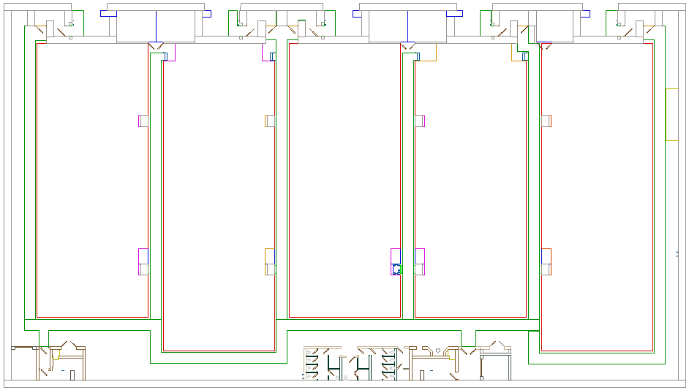
Layout XHEXP - SASE 2 instruments
MID & HED & NNN scientific instruments
MID
elec.
Crane
Area
~4 x 7 m²
NNN
ctrl/
elec.
MID
ctrl
HED
ctrl/elec.
NNN
experiments
MID
experiments
MID
optics
HED optics
Laser prep.
HED
experiments
PP
Laser
100TW-class
Laser
lock
(preliminary)

Slide 8
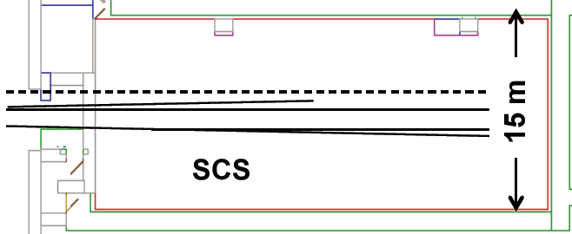
Layout XHEXP - SASE 3 instruments
SQS 1 & SCS & SQS/SCS 2 scientific instruments
lock
PP-laser
ctrl.
Prep, service, spare
SQS
SQS/SCS 2
exp.
1.4 m
1.4 m
SCS
ctrl.
ctrl.
182 m²
(preliminary)

Slide 9
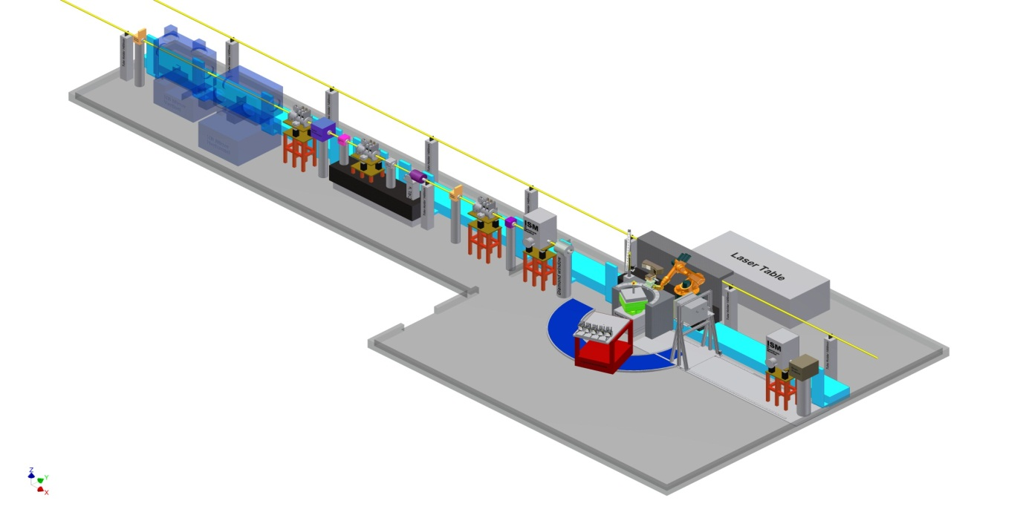

Femtosecond X-ray Experiments – FXE
Ultrafast dynamics of liquids and solid matter
Combination of spectroscopic & scattering techniques
  Collect scattering in forward direction (energies up to ~20 keV, large q)
  Spectrometer for XES & RIXS type measurements
  Very precise timing (diagnostics & synchronization)
<60°
Monochromator
(10⁻⁴)
Focusing optics
(1-100 µm)
Sample stage
w. environments

Slide 10
SQS Requirements
27 000 bunches per second
Variable pulse duration
Coincidence techniques:
multiple fragments (e, ion, hν)
TOF (electrons) : < 200 ns
high rep. rate
TOF (ions) : 1 – 10 μsec
reduced rep. rate
wish: c.w. operation
Time-resolved and non-linear
spectroscopy:
electronic relaxation: < 2 fs
molecular dissociation: < 10 fs
optical laser: 15 fs
optical cycle (800nm): 2.6 fs
wish: sub-fs X-ray pulses

Slide 11
High repetition rate issues
Advantages
  High average brilliance
  Simultaneous operation of many instruments
  Stabilization by feedback
Challenges
  Power load during pulse train can be as high as 20 kW
    Thermal deformation, stress, etc.
    Melting of sensitive materials
  Replacement of samples with (>) MHz repetition rate
  Detection and diagnostic schemes
  Data acquisition, storage and evaluation
All challenges have to be overcome in order to make the advantages fully available for users of European XFEL. This will be a real first !

Slide 12
Equipment protection system
Protect beam transport and instrument components from damage by x-ray beam
  definition of modes
  hardwired/SPS programmed
Fast reaction to EPS signals →e-bunch generation at injector
  connection of beam transport and scientific instrument operation to electron beam delivery
→ Workshop : Machine protection today at 11:00 (SemRm )

Slide 13
A prototypical experiment
Preparation
phase
  Detailed proposal → define parameters, check feasibility
  Pre-experiments; preparation of experimental setup
  Setup at European XFEL instrument (without beam)
  Set & verify x-ray parameters according to requirements
  Alignment of sample and additional/secondary diagnostics
  Verify optical laser beam settings and performance
  Verify detection systems settings and performance
  Search for signal
  Time fraction : significant (days) for non-standard exps.
  Time fraction : moderate (hrs) for standard exps.
  Collect data according to experiment protocol
  Modification of variables and switching of samples
  Try new ideas (sample or x-ray technique)
Setup
phase
Data taking
phase
Testing
phase

Slide 14
Definition of x-ray beam parameters
Preparation
phase
  Detailed proposal → define parameters, check feasibility
  Photon energy - Undulator gap / Accelerator WP
  Pulse duration – Accelerator setting
  Photons per pulse – Absorber / Accelerator settings
  Nominal/red. x-ray delivery – Accelerator settings
  X-ray bandwidth – Natural / Mono. / Chirp (Acc.)
  X-ray spot size – Focussing / Slits
  + Correlations between these settings

Slide 15
X-ray delivery patterns
99.4
ms
Single pulses (0 – 10 pl/s)
  1 x-ray pulse per train
Few pulses (60 – 6000 pl/s)
  6/60/600 x-ray pulses per train
  Groups of pulses
  Specific time pattern (e.g. log)
Full pulse train (27000 pl/s)
  2700 x-ray pulses per train
0.6 ms
1/10/
100 µs

Slide 16
Specific X-ray delivery requests
Chirped pulses
  Add. correlated bw spread of single electron bunches (→x-ray pulses)
  Maximize slice bandwidth
  e.g. 10⁻⁴×100 slices
Chirped pulse trains
  Controlled variation of electron energy (→ photon energy) over the bunch train
  Use dynamic aperture of acc.
  ±1.5% E_{e} → ±3% ħω

Slide 17
Setup phase
Setup
phase
  Set & verify x-ray parameters according to requirements
  Alignment of sample and additional/secondary diagnostics
  Verify optical laser beam settings and performance
  Verify detection systems settings and performance
  Search for signal
  1 – 10 pulses/train
  1 – 10 pulses/train
  1 – 10 pulses/train
  Nominal delivery pattern
  1 – 10 – nom. delivery
  + small variation of param.
  + freq. switch beam on/off
  + access to x-ray hutch

Slide 18
Data taking phase
Data taking
phase
  Collect data according to experiment protocol
  Modification of variables
  Modification to instrument / sample
  Nominal delivery pattern
  Switching between modes
  Tune photon energy
  Switch pulse duration
  Modify photons per pulse (absorber)
  access to x-ray hutch
  Realignment (red. rep. rate)

Slide 19
Testing phase
Testing phase
  Try new ideas (sample or x-ray technique)
  Initially red. rep. rate
  Frequent switching of x-ray (electron beam) parameters
  access to x-ray hutch

Slide 20
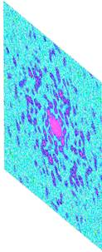
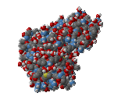
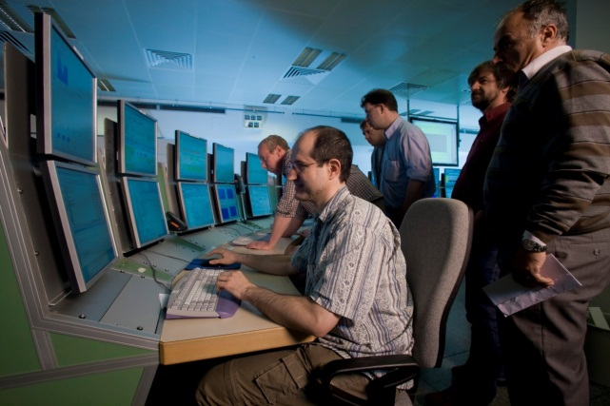
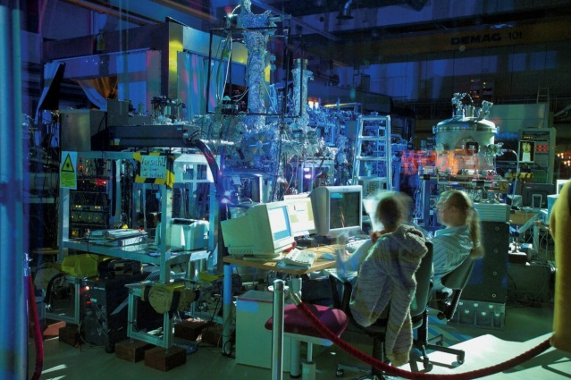
Interaction of acc. operators & experimenters
X-ray pulse
Electron bunch
Diffraction
pattern
Reconstruction
Accelerator operation
Instrument operation
As close as possible interaction

Slide 21
Simultanous operations of many instruments
The challenge
  Operate several undulators / x-ray beam lines / scientific instruments with minimal interference.
  Maintain e-beam / x-ray performance while modifying parameters
Scheduling issue
  Schedule experiments at same time with as close as possible requirements to e-beam beam parameters (energy, bunch duration, delivery pattern)
Various optimizations
  Dedicate electron bunches (x-ray pulses) to undulators / instruments will provide largest de-coupling of instruments
  Use spent electron bunches in subsequent undulators will allow highest integrated average brightness over all instruments

Slide 22
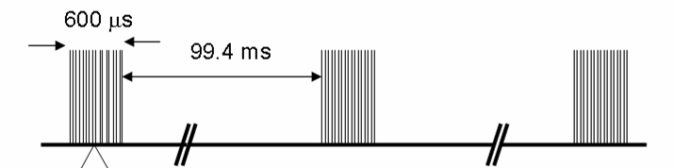
High repetition rate electron beam delivery
Time pattern
  due to pulsed RF
  27.000 bunches/sec
Dedication of bunches to undulators
  distribution to 2 beamlines & dump line
  surpression of FEL process
BL2 & Inst
BL1 & Inst
feedback

Slide 23
X-ray delivery patterns / electron bunch distr.
99.4
ms
Single pulses (0 – 10 pl/s)
  1 x-ray pulse per train
Few pulses (60 – 6000 pl/s)
  6/60/600 x-ray pulses per train
  Groups of pulses
  Specific time pattern (e.g. ln)
Full pulse train (27000 pl/s)
  2700 x-ray pulses per train
e-beam distribution to 2 beamlines
  Split train / maintain patterns
  Time for feedback & switching
0.6 ms
1/10/
100 µs
0.01 – 0.3 ms

Slide 24
Electron bunch distribution to 2 BL / 5 undulators
e-beam distribution to 2 beamlines
  Slots for feedback & switching
  Equal splitting on both e⁻-BL
  Equal splitting on 3 undulators
  Equal splitting on 5 und. (future)
  Assymetric splitting
  Specific electron bunch properties
SASE 2
SASE 1 & 3
SASE 2
SASE 1
SASE 3
SASE 2
SASE 4
SASE 5
SASE 1
SASE 3
SASE 2
SASE 1
SASE 3
SASE 2
SASE 1
SASE 3

Slide 25
Conclusions
  Challenges related to high repetition rates have to be overcome in order to make its advantages fully available for users of European XFEL. This will be a real first !
  Operate several undulators / x-ray beam lines / scientific instruments with minimal interference
  Maintain e-beam / x-ray performance while modifying parameters and switching on/off bunches
  Allow specific electron bunch properties. In general only for part of bunch train
  …

Slide 26
Simultaneous operation of many instruments
Within the bunchtrain
  2 e⁻-beamlines
  5(+) undulators
  15(+) instruments
MID
HED
SPB
FXE
On trajectory → lases
Off trajectory → only SR
SQS
SCS
Sophisticated electron bunch distribution
27.000 bunches/sec to 5 beamlines
in average 10-20 Hz and ~500 pulses/train
using kicking methods to make bunches lase only in dedicated undulator
Boxes only placeholders !

