Slide 1


ACC Meeting April 2012
Workgroup Summary
Milestone Follow-Up, Scheduling, Infrastructure Installation, Quality Management
presented by Riko Wichmann, April 19th, 2012
Notes:
How to edit the title slide
Upper area: Title of your talk, max. 2 rows of the defined size (55 pt)
Lower area (subtitle): Conference/meeting/workshop, location, date,
your name and affiliation,
max. 4 rows of the defined size (32 pt)
Change the partner logos or add others in the last row.

Slide 2
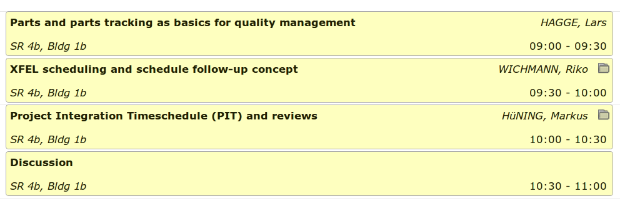
Session Agenda
72 interested registrants
~40 – 50 participants in the working group
Notes:
Before you start editing the slides of your talk change to the Master Slide view:
Menu button “View”, Master, Slide Master:
Edit the following 2 items in the 1st slide:
1) 1st row in the violet header:
Delete the existent text and write the title of your talk into this text field
2) The 2 rows in the footer area: Delete the text and write the information
regarding your talk (same as on the Title Slide) into this text field.
If you want to use more partner logos position them left
beside the DESY logo in the footer area
Close Master View

Slide 3
Quality Management
Quality Management is about “meeting the requirements”
QM activities asked for at XFEL include:
  Defining and assigning roles and responsibilities
  Managing resources and infrastructure
  Organizing and monitoring purchasing and production,
  and handling non-conformities
  Controlling documents, data and records
HOW to organize Quality Management …
  Project planning
  Parts Tracking in Design, Fabrication, Installation
  Monitoring and Reviewing
of WHAT ?
Deliverables

Slide 4
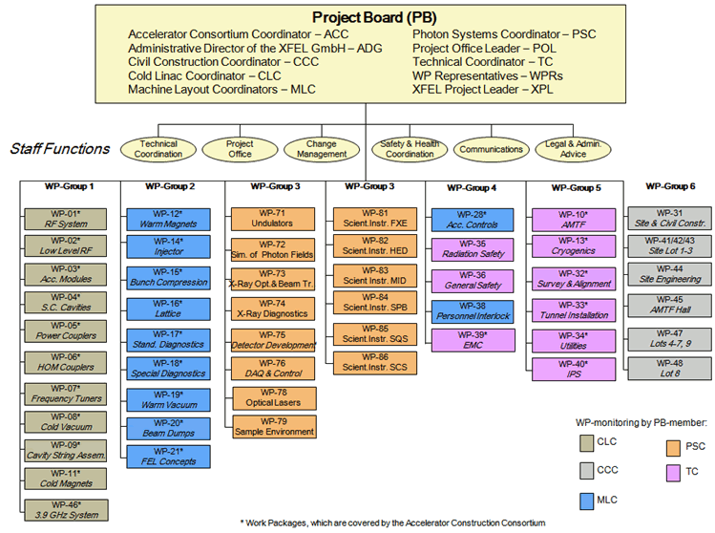
XFEL Project Structure
plans on WP level only!

Slide 5
XFEL Project Plan = Hierarchical System of Plans
WP plans: maintained by the WPLs
  schedule tasks and milestone for the deliverables
  progress reporting by “% complete” and remaining work
WP Dependency Schedule (WPD): maintained by XPO
  dependencies between different WPs via milestones
Project Integration Time-Schedule (PIT):
maintained by TC / SC
  infrastructure and machine / instrument installation slots
XFEL Global Schedule Plan (GSP): maintained by XPO
  project relevant milestones linked to WP milestones
  few composite milestones

Slide 6
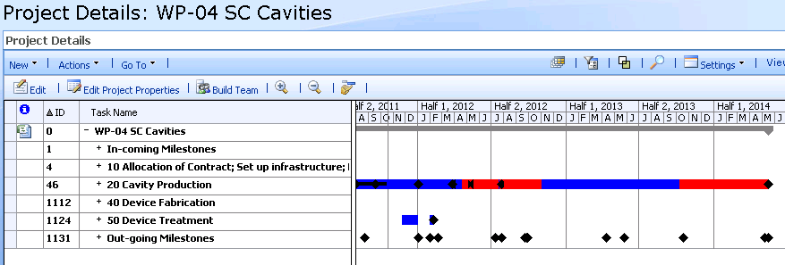
MS Project Plan Structure
all project plans have the same structure
WPD → schedule information for the WP
schedule information provided by the WP → WPD
→ GSP
→ PIT
XFEL Project Management System:
MS Project 2007 Enterprise

Slide 7
Content of the WP Plans
activities and milestones that lead to the bringing the XFEL into operation
for all deliverables / major systems / components / top MBOM elements:
  development, design, fabrication, installation tasks
  milestones: technical reviews like CDR, DR, PRR, start and end fabrication, IRR, start and end of installation
installation tasks and milestones are matched with the time slots in the → Project Integration Time-Schedule (PIT)

Slide 8
IKCs in the WP Plans
Tasks of the IKCs are maintained by the contributor
  contributor has to go through the XFEL MS Project training
  work remotely on the DESY server
  close coordination with WPL @ DESY
Tasks of IKC are added / updated by WPL
  regular communication of progress from contributor to WPL
  utilize set of predefined milestone
    typical candidates: technical reviews (CDR, DR, PRR, IRR → RFI)
Preferred

Slide 9
Complex Parts
More complex components are hierarchically decomposed into smaller, better manageable parts, yielding the so-called product breakdown structure PBS.
PBS level of detail depends on purpose: PBS for fabrication is called “Manufacturing Bill of Materials, MBOM” and shall contain all parts that occur in assembly, inspection, maintenance processes.
MBOM contains all parts which are relevant during fabrication, e. g. which need to be transported, assembled, changed, tested, certified, …

Slide 10



Example: Parts & Documents
10
Contract with Vendor
Warranty Statement
Has Description ►
Installation Manual
Vacuum Pump
Has Template ►
[Empty] Acceptance Test Record
Has
Instance ►
[Empty] Installation Record
Acceptance Test Record VP-12345
Purchased Physical
Vacuum Pump #12345
Has Description ►
Installation Record VP-12345/1
Inspection Record VP-12345 Year 1
Inspection Record VP-12345 Year 2
Purchased Physical
Vacuum Pump #12349
Acceptance Test Record VP-12349
Has Description ►
Installation Record VP-12349/1
Repair Record VP-12349/1
Inspection Record VP-12349 Year 1
Inspection Record VP-12349 Year 2
Fabrication Part type of part
Physical Part particular individual (serialized) part
Document describes selected aspects of part

Slide 11
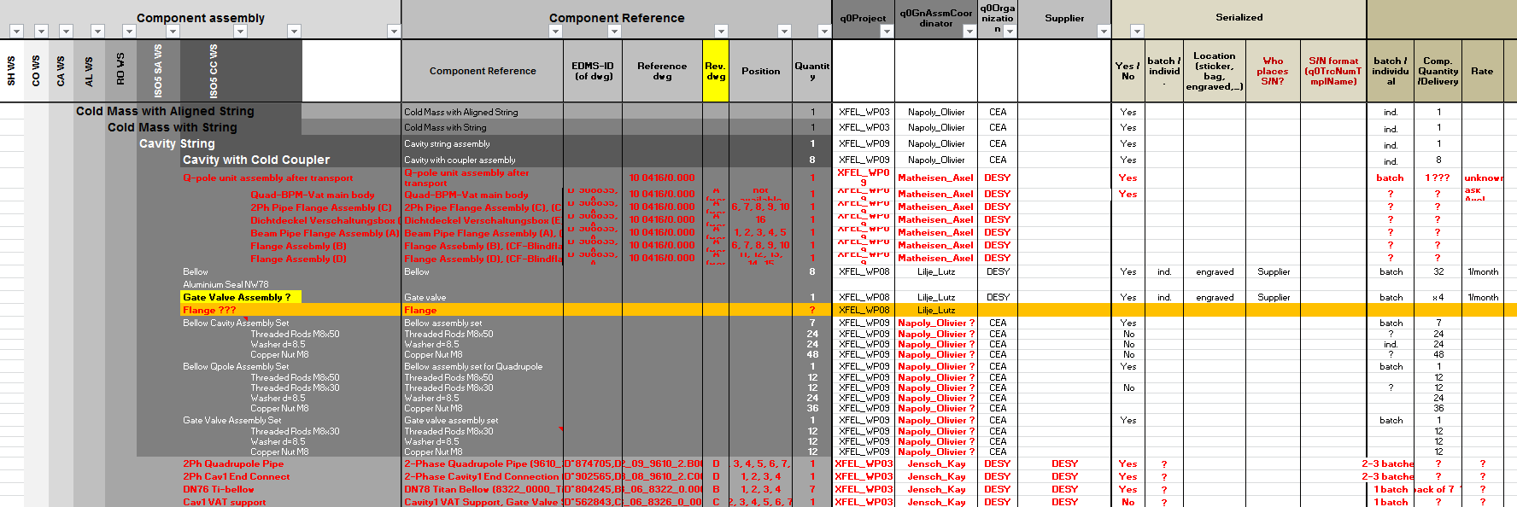
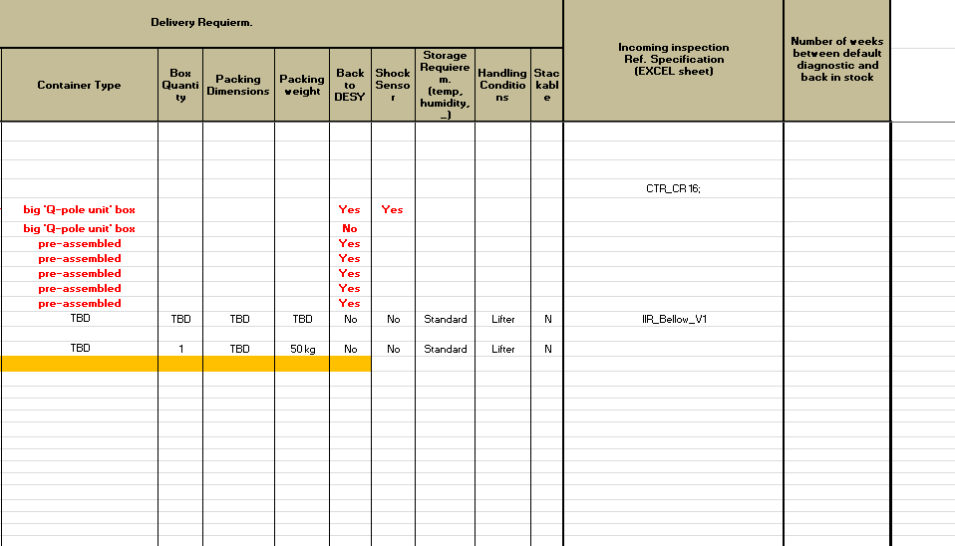
Example: Cryomodule MBOM
MBOM contains all parts which are relevant during fabrication, e. g. which need to be transported, assembled, changed, tested, certified, …
MBOM has ca. 400 parts – iterative procedure within WPG1 to agree on names, assign responsibilities, link with docs, …
Part Name
EDMS
Reference
Responsible
Party
Tracking
Info
Logistics
Info
Quality
Inspection

Slide 12
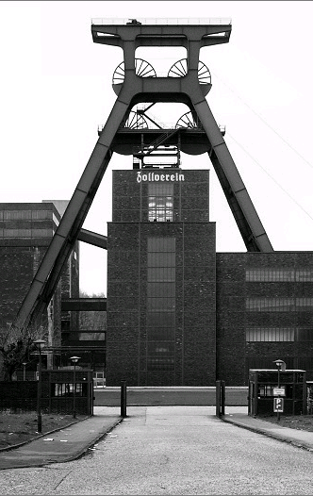
The PIT and Milestones
Global Schedule and PIT define the schedule – once planned – Top-Down
  Dates agreed with external contributors and contractors cannot be shifted easily
  Shifts within one WP must not alter the overall planning
  The delayed task must be accomodated without affecting others
  Frequency of updates must be weeks rather than quarters
  This is a minor clash with the usual Milestone follow-up
www.industriedenkmal.de

Slide 13
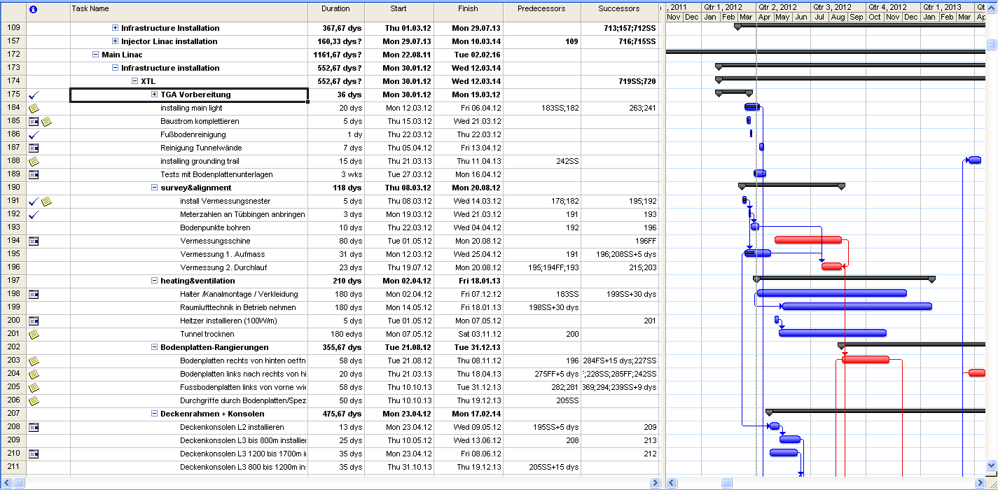
PIT and IRR
in length discussed by Markus on Monday, summary slides included for reference

Slide 14
Scheduling of IRR → RFI
Installation campaigns are defined in the PIT
Sequence of installation to be agreed upon in meetings beforehand
2 months prior to installation IRR will be arranged
  Availability of Material & Personnell
  Known Delays
  Safety Assessments
  Safety Training
  Registration of workers
This will be asked for by TC, there is no need to schedule it yourselves
The milestones asked for are „ready for installation“ (RFI)
The IRR is merely a „friendly reminder“

Slide 15
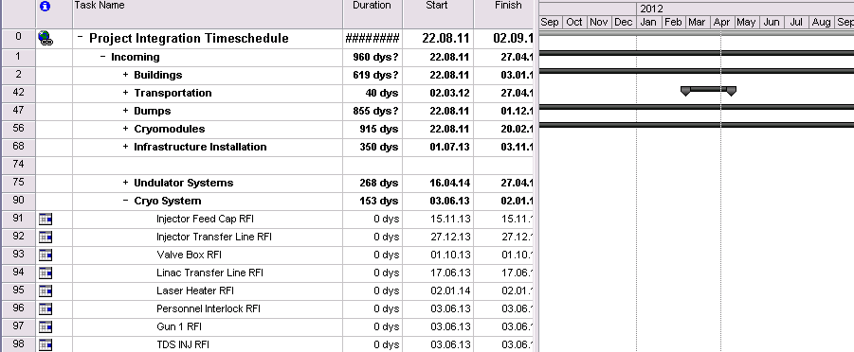
Project Integration Time-Schedule (PIT)
Incoming are typically Ready-for-Installation (RFI) milestones
  result of the Installation Readiness Review (IRR)

Slide 16
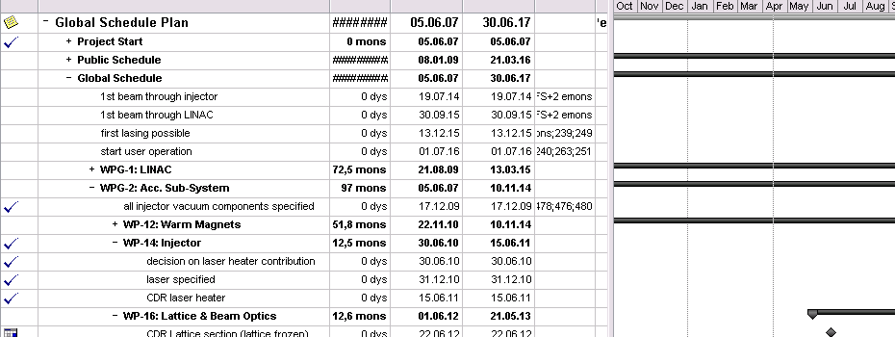
Global Schedule Plan (GSP)
used to provide an overview schedule
  typical milestones are again the technical reviews
(+ WPD) used to track and follow-up the overall progress
  regular follow-up in the weekly TC Meeting
  big consolidation after every status update of all WP plans

Slide 17
Production Readiness Review and others
To be performed before actually starting production or procurement
A number of mandatory documents to be reviewed by project stakeholders
Documentation of documents and reviewing process in EDMS
The PRR is a means to institutionalize good project management practice
There is the effort to make documents from earlier reviews (PRRs and others) available in EDMS
  Publish unpublished documents

Slide 18
Public Schedule on XFEL Web Servers (planned)
overview schedule picture
pdf version of the consolidated Global Schedule Plan
to be provide on http://xfel.eu and/or http://xfel.desy.de

Slide 19
(personal) Summary
XFEL is well set-up in terms planning, follow-up and support processes for managing the project
but it’s not everywhere “one size fits all”
  implementation for different WPs / deliverable may (slightly) vary
  “live” those processes
  generally independent on “who” delivers and “what” is delivered
if you need help in “living” those:
  parts tracking and MBoM → WP-40 (WPL: Lars Hagge)
  scheduling → XPO (Riko Wichmann)
  installation and reviews → TC (Markus Hüning)

