Slide 1


XFEL Pulse Pattern Options
Winni Decking
XFEL Machine Layout Coordinator
Accelerator Consortium Meeting, 17.04.2012
Notes:
How to edit the title slide
Upper area: Title of your talk, max. 2 rows of the defined size (55 pt)
Lower area (subtitle): Conference/meeting/workshop, location, date,
your name and affiliation,
max. 4 rows of the defined size (32 pt)
Change the partner logos or add others in the last row.

Slide 2
Basics
Time
  Pulse repetition rate: 10 Hz (up to 25 Hz)
  Useable flat top length: 600 μs
  Bunch frequency: n*111 ns with n ≥ 2
Energy
  Downstream Linac beam line bandwidth: 3%
Charge
  20 pc to 1 nC, diagnostics ok 100 pC to 1 nC
Compression
  Igor Zagorodnovs talk

Slide 3
Pulse Patterns: Linac Operation Baseline
RF operated at max. rep rate (10 Hz) and pulse width (600 μs)
Constant beam loading (i.e. equidistant bunches with same charge)
Allow few (~ 20 μs) portion for beam based feedbacks at beginning of train

Slide 4
Pulse Patterns: Laser Operation
  Pulse pattern with laser at n*111 ns with n ≥ 2
    n=2: 2700 bunches, 4.5 MHz
    n=9: 600 bunches, 1.0 MHz
    n=90: 60 bunches, 0.1 MHz
    N=900: 6 bunches, 0.01 MHz
  Less bunches/pulse at above frequencies: shorten laser pulse
Option to pick pulses at laser => Matthias Gross talk this afternoon

Slide 5
Pulse Pattern: Beam Distribution
Pulse switching is done with fast kickers
Both beam lines have same bunch properties
  One split per pulse into two beam lines
  Arbitrary patterns in each beam line by stopping bunches in pulse picker dump (=commissioning dump)

Slide 6
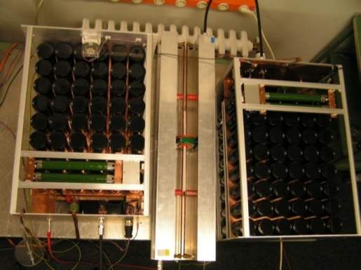
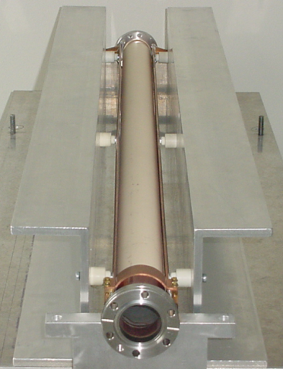
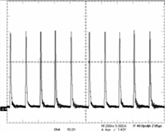
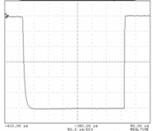
Pulse pattern: Fast kickers
4.5 MHz Dump Kicker
5 MHz Dump Kicker
Gun Linac
5MHz Dump Kicker
(pulse pattern)
(pulse pattern)
(Pulse pattern)
Dump
Flat Top Kicker (pulse width 290 μs)
a)
Dump Gap
< 20 μs
290 μs
μ
600
μ
600
s
650us
s
200 ns
low accuracy
(>1 %)
4.5 MHz burst operation
high accuracy
(< 0.01 %)
10 Hz operation
300 μs
example:
pulser prototype
example:
pulser prototype

Slide 7
Pulse Pattern: Subsequent undulators
SASE 1 / 2 undulator
Fast Kicker
Corrector
Corrector
Reasonable in one undulator only if L_{und}>L_{sat}
Bunch to bunch switching possible
Separate beam lines (θ ≈ 10 μrad) possible ?
‘De-coupled’ operation of SASE1 and SASE3 obviously possible

Slide 8
Summary: Pulse Pattern Baseline
Laser pulse frequency defines bunch distance (benefits if similar requests from experiments to relax burden on fast kicker)
Laser pulse length defines pulse length
Distribution into two beam lines
Individualization of pulse with fast kickers
Fate of each bunch coded into the timing system, hardware extracts info and acts accordingly (session this afternoon)

Slide 9
Bunch Property Variation within Pulse
Three to five independent experiments require individual bunch properties
Split pulse into three (five) sections with similar properties within each section
Allow settling time in between for transients and intra-train feedbacks

Slide 10
Bunch Property Variation within Pulse: Energy
Vary gradient of last linac modules
E₀+1.5%
ΔE/E_{max} = 3 %
E₀
E₀-1.5%
280 μs
1350 bunches
SASE1, SASE3
280 μs
1350 bunches
SASE2, UN1, UN2
ΔE/E = + 10⁻⁴ / μs
- 10⁻³ / μs
Time constants to be verified
E₀+1.5%
20 μs
E₀
20 μs
E₀-1.5%
300 μs
1350 bunches
SASE1, SASE3
300 μs
1350 bunches
SASE2, UN1, UN2

Slide 11
Bunch Property Variation within Pulse: Charge
Requires re-setting of laser, gun and injector parameters
Studies on-going two find optimum compromise working points
Varying beam loading puts load on LLRF (talk by Holger Schlarb)
Beam based feedbacks have to cope with transients

Slide 12
Bunch Property Variation within Pulse: Compression
Might require re-setting of charge (see before)
At least requires re-adjustment of linac phases within bunch compression system

Slide 13
Summary: Bunch Property Variations within train
Baseline layout assumes constant linac and bunch compression parameters
Variation within bunch train should be divided into three (five) sections
Energy variation appears to be easiest
Variation of charge and pulse length much more challenging
Need to define a subset of patterns not to get lost in the jungle

Slide 14
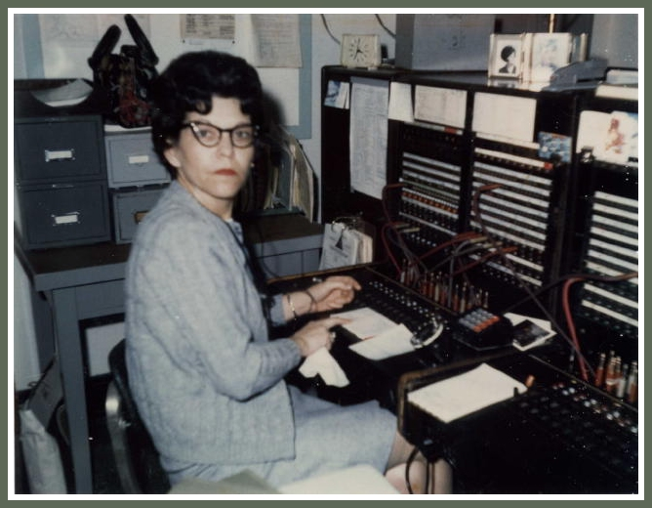
Customer Interaction Needed
Controls session

