Slide 1
Vacuum Components for Standard Beam Diagnostics
Dirk Nölle
DESY, MDI
XFEL, WP-17
XFEL Accelerator Construction Consortium Meeting
Notes:
How to edit the title slide
Upper area: Title of your talk, max. 2 rows of the defined size (55 pt)
Lower area (subtitle): Conference/meeting/workshop, location, date, your name and affiliation, max. 4 rows of the defined size (32 pt)
Change the partner logos or add others in the last row.

Slide 2
Vacuum Components to be delivered by WP-17
BPMs
250 Standard Button BPMs (BPMA, BPMB, BPMD, BPMW)
101 Cold BPMs for Cryo-modules (BPMC, BPMR)
30 Cavity BPMs Beamline Type (BPMF/I)
118 Cavity BPMs for Undulator Intersections (BPME)
36 Toroids (TORA, TORB, TORC)
Dark Current Monitors (DCM)
Screens/Wire Scanners
20 Standard Screen Station (OTRA/C)
20 Long Screen Stations with Wirescanner Option (OTRB)
Screen Stations for Dump and Septum Areas (OTRD)
Stuff for WP-18
BAM
E-BPM

Slide 3
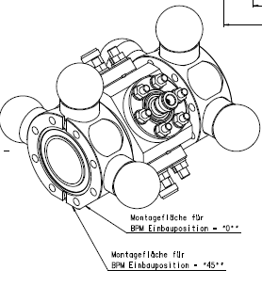
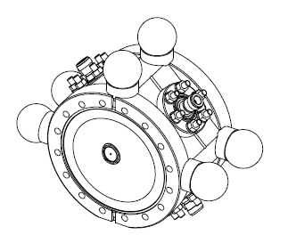
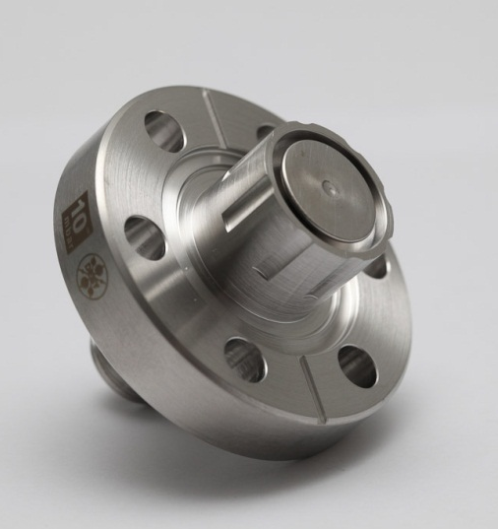
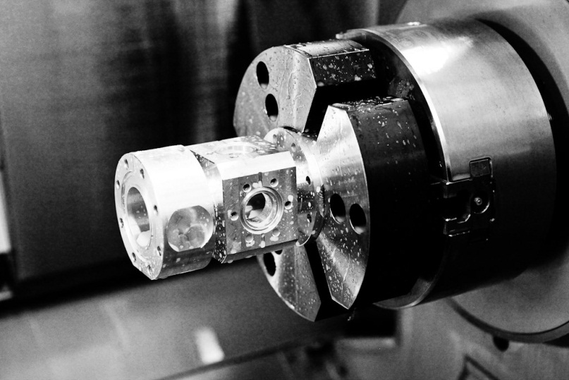
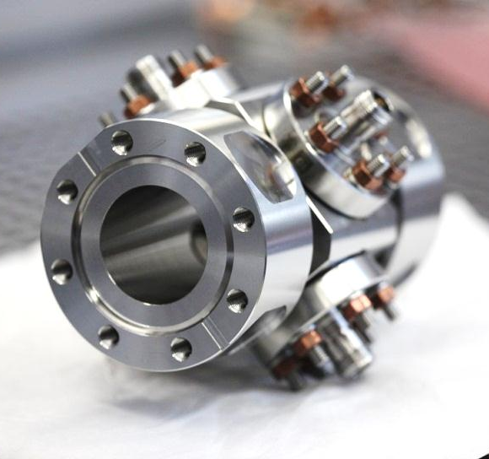
Standard Button BPMs
Based on an In-house Feed-through Development
(build by Industry, 50% delivered)
BPM Housings produced in the DESY Workshop
BPMA: 40.5 mm beam pipe, 150 mm long, flanged,
main working horse
BPMB: 40.5 mm, 80 mm long, weld in version of BPMA
BPMD: 96 mm beam pipe, flanged
BPMW: 200 mm beam pipe, flanged
BPMA
BPMD

Slide 4
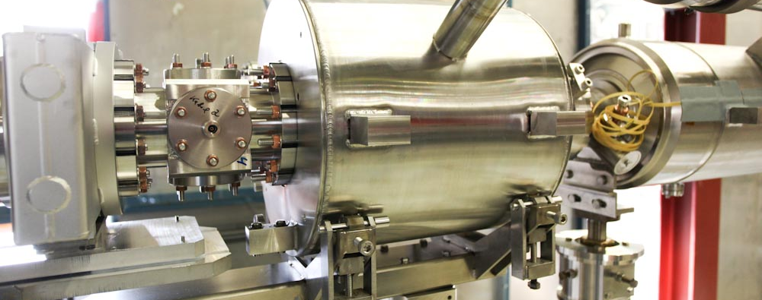
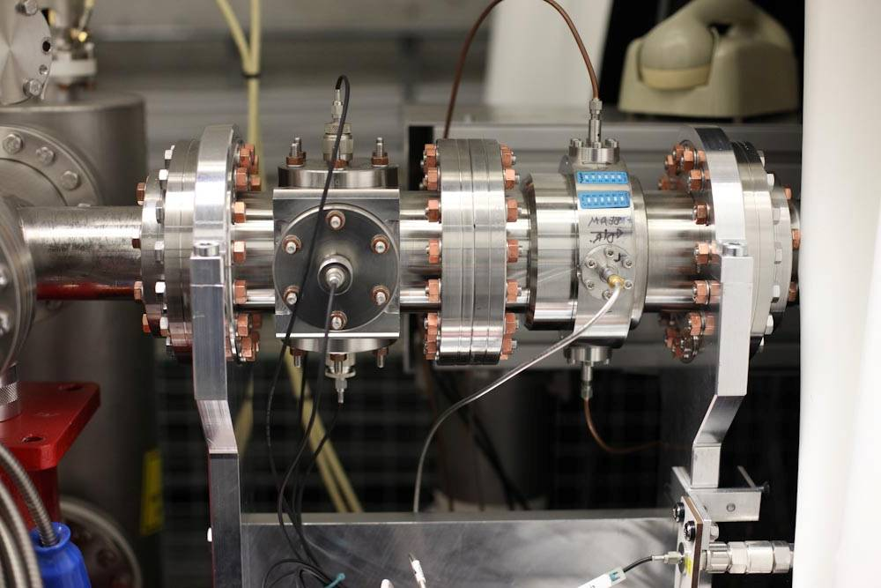
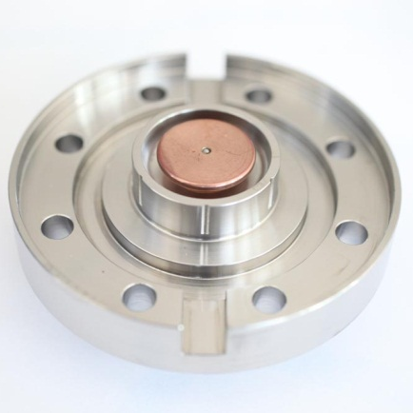
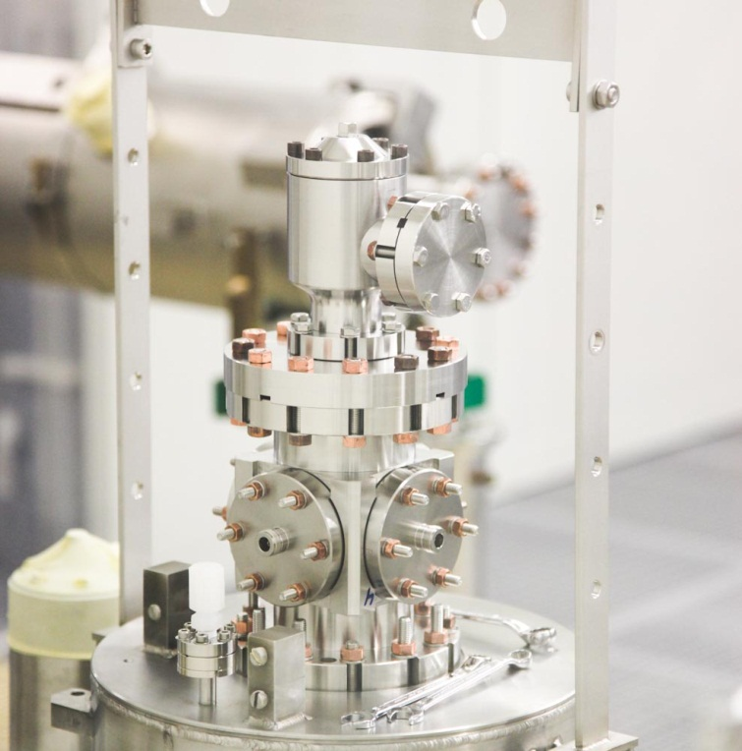
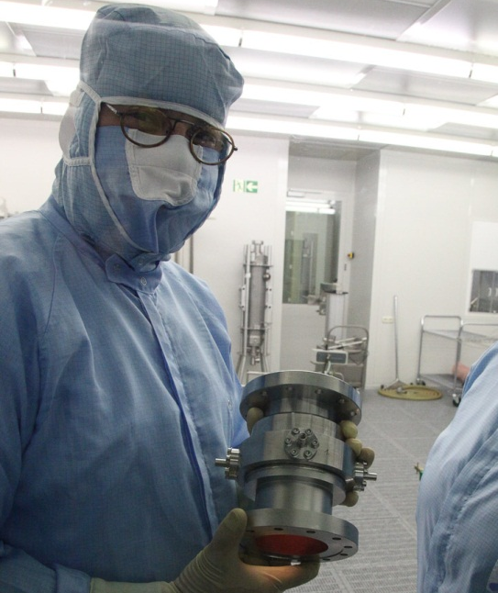
Cold BPM: Buttons (BPMC); Reentrant Cavity BPM (BPMR)
String of PXFEL3
Button
2 Types of Cold BPM (Button, Re-entrant Cavity)
Modest Resolution: 50 µm
Operation at few k Level (connected to cold quad)
Close to the Cavities -> Clean room Class 10!
Series Production running

Slide 5
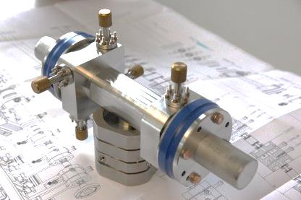
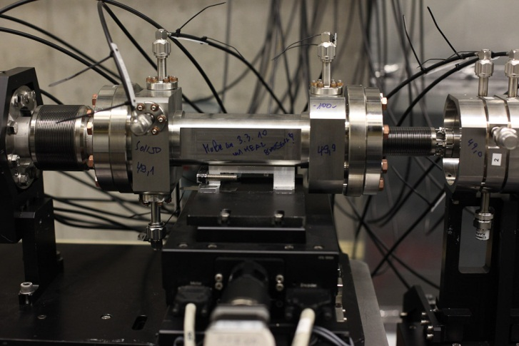
Cavity BPM Beamline Type; BPMF/I
Cavity BPM for 40.5 mm Beam Pipe, 255 mm long
Resolution below 10 µm
To be used
for precision measurements
For the Intra Bunch Train Orbit Feedback System
Tender to be started soon (30 components).

Slide 6
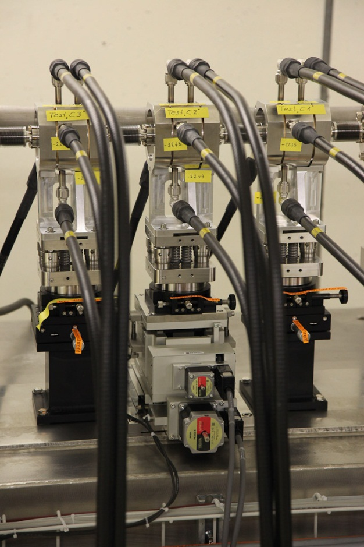
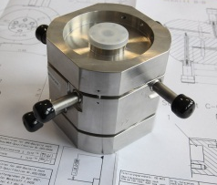
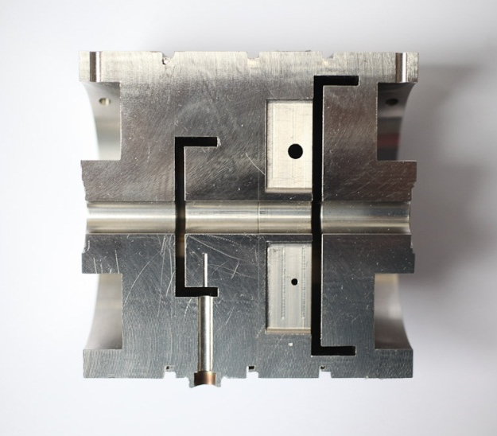
Cavity BPM Beamline Type; BPME
Cavity BPM for 10 mm Beam Pipe, 100 mm long
Resolution below 1 µm
To be used in the undulator intersections
Production for Pre-Series (18 devices) finished
in Summer.
Series Production to be contracted depending on Pre-Series Results.

Slide 7
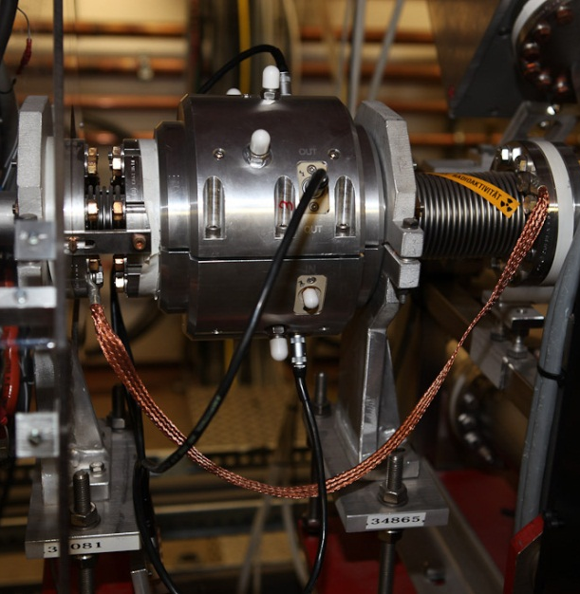
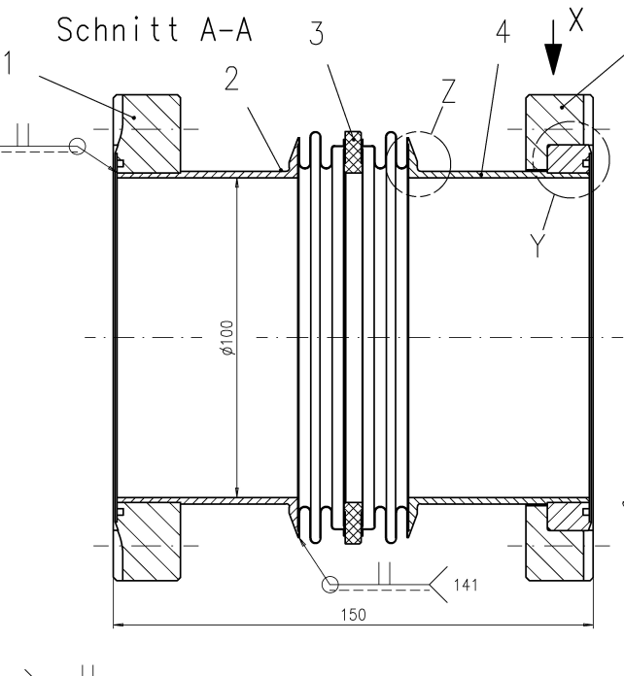
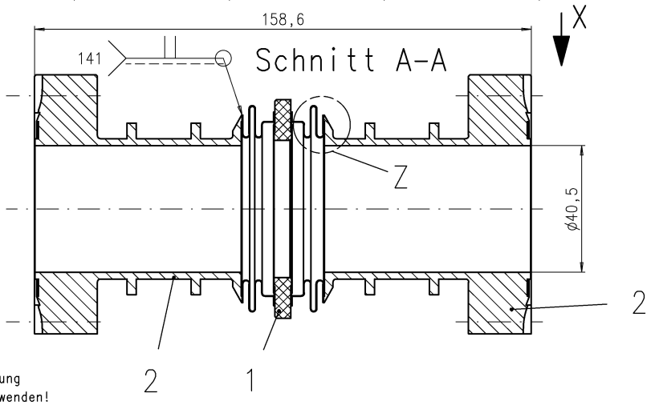
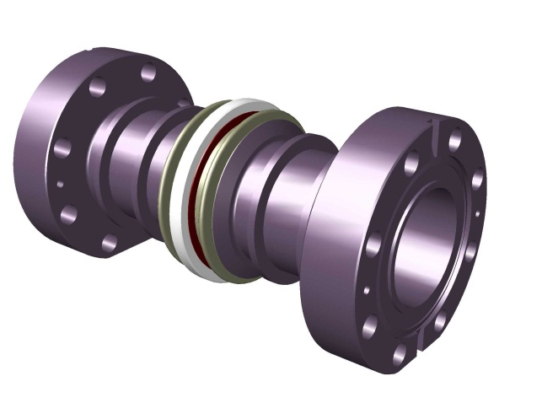
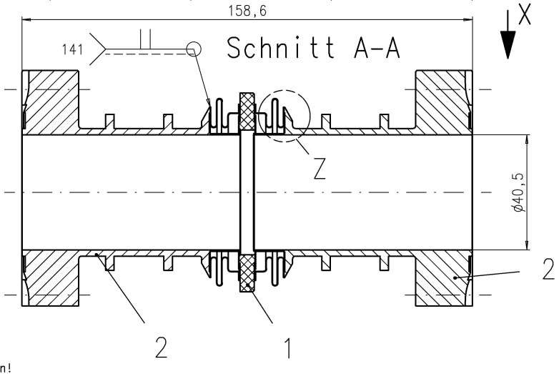
Toroids – Charge Monitors (TORA, TORB, TORC)
Toroids: Current Transformers
Vacuum Part: Chamber with Ceramic Gap
Chamber in production
Delivery in March

Slide 8
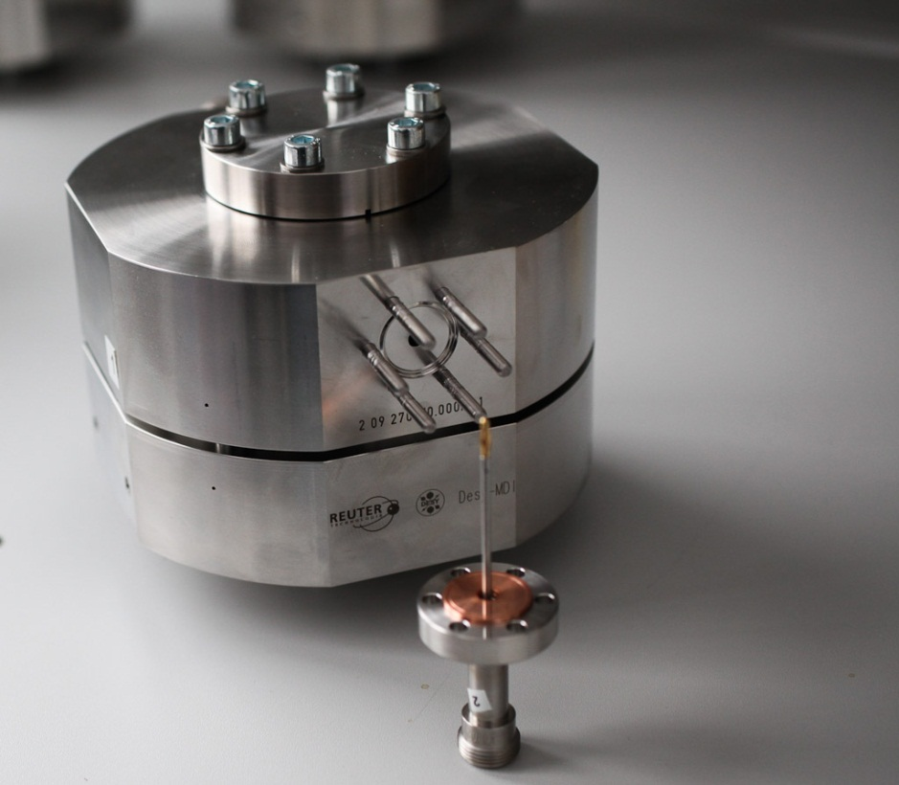
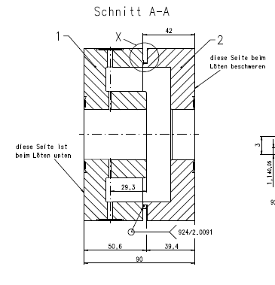
Dark Current Monitor
1.3 GHz Low Q Cavity
Measure Dark Currents of O(nA)
Charge Monitor for Low Charge Operation

Slide 9
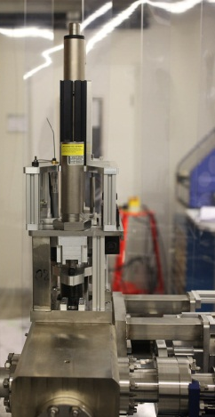
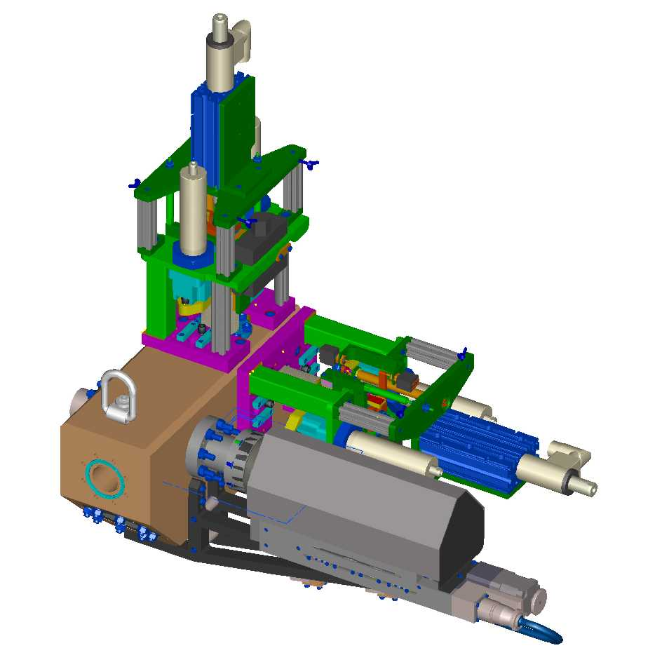
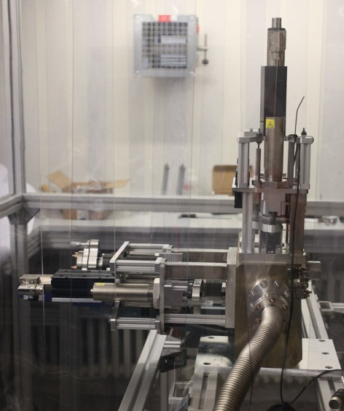
Beam Size Measurements
Hotspots for Screens/WS
4 stations with known phase advance
for optics characterization
Vert. Wire scanner
Hor. Wire scanner
Two systems:
~ 50 Screens
12 (fast) Wire scanners
Some installed at the “same” place
FLASH result -> OTR not usable for compressed Beams, => extensive R&D Program for luminescent Screens
Wire scanners
Triggered, Fast scans within a bunch train (1 m/s)
Also Slow Scans
Will be compatible to ISO5 (CRC 100)
Both DESY In-House developments, parts purchased from industry
Beam
Light
Screen Mover

Slide 10
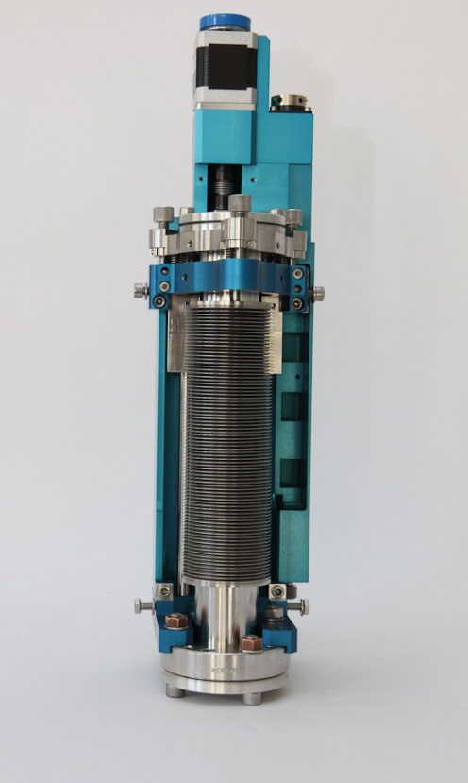
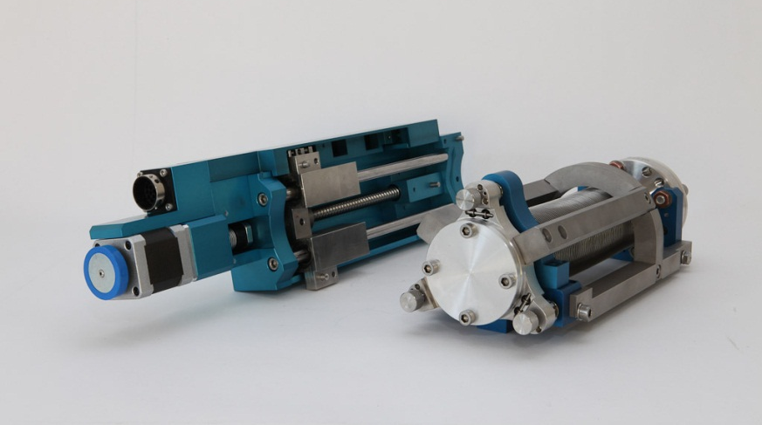
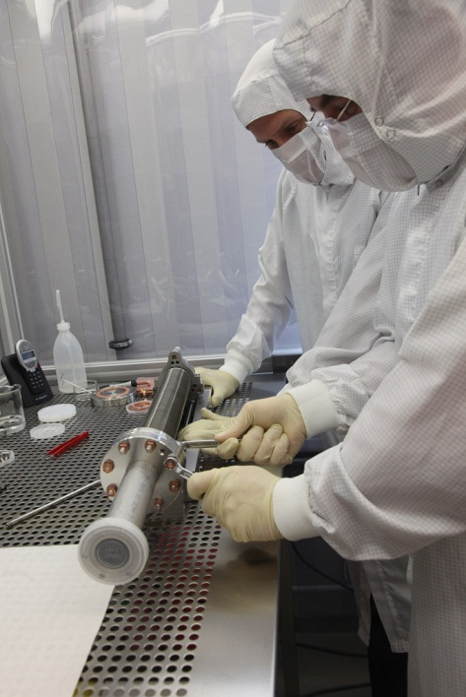
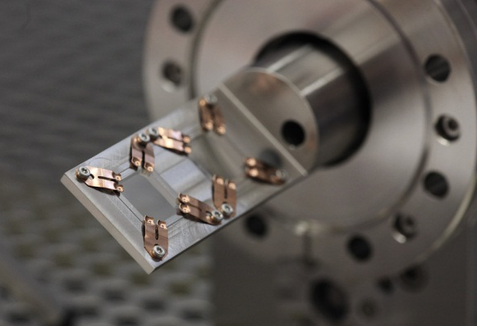
Screen Systems: Screen Mover for low particle installations
Design for ISO5 (CRC100)
Separated vakuum/motor part
Easy to adapt to different stroke
Connection to MPS
Pre Series under Production

Slide 11
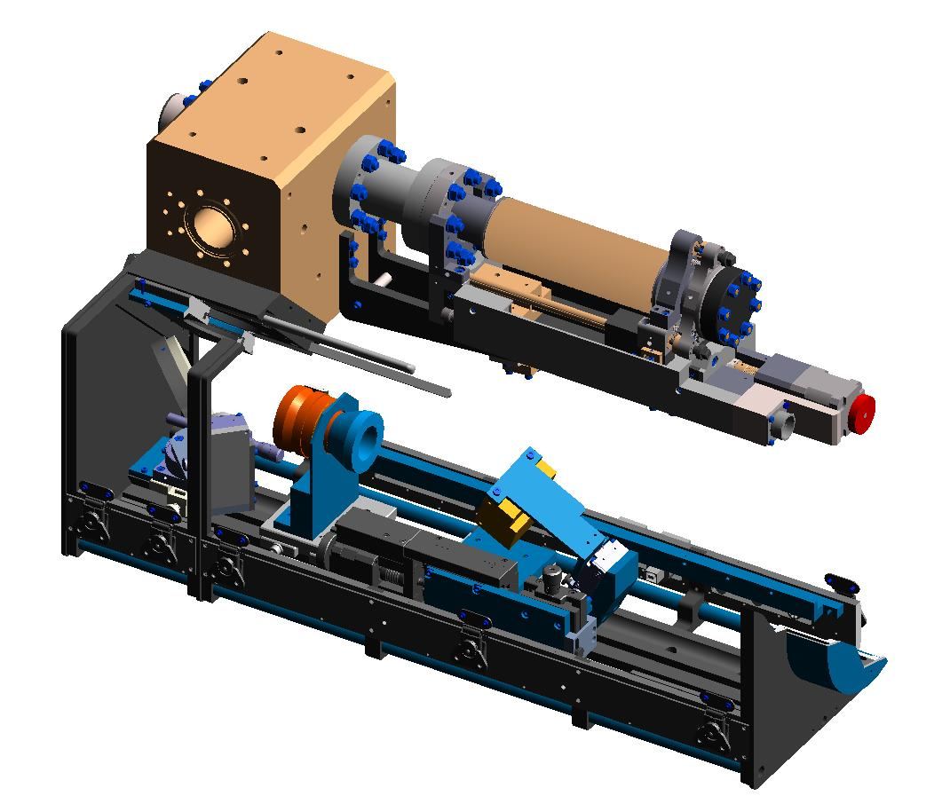
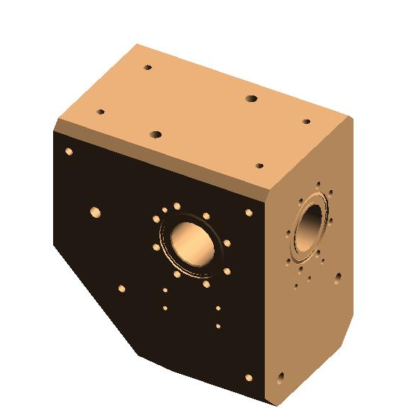
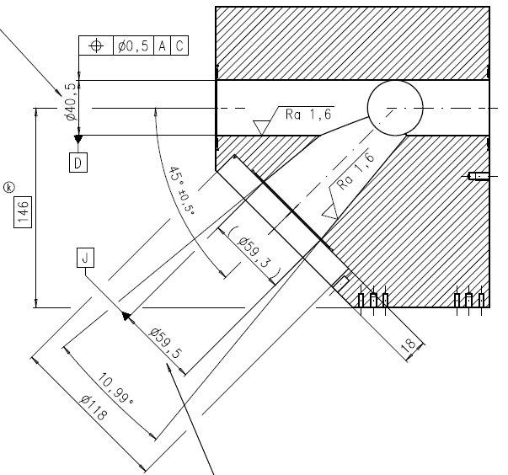
OTR A/C
Short Screen Chamber (200 mm)
Can be used with 0°and 90°Rotation
View Port 45° to the beam axis
Use Scheimpflug Optics to get entire Screen focussed.

Slide 12
OTR B
Long Screen Chamber (400 mm)
Can be equipped with addtional Wire scanners
View Port 45° to the beam axis
Use Scheimpflug Optics to get entire Screen focussed.
Wire scanners need to be exchangeable in the machine.

Slide 13
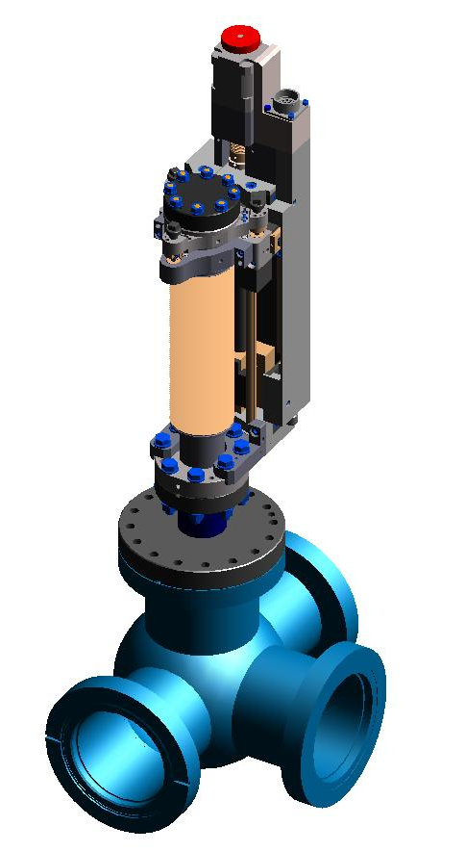
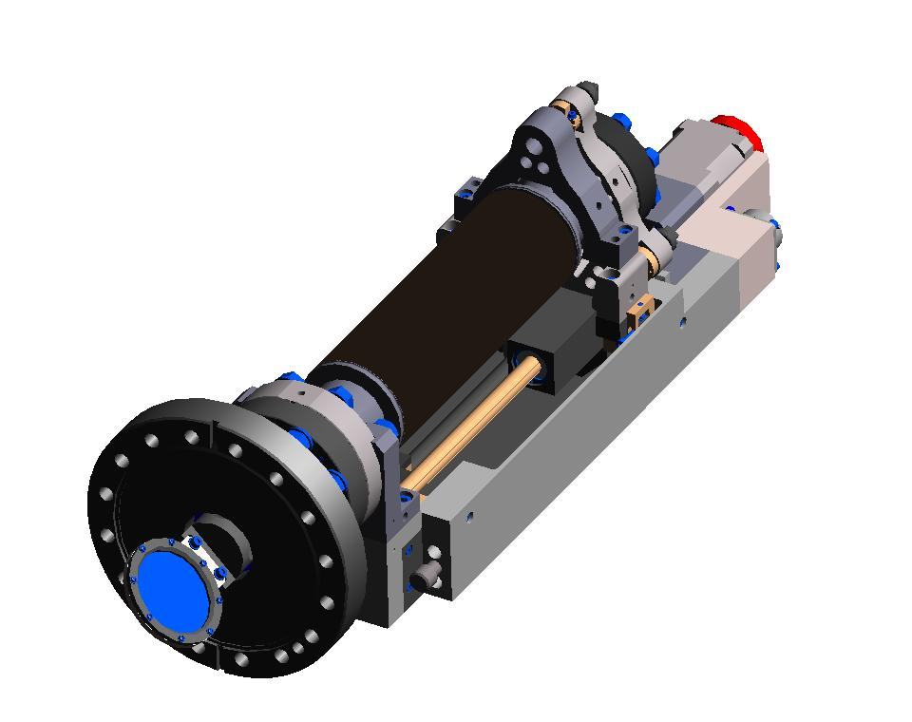
OTR D
Screen Chamber for Dump Septum Regions
Large field of view with modest performance requirements.
View Port 90° to the beam axis

Slide 14
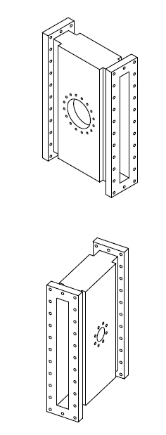
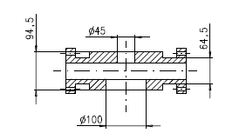
OTR S
Screen Chamber for the Schicanes
40 x 400 mm chamber
Up to now only conceptual design.

Slide 15
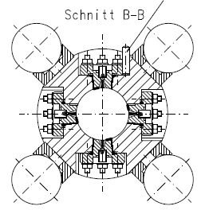
BAM and E-BPM for WP-18
BAM
RF requirements highly increases with respect to FLASH
RF design ready
Prototypes being prepared
E-BPM
RF design has started
First conceptual ideas under discussion
Getting tight.

